Slide 1
Rotary Club Board Forum
July 27, 2024
Title Page Option

Slide 2
Announcements
“Programs for Young Leaders” position in ClubRunner
District Awards Checklists available August 1
Monthly “Welcome to Rotary” orientation for prospects/new members Aug 3, 9am
Community Service Chair Workshop August 3, 10am
  Days of Service in September (Education) and April (Environment)
RI Convention in Calgary info Zoom August 12. 4:30pm
Maui Fire Recovery Zoom August 17, 1pm and Online Auction
International Service and Global Grants August 24, 9am
Youth Protection Annual Certification August 24, 10am

Slide 3
District Grants
Rotary approval expected soon
Send copy of club bank statement showing club cash on deposit
Grant funds deposited to club’s grant account
Let the club know how you earned the funds

Slide 4
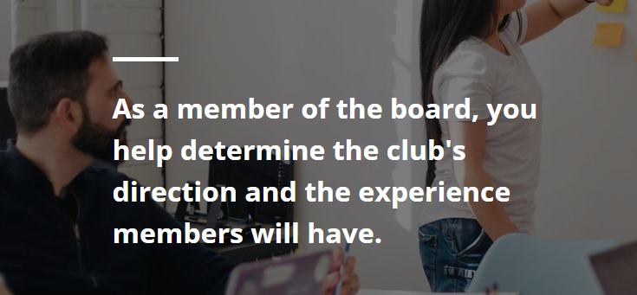

Slide 5
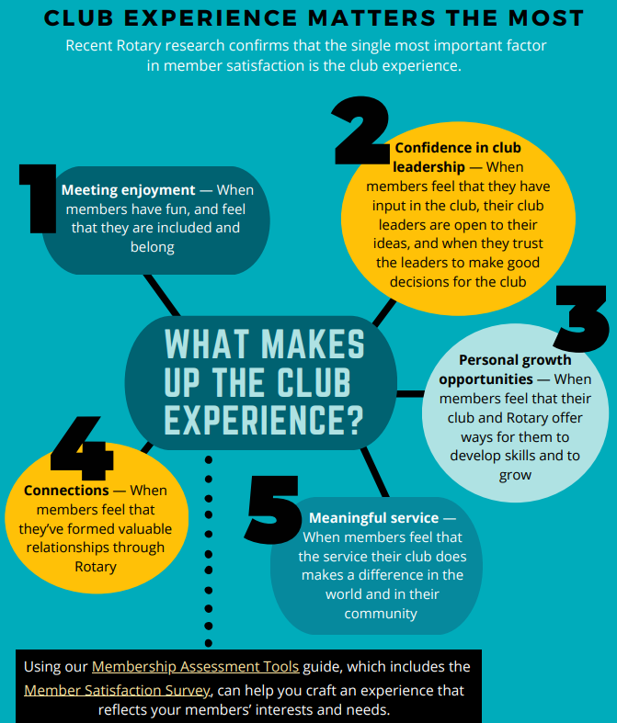
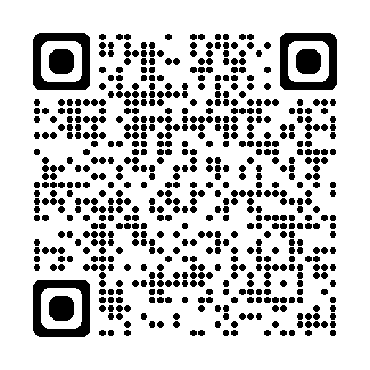
More resources at:
https://my.rotary.org/en/learning-reference/learn-topic/membership

Slide 6
The most important factor in member satisfaction is their club experience
The results of the 2022 Rotary International All-Member Survey are clear – the number one driver of member satisfaction is club experience. Just over 78,000 members responded to the online survey conducted by RI’s Research and Evaluation team.
What makes up the club experience — When clubs offer their members a club experience based on their members’ ideas, interests, and input, they will be happier, stay longer, and get more involved.

Slide 7
Breakout
What is the “Club Experience” in your club?
How can you make it an irresistible Club Experience?

Slide 8
The Rotary Trustees approved this new strategic initiative in 2024-25:
  The Club Experience, aims to enhance club activities and increase member satisfaction through consistent, cross-functional efforts that will bring enhanced products and tools to best meet member needs

Slide 9
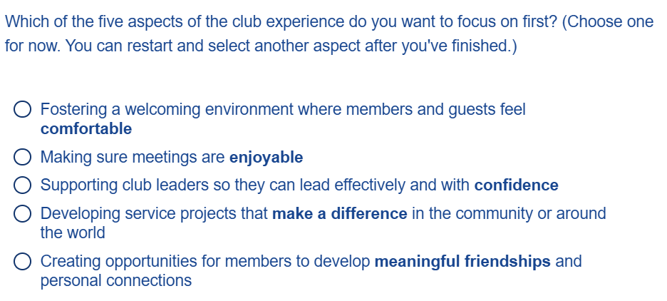
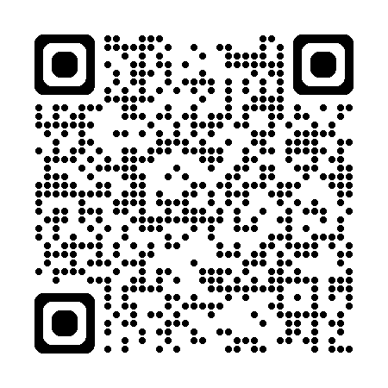
Club Experience Concierge — Explore ways to improve the club experience through practical tips and resources with this interactive, online resource.
https://rotary.qualtrics.com/jfe/form/SV_719FQ2l1pxDqvLE

Slide 10
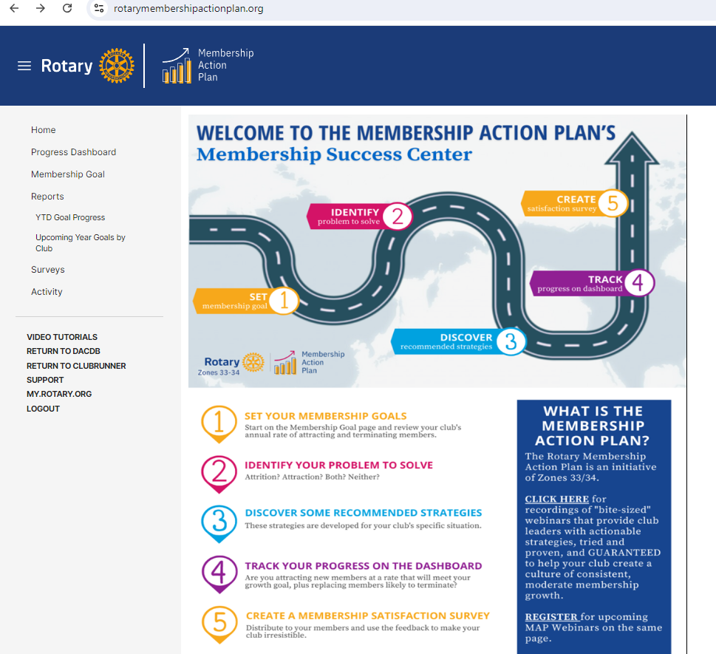
Member Survey
Log in to ClubRunner,
go to Reports,
Membership Action Plan. Click on “Surveys” on the left to create a survey.
Send link to members.

Slide 11
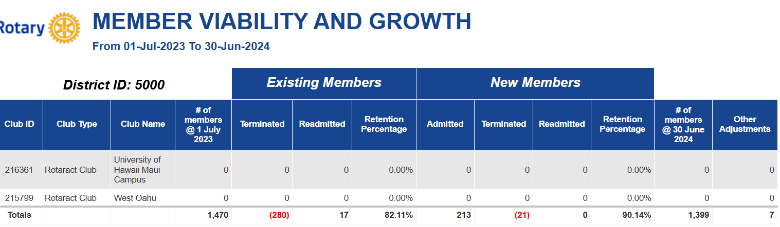

Slide 12
Meaningful club assemblies
Communication : Talk about project ideas or updates about current projects
Feedback: What members like about the club and what needs to change
Inclusive: Ask for input on the club's goals and strategic plan, and try to build consensus
Engagement: Encourage participation in Rotary and Rotary Foundation programs
Recognition: Celebrate the club's and its members' achievements

Slide 13
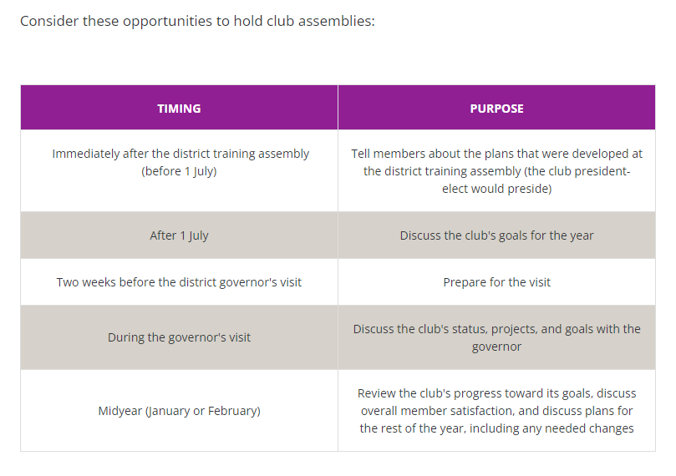
Title Page Option
Notes:
A club assembly should inspire and engage all members. Most clubs have four to six assemblies each year, though some clubs hold them every month.
Work together to plan assemblies that are meaningful to members as well as to club leaders, and encourage all members to attend. You might use the assemblies to:
Talk about project ideas or update members about current projects. Discuss what members like about the club and what they want to change. Ask for input on the club's goals and strategic plan, and try to build consensus. Update people about committee activities and initiatives.

Slide 14
New leadership opportunities
Leadership 101 - Kupu Mau for a future leader
Leadership 201 – District Leadership Academy for Past Presidents
Masters Program – DLA graduate. Deeper dive into district operations

Slide 15
QUESTIONS

Slide 16

Mahalo!

