Slide 1
Community Service
Wally Wong, District Community Service Chair

Slide 2

BE A VIBRANT CLUB
Engage members
Conduct meaningful projects
Try new ideas

Slide 3
Role of the Service Project Committee
Your role as the club service projects committee is to help your club identify and meet real needs in your community and around the world by developing and implementing service projects.

Slide 4
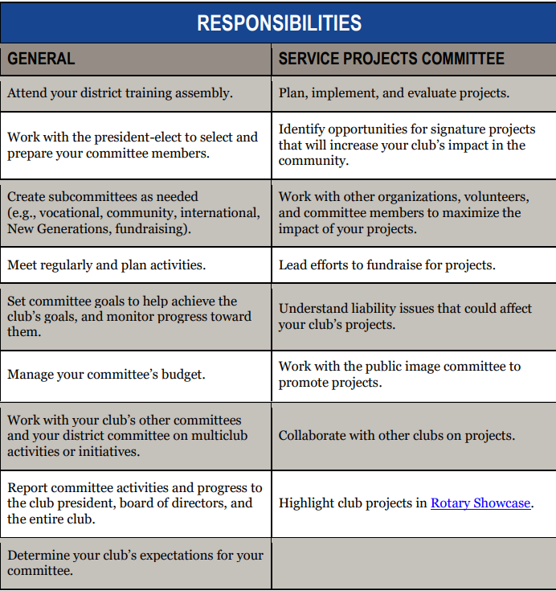

Slide 5
Plan your Projects
Goals should be shared, measurable, challenging, achievable and impactful
Action Plan
  Who is responsible
  Timeline: due dates
  How to measure progress and success
  What resources do you have and need
  Regularly assess your progress and make adjustments, if necessary

Slide 6
Increase our impact
DEVELOP A STRATEGY for educating members about the importance of impactful service projects.
CONDUCT A COMMUNITY ASSESSMENT to determine which issues are top concerns in the area. Learn about needs and strengths and identify the key decision-makers.
FOCUS YOUR EFFORTS. Review your club’s activities and determine which ones can be streamlined or eliminated so your club can spend more time on activities that make a real impact.
CELEBRATE THE LONG-TERM SUCCESSES of service and program offerings, but to be open to new projects or opportunities to prove that your club or district’s impact has only begun. Apply for a global or district grant to fund a project that will have sustainable, measurable outcomes.

Slide 7
Community Assessments
Assess your community’s strengths, weaknesses, needs, and assets
Learn about your community and discover the best opportunities for service
Maximize your club’s ability to make an impact.
An assessment not only helps you better understand the dynamics of your community but also allows you and your project’s beneficiaries to make informed decisions about service priorities. Even if you’re actively involved in your community, an assessment can reveal additional strengths and opportunities for growth.
Notes:
Remain open minded. Do not underestimate the community. Don’t presume you know what it needs or what challenges it faces.  Choose participants carefully. Consider the makeup of the community and ensure you include a diverse cross-section of relevant groups (e.g., gender, age, ethnicity, religion, income level, vocation).  Include overlooked or marginalized groups. Women, young people, the elderly, and religious and ethnic minorities are often overlooked. Keep the community’s social dynamics in mind, and provide a forum in which all groups feel comfortable sharing their views.

Slide 8
Types of Assessments
You can combine or adapt the following six assessments to best suit your club’s resources and the preferences of community members:
Community meeting
Asset inventory
Survey
Interview
Focus group
Community mapping

Slide 9
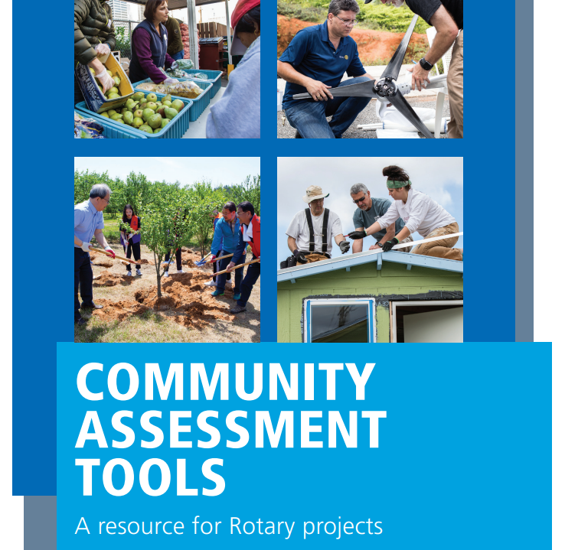
Resources on rotary.org
→Take action →develop projects
→Lifecycle of a project

Slide 10
Breakout – 10 minutes
What impactful project is your club doing?
What impactful projects can we do?
What project partners can we include?
Recorder to take notes, report and post to the Chat.

Slide 11
D5000 Traditional days of service
Rotary Gives Thanks – Last Saturday in November
Rotarians at Work – Last Saturday in April
or near Earth Day

Slide 12
Publicize your Projects
Work with the Public Image Chair to tell the Rotary Story and publicize your project
Work with the Membership Chair to invite potential members and recruit new members
Work with your Foundation Chair to use district grant funds

Slide 13
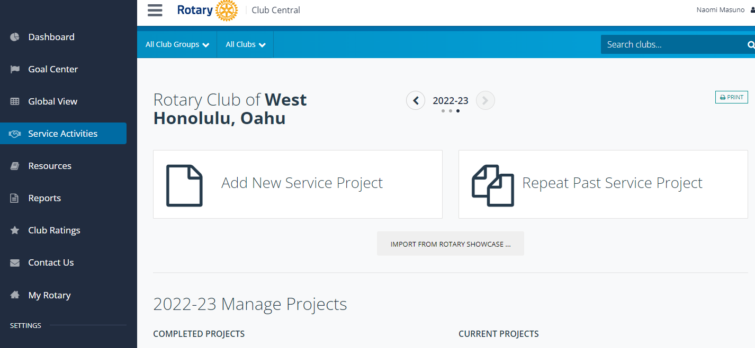

Rotary Club Central – input Service Activities (Description, # volunteers, volunteer hours, $s spent)
New : Name a Service Projects Chair in ClubRunner to be able to update the rotary.org Service Activities in Rotary Club Central.
Notes:
New this year is the ability to name a Service Project Chair who would be able to input the projects into Rotary Club Central on the Rotary website. The current club Secretary or President, should input that chair’s name into ClubRunner.

Slide 14
Risk Management
Have an emergency management plan
  Consider risks to health, safety and security
  Have a Communication plan
  Youth Protection plan
  Plan B?
Need insurance?
  The U.S. Rotary Club & District Liability Insurance Program provides all U.S. Rotary Clubs & Districts and Rotaract Clubs with general liability and directors & officers/employment practices liability coverage through Arthur J. Gallagher & Co. Club Presidents are sent information at the start of the Rotary year,

Slide 15
Consider this….
How will you determine which projects will have the greatest impact on the community?
In what innovative ways will you promote your club this year?
What types of projects are important to your club, and do they reflect your club’s vision and culture

Slide 16
QUESTIONS

Slide 17
Mahalo!

