Slide 1
2023 Grant Qualification Webinar
Notes:
The slide will be on the screen when PEs enter the room.
Introduce yourself. Put forth that we’ve attempted to change the Foundation presentation to hopefully give a better understanding of how TRF is different and why Rotarians should choose to give to the Foundation first over other charitable organizations

Slide 2
Agenda – Learning Plan
Overview of grant program
Grant funding (where does the money come from)
How to qualify for grant funds
Grant agreements
Memorandum of Understanding (MOU)
Addendum to MOU
Financial Management Plan
Resources

Slide 3
Key takeaways
Use of grant funds
Used for the purpose described on the application that was approved
Do not spend project funds until after the grant funds are in the account
Use funds by May 31, return funds to D5000 asap if not used
Disbursements authorized by 2 people via the voucher or on the grant check
Grant funds cannot be carried over to another year
Complete qualification checklist by January 31
Maintain separate club grant account – all disbursements from this account
Keep documents for 5 years

Slide 4
Grant Timeline
For 2024-2025 Grants:
Fall 2023 – 2 members attend grant management training
Jan 31, 2024- submit 3 documents (MOU, Addendum, Financial Plan) and the filing confirmation of fed tax return and GET for year ended 6/30/23. The president for 2023-2024 and 2024-2025 sign the documents. If no President Nominee (PN), the current president can sign.
May 31, 2024-Final grant report submitted by this year’s team.
June 15, 2024-Grant application for Rotary year 2024-2025 submitted
July 15, 2024 – Submit District grant to RI for approval
August - distribute grant funds to clubs
All documents are emailed to grants@rotaryd5000.org
Forms can be found on the District website at: https://rotaryd5000.org/sitepage/district-grant-info-documents

Slide 5
Types of grants
The Rotary Foundation offers grants that support humanitarian projects, scholarships, and vocational training teams. Here’s an overview:
Global grants support large international projects with long-term, sustainable outcomes in one or more of Rotary’s areas of focus. They range from $30,000 to $400,000.
District grants fund smaller-scale, short-term projects that address immediate needs in your community or abroad. 50% of DDF
Disaster response grants support disaster relief and recovery efforts through grants from the Rotary Disaster Response Fund. Max Is $25k
Programs of scale grants support Rotary member-led, evidence-based, programs that have already demonstrated success. $2million over 3-5 years

Slide 6
2021-2022 Grants

Slide 7
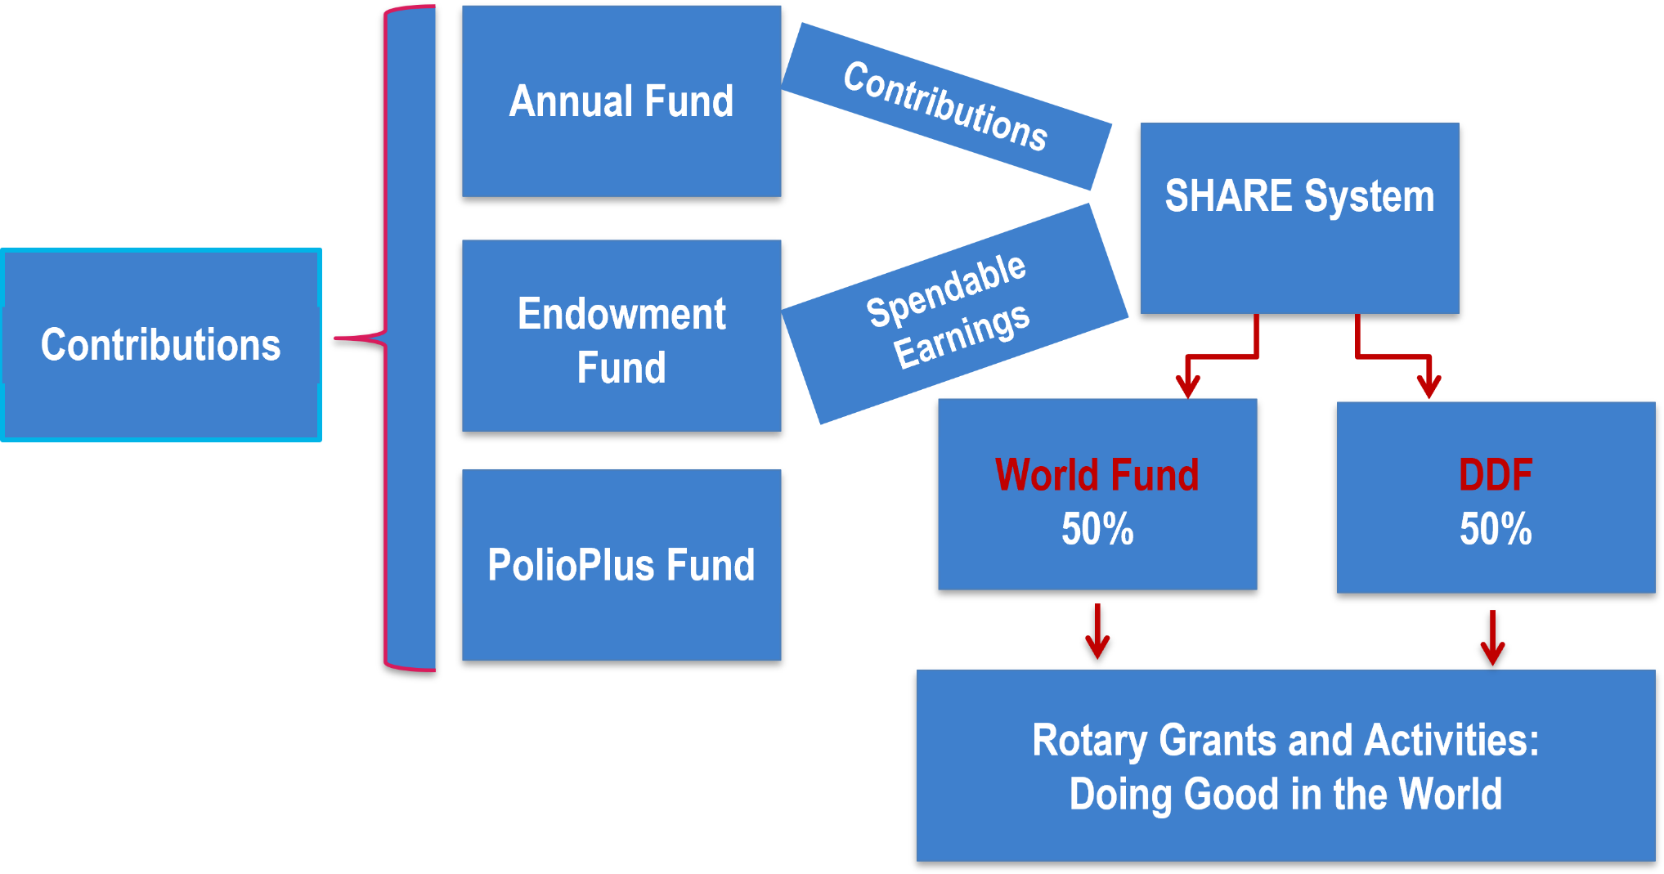
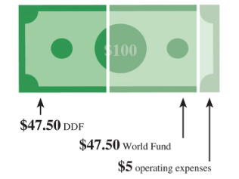
The Rotary Foundation Funding Model
Notes:
So where does the money come from for these grants>

Slide 8
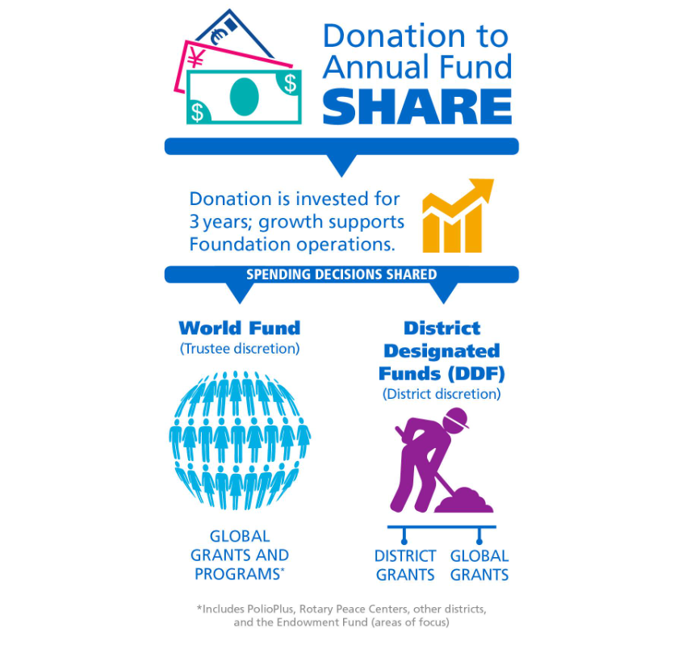
Notes:
Annual Fund contributions are transformed into grants and programs that support Rotary's humanitarian service using the SHARE system.
SHARE uses a three-year funding cycle. It allows the Foundation to invest donations and use the earnings for administrative and fund development costs.
After the investment period, the donation is divided. Annual Fund-SHARE contributions now have the first 5% of the total directed to operating expenses, with the remainder split equally between the World Fund and District Designated Funds.
The Foundation uses the portion credited to the World Fund to pay for grants and programs that are available to all Rotarians. Your district can use the portion that becomes DDF to participate in grants and the programs you choose.

Slide 9
District 5000 Program Allocations 2023-2024
SHARE ALLOCATION
$143,794
Polio Plus $14,379
RCIS (Peace Centers) $ 2,000
District Governor Global Grant $12,000.00
District Grants $68,170 + $1,570 (small clubs & Rotaract)
Global Grants $71,897
Admin fee $2,156.91
Notes:
RCIS=Rotary Centers for International Studies

Slide 10
Grant Funds to Rotary Projects
2019-2020 donations = $299,967
2020-2021 donations= $288,490
2021-2022 donations= $300,989
Funds returned in 3 years to the club as grants. Available this year for projects:
$ 27,268 No match
$ 40,902 Match
$ 71,897 Match for Global Grants
$140,067 From District Designated Funds (DDF)
$ 40,902 Matching Club Cash for matching District Grant
$ 71,897 Matching Club Cash for Global Grants
$ 57,517 From World Fund to match Global Grants
$310,383 Total for Global and local projects
.
Notes:
This year, we have $140k in DDF –District Designated Funds for District and Global Grants. With the club matching cash and the World Fund for Global grants, there is potentially $310k for projects and this is because of the donations to The Rotary Foundation and club funds.

Slide 11
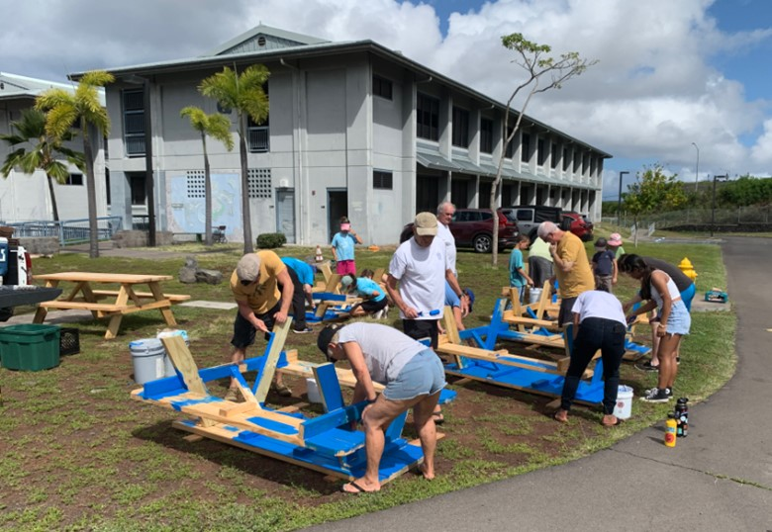
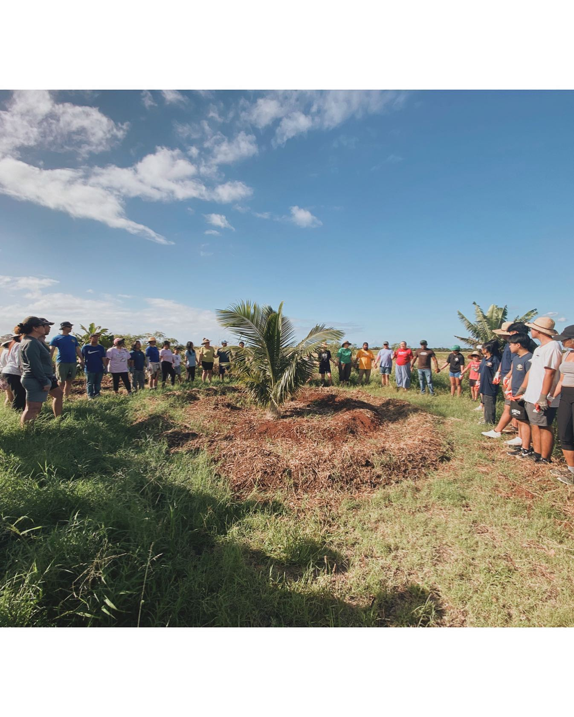
District Grants: 111 District Grants in 2022-2023--$123k
Small-scale, short-term
Local or international activities
Alignment with the Foundation’s mission
Single grant awarded annually to District
Notes:
Includes club cash

Slide 12
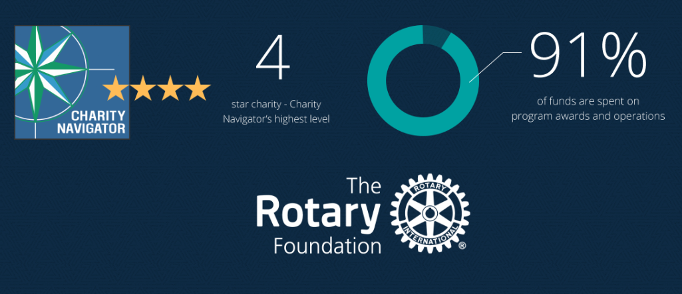
The Rotary Foundation of Rotary International has received 15 consecutive 4-star ratings from Charity Navigator.
The rating reflects Charity Navigator's assessment of how the Foundation uses donations, sustains its programs and services, and practices good governance and openness. (aka Stewardship)
Notes:
The Foundation earned the recognition for adhering to sector best practices and executing its mission in a financially efficient way, demonstrating both strong financial health and commitment to accountability and transparency. Only one percent of the organizations Charity Navigator evaluates have received 15 consecutive 4-star evaluations. The rating reflects Charity Navigator's assessment of how the Foundation uses donations, sustains its programs and services, and practices good governance and openness. This is also known as Stewardship. The District signs an MOU and must oversee the process and adhere to Rotary’s rules.

Slide 13
What is Stewardship?
Stewardship is the responsible management and oversight of grant funds, which ensures that funds are used properly and truly benefit the populations in need:
Supervise projects—MOU Guidelines
Implement projects as approved
Report irregularities
Submit reports
Retain documents- 5 years of soft (electronic) and hard copy

Slide 14
Grant eligibility guidelines
Relate to the Foundation’s mission
Can’t use grants to reimburse clubs or districts for activities and expenses that are in progress or already completed.
If you want to alter a project after a grant is approved, the Foundation also needs to approve those changes before they are carried out.
Comply with the Conflict of Interest Policy for Program Participant
Include signs on/near projects that identify The Rotary Foundation
Follow Rotary’s Privacy Statement (personal data, images, etc)

Slide 15
Grants cannot fund:
Unrestricted cash donations to a beneficiary or cooperating organization
Continuous or excessive support of any one beneficiary, entity, or community
The purchase of land or buildings
Fundraising activities
Expenses related to Rotary events such as district conferences, conventions, institutes, anniversary celebrations, entertainment activities, or project ceremonies
Public relations initiatives, unless they are essential to carrying out the project
Project signs that cost more than $1,000
The operating, administrative, or indirect program expenses of another organization
Activities for which the cost has already been incurred

Slide 16
Qualification checklist
By January 31:
1) Review, Sign and Submit
Memorandum Of Understanding (MOU)
District 5000 Addendum to the MOU
Financial Management Plan
2) Evidence of tax filing (tax return copy or 990N confirmation, proof of GE return)
3) Evidence of grant bank account (bank statement or check copy)
4) Attended District Grants training by 2 members, preferably the PE and person handling grant funds
By May 31: Final grant report for the current year
Notes:
So, how does the club qualify?

Slide 17
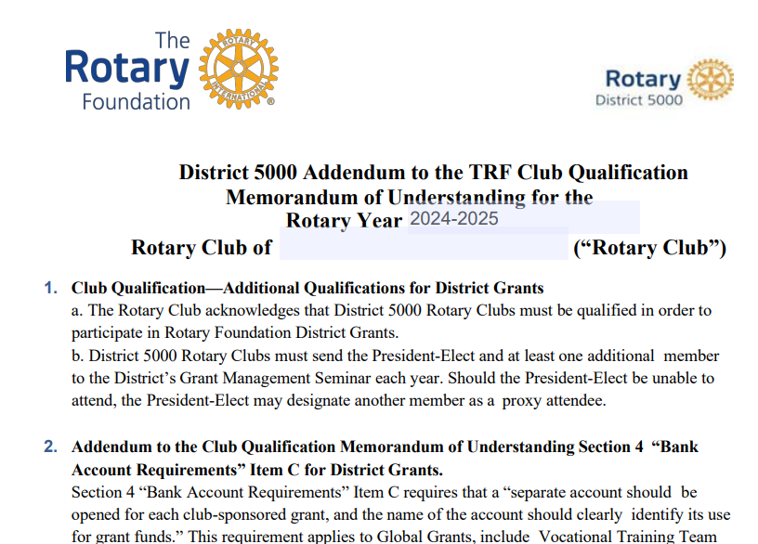
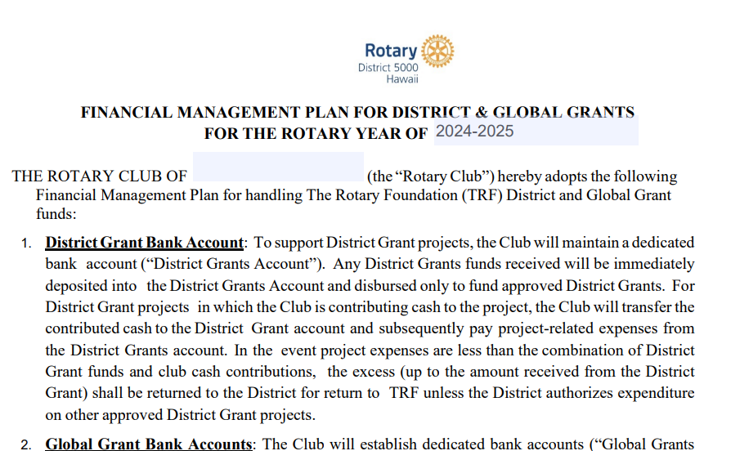
Three forms signed by PE and PN

Slide 18
MEMORANDUM OF UNDERSTANDING
1. Club Qualification
2. Club Officer Responsibilities (adhere to stewardship measures)
3. Financial Management Plan (handling funds)
4. Bank Account Requirements (2 authorizing disbursements)
5. Report on Use of Grant Funds (how funds were spent)
6. Document Retention (5 years)
7. Reporting Misuse of Grant Funds (no tolerance)

Slide 19
District 5000 Addendum to the TRF Club Qualification
Section 4 “Bank Account Requirements” Item C requires that a “separate account should be opened for each club-sponsored grant, and the name of the account should clearly identify its use for grant funds.” This requirement applies to Global Grants, include Vocational Training Team and Global Scholar Global Grants.

Slide 20
FINANCIAL MANAGEMENT PLAN FOR DISTRICT & GLOBAL GRANTS
Maintain a dedicated bank account.
Grant funds deposited and disbursed to fund approved District Grants.
Club cash is transferred to the District Grant account and subsequently pay project-related expenses from the District Grants account
Title of the account: Rotary Club of xxxx TRF District Grants Account
Disbursements require two (2) signatures on a Disbursement authorization form or checks written from the Club District Grants Account or Global Grants Accounts. Authorized signatories may be: The Club President, the Immediate Past President, the Club Treasurer, or the Rotary Foundation Chair. An invoice or receipt, retained by the Club Treasurer, shall be required for all disbursements.
The Club will retain receipts and other documentation of disbursement of Funds in physical form and electronic form for five (5) years from the date of Approval of the Final Report

Slide 21
FINANCIAL MANAGEMENT of District Grants
Important
Any DDF received will be immediately deposited in the District Grants Account and disbursed only to fund approved District Grants.
For DG projects in which the Club is contributing cash to the project, the Club will transfer the contributed cash to the District Grant Account
Pay project-related expenses only from the District Grants Account.
Do not disburse any funds until your application is approved and all DDF from District 5000 and Club contributions for matching are deposited in the District Grant Account.

Slide 22
FINANCIAL MANAGEMENT of District Grants—the District Audit
About 15-20% of District Grants audited each Rotary Year
Documents you will need:
The DG Application and Final Report with explanation of any changes
Current Bank Signature Cards
Bank Statements showing incoming funds (Club cash and DDF) and disbursements
Cancelled checks
Check registers
Paid invoices, receipts, D5000 Disbursement Authorizations/Payment Vouchers
Bank Reconciliation

Slide 23
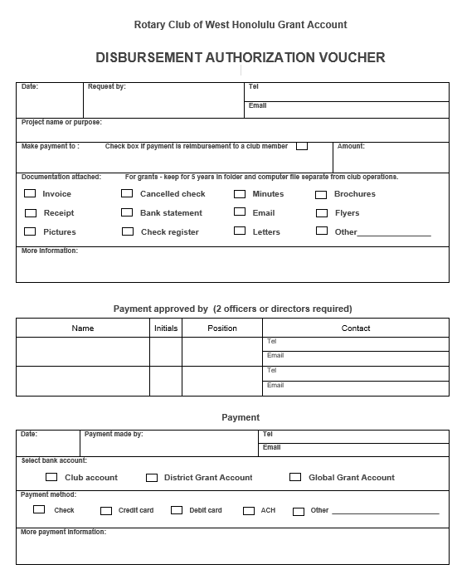
Disbursement Authorization Voucher

Slide 24
Grant Application due June 15
Notes:
Project description: start with sentence describing the project.

Slide 25
Page 2

Slide 26
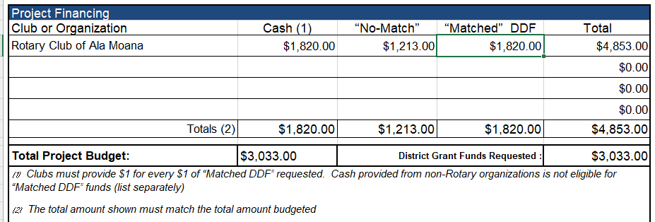
DDF Allocated to the Clubs for district grants and global grants 2023-24 https://rotaryd5000.org/sitepage/district-grant-info-documents

Slide 27
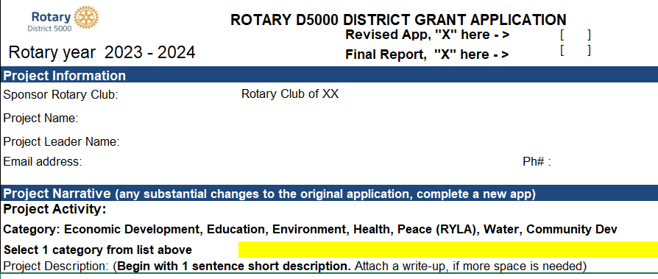
Final Reports
Final Reports are due 2 months after the completion of the project, but no later than May 31. Send the receipts along with the report to grants@rotaryd5000.org

Slide 28
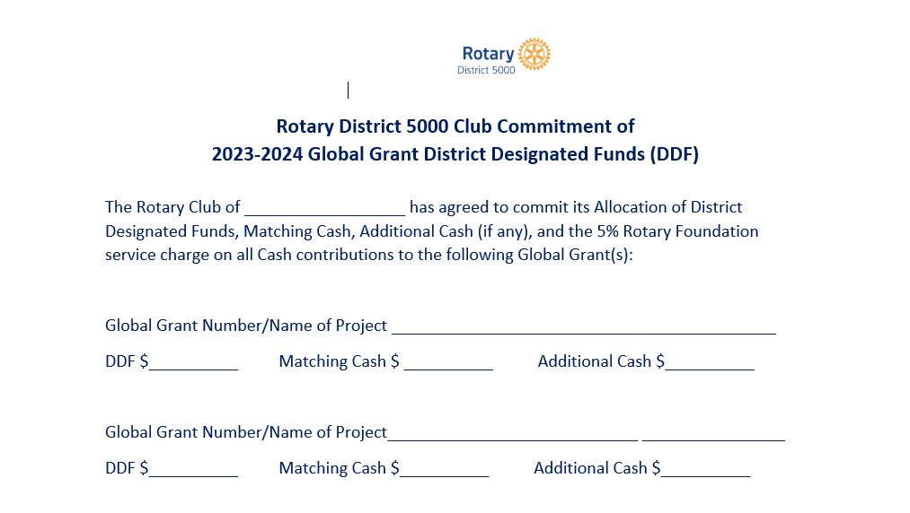
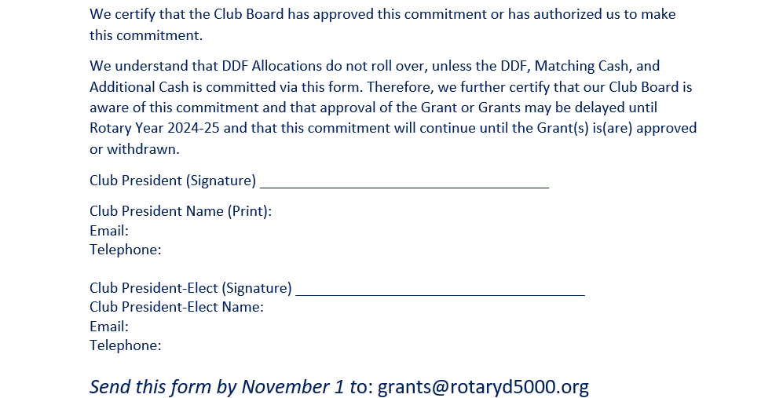
FINANCIAL MANAGEMENT for Global Grants – Pledge form
Important
Retain copies of Global Grants Commitment Letter
Make sure PE and incoming Board have copies and understand commitment
COMMITMENT EXISTS UNTIL GRANT IS APPROVED/FUNDED OR CANCELLED

Slide 29
District Grants vs Global Grants
Global Grant District Grant
Cost - $30,000 minimum No maximum
Funding - World Fund, DDF, Cash DDF and Mandatory Club Match
Application -Online District Application
Area of Focus No area of Focus requirement One of seven areas of Focus
Partnerships – Host Club required No partnership required
Sustainability - Required Not Required
Measurability - Required Required
Scholarships Sponsor Club Determines Graduate- Post Graduate
Notes:
What’s the difference between a District Grant and a Global Grant?

Slide 30
Rotary Foundation Areas of Focus

Slide 31
requirements for Global grants
Districts must be qualified in order to receive grant funding from The Rotary Foundation. Clubs that want to apply for global grants must also be qualified.
The qualification process helps ensure that your district or club understands your financial responsibilities, including stewardship, and is prepared to take them on. Qualification must be completed each year.
Club qualifies for global grants by someone taking the Grant Management Seminar in the Rotary Learning Center. New requirement starting this year.

Slide 32
District Sitepage
https://rotaryd5000.org/sitepage/district-grant-info-documents

Slide 33
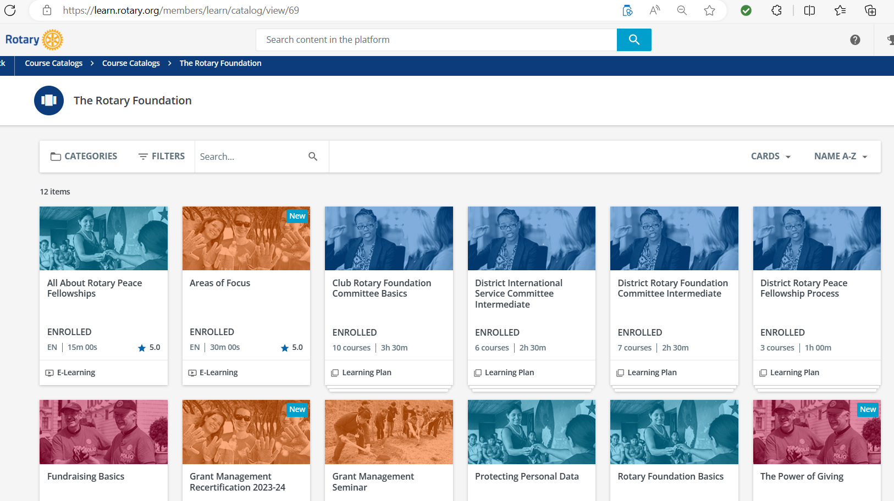
Learn.rotary.org

Slide 34
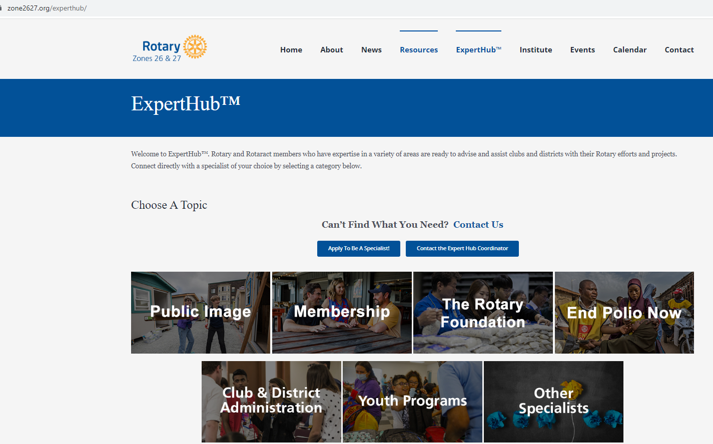

Slide 35
Upcoming webinars
Recording of Zooms are in the webinar tab under Quick Links on the rotaryd5000.org website.
Oct 21, 10:30am - Global Grants projects fair. The club pledges to global grants is due November 1. Learn about the possible global grants your club can participate in.
Oct 24 - World Polio Day
Nov 18, 10am - Foundation 201, a Deeper Dive. Want to know more about The Rotary Foundation programs? Join us to get an in-depth view of TRF programs, such as the Endowment Fund, Legacy Society, and donor recognitions.

Slide 36
District Foundation committee

Slide 37
Key takeaways
Use of grant funds
Used for the purpose described on the application that was approved
Do not spend project funds until after the grant funds are in the account
Use funds by May 31, return funds to D5000 asap if not used
Disbursements authorized by 2 people via the voucher or on the grant check
Grant funds cannot be carried over to another year
Complete qualification checklist by January 31
Maintain separate club grant account – all disbursements from this account
Keep documents for 5 years

