Slide 1


2027 Grant Process Overview
Notes:
The slide will be on the screen when PEs enter the room.
Introduce yourself. Put forth that we’ve attempted to change the Foundation presentation to hopefully give a better understanding of how TRF is different and why Rotarians should choose to give to the Foundation first over other charitable organizations

Slide 2
Grant Timeline
For 2027-2028 Grants:
Fall 2026 – 2 members attend grant management training
Jan 31, 2027- upload 3 documents (MOU, Addendum, Financial Plan) and the IRS filing confirmation of tax return and GET for year ended 6/30/26. The president for 2027-2028 and 2028-2029 sign the documents. If no President Nominee (PN), the current president can sign.
May 31, 2027-Final grant report submitted by this year’s team.
June 15, 2027-Grant application for Rotary year 2027-2028 submitted
July 15, 2027 – Submit District grant to RI for approval
August - distribute grant funds to clubs
All documents are emailed to grants@rotaryd5000.org
Forms on the District website at: https://rotaryd5000.org/sitepage/district-grant-info-documents
Notes:
Benson

Slide 3
Key takeaways
Use of grant funds
  Used for the purpose described on the application that was approved
  Do not spend project funds until after the grant funds are in the account
  Use funds by May 31, return funds to D5000 asap if not used
  Disbursements authorized by 2 people via the voucher or on the grant check
  Grant funds cannot be carried over to another year
Complete qualification checklist by January 31
Maintain separate club grant account – all disbursements from this account
Keep documents for 5 years
Notes:
Benson

Slide 4
Types of grants
The Rotary Foundation offers grants that support humanitarian projects, scholarships, and vocational training teams. Here’s an overview:
Global grants support large international projects with long-term, sustainable outcomes in one or more of Rotary’s areas of focus. They range from $30,000 to $400,000.
District grants fund smaller-scale, short-term projects that address immediate needs in your community or abroad. 50% of DDF
Disaster response grants support disaster relief and recovery efforts through grants from the Rotary Disaster Response Fund. Max Is $25k
Programs of scale grants support Rotary member-led, evidence-based, programs that have already demonstrated success. $2million over 3-5 years
Notes:
Benson

Slide 5
The Process
Qualification
By Jan 31
Application
By June 15
Funding
Club cash in grant account in July
3 Documents
Tax Filings
Club agreement on projects
Application submitted by June 15
Rotary approves
Grant funds deposited
All disbursements from grant account
Disbursements authorized by 2, use voucher form
Final Report
Allocation
Training
Documents
D5000 Grant Subcommittee: Joni Henderson, Naomi Masuno,
Stewardship: Paul Saito, Laura Steelquist,
Due May 31
Funds used as approved
All receipts sent with report
Keep 5 years

Slide 6
Qualification checklist
By January 31:
1) Review, Sign and Submit
Memorandum Of Understanding (MOU)
District 5000 Addendum to the MOU
Financial Management Plan
2) Evidence of tax filing (tax return copy or 990N confirmation, proof of GE return)
3) Evidence of grant bank account (bank statement or check copy)
4) Attended District Grants training by 2 members, preferably the PE and person handling grant funds
By May 31: Final grant report for the current year
Notes:
Laura: So, how does the club qualify?

Slide 7
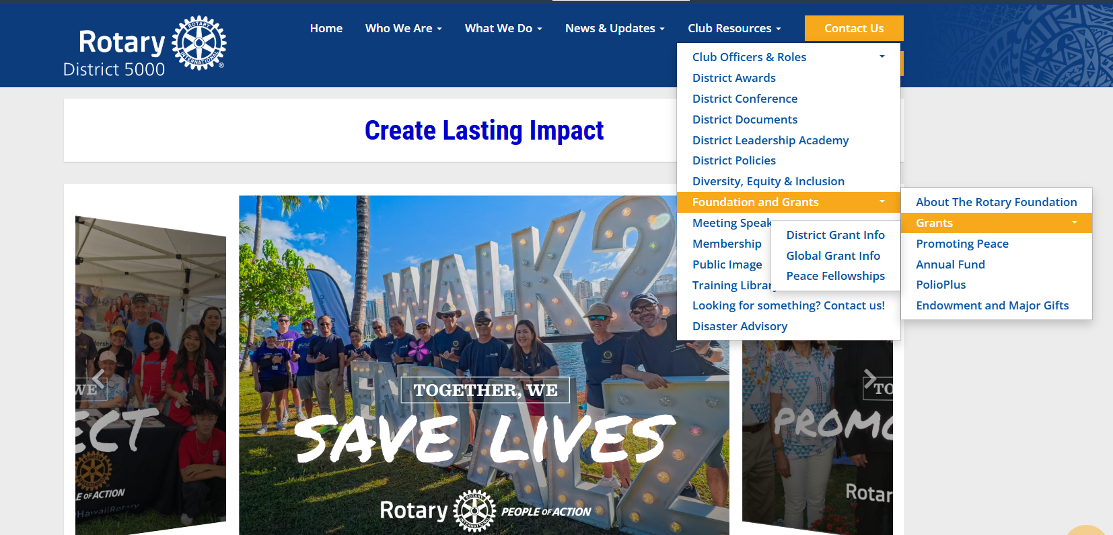
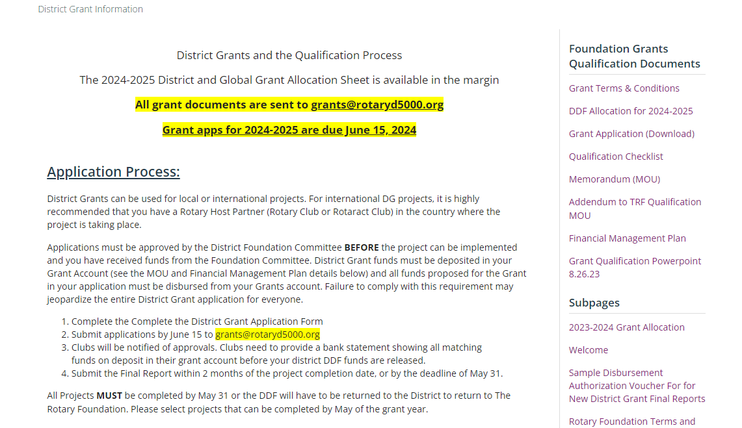
District Sitepage
https://rotaryd5000.org/sitepage/district-grant-info-documents
Notes:
Naomi

Slide 8
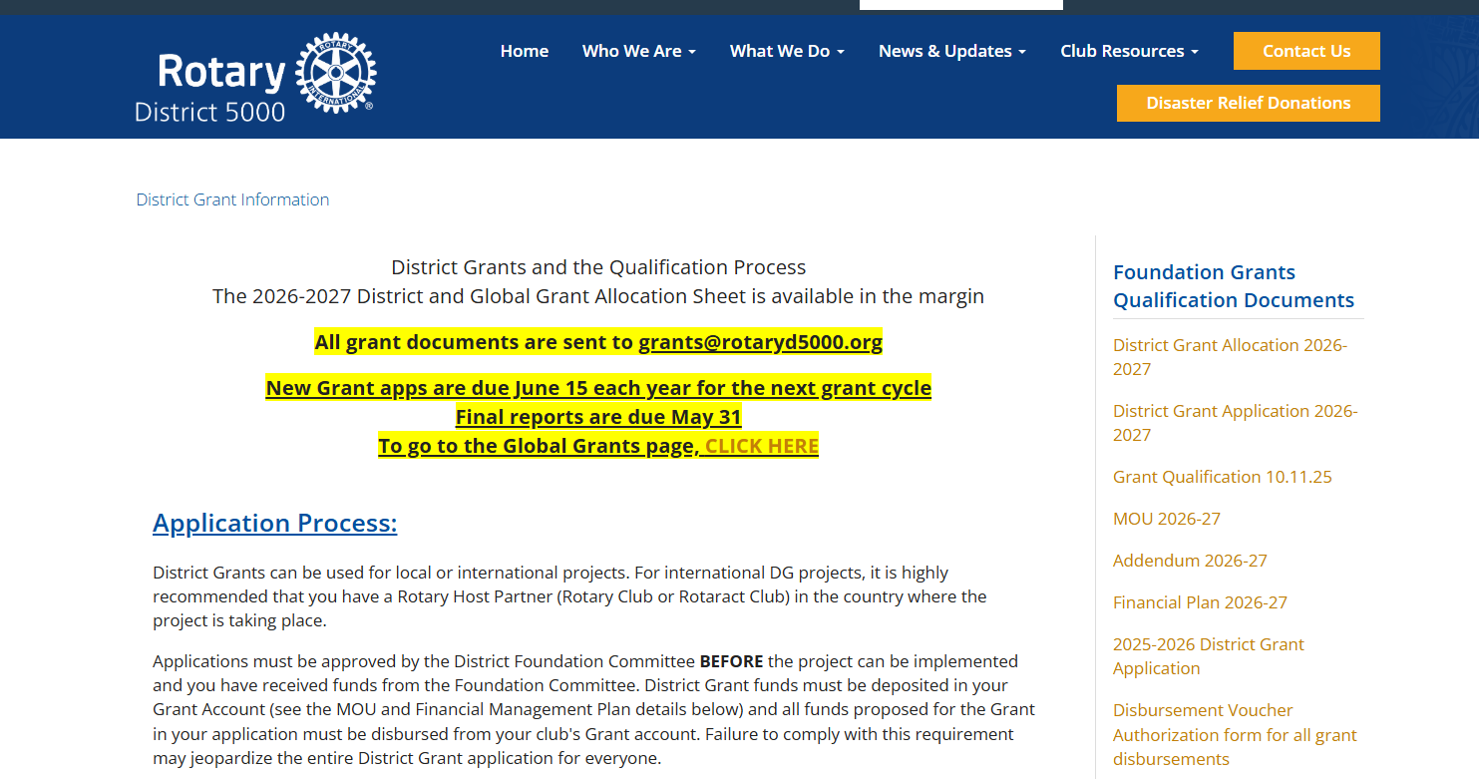

Slide 9
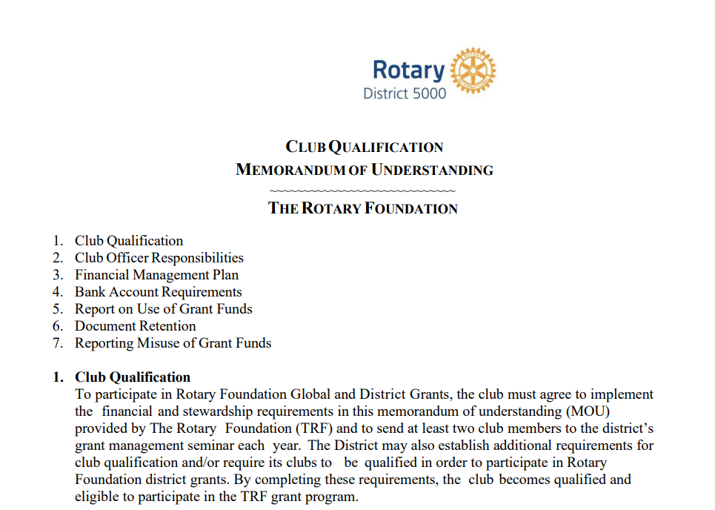
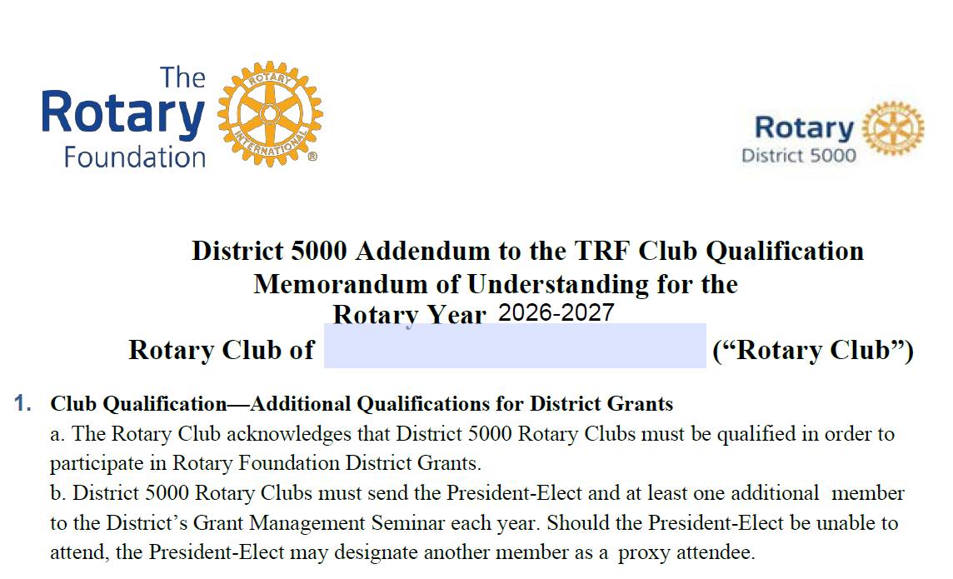
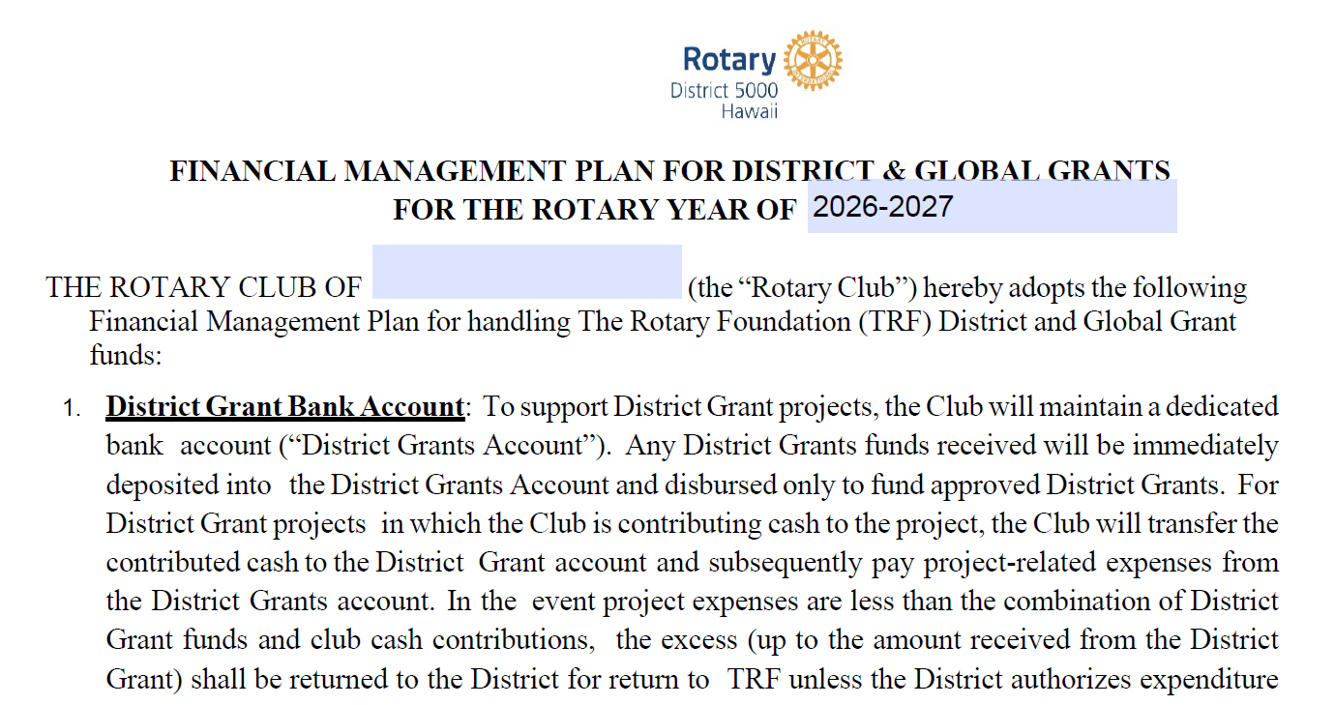
Three forms signed by PE and PN
Notes:
Laura

Slide 10
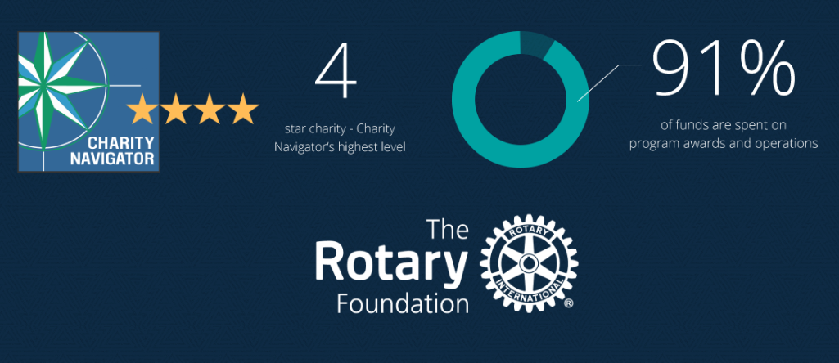
The Rotary Foundation of Rotary International has received 15 consecutive 4-star ratings from Charity Navigator.
The rating reflects Charity Navigator's assessment of how the Foundation uses donations, sustains its programs and services, and practices good governance and openness. (aka Stewardship)
Notes:
Laura: The Foundation earned the recognition for adhering to sector best practices and executing its mission in a financially efficient way, demonstrating both strong financial health and commitment to accountability and transparency. Only one percent of the organizations Charity Navigator evaluates have received 15 consecutive 4-star evaluations. The rating reflects Charity Navigator's assessment of how the Foundation uses donations, sustains its programs and services, and practices good governance and openness. This is also known as Stewardship. The District signs an MOU and must oversee the process and adhere to Rotary’s rules.

Slide 11
What is Stewardship?
Stewardship is the responsible management and oversight of grant funds, which ensures that funds are used properly and truly benefit the populations in need:
Supervise projects—MOU Guidelines
Implement projects as approved
Report irregularities
Submit reports
Retain documents- 5 years of soft (electronic) and hard copy
Notes:
Laura

Slide 12
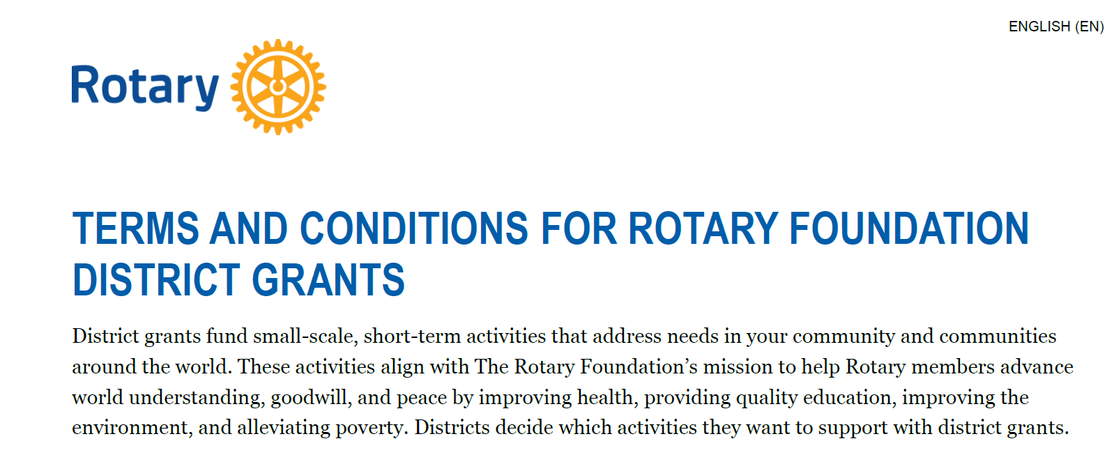
Notes:
Laura

Slide 13
Grant eligibility guidelines
Relate to the Foundation’s mission
Can’t use grants to reimburse clubs or districts for activities and expenses that are in progress or already completed.
If you want to alter a project after a grant is approved, the Foundation also needs to approve those changes before they are carried out.
Comply with the Conflict of Interest Policy for Program Participant
Follow Rotary’s Privacy Statement (personal data, images, etc)
Include signs on/near projects that identify Rotary Foundation
Notes:
Laura

Slide 14
Grants cannot fund:
Unrestricted cash donations to a beneficiary or cooperating organization
Continuous or excessive support of any one beneficiary, entity, or community
The purchase of land or buildings
A Rotary Club cannot own assets purchased with grant funds
Fundraising activities
Expenses related to Rotary events such as district conferences, conventions, institutes, anniversary celebrations, entertainment activities, or project ceremonies
Public relations initiatives, unless they are essential to carrying out the project
Project signs that cost more than $1,000
The operating, administrative, or indirect program expenses of another organization
Activities for which the cost has already been incurred
Notes:
Laura

Slide 15
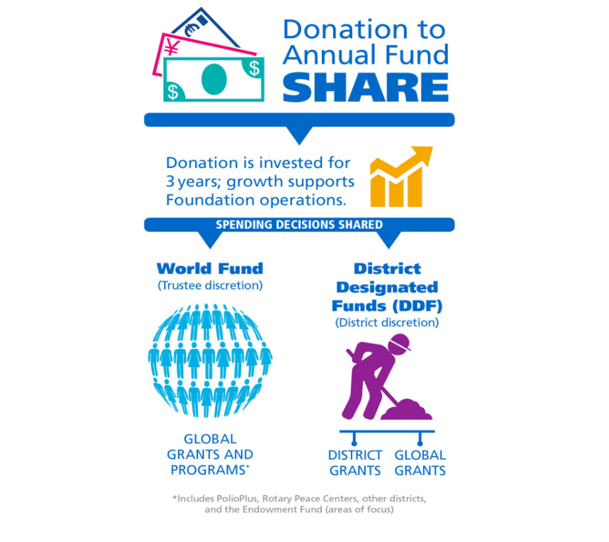
How DDF is determined

Slide 16
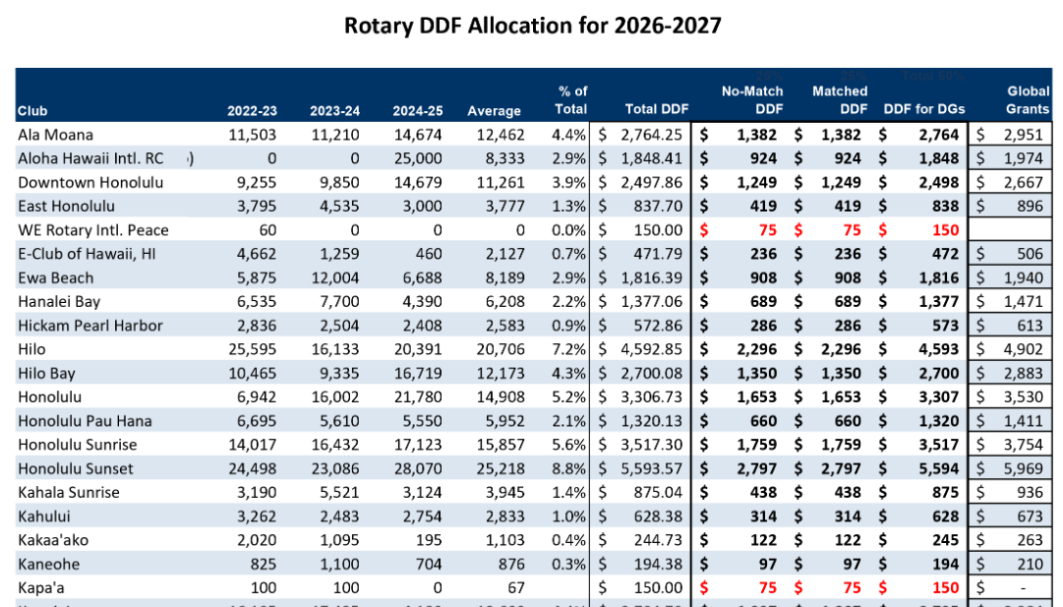
Notes:
This year, the no match and match is the same to reduce the amount of cash the club has to put up

Slide 17
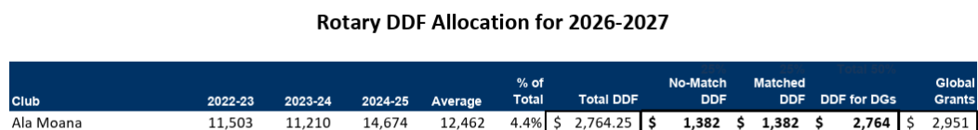
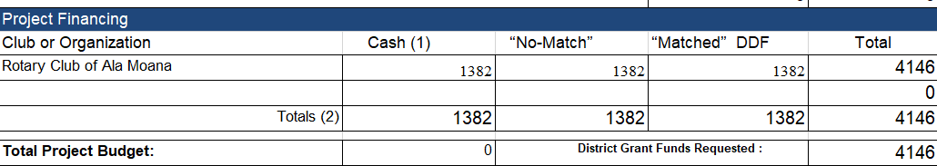

DDF Allocated to the Clubs for district grants and global grants 2026-27 https://rotaryd5000.org/sitepage/district-grant-info-documents
Notes:
Patti

Slide 18
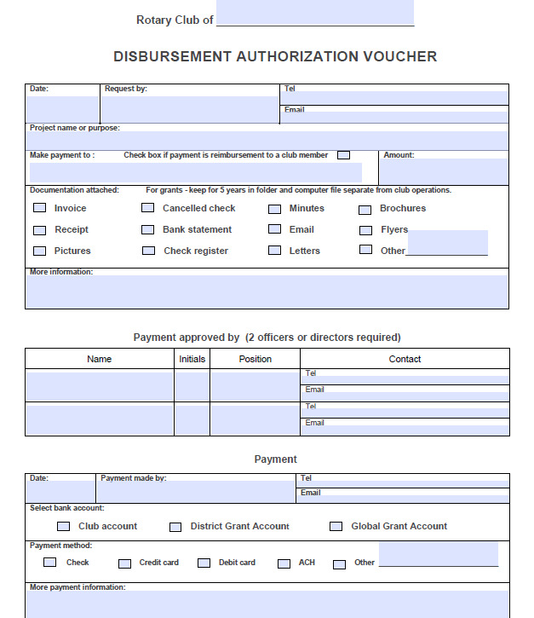
Disbursement Authorization Voucher
Notes:
Patti

Slide 19
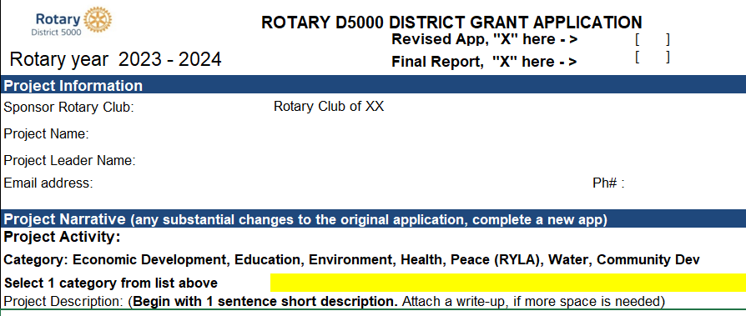



Final Reports
Final Reports are due 2 months after the completion of the project, but no later than May 31. Send the receipts along with the report to grants@rotaryd5000.org
Notes:
Naomi

Slide 20
FINANCIAL MANAGEMENT OF DISTRICT GRANTS—
THE AUDIT
About 15-20% of District Grants audited each Rotary Year
Documents you will need:
The DG Application and Final Report with explanation of any changes
Current Bank Signature Cards
Bank Statements showing incoming funds (Club cash and DDF) and disbursements
Cancelled checks
Paid invoices or receipts
D5000 Disbursement Authorization/Payment Vouchers
Notes:
Laura

Slide 21
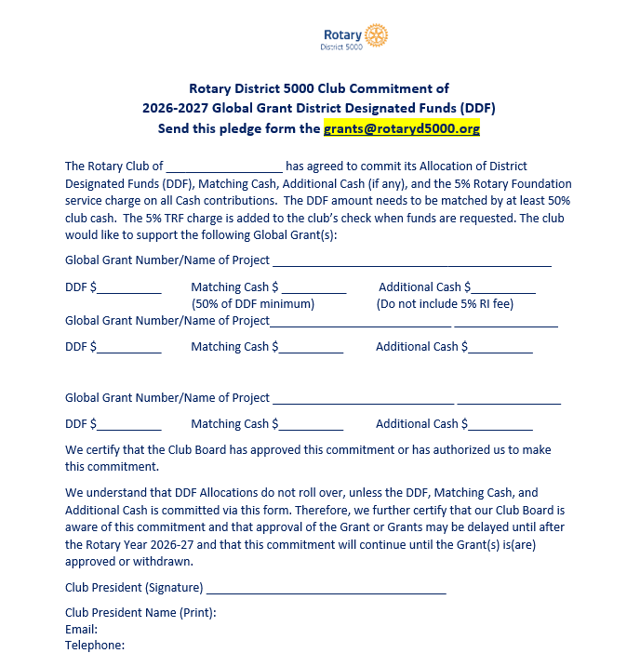
Global Grant Pledge Global Grants – Pledge form
Important
Retain copies of Global Grants Commitment Letter
Make sure PE and incoming Board have copies and understand commitment
COMMITMENT EXISTS UNTIL GRANT IS APPROVED, FUNDED OR CANCELLED
Notes:
Naomi

Slide 22
District Grants vs Global Grants
Global Grant District Grant
Cost - $30,000 minimum No maximum
Funding - World Fund, DDF, Cash DDF and Mandatory Club Match
Application -Online District Application
Area of Focus No area of Focus requirement One of seven areas of Focus
Partnerships – Host Club required No partnership required
Sustainability - Required Not Required
Measurability - Required Required
Scholarships Sponsor Club Determines Graduate- Post Graduate
Notes:
Naomi: What’s the difference between a District Grant and a Global Grant?

Slide 23
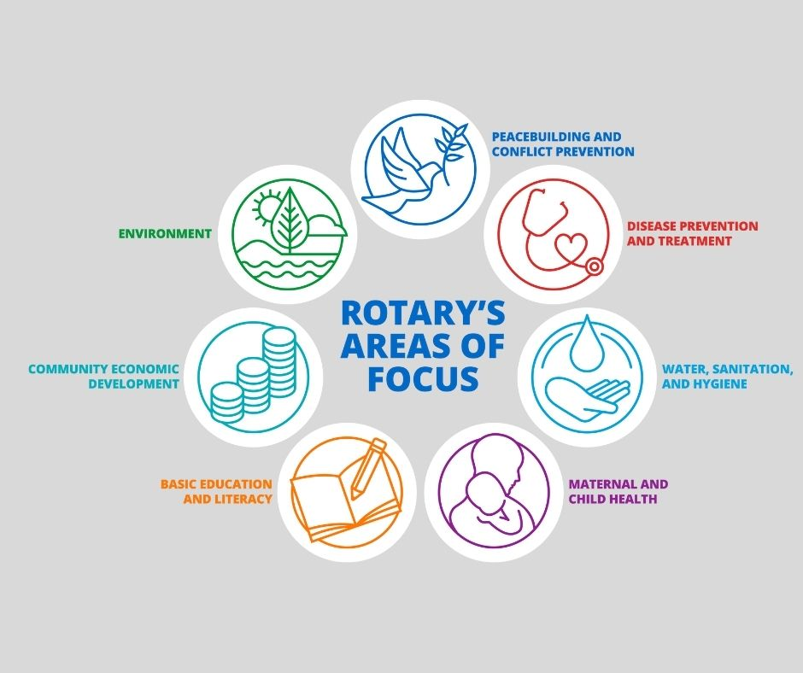
Notes:
Naomi

Slide 24
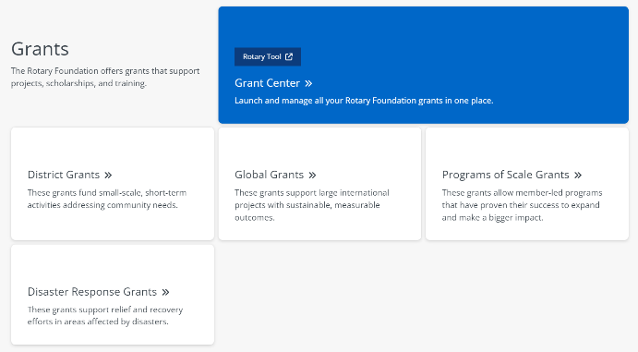
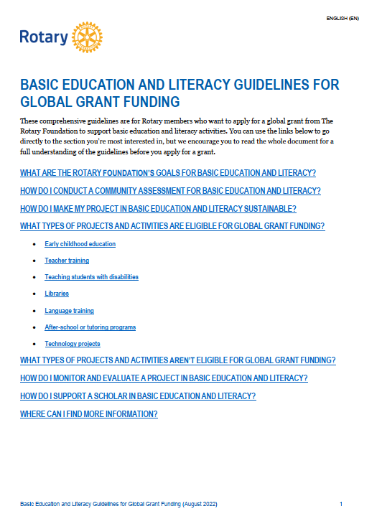

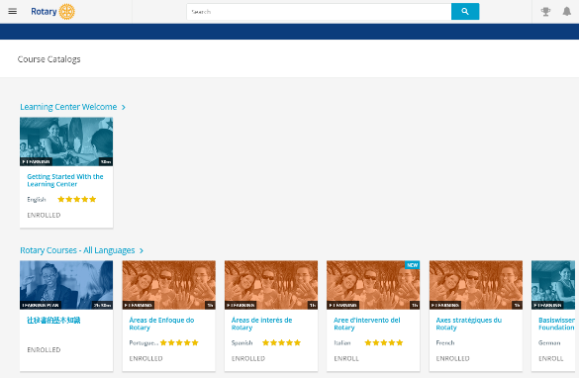
GRANT RESOURCES
My Rotary
A Guide to Global Grants
The Learning Center
Area of focus guidelines
District Rotary Foundation committee
Rotary grants staff
Notes:
Many resources can help you take full advantage of Rotary’s grant opportunities.
My Rotary has pages dedicated to each of our grant types.
If you’re interested in applying for a global grant, I encourage you to read A Guide to Global Grants. This manual includes everything you need to know to get started with global grants.
Rotary’s Learning Center offers resources on many grant-related topics. I encourage anyone interested in applying for a global grant to take the grant management seminar courses.
Another set of resources that will be helpful to you if you decide to apply for a global grant are the area of focus guidelines, one for each area of focus. You can find them in My Rotary.
Another resource is your district’s Rotary Foundation committee. This committee educates clubs about Foundation grant and fundraising activities, inspires them to participate in grants, helps clubs with the grant process, and can advise about whether certain activities are eligible for grant funding. This committee also oversees the distribution of DDF.
You also can talk to members of the Rotary grants staff throughout the process. They can answer questions about grant eligibility and project design. If you have a general idea about a project you’d like to fund with a global grant, you can ask your regional grants officer to conduct a preliminary review of your application. They’ll let you know if there are issues that need to be addressed before you formally submit your application in the Grant Center.

Slide 25
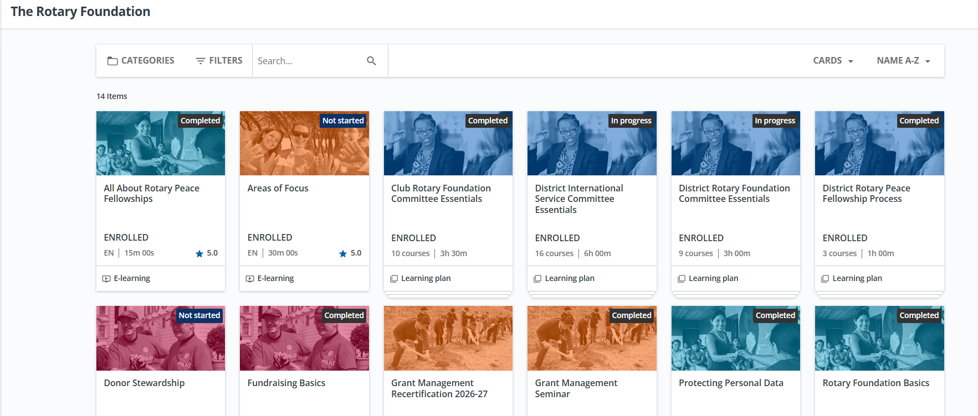

Learn.rotary.org
Notes:
Naomi

Slide 26
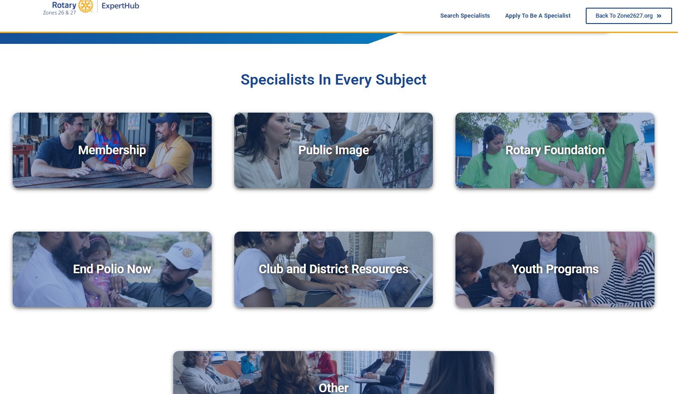
https://experthub.zone2627.org/
Notes:
Naomi

Slide 27
Key takeaways
Use of grant funds
  Used for the purpose described on the application that was approved
  Do not spend project funds until after the grant funds are in the account
  Use funds by May 31, return funds to D5000 asap if not used
  Disbursements authorized by 2 people via the voucher or on the grant check
  Grant funds cannot be carried over to another year
Complete qualification checklist by January 31
Maintain separate club grant account – all disbursements from this account
Keep documents for 5 years
Notes:
Naomi

Slide 28

QUESTIONS

Slide 29



