Slide 1
District 5000 Global Grants Project Fair
Rotary Foundation
Grants Subcommittee
Mark Harbison
August 13, 2022

Slide 2
Proposed Global Grant in Fiji: ESRAG Project Solar Power and WASH—DG Randy Hart, RC of Hilo
Now under discussion with the RC of Lautoko, the RC of Hilo, Chris Puttock, past director of ESRAG (and now in District 5000). Another great example of collaboration using the Zoom platform.
Solar power for a school on a remote island in Fiji will achieve environmental goals and enable a WASH in Schools project that will benefit the whole island community.
DG Randy and Steve Handy of the RC of Hilo working on a related trip to Fiji for District 5000 Rotarians.

Slide 3
Proposed Global Grant in Nepal Clean Cooking Gas and Nutrition (CCGN) Project
Biogas commonly known as GOBAR GAS is a clean natural source of energy in rural areas with no cost. Human waste, animal dung and waste food supply biogas plant, and biogas is produced through anaerobic digestion process. The gas is 55-70% methane which can be used for cooking, heating and lighting.
Environmentally planned cowsheds enable collection of cattle urine which otherwise remains unused as it gets lost through evaporation. The urine is very rich of nitrogen.
Poly-house style greenhouse will be a training center and product development center enabling crop expansion and testing of new fertilizer and pesticide products.
Joint project in Damgade, Thaha Municipality with RCs of Lakewood, District 5020 in Washington State and Kathmandu Metro in conjunction with GG2238159 WASH project.

Slide 4
GG2234525 A New Rotary Eye Hospital in New Delhi
Rotary Clubs of Delhi South Metropolitan (D3011), Nara East (D2650), and Kihei-Wailea.
The new hospital will be based in a densely populated area of Delhi, catering to charity patients with basic vision issues (people needing corrective lenses), cataracts, and more difficult problems such as glaucoma and diabetes related macular degeneration.
Partnering with International Agency for Blindness Prevention, the International Eye Foundation and Shrof’s Charity Eye Hospital. The IEF will match the Rotary grant and provide management training.
Our ‘Sister District’ 2650 (Kyoto, Nara) will contribute DDF and Cash. This will be our 4th major project together.

Slide 5
GG2240042 Equipping Spinal Injury Center of Bharatpur Hospital in Nepal
Rotary Club of Narayangarh and Honolulu Sunset
If you are interested in joining the District 5000 trip to Nepal, don’t forget to fill out the Survey about your travel plans
https://forms.gle/gCd5FgrVMqcnky188

Slide 6
Proposed Global Grant Thailand: Si Chomphu Hospital Equipment
A longstanding partnership between the RCs of Silom (Kasemchai Nitiwanakun) and Honolulu Sunrise (Dave Mozdren)
Approximately 45,000 USD for a defibrillator, dental unit, dialysis machine, and ICU unit.
Shifting the emphasis slightly from the tight focus on dialysis, this project aims to upgrade the overall capacity of this hospital located in a remote corner of the Northeaster Thailand.

Slide 7
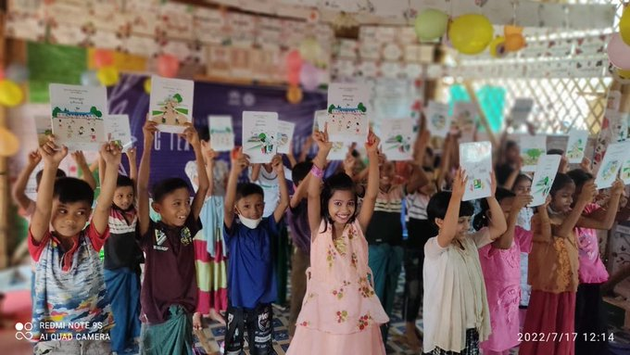
Proposed Global Grant in Cox’s Bazar Bangladesh: Peacebuilding Through Education Bhasan Char
Follow up to GG 2016381 Female Adolescent-centred Non-formal Education[FANE] for the Rohingyas in Bangladesh
Government of Bangladesh proposes sending more than 100,000 refugees to Bhasan Char Island
The Myanmar Curriculum Pilot, launched by UNICEF and partners in November 2021, is a critical step towards ensuring the right to education for Rohingya refugee children and it will help prepare for their return to Myanmar—however the pilot reaches only 10,000 students out of 300,000-400,000 children in Cox’s Bazar
This grant will extend the Myanmar Curriculum project in a UNICEF distance learning platform to Bhasan Char
A Rotary Action Group for Refugees, Forced Displacement and Migration project

Slide 8
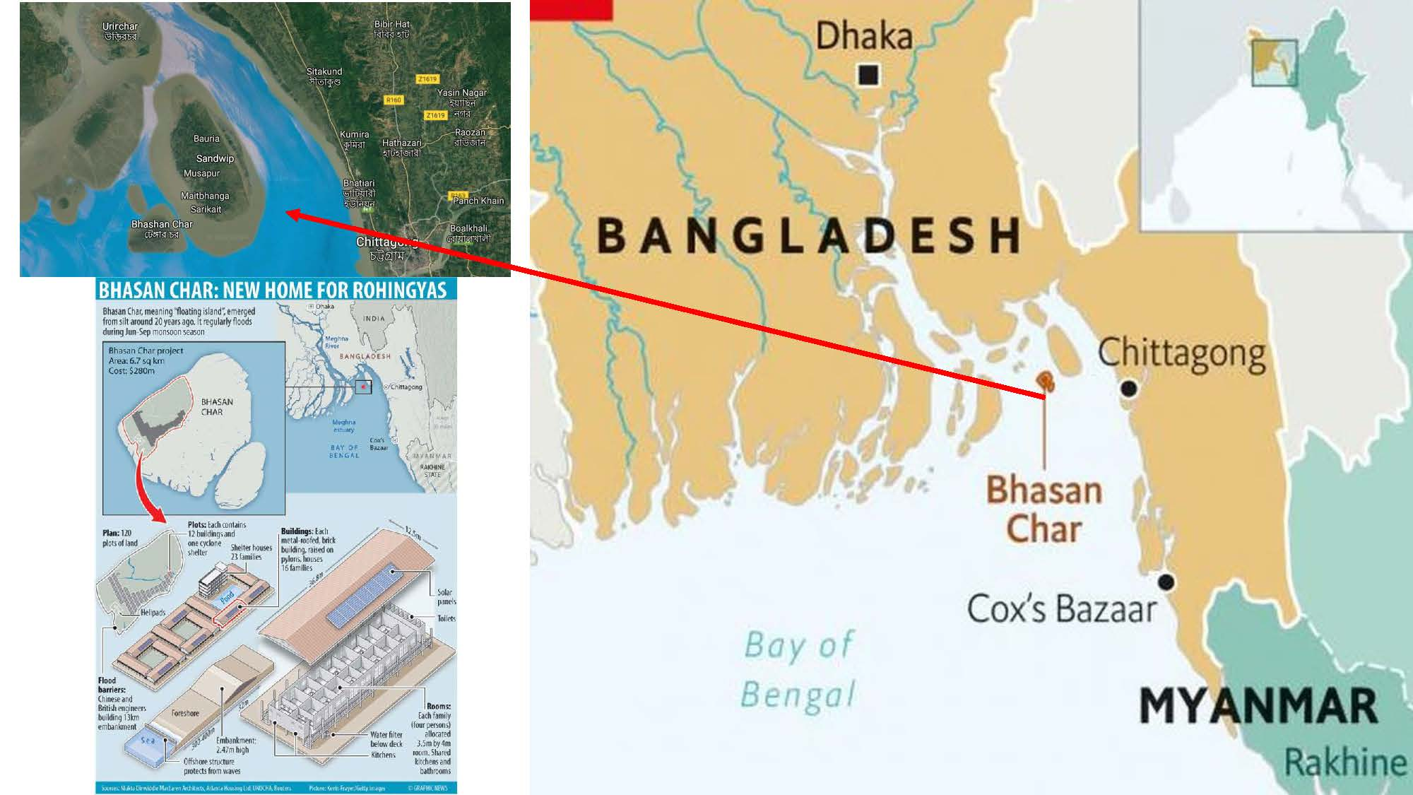

Slide 9
Proposed Global Grant in Vietnam: WASH in Schools and Building Rehab
Sanitation: School and school dormitories need new toilet blocks for girls and boys
Replacement and upgrade of 6,000 gallon water tank serving both school and dormitory
Either through Global Grant or Cooperating partner, rehabilitation of dormitory buildings (built in 2004 to low standards)
Adapt curriculum for sanitation and hygiene promotion
Project will enhance education from tribal students, promote gender equality and promote sanitation and hygiene best practices

Slide 10
Proposed Global Grant: ESRAG project—Mangrove Restoration in the Sundarbans, Bangladesh
Past ESRAG Director Chris Puttock has moved to Honolulu and will join District 5000. He is currently the Director of the Mangrove Project and is involved in Mangrove Restoration all over the world
Environmental impact of mangroves
Socioeconomic impact of mangroves
The Sundarbans as a unique environmental crisis zone

Slide 11
Proposed Global Grant: Education for Sexual and Reproductive Rights in Columbia
LOOKING FOR A D5000 PARTNER: Originally proposed by Pili Valderrama as a joint project with the Rotary Club of Tulua, District 4281
Provide an education curriculum and teacher workshops in 15 schools in 3 rural cities (Buenaventura, Buga and Tulua targeting 1,000 teenage girls focusing on empowering them to access their sexual and reproductive rights.
Teen pregnancy is often the result of rape (nearly 15% of girls experience sexual violence), early marriage, casual sex with older partners—usually results in leaving school, continued poverty, problematic maternal and child health.
The teenage pregnancy rate in this rural district of Columbia is 30%. The goal is to reduce this by half.

Slide 12
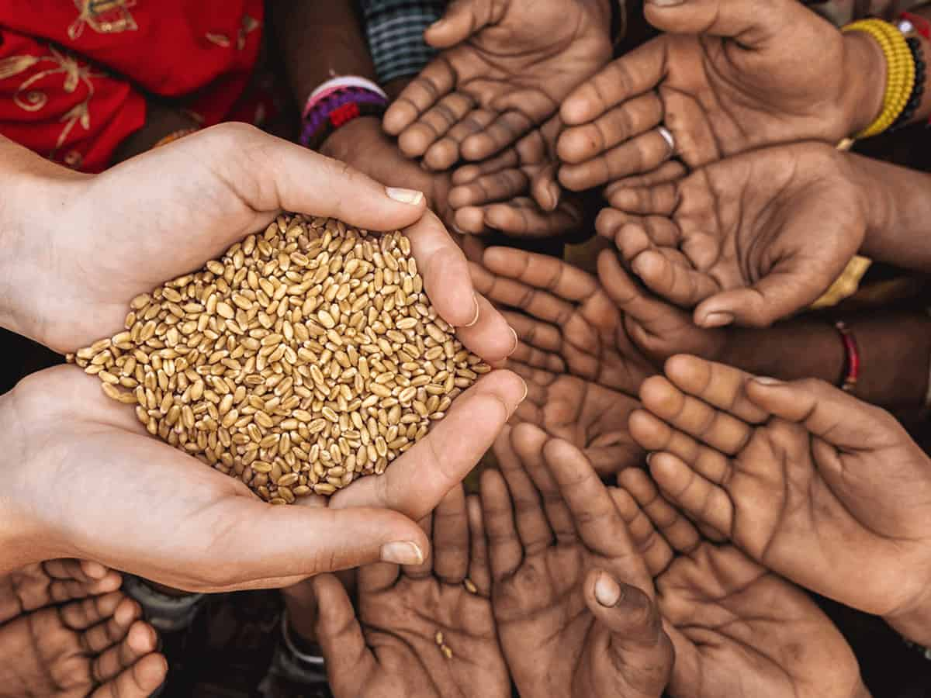
Sri Lanka’s economy is in meltdown, creating a critical shortage of food, medicine,and fuel. Rotary District 3220 and the Rotary Club of Columbo Port City are raising funds to provide food packages for needy families in rural areas—rice (5 kg), sugar (1 kg), shoyu (1 pint), flour (2 kg), dahl (1 kg), and oil. Each package is Rs 2,500, or $7 US. Mail checks to D5000 Foundation, PO Box 2784, Honolulu HI 96803.

Slide 13
More Projects in Sri Lanka: UNICEF Collaboration on Food and Fuel Crisis; Eye Camp for Child Vision and Cataract Surgeries
Joint Rotary-UNICEF Project to deliver food and fuel aid to families with children.
Global Grant LOOKING FOR A D5000 PARTNER: A Rotary Action Group for Blindness Prevention project
Mass eye camps for rural areas around Kandy, Sri Lanka—vision screening a free eyeglasses for children. Screening for cataracts, glaucoma, and macular degeneration.

Slide 14
District 5000 Joins the US-Ukraine/Ukraine-US Intercountry Committee: Proposed Multi-District Disaster Grant: $175,000 for emergency medical supplies
The Lviv International RC in Ukraine has 60 members in 11 European countries and US.
https://www.facebook.com/LvivInternationalRC
Natalia Dolinska, Club President 2022-23
Founded in 2014, United Help Ukraine is a DC area non-profit
purchasing and shipping medical supplies to the Ukraine warfront.
UHU has funding to ship our medical aid for FREE or low cost, a substantial benefit to Rotary,
making more funds go directly to saving lives.
UHU has funded over $18 million in supplies and services during the current crisis. They have an 87 rating in Charity Navigator.
www.unitedhelpukraine.org

Slide 15
District 5000 Global Grants Project Fair
QUESTIONS?????

