Slide 1
The Rotary Foundation
Recognitions and Awards

Slide 2


Arch Klumph Society

Slide 3
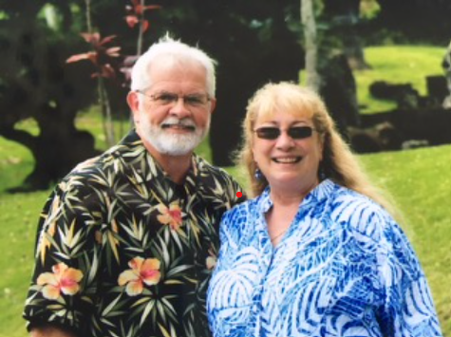

Arch Klumph Society
Ron and Sandi Mabry

Slide 4
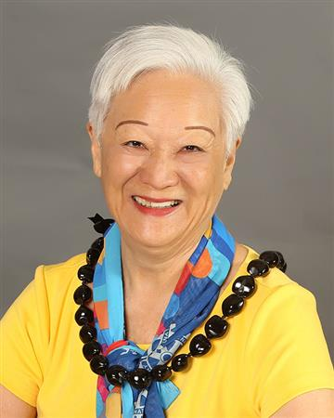
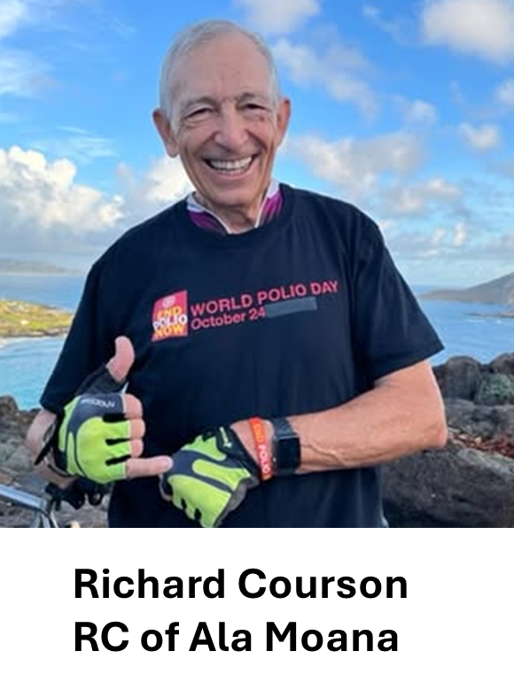
Arch Klumph Society
Marry Ann Berry
RC of Ala Moana
Notes:
Test note

Slide 5
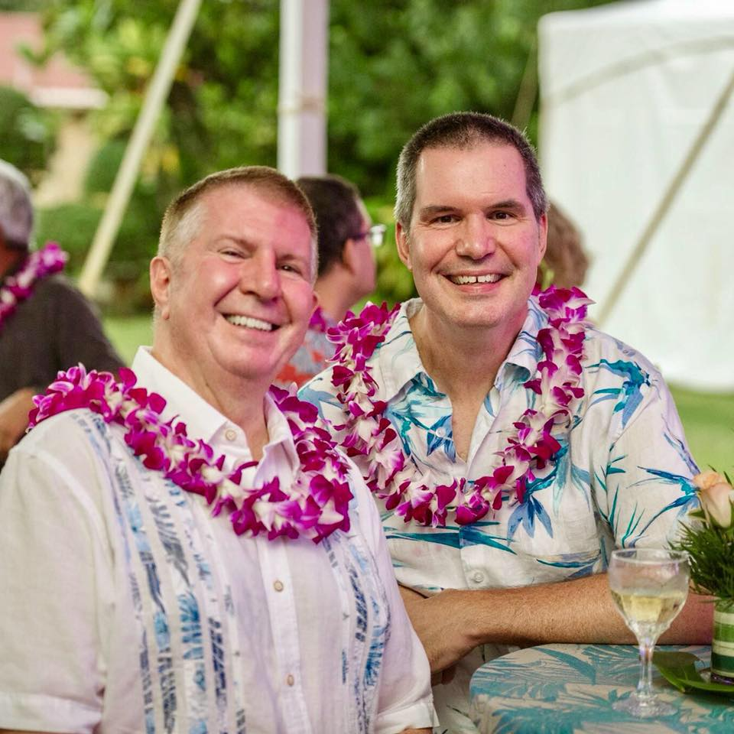
Legacy Society Member
These are Rotarians or friends of Rotary who have committed to make a future gift of $1 million or more to The Rotary Foundation.
PDG Ted Faigle & Rick Golba

Slide 6



Slide 7


New
Sandi Mabry E-Club of Hawaii
David DeLuz Hilo Bay
Helene “Sam” Shenkus Ala Moana
David Tsuda Downtown Honolulu
Lyman Morikawa Upcountry Maui
Richard Zegar- 2024 & 2025 Honolulu Sunset

Slide 8
New Major Donors – Level 1
Allie Ackerman Windward Oahu Sunrise Level 1
Sharon Amano Ala Moana Level 1
Natasha Clarin Kapolei Level 1
Alan Clark Kona Rotary Club Level 1
Thomas Daniel Kona Rotary Club Level 1
David S De Luz, Jr Hilo Bay Level 1
Michael DeWeert Metropolitan Honolulu Level 1
Carol England Kapolei Level 1

Slide 9
New Major Donors
Tracy Hargrave Ewa Beach Level 1
Allen Kamemoto Hickam Pearl Harbor Level 1
Lani Paet Ala Moana Level 1
Sean Slentz Downtown Honolulu Level 1
Chris Tamm Hilo Rotary Club Level 1
Richard Thompson Upcountry Maui Level 1
Ted Faigle & Rick Golba Poipu Beach Level 2 Marilyn & Lyman Morikawa Maui Rotary Club Level 2
Helen “Sam” Shenkus Ala Moana Level 2
Richard May Kapolei Level 3

Slide 10

TRIPLE CROWN
DONOR CIRCLE
Recognizing Rotary Foundation contributors who are:
  Paul Harris Society Members
  Major Donors
  Bequest Society Members

Slide 11
Richard Courson Ala Moana Club
David Hamil Rotary Club of Waikiki
Beth Hoban Honolulu Sunset
James Hoban Honolulu Sunset
Rickard May Rotary Club of Kapolei
Sam Shenkus Ala Moana RC
Sean Slentz Downtown RC
Laurie Yoshida Kauai RC

Slide 12
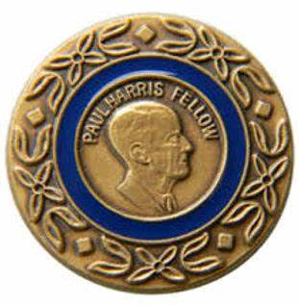
New
Paul Harris Fellows

Slide 13
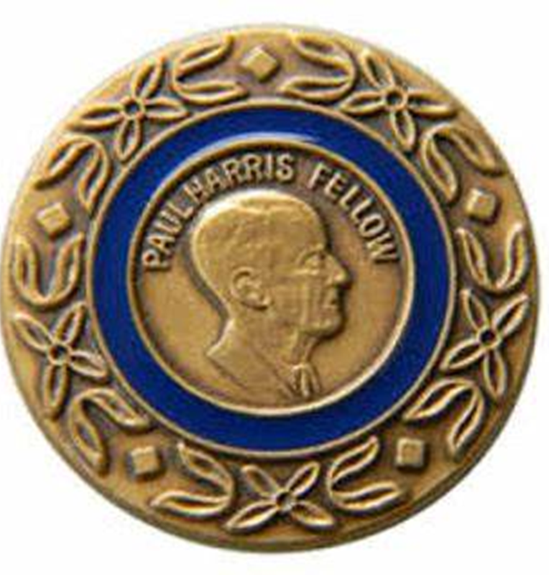
New - Paul Harris Fellows
Edith L. Choy RC of Pearl Harbor
Dennis Drake RC of Pearl Harbor
Tomas P. Logan RC of Pearl Harbor
Jennifer Macaraeg RC of Pearl Harbor
Christopher Moylan RC of Pearl Harbor
Gordon E. Powers RC of Pearl Harbor
Jana U. Stern RC of Pearl Harbor
Donna Takasaki RC of Pearl Harbor
Laura Arnone RC of Honolulu Sunrise
Dannah Barnes RC of Honolulu Sunrise
Oksana Enriquez RC of Honolulu Sunrise
Gina Rae Inoue RC of Honolulu Sunrise
Eric Schiff RC of Honolulu Sunrise

Slide 14

New - Paul Harris Fellows – cont.
Henry Hale RC of Downtown Honolulu
Jaymes Song RC of Downtown Honolulu
Rod Quartararo RC of Kona
Michele Romo RC of Kona
Len Miyazono RC of South Hilo
Girard Perone RC of Honolulu Sunset
Lucci R. Pinoliad RC of Honolulu
Lillian L. Shaw RC of East Honolulu
Toni Ann Symons RC of Kona Sunrise
Harvey S. Tajiri RC of Hilo
Augusta “Augie” Tulba RC of Ala Moana

Slide 15

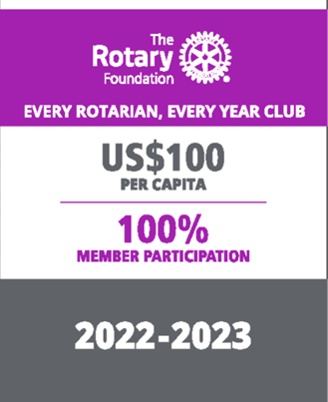


Club Banner Awards (2024-2025)

Slide 16
2024-25 Annual Fund Giving Award
Club Name | Total Annual Fund Giving | Annual Fund Per Capita Rank | Annual Fund Per Capita Giving
Honolulu Sunset | $28,069.51 | #1 | $738.67
Upcountry Maui | $6,977.50 | #2 | $697.75
Honolulu Sunrise | $17,123.13 | #3 | $535.10
District Annual Fund Goal $221,865.00
Total Annual Fund Giving $294,085.73

Slide 17
2024-25 Club Banner Awards
Club Name | 100% TRF Banner | 100% EREY Banner | 100% Sustaining Banner
Honolulu Sunset | Yes
Downtown Honolulu | Yes | Yes
Hickam Pearl Harbor | Yes | Yes
Kihei-Wailea Maui | Yes | Yes
Kona Sunrise | Yes | Yes
Lahaina | Yes | Yes
Honolulu Sunrise | Yes | Yes | Yes
West Kauai | Yes | Yes | Yes
Notes:
This year we would like to have 100% of the clubs to strive to get every member to be 100%TRF Banner Club. This would be a fabulous Club Goal to strive for and hopefully more of the clubs will become 100% EREY Clubs or 100% Sustaining Clubs.

Slide 18



Slide 19

Rotary Direct
Enroll in Rotary’s recurring giving program, Rotary Direct, which makes giving easy, fast, and secure. You can schedule a monthly, quarterly, or annual donation that empowers Rotarians to change lives in communities around the world.

Slide 20

2024-2025 End Polio Now Club Certificates for $1,500 Goal
Rotary Clubs of
  Ala Moana Kihei-Wailea
  Downtown Honolulu Kona
  Ewa Beach Kona Sunrise
  Hanalei Bay Metropolitan Honolulu
  Hilo Mililani Sunrise
  Honolulu Sunrise Waikiki
  Honolulu Sunset West Honolulu
  Kauai

Slide 21

Serving humanity, empowering a positive change globally

Slide 22
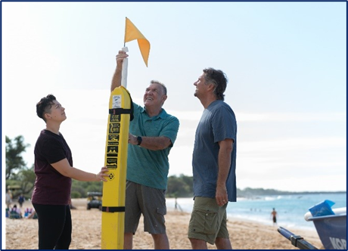

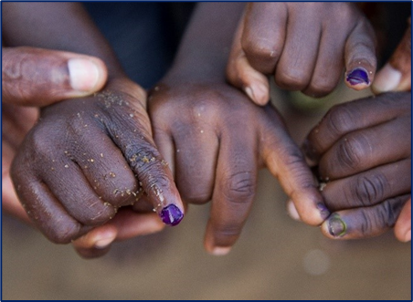
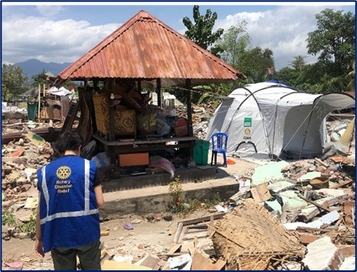

SUPPORTING THE ROTARY FOUNDATION
Annual Fund
For support today
Endowment Fund
To secure tomorrow
PolioPlus Fund
End Polio Now
Donating to The Rotary Foundation earns the donor Paul Harris recognition points
Notes:
Rotarians support our Foundation through these funds:
PolioPlus Fund, dedicated to global polio eradication
Annual Fund, the primary source of funding for Foundation grants and activities
Endowment Fund, which supports the Foundation in perpetuity

Slide 23
Global grants for D5000
$74,897 allocated in 2023-2024
$62,692 allocated in 2024-2025
$70,195 allocated in 2025-2026
Notes:
Jmes and Arjun (3min)

Slide 24
Global grants approved

Slide 25
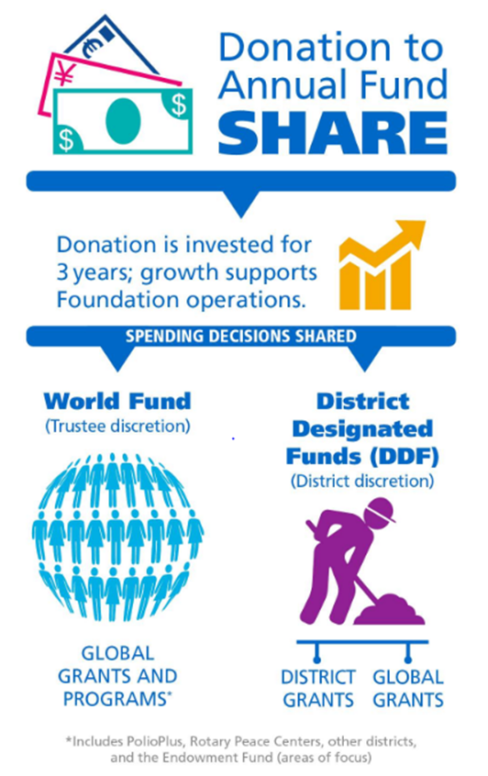
SHARE PROGRAM
When you select Annual Fund – SHARE, the contribution enters the SHARE system for the next 3 years
Under the SHARE system, contributions are divided between the World Fund and District Designated Funds (DDF), after operating expenses of 5% are deducted

Slide 26
Rotary District 5000 Grants
The Rotary Foundation awarded D5000 $68,050 in funding to 84 district grants for fiscal
year 2024-2025. Here is a breakdown of causes the grants supported:
$ 20,045 Community Development
26,690 Education
2,302 Environment
9,126 Health
9,887 Peace (includes RYLA)
For 2025-2026, we received $67,789
Notes:
Largest grant to Kihei-Wailea for $2,314 for recue tubes
Honolulu $3,399 Creating peace contest

Slide 27
Grant Funds to 2025-2026 Rotary Projects
2022-2023 donations of SHARE $295,557 from District 5000
5% Admin Fee $ 14,777 to Rotary International
47.5% to World Fund $140,390 to The Rotary Foundation
47.5% to District Designated Fund (DDF) $140,390 to District 5000
Funds returned in 3 years to the District as grants. Available this year for projects:
$ 33,894 No match (25% of DDF)
$ 33,894 Match (25% of DDF)
$ 70,195 Match for Global Grants (50% of DDF)
$137,983 From District Designated Funds (DDF), net of Admin fee
$ 33,894 Matching Club Cash for matching District Grants
$ 35,097 Matching Club Cash for Global Grants
$ 60,367 From World Fund to match Global Grants
$ 267,341 Total for Global and local projects
.

Slide 31

RESOURCES

Slide 32

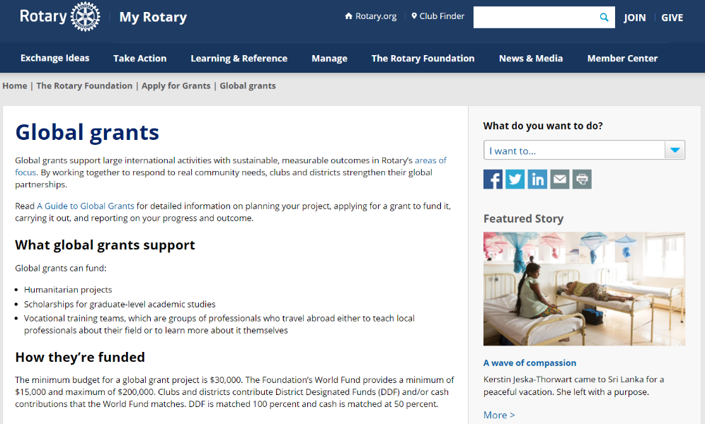

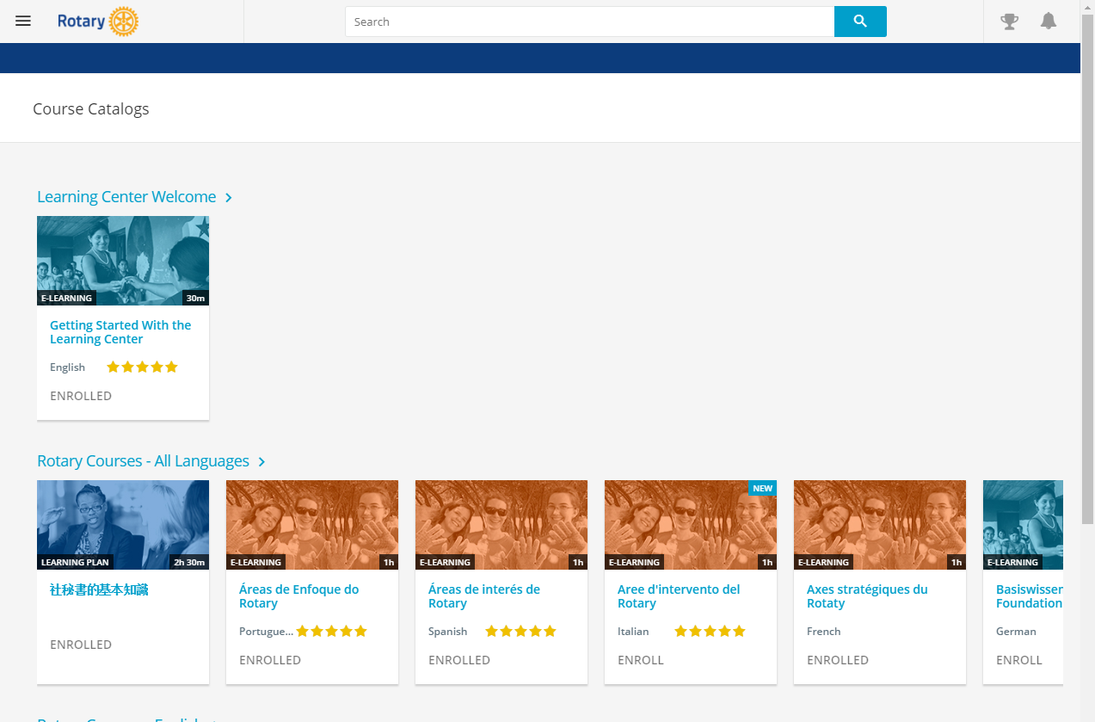
RESOURCES
Notes:
We have a number of resources available to help you take full advantage of grant opportunities.
First and foremost, I encourage you to read A Guide to Global Grants, as it was recently updated back in July. This helpful manual includes everything you need to know to get started and goes through the global grant lifecycle in great detail.
Rotary’s website has a wealth of general and detailed information about each of our grant types. If you navigate to the global grants informational page in My Rotary, there are a ton of resources listed, such as the Terms and Conditions, the Area of Focus Policy Statements, various guides, and other super helpful documents.
The recently refreshed learning center offers training resources on a wide variety of topics, including information to help you apply for Foundation grants. I would encourage anyone interested in applying for grants to take the grant management seminar courses in the Learning Center if you haven’t already.
And last, the guide you see on the right there, Community Assessment Tools, is an invaluable resource for clubs and districts who are conducting a community assessment.

Slide 33
QUESTIONS

