Slide 1


MAGIC ALL AROUND
21-25 JUNE 2025 • CALGARY, CANADA

Slide 2
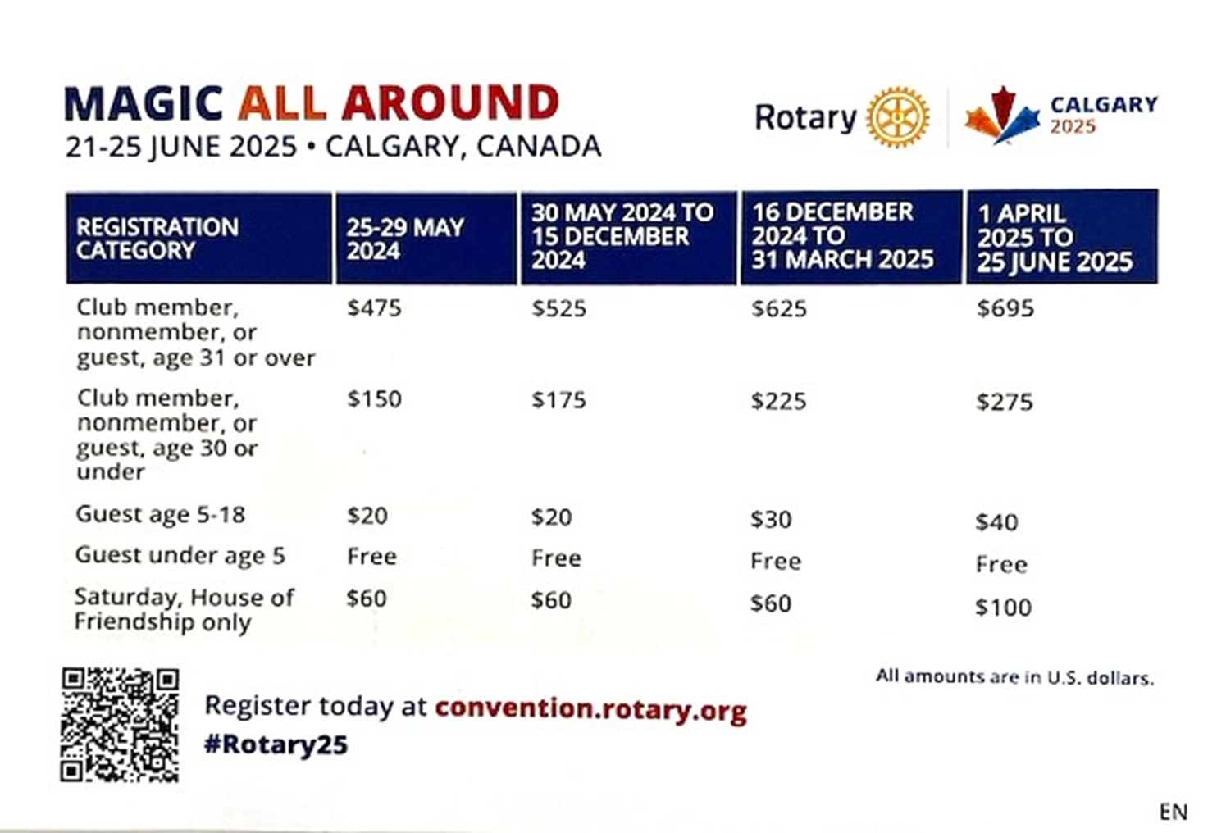

21-25 JUNE 2025 • CALGARY, CANADA
convention.rotary.org

Slide 3
program
All RI events take place at BMO Center at Stampede Park, Calgary, Alberta, Canada, unless otherwise indicated.
General Sessions will take place Sunday-Wednesday, 22-25 June 2025
Breakout Sessions will take place Monday-Wednesday, 23-25 June 2025
The House of Friendship will be open Saturday-Wednesday, 21-25 June 2025

Slide 4
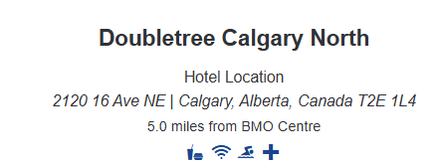
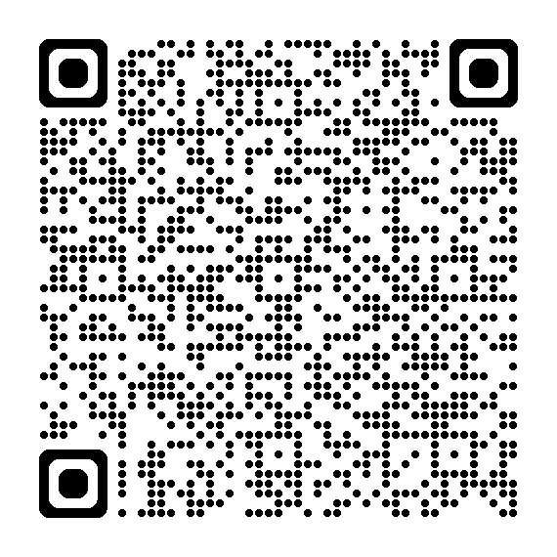
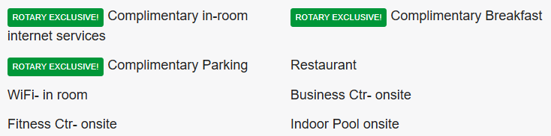
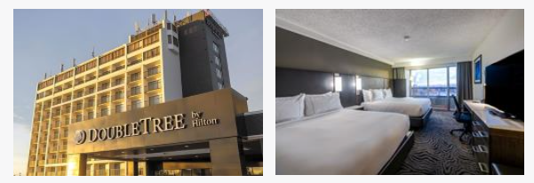
D5000 Hotel room block

Slide 5
Group housing deadlines
25 October 2024: Last day to submit check in and check-out dates to reserve your room without penalty.
1 November 2024: A two night room & tax deposit will be required for each of the held rooms within the block.
CAD$162.40 x 2 = US$236 approx
23 May 2025: Last day to change names on reserved rooms.

Slide 6
Rotary ticketed events
President’s Recognition Luncheon
Come celebrate a successful and productive 2024-25 Rotary year with RI President Stephanie Urchick.
Monday, 23 June | $75
President-elect’s Leadership Luncheon
Join RI President-elect Mário César Martins de Camargo as we look forward to the coming Rotary year and the 2026 International Convention in Taipei.
Tuesday, 24 June | $75
Celebrating Rotary’s Endowment: Your Legacy, Rotary’s Promise Luncheon
Join The Rotary Foundation Trustee Chair Mark Daniel Maloney as we applaud the efforts to achieve the goal to grow the Foundation’s Endowment to $2.025 billion by 2025. Commemorate the accomplishment of this campaign and celebrate the impact of your legacy.
Wednesday, 25 June | $75

Slide 7
Rotary Donor events
The Rotary Foundation Donor Summit
Monday, 23 June 2025
The Rotary Foundation Donor Summit is the largest annual gathering of Foundation donors. This general session-style event features stories and updates about the impact donors make through their support of Rotary’s programs. This session includes an Arch Klumph Society ceremony, keynote messages from Rotary leaders, and entertainment.
Arch Klumph Society members, Legacy Society members, Major Donors, Bequest Society members, and Paul Harris Society members are eligible to attend.

Slide 8
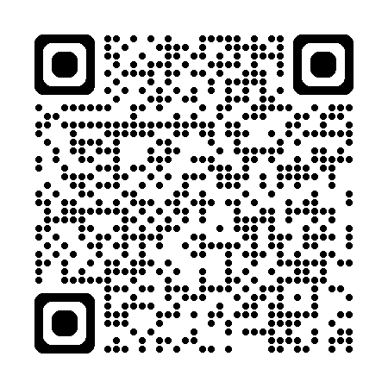
HOC Signature events (US $)
Sat June 21, 8-10:30pm, Grandstand Spectacular at GMC Stadium $95
Sun June 22, 7-10pm, Rockin’ the Big Tent at Nashville North Tent $60
Sun June 22, 7-9pm, New Blood with the Calgary Civic Orchestra $65
Tues June 24, 7-9:30pm, Western Ranch Showcase $60
Go to : rotarycalgary2025.org

Slide 9
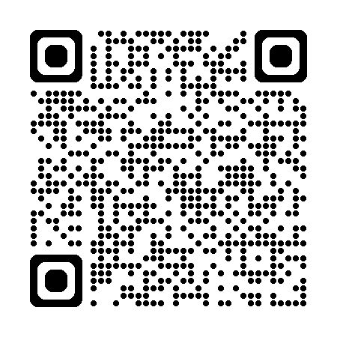
HOC Host Hospitality Night
Monday, June 23 USD $50
Host Hospitality Night is an RI Convention tradition in which registrants are given a memorable evening of local hospitality and international fellowship. Local customs and interaction between guests and hosts are the integral part of this Experience.

Slide 10
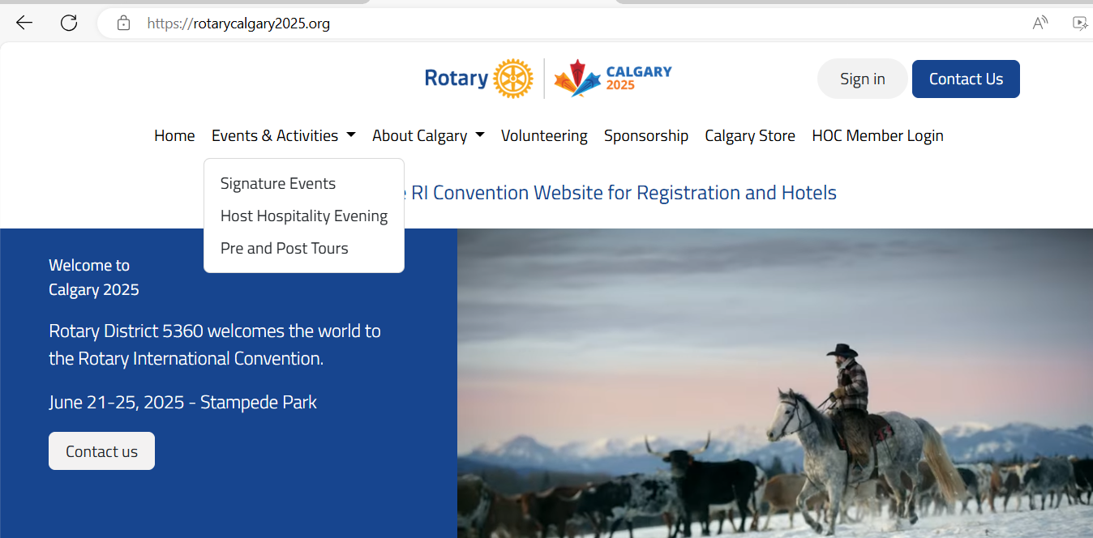
Calgary information

Slide 11
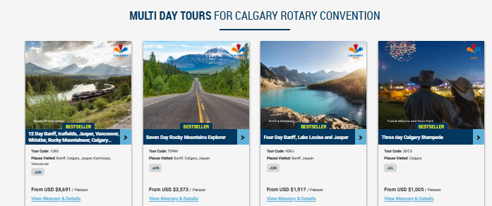
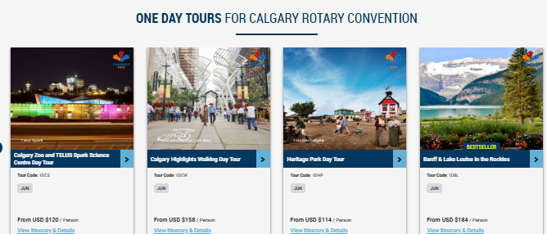
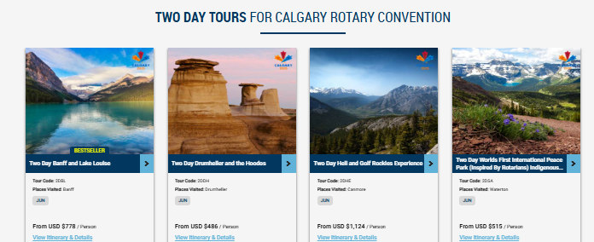
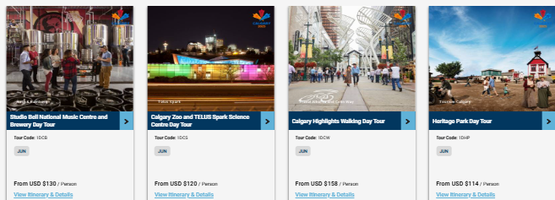
https://www.andersonvacation.com/calgary-rotary-convention

Slide 12
THE ROTARY INTERNATIONAL CONVENTION
The Rotary International Convention takes place each May or June and welcomes all members and their families. It’s generally held in a different world city each year and is attended by 15,000 to 40,000 people. The convention is an opportunity to celebrate Rotary and to network and connect with Rotarians from around the world. Future conventions:
2025 - Calgary
2026 - Taipei
2027 - Honolulu!

Slide 13

MAGIC ALL AROUND
21-25 JUNE 2025 • CALGARY, CANADA
convention.rotary.org

