Slide 1
ROTARY 101
Rotary International
District 5000 Hawaii
rotary.org
rotaryd5000.org
Mark Merriam, mark.rotary@outlook.com
Kelly McDonald, kellymmcdonald@outlook.com
Title Page Option

Slide 2

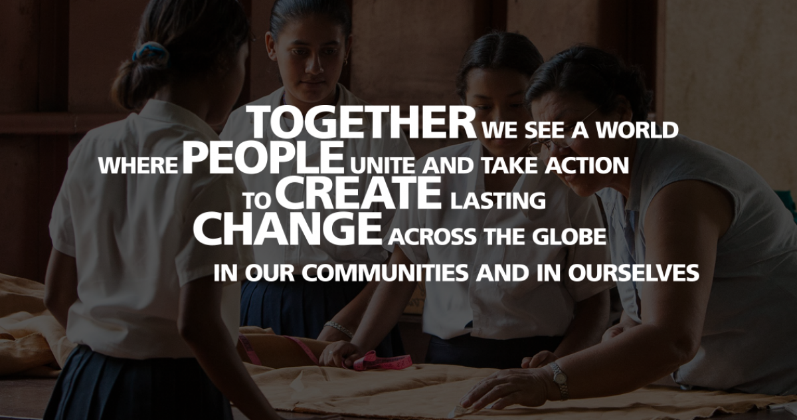
Service Above Self

Slide 3
Diversity, equity and inclusion
As a global network that strives to build a world where people unite and take action to create lasting change, Rotary values diversity and celebrates the contributions of people of all backgrounds, regardless of their age, ethnicity, race, color, abilities, religion, socioeconomic status, culture, sex, sexual orientation, and gender identity.

Slide 4
Our structure
Rotary Clubs - You are a Rotarian in a Rotary club. Dedicated volunteers to exchange ideas, build relationships, and take action.
District 5000 - 1,500 members in 53 communities across the state.
Rotary International - An association of Rotary clubs across the globe. RI Supports clubs worldwide by coordinating programs and initiatives at the local and international level. 1,200,000 members in 37,000 clubs.
The Rotary Foundation – Permanent endowment to help fund our humanitarian activities.

Slide 5

Rotary isn’t just a club for people to join, but rather “an invitation to endless opportunities.”
“We believe that our acts of service, big and small, create opportunities for people who need our help,”
“Everything we do opens another opportunity for someone, somewhere,” said Knaack.
Notes:
He says that Rotary isn’t just a club to join, but rather an invitation to endless opportunities

Slide 6
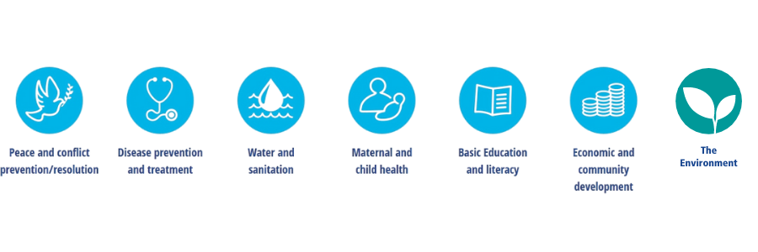
Our causes
Notes:
The Rotary Foundation has a 100% rating, the highest one can get, from the Charity Navigator.

Slide 7


Slide 8

The Rotary Foundation
DOING GOOD iN THE WORLD
The Rotary Foundation helps clubs and districts work together to perform meaningful, sustainable service. Our top-rated, award-winning Foundation has spent more than $3.7 billion in support of the 7 primary causes.
In 2020, The Rotary Foundation funded $20,000,000 in grants to fight the COVID-19 pandemic.
Hawaii District 5000 received a $25,000 Foundation grant for relief efforts. In addition, our district funded $30,000 for local service projects, supporting every community in the state.
Notes:
The Rotary Foundation has a 100% rating, the highest one can get, from the Charity Navigator.

Slide 9
ERADICATING POLIO WORLDWIDE
Rotary works with partners in the Global Polio Eradication Initiative (GPEI),
Rotary’s contributions to the global polio eradication effort now exceed $1.6 billion, including matching funds from the Bill & Melinda Gates Foundation. Since 1988, more than 2 billion children have received oral polio vaccine, and we’ve achieved a 99.9 percent reduction in polio cases. It may be considered the greatest humanitarian service the world has ever seen, and every Rotarian can take pride in the achievement!

Slide 10
District & global grant funding
As a direct result of donations to The Rotary Foundation, funds become available for local club decisions on grant funding.
020-2021: $309,646
2021-2022: $289,195
Year Rotary Foundation D5000 Clubs Total
20-21 $201,571 $108,075 $309,646
21-22 $183,843 $105,352 $289,195

Slide 11

Your Club Organization
President, Officers & Board of Directors
Avenues of Service Committees
Club Service
Community Service
Vocational Service
International Service
Youth Service

Slide 12

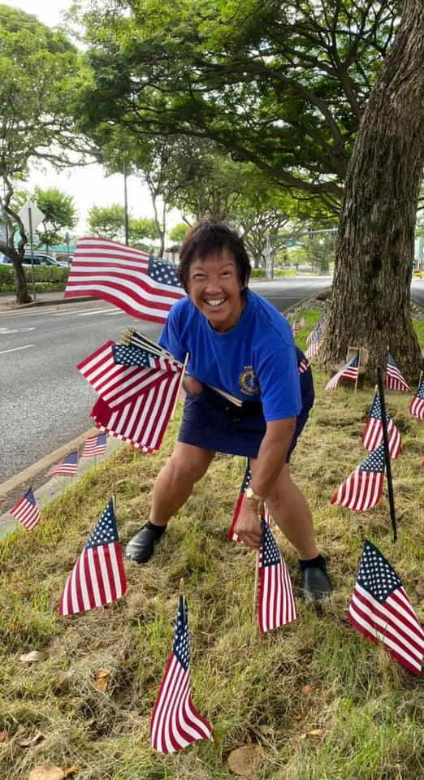
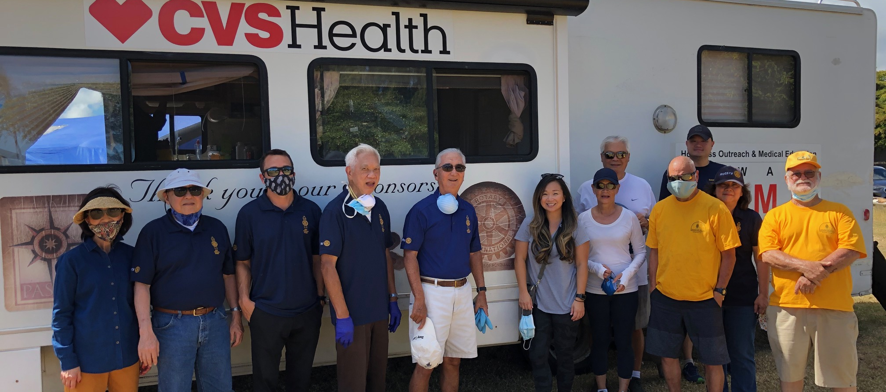
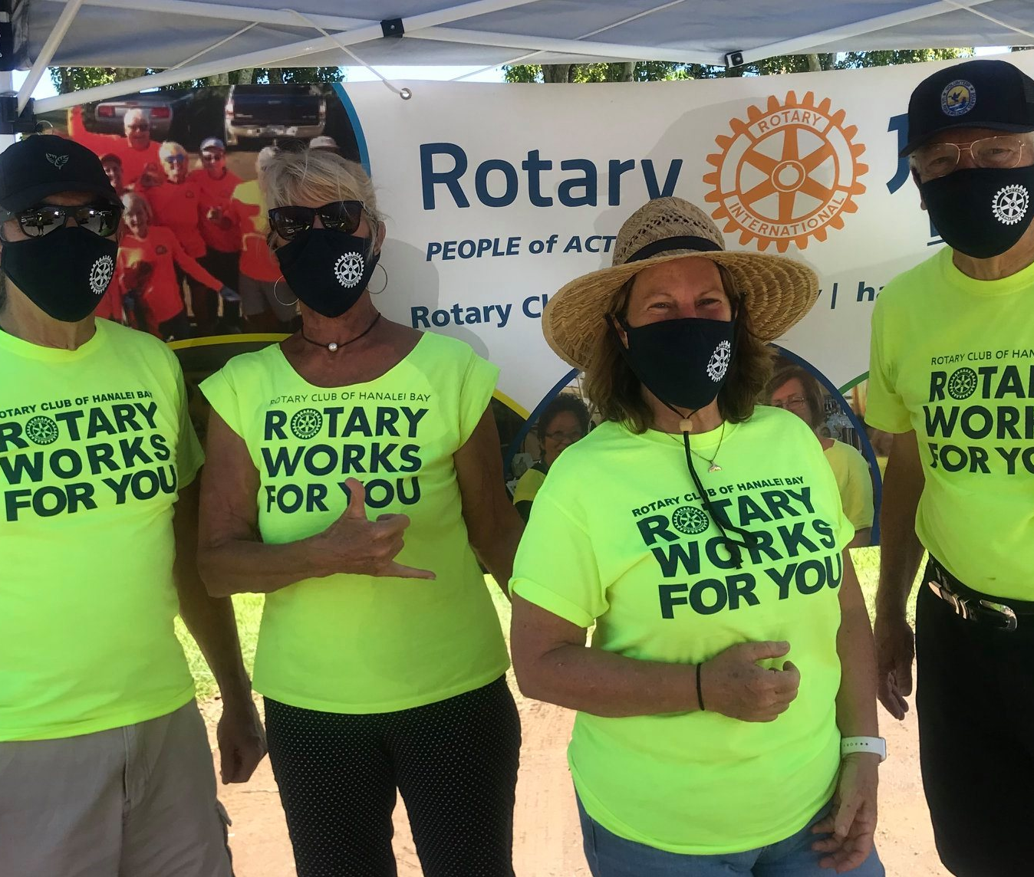
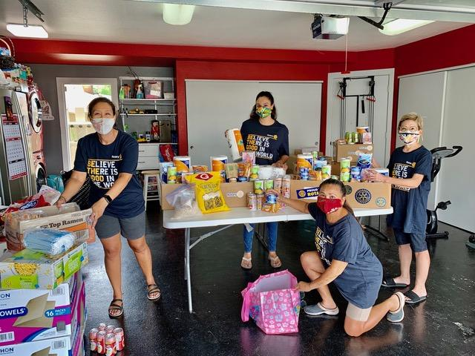
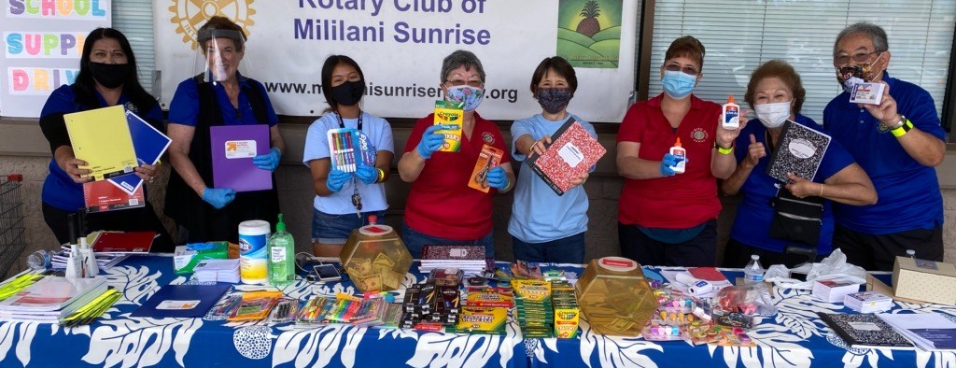

Slide 13
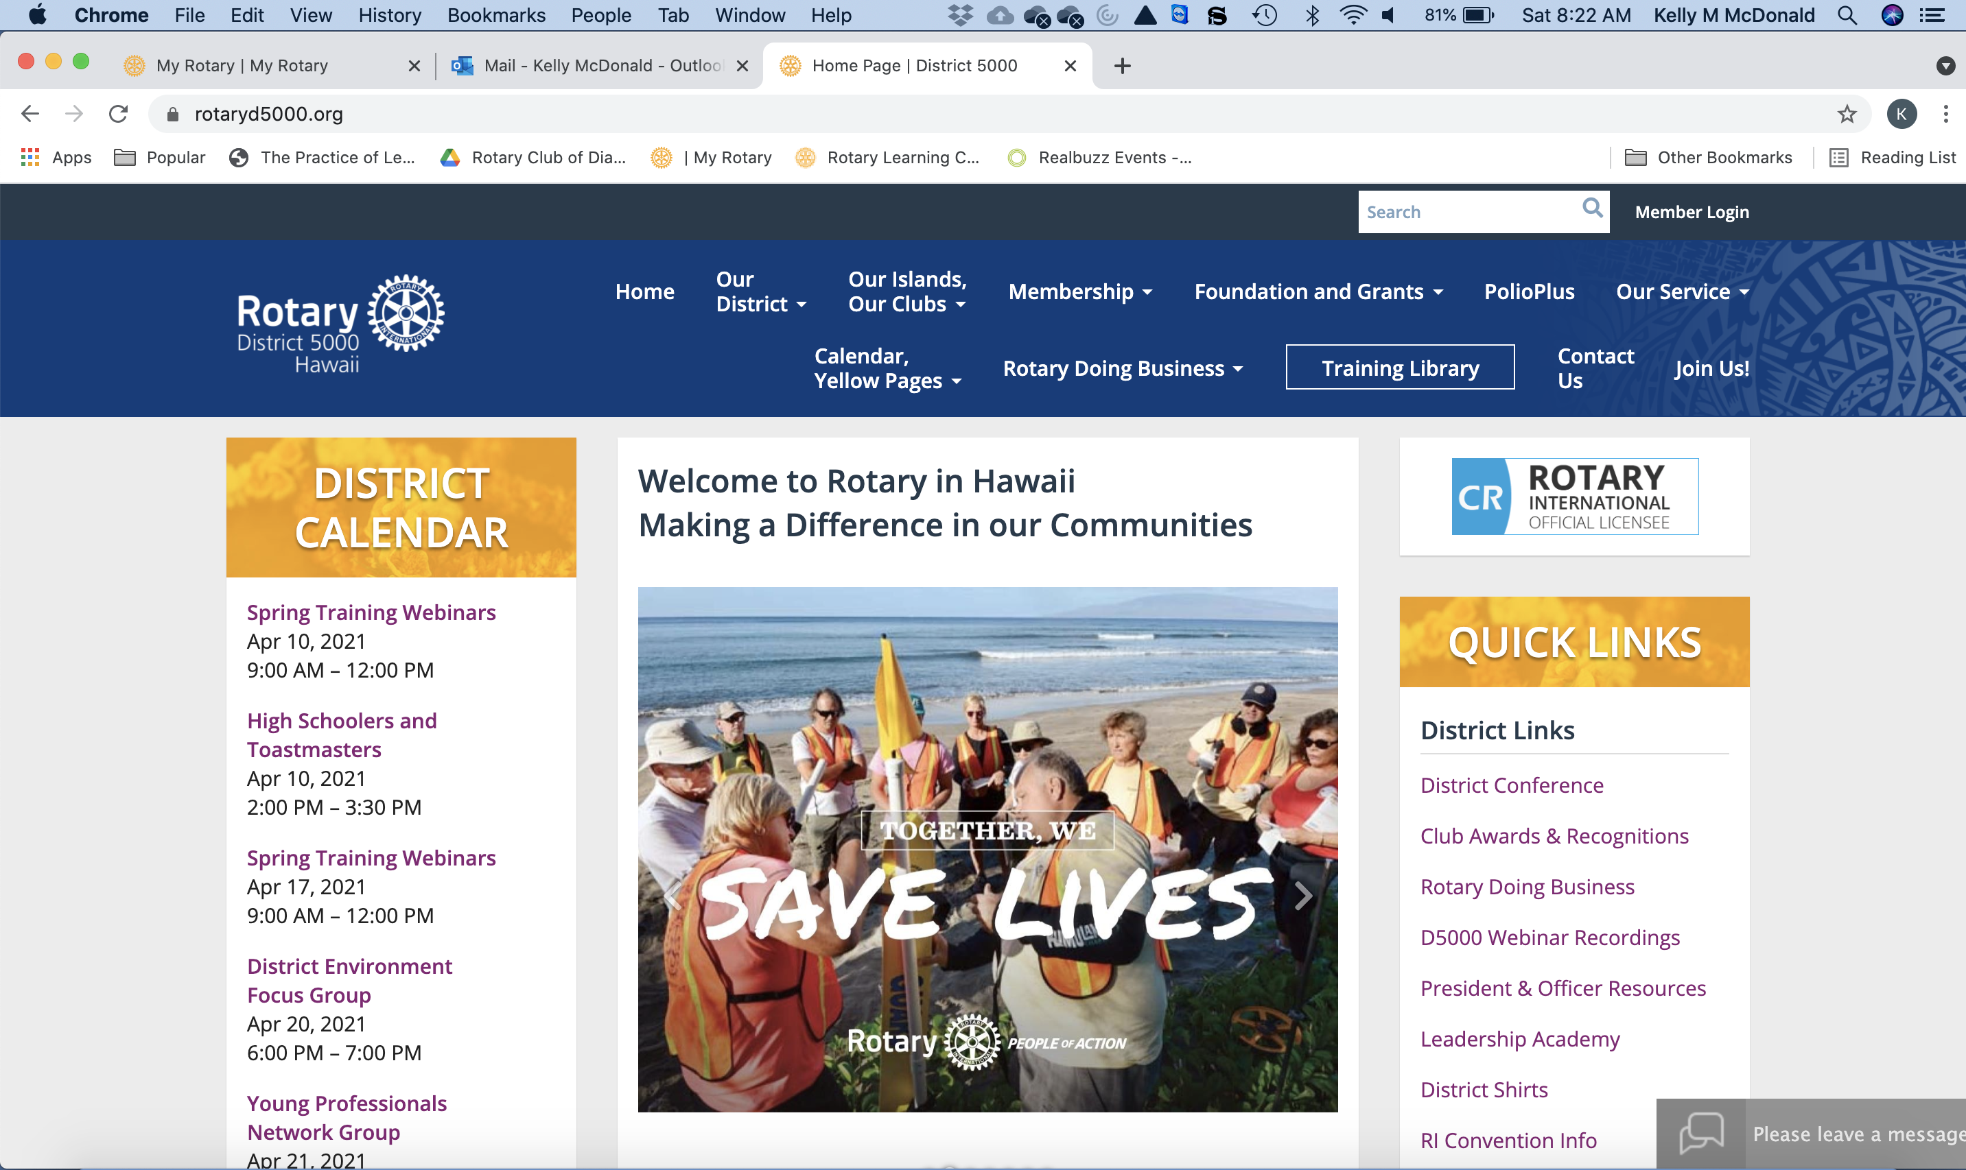
DISTRICT & CLUB resources
District Training Resource Library:
https://rotaryd5000.org/sitepage/training-library
District Website: www.rotaryd5000.org

Slide 14
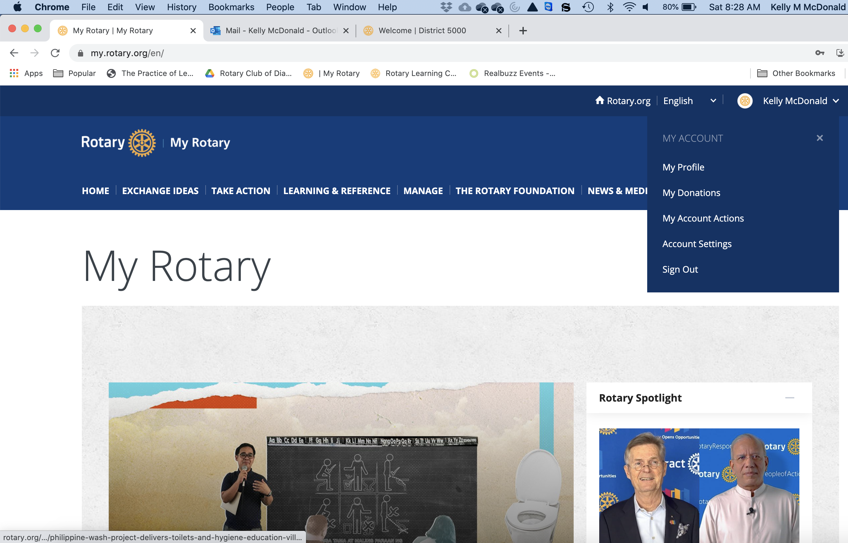
ROTARY resources
RI Website: my.rotary.org
Sign in and gain access to:
Profile – keep your information current
Brand – get RI templates and digital resources
Donation – track your contributions
Education – Learning Center resources

Slide 15
The four way test adopted in 1943
Of the things we think, say or do
First Is it the TRUTH?
Second Is it FAIR to all concerned?
Third Will it build GOODWILL and BETTER FRIENDSHIPS?
Fourth Will it be BENEFICIAL to all CONCERNED?

Slide 16
QUESTIONS
Kelly McDonald, kellymmcdonald@outlook.com
480.390.5699
Mark Merriam, mark.rotary@outlook.com
808.381.5504

