Slide 1


Club Training 2020-2021
CLUB SECRETARY BASICS

Slide 2
As club secretary, you have an important role in helping your club run smoothly and effectively

Slide 3
DUTIES
Maintain Records:
1. Membership
2. Calendar of club and District activities
3. Meetings
Meeting notices
Agendas
Minutes (written minutes provided to members within 60 days of meeting)
4. Club Records (retain for 7 years)
Constitution, By-Laws
Correspondence
Preserve historical records
Reporting – rotaryd5000.org
Attendance by the 15th of the next month
Membership Changes - within 2 weeks
Officers and Chairs – by January 31 for incoming officers

Slide 4
District Website: rotaryd5000.org (ClubRunner)
Membership Information:
Add or terminate members
Update Member Profiles
Identify Officers and Club Chairs
Membership information uploads to Rotary International automatically (sometimes there is a time delay.)
Important to have the correct address and email address.
The email address is the RI website User Name and the address is where the rotarian magazine is mailed.

Slide 5
District Uses ClubRunner
District 5000 uses ClubRunner’s program for the website.
Clubs do not need to use ClubRunner for their own websites, however, if clubs are using ClubRunner, the club’s information uploads to the District’s website when integrated.
If your club does not have a website or uses another web designer, input the member information and officer list on the District’s website.
ClubRunner has recorded and live webinars available to learn how to utilize the website features at: clubrunner.helpserve.com. You can also click on the “Help” button and go to the Support Center or On Demand Demos to help -you find information on maneuvering the website. You can also call them in the morning (they’re in Canada) at 1877-469-2582.
If your club is interest in updating your ClubRunner website with the new RI branding or want an almost turn-key ClubRunner website, give them a call and they will be happy to help.

Slide 6
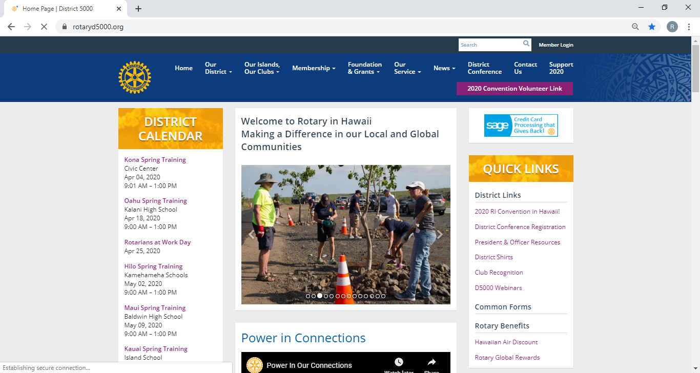
Log in to rotaryd5000.org
Log in to the District’s website. Click on Member Login

Slide 7
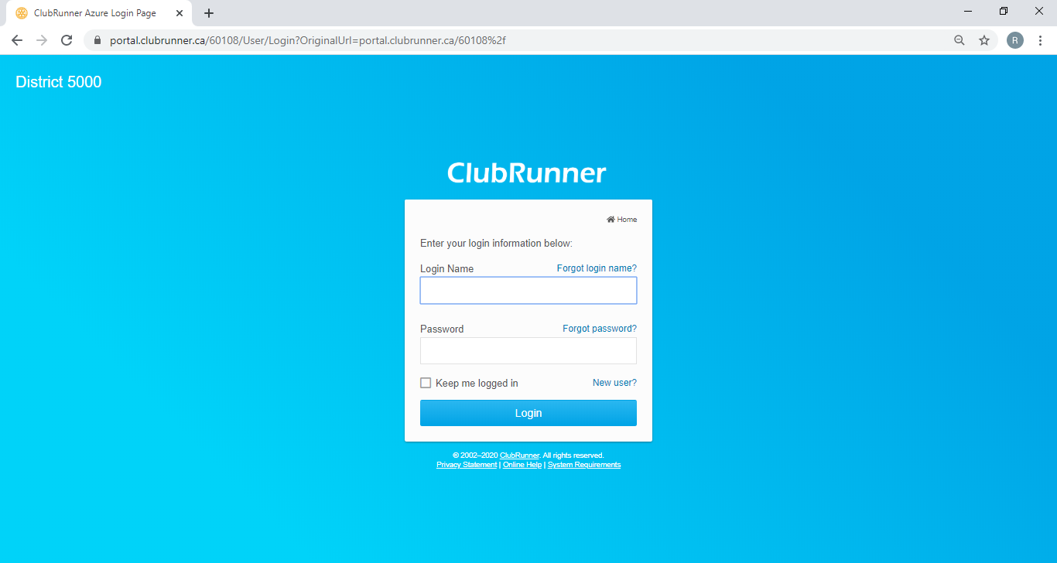
Member Area
For First Time users or if you forgot your password, click on the “New user? or Forgot password?”, an email will be sent to the address in the profile. Follow the instructions in the email. Make sure the email address is correct.

Slide 8
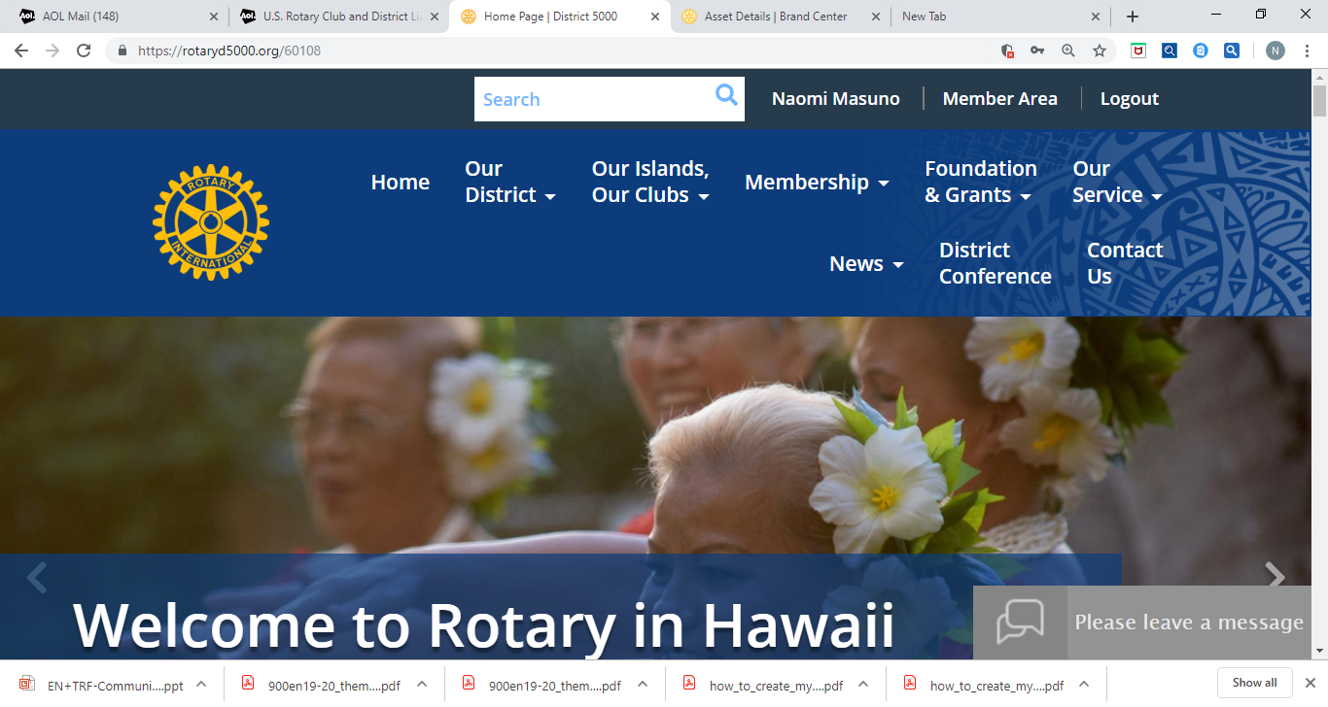
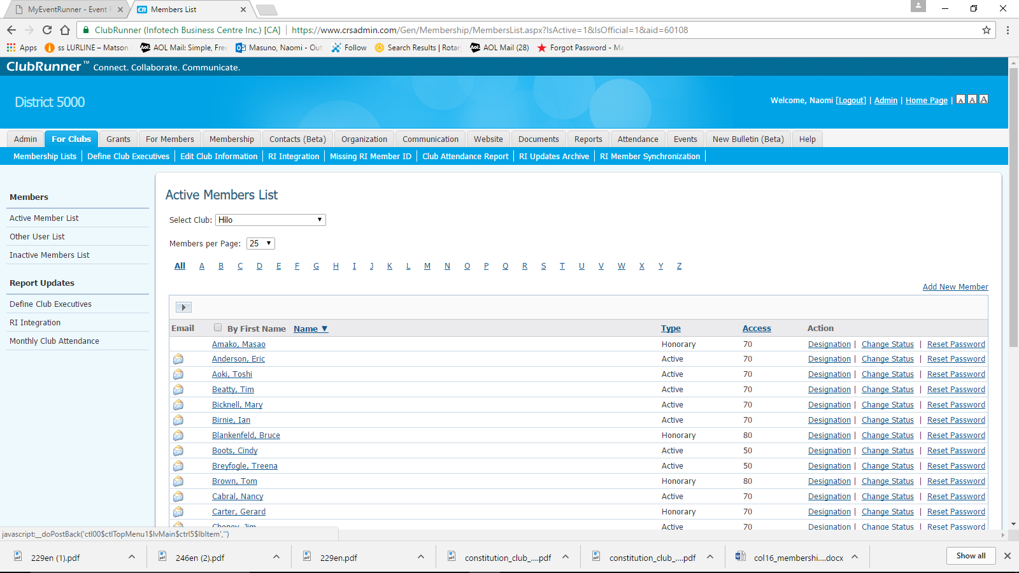
After Logging In, click on ”Member Area” to get to Admin Sitepages
To Add a Member:
Click on “For Clubs” , “Membership Lists”, “Add New Member”

Slide 9
Membership Types
The RI Bylaws and Standard Rotary Club Constitution provide for two types of membership: active and honorary. Only Active members can hold office and vote on Rotary matters.
By amending the By-Laws, clubs may offer additional membership types such as:
  Associate (no dues, no benefits of an Active member)
  Corporate (membership in the individual’s name, not the entity)
  Family membership (can be Active member with reduce dues)
Clubs and districts set their own policies about these members’ other financial obligations (club and district dues, meal costs, etc.), attendance requirements, and service expectations and reflect these policies in their bylaws
Note: Find the recommended Constitution and By-Laws at rotary.org and type Document Center in the search box.

Slide 10
Tips - Membership Rosters
Keep your roster up to date. RI will prepare invoices as of July 1 and January 1 and you are not able to adjust that number. If terminating any membership, best to do it by June 15 and Dec 15. Suggest sending the club invoices out no later than June 1 and December 1, with payment due dates of July 1 and January 1.
New members added after the RI invoice date will be prorated for dues at the RI next billing.
If adding a Rotarian, make sure you keep their same Rotary ID number to preserve their Paul Harris point history. You can add them to your roster from the RI website by doing a search from the Club Administration, Club & Member Data area. Click on “Add, edit or remove members” and then: Search for an existing member.
Periodically, perform a synchronization from ClubRunner by clicking on “RI Member Synchronization”. This action compares the ClubRunner roster with the RI roster and lists those who are not on the RI website and also those on the RI website, but not in ClubRunner. Click on the link to add them to the site that is missing the listing. If you find a member with 2 RI numbers, they need to call RI to consolidate the profiles.
1 866-976-8279 (toll free)
Ensure that the name on the RI records is exactly the same as ClubRunner’s records.

Slide 11
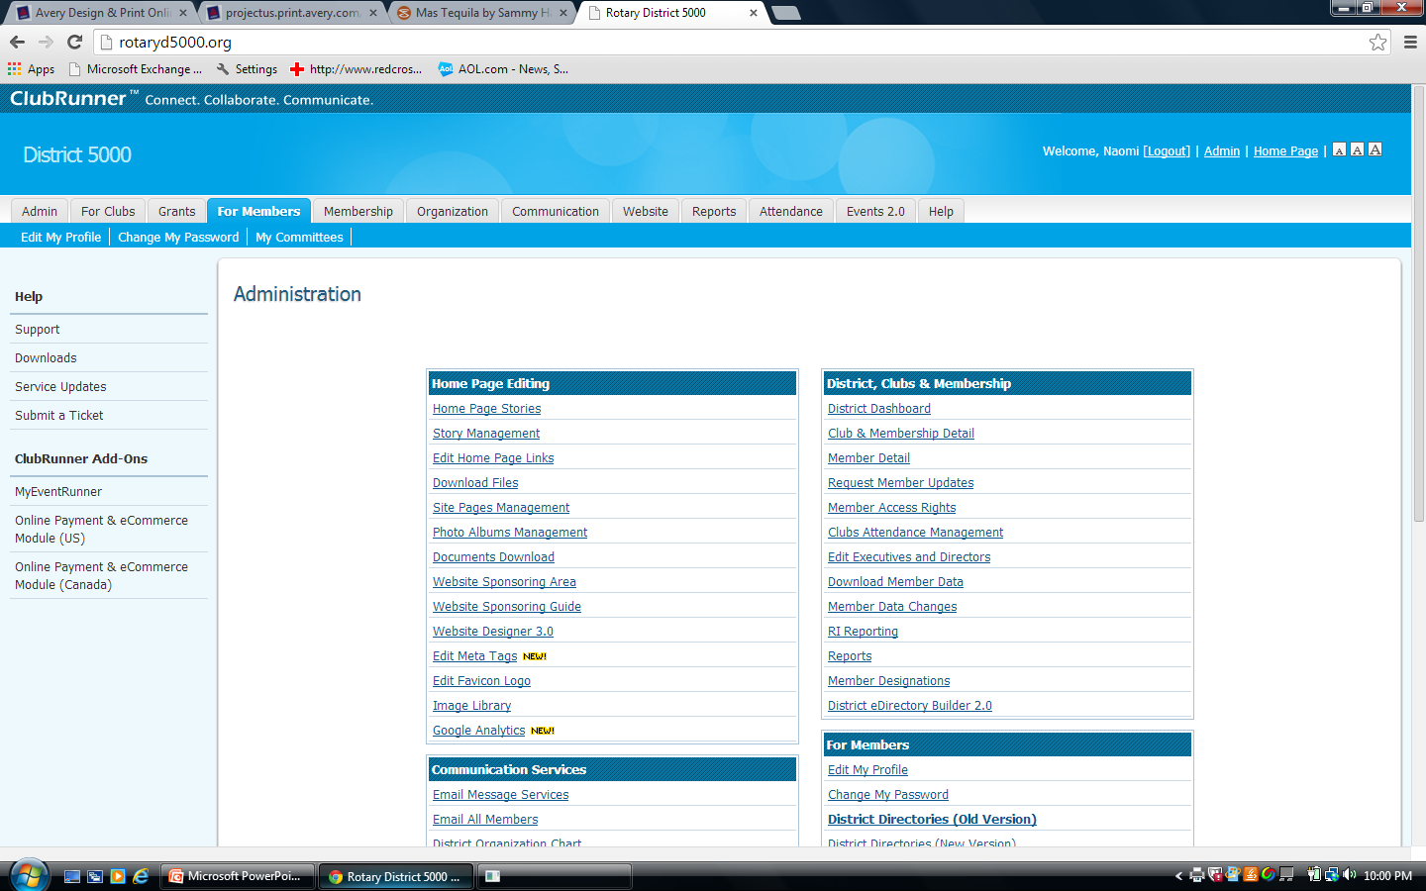
To Update Member Information
Click on “For Members”, then “Edit My Profile”

Slide 12
Member Profile
Click “Edit” and enter information
To download a picture, click on “Update” under the silhouette
The primary email address will be used for emails.
Check other tabs for other categories to edit.
Change passwords in the “Settings” tab.
Opt in or out in the “Privacy” tab
Don’t forget to click on “Save” at the bottom.

Slide 13
New Officers: Elected by December 31. Nominations 30 days Before
ELECTIONS. Review your Constitution and By-Laws
The annual meeting for the election of officers should be held no later than December 31st. Elect officers, including the President-Elect (President for 2021-2022) and Club Trainer. The President for 2020-2021 was elected last year and is the current P.E.
Input the elected officer names on the district website by January 31. Information uploads to the RI website.

Slide 14
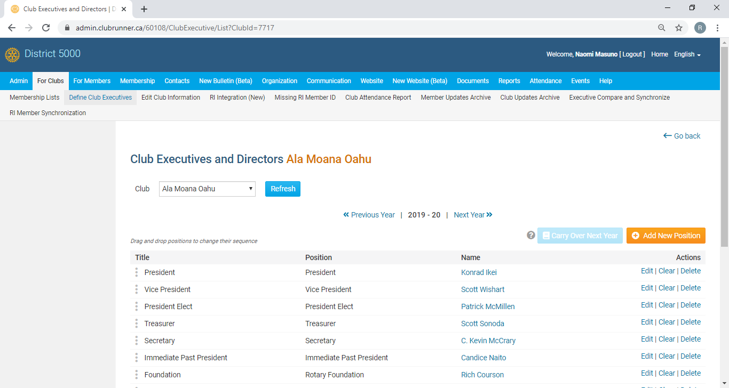
Click on “Define Club Executives”
Click on “Next Year” to list your officers. Use the “Add New Positions” to add lines.
Tip: If “Carry over Next Year” is highlighted, click on it and all the positions will carry to the next year!

Slide 15
Attendance Policy is Dictated by the Club By-Laws
The RI Council on Legislation granted clubs greater flexibility on attendance policies, BUT, to adopt any of the policies, the club must revised their By-Laws. Rotary clubs now have the option of reducing their meeting frequency as long as they meet in some way at least twice per month and is still expected to updated the district attendance report on the website within 15 days of the last meeting of each month. Allowable options:
Determine the best day and time for their meetings
Change or cancel a meeting, if the need arises
Count service projects or social events as meetings
Choose whether to gather in person, meet online, alternate between online and in-person meetings, or even use both formats at the same time (video chat)
Amend their bylaws to either relax or tighten attendance requirements and policies of terminating members for poor attendance

Slide 16
Attendance Reporting by the 15th
Login to rotaryd5000.org=> “Attendance”=>”Monthly Club Attendance”
Input total active members, new and terminated members, # meetings, % attendance.
Attendance= attending members and make-ups divided by M
M=active members + Rule of 85 attending members (exclude excused and honorary)
Clubs using ClubRunner for their club, attendance reports automatically upload to the District’s website.

Slide 17
Attendance (refer to Club Constitution)
Make-Ups ( new - anytime within the same Rotary year) :
attends at least 60 percent of the regular meeting of another club
30 minutes of a e-club “meeting”
attends a meeting of a Rotaract or Interact club, Rotary Community Corps, Rotary Fellowship
attends a RI convention, an international assembly
Rotary district conference, a Rotary district training assembly, any district meeting
participates in a club service project or a club-sponsored community event
attends a board meeting or a service committee
---Can exclude from attendance:
“Rule of 85” Rotarians can be excused from attendance if two conditions are met: They have been a member of one or more Rotary clubs for at least 20 years, and their years of club membership plus their age equals at least 85

Slide 18
rotaryd5000.org
What you can find on the district website:
Membership rosters
District dues invoice template
District Chairs and Org Chart
Information on the Avenues of Service
Club Presidents and Meeting Locations
Events in the Calendar
Register for Events
Look for Rotarians in the Yellow Pages

Slide 19
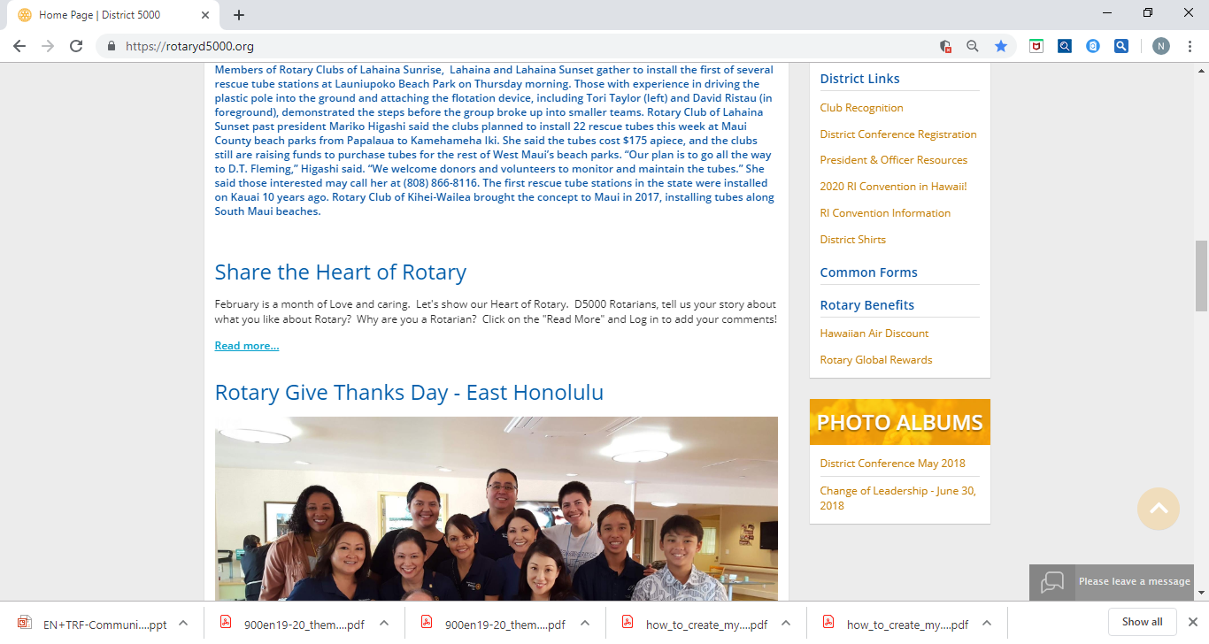
President & Office Resource Site Page
Find this link on right side of the Home Page. There’s a calendar for important dates and the miscellaneous information is posted here. i.e.Powerpoints from seminars, etc.

Slide 20
Download the ClubRunner App to your phone
The ClubRunner Mobile App is your key to connect to your ClubRunner website on the go! Free to download and use, this app will let you access the key info you need while you're on the go. Password protected just like your website, the ClubRunner Mobile app allows you to view your member directory, contact your members and executives, read the latest articles posted to your website, and even learn more about your upcoming events and speakers, right from your smartphone or tablet!
To download the app from the Apple App Store or from Google Play, simply type in 'ClubRunner' in the search bar. The mobile app is compatible with all versions of the iPhone, iPad and iPod Touch sets that have iOS 8.0 or later and with versions of Anrdoids that are 4.0.3 or better.

Slide 21
RI Website: rotary.org/myrotary

Slide 22
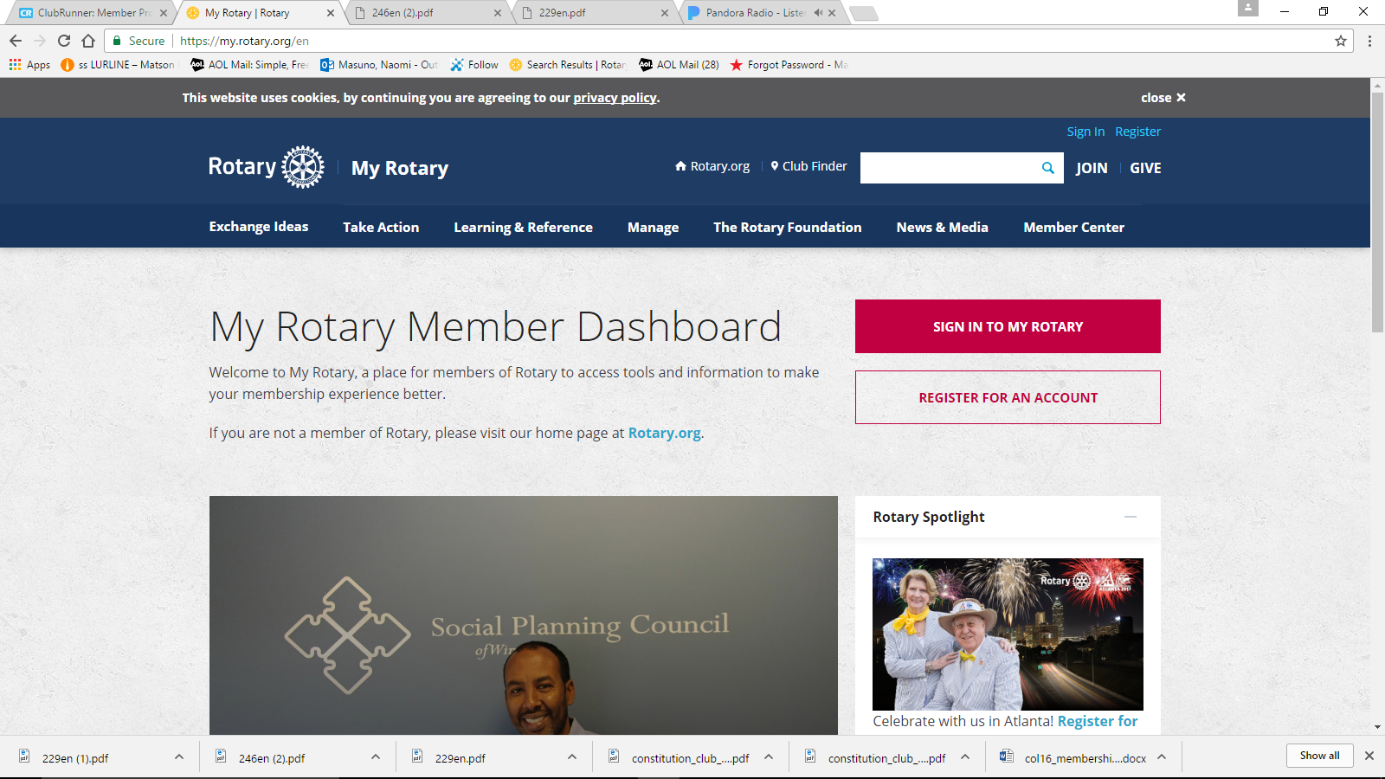
rotary.org - Sign In
Sign in with your email address and password. “Register for an Account”, if you have never signed in or if you have entered the wrong sign-in info too many times. The User Name or Login password may be different from District’s website password. Email address is from the District’s website, unless you change it for RI. If your email address changes, RI’s website needs to be updated separately.

Slide 23
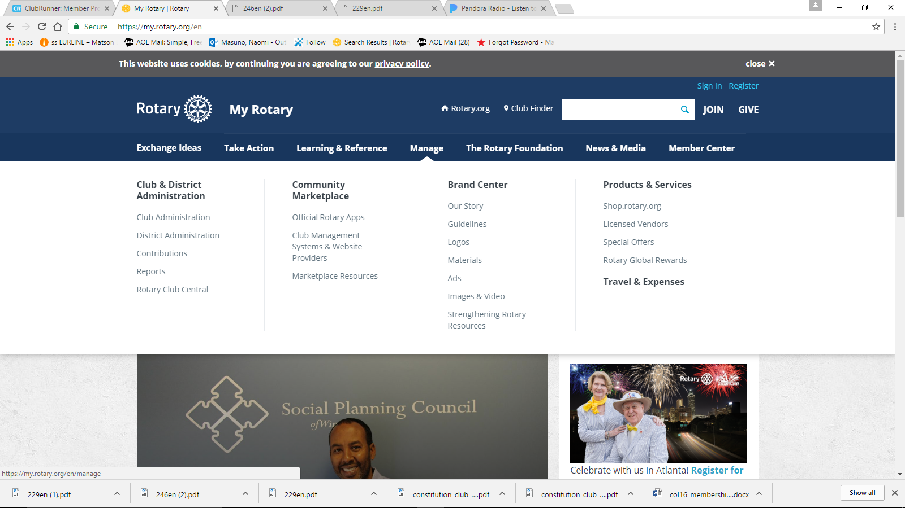
Click on “Manage”
Go to “Club Administration” for Dues Invoice or Member Data. Go to “Reports” or “Rotary Club Central”

Slide 24
rotary.org - Resources
Rotary Club Central Goals
Sign up for Newsletters
Get Membership and Foundation Reports
Find Projects and Ideas
Download Manuals, Documents
Find Global Rewards (Discounts for Rotarians)

Slide 25

Mahalo!

