Slide 1
CLUB SECRETARY
Spring Training April 2021

Slide 2
As club secretary, you have an important role in helping your club run smoothly and effectively
Notes:
The session is being record so you can refer to this later and this powerpoint will be in the Training Library

Slide 3
DUTIES
Maintain Records and Reporting:
1. Membership – new, terminating
2. Calendar of club and District activities
3. Meetings
Meeting notices
Agendas
Minutes (written minutes provided to members within 60 days of meeting)
4. Club Records (keep a folder and retain for 7 years)
Constitution, By-Laws
Correspondence
Preserve historical records
Reporting – rotaryd5000.org
Attendance by the 15th of the next month
Membership Changes - within 2 weeks
Officers and Chairs – by January 31 for incoming officers
Club Info – Changes in meeting days/time/location

Slide 4
Tasks
Training – District training, Learning Center
Transition - Meet with the outgoing secretary and receive club records
Meet with the incoming club officers or board of directors to plan the year
Create a My Rotary account on Rotary.org, if you don’t have one
Update your club’s records and member list on My Rotary, or through your club management system
Make sure the club treasurer has the club invoices, due in January and July
Take minutes at club and board meetings and club assemblies
Update club and officer information for the Official Directory and Rotary’s records
Manage club correspondence, including responding to emails and sending official notices and invitations
Keep promotional items, name badges, and other materials used at meetings and events
Submit monthly attendance reports to your governor; if your club doesn’t track attendance, let your governor know
Preserve your club’s historical records
Write an annual report for the club at the end of the Rotary year
Assist the club president, treasurer, and committees as needed
Meet with your successor and hand over club records

Slide 5
Calendar
 | 2021-2022 CLUB PLANNING CALENDAR
May-June 2021 |  |  | December - Disease Prevention and Treatment
 | 5/14-16 Virtual District Conference |  |  | 6th, 7pm- President Forum
 | 5/31- Final Grant reports due |  |  | Club Elections by Dec 31
 | 6/12-16 Virtual RI Convention |  |  | President 2023-24 elected by Dec 31
 | Club Assembly to plan upcoming year |  |  | Update membership roster
 | Plan calendar of activities for the year |  |  | Send out dues invoice
 | Enter Goals in Rotary Club Central |  |  | Soth West PETS Registration
 | Prepare budgets
 | Send out dues invoice |  | January - Vocational Service Month
 | Update membership rosters |  |  | 4th, 7pm- President Forum
 |  |  |  | Update Officer/Directors in ClubRunner
July 2021 - Showtime! |  |  |  | Pay RI and District Dues by Jan 31
 | 5th, 7pm- President Forum (1st Friday)
 | Officer/Board Installation |  | February - Peacebuilding & Conflict Prevention
 | Approve Budget |  |  | HRYF apps due to club
 | Pay RI and District Dues by July 31 |  |  | 7th, 7pm - President Forum on Zoom
 | Pay HRYF Dues by July 31, submit rep list |  |  | 12th Pre-PETS
 | District Grant Application due by Aug 1 |  |  | 25-27- Southwest PETS in Los Angeles
 | Confirm DG Visit dates |  |  | HRYF club interviews completed
 |  |  |  | 2022-2023 Grant Qualification Docs Submitted
August -Memberhip and New Club Development
 | 2nd, 7pm- President Forum (1st Friday) |  | March - Water and Sanitation Month
 | 15th - Rotaract & Interact Citations due to RI |  |  | 19th- virthual Vibrant Club Workshop
 | DG Visits with Club and Board |  |  | HRYF club selection to Area committee
 | Nominations for DG open |  |  | 26th Spring Training Assembly
 |  |  |  | Awards submission due
September - Basic Education and Literacy Month
 | 6th, 7pm- President Forum |  | April - Maternal and Child Health
 | DG Visits with Club and Board |  |  | 4th, 7pm- President Forum
 | 18th-Fall Seminars - Membership & Foundation |  |  | 2nd & 9th Spring Training Assembly
 |  |  |  | 23rd - Rotarians at Work Day Project
October - Community & EconomicDevelopment
 | 4th, 7pm- President Forum |  | May - Youth Service Month
 | 24th - World Polio Day |  |  | 3rd, 7pm - President & PE Forum
 | 30th- Quarterly Board Training |  |  | District Conference
 |  |  |  | Final Grant Reports due by May 31
November - The Rotary Foundation Month |  |  |  | Rotary scholarship apps due by May 31
 | 1st, 7pm- President Forum
 | 11th-14th-Zone Institute Tuscan Arizona |  | June - Rotary Fellowship Month
 | 15th - Tax filing deadline |  |  | 4-8th RI Convention in Houston
 | 27th - Rotary Gives Thanks Day |  |  | 13th, 7pm-President Forum
 | Call for Club Board Nominations |  |  | Assembly conducted by PE -next year plan
 | DG candidate interviews |  |  | Rotary Citation deadline June 30
 | HRYF Scholarship apps available
Club Calendar
Meeting dates
dark days
assemblies, etc
District Calendar
Notes:
How much notice is best to give to let people know there is a meeting?

Slide 6
Club Meetings (Rotary requirements)
(c) Change of Meeting. For good cause, the board may change a regular meeting to any day between the preceding and following regular meetings, to a different time of the regular day, or to a different place.
(d) Cancellation. The board may cancel a regular meeting for these reasons: (1) a holiday, or during a week that includes a holiday; (2) in observance of the death of a member; (3) an epidemic or a disaster that affects the whole community; or (4) an armed conflict in the community. The board may cancel up to four regular meetings a year for causes not listed here, but may not cancel more than three consecutive meetings.

Slide 7
Annual Meeting by December 31 (Rotary requirements)
Section 2 — Annual Meeting.
An annual meeting to elect officers and present a mid-year report, including current year income and expenses, together with a financial report on the previous year, shall be held before 31 December, as provided in the bylaws.
Section 3 — Board Meetings. Within 60 days after all board meetings, written minutes should be available to all members.

Slide 8
Websites
District – rotaryd5000.org
Rotary International – rotary.org

Slide 9
District Uses ClubRunner
District 5000 uses ClubRunner’s program for the website.
Clubs do not need to use ClubRunner for their own websites, however, if clubs are using ClubRunner, the club’s information uploads to the District’s website when integrated.
If your club does not have a website or uses another web designer, input the member information and officer list on the District’s website.
ClubRunner has recorded and live webinars available to learn how to utilize the website features at: clubrunner.helpserve.com. You can also click on the “Help” button and go to the Support Center or On Demand Demos to help -you find information on maneuvering the website. You can also call them in the morning (they’re in Canada) at 1877-469-2582.
If your club is interest in updating your ClubRunner website with the new RI branding or want an almost turn-key ClubRunner website, give them a call and they will be happy to help.

Slide 10
District Website: rotaryd5000.org (ClubRunner)
Membership Information:
Add or terminate members
Update Member Profiles
Identify Officers and Club Chairs
Membership information uploads to Rotary International automatically (sometimes there is a time delay.)
Important to have the correct address and email address.
The email address is the RI website User Name and the address is where the Rotary magazine is mailed.

Slide 11
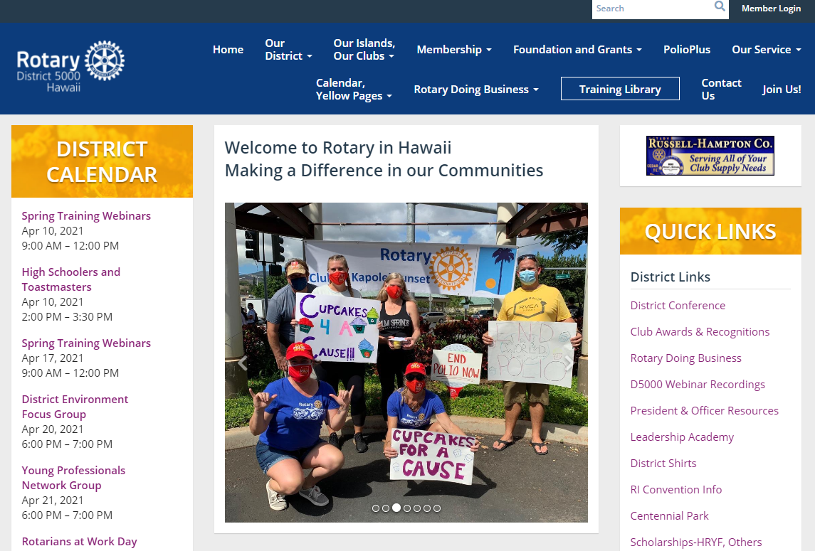
Log in to rotaryd5000.org
Log in to the District’s website. Click on Member Login

Slide 12
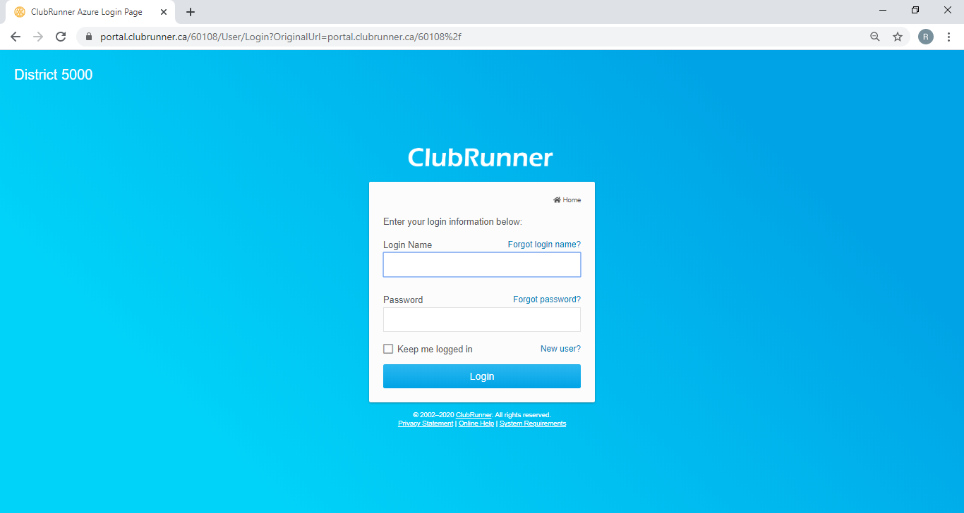
Member Area
For First Time users or if you forgot your password, click on the “New user? or Forgot password?”, an email will be sent to the address in the profile. Follow the instructions in the email. Make sure the email address is correct.

Slide 13
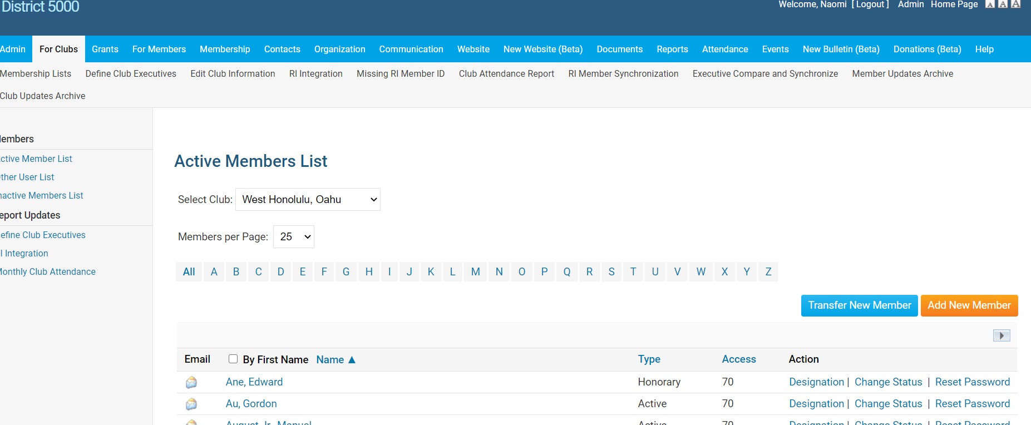
After Logging In, click on ”Member Area” to get to Admin Sitepages
To Add a Member:
Click on “For Clubs” , “Membership Lists”, “Add New Member”

Slide 14
Membership Types
The RI Bylaws and Standard Rotary Club Constitution provide for two types of membership: active and honorary. Only Active members can hold office and vote on Rotary matters.
By amending the By-Laws, clubs may offer additional membership types such as:
Associate (no dues, no benefits of an Active member)
Corporate (membership in the individual’s name, not the entity)
Family membership (can be Active member with reduce dues)
Clubs and districts set their own policies about these members’ other financial obligations (club and district dues, meal costs, etc.), attendance requirements, and service expectations and reflect these policies in their bylaws
Note: Find the recommended Constitution and By-Laws at rotary.org and type Document Center in the search box.

Slide 15
Tips - Membership Rosters
Keep your roster up to date. RI will prepare invoices as of July 1 and January 1 and you are not able to adjust that number. If terminating any membership, best to do it by June 15 and Dec 15. Suggest sending the club invoices out no later than June 1 and December 1, with payment due dates of July 1 and January 1.
New members added after the RI invoice date will be prorated for dues at the RI next billing.
If adding a Rotarian, make sure you keep their same Rotary ID number to preserve their Paul Harris point history. You can add them to your roster from the RI website by doing a search from the Club Administration, Club & Member Data area. Click on “Add, edit or remove members” and then: Search for an existing member. Or, from ClubRunner, click on Transfer New Member.
Periodically, perform a synchronization from ClubRunner by clicking on “RI Member Synchronization”. This action compares the ClubRunner roster with the RI roster and lists those who are not on the RI website and also those on the RI website, but not in ClubRunner. Click on the link to add them to the site that is missing the listing. If you find a member with 2 RI numbers, they need to call RI to consolidate the profiles.
1 866-976-8279 (toll free)
5) Ensure that the name on the RI records is exactly the same as ClubRunner’s records.

Slide 16
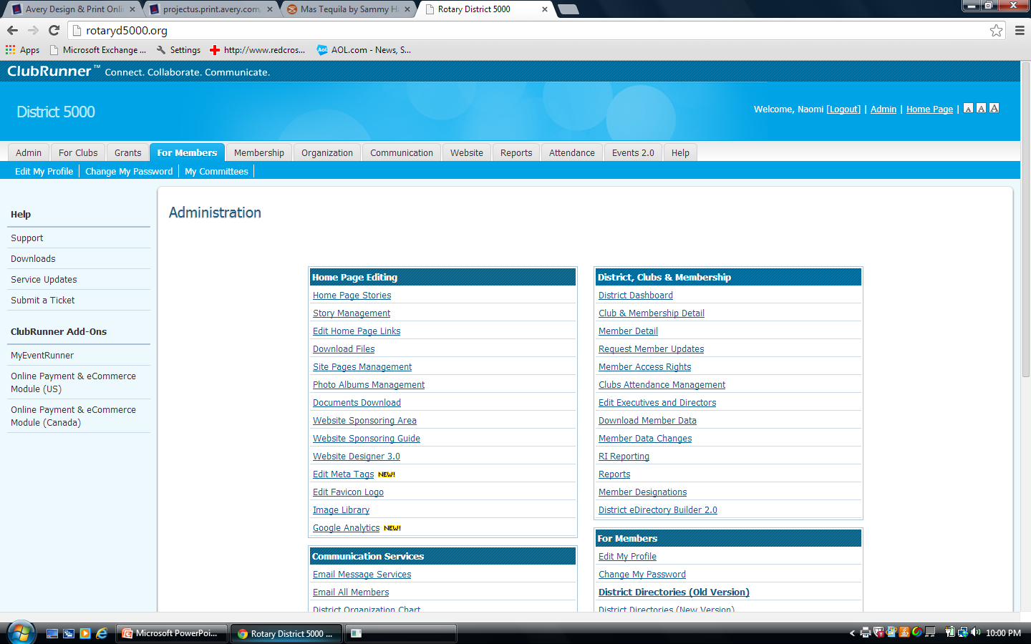
To Update Member Information
Click on “For Members”, then “Edit My Profile”

Slide 17
Member Profile
Click “Edit” and enter information
To download a picture, click on “Update” under the silhouette
The primary email address will be used for emails.
Check other tabs for other categories to edit.
Change passwords in the “Settings” tab.
Opt in or out in the “Privacy” tab
Don’t forget to click on “Save” at the bottom.

Slide 18
New Officers: Elected by December 31. Nominations 30 days Before
ELECTIONS. Review your Constitution and By-Laws
The annual meeting for the election of officers should be held no later than December 31st. Elect officers, including the President-Elect (President for 2022-2023) and Club Trainer. The President for 2021-2022 was elected last year and is the current P.E.
Input the elected officer names on the district website by January 31. Information uploads to the RI website.

Slide 19
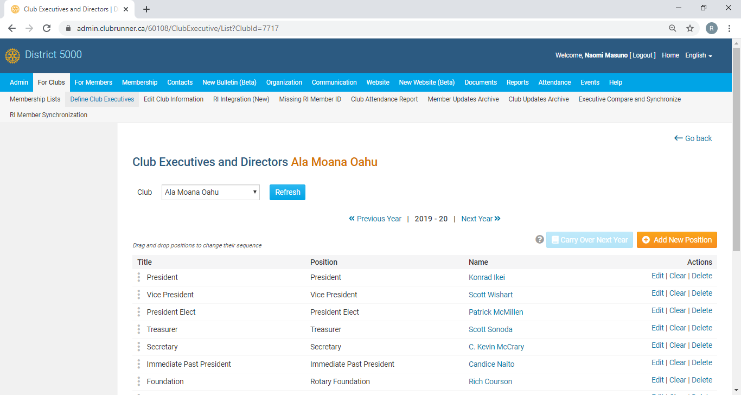
Click on “Define Club Executives”
Click on “Next Year” to list your officers. Use the “Add New Positions” to add lines.
Tip: If “Carry over Next Year” is highlighted, click on it and all the positions will carry to the next year!

Slide 20
Attendance Policy is Dictated by the Club By-Laws
The RI Council on Legislation granted clubs greater flexibility on attendance policies, BUT, to adopt any of the policies, the club must revised their By-Laws. Rotary clubs now have the option of reducing their meeting frequency as long as they meet in some way at least twice per month. Allowable options:
Determine the best day and time for their meetings
Change or cancel a meeting, if the need arises
Count service projects or social events as meetings
Choose whether to gather in person, meet online, alternate between online and in-person meetings, or even use both formats at the same time (video chat)
Amend their bylaws to either relax or tighten attendance requirements and policies of terminating members for poor attendance

Slide 21
Attendance Reporting by the 15th
Login to rotaryd5000.org=> “Attendance”=>”Monthly Club Attendance”
Input total active members, new and terminated members, # meetings, % attendance.
Attendance= attending members and make-ups divided by M
M=active members + Rule of 85 attending members (exclude excused and honorary)
Clubs using ClubRunner for their club, attendance reports automatically upload to the District’s website.

Slide 22
Attendance (refer to Club Constitution)
Make-Ups ( new - anytime within the same Rotary year) :
attends at least 60 percent of the regular meeting of another club
30 minutes of a e-club “meeting”
attends a meeting of a Rotaract or Interact club, Rotary Community Corps, Rotary Fellowship
attends a RI convention, an international assembly
Rotary district conference, a Rotary district training assembly, any district meeting
participates in a club service project or a club-sponsored community event
attends a board meeting or a service committee
---Can exclude from attendance:
“Rule of 85” Rotarians can be excused from attendance if two conditions are met: They have been a member of one or more Rotary clubs for at least 20 years, and their years of club membership plus their age equals at least 85

Slide 23
rotaryd5000.org
What you can find on the district website:
Membership rosters
District dues invoice template
District Chairs and Org Chart
Information on the Avenues of Service
Club Presidents and Meeting Locations
Events in the Calendar
Register for Events
Look for Rotarians in the Doing Business Directory or Yellow Pages

Slide 24
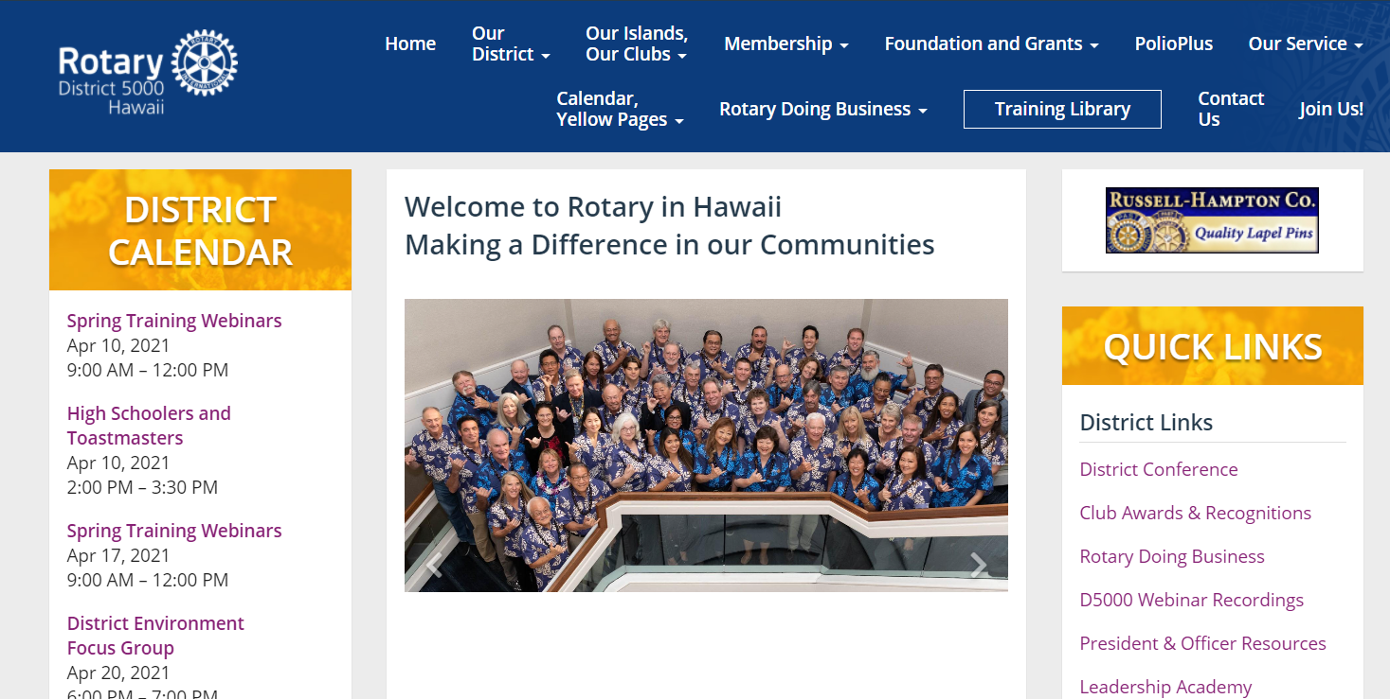
President & Office Resource Site Page and Training Library
Find this link on right side of the Home Page. There’s a calendar for important dates and the miscellaneous information is posted here. i.e.Powerpoints from seminars, etc. Check out the Training Library too!

Slide 25
Download the ClubRunner App to your phone
The ClubRunner Mobile App is your key to connect to your ClubRunner website on the go! Free to download and use, this app will let you access the key info you need while you're on the go. Password protected just like your website, the ClubRunner Mobile app allows you to view your member directory, contact your members and executives, read the latest articles posted to your website, and even learn more about your upcoming events and speakers, right from your smartphone or tablet!
To download the app from the Apple App Store or from Google Play, simply type in 'ClubRunner' in the search bar. The mobile app is compatible with all versions of the iPhone, iPad and iPod Touch sets that have iOS 8.0 or later and with versions of Anrdoids that are 4.0.3 or better.

Slide 26
RI Website: rotary.org/myrotary

Slide 27
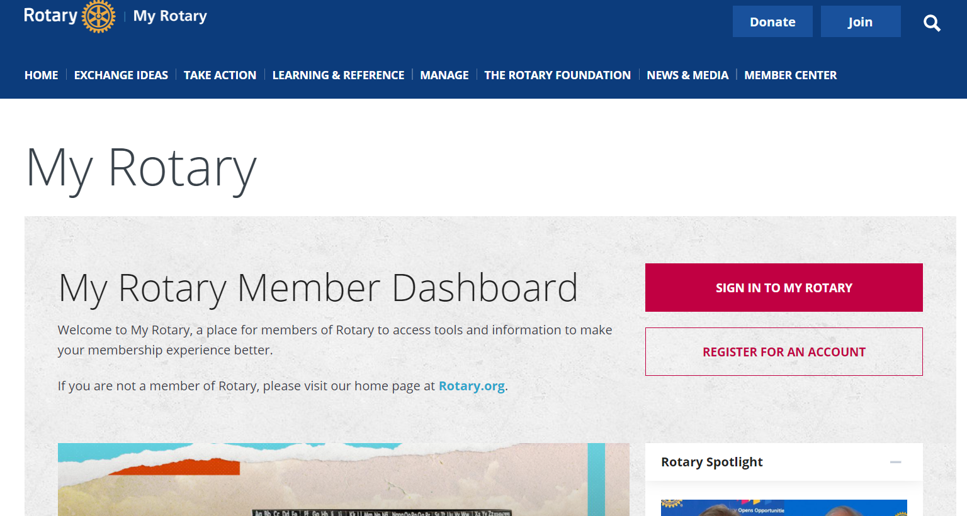
rotary.org - Sign In
Sign in with your email address and password. “Register for an Account”, if you have never signed in or if you have entered the wrong sign-in info too many times. The User Name or Login password may be different from District’s website password. Email address is from the District’s website, unless you change it for RI. If your email address changes, RI’s website needs to be updated separately.

Slide 28
Click on “Manage”
Go to Manage and then “Club Administration” for Dues Invoice or Member Data.
Go to “Reports” or “Rotary Club Central”

Slide 29
rotary.org - Resources
Rotary Club Central Goals
Sign up for Newsletters
Get Membership and Foundation Reports
Find Projects and Ideas
Download Manuals, Documents
Find Global Rewards (Discounts for Rotarians)

Slide 30
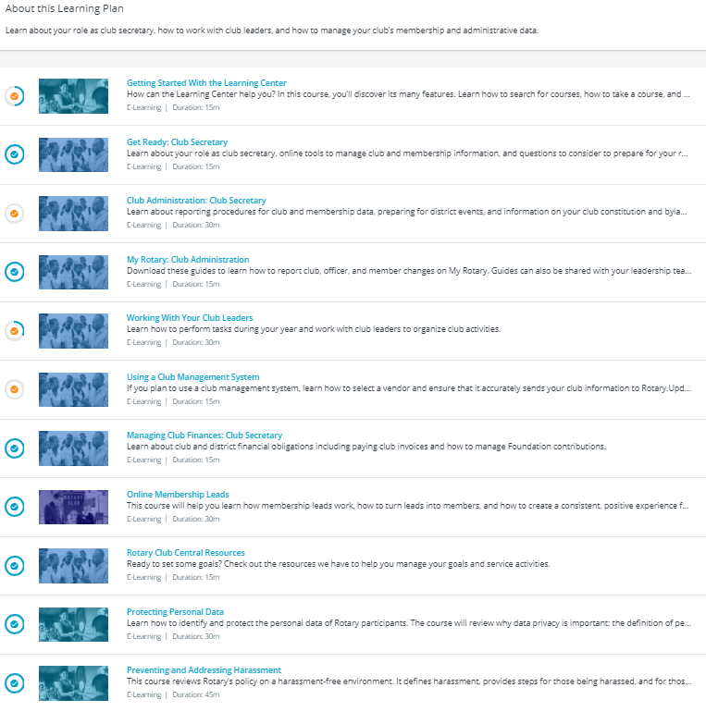
Rotary Learning Center
Take online courses for club secretary in the Learning Center
at rotary.org

Slide 31
Delegates – RI Convention and District Conference
The Rotary International Convention is our largest event of the year. It brings together Rotary members and the family of Rotary from around the world for inspiration, information, and fun. It’s also our annual meeting where Rotary conducts business and officially elects officers. Each club should send at least one delegate to represent its club in all business decisions made at the convention. Work with the club president to help your club select its delegate for the international convention.
Elect delegates
Each club must elect at least one delegate and officially designate all of its delegates even if no members of the club, including the delegates, plan to attend the convention. Only active members of the club may serve as delegates. Each club is entitled to one delegate for every 50 members or a major fraction thereof. This means that clubs with up to 74 active members have one delegate, those with 75 to 124 have two, and so on. Use your club’s official member count as of 1 January of the year of the convention, not including honorary members, to calculate the number of delegates your club gets.
If your club has two or more delegates, it may authorize one of them to cast all of the club’s votes. You can indicate that authorization by giving the delegate a credentials certificate (which includes the voting delegate’s card) for each vote the delegate is authorized to cast.
Designate proxies
A club that is not represented at the convention by a delegate or an alternate may designate a proxy to cast one or more of its votes. The proxy must be an active member of a club within the same district.

Slide 32
MEMBER LEADS ON ROTARY.ORG

Slide 33
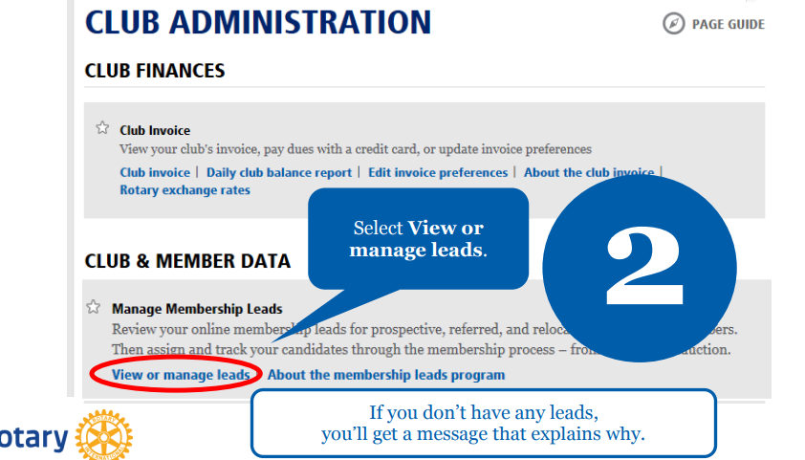
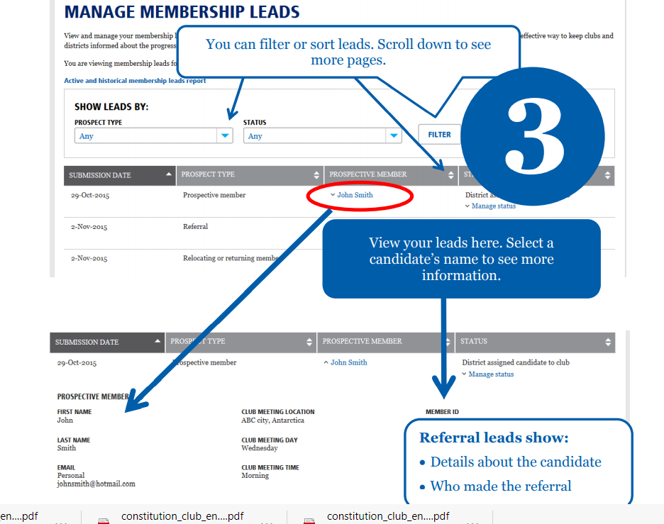

Slide 34
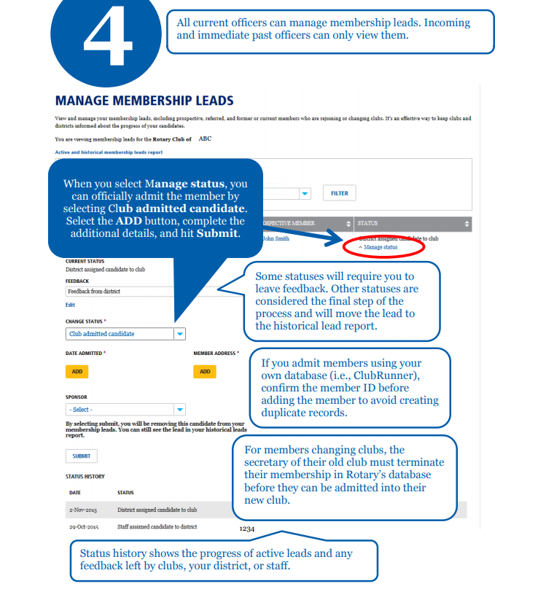

Slide 35
Mahalo!

