Slide 1
CLUB SECRETARY
Spring Training April 2024

Slide 2
As club secretary, you have an important role in helping your club run smoothly and effectively
Notes:
The session is being record so you can refer to this later and this powerpoint will be in on the District website in the webinar recordings page

Slide 3
DUTIES
Maintain Records and Reporting:
1. Membership – new, terminating, updates
2. Calendar of club and District activities
3. Meetings
Meeting notices
Agendas
Minutes (written minutes provided to members within 60 days of meeting)
4. Club Records (keep a folder and retain for 5 years)
Constitution, By-Laws
Correspondence
Preserve historical records
Reporting – rotaryd5000.org
Attendance by the 15th of the next month, if applicable
Membership Changes - within 2 weeks
Officers and Chairs – by January 31 for incoming officers
Club Info – Changes in meeting days/time/location

Slide 4
Tasks
Learning – District training, Learning Center
Transition - Meet with the outgoing secretary and receive club records
Meet with the incoming club officers or board of directors to plan the year
Create a My Rotary account on Rotary.org, if you don’t have one
Update your club’s records and member list on My Rotary, or through your club management system
Make sure the club treasurer has the club invoices, due in July and January
Take minutes at club and board meetings and club assemblies
Update club and officer information
Manage club correspondence, including responding to emails and sending official notices and invitations
Keep promotional items, name badges, and other materials used at meetings and events
Submit monthly attendance reports to your governor; if applicable
Preserve your club’s historical records
Write an annual report for the club at the end of the Rotary year
Assist the club president, treasurer, and committees as needed
Meet with your successor and hand over club records
And anything as assigned

Slide 5
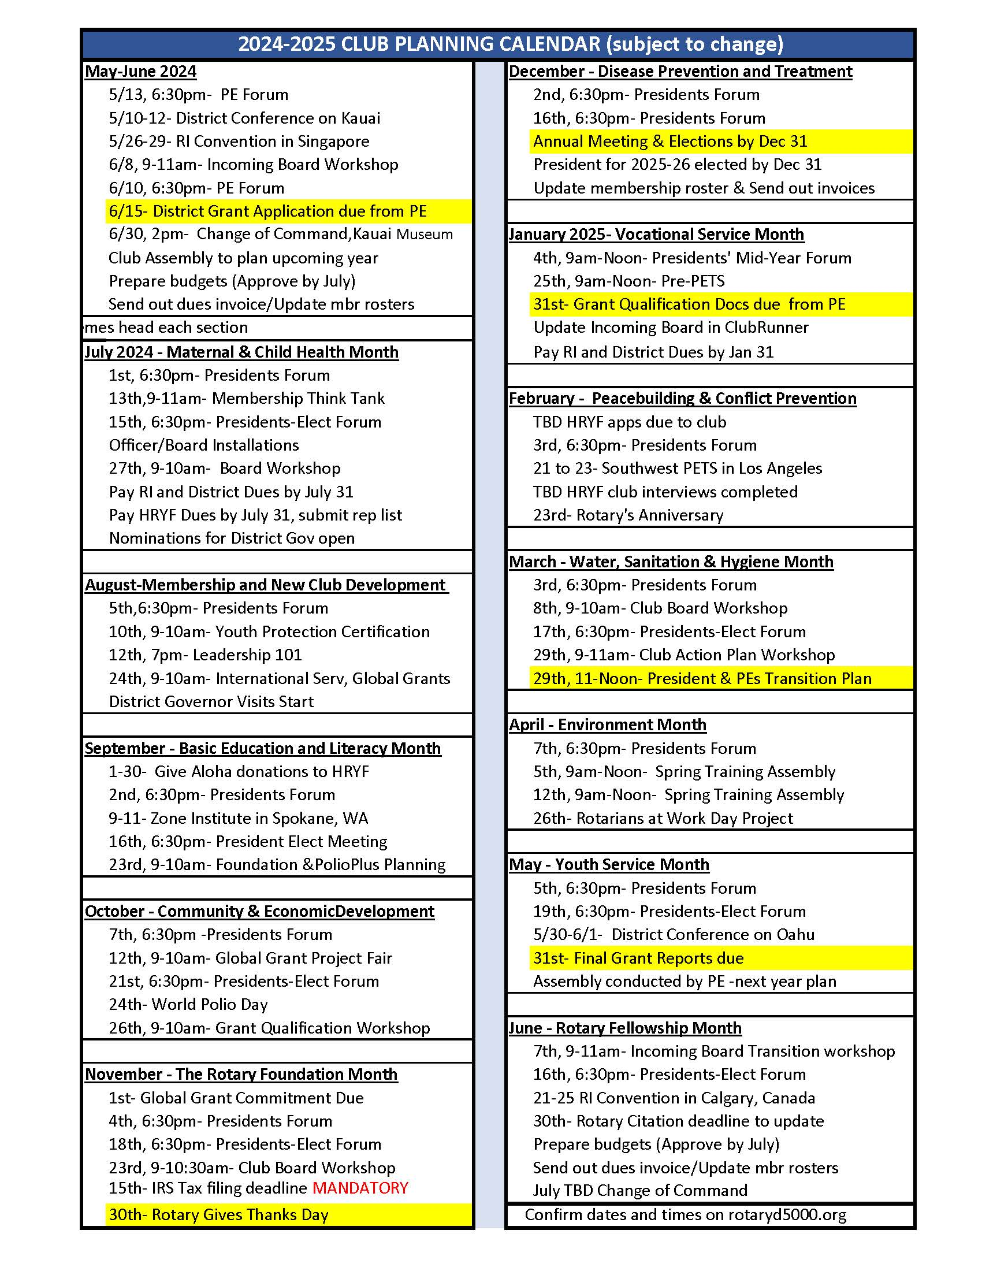
Calendar
Club Calendar
Meeting dates
Dark days
Assemblies (3/yr)
Events, projects
District Calendar
Notes:
How much notice is best to give to let people know there is a meeting?

Slide 6
Club Meetings (Rotary requirements)
(c) Change of Meeting. For good cause, the board may change a regular meeting to any day between the preceding and following regular meetings, to a different time of the regular day, or to a different place.
(d) Cancellation. The board may cancel a regular meeting for these reasons: (1) a holiday, or during a week that includes a holiday; (2) in observance of the death of a member; (3) an epidemic or a disaster that affects the whole community; or (4) an armed conflict in the community. The board may cancel up to four regular meetings a year for causes not listed here, but may not cancel more than three consecutive meetings.

Slide 7
Annual Meeting by December 31 (Rotary requirements)
Section 2 — Annual Meeting.
An annual meeting to elect officers and present a mid-year report, including current year income and expenses, together with a financial report on the previous year, shall be held before 31 December, as provided in the bylaws.
Section 3 — Board Meetings. Within 60 days after all board meetings, written minutes should be available to all members.

Slide 8
Websites
District – rotaryd5000.org
Rotary International – rotary.org

Slide 9
District Uses ClubRunner
District 5000 uses ClubRunner’s program for the website.
Clubs do not need to use ClubRunner for their own websites, however, if clubs are using ClubRunner, the club’s information uploads to the District’s website when integrated.
If your club does not have a website or uses another web designer, input the member information and officer list on the District’s website.

Slide 10
Download the ClubRunner App to your phone from the App Store
The ClubRunner Mobile App is your key to connect to your ClubRunner website on the go! Free to download and use, this app will let you access the key info you need while you're on the go.
To download the app from the Apple App Store or from Google Play, simply type in 'ClubRunner' in the search bar.

Slide 11
rotaryd5000.org
What you can find on the district website:
Membership rosters
District dues invoice template
District Chairs and Org Chart
Information on the Avenues of Service
Club Presidents and Meeting Locations
Events in the Calendar
Register for Events
Look for Rotarians in the Doing Business Directory or Yellow Pages

Slide 12
District Website: rotaryd5000.org (ClubRunner)
Membership Information:
Add or terminate members
Update Member Profiles
Identify Officers and Club Chairs
Membership information uploads to Rotary International automatically (sometimes there is a time delay.)
Important to have the correct address and email address.
Notes:
User Name for the RI website is the original email address on record and the address is where the Rotary magazine is mailed

Slide 13
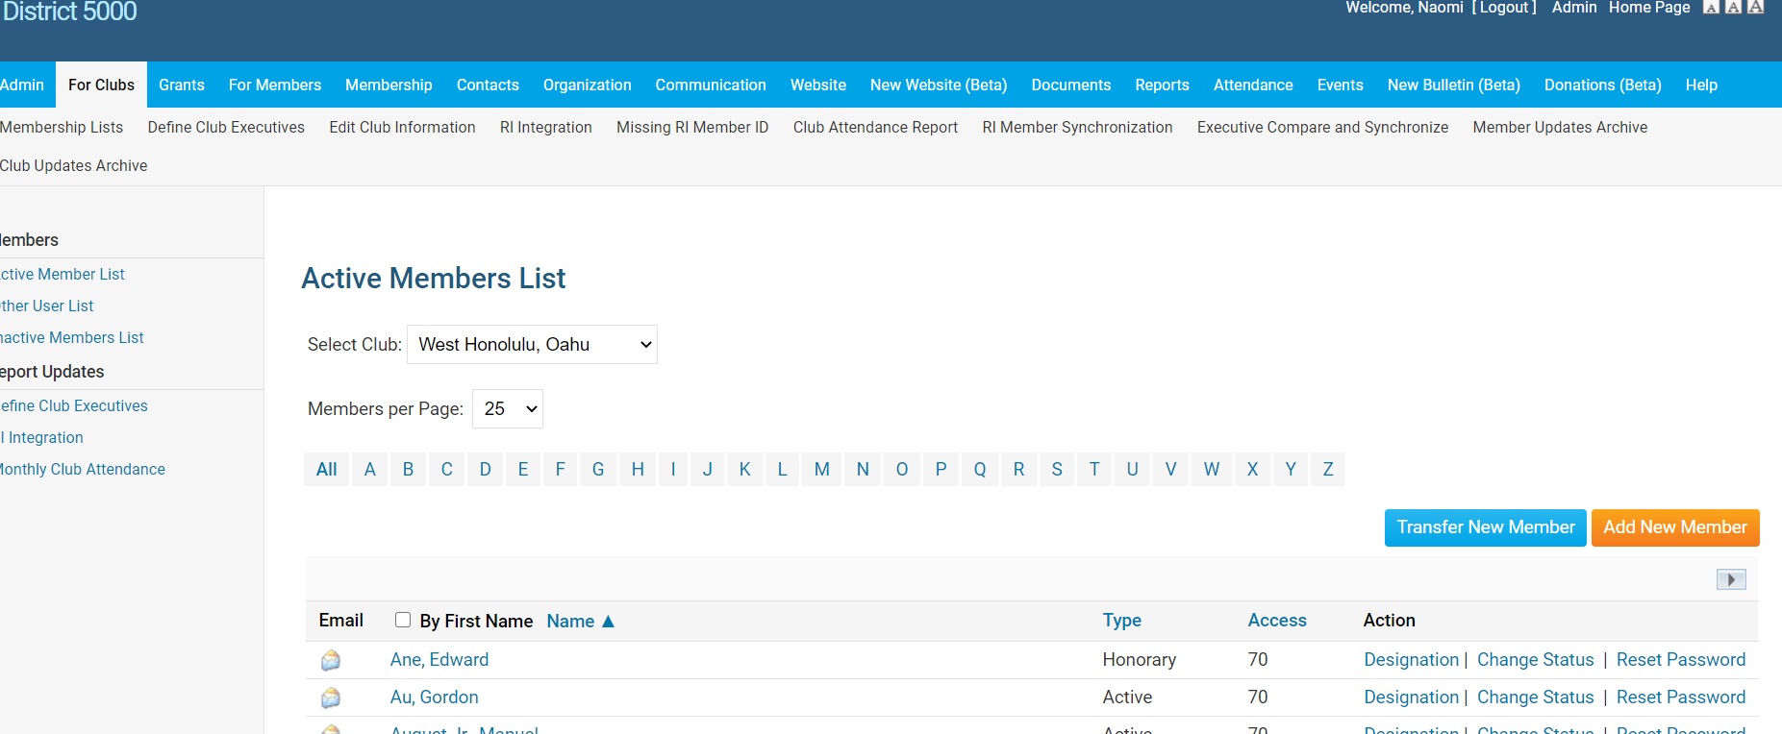
After Logging In, click on ”Member Area” to get to Admin Sitepages
To Add a Member:
Click on “For Clubs” , “Membership Lists”, “Add New Member”

Slide 14
Membership Types
The RI Bylaws and Standard Rotary Club Constitution provide for two types of membership: active and honorary. Only Active members can hold office and vote on Rotary matters.
By amending the By-Laws, clubs may offer additional membership types such as:
Associate (no dues, no benefits of an Active member)
Corporate (membership in the individual’s name, not the entity)
Family membership (can be Active member with reduce dues)
Clubs and districts set their own policies about these members’ other financial obligations (club and district dues, meal costs, etc.), attendance requirements, and service expectations and reflect these policies in their bylaws
Note: Find the recommended Constitution and By-Laws at rotary.org and type Document Center in the search box.

Slide 15
Tips - Membership Rosters
Keep your roster up to date. RI will prepare invoices as of July 1 and January 1 and New members added after the RI invoice date will be prorated for dues at the RI next billing.
If adding a Rotarian, make sure you keep their same Rotary ID number to preserve their Paul Harris point history. You can add them to your roster from the RI website by doing a search from the MyRotary-Club Resources-Club & Member Data area. Click on “Add, edit or remove members” and then: Search for an existing member. Or, from ClubRunner, click on Transfer New Member.
Periodically, perform a synchronization from ClubRunner by clicking on “RI Member Synchronization”. This action compares the ClubRunner roster with the RI roster and lists those who are not on the RI website and also those on the RI website, but not in ClubRunner. Click on the link to add them to the site that is missing the listing. If you find a member with 2 RI numbers, they need to call RI to consolidate the profiles.
1 866-976-8279 (toll free)
5) Ensure that the name on the RI records is exactly the same as ClubRunner’s records.
Notes:
you are not able to adjust that number. If terminating any membership, best to do it by June 15 and Dec 15. Suggest sending the club invoices out no later than June 1 and December 1, with payment due dates of July 1 and January 1.

Slide 16
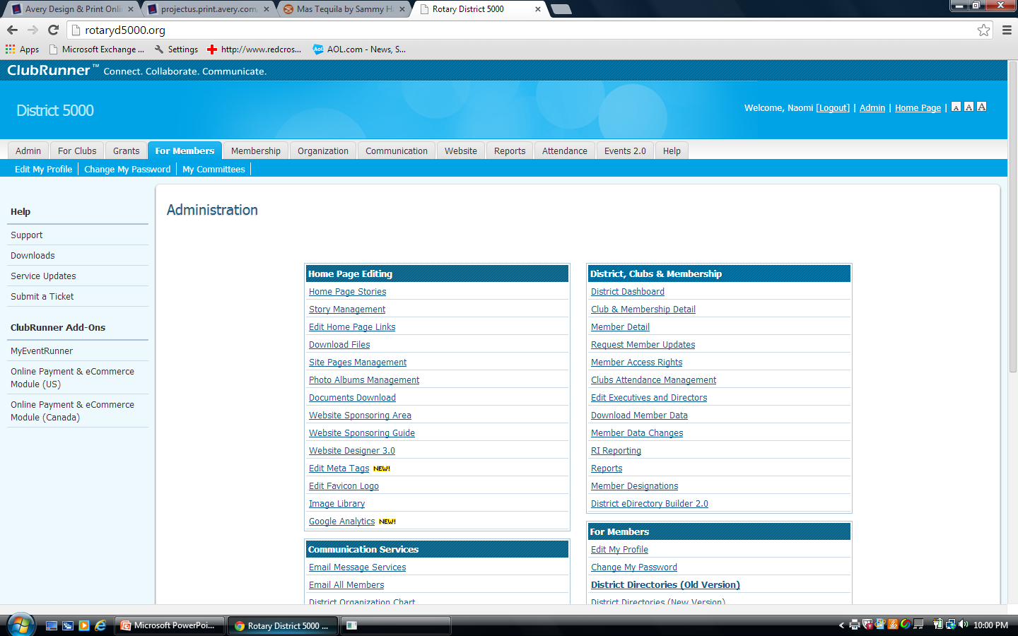
To Update Member Information
Click on “For Members”, then “Edit My Profile”
Notes:
Each member can update their own record

Slide 17
Member Profile
Click “Edit” and enter information
To download a picture, click on “Update” under the silhouette
The primary email address will be used for emails.
Check other tabs for other categories to edit.
Change passwords in the “Settings” tab.
Opt in or out in the “Privacy” tab
Don’t forget to click on “Save” at the bottom.

Slide 18
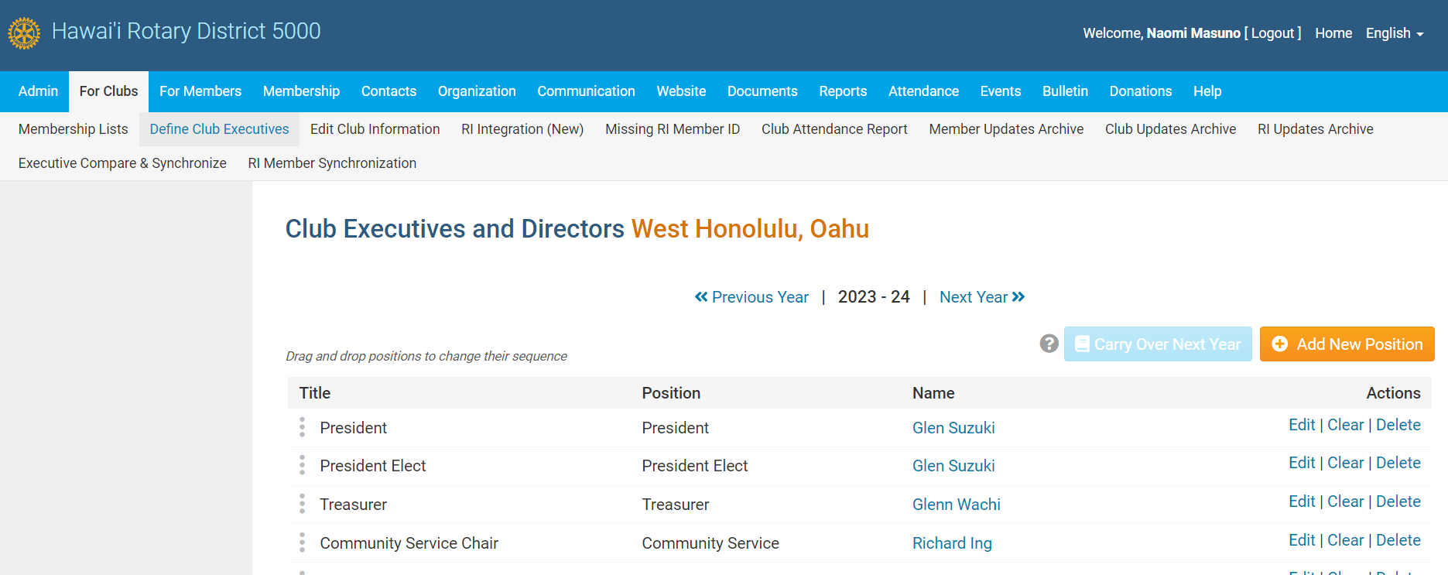
Click on “For Clubs”, then “Define Club Executives”
Click on “Next Year” to list your officers. Use the “Add New Positions” to add lines.
Tip: If “Carry over Next Year” is highlighted, click on it and all the positions will carry to the next year!

Slide 19
New Officers: Elected by December 31. Nominations 30 days Before
ELECTIONS. Review your Constitution and By-Laws
The annual meeting for the election of officers should be held no later than December 31st. Elect officers, including the President-Elect and Club Trainer. The President for 2024-2025 was elected last year and is the current P.E.
Input the elected officer names on the district website by January 31. Information uploads to the RI website.
Notes:
This coming December, the club would be electing the President for the 2025-2026 Rotary year. The 2024-2025 President was elected this past December and becomes the PE July 1
The Club Trainer title is changing to Club Learning Facilitator beginning July 1.

Slide 20
Attendance Policy is Dictated by the Club By-Laws
The RI Council on Legislation granted clubs greater flexibility on attendance policies. Rotary clubs now have the option of reducing their meeting frequency as long as they meet in some way at least twice per month. Allowable options:
Determine the best day and time for their meetings
Change or cancel a meeting, if the need arises
Count service projects or social events as meetings
Choose whether to gather in-person, meet online, alternate between online and in-person meetings, or even use both formats at the same time (hybrid)

Slide 21
Communication
Bulletins
Email
Text
Electronic - Whatsapp, GroupMe, Discord, Threema, Slack
FaceBook

Slide 22
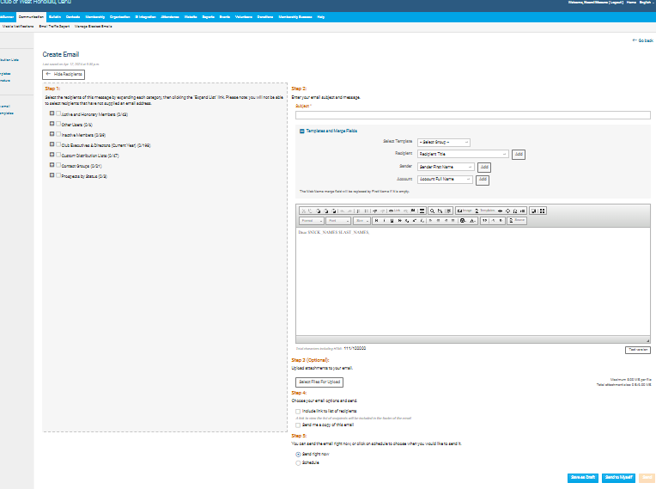
ClubRunner Email
Log in – Member Area – Communication - Email Services
Compose new message:
Step 1 – Who is the email going to?
Step 2 – What is the message
Step 3 – Upload attachments, if applicable
Step 4 – email options
Step 5 – When to send it?

Slide 23
RI Website: rotary.org/myrotary

Slide 24
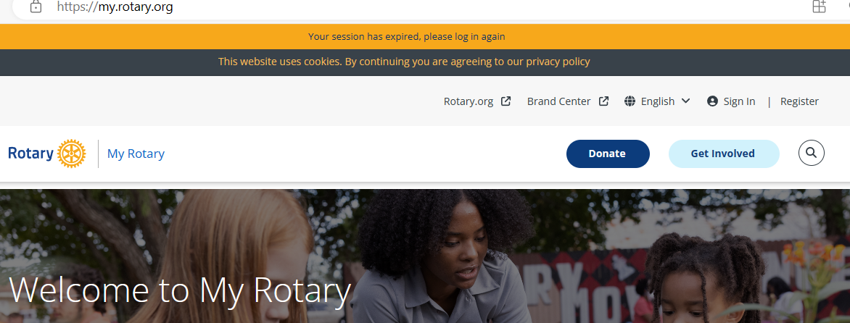
rotary.org - Sign In
Sign in with your email address and password. “Register for an Account”, if you have never signed in or if you have entered the wrong sign-in info too many times. The User Name or Login password may be different from District’s website password. Email address is from the District’s website, unless you change it for RI. If your email address changes, RI’s website needs to be updated separately.

Slide 25
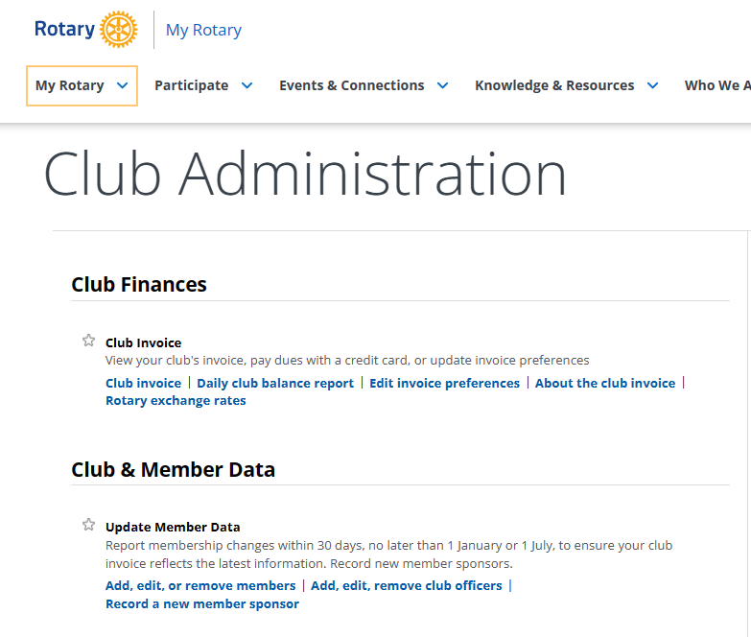
Click on “Manage”
Go to My Rotary and then “Club Resources” for Dues Invoice or Member Data.

Slide 26
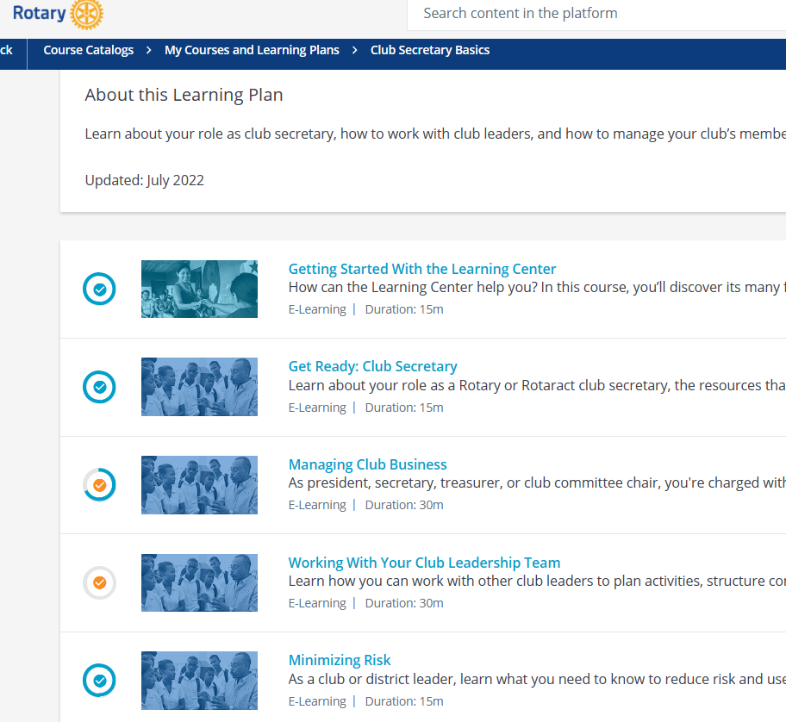
Rotary Learning Center
Take online courses for club secretary in the Learning Center
at learn.rotary.org
Club Secretary Basics

Slide 27
Minutes
Club Assemblies
Board Meetings
Committee Meetings
Notes:
As assigned. Rotary International requires the Board minutes to be made available to the members within 60 days of the meeting.

Slide 28
Other Duties
Maintain Club Records
Ordering supplies i.e. New member badges, packets, pins
Assisting w/ DG’s visit

Slide 29
MEMBER LEADS ON ROTARY.ORG

Slide 30
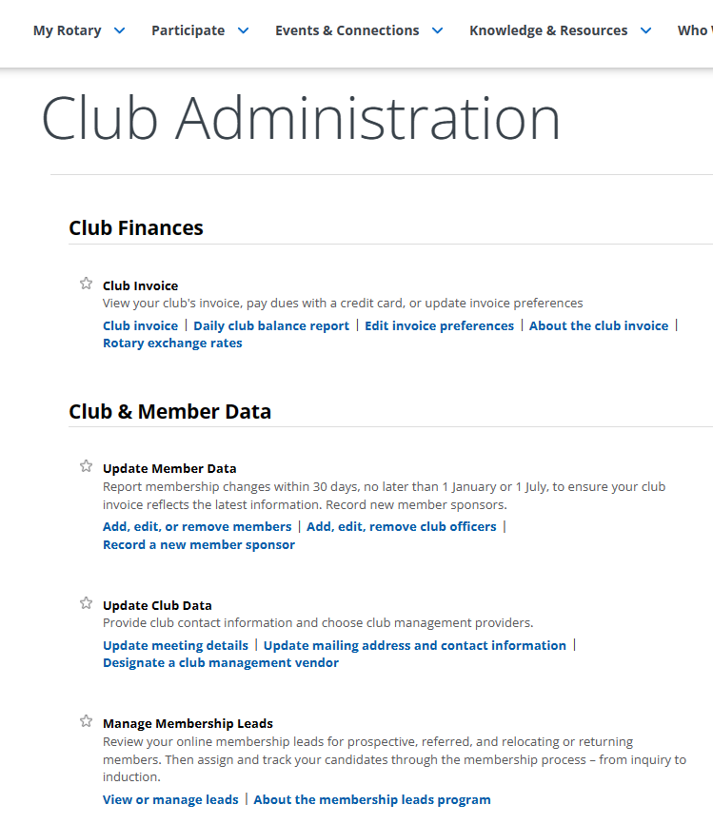
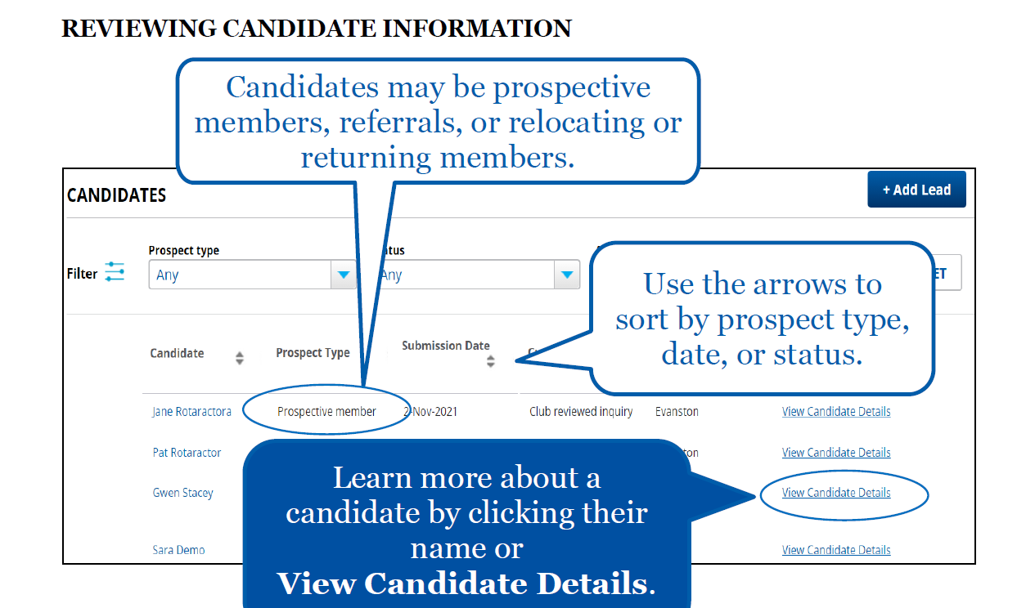

Slide 31
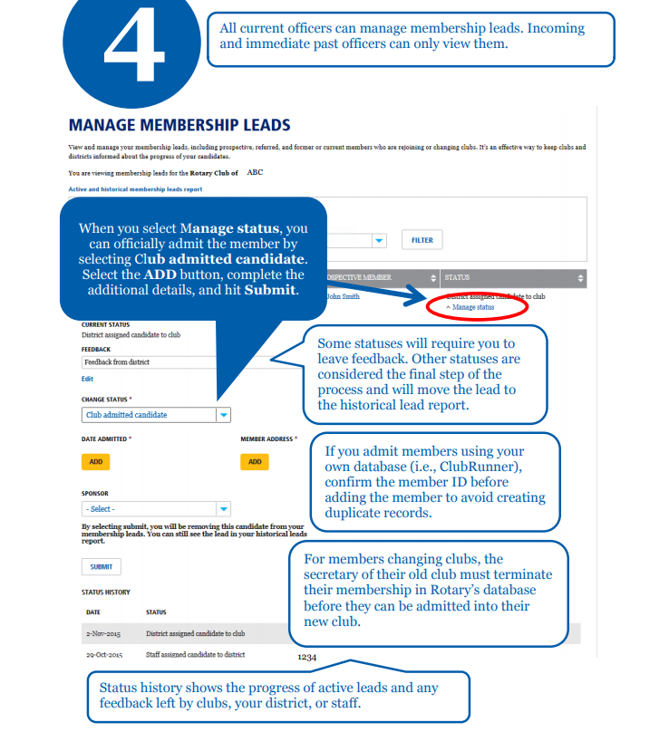
Add the new members in the Membership Leads page
Use the Manage Membership Leads page of My Rotary to store information about all of your prospective members. Some things to note:
Choose Club proposed candidate for membership if the candidate was proposed for membership and still needs board approval.
Choose Club admitted candidate if the candidate is now a member of your club.

Slide 32
Upcoming ClubRunner Training https://site.clubrunner.ca/Page/webinars
April 10, 2024, 3pm EDT – Training for Club Executive using District Site
April 17, 2024, 3pm EDT – Cloud Events
April 224, 3:00 EDT - Bulletin Live Designer
April 19, 2023, 4-5pm EDT - Membership Management

Slide 33
Mahalo!

