Slide 1
CLUB TREASURER BASICS
District Spring Training Assembly
2024

Slide 3
DUTIES
Manage club funds:
1. Control of club funds
2. Collect dues and fees
3. Keep Board informed of the finances
4. Remit payments, may include Rotary Foundation & HRYF donations
Maintain Records:
1. Bank statements and reconciliations (5-year retention)
2. Grant finances
3. Include Satellite club financial numbers
Reporting:
1. Taxes: Federal, State, General Excise
2. Keep Board informed of the finances and budget comparisons

Slide 4
Financial Controls
Financial controls are highly suggested to help ensure that funds are managed properly and preclude misuse.
Require more than 1 signature on checks or have a disbursement authorization form approved by an officer for payment
Review bank statements before giving them to the treasurer
Reconcile bank statements monthly
Update bank signature cards for new officers
Close accounting records in a timely fashion
Submit tax forms on time
Have an audit committee for oversight and continuity

Slide 5
Annual Requirements
Budget – approved by Board (ideally before 7/1)
IRS 990 – due by 11/15 MANDATORY
Due 15th day of the 5th month after June 30 (Nov 15)
Send a copy to Grants Chair at Email: grants@rotaryd5000.org for grant qualification purposes
General Excise Tax (GET) filings as required by State Tax Department

Slide 6
Budget Templates
Budget template sample below. QuickBooks for club accounting is easy to use and has a budget feature.
 | Budgeted income last year | Actual income last year | Amount under/over last year | Estimated income this year
OPERATIONS
Membership dues
Admission fees
Income from visitors
Other income
SUBTOTAL | 0 | 0 | 0 | 0
CHARITABLE
Donations to club for projects
Club fundraisers
Other income
SUBTOTAL | 0 | 0 | 0 | 0
TOTAL INCOME | 0 | 0 | 0 | 0
EXPENSES | Budgeted income last year | Actual income last year | Amount under/over last year | Estimated income this year
OPERATIONS
Secretary's Office
Badges/engraving
Postage and post box

Slide 7
Budget Items 2024-2025
RI Invoice - $102.77
District Dues – $65.00
HRYF Club Dues - $200.00
PETS (Los Angeles airfare, registration, extra nights) - $1,500 approx.
Unpaid Global Grant pledges
PETS Hospitality Room (about $100)
District Workshops (Foundation, Membership Seminars)
RYLA
District Conference
Virtual meetings:
Pre-PETS
Training Assemblies

Slide 8
Rotary Dues
RI Invoice: $102.77 annually for 2024-25
$78.50 Dues + $1.00 COL, $5.27 Insurance and $18 for magazine. Due July 31 ($54.52) and Jan 31 ($48.25) to RI. New members prorated. Honorary magazine $18. (RI dues increase 2025-2026 to $82.00)
District Dues: $65.00 per active member annually) due July 1 ($32.50) and Jan 31($32.50) to District Treasurer, PO Box 3325, Honolulu, HI 96801.
Suggest that you send out the club invoice by June 1 and Dec 1 and have a due date of July 1 and January 1. You may want to include an “Optional” line for Rotary Foundation giving and HRYF ($20).

Slide 9
Rotary International Dues
RI dues are based on the members count as of 7/1 and 1/1 and cannot be adjusted. Very important to have the correct roster before those dates.
RI invoices are emailed to Club President, Secretary and Treasurer. Please ensure that the email addresses are correct. The invoice can also be found on the rotary.org/myrotary website in the Club Administration section. A detailed listing of members is available. Payments can be made online with a credit card.

Slide 10
RI Dues – Where Does It Go?
Annual RI dues $78.50 for:
HR, Legal, Audit
Finance
Governance and Executive
International Operations
Messaging and Communications
IT, Operations, Administration
Programs and Member Services
$1.00 per member annually for Council on Legislation *
$1.16 per member annually for D&O/EPL insurance *
$4.11 per member annually for General Liability insurance *
$18 annually for the Rotarian magazine
* Annual payments on only the July 1 invoice

Slide 11
District Website: rotaryd5000.org
What you can find on the district website:
Membership rosters
District dues invoice
District Chairs and Org Chart
Information on the Avenues of Service
Club Presidents and Meeting Locations
Events in the Calendar
Register for Events
Look for Rotarians in the Yellow Pages

Slide 12
District Dues Invoice– Input number of members
 |  | Rotary International District 5000
 |  | District Dues Invoice
 | Rotary Club of
 | Contact Name
 | Phone/Email:
 | DESCRIPTION |  | AMOUNT
 | Semi-annually | Semi-Annual Dues Per Active Member: | $30.00
 | (July 1, Jan 1)
 |  | Input number of members --->
 |  | Sub-total | $0.00
 |  | Total District Dues: | $0.00
 |  | Payment due by: | Upon Receipt
 | Please make check payable to Rotary International District 5000 for the total.

Slide 13
District Grants

Slide 14
District Grant Key Dates
May 31 - Final Grant report
June 15 – Grant application for 2024-2025 grant due
July 31 – Deposit club cash portion in grant account
A copy of the bank statement showing the club cash is required to receive the grant funds. The President will be notified when the funds are available, hopefully sometime in August.

Slide 15
Foundation Grant Financial Requirements
Disbursement Requirements:
Do not disburse funds until your grant application is approved
Maintain separate grant bank accounts
Two (2) signatures required for disbursements.
Invoices and proof of payment required for all disbursements.
Proof of Expenditures:
Promptly deliver receipts for all expenditures to the Club Treasurer.
If there is a difference between the receipt and invoice amounts, provide documentation to the Treasurer
Retain account records in physical form and electronic form for five (5) years from the date of Approval of the Final Report.
Monthly Reconciliation:
The District Grant Account and each Global Grant Account will be reconciled on a monthly basis by the Club Treasurer and a report of this shall be made to the Club President and President-elect

Slide 16
District Audit of Grant Records
If your club is selected to be audited, the following documents will be requested for the review by a member of the audit committee:
1. The grant qualification documents and application
2. Bank statements
3. Cancelled checks
4. Bank signature cards
5. Check registers or ledger showing revenue and disbursements for each project
6. Invoices and receipts to support disbursements
7. Bank reconciliations
8. List of physical assets acquired for the grant projects, if any
9. Report to district of misuse of funds, if any
The review is limited only to the transactions regarding the grant, and does not include the other operations and bank accounts of the club.

Slide 17
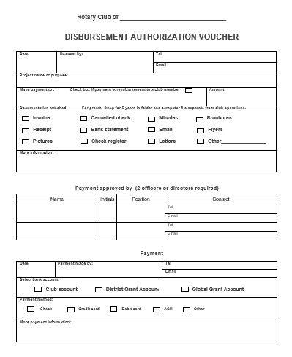
New Requirement: Use this Voucher to authorize disbursements from the grant account.
Form posted on the district website in the District Grants page.

Slide 18
RI Website: rotary.org/myrotary

Slide 19
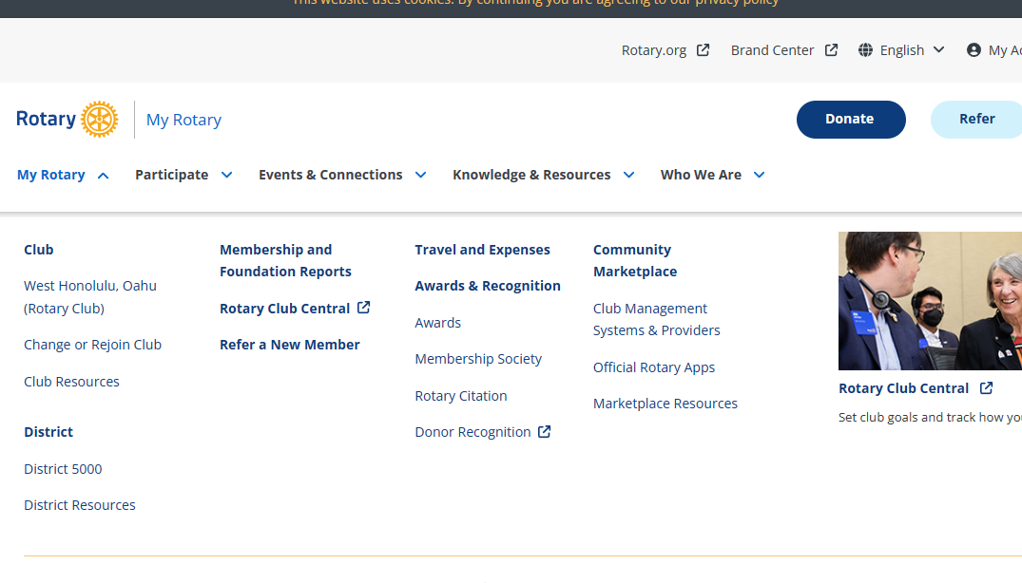
rotary.org - Sign In
Sign in with your email address and password. “Register for an Account”, if you have never signed in or if you have entered the wrong sign-in info too many times. The User Name or Login password may be different from District’s website password. Email address is from the District’s website, unless you change it for RI. If your email address changes, RI’s website needs to be updated separately.

Slide 20
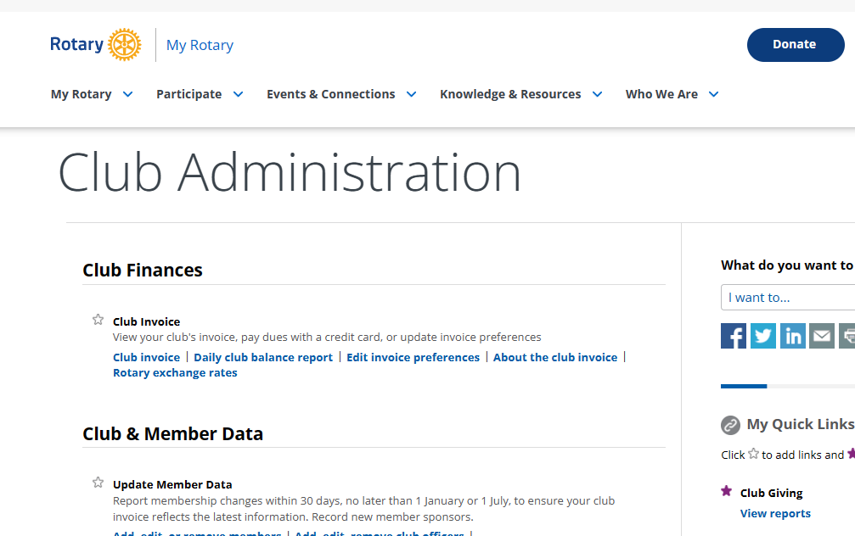
RI Club Invoice in the “Club Resources” site page

Slide 21
Rotary Foundation Contributions
Forms and Foundation Reports can be fund on the rotary.org website, under “Who We Are” tab –then “Get Involved” – then “Ways to Give”. Forms are on the bottom of the site page.
Submitted using The Rotary Foundation Contribution Form
Members can donate online.
Multiple Donor Form
Memorial or Tribute Gift form
Rotary Direct enrollment form
Indicate gift designations (such as Polio Plus or Annual Fund- SHARE).
In addition to monetary gifts, contributions can include stock, appreciated securities, life insurance policies, property, and bequests. Contact Planned Giving staff at Rotary headquarters or your international office for assistance in sending these types of contributions. See the Foundation’s Gift Acceptance Policy for more information.

Slide 22
What is State general excise tax revenue ?
Jim Hasselman

Slide 23
Not GE Taxable
Tax facts 98-3, “Tax Issues for Hawaii Nonprofit Organizations”
The organization is exempt from paying the general excise tax on income that is (a) derived from its activities that fulfill its exempt function and (b) that do not have as a primary purpose the production of income. (TF99-04).
Not taxable (Q8):
Dues, donations or gifts
Interest income from bank deposits, including CDs, for safekeeping of cash (Q16).
Logo merchandise sales (shirts, hats, tote bags) sold at or near cost (TF99-04, Q52)
However, such sales sold with intent to make a profit are taxable.
Dividend income (HRS 237-3(b)).

Slide 24
GE Taxable
Taxable
“Gross receipts derived from any activity the primary purpose of which is to produce income are subject to the GET”. (Q8)
Fundraising activities (Q9): white elephant sales, fairs, bazaars, bake sales.
Also: gala dinners, concerts, chili sales, etc. (Q12).
Rental income (Q11)
Gross proceeds from benefit dinner, even if some of it is a donation (Q13).
Silent auction and other sales of donated items (Q14).
Interest income, rents, royalties etc from investment portfolio (ie earned from the “investment of the capital of the business) (TIR 42-74)
Advertising in newsletters (TF99-04, Q34).

Slide 25
General Excise Tax Filings
Evidence of Annual GE Tax filings is required for grant qualifications starting with the 6/30/23 report, which is due Oct 20, 2023 (4 months after the close of the year.)
If no revenues subject to GET, you should still need to file the return.

Slide 26
Exemption
Use form G-6 to obtain GET exemption (ref HRS 237-23(a)).
Exemption letters may have been issued by tax office prior to 1990.
Typically needed for organizations that earn income from “exempt” activities such as school tuition, museum admission income, hospital patient revenue, etc. (“exempt function income”).
Tax exempt for income tax purposes is not the same as tax exempt for GET.

Slide 27
Mahalo!

