Slide 1


Slide 2
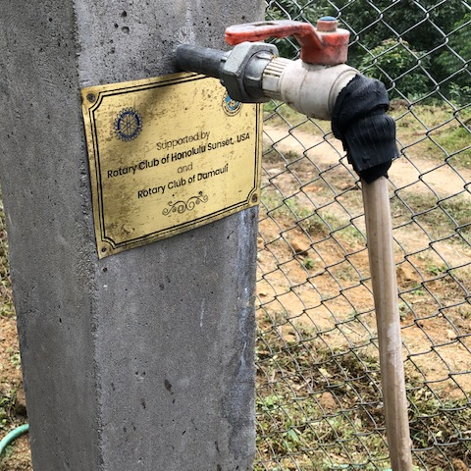
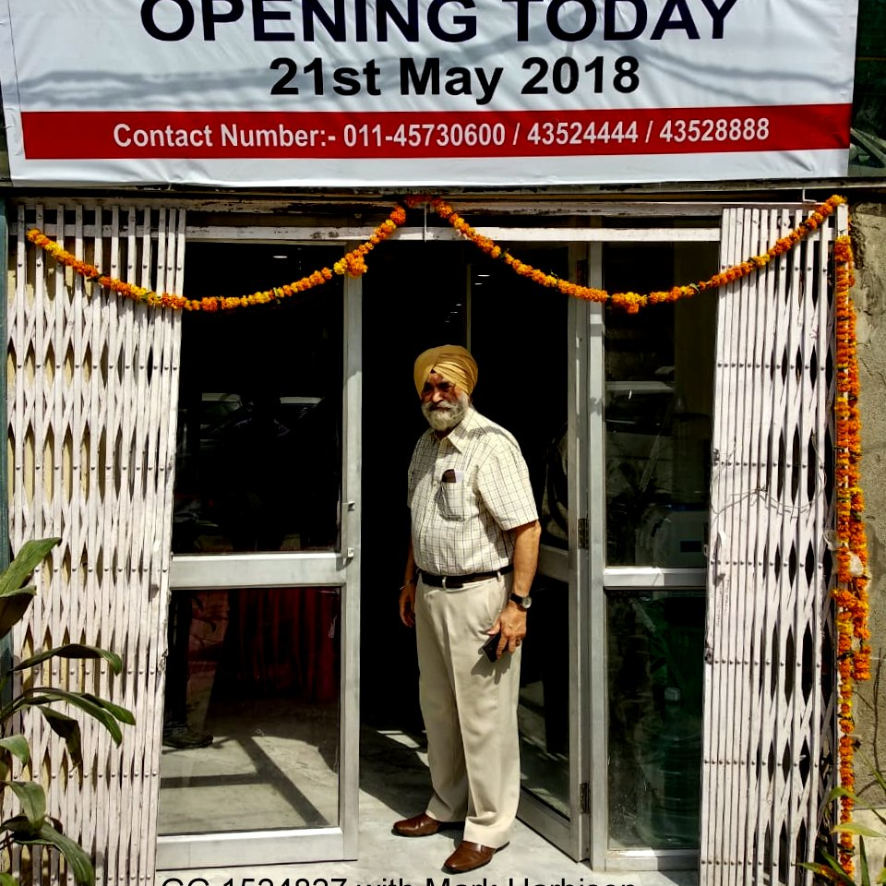
Your Rotary Foundation
The Rotary Foundation has been Doing Good in the World for over 100 years with over $4 billion in contributions.
Your donations ensure the progress and future of the Foundation’s work.

Slide 3
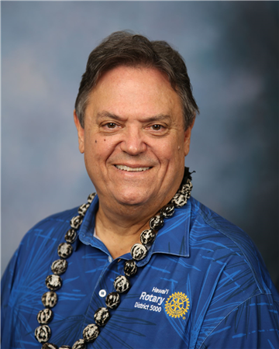
Your District team
District Foundation Committee
David | Mozdren | Honolulu Sunrise | District Rotary Foundation Chair (2024-27)
David | Hamil | Waikiki | Dist. Rotary Subcommittee Chair
Dick | May | Kapolei | TRF Annual Giving Chair
Rick | Golba | Poipu Beach | Endowment/ Major Gifts
Virginia | Juettner | Hilo Bay | Paul Harris Society
Rosalynn | Cooper | Metropolitan Honolulu | PolioPlus
Patti | Look | Waikiki | District Grants
James | Ham | Honolulu Sunset | Global Grants, International Service (2024-2027)
Arjun | Aryal | Honolulu Sunset | Global Grants Chair
Laura | Steelquist | East Honolulu | Grants Stewardship Subcommittee
Naomi | Masuno | West Honolulu | District Finance Committee Chair
David | Mozdren | Honolulu Sunrise | Triple Crown Society
Paul | Jurcsak | Honolulu Sunset | White Hat Society
Stephen | Dyer | Pearl Harbor | Alumni Committee
Alan | Kusunoki | Hilo | Rotary Peace Fellows/Scholarships
Ron | Young | West Honolulu, Oahu | Grants Audit Team Leader
Notes:
Dave M

Slide 4
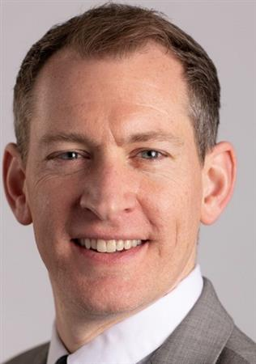
Geoff Cochran
Rotary International Annual Giving Officer

Slide 5
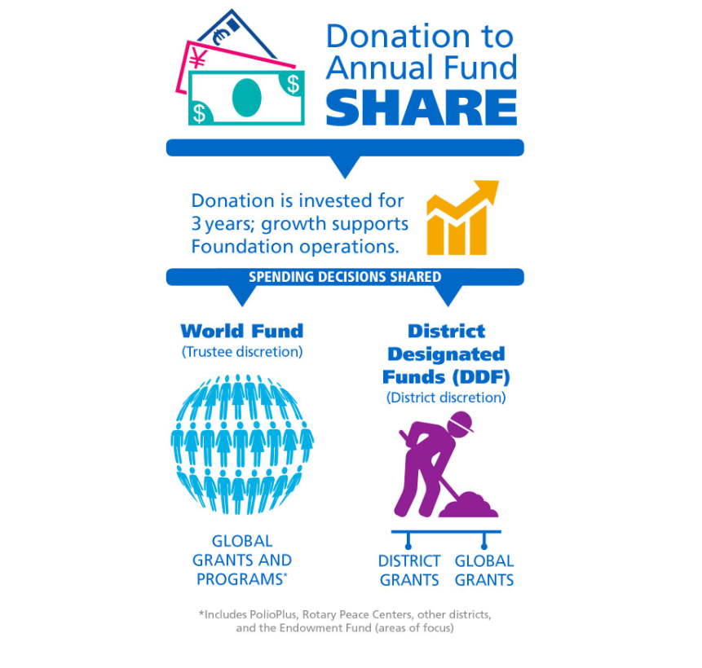
Notes:
Annual Fund contributions are transformed into grants and programs that support Rotary's humanitarian service using the SHARE system.
SHARE uses a three-year funding cycle. It allows the Foundation to invest donations and use the earnings for administrative and fund development costs.
After the investment period, the donation is divided. Annual Fund-SHARE contributions now have the first 5% of the total directed to operating expenses, with the remainder split equally between the World Fund and District Designated Funds.
The Foundation uses the portion credited to the World Fund to pay for grants and programs that are available to all Rotarians. Your district can use the portion that becomes DDF to participate in grants and the programs you choose.

Slide 6

Rotary District Grants
The Rotary Foundation awarded $78,209 in funding to 114 district grants for fiscal year 2023-2024. Here is a breakdown of causes the grants supported.
$ 14,756 Community Development
2,143 Economic Development
30,854 Education
4,290 Environment
6,288 Health
14,436 Peace (includes RYLA)
2,233 Water
For 2024-2025, we received $69,857
Patti Look
Notes:
Patti (2min)

Slide 7
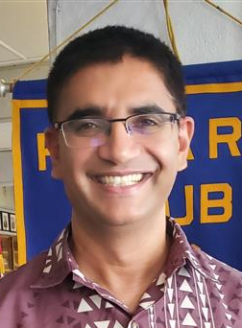
Global grants
$74.897 allocated for global grants in 2023-2024
$62,692 allocated for global grants in 2024-2025
Upcoming District Maui (Lahaina) Tree Planting Project (Hosted Global Grant)
Arjun Aryal
Notes:
Jmes and Arjun (3min)

Slide 8
Projects completed
PNG – Provide safe drinking water to 700 nursing students, 30 faculty, and 3000 rural villagers $72,200
Nepal - Women-led project - Improve the livelihoods of people from very remote villages in Nepal by drinking water and commercial farming (fruits, vegetables) with the help of all year round available water through surface water hybrid solar pumping - $47,905
Thailand – Grow rural healthcare capacity to improve access to healthcare $74,400
Ghana- Water and Sanitation (Kona club partnered) - $239,000
Nepal – Wash in 6 schools - $77,000

Slide 9
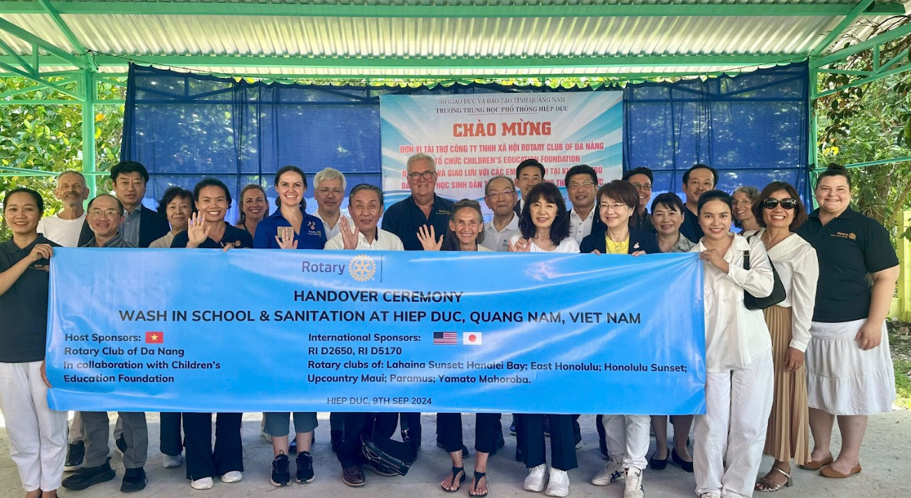
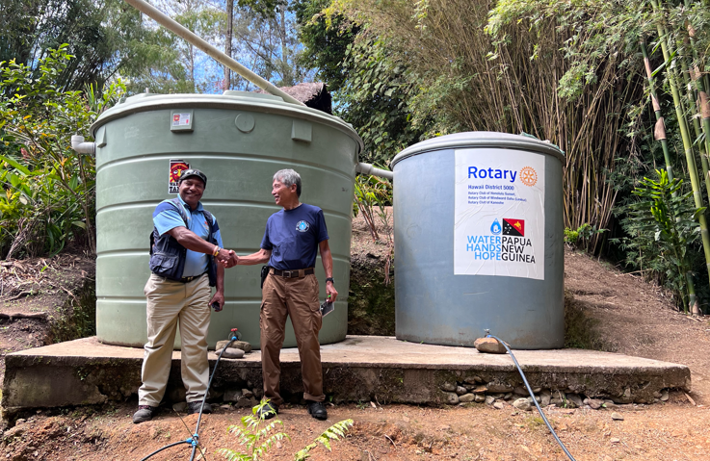
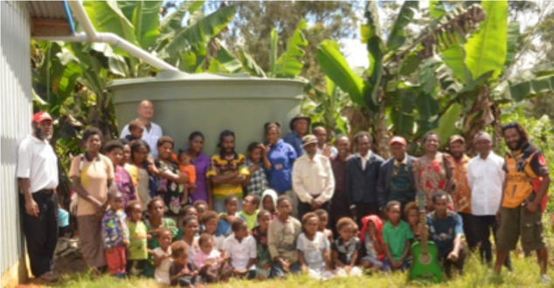
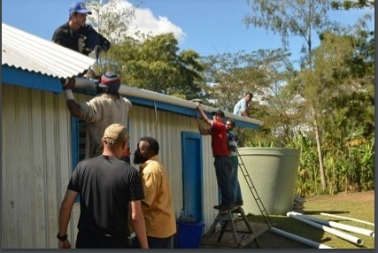

Slide 10
Foundation learning opportunities
October 12 – Global Grant Project Fair
  Find out what global grants are looking for funding. Club pledged due Nov 1
October 24 – World Polio Day, 5:30 on Zoom
October 26 – Mandatory Grant Qualifications for PEs and club rep
November 2 – The Rotary Foundation – all Rotary Members in the District are invited to learn about what The Rotary Foundation is about, what is does, what giving opportunities Rotary members can participate in.
Notes:
Benson (2 min)

Slide 11
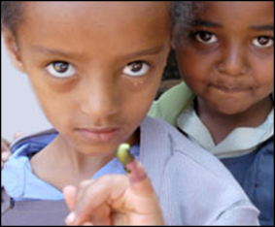
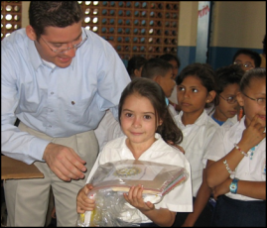
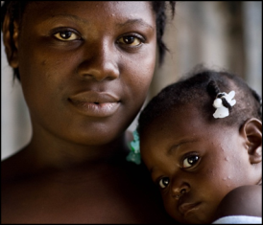
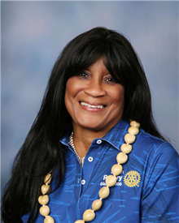

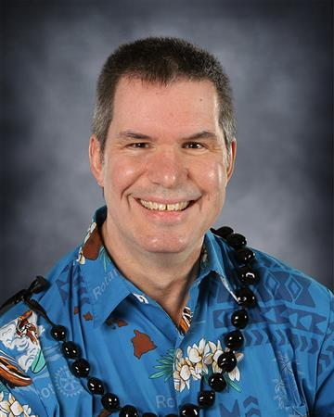
SUPPORTING THE ROTARY FOUNDATION
PolioPlus Fund
End Polio Now
Annual Fund
For support today
Endowment Fund
To secure tomorrow
Roz Cooper
Dick May
Rick Golba
Notes:
Rotarians support our Foundation through these funds:
PolioPlus Fund, dedicated to global polio eradication
Annual Fund, the primary source of funding for Foundation grants and activities
Endowment Fund, which supports the Foundation in perpetuity

Slide 12
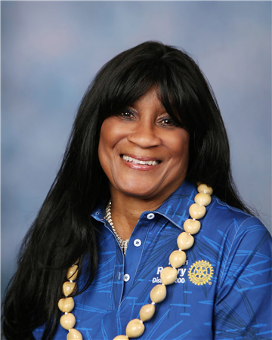
ENDING POLIO: MAKING HISTORY
Roz Cooper
Every year more than 650,000 children are spared lifelong paralysis thanks to continued polio eradication efforts
1985 – Nearly 3 billion children have received the oral polio vaccine
1998 – Distribution of essential vitamin A has saved the lives of more than 1.25 million children
Every year on the average, 82 million doses of vitamin A; 64 million doses of measles vaccine; 34 million deworming tablets; 7 million doses of yellow fever vaccine; 5 million doses of tetanus toxoid vaccine; and 4 million insecticide treated bed-nets are delivered alongside oral polio vaccine during polio activities.
Notes:
Roz (3 min) Rotary’s own financial support for PolioPlus will be magnified by an agreement with the Bill & Melinda Gates Foundation.
From 2017 to 2020, every $1 that Rotary commits to direct support of polio immunization (up to $50 million per year) will be matched by an additional $2 from the Gates Foundation. This means contributions to Rotary’s PolioPlus program will have three times the impact.

Slide 13
ENDING POLIO: MAKING HISTORY
Cold chain, transport and communications systems for immunization have been strengthened because of the polio eradication initiative.
Polio eradication is helping countries to develop public health and disease surveillance systems useful in the control of other vaccine-preventable disease.
The disease surveillance system – the network of 146 laboratories and trained personnel established during the Polio Eradication Initiative – helps track measles, rubella, yellow fever, meningitis, COVID 19, and other deadly infectious diseases.
Acute Flaccid Paralysis (AFP) surveillance systems and global laboratory networks that supports it will continue to support the surveillance of other diseases long after polio has been eradicated. Immunization campaigns for polio have been used as an opportunity to provide other essential health services.
Notes:
Roz (3 min) Rotary’s own financial support for PolioPlus will be magnified by an agreement with the Bill & Melinda Gates Foundation.
From 2017 to 2020, every $1 that Rotary commits to direct support of polio immunization (up to $50 million per year) will be matched by an additional $2 from the Gates Foundation. This means contributions to Rotary’s PolioPlus program will have three times the impact.

Slide 14
ENDING POLIO: MAKING HISTORY
The GPEI vaccinates more than 370 million multiple times annually
Polio eradication is a cost-effective public health investment as its benefits accrue forever… on the other hand, as many as 200,000 children could be paralyzed annually in the next 10 years if the world fails to capitalize on the more than $19 billion already invested in eradication.
Notes:
Roz (3 min) Rotary’s own financial support for PolioPlus will be magnified by an agreement with the Bill & Melinda Gates Foundation.
From 2017 to 2020, every $1 that Rotary commits to direct support of polio immunization (up to $50 million per year) will be matched by an additional $2 from the Gates Foundation. This means contributions to Rotary’s PolioPlus program will have three times the impact.

Slide 15
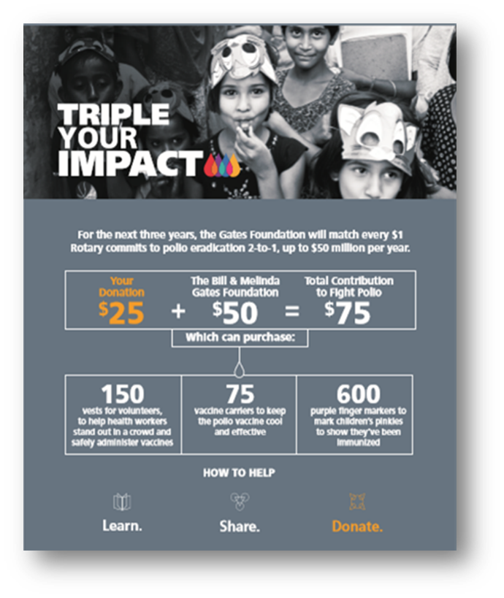



ENDING POLIO: MAKING HISTORY
+
=
Notes:
Roz (3 min) Rotary’s own financial support for PolioPlus will be magnified by an agreement with the Bill & Melinda Gates Foundation.
From 2017 to 2020, every $1 that Rotary commits to direct support of polio immunization (up to $50 million per year) will be matched by an additional $2 from the Gates Foundation. This means contributions to Rotary’s PolioPlus program will have three times the impact.

Slide 16

ENDING POLIO: MAKING HISTORY
Our Legacy
In 1985 Rotary made the historic decision to immunize all the world’s children against polio. Today, the world is nearly polio free…
Through the continued leadership of the United States, that of polio-affected countries, civil society, and partner agencies, we will fulfil the promise of a polio free world…
Through you, your contributions, your support, your commitment, your believing – we will fulfil that Legacy…
Notes:
Roz (3 min) Rotary’s own financial support for PolioPlus will be magnified by an agreement with the Bill & Melinda Gates Foundation.
From 2017 to 2020, every $1 that Rotary commits to direct support of polio immunization (up to $50 million per year) will be matched by an additional $2 from the Gates Foundation. This means contributions to Rotary’s PolioPlus program will have three times the impact.

Slide 17
Encourage giving
Rotary Direct – Easiest and painless way to give
Annual Fund – Money returned to us to support our projects (EREY - $25 from every member in your club)
PolioPlus – Funds given for immediate use to eradicate Polio.
Paul Harris Fellow (PHF) – PHF for each $1000 or 1,000 Recognition Points
Paul Harris Society (PHS) – Pledge to give $1,000 Annually
Benefactor – Pledge to give $1,000 to the Endowment Fund
Bequest Society – Minimum pledge of $10,000 to the Endowment Fund
Triple Crown Society – Bequest Society; PHS and Major Donor
White Hat Society - $5,000 in a given Rotary year
Notes:
Dave M (5 min)

Slide 18
What can you do?
Increase awareness about The Rotary Foundation in the club.
Share the foundations goals with club members
Get people signed up for Rotary Direct (Easy and Painless)
Use Recognition points to encourage club giving
Openly Celebrate Foundation Accolades.
Increase giving to The Rotary Foundation
Promoting PolioPlus Awareness
Understand the Foundation reports and how to use them.

Slide 19

How does your club encourage giving to TRF?

Slide 20
QUESTIONS

Slide 21


