Slide 1
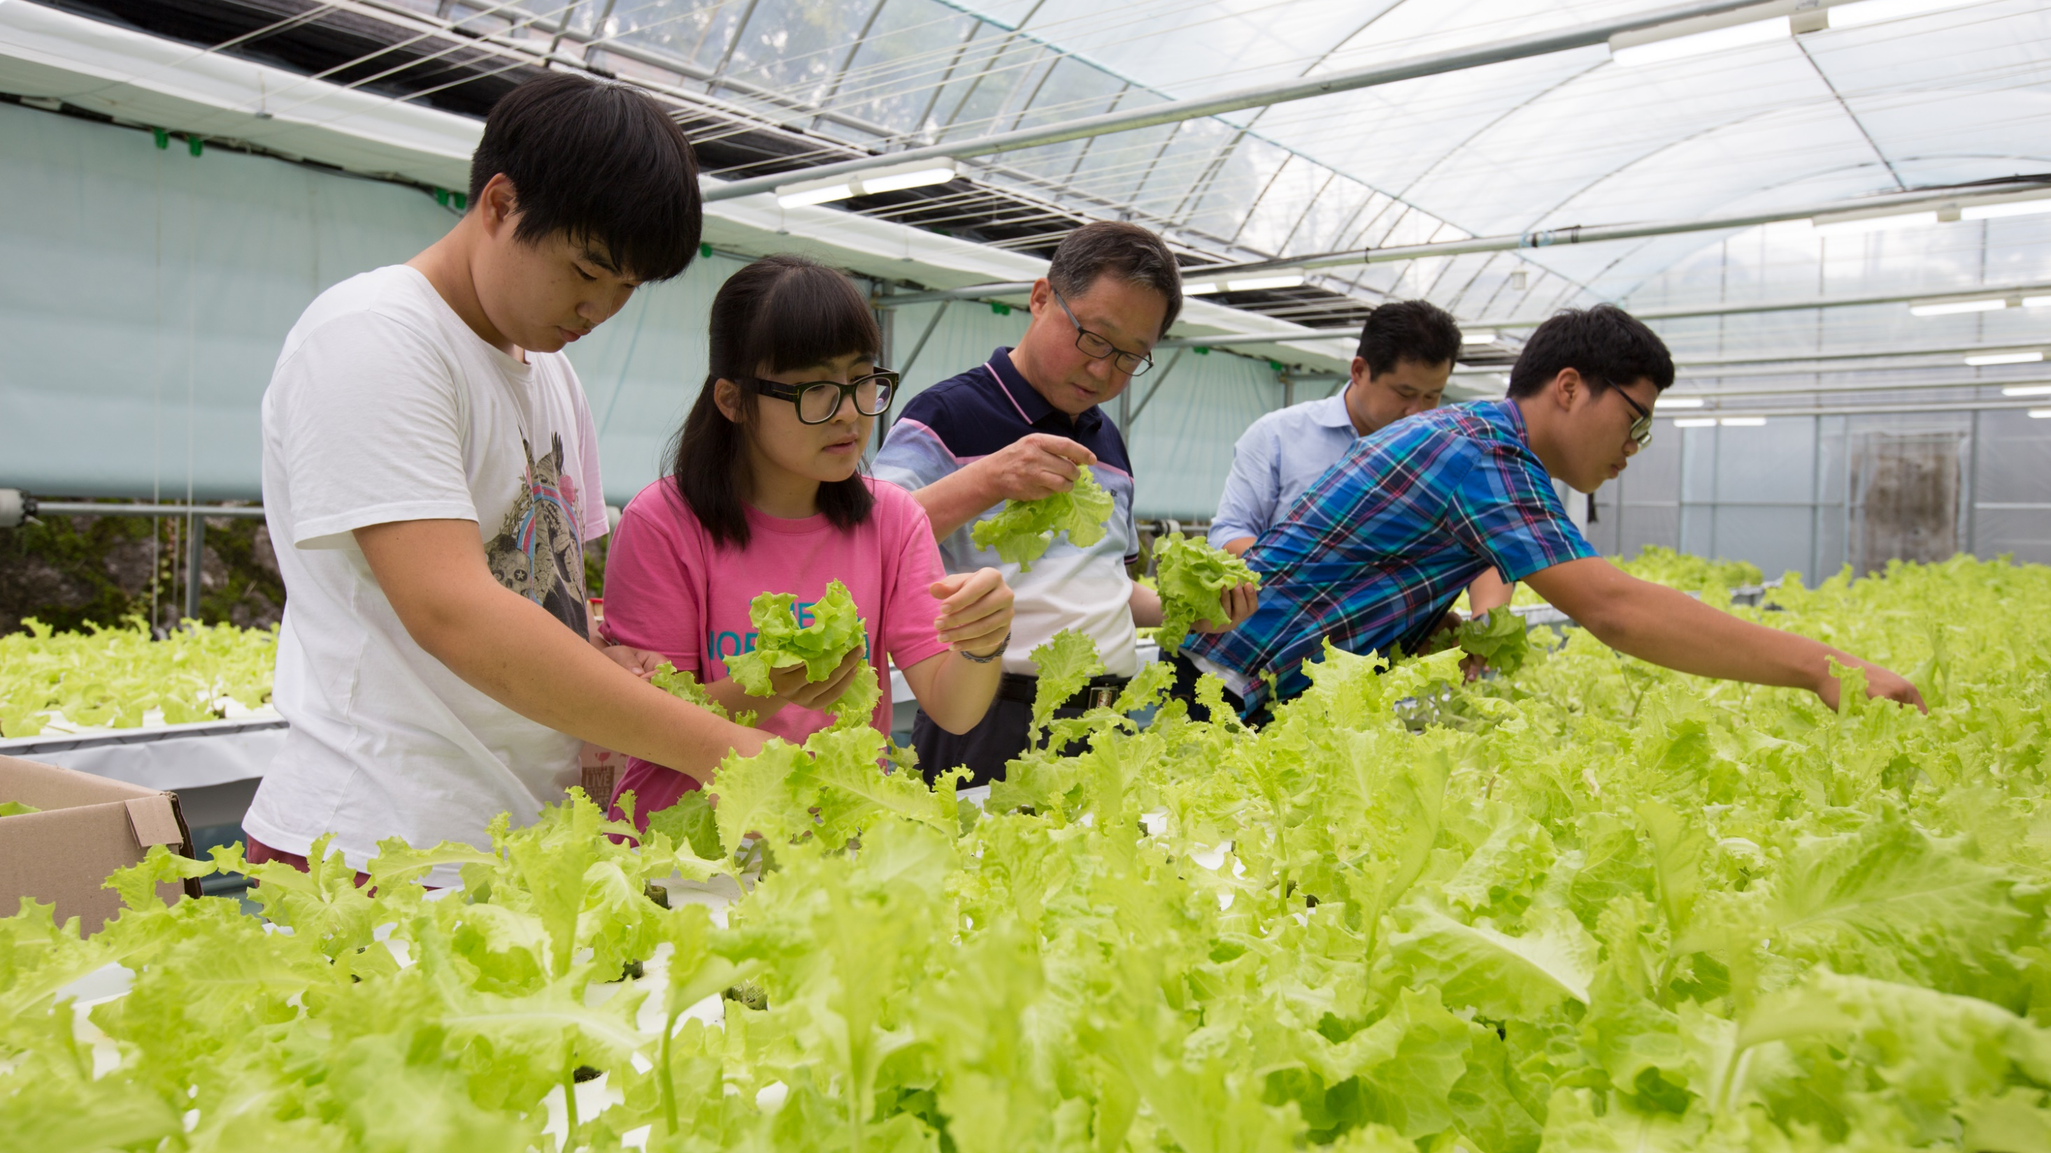
Vocational Service

Slide 2
Vocational Service
Through vocational service we:
  Serve others by using our unique skills to address community needs
  Empower others through training and skill development
  Inspire others to act with integrity by following Rotary’s guiding principles
One of Rotary’s Avenues of Service

Slide 3
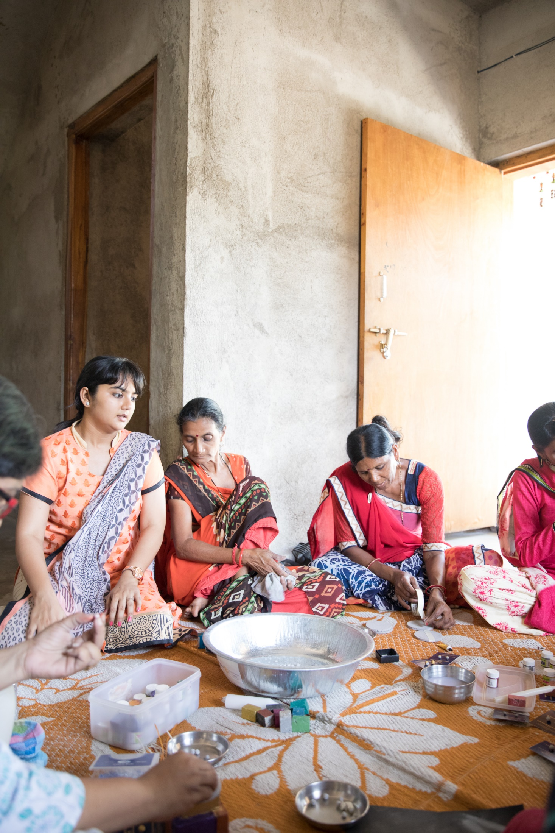
subhead
Vocational Service Includes:
Connecting our professions and professional networks with our club activities;
Using our expertise to address community problems and help others discover new vocational opportunities and interests;
Promoting Rotary’s commitment to integrity in our professional and personal lives;
Recognizing and advancing the worthiness of all professions.

Slide 4
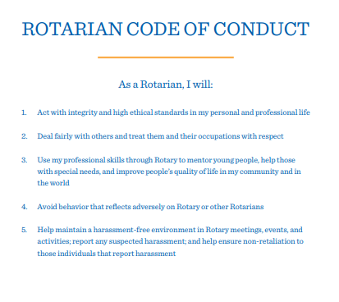
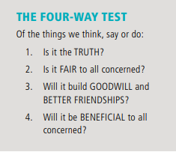
Integrity and ethics
Rotary emphasized integrity and high ethical standards. Two useful tools for providing a framework for ethical behavior include:

Slide 5
Vocational service Project ideas
Host a business networking event with non-Rotary professionals in your community.
Offer career counseling for unemployed or underemployed adults.
Mentor young people to achieve their career goals.
Apply your professional skills to a club or district service project.
Lend your expertise through your district’s resource network, by joining a Rotary Action Group, or by joining or starting a professionally-oriented Fellowship.
Work with your district Rotary Friendship Exchange chair to organize a vocationally-oriented exchange to explore how your profession is practiced in another country and introduce international friends to how yours is practiced in your country.
Work with your district Rotary Foundation Committee to organize a Vocational Training Team to travel abroad to teach local professionals about a particular field or to learn more about your own.

Slide 6
Advancing ETHICS at work
As leaders in our businesses and professions, we can advance high ethical standards by setting a positive example among colleagues and in our communities. Here are a few ideas to integrate ethics into daily work life:
Discuss and emphasize honesty, accountability, fairness, integrity, and respect when hiring, training and supervising employees;
Praise and encourage exemplary behavior;
Demonstrate personal commitment in relations with customers, vendors, associates, and partners by treating each interaction with care and consideration;
Promote socially and environmentally responsible practices in your businesses and organizations.

Slide 7
Responsibilities
  Professionals join a Rotary club as representatives of their particular business or profession.
  D-5000 Rotarians have a dual responsibility: represent their vocation within their club and to exemplify the ideals of Rotary in their place of business.
Vocational Service
IS CRITICAL
To Membership!

Slide 8
Put Rotary Ideals into Action
Talk about your profession in your club and take time to learn about fellow members’ occupations.
Use your skills and expertise to serve a community.
Practice your profession with integrity and inspire others to behave ethically through your words and actions.
Help young people achieve their career goals.
Guide and encourage others in their professional development.
By undertaking these activities, you bring vocational service to life. Vocational service is the essence of Rotary and serves as the foundation from which we serve our communities around the world.

Slide 9
Take Action
Join a Rotarian Action Group, and support service projects around the world. Learn more at rotary.org/actiongroups.
Join or form a Rotary Fellowship that’s related to your vocation. See more at rotary.org/fellowships. (Rotary Means Business Fellowship)
Volunteer to work on a service project and use your vocational skills to serve others.
Share your expertise through your district resource network. Lend your skills to local clubs and help develop projects with greater impact.
Participate in a vocation-related Rotary Friendship Exchange. Involve young professionals, and organize activities allowing exchange participants to experience cultural immersion while exploring their field in a new environment.
Notes:
Join a Rotarian Action Group, and support service projects around the world. These independent groups include Rotarians, family members, and Rotary program participants and alumni who have expertise in a particular field. Members advise clubs and districts and collaborate with them on service projects. Learn more at rotary.org/actiongroups. Join or form a Rotary Fellowship that’s related to your vocation. Rotary Fellowships are international groups of Rotarians, family members, and program participants and alumni who share a vocational or recreational interest. Many fellowships are related to professions, such as Editors and Publishers, Health Professionals, Lawyers, Photographers, and Police and Law Enforcement. See more at rotary.org/fellowships. Volunteer to work on a service project, and use your vocational skills to serve others. Think about the skills that make you successful in your profession: Maybe you have training in some branch of science or medicine, are handy with tools or machinery, know how to start a business, have expertise managing finances, or can influence others through public speaking or writing. Use your unique set of talents to make a difference in your community. Share your expertise through your district resource network. If you have technical expertise in one of Rotary’s six areas of focus — or with project planning and implementation; community assessment, measurement, and evaluation; or other important aspects of large-scale project grants — let your district international service chair know. Lend your skills to local clubs, and help develop projects with greater impact. Participate in a vocation-related Rotary Friendship Exchange. Work with your district Rotary Friendship Exchange chair to organize an international, reciprocal exchange between two districts interested in exploring a professional field in a new cultural context. Involve young professionals, and organize activities allowing exchange participants to experience cultural immersion while exploring their field in a new environment.

Slide 10
Examples: Club Goals
Host / Co-Host business networking events
  Ex: Chamber of Commerce, DBEDT, etc.
Career Guidance & Counseling / Partnership with Rotaract
  Start Mentoring Program with UH, HPU, etc.
  Career Counseling for Veterans, unemployed (partnership with State, SCORE)
Monthly Seminars or meetings with focus on a profession
Get listed in the Rotary Doing Business directory on rotaryd5000.org
Do Classification/Vocational Minutes
Tours of members’ and local businesses
Continue to apply our professional skills to projects
y

Slide 11
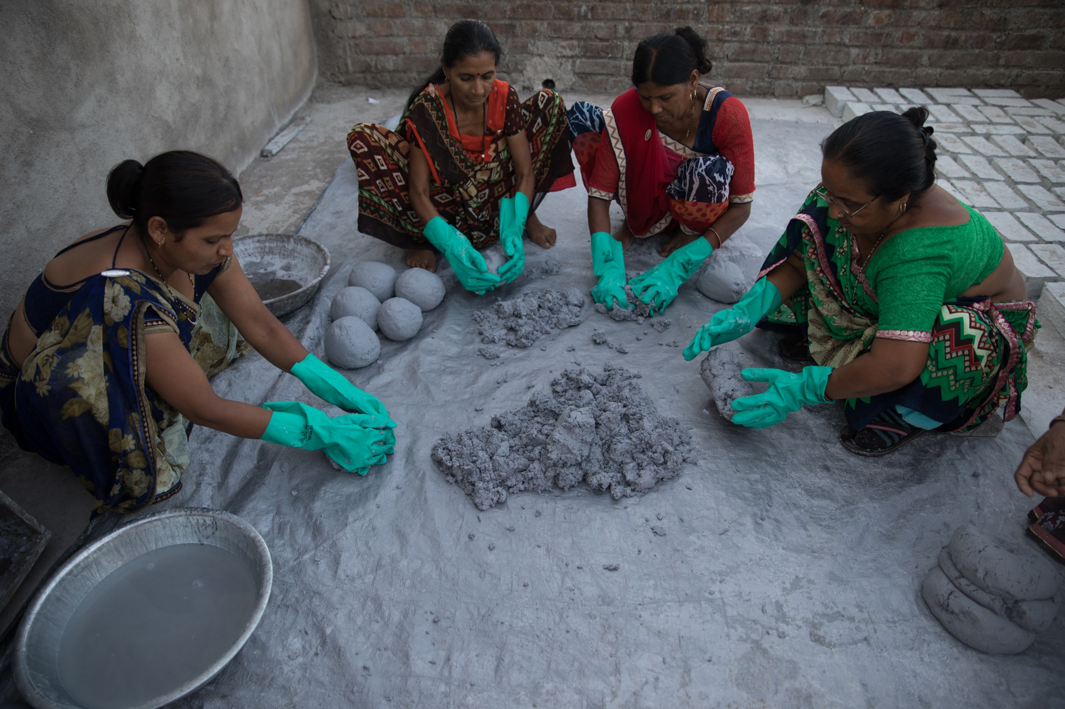
Rotary Action Groups
are international groups of Rotary members and friends who help clubs and districts plan and implement projects in a particular area of specialization
Join one of Rotary’s 26 Rotary Action Groups to lend your skills to support projects around the world.
www.rotary.org/actiongroups

Slide 12
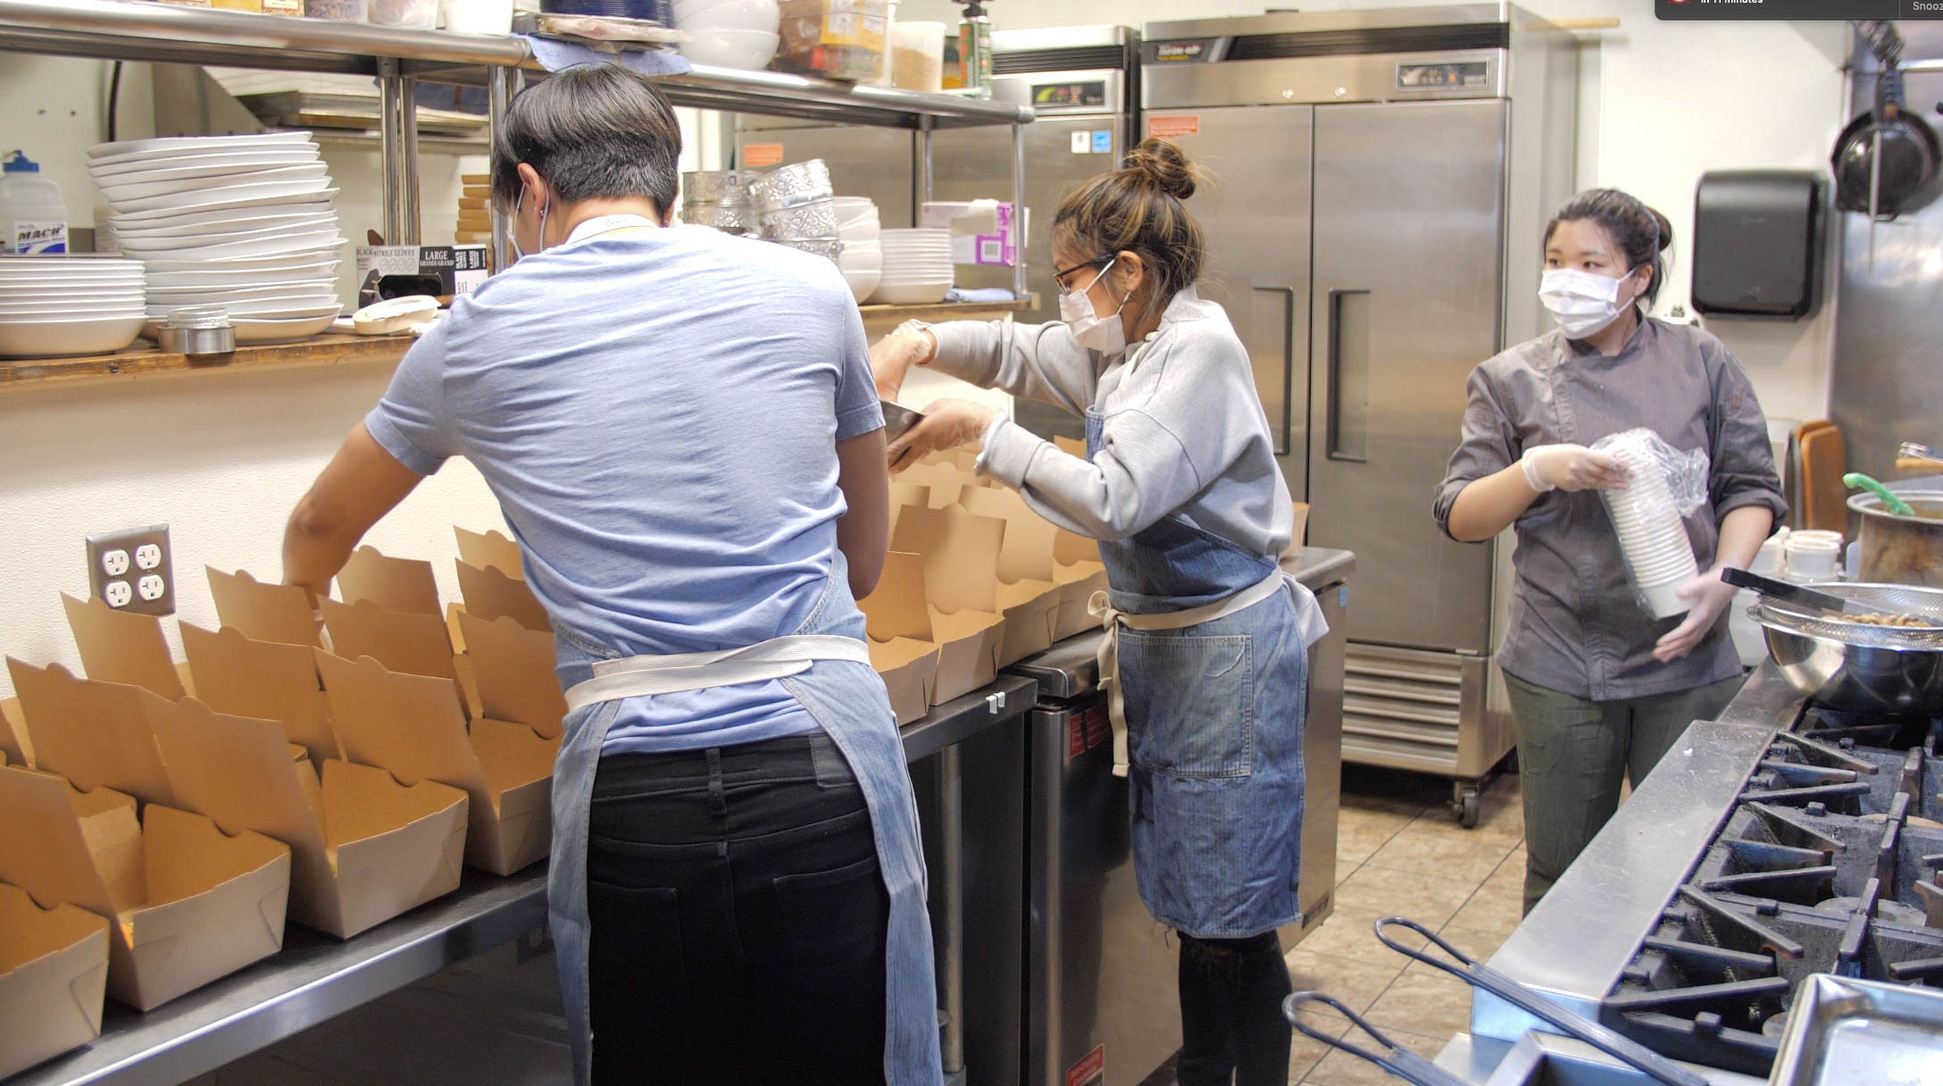
Rotary Fellowships
are international groups of participants who build community around shared professions, hobbies or identities.
Rotary has more than 90 Fellowships; join one related to your profession or consider organizing one if your field isn’t represented.
www.rotary.org/fellowships

Slide 13
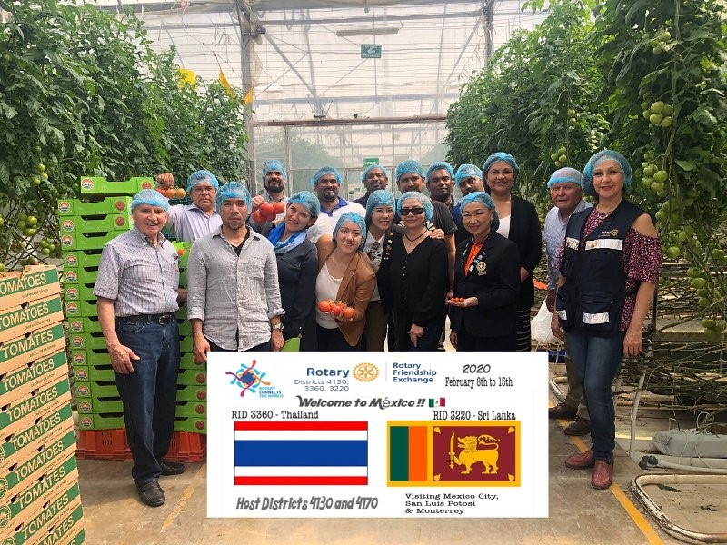
Rotary Friendship Exchange
a district program where teams of Rotary members and friends travel to an international district to explore another culture, undertake a service project, or explore a profession in partnership with local clubs.
Partnering districts determine the length of the exchange, group composition, itinerary, and arrange all details. Visitors are hosted in members’ homes and exchanges are reciprocal.
www.rotary.org/friendship-exchange

Slide 14
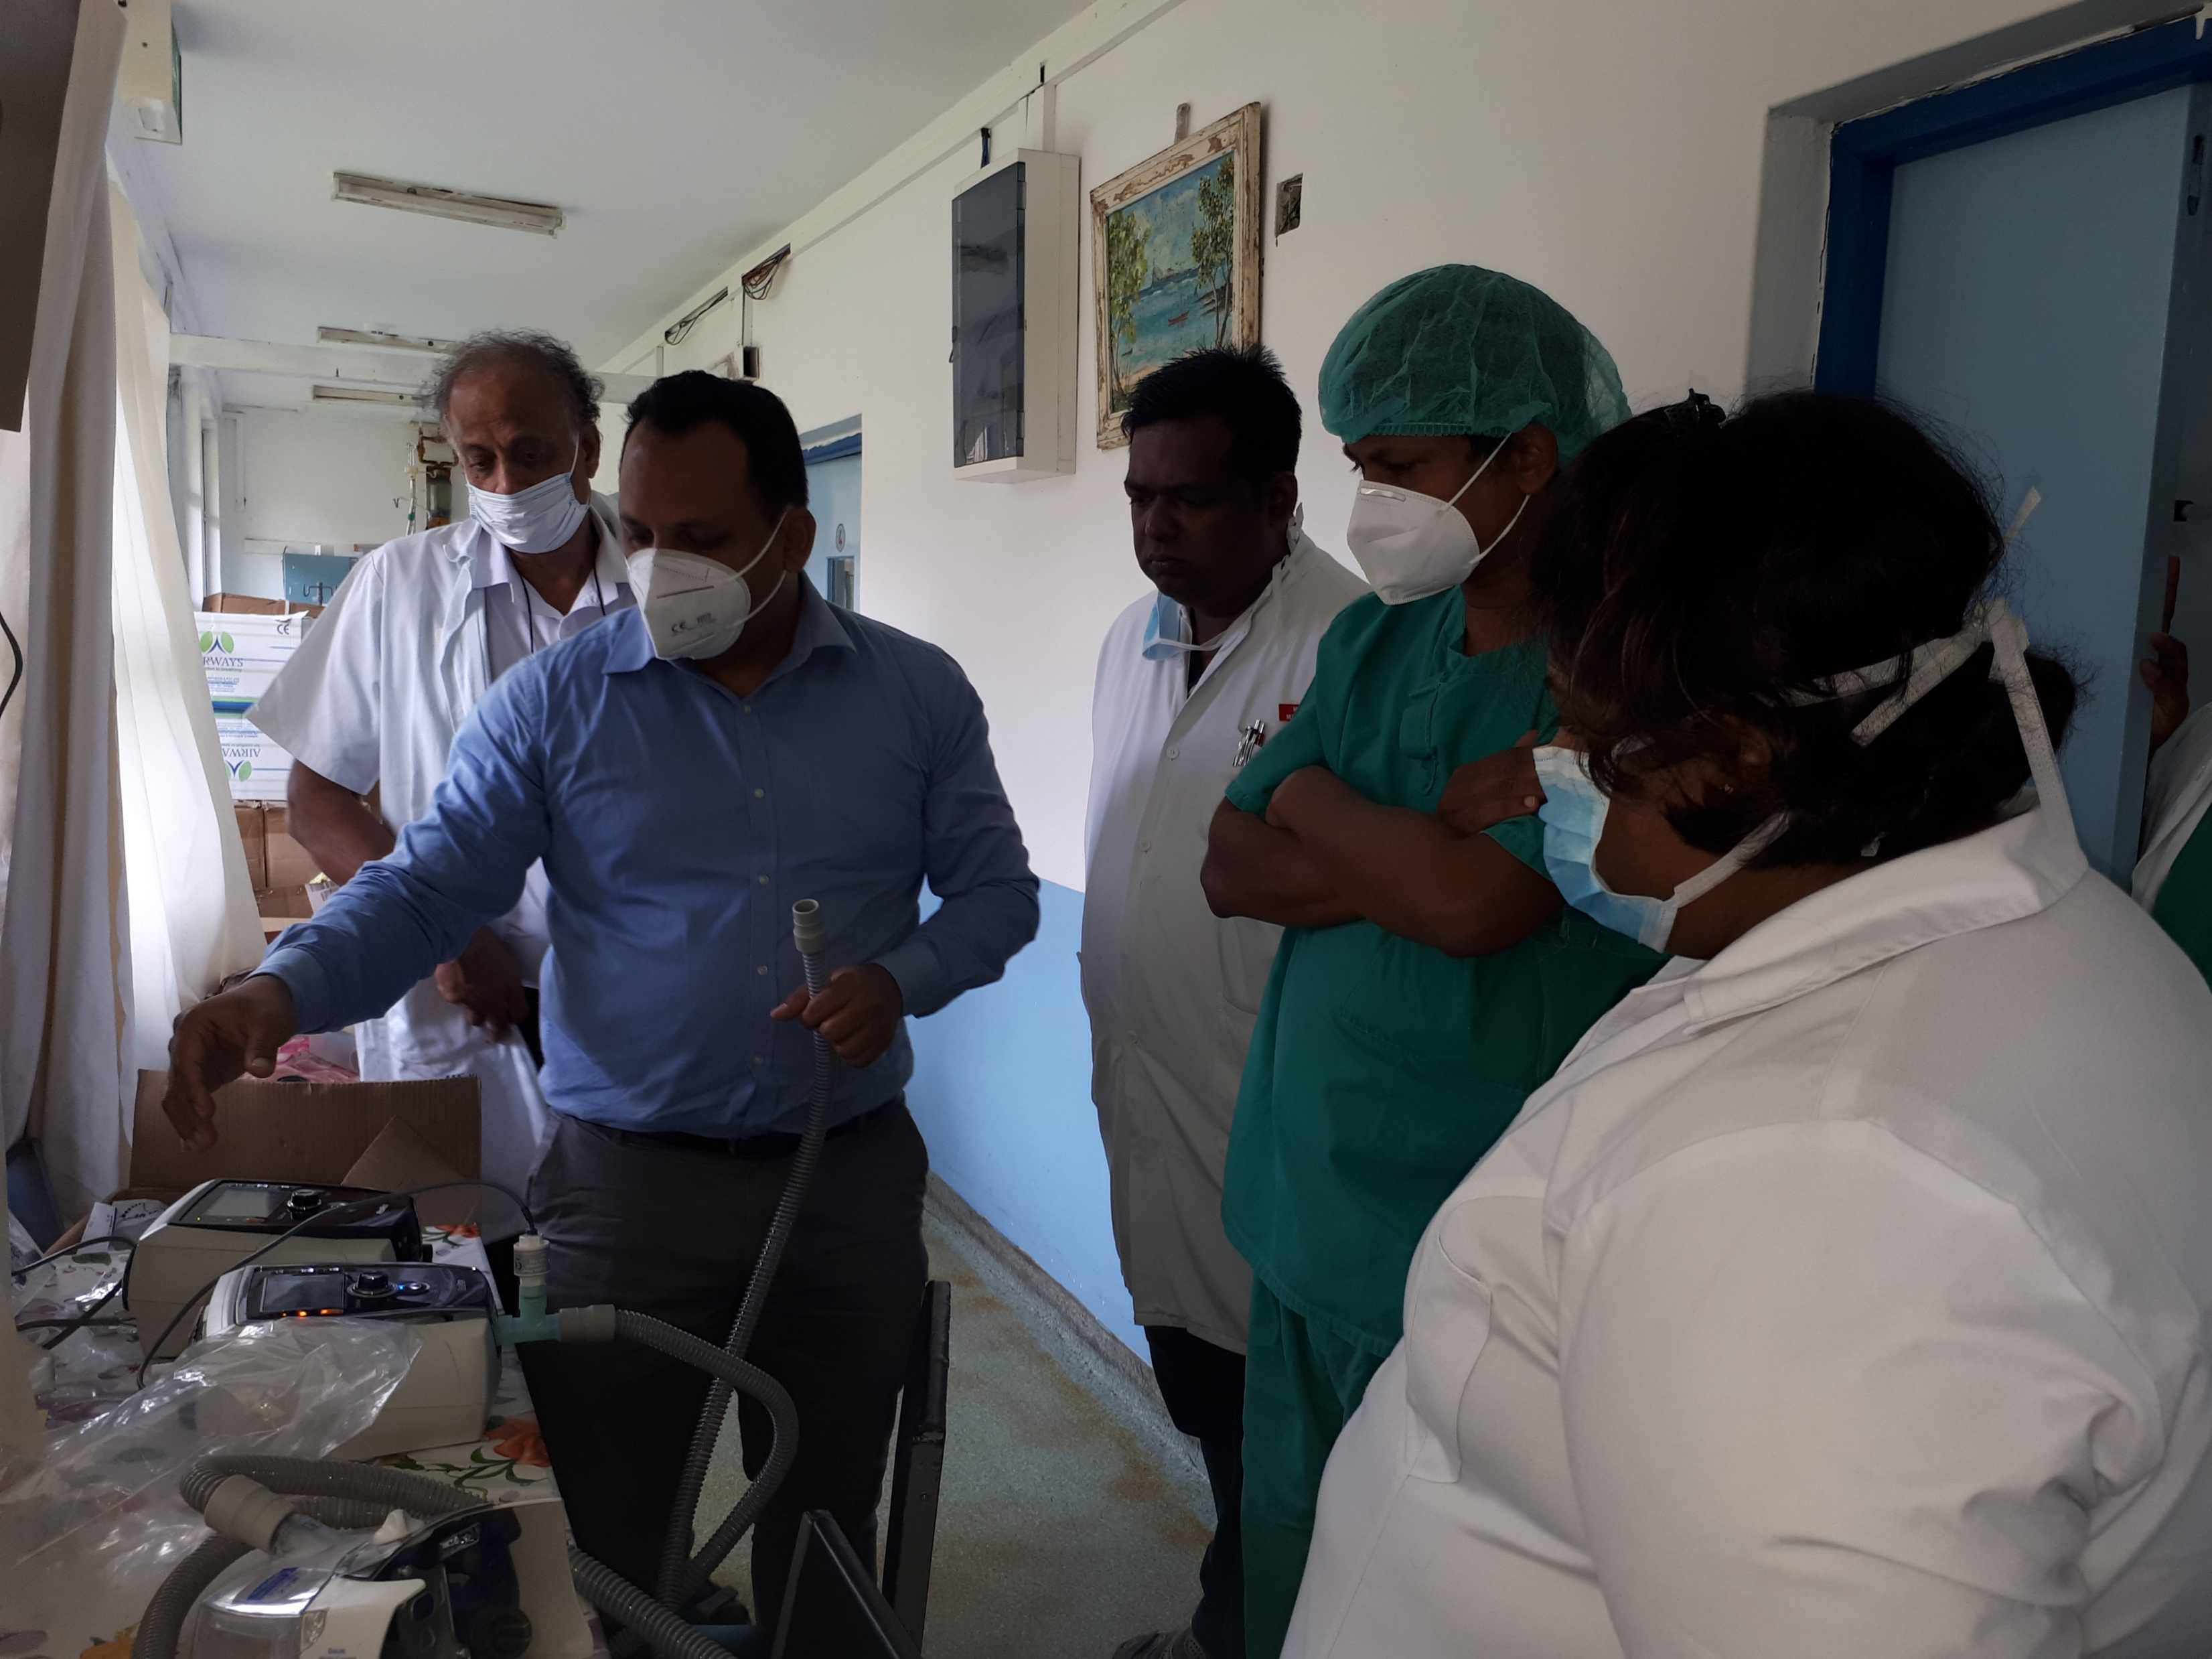
Vocational Training Teams
are groups of professionals who travel abroad either to teach local professionals about a particular field or to learn more about their own.
Teams can be funded by district grants and global grants.
Visit: www.rotary.org/grants

Slide 15
More Resources
The Rotary Service newsletter, a bimonthly digital publication, keeps the family of Rotary informed about service, including:
Project ideas to apply professional skills through service projects;
Supporting the professional development of individuals and communities in need;
Representing Rotary and promoting Rotary values in the workplace
Subscribe: www.rotary.org/newsletters
The Rotary Service in Action blog features weekly stories, resources, and best practices for community, international and vocational service.
Follow us: www.rotaryserviceblog.org/blog
Vocational Service in Action is a handy guide with information, resources, and project ideas related to vocational service.
Find inspiration, project partners, and share about your completed projects on Rotary Showcase.
Learn about organizing a vocational training team to conduct training and build capacity in collaboration with Rotary members in others of the world through Vocational Training Teams.

Slide 16
Support
Your district community service committee chair, appointed by your district governor, coordinates and promotes vocational service activities within the district.
Your district international service committee chair, appointed by your district governor, coordinates your district’s resource network of local experts who lend their professional expertise to local clubs as they plan related service projects.
Check your district’s website or with your district governor to identify both district leaders. Contact Rotary staff at rotary.service@rotary.org with questions.

Slide 17
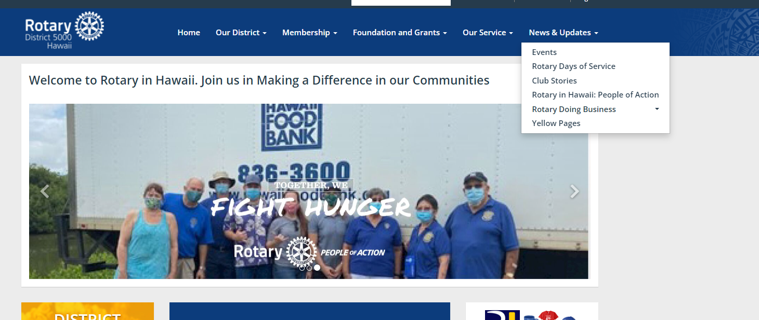
District directory and
Yellow pages

Slide 18
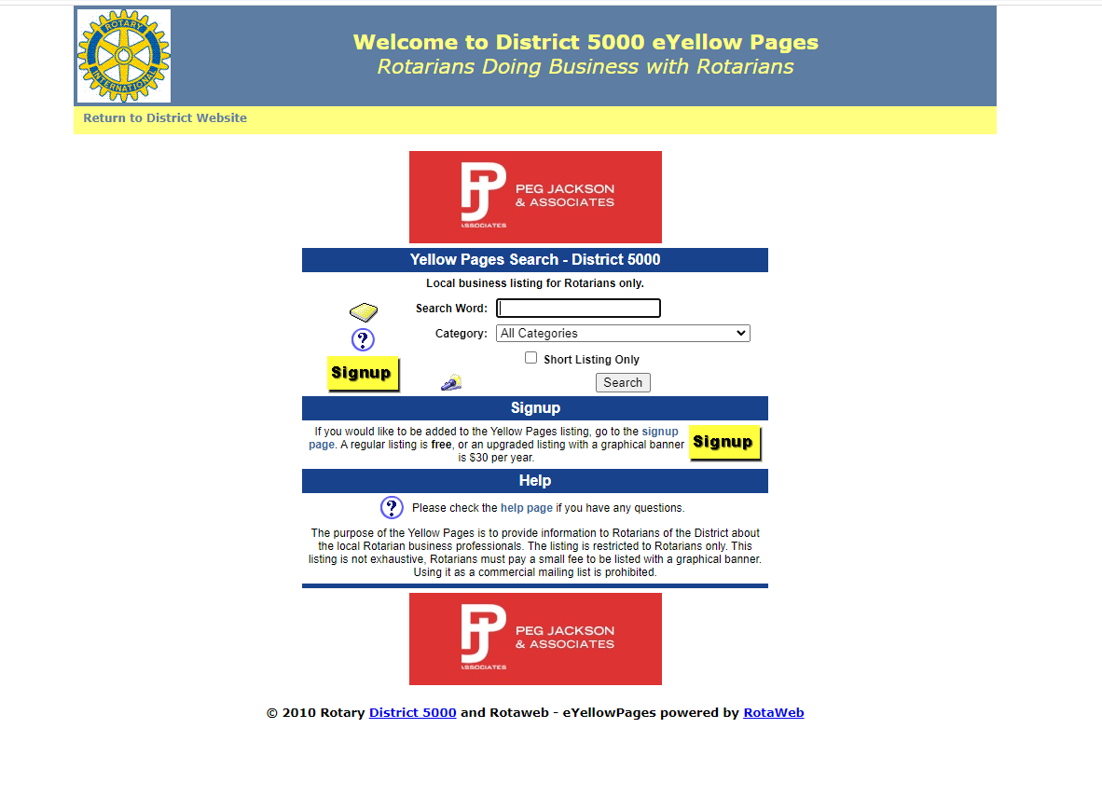
Rotary yellow pages- free to list
$30 for a banner

Slide 19

Vocational Service in Action Handbook
Notes:
Find this on rotary.org

Slide 20
Rotary D5000 - ‘PEOPLE OF ACTION’ – Vocational Service
Let’s Have Some FUN!
Mahalo!

