Slide 1
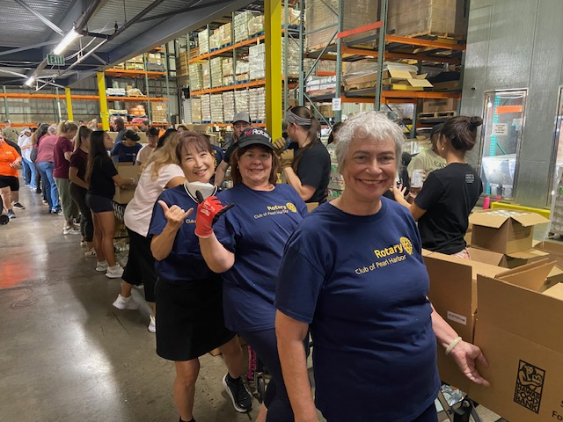
WELCOME TO ROTARY
DISTRICT 5000 HAWAII
Title Page Option

Slide 2

Title Page Option

Slide 3
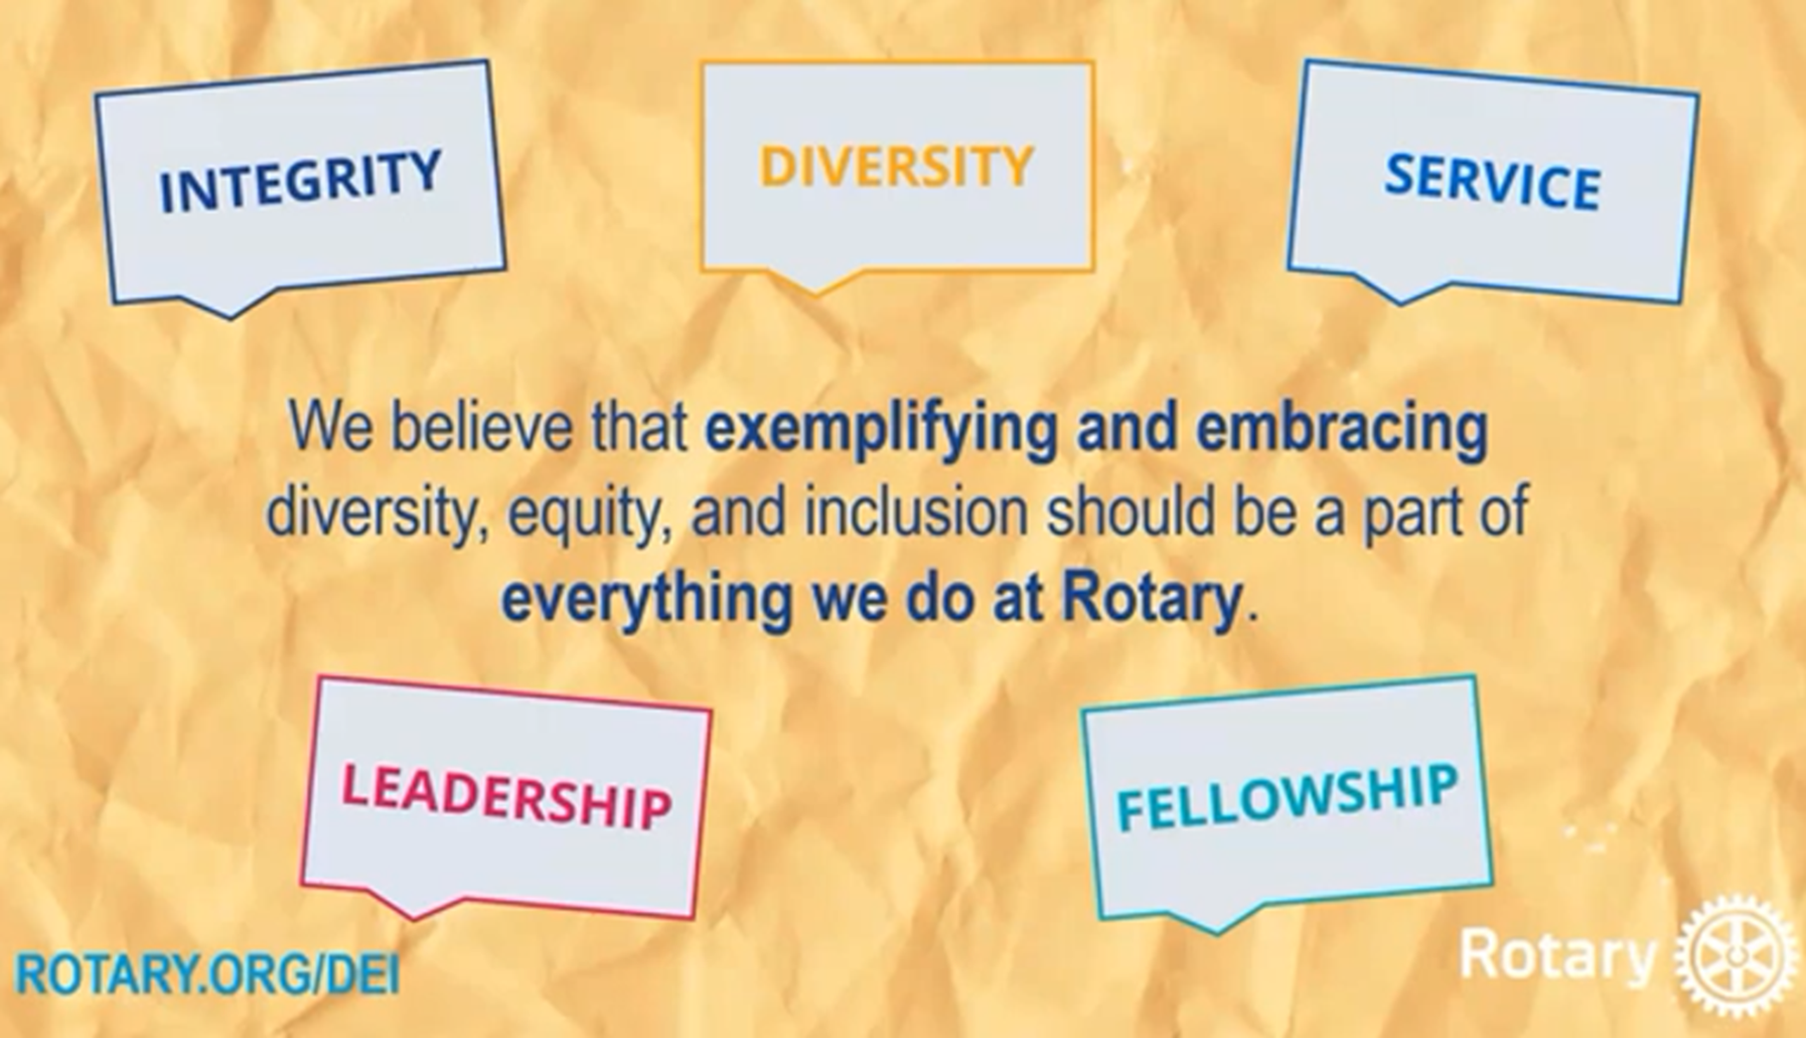
OUR CORE VALUES

Slide 4
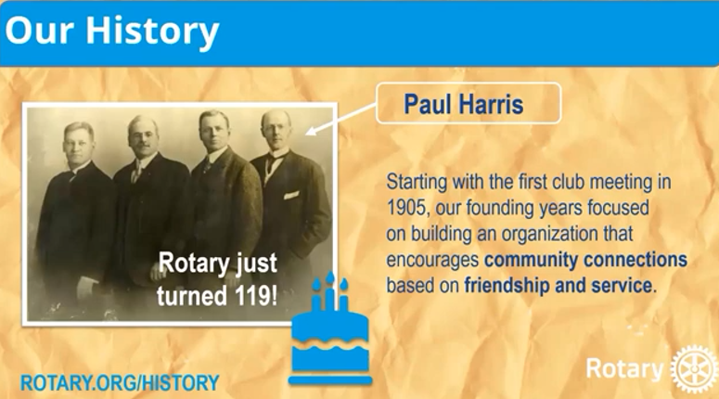
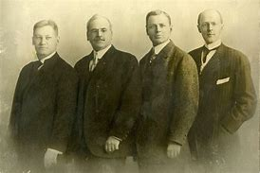



ROTARY WAS STARTED IN 1905
in Chicago by an attorney named Paul Harris
Title Page Option

Slide 5
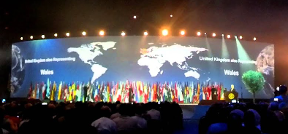
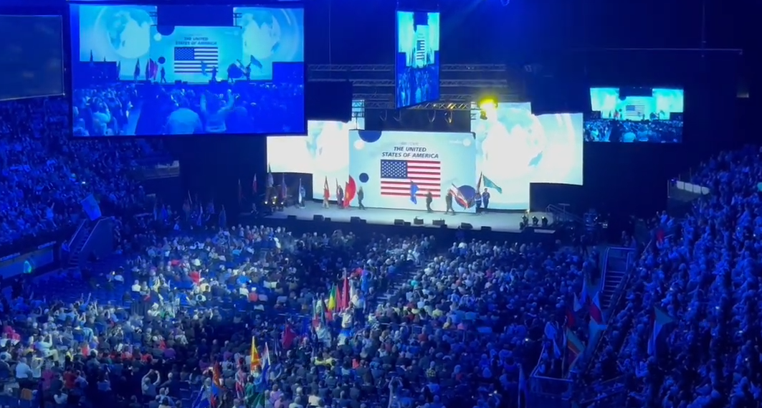
ROTARY IS AN INTERNATIONAL SERVICE ORGANIZATION
Title Page Option

Slide 6
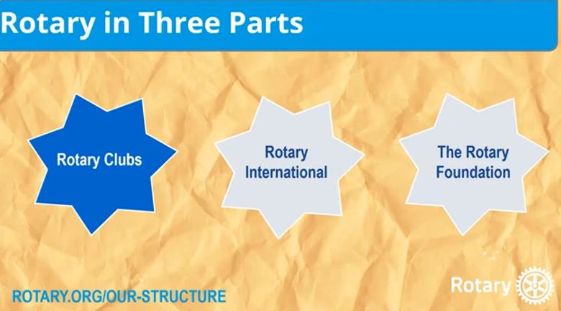

Slide 7

The Stats – Rotary international
46,000 Rotary Clubs
1,200,000 Rotary members
10,000 Rotaract Clubs
183,00 Rotaractors
14,911 Interact Clubs
342,953 Interactors
520 Districts
34 Zones
200 Countries

Slide 8
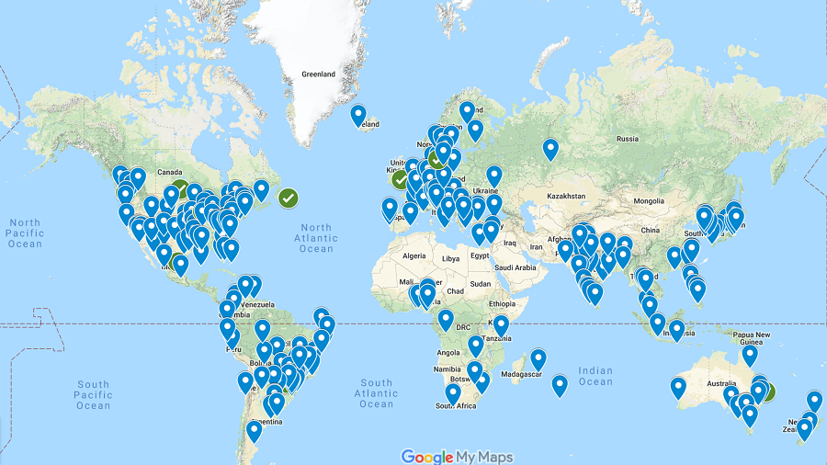
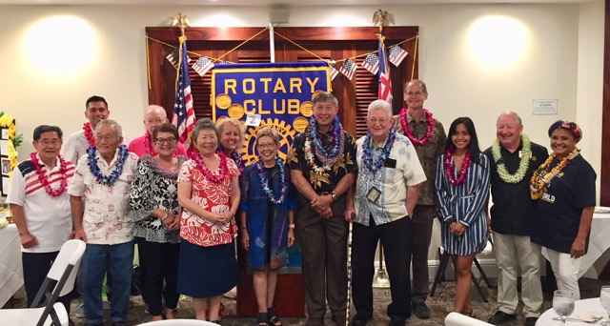
WE ARE A NETWORK OF 46,000 CLUBS AROUND THE WORLD IN 200 COUNTIRES
Title Page Option

Slide 9
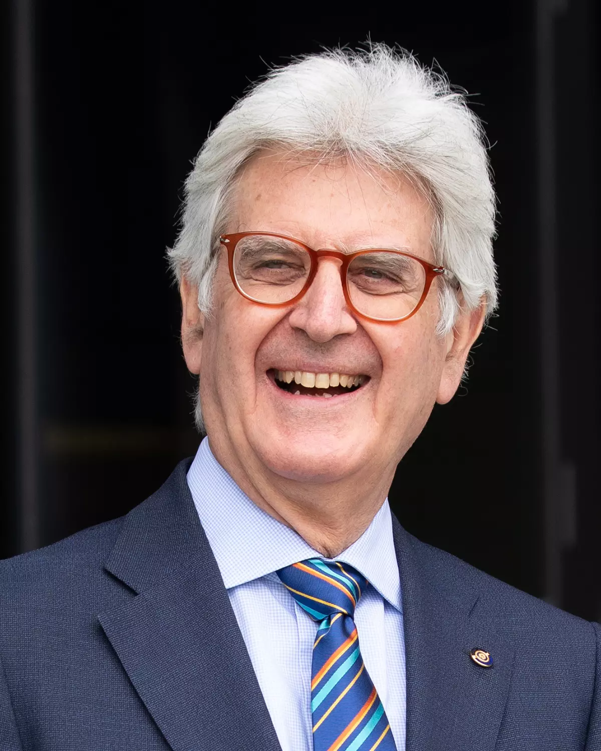
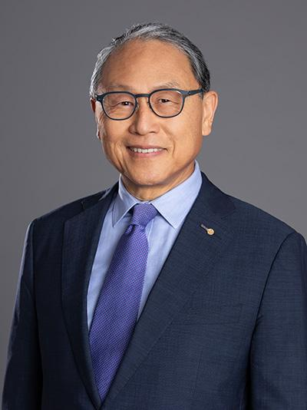
Rotary International President
Francesco Arezzo
President 2025-26
Rotary Club of Ragusa
Italy
Sangkoo Yun
President 2026-27
Rotary Club of Sae Hanyang
Seoul, Korea

Slide 10

Rotary International Presidential message for 2025-2026
Unite for Good by embracing growth, service, and connection. Rotary’s greatest asset is not our history, our projects, or even our unmatched global reach. Let’s seek out new perspectives and strengthen Rotary’s service to communities around the globe. Our essential pillars are innovation, continuity, and partnership.

Slide 11
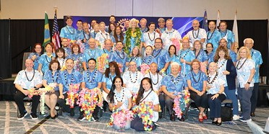
We are rotary district 5000
Title Page Option

Slide 12
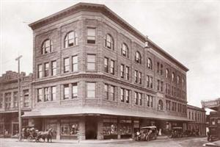
THE FIRST ROTARY CLUB
IN HAWAII WAS CHARTERED
IN 1915 WITH 29 MEMBERS
Title Page Option

Slide 13

District 5000 – Hawaii stats
1,350 Rotarians
49 Clubs, including 2 E-clubs (online)
1 Rotaract Clubs (from age 18)
36 Interact Clubs (12-18 years old)
2 Community Corps

Slide 14
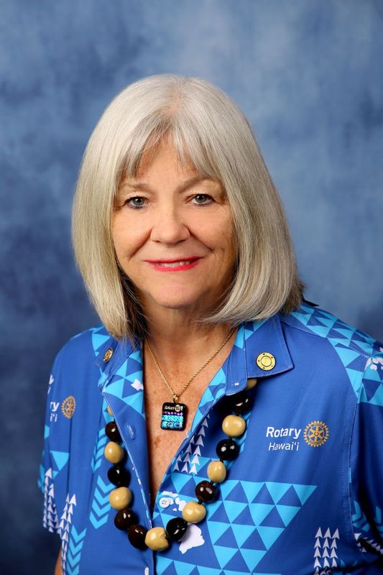
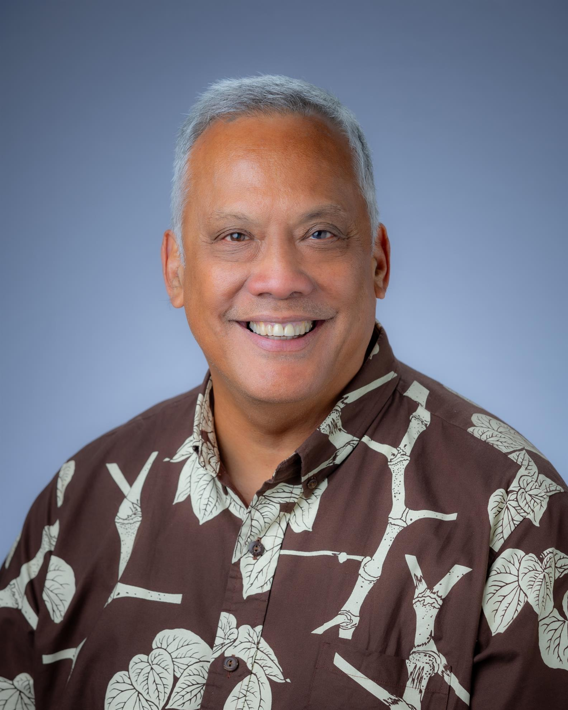
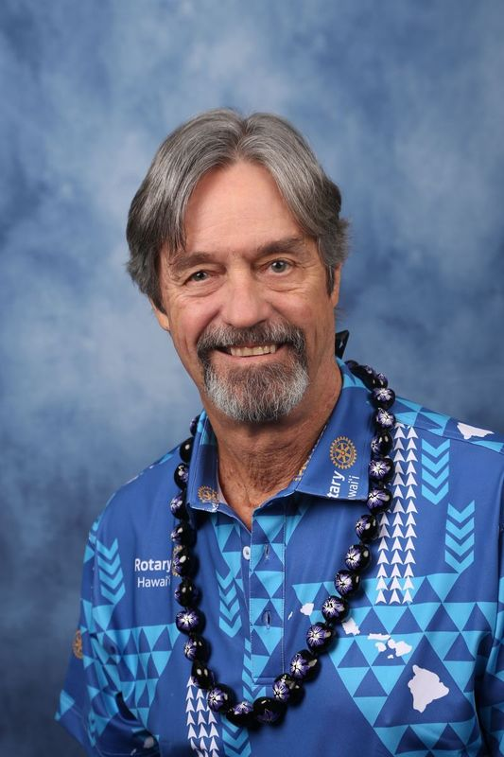
District 5000 Leadership
Nancy Cabral Benson Medina Rich Proctor
District Governor District Governor Elect District Governor Nominee
Rotary Club of Hilo Rotary Club of South Hilo Rotary Club of Honolulu

Slide 15
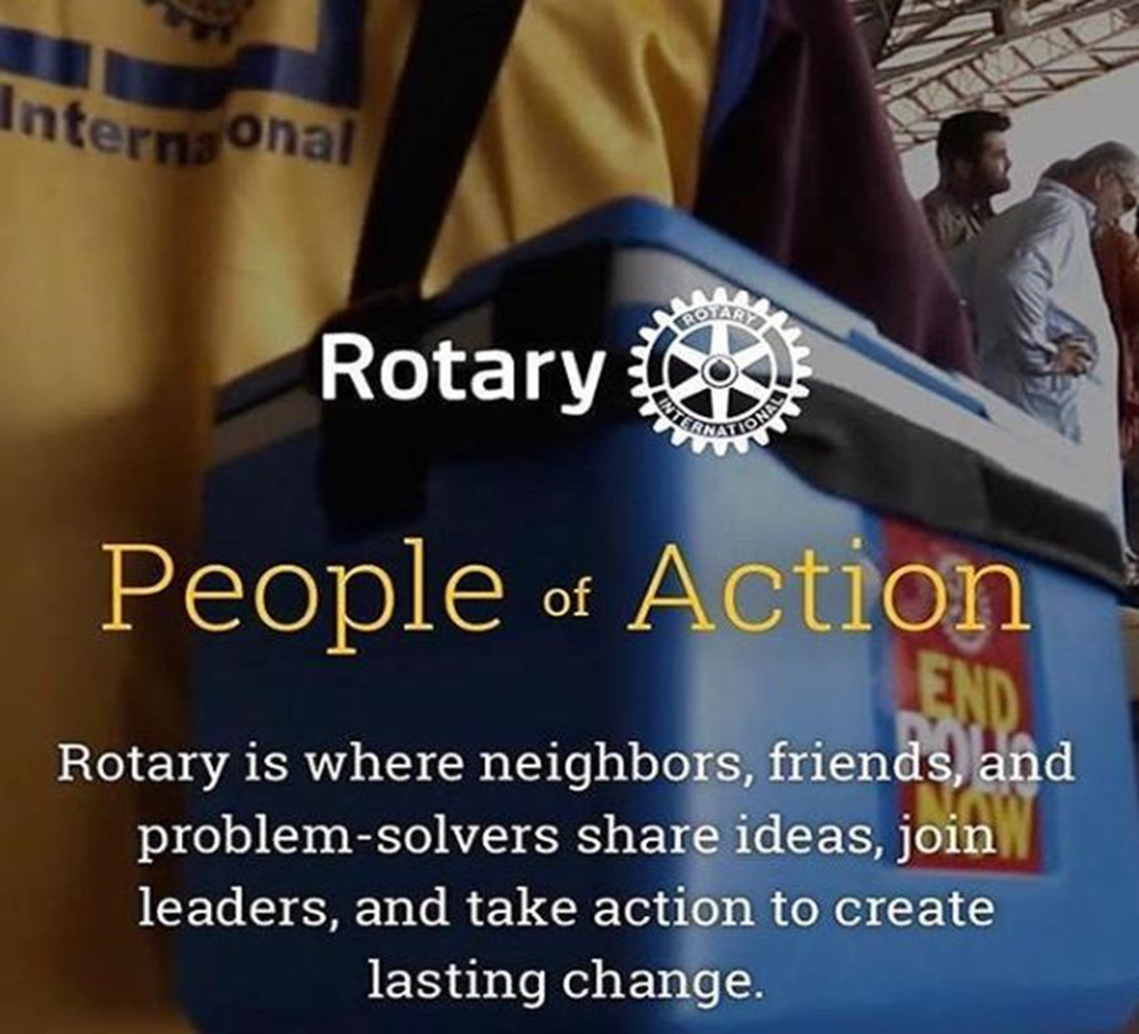

WHAT DO ROTARIANS DO?

Slide 16
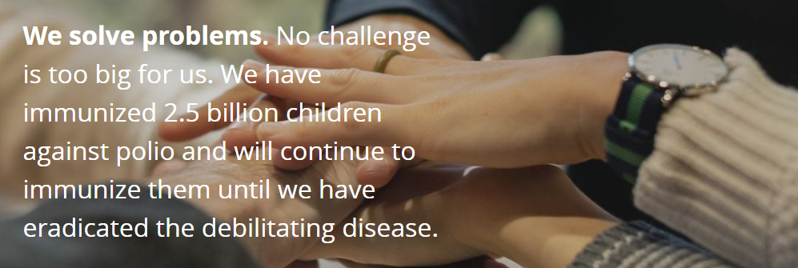

Slide 17
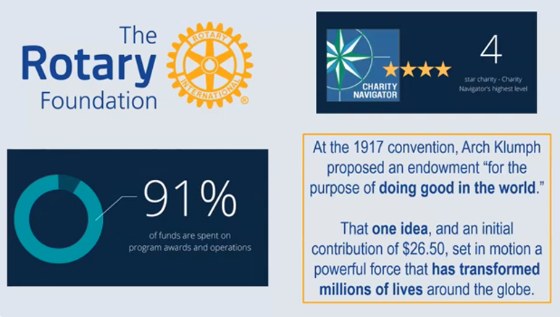

Slide 18

2023-24 GRANT STATISTICS
District grants
485 grants
$30 million
Global grants
1,285 grants
$ 82 million
Disaster response grants
105 grants
$ 4 million
Programs of scale grants
$ 2 million
Notes:
Benson

Slide 19
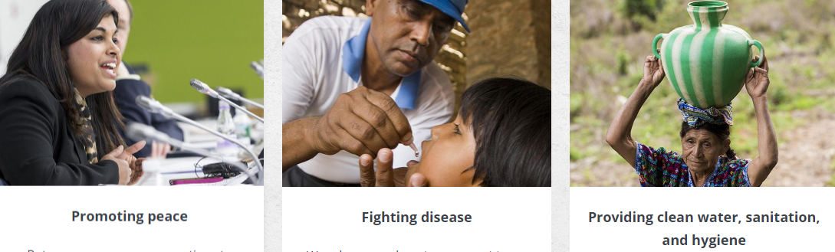

Seven Areas of Focus

Slide 20

Rotary’s seventh area of focus:
The environment
subhead
More than $18 million in Foundation global grant funding has been allocated to environment-related projects over the past five years.
Notes:
We each have our own interests and activities and clubs bring value to Rotarians, not only from the satisfaction of helping others, but with the friendships. We are starting groups with common interest, such as an ecology/climate change group. By the way, The Environment was recently added as the 7th area of focus for Rotary.

Slide 21
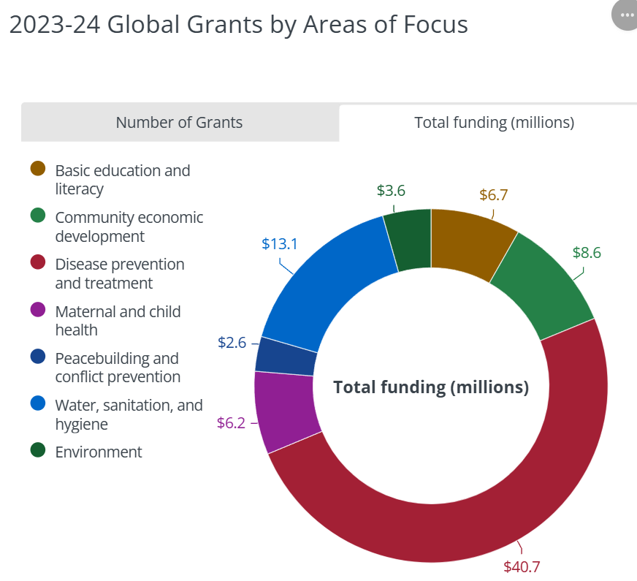

Slide 22
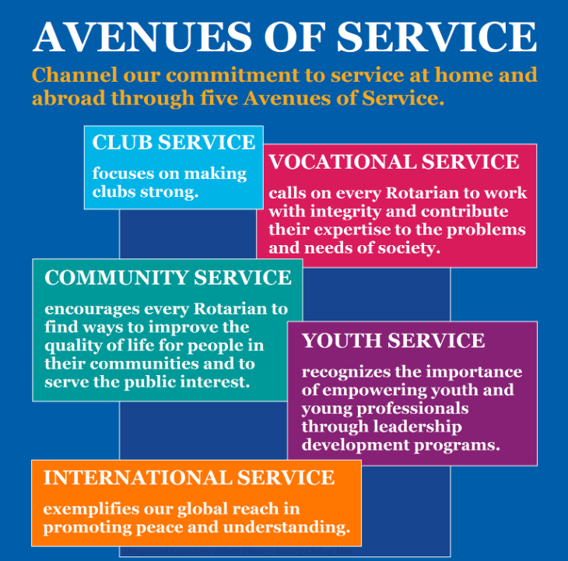

Slide 23

Hawaii Rotary Youth Foundation (HRYF)
The Hawaii Rotary Youth Foundation (HRYF) was founded by Maurice J. “Sully” Sullivan during his year as District Governor in 1976-77. It was Sully’s desire to assist Hawaii’s high school graduates to realize their potential by attending a college of their choice here in Hawaii or on the mainland United States.
Last year, each of the participating clubs awarded a $5,000 scholarship. HRYF gave out $270,000 in scholarships last year.

Slide 24

WHAT’S IN IT
FOR YOU?
Title Page Option

Slide 25
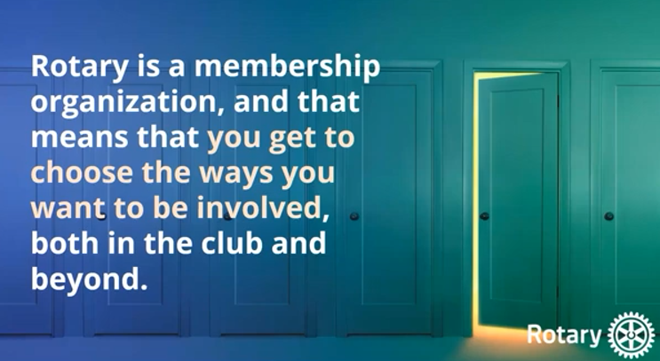

Slide 26
The Benefits of Rotary Membership
Opportunities to serve your community through planning/implementing projects
Make lasting friendships beyond your club
The International convention is a unique and memorable experience
Professional development. Free online courses are available
Business development networking opportunities are endless
District 5000 eYellow Pages, Rotarians Doing Business with Rotarians.
Hawaiian Airlines Preferred Affiliate Program
Rotary Fellowships
Rotarian Action Groups
Friendship Exchange

Slide 27
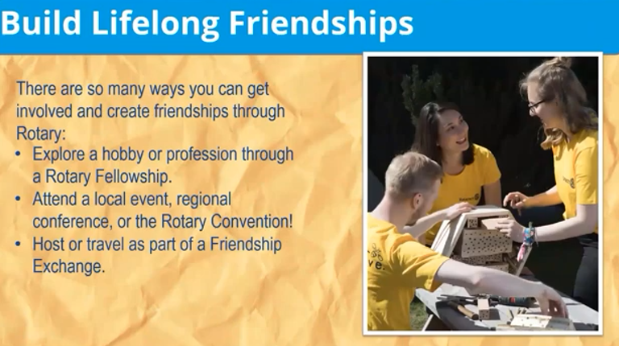

Slide 28
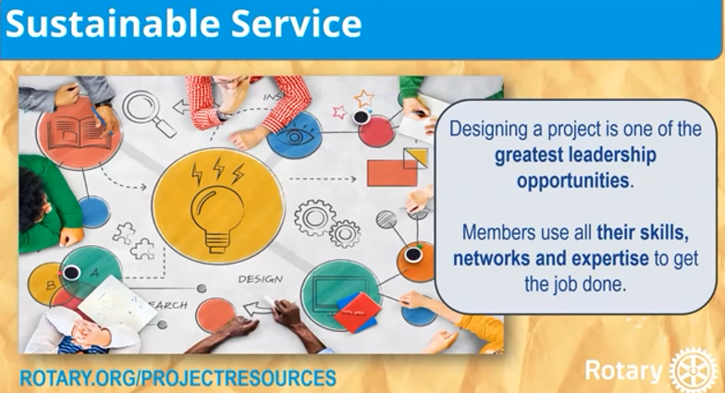

Slide 29


Slide 30
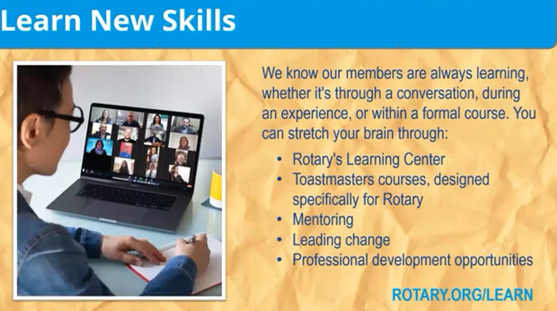

Slide 31
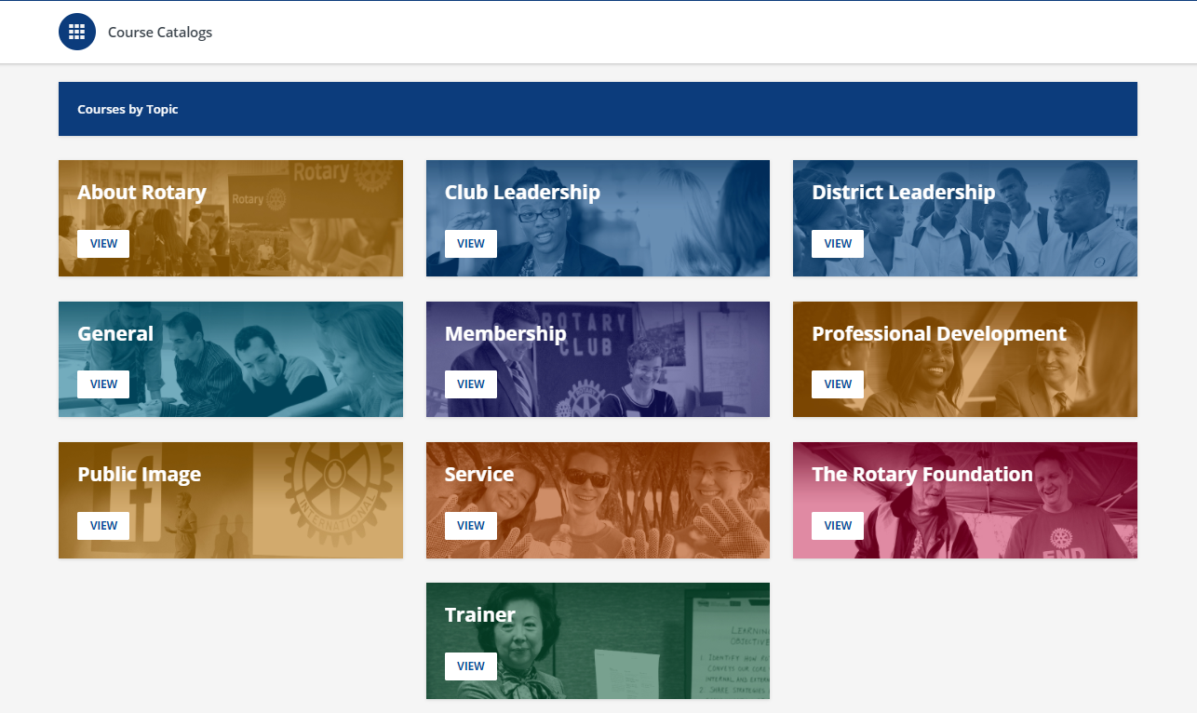
Courses for Everyone (rotary.org)

Slide 32
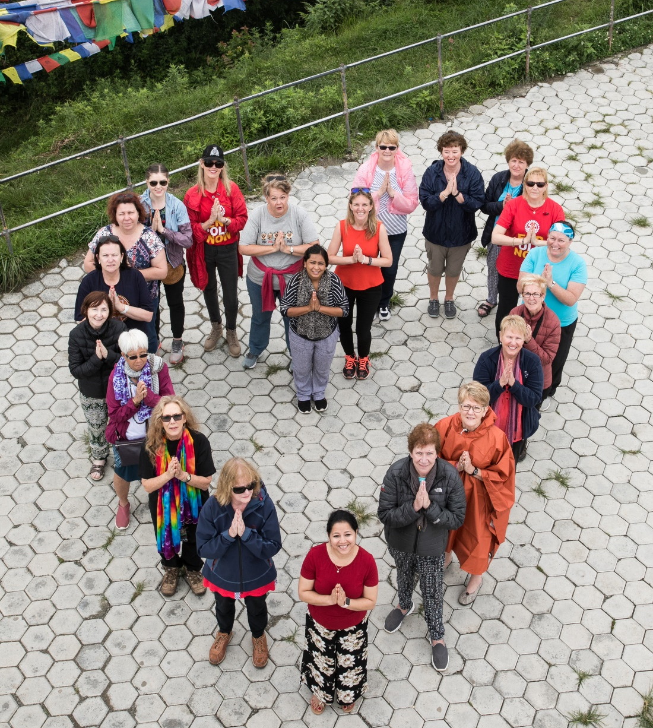
What are rotary fellowships?
Groups of any interested individuals who connect to explore shared interests in:
Recreational Activities
Hobbies
Sports
Vocations
Rotary History & Culture
Notes:
Rotary Fellowships are international, independently organized groups of any interested individual who share a common hobby, recreational interest, or profession. Rotary Fellowships give their members the opportunity to have fun, make new friends around the world, and enhance their experience in Rotary. Membership is open to any interested individual. The Fellowship are independent of Rotary International and cannot be used to promote religious or political beliefs or other organizations. Fellowships are self-sustaining financially and administratively. The Fellowships are not covered by RI insurance. Some Fellowships allow non-Rotary members to join.

Slide 33



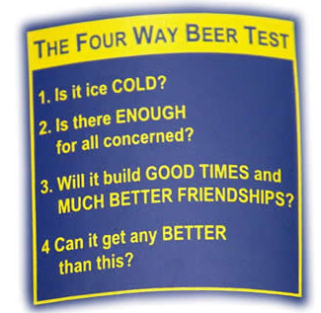






Examples of Rotary Fellowships
More than 100 Rotary Fellowships are now officially registered with Rotary International in 150+ countries
Notes:
Many fellowships also use their special interests to serve others. For example, the Fellowship of Canoeing Rotarians has organized cleanups of polluted rivers; members of the International Computer Users Fellowship of Rotarians have hosted training sessions for Rotarians and the general public; and members of the International Fellowship of Rotarian Scuba Divers join local Rotary clubs to undertake service projects on each of their diving trips.

Slide 34
Why join a Rotary Fellowship?
Rotary Fellowships consist of members who share a common interest in recreational activities, sports, hobbies, or professions. These groups help expand skills, foster vocational development, and enhance the Rotary experience by exploring interests while developing connections around the world.
Help participants make lasting friendships outside their own club, district, or country
Advance Rotary’s public image and identity
Serve as an incentive for joining Rotary and for maintaining active membership
https://www.rotary.org/en/our-programs/more-fellowships
Notes:
Rotary Fellowships are international, independently organized groups of any interested individual who share a common hobby, recreational interest, or profession. Rotary Fellowships give their members the opportunity to have fun, make new friends around the world, and enhance their experience in Rotary.

Slide 35
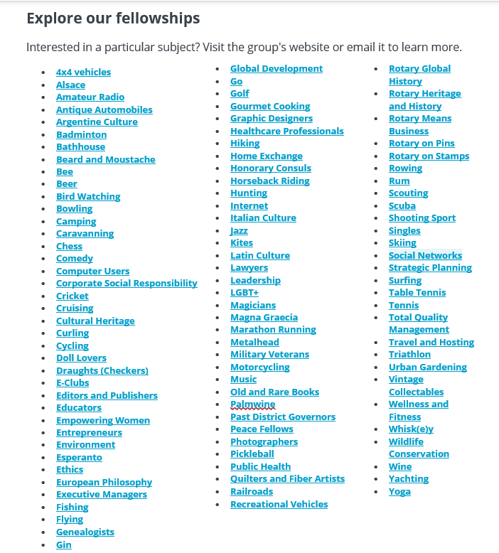

Slide 36
Rotary Action Groups (RAGs) my.rotary.org/en/rotarian-action-groups

Slide 37
What is a Rotarian Action Group?
A Rotarian Action Group is an autonomous group of Rotarians, family members, program participants and alumni who are experts in a particular field, such as microcredit or water and sanitation. Group members share their expertise by collaborating with clubs and districts on service projects.
Join a Rotarian Action Group to share your expertise and make a difference in projects beyond your club or district.

Slide 38
RAGs Statistics
27 RAGs currently recognized by Rotary
34,000+ RAG members reported worldwide
2400 Service Projects
150+ countries represented by RAG members

Slide 39
RAGs by Rotary’s Areas of Focus: my.rotary.org/en/rotarian-action-groups
Promoting Peace
Domestic Violence Prevention
Peace, Refugees, Slavery Prevention
Fighting Disease
Addiction Prevention
Alzheimer’s/Dementia
Blindness Prevention
Blood Donation
Diabetes
Family Health/AIDS
Health Education and Wellness
Hearing
Hepatitis
Malaria
Mental Health
Multiple Sclerosis
Polio Survivors
Providing Clean Water & Sanitation
Water, Sanitation and Hygiene
Menstrual Health and Hygiene
Saving Mothers & Children
Clubfoot
Reproductive Maternal and Child Health
Supporting Education
Basic Education and Literacy
Growing Local Economies
Community Economic Developement
Disaster Assistance
Protecting the Environment
Endangered Species
Environmental Sustainability
Action Groups in more than one area
Environmental Sustainability
Food Plant Solutions
Notes:
Most RAGs view themselves not only as specific subject-matter resources, but as resources in an Area of Focus.
*The above list of RAGs per area of focus is self-identified.

Slide 40
THE ROTARY INTERNATIONAL CONVENTION
The Rotary International Convention takes place each May or June and welcomes all members and their families. It’s generally held in a different world city each year and is attended by 15,000 to 40,000 people. The convention is an opportunity to celebrate Rotary and to network and connect with Rotarians from around the world. Future conventions:
2025 - Calgary
2026 - Taipei
2027 - Dubai
2028 - Minneapolis

Slide 41
Websites for more information
District Website: rotaryd5000.org
Rotary International: rotary.org

Slide 42


Slide 43
QUESTIONS

