Slide 1
Protecting Our Youth
DISTRICT 5000
COMPLIANCE
Peter Evans
Youth Protection Officer
District 5000

Slide 2
subhead
OUR AGENDA
Introduction
Youth Protection Overview
Compliance
Risk Management
Best Practices/Key Takeaways
Questions?

Slide 3
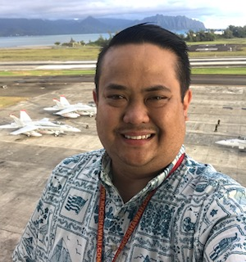
Intro
Peter Evans member of Eco Rotary Kakaako
Your Youth Protection Officer Rotary District 5000
Been the Youth Protection Officer 2016,2020,2021,2022
Started work in Youth Services with Honolulu Rotary 2015-2017
25 years of Risk Management Experience in General liability and Occupational Safety and Health
Currently Deputy Director for Installation Safety appointed as the Risk Manager for Marine Corps Base Hawaii
Two beautiful daughters Sasha and Tiarra (Rotarian), and my beautiful wife of 26 years, Camille.

Slide 4
subhead
Keep our keiki safe!
WHY DO YOU CHOOSE TO WORK WITH YOUTH?

Slide 5
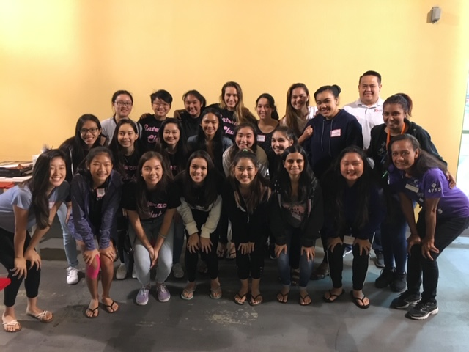
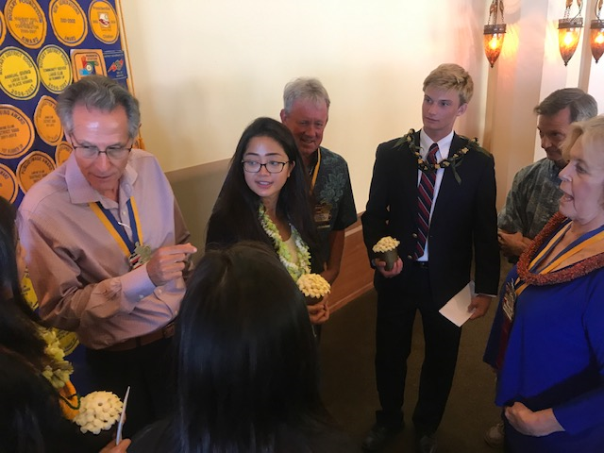
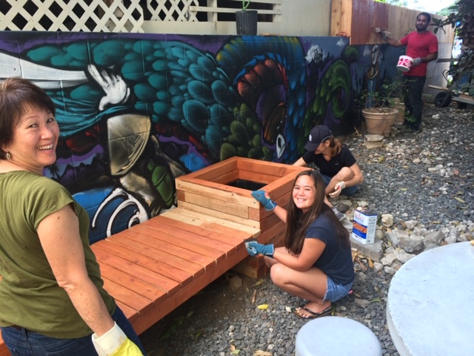
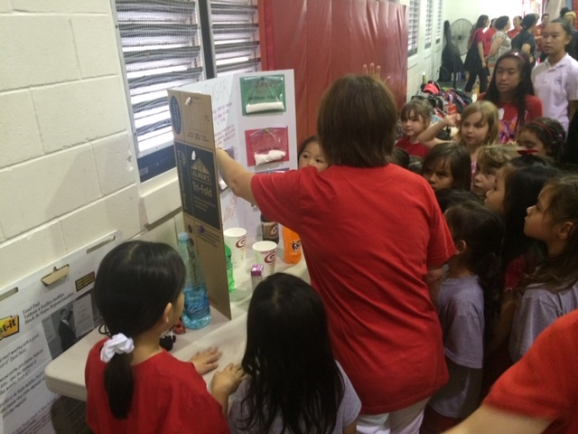
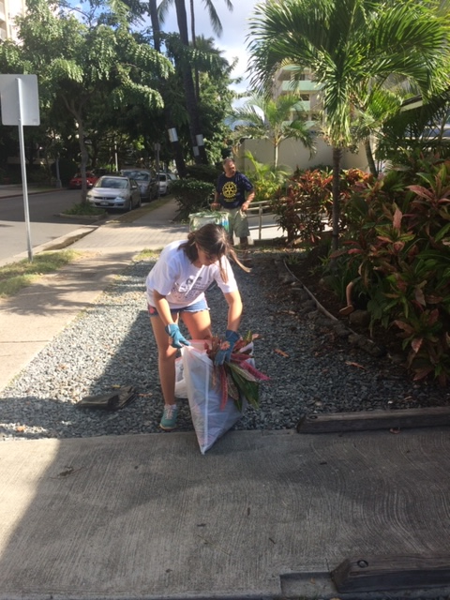
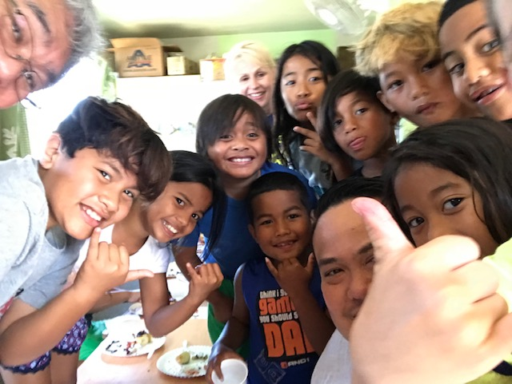
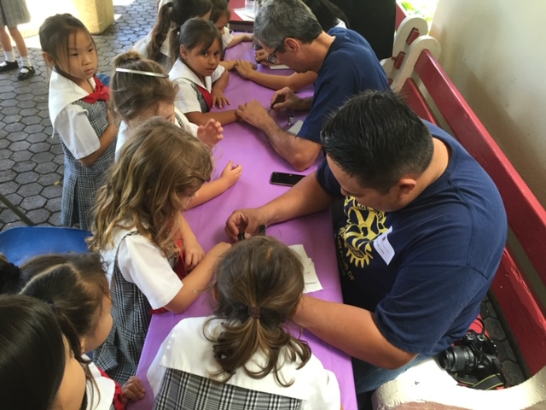
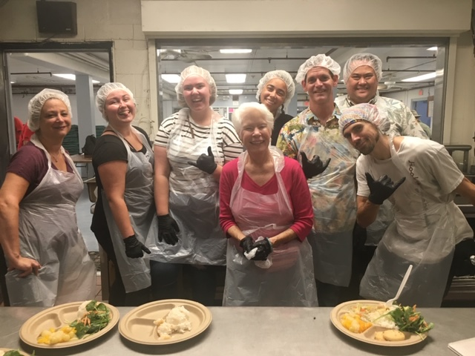
The Things We Do
Youth Services bring many opportunities to help shape the youth within our communities.

Slide 6

Rotary Youth Protection Guide
Utilize the Rotary Youth Protection guide for guidance in ensuring your club is compliant with standards
Guide should be used for initial or refresher training as well as a resource.
Guide can be found online in the D5000 website under the youth services page.
https://clubrunner.blob.core.windows.net/00000060108/en-ca/files/sitepage/youth-services/youth-protection-guide/youth-protection-guide.pdf

Slide 7

ROTARY INTERNATIONAL
DISTRICT 5000
POLICY MANUAL
Utilize the Rotary International District 5000 Policy Manual as your governing document for local policy
Manual should be used for initial and refresher training as well as a resource
This manual can be found online in the D5000 website
This manual contains everything you need to ensure compliance
https://rotaryd5000.org/documents/en-ca/69a98996-d472-4f87-96ed-8420b0a8babb/1

Slide 8
AWARENESS AND PREVENTION
RECOGNIZING ABUSE and HARASSMENT
Be aware of the signs of abuse or harassment
Be observant, when a youth is known to be cheery and suddenly becomes detached, that may be a sign of a problem.
Don’t over analyze but be aware. Sometimes changes of behavior may just be due to homesickness, cultural adjustment, etc.
STATEMENT of CONDUCT for WORKING WITH YOUTH:
Rotary International strives to create and
maintain a safe environment for all youth who
participate in Rotary activities. To the best of
their ability, Rotarians, Rotarians’ spouses and
partners, and other volunteers must safeguard
the children and young people with whom
they come into contact and protect them from
physical, sexual, and psychological abuse.
Abuse and Harassment of young people can go unaddressed when adults fail to recognize them.
Youth protection depends on awareness of the possibility of abuse and harassment and vigilance in guarding against it.

Slide 9
Our heart is with Keiki but our minds are with compliance
Club Presidents, Club Program Chairs, and Other Club Officers have overall responsibility for operating and coordinating club youth activities to include integrating youth protection policies.
Club Executives should:
Know all Rotary and District Youth Protection Policies
Implement required training, screening, program logistics, and risk management procedures
Engage regularly with youth program participants to get feedback on programs
Report all allegations of abuse, harassment, and other crises to YPO, who will in turn disseminate information to proper District level leaders. Utilize the 5 W’s and ensure that one person gathers the facts and reports right away.

Slide 10
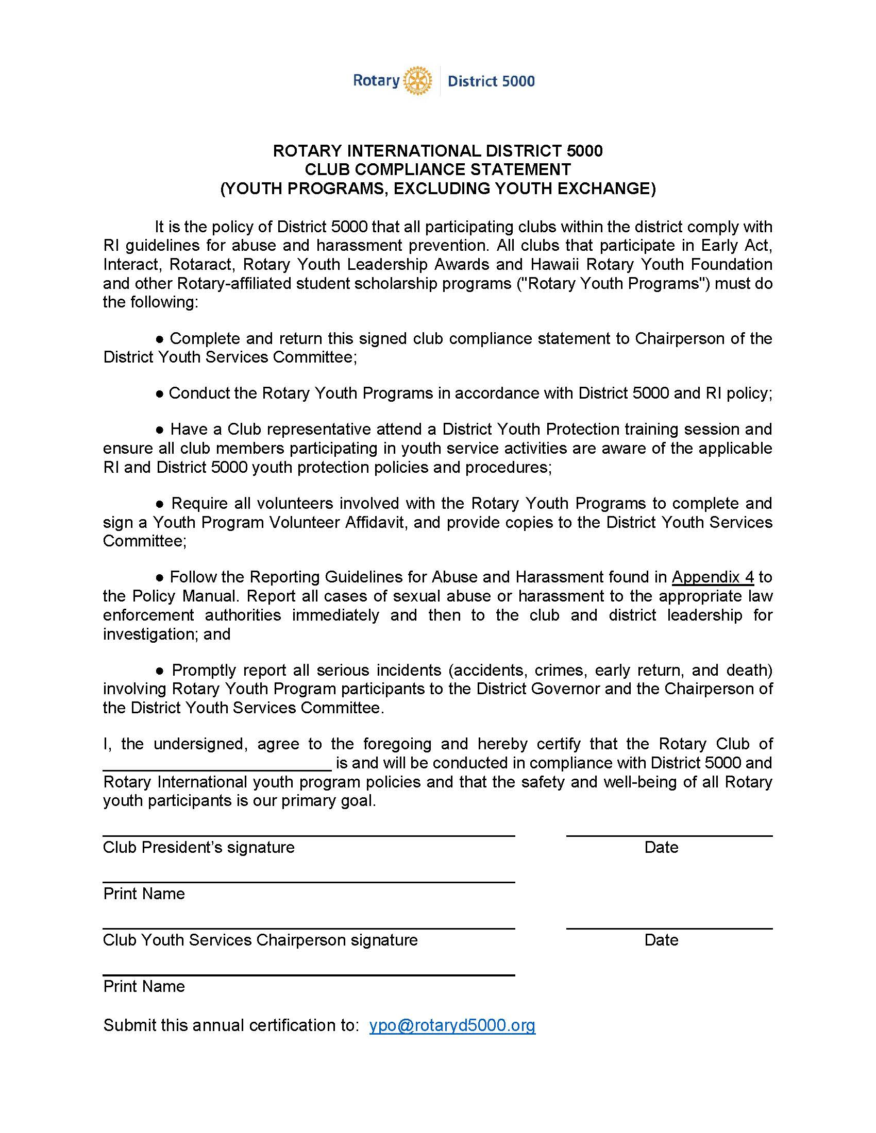
Compliance form
Every club to review and sign this form attesting to your club’s youth program compliance
Form can be found in D5000 website or though link below.
Send completed forms to YPO@Rotaryd5000.org
https://view.officeapps.live.com/op/view.aspx?src=https%3A%2F%2Fclubrunner.blob.core.windows.net%2F00000060108%2Fen-ca%2Ffiles%2Fsitepage%2Fyouth-services%2Fclub-compliance-statement%2FYouth-Service-Club-Compliance-Certification.docx&wdOrigin=BROWSELINK

Slide 11
Volunteer Selection and Screening
Utilize a Youth Program Volunteer Application form, found in the youth services website.
Interview
Reference checks
Criminal Background Checks
Home Visits (host families for Youth Exchange)
YOUTH PROTECTION PROCEDURES
District level policies and procedures that comply with Rotary Code of Policies and the Rotary’s Statement of Conduct for Working With Youth.
Volunteer Training
Training Specific to program role
Include abuse, harassment, and crisis prevention information.

Slide 12
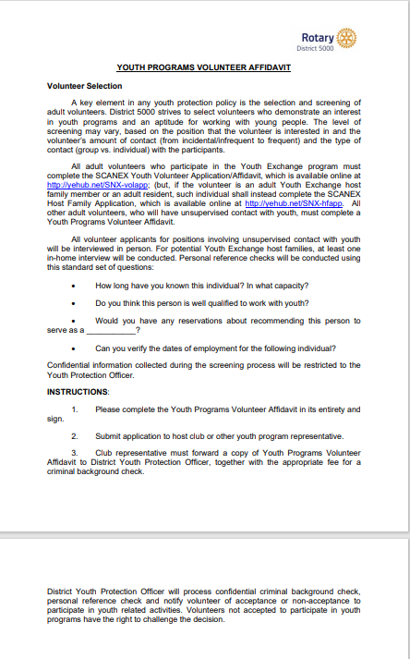
Volunteer
Affidavit
Utilize Youth Programs Volunteer Affidavit to screen volunteer applicants
This Affidavit can be found in the D5000 website as well as in the D5000 Policy Manual
Send completed affidavit to Youth Protection Officer after completion of the screening process
Records will be retained by YPO for a period of 3 years after creation.
https://rotaryd5000.org/Documents/en-ca/98654a27-2635-4827-92b1-d5a576e5de99/1

Slide 13
Background Checks
Conducted by IntelliCorp. Reputable organization committed to conducting thorough background checks while keeping your information safe.
How to obtain a background check?
1) Email Natasha at : natashaclarin777@gmail.com the following information: Name, email address, home zip code, city, county.
2) Wait for an email invitation from ypo@rotaryd5000.org ("ypo"=Youth Protection Officer") and use the link to go to IntelliCorp's website.
3) Follow the instructions for submitting your information and paying online. Fee is $14.96 to $20.90.
Good for Two Years
Background checks are needed for any adult volunteer working with youth.
Any Volunteer awaiting results of a background check, a “one time volunteer”, or volunteer minor should be accompanied at all times during the event by a vetted volunteer.

Slide 14
Risk Management
The purpose of the risk management plan is to encourage our youth services to consider how they will provide for the safety of the youth in their care and how they will mitigate those risks.
By recognizing the unique challenges that are faced by minors, I have put together some points to consider when developing a Risk Management Plan specific to the safety of the youth involved with your clubs’ program.
Consider what risks are involved and put plans in place to eliminate that risk or reduce it to an acceptable level.
Does the risk outweigh the benefit??

Slide 15
Risk Management, continued
Some questions to consider for in person events:
What is the layout of the location and space where the program is being held? Is there anything in that space that could pose a danger to a minor?
How will the program ensure that a minor is not left alone at any time with an adult?
What are the supervisory ratios?
If the program is in a public place, what measures will you take to supervise minor participants?
How will the program handle volunteer or staff who are not Authorized Adults, but participating in the program on a temporary basis?
How will the minors be dropped off and picked up? Will there be a list of people authorized to pick up the minor? Will there be a check-in/check-out process?

Slide 16
Technology
ONLINE SAFETY
ZOOM meetings or similar platforms are common, be aware of storing information or pictures or youth, especially on a personal computer.
Each program should consider potential risks and develop policies to address them.
Review the Electronic/Online safety considerations PDF that was published by Rotary International.
http://msgfocus.rotary.org/files/amf_highroad_solution/project_190/Youth_Exchange/Publications/Electronic-Online_Safety_Considerations/Electronic-Online_Safety_Considerations-EN.pdf

Slide 17
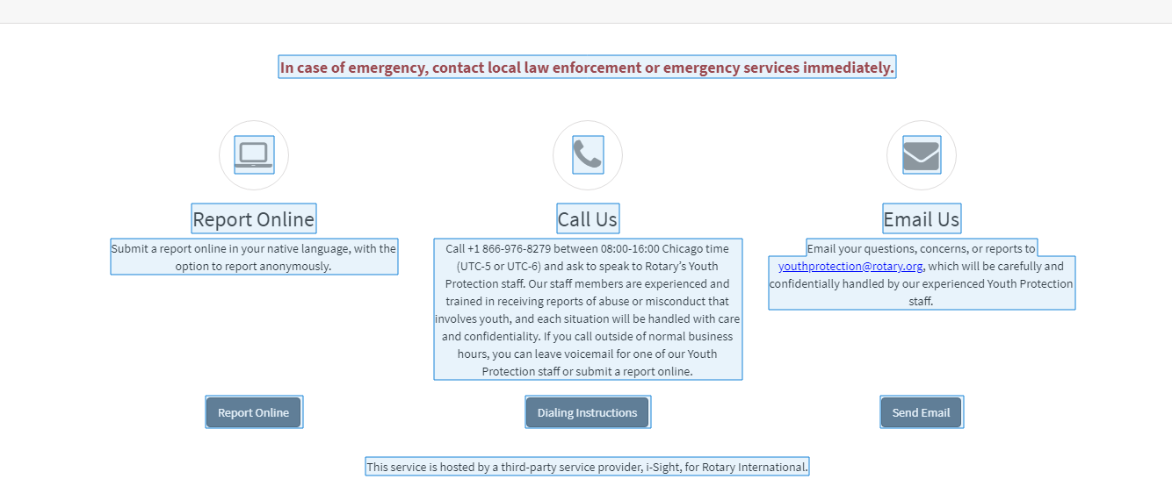
Reporting a concern
How do I report a youth protection concern?
Ensure that the young person is in a safe environment.
In case of emergency, contact local law enforcement immediately.
Report your concern to Rotary International, using the button below, within 72 hours

Slide 18
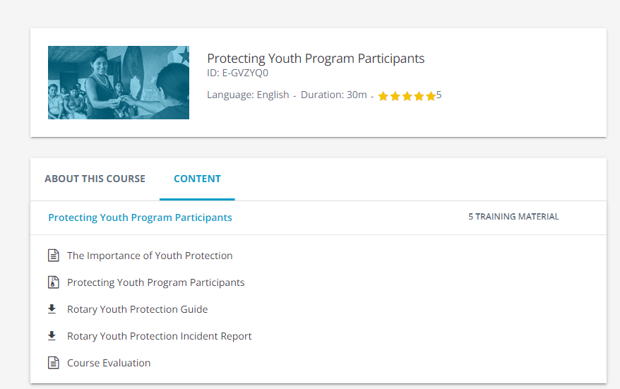
Training??
Recommend going on Rotary’s learning platform called learn.rotary.org and participating in this webinar.
https://learn.rotary.org/members/learn/course/internal/view/elearning/422/protecting-youth-program-participants

Slide 19
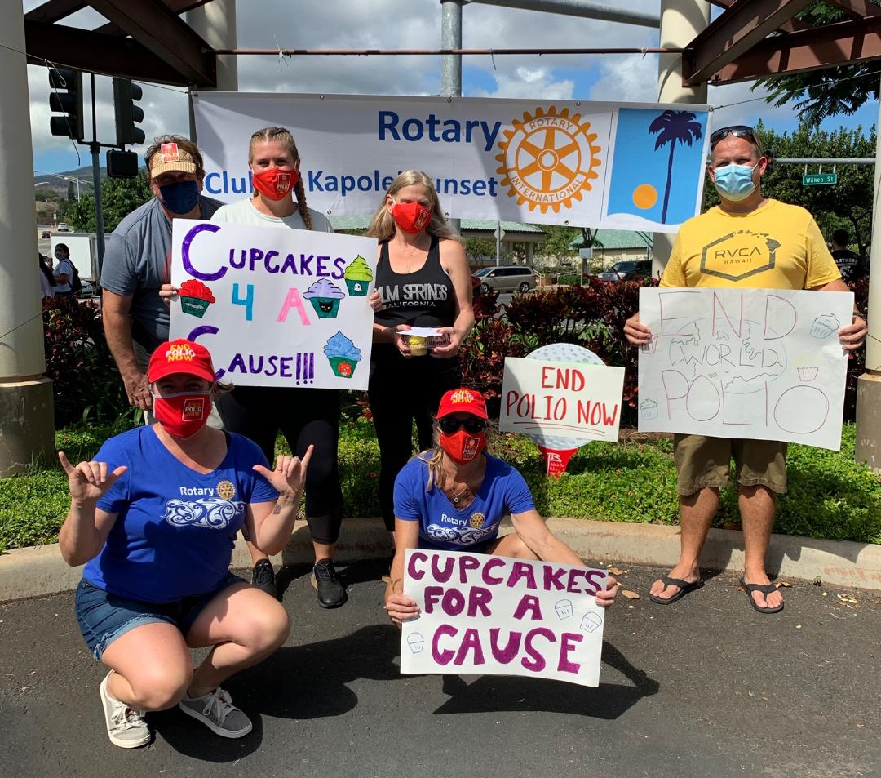
BEST PRACTICES / KEY TAKEAWAYS
Provide environment for youth to grow and become productive adults
Recognize and address abuse and harassment
Never be alone with a child
Be aware of local policies such as DOE etc.
Encourage volunteering but scrutinize those volunteers
Be an example, no profanity and no offensive behavior or language
Conduct a risk analysis for every activity
Ask yourself, is hugging or giving a kiss appropriate? A handshake or “knuckles” may be a better choice.
https://www.rotaryd5000.org/SitePage/district-information/district-policies-and-forms

Slide 20

QUESTIONS?

Slide 21
Mahalo for you time and commitment to our Rotary Club and the Youth that we work with.
Any questions please don’t hesitate to call me:
Peter Evans
808-389-7459
YPO@rotaryd5000.org
For background check submittal, send affidavit to Natasha Clarin
natashaclarin777@gmail.com

