Slide 1
Protecting Youth In All We Do
DISTRICT 5000
Peter Evans
Youth Protection Officer
District 5000

Slide 2
subhead
COMMITMENT IS KEY
FOR US TO BE SUCCESSFUL

Slide 3
subhead
OUR AGENDA
INTRODUCTION
ROTARY INTERNATIONAL
AWARENESS and PREVENTION
LEADERSHIP and POSTIONS RESPONSIBILITIES
YOUTH PROTECTION PROCEDURES
BEST PRACTICES/ KEY TAKEAWAYS
QUESTIONS

Slide 4
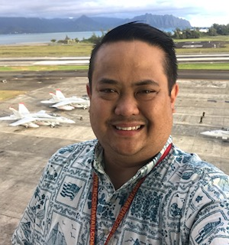
Intro
Peter Evans with Eco Rotary Kakaako
Your Youth Protection Officer for this Rotary Year District 5000
Chaired Youth Services for Honolulu Rotary
Youth Protection Officer for PDG Nalani Flinn during her tenure as DG.
Bachelors in Business Management currently busy working on a Masters in Engineering
25 years of Risk Management Experience in General liability and Occupational Safety in Senior Management level.
Currently work for the Department of Defense for Installation Safety Directorate.
Two beautiful daughters Sasha and Tiarra, one of which has just became a Rotarian and my beautiful bride of 25 years, Camille.

Slide 5
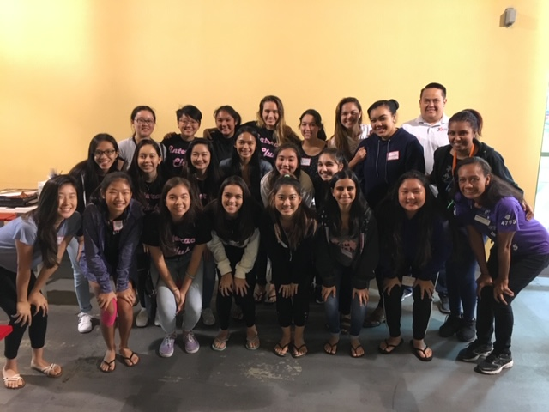
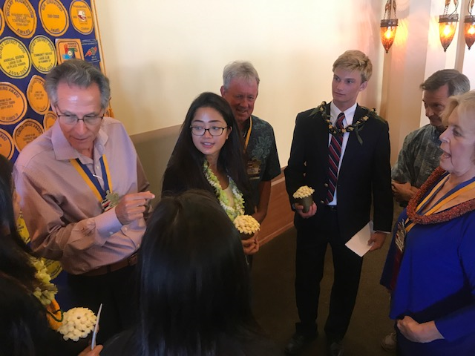
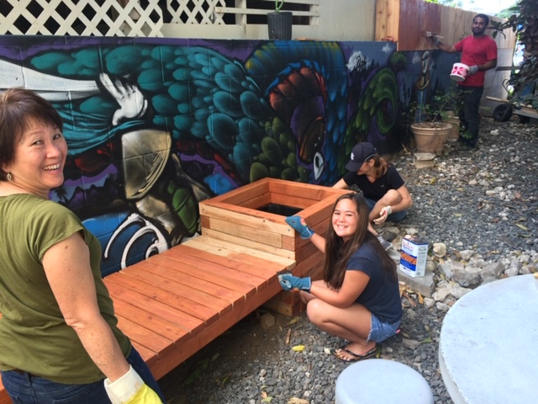
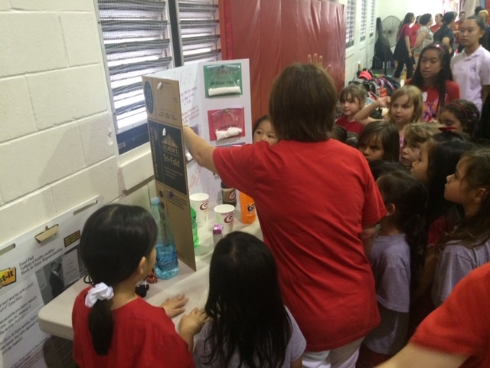
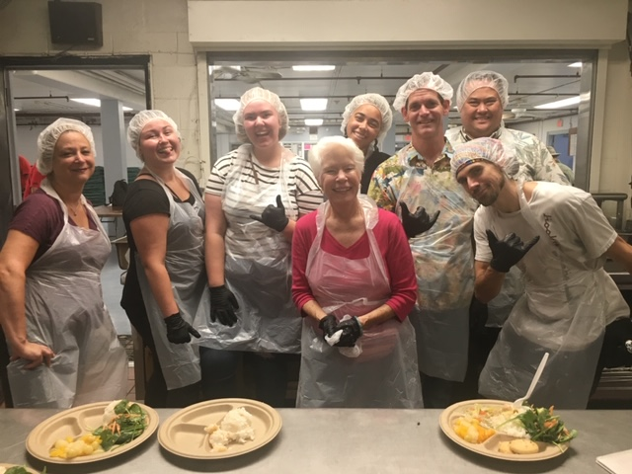
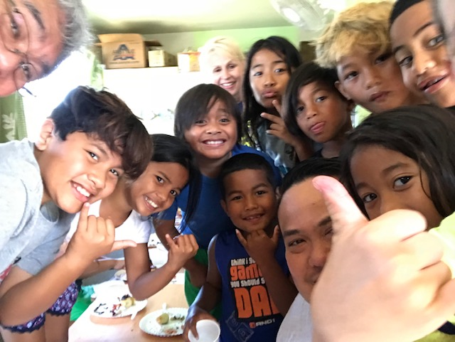
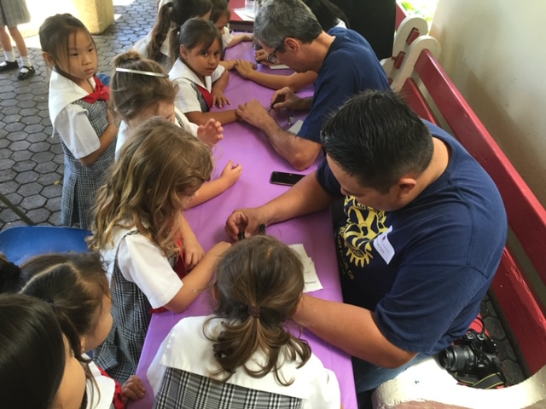
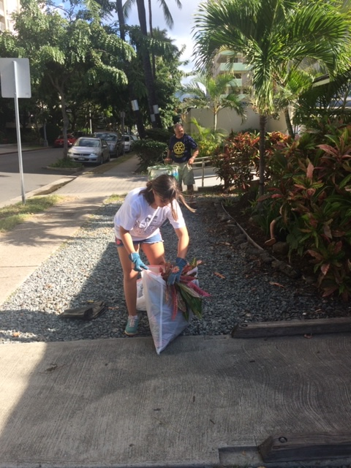
The Things We Do
Youth Services bring many opportunities to help shape our youth in within our communities.

Slide 6

Rotary International
The Rotary International Youth Protection and District Youth Protection Guides are the governing guides to our Youth Protection Program.
Should be printed and kept with the Youth Protection Guide.
Guide should be portable.
DG, District Youth Protection Officer, and all club and district leaders involved with Interact, RYLA, and Rotary Youth Exchange.

Slide 7
AWARENESS AND PREVENTION
RECOGNIZING ABUSE and HARASSMENT
Be aware of the signs of abuse or harassment
Be observant, when a youth is known to be cheery and suddenly becomes detached, that may be a sign of a problem.
Don’t over analyze but be aware. Sometimes changes of behavior may just be due to homesickness, cultural adjustment, etc.
STATEMENT of CONDUCT for WORKING WITH YOUTH:
Rotary International strives to create and
maintain a safe environment for all youth who
participate in Rotary activities. To the best of
their ability, Rotarians, Rotarians’ spouses and
partners, and other volunteers must safeguard
the children and young people with whom
they come into contact and protect them from
physical, sexual, and psychological abuse.
Abuse and Harassment of young people can go unaddressed when adults fail to recognize them.
Youth protection depends on awareness of the possibility of abuse and harassment and vigilance in guarding against it.

Slide 8
AWARENESS and PREVENTION, Continued
CHARACTERISTICS OF ABUSE AND HARASSMENT
Typical abuser blends into society:
Cannot be identified by age, economic status, community standing, race, gender or mental capacity.
Many abuse incidents are perpetrated by someone known to and trusted by the abused
Offenders can be other young people
Victims of sexual abuse are often carefully chosen and skillfully manipulated
Offenders may seek positions that provide proximity to youth.
NEVER ALLOW ANYONE TO BE ALONE WITH A CHILD AT ANY TIME
MAJORITY OF ALLEGATIONS OF ABUSE OR HARASSMENT GO UNREPORTED
Young People tend to minimize and deny abuse, not exaggerate, or Over Report incidents
They may not tell anyone about an assault because they are convinced that they are to blame, or they fear consequences.
Males are less likely to report abuse because of self blame, social stigmas, or fears of not being believed or to be seen to have a particular sexual orientation.
In some cases, youth wait to report abuse until they are adults.

Slide 9
“The most powerful leadership tool you have is your own personal example”
John Wooden

Slide 10

LEADERSHIP AND POSITIONS OF RESPONSIBILITY
District Youth Protection Officer placed to foster safety operations across all youth programs
Resource on abuse, harassment, and other risk and crisis.
As YPO, my responsibilities are:
Monitor changes in local and national laws as well as RI policies and communicate those changes
Work with you, our clubs, to inform you of your YPO obligations
Confirm screening measures are current and compliant
Ensure proper training
OVERSEE PROPER HANDLING OF ALLEGATIONS
Maintain records of allegations of abuse, harassment, and other crisis.

Slide 11
LEADERSHIP AND POSITIONS OF RESPONSIBILITY, Continued
Club Presidents, Club Program Chairs, and Other Club Officers have overall responsibility for operating and coordinating club youth activities to include integrating youth protection policies.
Club Executives should:
Know all Rotary and District Youth Protection Policies
Implement required training, screening, program logistics, and risk management procedures
Engage regularly with youth program participants to get feedback on programs
Report all allegations of abuse, harassment, and other crises to YPO, who will in turn disseminate information to proper District level leaders.

Slide 12
Volunteer Selection and Screening
Utilize a Youth Program Volunteer Application form.
Interview
Reference checks
Criminal Background Checks
Home Visits (host families for Youth Exchange)
YOUTH PROTECTION PROCEDURES
District level policies and procedures that comply with Rotary Code of Policies and the Rotary’s Statement of Conduct for Working With Youth.
District level policy is under revision and will be distributed to membership shortly.
Volunteer Training
Training Specific to program role
Include abuse, harassment, and crisis prevention information.

Slide 13
TRAVEL BY YOUTH
Our clubs and district may offer youth opportunities to travel outside of their home to participate in activities such as RYLA, Youth Exchange, etc. While there are many benefits for youth participant's, there are inherent risks, for all parties.
At a minimum, receive written permission from parents or legal guardians
ONLINE SAFETY
ZOOM meetings are common, be aware of storing information or pictures or youth, especially on a personal computer.
Each program should consider potential risks and develop policies to address them.
Youth protection procedures, continued

Slide 14
CRISIS MANGEMENT
Awareness of threats to participants is necessary to evaluating potential risks and developing crisis management procedures in advance.
Be aware of types of crisis
Communication
Procedures
Youth protection procedures, continued
ALLEGATION RESPONSE AND FOLLOW-THROUGH
All allegations must be handled according to local laws and RI policy.
When receiving a report of abuse or harassment:
Remain neutral and responsibly
Listen Attentively
Ask questions to establish facts

Slide 15
ALLEGATION RESPONSE AND FOLLOW-THROUGH, CONTINUED
Document the allegation as soon as possible
Ensure parent of the involved youth are contacted and the actions being taken.
Take immediate action to ensure the participant health and well-being
Promptly report allegation of abuse and harassment to law enforcement for investigation.
Follow district policy of notifying Youth Protection Officer
Until issue resolved, remove all youth program participants from contact with any person accused of sexual abuse or harassment.
District to report all allegations to RI headquarters within 72 hours of learning of the incident.
AVOID GOSSIP AND BLAME- KEEP INFORMATION CONFIDENTIAL AND RELEASE ONLY TO THOSE AUTHORIZED
Youth protection procedures, continued

Slide 16
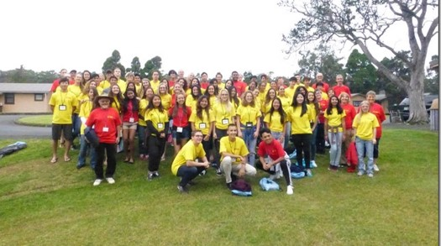
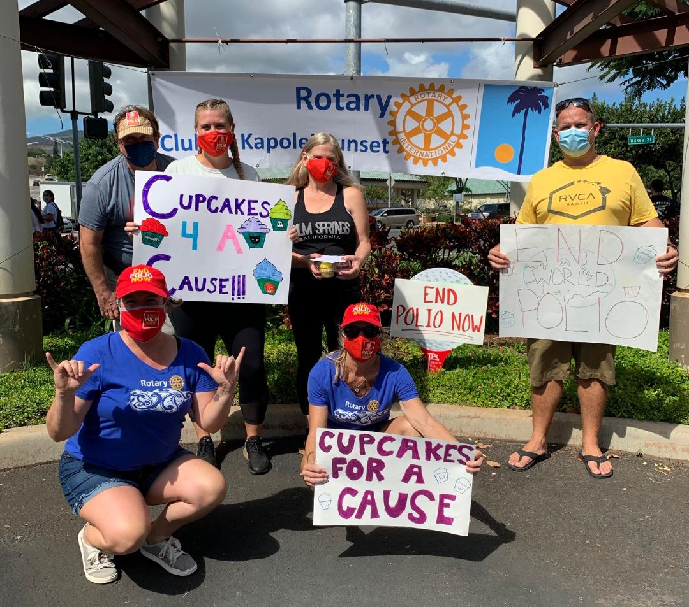
BEST PRACTICES / KEY TAKEAWAYS
Provide environment for youth to grow and become productive adults
Recognize and address abuse and harassment
Never be alone with a child
Be aware of local policies such as DOE etc.
Encourage volunteering but scrutinize those volunteers
Be an example, no profanity and no offensive behavior or language
Crisis management
Conduct a risk analysis for every activity
Ask yourself, is hugging or giving a kiss appropriate? A handshake or “knuckles” may be a better choice.
https://www.rotaryd5000.org/SitePage/district-information/district-policies-and-forms

Slide 17
BEST PRACTICES / KEY TAKEAWAYS, continued
YOUTH PROGRAMS
BASIC SCREENING (No significant or unsupervised contact):
Youth Programs Volunteer Affidavit
Criminal background check (valid 2 years)
INTERMEDIATE SCREENING (unsupervised contact):
Youth Programs Volunteer Affidavit
Criminal background check
Interview

Slide 18
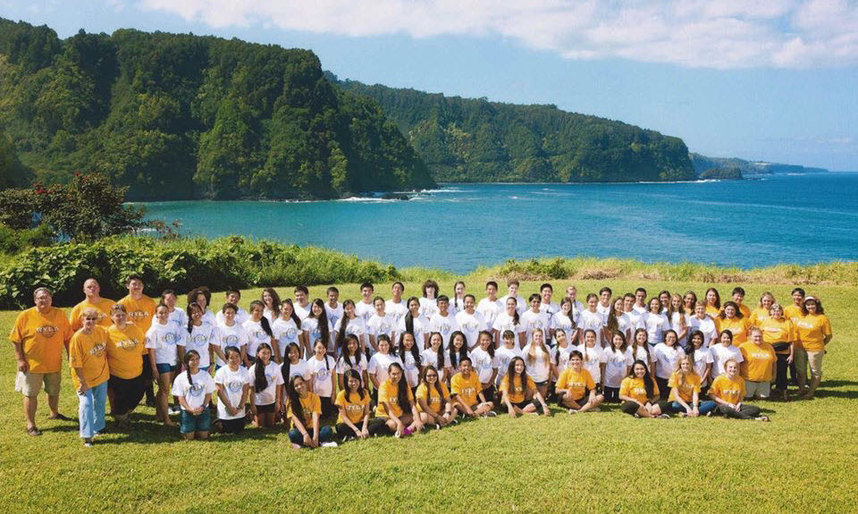
BEST PRACTICES / KEY TAKEAWAYS, continued
YOUTH EXCHANGE
COMPREHENSIVE SCREENING:
Youth Volunteer (or Host Family) Affidavit
Criminal background check (valid 1 year)
Reference Checks
Interviews
Home visits (host family)
CLUB CERTIFICATION:
Complete Club Compliance Statement
Implement club abuse and harassment prevention training program

Slide 19

QUESTIONS?

Slide 20
Mahalo for you time and commitment to our Rotary Club and the Youth that we work with.
Any questions please don’t hesitate to call me:
Peter Evans
808-389-7459
YPO@rotaryd5000.org
For background check submittal, send affidavit to Natasha Clarin
natashaclarin@gmail.com

