Slide 1
The Rotary Club of Cedar Rapids
New Member Orientation

Slide 2
Meeting Objectives
Welcome / Introductions
Rotary International
The Rotary Foundation
Our Cedar Rapids Downtown Rotary Club
Expectations of our Rotary members
How to get more involved
Information about our committees
Questions

Slide 3
The World’s First Service Club
Rotary was Formed:
In Chicago, IL on
February 23, 1905
by Paul P. Harris, Attorney
Where did Paul Harris attend Law School?
“Whatever Rotary may mean to us, to the world it will be known by the results it achieves.”
Paul P. Harris

Slide 4
The Rotary Organization
Rotary is made up of:
Rotary International
The Rotary Foundation
The Rotary Clubs

Slide 5
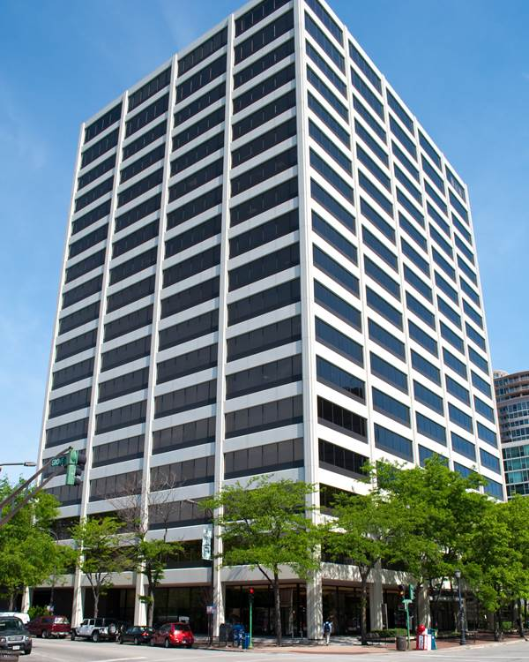
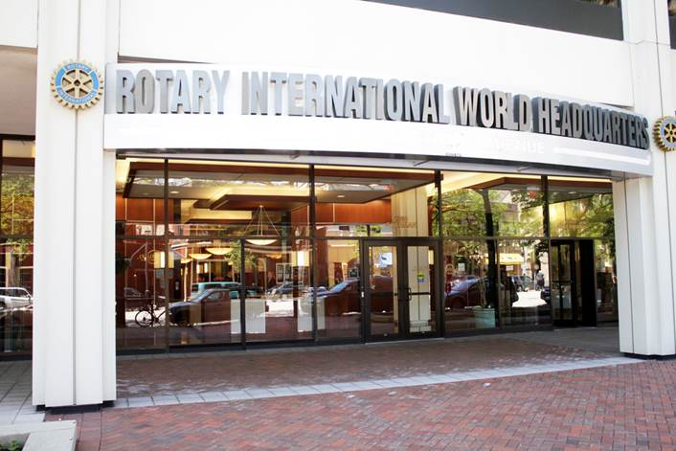
Rotary International Headquarters
Located In Evanston, IL

Slide 6
Rotary International
Rotary International has more than 1.21 million members
Rotary has more than $1 billion dollars in assets and manages its assets in 29 different currencies
There are 35,399 Rotary clubs in 200 countries around the world

Slide 7
Rotary International
Rotary International is divided into 534 districts.
The Cedar Rapids Downtown Rotary Club is in district #5970, which covers the northern half of Iowa and includes a total of 51 clubs.
The Cedar Rapids Downtown Rotary Club is:
The largest club in our district
In the top 25 largest Rotary clubs in the United States

Slide 8
Rotary.org

Slide 9
Rotary Mission
Provide service to others
Promote high ethical standards
Advance world understanding, goodwill and peace through fellowship of business, professional and community leaders.

Slide 10
Rotary - Guiding Principles

Slide 11
Rotary - Motto

Slide 12
The Rotary Logo
The evolution of the Rotary logo:

Slide 13
Affiliated Rotary Programs
Interact Clubs: (Jefferson High School)
For Youth - Ages 12 to 18
Students develop leadership skills while working on projects designed to help their local community and also build international understanding.
468,556 Interactors in 20,372 Interact clubs in 159 countries
Rotaract Clubs: (Kirkwood Community College)
For adults - ages 18 to 30
Promote leadership, professional development and community service
250,792 Rotaractors in 10,904 clubs in 184 countries

Slide 14
Affiliated Rotary Programs
Rotary Youth Exchange:
9,000 students ages 15 to 19 from more than 100 countries
Opportunity for students to live and attend school in other countries
Rotary Youth Leadership Awards (RYLA):
Leadership development seminars and events that are organized by Rotary for 500,000 students and young professionals ages 14 to 30
Rotary Community Corps:
Rotary Community Corps members support local Rotary club projects but are not members of a Rotary club. There are more than 8,500 corps in over 90 countries.

Slide 15
Rotary International Conventions
Future Rotary International Conventions:
June 6 to 10, 2020 in Honolulu, Hawaii, USA
June 12 to 16, 2021 in Taipei, Taiwan
June 4 to 8, 2022 in Houston, Texas, USA
Attendance at a Rotary International Convention is 40,000.
(Future Convention dates and locations are tentative.)

Slide 16
The Rotary Foundation Mission:
Advance the world understanding, goodwill, and peace through the improvement of health, the support of education, and the alleviation of poverty.

Slide 17
The Rotary Foundation
The Rotary Foundation transforms your financial gifts into service projects that change lives both close to home and around the world.
Last year Rotary provided $87 million dollars in grants for more than 1,306 projects worldwide.
During the past 100 years, the Rotary Foundation has spent $4 billion dollars on life-changing, sustainable projects.
92 percent of donations to the Foundation go directly to support Rotary service projects around the world.

Slide 18
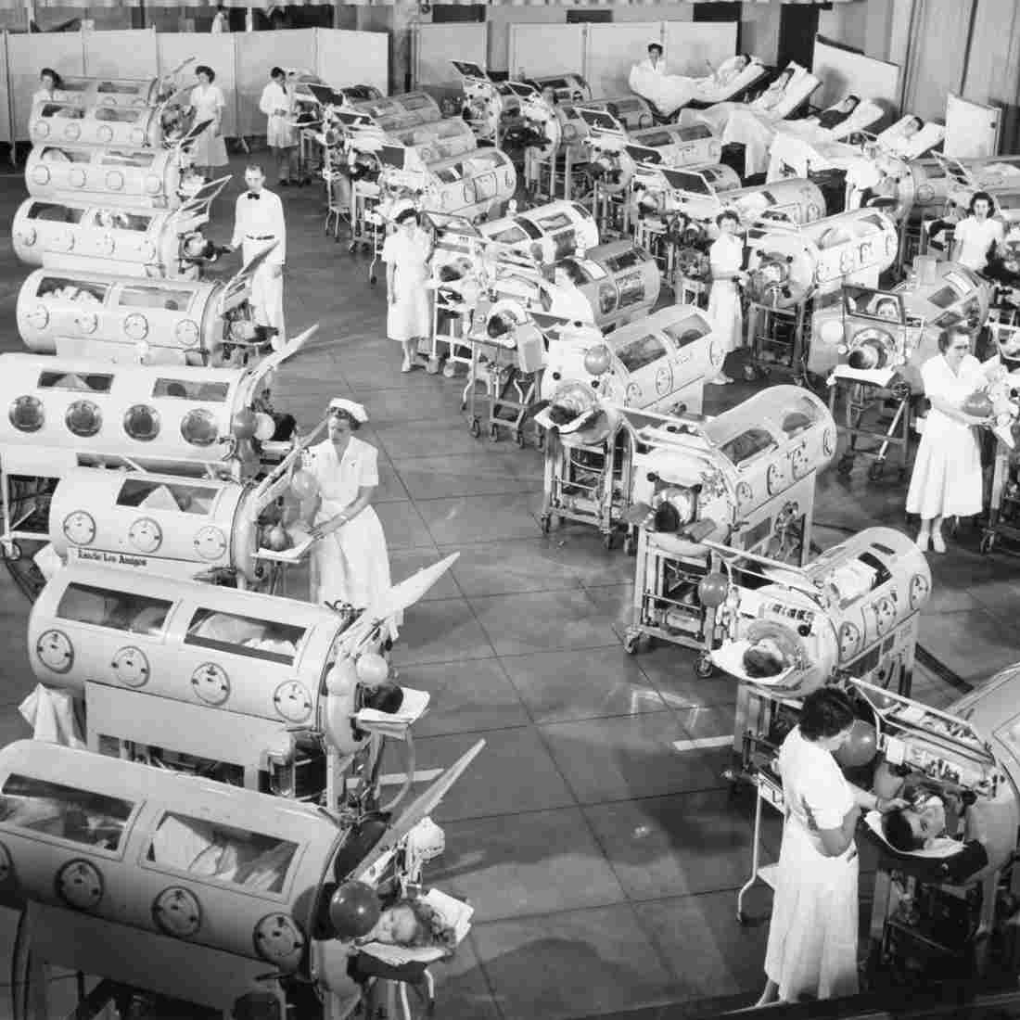
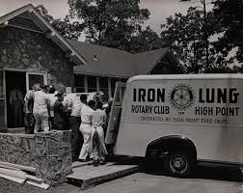
The Rotary Foundation - Polio
The Iron Lung

Slide 19
The Rotary Foundation - Polio
Rotary has helped fund the fight to end Polio since 1988: (350,000 people around the world contracted Polio in 1988)
Polio is 99.9% of the way to being eradicated. Polio will become only the second human disease in history to be eradicated worldwide, the first was smallpox.
During 2018, only 33 new diagnosed cases of wild Polio were reported in 2 countries – Afghanistan and Pakistan.
The cost to immunize a child against Polio is less than 60 cents.

Slide 20
Funding the Rotary Foundation
Funding for the Rotary Foundation comes primarily from voluntary contributions from Rotarians and friends of Rotary.
There are 1.1 million Paul Harris Fellows (individuals who have donated $1,000 or more to the Rotary Foundation).
Every new member in our Rotary club is charged $100 for an initial contribution to the Rotary Foundation.
Our Rotary club encourages members to continue to make an annual contribution of $100 toward achieving PHF.
Annually, the CR Downtown Rotary club members donate approximately $30,000 to the Rotary Foundation.

Slide 21
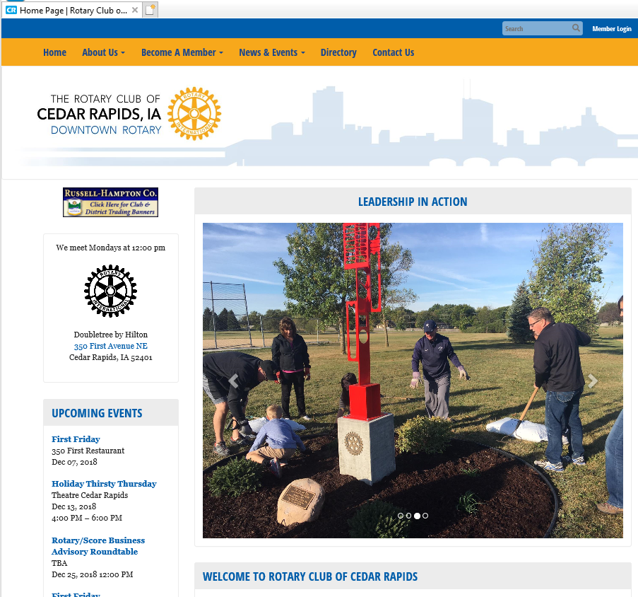
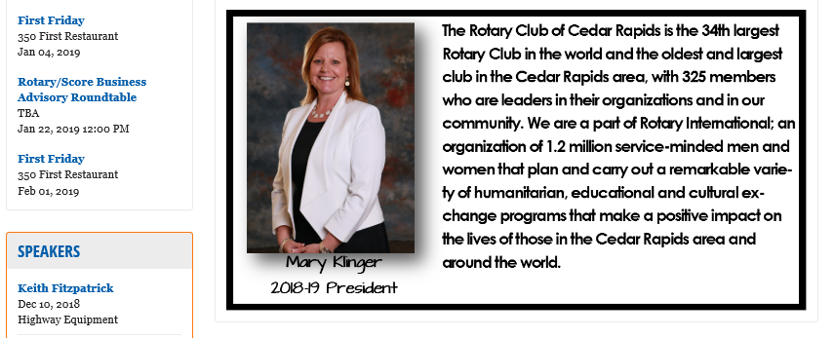
RotaryClubofCedarRapids.org

Slide 22
CR Downtown Rotary Club
Chartered on June 1, 1914 in Cedar Rapids, Iowa
Club ID Number is 2185
The 4th oldest Rotary club in Iowa
In the top 25 largest Rotary clubs in the United States
Approximately 330 members (Active and Honorary)
Average age of our members is 54 years
Gender diversity is 37% Female and 63% Male
The average tenure in our Club is 12 years

Slide 23
CR Rotary Club Leadership
Bill Courter, President from July 2019 thru June 2020
Kyle Kunz, President-Elect from July 2020 thru June 2021
Mary Klinger, Past-President from July 2018 thru June 2019
Additional Current Board Members include:
Amber Jedlicka Youth Exchange CMTE Chair
Adam Moore Communications CMTE Chair
Joe Lock International Grants CMTE Chair
Corey Chestnut Community Services CMTE Chair
Tiffany O’Donnell Program CMTE Chair
Jim Koch President-elect Nominee
Maureen Kler Osako Membership CMTE Co-chair
Steve Heyer Membership CMTE Co-chair
Barb Randall Foundation CMTE Chair
Susan Koch Social CMTE Chair
Additional Members include: Chris Crosby, Executive Director, Michelle Beisker, Treasurer and Nick Gearhart, Sergeant-at-Arms

Slide 24
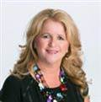
Executive Director
Christine Crosby is the Executive Director for the CR Downtown Rotary Club.
Email: CRdowntownRotary@gmail.com
Phone Number: 319-310-8069
Cedar Rapids Downtown Rotary Club Website: www.rotaryclubofcedarrapids.org

Slide 25
CR Rotary Club Committees
Membership - Maureen Kler Osako / Steve Heyer
Programs - Tiffany O’Donnell
Community Service – Corey Chestnut
Social – Susan Koch
International Service - Joe Lock
Rotary Foundation - Barb Randall
Communications - Adam Moore
Youth Exchange / Initiatives – Amber Jedlicka
Fellowship – Nick Gearhart

Slide 26
CR Rotary Club 3 Year Strategic Initiatives
Make a Difference: In our club, community, district and internationally
Strengthen Metro / Corridor Rotary relationships
Develop our youth
Increase membership and engage members

Slide 27
CR Rotary Club 3 Year Strategic Initiatives
Make a Difference: In our club, community, district and internationally:
Annual Service Awards - Larry Christy, Community Service and Club Appreciation Awards
Community grants in areas of Children, Education, Health/Human Services and Civic/Economic
Signature community projects - Club “WOW” funds
District matching grants - district will match local club funds for community projects up to $5,000
Rotary Foundation programs
Rotary international grants and projects

Slide 28
CR Rotary Club 3 Year Strategic Initiatives
Strengthen Metro / Corridor Rotary Relationships:
Visit other Rotary club meetings in the Corridor
Encourage our club members to attend events/fund raisers that are sponsored by the other Metro clubs
Encourage other Rotary clubs to promote their events at our club meetings
Promote CR Downtown Rotary club events at other club meetings
Organize Infinity Groups for Metro Rotary clubs

Slide 29
CR Rotary Club 3 Year Strategic Initiatives
Develop our Youth:
Sponsorship of the annual Rotary Pribyl Golf event
Service Above Self Awards for High School students
Annual sponsorship of students for Youth Exchange Program (both inbound and outbound students)
RYLA (Grades 10 to 11) and Young RYLA (Grades 7 to 8)
Strengthen “Rotaract” participation at Kirkwood College
Strengthen “Interact” participation at Jefferson High School including the Rotary Active mentoring program

Slide 30
CR Rotary Club 3 Year Strategic Initiatives
Increase Membership and Engage Members:
Identify opportunities to speak about Rotary at local community organizations
Analyze and enhance topics for our weekly programs.
Videotape key meetings/presentations for publication on our website
Incorporate portions of the New Member Orientation into club meetings
Track historical membership information
Create Infinity Group for retired club members

Slide 31
Rotary Club Membership Dues
The membership dues are used to fund the club’s operations and charitable initiatives:
The annual membership dues for our club are $475.00
Approximately $83.00 goes to pay Rotary International dues
Approximately $36.00 goes to pay Rotary District dues
Approximately $175.00 goes toward community grants and contributions on behalf of our Club
The remaining $181.00 funds the operation of our club
The suggested $100.00 annual donation to the Rotary Foundation is in addition to the club membership dues
Potential for reimbursement of dues from employer

Slide 32
Charitable Contribution Initiatives
A portion of your annual membership fee is used to fund the club’s charitable initiatives:
The club budgets annually for charitable contributions of approximately $50,000
Budgeting charitable contributions enables our club to stay true to the Rotary mission to help give back to our community
Think of Rotary as being made up of committed Individuals versus being a representative from a company or an organization

Slide 33
Charitable Contributions
The $50,000 in annual charitable contributions is allocated to the following awards and programs:
Club Appreciation Award
Community Service Award
Larry Christy Award
International Projects (Ponsetti Project)
Metro Rotary Council Projects
Rotary Youth Leadership Awards (RYLA) Program
Youth Exchange Program
Interact Club at Jefferson High School
Various Community Grants
Prospect Meadows Baseball / Softball Complex
WOW Projects (Future Reserves)

Slide 34
Local Service Projects
Collaborated with other Rotary clubs in the area to provide playground equipment for 13 Cedar Rapids and Marion elementary schools. (Gearing up for Kids)
Supported education projects at local schools
Cash donation for the NewBo City Market - Rotary Hall
Rejuvenation of the Czech Village Bandstand Plaza
Supported Art in the Parks with sculptures in city parks
Prospect Meadows - Baseball / Softball Complex
Recognition Wall – Metro-wide project
Miracle Field Pavilion & Memorial Garden – District Grant

Slide 35
International Service Projects
Sustainable Farming Project:
Donations to help create the means for people to feed themselves while creating income for their families and communities in Liberia
Clean Water Projects:
Collaborated with First Lutheran Church to help fund a well that provides clean drinking water for 26,000 residents in the town of Same, Tanzania
Worked with Haiti Community Health Initiative and other area Rotary clubs. Roughly 30,000 citizens of Haiti will be positively impacted by the clean water systems built via this project.
Ponseti / RAG4Clubfoot Project:
Doctors around the world are trained in the highly effective Ponseti method to treat / correct clubfoot.

Slide 36
Expectations of Rotary Members
Strive to attend 60% of weekly Rotary meetings
Our Monday meetings start at noon and end by 1:00 pm
You can make-up the Rotary meetings that you miss by:
Visiting other Rotary Clubs
Attending an Affinity Group Meeting
Participating in Special Events
Attending Committee Meetings
Online @ rotaryeclubone.org (max. 6 make-ups per year)
Support Rotary sponsored events when possible
Bring a guest to a meeting; encourage new members

Slide 37
Where To Do Local Make-Ups
24/7/365 - Rotary eClub One make-ups: www.rotaryeclubone.org
Tuesday @ 12:00 pm - Marion/East Cedar Rapids
Indian Creek Country Club
Wednesday @ 12:00 pm - Cedar Rapids West
African American Museum
Thursday @ 7:00 am - Cedar Rapids Sunrise
Matthew 25
Thursday @ 11:30 am - Cedar Rapids/Hiawatha Metro North
Butcher Block Northeast
Friday @ 7:00 am - Cedar Rapids Daybreak
Cedar Rapids Country Club
Friday @ 7:00 am (1st and 3rd Fridays of the Month) - Gateway
Four Oaks Campus, 5400 Kirkwood Blvd. SW

Slide 38
How To Get Involved
Serve on a committee
Consider volunteering to serve on the Board of Directors
Host a Breakout Session
Attend a club social event
Volunteer to work on a project - grants, youth golf tournaments, etc.
Donate cell phones and eyeglasses
Sit at a different table each week

Slide 39
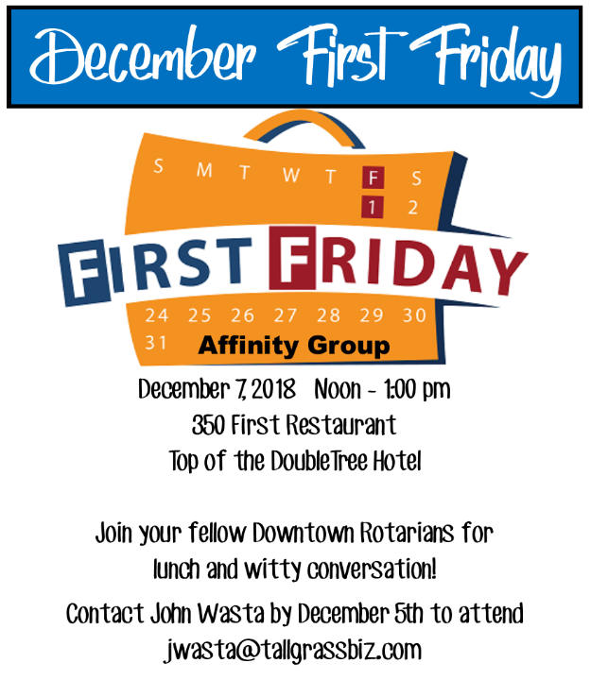
e-Newsletter-Ripples

Slide 40
Get Social!
Follow us on Facebook and Twitter

Slide 41
Thank You for being a Rotarian!
Questions?

