Slide 1

Notes:
HOw long have I been using it, and speak to high level how it has changed what can be accomplished.

Slide 2

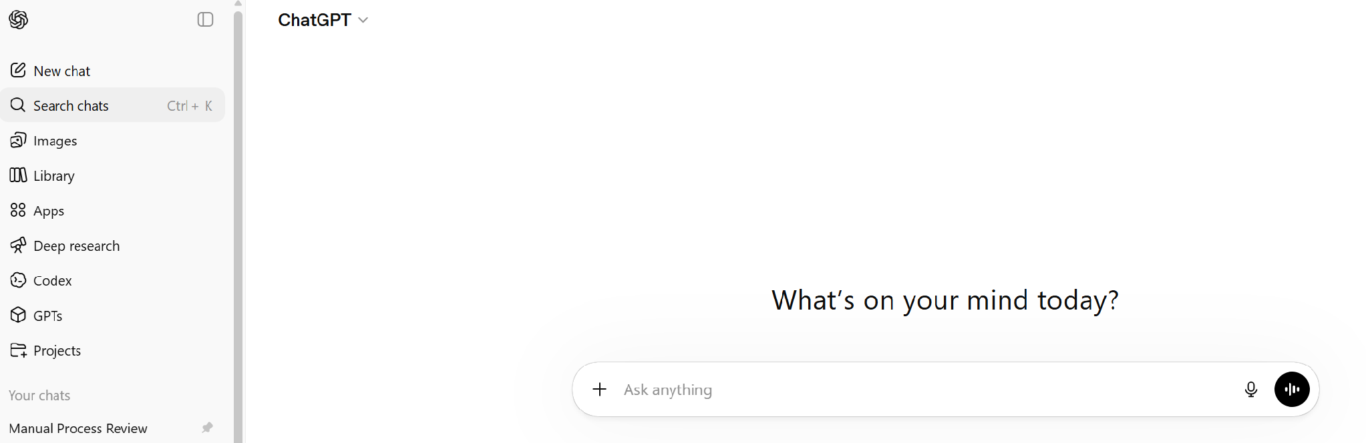
Session Objectives
• Understand ChatGPT basics
• Learn effective prompting
• Apply to recruitment & marketing
• Practice real examples
Notes:
• Understand ChatGPT basics
• Learn effective prompting
• Apply to recruitment & marketing
• Practice real examples

Slide 3

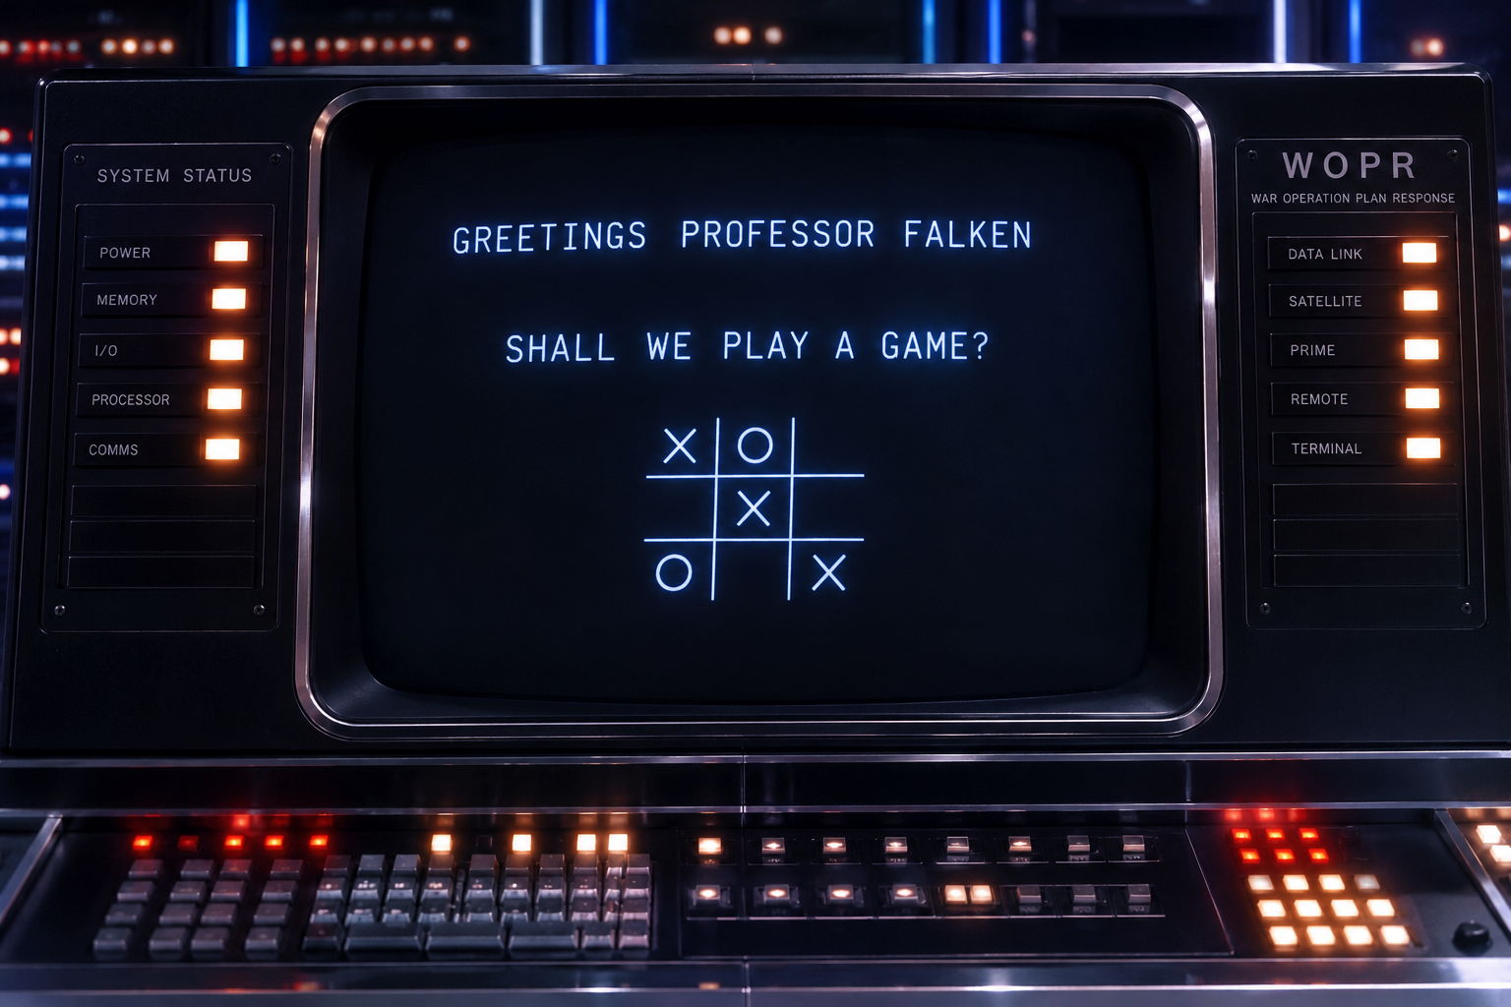
WHAT IS CHATGPT?
JUST KIDDING!
Meet H.A.L.
Notes:
WAR GAMES, (1983) Starring MAtthew Broderick

Slide 4
DEFINE “ChatGPT”
ChatGPT stands for:
Chat – It is designed to have natural, conversational interactions with users.
G – Generative / P – Pre-trained / T – Transformer
Chat Generative Pre-trained Transformer
HERE IS WHAT EACH PART MEANS
Generative: The model generates new text rather than simply retrieving existing answers. It can write articles, emails, code, stories, summaries, and more.
Pre-trained: Before being made available to users, the model is trained on a large amount of text to learn language patterns, grammar, reasoning, and general knowledge. It can then be further adapted and improved for conversation.
Transformer: This refers to the neural network architecture introduced by Google researchers in the 2017 paper "Attention Is All You Need." The Transformer architecture revolutionized AI by allowing models to understand context and relationships between words much more effectively than previous approaches.
IN SIMPLE TERMS, think of it like this…
Chat = talks with you naturally.
Generative = creates new content.
Pre-trained = learned from a vast amount of information before you started using it.
Transformer = the AI technology that makes it possible to understand context and generate coherent responses.
FOR SOMEONE NEW TO AI, A SIMPLE ANALOGY IS:
Imagine hiring an incredibly well-read assistant who has studied millions of books, articles, and documents. Instead of searching for an answer, they use what they've learned to write a new, original response tailored to your question.
Notes:
DON’T GO INTO ALL THE DETAIL: Presentation will be available for download on the website after convention.
FOR SOMEONE NEW TO AI, A SIMPLE ANALOGY IS:
Imagine hiring an incredibly well-read assistant who has studied millions of books, articles, and documents. Instead of searching for an answer, they use what they've learned to write a new, original response tailored to your question.

Slide 5
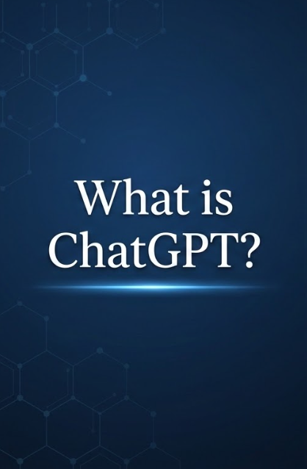



Notes:
Remember to talk to the privacy factor. Do not put sensitive data into ChatGPT
NOTE the fact that Chat GPT is learning about me and what I work with and tailoring responses to that. Even when I don’t ask for it.

Slide 6
  PROMPT: Tell me what you know about Cosmopolitan International
  tell me what you know about cosmopolitan international
RESULT
Cosmopolitan International (often called “Cosmo”) is a service organization with a long history focused on community impact, fellowship, and leadership development.
Here’s a clear overview:
Origins & Structure
  Founded in 1918 in the United States.
  Operates as an international association of clubs (primarily in the U.S. and Canada).
  Members belong to local clubs, which are grouped into districts and governed internationally.
Mission & Focus
  The organization’s long-standing mission centers on community service and supporting people with disabilities, especially those with hearing and speech disorders.
  Many clubs support causes like:
    Speech & hearing clinics
    Accessibility initiatives
    Youth programs and scholarships
    Local community improvement projects
Key Program – Deaf & Hard of Hearing Support
  A major emphasis is on assisting individuals who are deaf or hard of hearing, including:
    Funding hearing aids
    Supporting speech therapy programs
    Partnering with schools or clinics
  Membership & Culture
    Membership is typically adult professionals and community-minded individuals.
    Known for:
      Strong sense of fellowship and networking
      Volunteer-driven leadership (club, district, international levels)
      Emphasis on personal growth and service leadership
  Activities
    Local clubs run fundraisers, events, and service projects.
    There are district and international conventions for networking, governance, and training.
    Clubs often adapt their projects to local community needs, so activities can vary widely.
  Brand Positioning (Historically)
    Compared to groups like Rotary or Lions, Cosmopolitan is:
      Smaller and more tight-knit
      Often described as more family-like and relationship-focused
      Sometimes less visible publicly, which has been a challenge for growth
  FOLLOW UP FROM CHAT GPT
  If you want, I can go deeper into:
how it compares to Rotary/Lions (useful for recruitment strategy),
current challenges (like declining membership), or
ideas to modernize and attract younger members (which I suspect might be especially relevant for you).

Slide 7
Why It Matters for Cosmopolitan
• Attract younger member
• Create marketing content quickly
• Support club growth initiatives
Why….
Notes:
(1) Using tools that expidit work effort, learning new skills with up to date tools… this are things that engage the younger potential members. Resume building, experiences etc.
(2) When you use ChatGPT, it accesses anything that exists digitally. If you provide enough prompts and links to information that you want considered, it can create a very robust plan as a starting point that you can fine tune. Very specifically, building a marketing campaign for 25-40 age group utilizing facebook and other popular social media outlets. Utilize images that will appeal to your target market.
(3) Help brainstorm ideas that can be specific to the Region (Mid States, Canadian, Captal Region). The more specific you are in your prompt, the higher quality the output will be. (Introducing the next page, C.L.E.A.R.)

Slide 8





Prompting Framework
(C.L.E.A.R.)
(C)ONTEXT What background does ChatGPT need? Include the situation, organization, purpose, or problem.
(L)IMIT What constraints should it follow? Specify length, tone, format, or boundaries.
(E)XPECTATIONS What does success look like? Be clear about the desired outcome.
(A)UDIENCE Who is this for? Tailor language and style to the reader.
(R)OLE Who should ChatGPT act as? Assign a perspective or expertise.
Notes:
C — Context
What background does ChatGPT need?
Include the situation, organization, purpose, or problem.
Example:
“For a local Cosmopolitan club planning a fundraiser…”
L — Limit
What constraints should it follow?
Specify length, tone, format, or boundaries.
Examples:
“Keep it under 100 words”
“Use a friendly, professional tone”
E — Expectation
What does success look like?
Be clear about the desired outcome.
Examples:
“Create a social media post that encourages sign‑ups”
“Generate 3 headline options”
A — Audience
Who is this for?
Tailor language and style to the reader.
Examples:
“Young professionals (ages 25–40)”
“Current members, not the general public”
R — Role
Who should ChatGPT act as?
Assign a perspective or expertise.
Examples:
“Act as a nonprofit marketing expert”
“Act as a volunteer recruitment coordinator”

Slide 9
Example #1 : Recruitment Messaging
PROMPT:
Write a friendly social media post inviting young professionals to join a volunteer club focused on community impact.

Slide 10
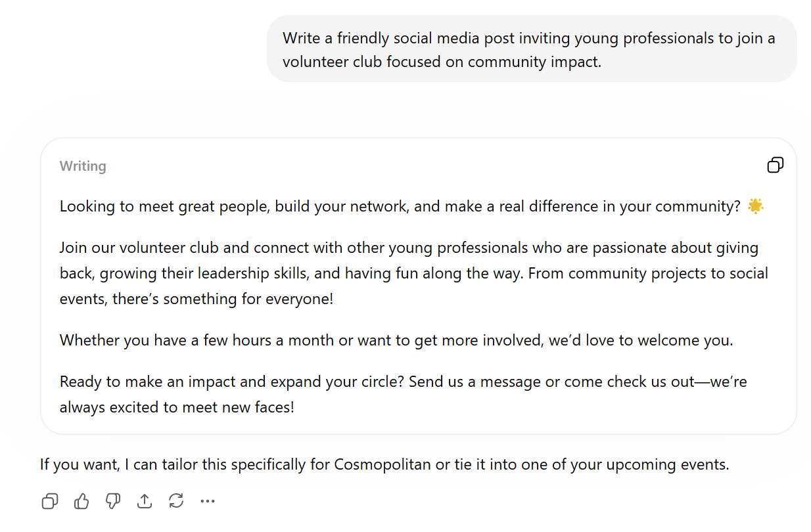
Example 1 - CHATGPT Output
PROMPT:
FURTHER RECOMMENDATIONS FROM CHATGPT:

Slide 11
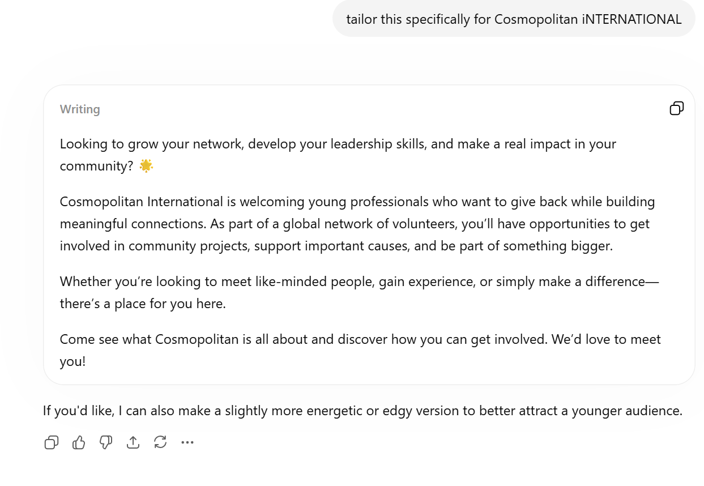
Example 1 - CHATGPT Output – Version #2
REVISED PROMPT:
FURTHER RECOMMENDATIONS FROM CHATGPT:

Slide 12
Example #2 : Event Promotion
PROMPT:
Create a promotional flyer text for a community car-themed fundraising event targeting families and young adults.

Slide 13
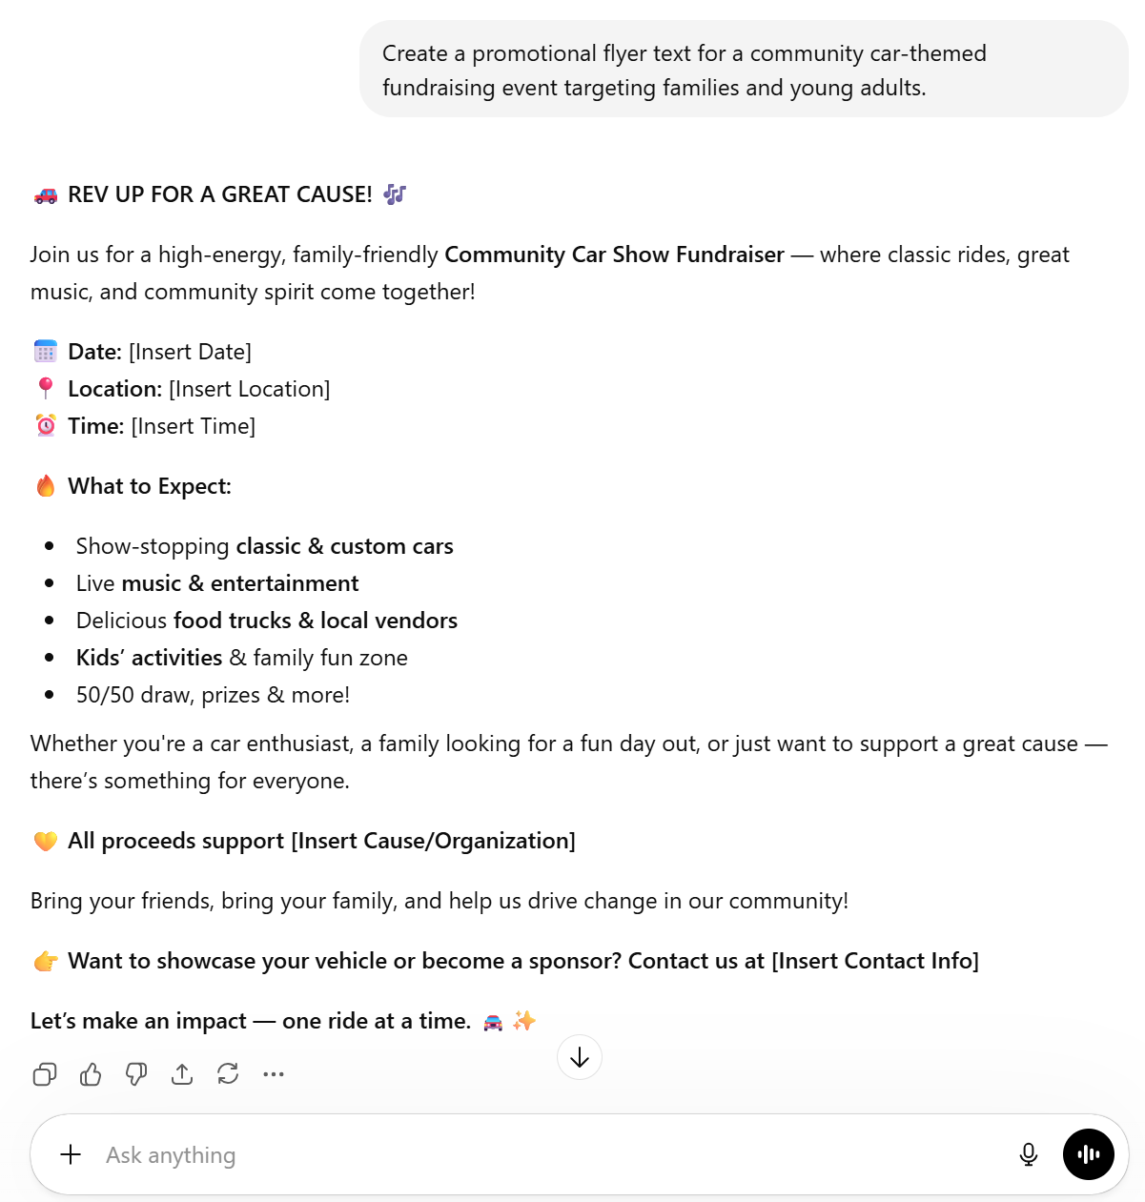
Example 2 - CHATGPT Output
PROMPT:

Slide 14
Example #3 : Member Engagement Ideas
PROMPT:
Generate 10 creative ideas to engage younger members in a service organization.

Slide 15
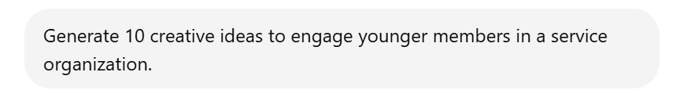
Example 3 - CHATGPT Output
PROMPT:
Here are 10 practical, engaging ideas designed to genuinely appeal to younger members—not just attract them, but keep them involved:
1. Micro-Volunteering Opportunities
Offer short, flexible volunteer options (1–3 hours, virtual or in-person). Younger professionals often want to help but struggle with time commitments.
2. Social + Service Events
Blend purpose with fun—think “volunteer day + patio hangout” or “community clean-up + coffee meetup.” The social element is key.
3. Skill-Based Volunteering
Let members use (and build) real-world skills—marketing, event planning, finance, social media, design. This makes participation feel valuable to their careers.
4. Leadership Fast-Track Roles
Create small, low-risk leadership opportunities (project leads, event captains) so younger members don’t have to “wait their turn” for years.
5. Cause-Focused Pop-Up Projects
Run short-term initiatives around specific causes (mental health, environment, youth support). Clear purpose = higher engagement.
6. Networking with Purpose Nights
Host events that combine networking and impact—guest speakers, panel discussions, or “meet a mentor” nights tied to service themes.
7. Modernize Communication Channels
Use platforms they actually use (Instagram, LinkedIn, WhatsApp/Discord). Keep messaging visual, concise, and consistent.
8. Bring-a-Friend Incentives
Encourage current members to invite peers—offer perks like event discounts, recognition, or small rewards for referrals.
9. Personal Branding & Recognition
Highlight members on social media, celebrate contributions, and provide volunteer certificates or LinkedIn-ready experience.
10. Signature “Flagship” Event
Create one standout, highly branded annual event (like a themed fundraiser or community festival) that younger members feel proud to be part of and promote.
If you want, I can turn these into a targeted recruitment plan specifically for Cosmopolitan or tie them into your Rock’n August event to cross-promote younger engagement.
FURTHER RECOMMENDATIONS FROM CHATGPT:
Notes:
That list of 10… ChatGPT uses any digital content it can find to create these types of list. It may be digital books, reports, social media posts, surveys… everything that has a digital footprint can be a part of the equation.
CAUTION: Chat GPT does not necessarily identify copywritten work. You can ask ChatGPT for the source of the information so that you can understand where it came from. Note that if you do not intend to publish work calling it your own, this generally will not come into play. It does only access digital content that it can find which usually indicates it is in the public domain, unless it is quoting from a published work.

Slide 16
Example #4 : Member Engagement Ideas
PROMPT:
Write a short email welcoming a new member and encouraging participation in upcoming events.

Slide 17
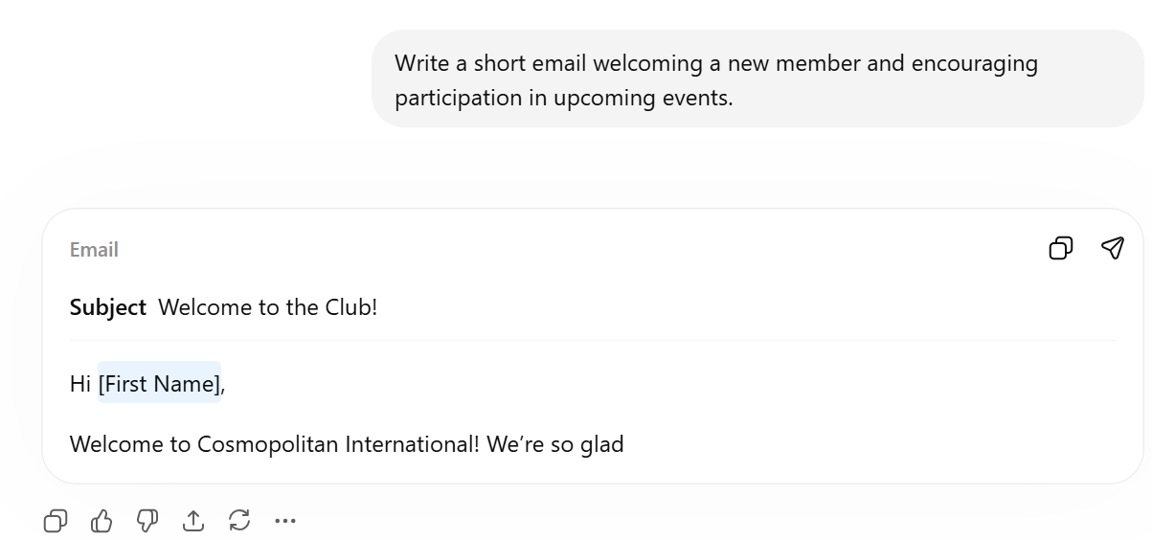
Example 4 - CHATGPT Output
PROMPT:
The response did not work, ChatGPT did not come back with anything useful. This happens…

Slide 18
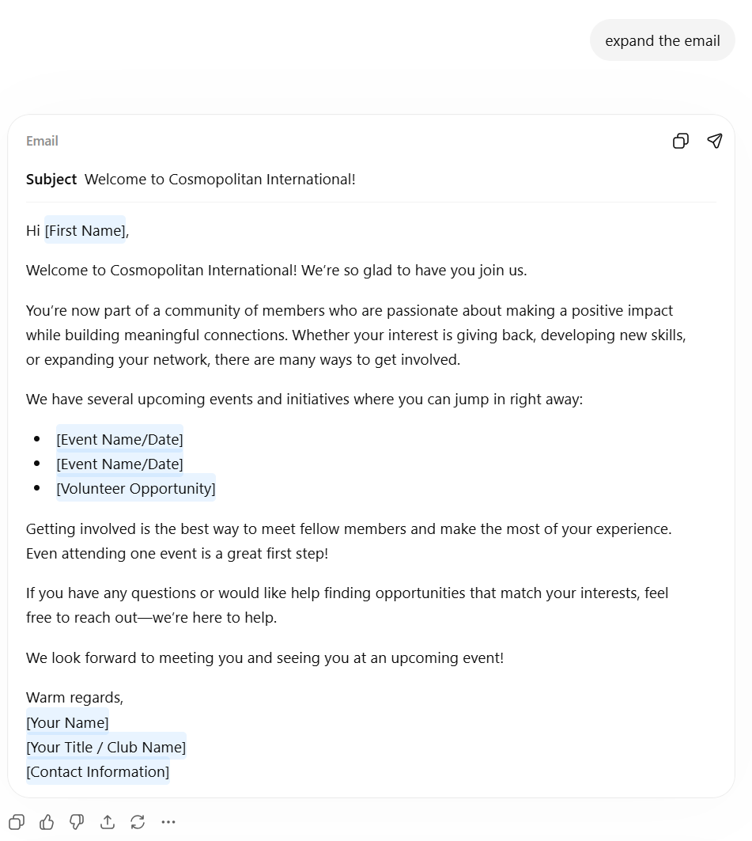
Example 4 - CHATGPT Output
Revised PROMPT:

Slide 19
Example #5 : LIVE
CHATGPT.COM
PROMPT:...
Notes:
Live Demo (Facilitator Script)
1. Start with a basic prompt
2. Improve with CLEAR framework
3. Show before/after results
4. Ask audience for input

Slide 20
Example #6 : HANDS ON
TRY:
“Write a recruitment post for students”
“Write a Promotional Advert for a Community Clean Up Event”
or… ONE OF YOUR OWN.
THEN:
Improve it with better instructions (CLEAR)
Notes:
Live Demo (Facilitator Script)
Start with a basic prompt
2. Improve with CLEAR framework
3. Show before/after results
4. Ask audience for input

Slide 21
BEST PRACTICE
• Be specific
• Review outputs
• Avoid sensitive data
• Use as a first draft tool

Slide 22
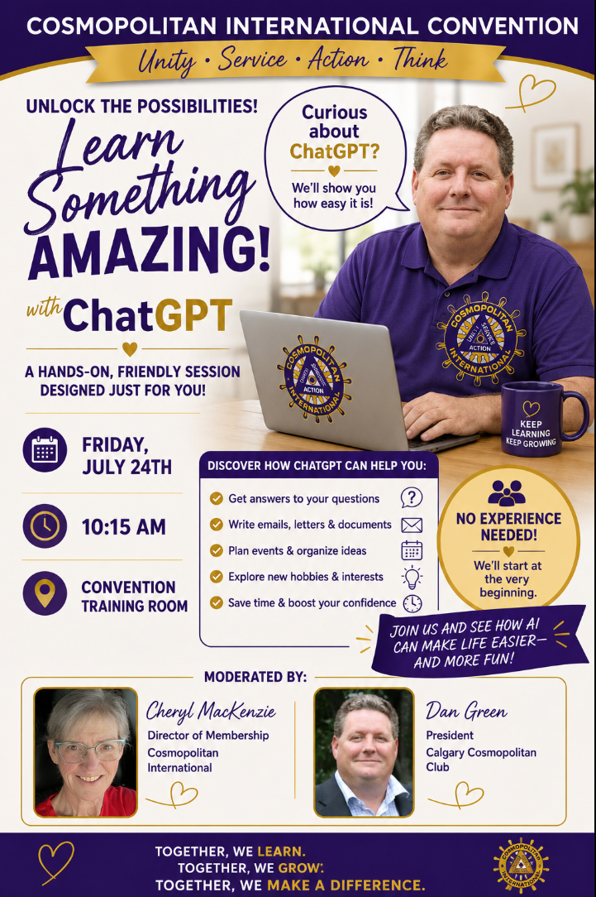
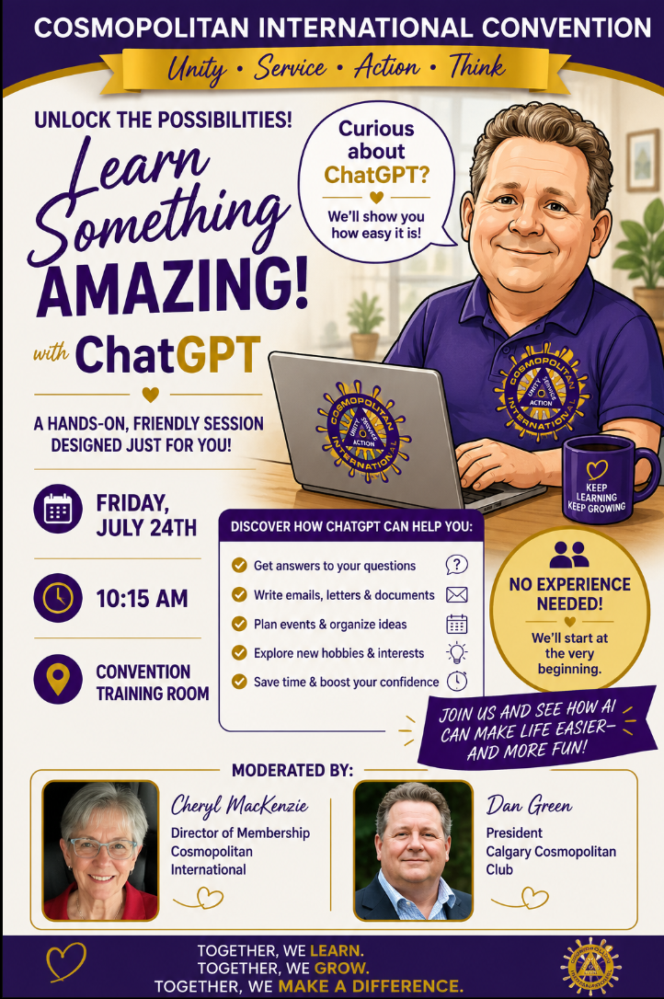
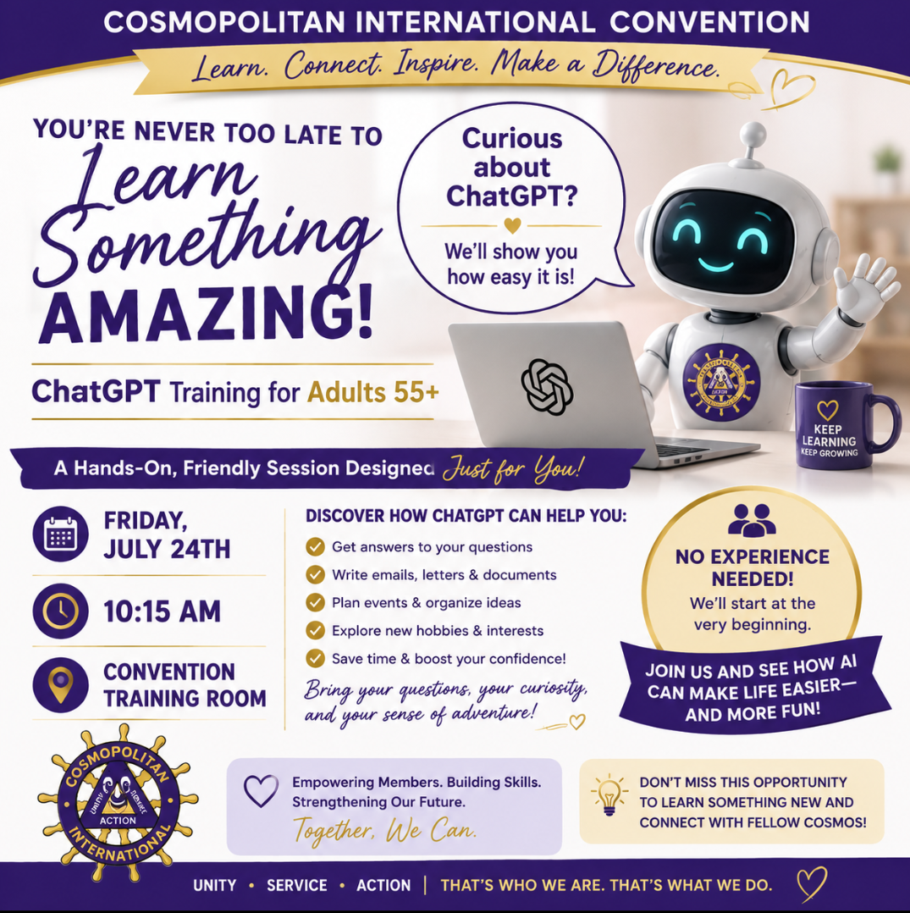
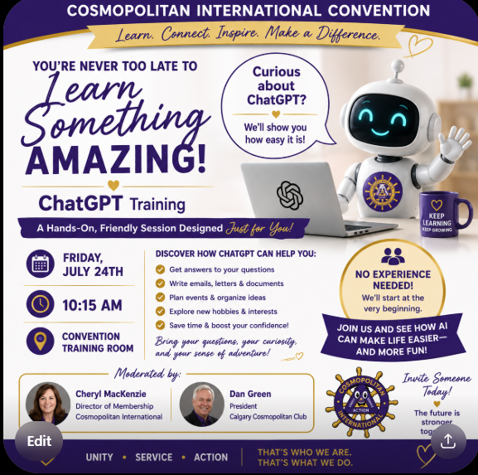
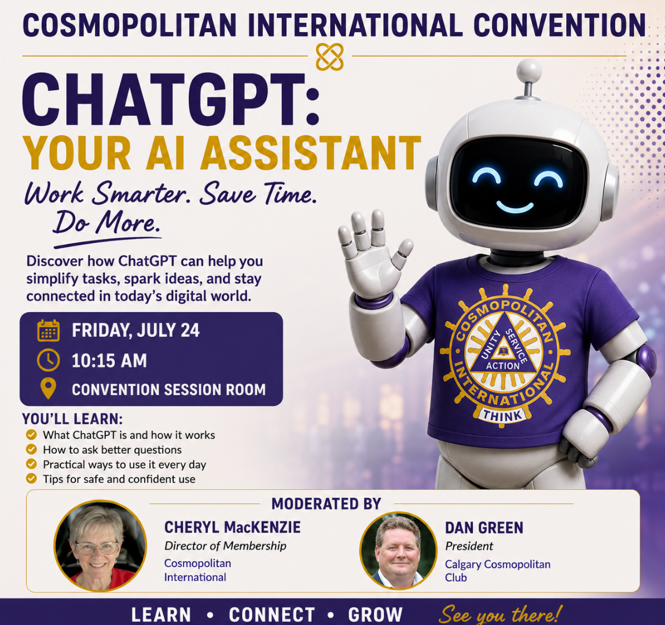
RECENT EXAMPLES: This effort took about 10-15 minutes to get what I wanted.
(1) PROMPT:
“you helped build a training program for people 55+ on how to use ChatGPT, can you create a graphic advertising the session at the Cosmopolitan International Convention on Friday, July 24TH at 10:15am”
(2) PROMPT: REVISION NEEDED
“remove the reference "for Adults 55+" also you can add that the session will be moderated by Cheryl MacKenzie, DIrector of Membership and Dan Green, President of the Calgary Cosmopolitan Club.”
(3) PROMPT: REVISION NEEDED
It took a couple of more requests with fine tuned details to get to the final iteration.
Robot became Dan for a while, and then a caricature of Dan!
(5) PROMPT: RESET
“remove the reference "for Adults 55+" also you can add that the session will be moderated by Cheryl MacKenzie, Director of Membership and Dan Green, President of the Calgary Cosmopolitan Club.”
Part two was to “fix CI logo on Robot’s Shirt” & then replace the picture for Cheryl with attached photo”, and then the same for Dan.
(4) PROMPT: RESET
ChatGPT was starting to go down the road that I didn’t want to go, so I took a screen grab of the original image it developed and started over as a new “branch” in the chat window to get away from the misdirections.
Notes:
Live Demo (Facilitator Script)
Start with a basic prompt
2. Improve with CLEAR framework
3. Show before/after results
4. Ask audience for input

Slide 23


RECENT EXAMPLES:
The effort to get the next two images was less than 10 minutes combined which included the computer rendering time.
IT LEARNS:
In developing the promo for The INTERNATIONAL PROJECT Education Session, it was much quicker to a solution. The final design for Leaders Training was even quicker.
PROMPT:
“Following a similar design graphic advertising the session at the Cosmopolitan International Convention you just completed, we need one for a session Moderated by Dick Gorton, Director of Special Projects and CI Past International President (PIP} on the Cosmopolitan International Project to Fund Diabetes Research. You can get all of the information you need on that project at our site https://cosmopolitan.org/page/international-project. The session is Friday, July 24th at 11am Dick's image is attached that can be used to show him as the moderator.”
PROMPT:
“Following the same design, Judy Weitkemper will be delivering an Education Session on Friday July 24th at 9:15am. She will be delivering Club Officer Training utilizing resources that can be found on our website in the attached pdf. Also, Judy is the Director of Education and Cosmopolitan International Past International President (PIP) and will act as the moderator. Her image is attached.”
In the design for the Int’l Project Promo, it gave me two options. I selected the one
I liked. When I asked for the Promo for Judy’s session, it designed based on what I liked
for Dick’s. ChatGPT learns the user’s preferences.
Notes:
Live Demo (Facilitator Script)
Start with a basic prompt
2. Improve with CLEAR framework
3. Show before/after results
4. Ask audience for input

Slide 24
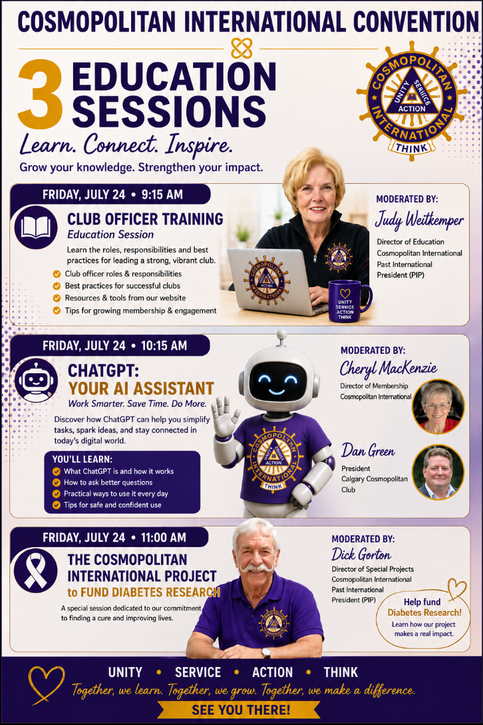
RECENT EXAMPLES: The effort to get this final design was about 10 seconds to type in the request and 2/3 minutes to render. I made no further changes.
TIP: The more you try to incorporate ChatGPT into your efforts, the easier it gets.
Once you have work product that you like, you can then ask ChatGPT to use the images any way you want.
In this case, I wanted one image for the three sessions. The only time it took was to type the prompt.
PROMPT: “Can you build one graphic that promotes the three Education Sessions identified in these attached images.”

Slide 25
Key Takeaways
• Better prompts = better results
• ChatGPT supports creativity
• Useful for recruitment & marketing
FOR MORE INFORMATION:
Cheryl MacKenzie, Director Membership
membership@cosmopolitan.org
780-907-1034

