Slide 1


Cosmopolitan International: The Club that Fights Diabetes
Founded in 1918 in Kansas City, Missouri. Over a century of community service.
Global presence across the United States and Canada with ~53 clubs and ~1,000 members.
United by our mission to fight diabetes through charitable donations and volunteer service.
Notes:
Welcome, everyone! I’m excited to introduce you to Cosmopolitan International – The Club that Fights Diabetes.
Since 1918, we’ve been uniting communities through service, and today, we’re stronger than ever with over 50 clubs across the U.S. and Canada.
Our mission? To fight diabetes and serve our communities with heart and purpose.

Slide 2




Our Mission & Values
Unity
Service
Action
We embrace our founder's vision of unity of purpose, working collectively for the betterment of all.
We serve our communities unselfishly, with special emphasis on diabetes prevention and finding a cure.
We take meaningful action to build better communities and improve lives affected by diabetes.
Notes:
At the core of everything we do are three values: Unity, Service, and Action.
We believe in working together, serving unselfishly, and taking meaningful action to support those impacted by diabetes. These values are not just words – they’re the foundation of every club project and initiative we launch.

Slide 3
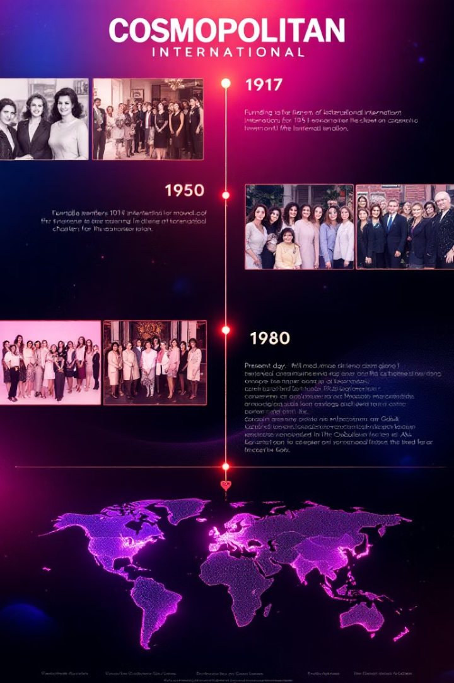
A Century of Service
1
1918
Founded in Kansas City, Missouri as a civic service club.
2
1977
Members voted to make fighting diabetes our primary international project.
3
2018
Celebrated our centennial, renewing our commitment to community service.
4
2024
Adopted a new International Project to support diabetes research with DRIF and DRIF-CAN.
Notes:
We’ve been doing this work for over 100 years. In 1977, we officially adopted diabetes as our flagship cause.
In 2018, we celebrated our centennial. And just last year in 2024, we expanded our impact again through a new international project with DRIF and DRIF-CAN.

Slide 4

Community-Focused Service
Local Impact
Health Screenings
Each club identifies community needs and takes action. We build parks, support hospitals, and support diabetes camps.
Members volunteer at health fairs and free screening clinics, providing blood glucose tests and education.
Emergency Support
Some clubs provide emergency insulin and supplies to diabetic patients in crisis.
Notes:
Each Cosmopolitan club identifies and serves local needs — from building parks and supporting hospitals to organizing youth diabetes camps.
Our members also provide free health screenings, including blood glucose tests and education at community events.
And in times of crisis, some clubs even provide emergency insulin and supplies — quite literally saving lives.

Slide 5
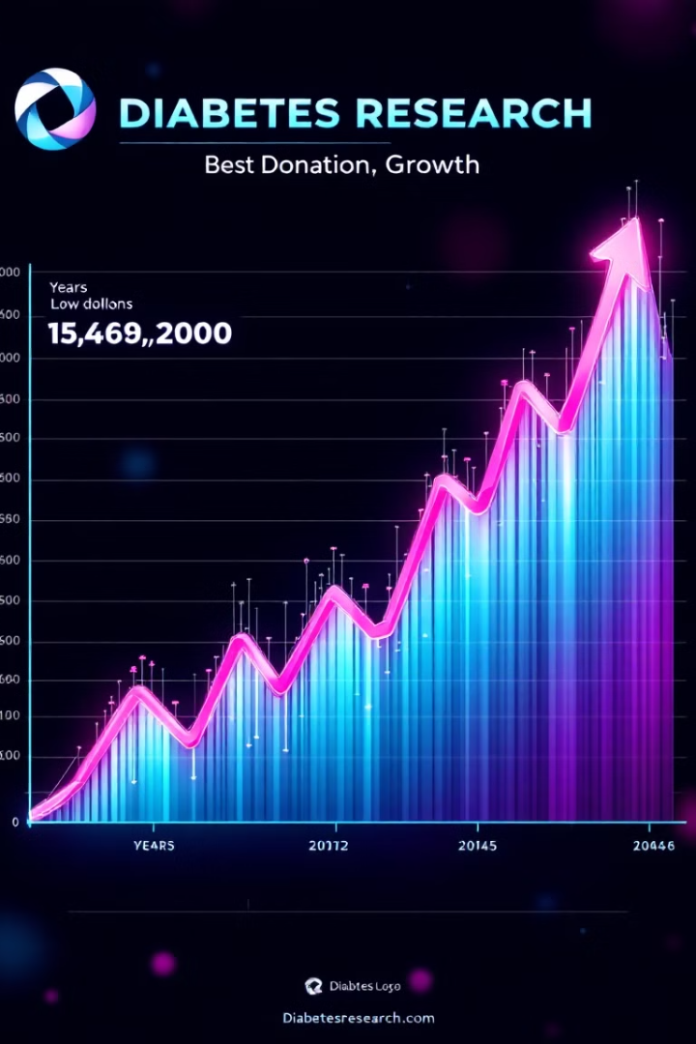
Impact by the Numbers
$950K+
$5M+
Annual Donations
Total Contribution
Raised and donated yearly to diabetes-related and community causes.
Donated toward diabetes research, treatment, and education since 1977.
16
Supported Diabetes Centers and Programs
Established through major fundraising campaigns.
Notes:
Our impact is significant:
Over $950,000 raised and donated every year
More than $5 million contributed to diabetes-related efforts since 1977
16 diabetes programs and centers supported through major fundraising efforts
Every dollar raised brings us closer to a cure.

Slide 6






Our Diabetes Centers & Programs
Improved Lives
Expanded access to specialized care for countless patients.
Advanced Research
Facilities conduct cutting-edge diabetes research and clinical trials.
Major Investments
Over $2 million pledged to establish these centers of excellence.
Notes:
We’ve made major investments in specialized diabetes care:
Improved lives by expanding access to care
Supported cutting-edge research
And pledged over $2 million to establish and grow these centers of excellence

Slide 7





Driving Research Breakthroughs
INGAP Research
Pledged $750,000 to develop a drug aimed at regenerating insulin-producing cells.
Edmonton Protocol
Helped kickstart islet cell transplant procedure that has enabled many diabetics to become insulin-independent.
DRIF and DRIFCAN Research
Pledging $1,000,000 over 5 years to support stem cell research to cure diabetes.
Pioneering Spirit
We fund novel research to accelerate the day when diabetes is cured.
Notes:
We don’t just support care — we help fund cures.
$750,000 helped launch INGAP research, which explores regenerating insulin-producing cells
We backed the Edmonton Protocol, an islet transplant procedure that has made some diabetics insulin-independent
And now, through our partnership with DRIF and DRIFCAN, we’re pledging $1 million over 5 years to support stem cell research
We’re proud to be part of the breakthroughs that give people hope.

Slide 8








Partnership with EVMS
Strelitz Diabetes Center
Patient Care
CI raised $1,000,000 to help establish this leading facility on the U.S. East Coast.
Thousands have received treatment from cutting-edge clinical trials to compassionate outpatient care.
Research
Helped seed the INGAP trial. Researchers conducting numerous clinical trials and studies to explore better management strategies and develop possible treatments for diabetes and diabetic complications.
Ongoing Support
Continued contributions by Cosmopolitan Capital Federation fund special projects and equipment.
Notes:
One of our proudest achievements is our partnership with Eastern Virginia Medical School.
We raised $1 million to help establish the Strelitz Diabetes Center, where thousands have received life-changing care and participated in advanced clinical trials.
And we continue to support them through special project funding — our commitment doesn’t end with a one-time donation.

Slide 9

Canadian Research Partnerships
Alberta Diabetes Foundation
Beta Cell Regeneration Project
Committed $175,000 over 7 years (2015-2021)
CI contributed $100,000 to
Dr. Buteau's groundbreaking research
Clinical Trials
Helped advance research toward a pill that could restore insulin production
Notes:
Our Canadian members are just as committed.
We donated $175,000 to the Alberta Diabetes Foundation over seven years.
And we contributed $100,000 to Dr. Jean Buteau’s beta cell regeneration research — now heading into human clinical trials.
Imagine a pill that could restore natural insulin production — that’s the future we’re helping to build.

Slide 10


DRIF and DRIFCan
International Project
"Together for a Cure" Campaign
CI aims at raising $1,000,000 in 5 years to support stem cell research.
Collaborative Effort: In 2023, DRIF (USA) and DRIFCan (Canada) signed a Memorandum of Understanding to enhance cross-border research collaboration.
DRIF (USA): Supports the Diabetes Research Institute in Miami, focusing on developing a biological cure for diabetes.
DRIFCan (Canada): Funds Dr. James Shapiro’s team at the University of Alberta, renowned for pioneering islet cell transplantation.
Notes:
Our latest initiative is called ‘Together for a Cure’ — a bold 5-year goal to raise $1 million to fund research with DRIF and DRIFCAN.
This collaboration is cross-border, uniting researchers in Canada and the U.S. with a shared mission to find a biological cure for diabetes.
From Miami to Alberta, we’re helping scientists take giant steps forward.”

Slide 11
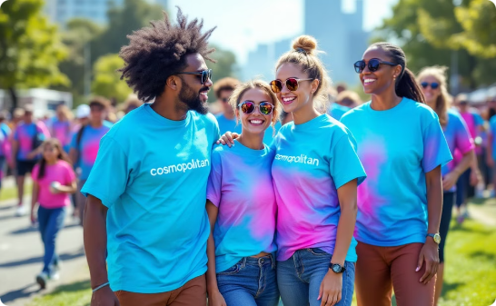


Join the Fight Against Diabetes
Make an Impact
Serve Your Community
Find Camaraderie
Help CI raise the next $1 million that funds a cure. Every member amplifies our reach.
Organize local events that improve lives one neighbor at a time.
Join a network of like-minded friends and develop leadership skills.
Notes:
This is your invitation to join us.
Help us raise the next $1 million to fund a cure.
Organize local events that truly change lives.
And most of all, find a community of passionate people who care deeply and take action.
At Cosmopolitan International, we’re not just volunteers — we’re visionaries, supporters, and champions for the cause.
We believe in better tomorrows — and we invite you to be part of them.”

