Slide 1
Global Network for Blood Donation

Slide 2
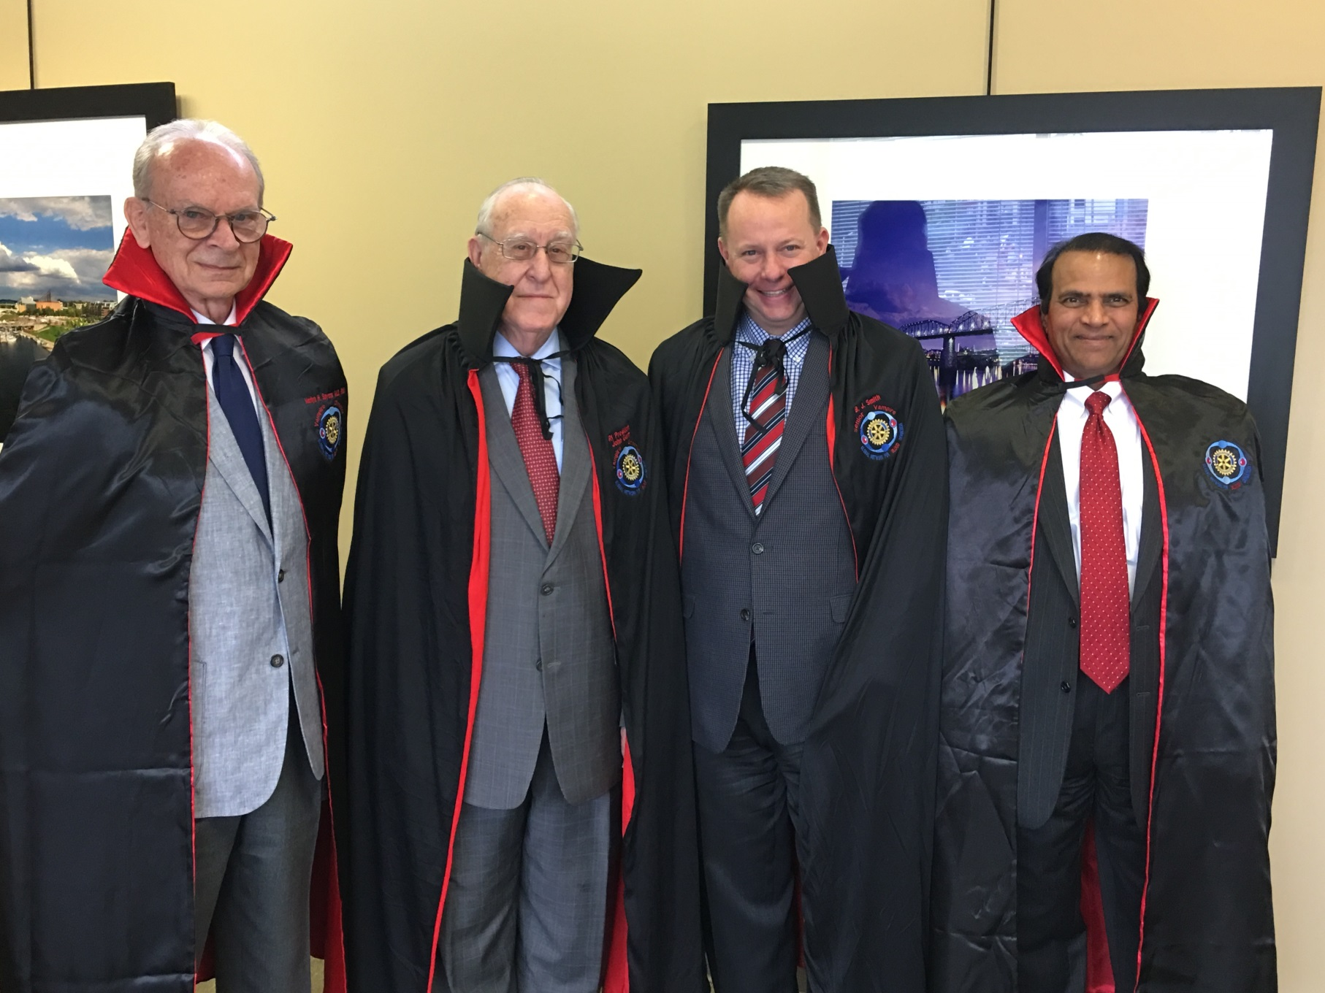

Slide 3
RAG’s
A Rotarian Action Group is an autonomous group of Rotarians, family members, program participants and alumni who are experts in a particular field, such as microcredit or water and sanitation. Group members share their expertise by collaborating with clubs and districts on service projects.

Slide 4
RAG’s
AIDS and Family Health Alzheimer’s and Dementia
Blindness Prevention Blood Donation
Clubfoot Dentistry
Diabetes Disaster Assistance
Endangered Species Environmental Sustainability
Food Plant Solutions Health Education and Wellness
Hearing Hepatitis humbertowcf@hotmail.com
Hunger and Malnutrition Literacy
Malaria Maternal Child Health
Mental Health Microfinance and Community Development
Multiple sclerosis Peace
Polio Survivors and Associates Preconception Care
Water and Sanitation Addiction Prevention
Slavery

Slide 5
Global Network for Blood Donation
An international network of Rotarians involved in blood donation projects that inspire other clubs and districts to ensure that local blood banks are adequately supplied.
GNBD will promote voluntary (non-remunerated and regular) blood donation and support for local community blood centers.

Slide 6



RI AREAS OF FOCUS
Peace and Conflict
Prevention/Resolution
Maternal and Child
Health
Maternal and
Child Health
Basic Education and
Literacy
Disease Prevention
And Treatment
Disease Prevention
and Treatment
Economic and
Community Development
Water and Sanitation
Water and Sanitation

Slide 7
GNBD AND AREAS OF FOCUS
Disease Prevention and Treatment
Maternal and Child Health
A safe, pure, efficacious and readily available blood supply is key component to a successful healthcare delivery system.
GNBD promotes safe voluntary blood donation through Rotarians.
75% of transfusions in restricted economy countries are given to OB and pediatric patients. A number of these patients die due to unavailability of blood.

Slide 8
GNBD Milestones
1996 – Governors’ Challenge D5790
2001 – D9300 Johannesburg area joins
2002 – D5810 joins the Challenge
2007 – RI approves GNBD as a RAG
– first exhibiting at the RI Convention Salt Lake City
2010 – Districts in Texas embrace Challenge
and many others follow
– D5790 & D5810 Challenge reaches 100,000 units collected

Slide 9
GNBD Milestones
2011 – Cowboys and Indians competition
– Collaborative agreement with the Association for Donor Recruitment Professionals (ADRP)
2013 – Partnership with the Global Blood Fund
2017 – 11th year exhibiting at the RI Convention (Atlanta)

Slide 10
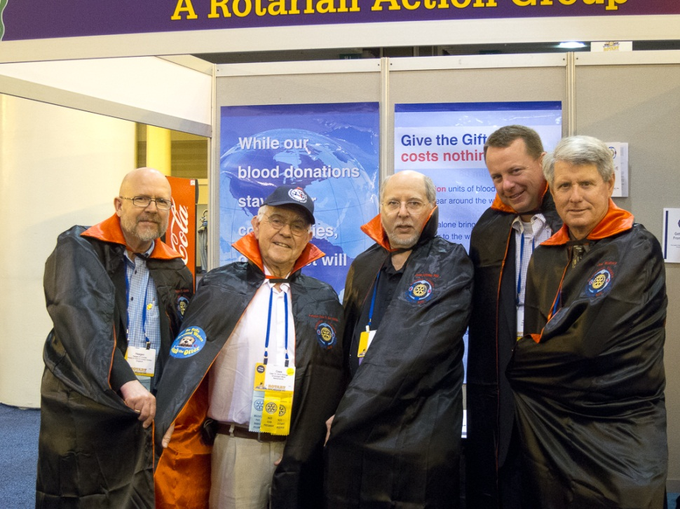
GOVERNORS’ CHALLENGE
Pre-GNBD exhibition
  2001,2005&2006
Golden Vampire D5810 & D5790
Cowboy Challenge in Zones 21b & 27
Spreading the word at Conferences, Assembly's and Conventions
140K units collected in Texas

Slide 11
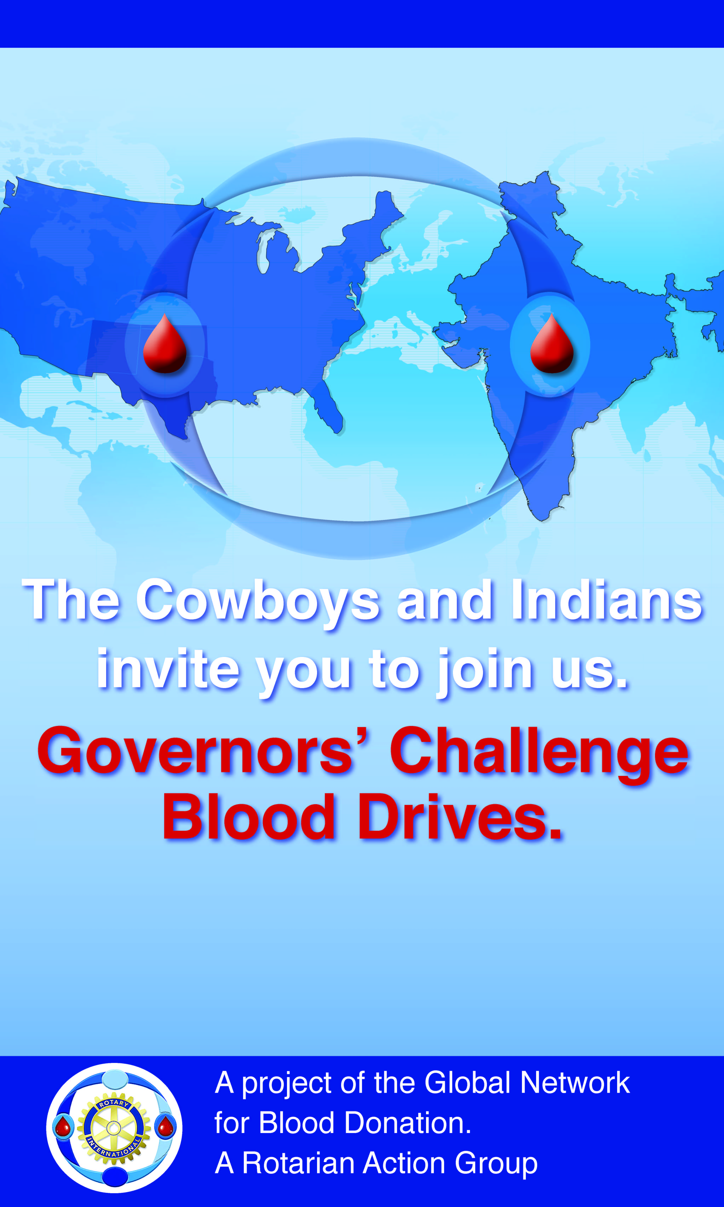
GOVERNORS’ CHALLENGE
In May of 2011, RI President Elect, Kaylan Banerjee Challenges Districts and Clubs in India to join the Governors’ Challenge.

Slide 12
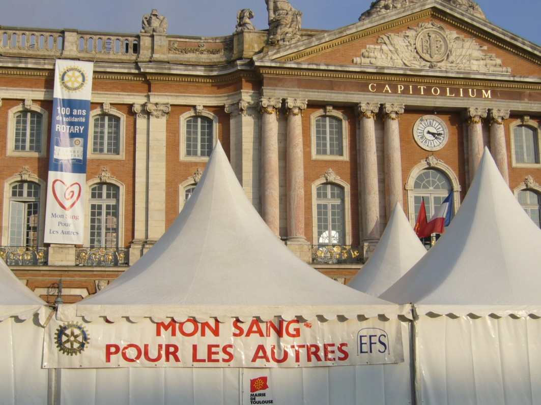


Mon Sang Pour Les Autres
First blood collection in Toulouse
District 1700, France, in1998
Global Network for Blood Donation
My Blood For Others

Slide 13
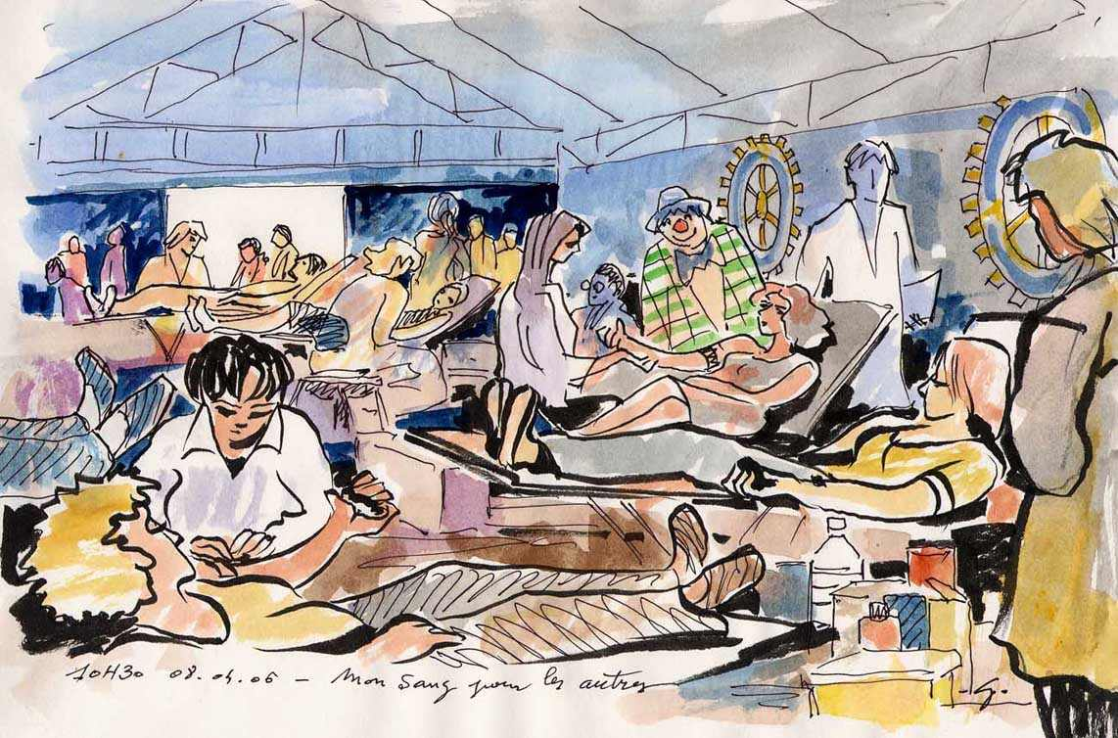
Expansion in France
292.000 donors welcomed in 18 years
Global Network for Blood Donation
My Blood For Others

Slide 14
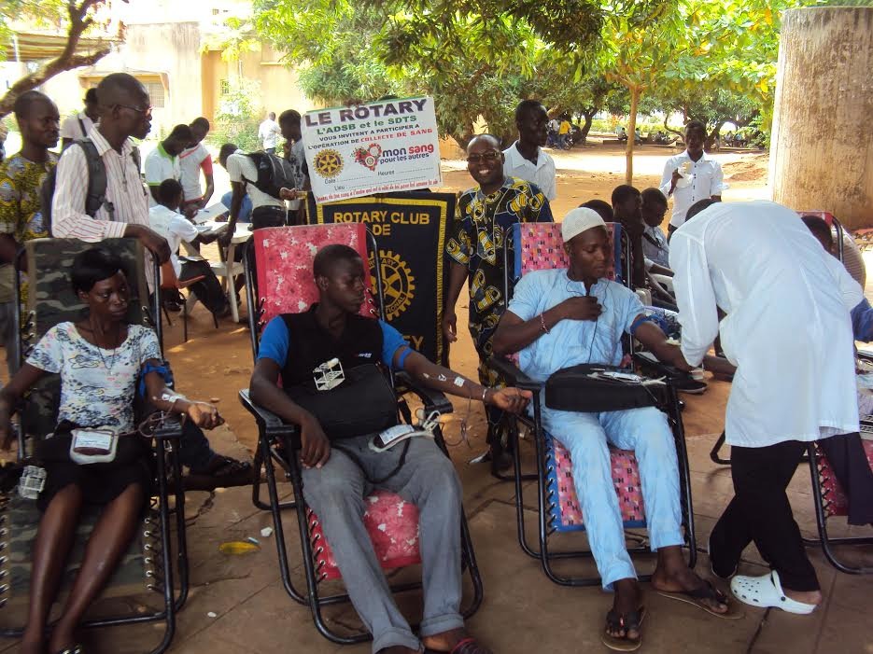
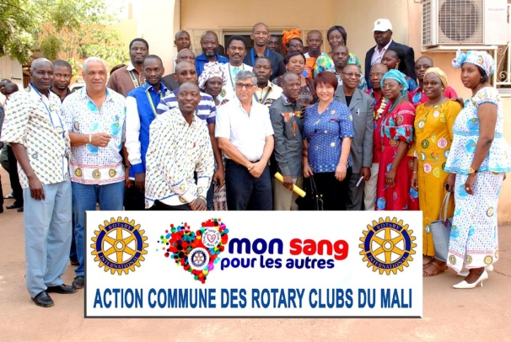
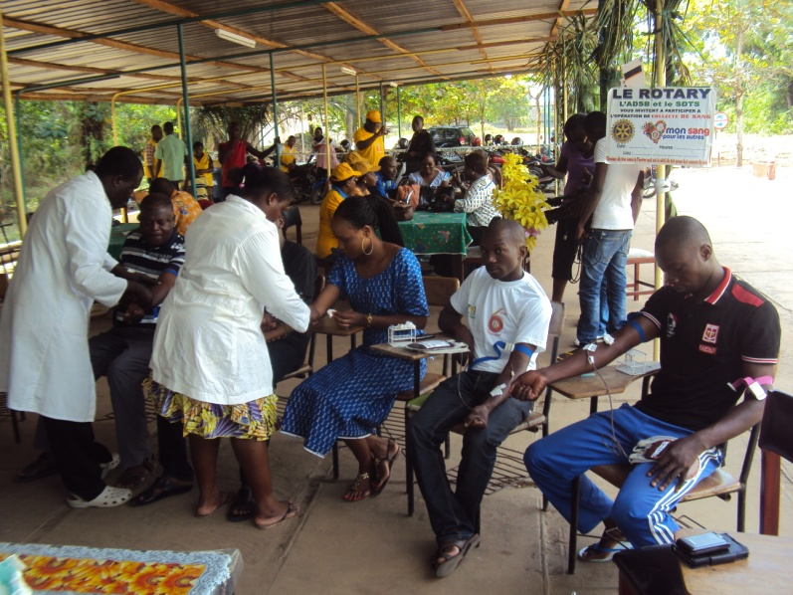
Out of France
Mali,
Togo,
Benin,
Gabon, Senegal,
Ivory Coast,
Reunion Island
Global Network for Blood Donation
My Blood For Others

Slide 15

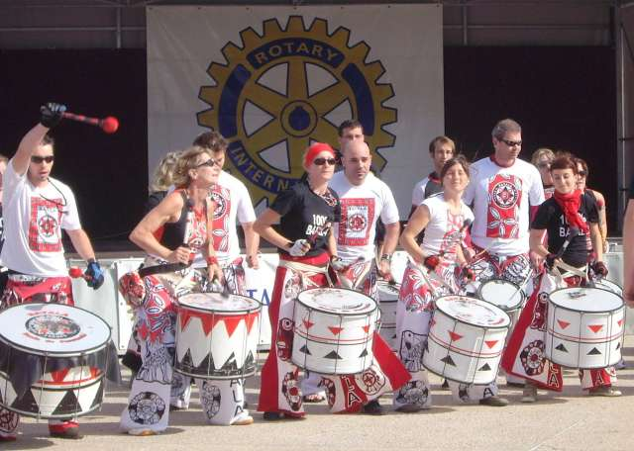
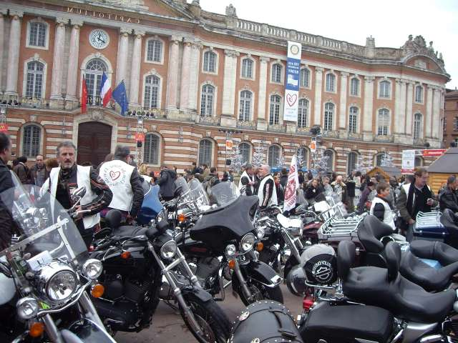
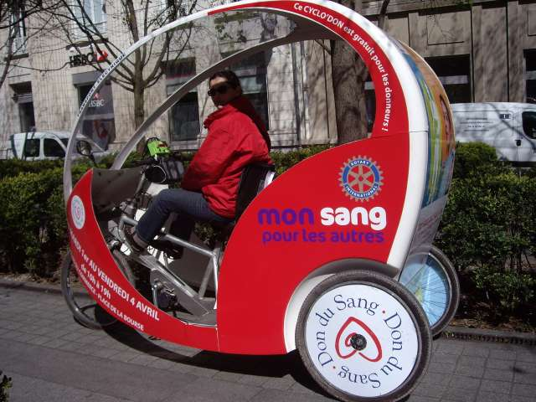
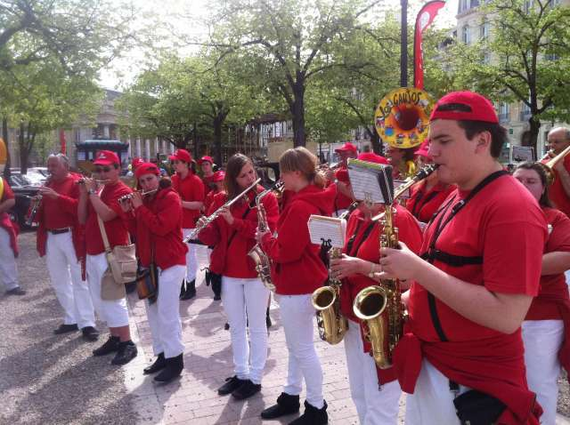
Conditions for success
Numerous and varied associated events
Global Network for Blood Donation
My Blood For Others

Slide 16
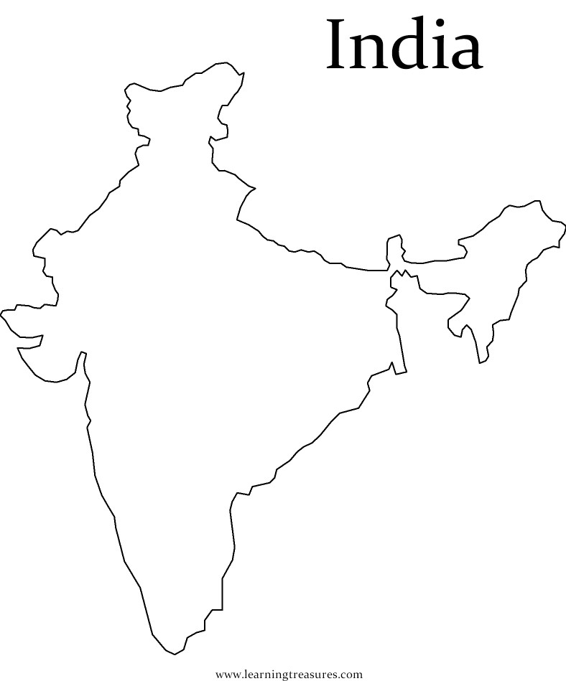
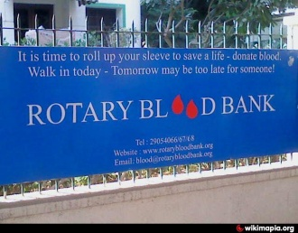

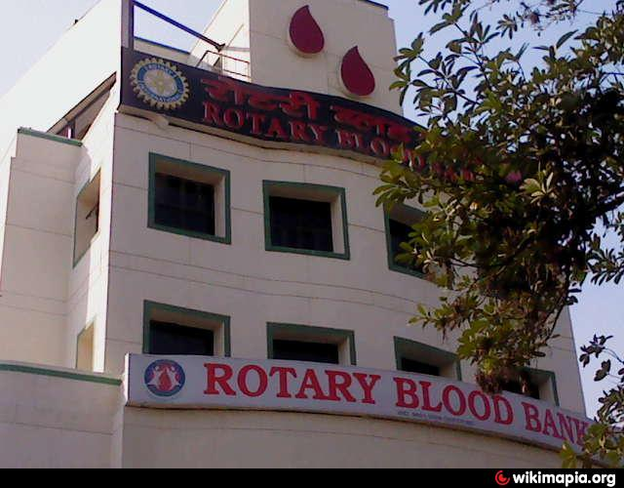
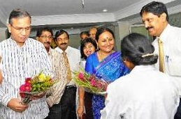
INDIA
Rotary Blood Bank Vizag

Slide 17
Questions

