Slide 1
Alternate Assessment
Andrew Hinkle

Slide 2
Better than a Collection of Evidence:
What We’ve Learned and What’s Coming Next with the Ohio Alternative Assessment for Students with Significant Cognitive Disabilities (AASCD)

Slide 3
Training 2012-2013
OACS-E
2200 online modules
8000 face-to-face
500 Trainers
10,000 TAs
AASCD
Notes:
Describe SST/Urban process. Initial training. Pilots. Weekly calls. Regional TTT.

Slide 4
Participation Data
Grade Band | Students 2013 | Students 2012
3-5 | 7030 | 7039
6-8 | 7315 | 7238
OGT | 2220 | 2326
Total | 16,565 | 16,603
Notes:
Has been steady for last 4-5 years. We will be monitoring.

Slide 5
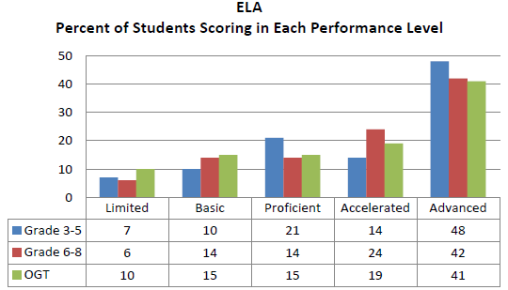
Notes:
Percent at each performance level is the difference between each level.
3-5
Limited = 7%
Basic = 10%
Proficient = 21%
Accelerated = 15%
Advanced = 47%

Slide 6
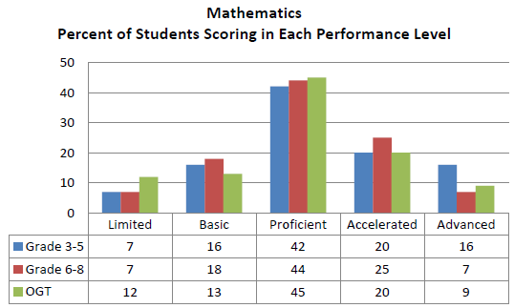

Slide 7
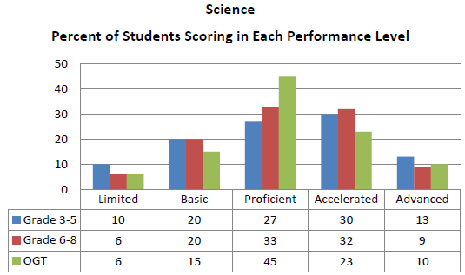

Slide 8
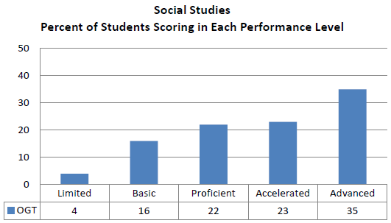

Slide 9
Completion Rates
TA Completion Rate | 94.61%
SR Completion Rate | 93.14%
Notes:
3-8 = 96.5% OGT = 88.25%
Completion Rate = number of tests submitted / number of students pre-identified
NOTE: Rates may reflect schools that over pre-identified students, or students who took only certain content areas within their assigned grade band.
Can be monitored in real time in the ORS in Plan and Manage Testing
Monitor test progress for students who have been pre-identified to participate in the Ohio AASCD and identify whether test data hasbeen submitted for students in the Data Entry Interface (DEI)

Slide 10
TA Training Feedback
Did the test administrator training you received adequately prepare you to administer the AASCD?
Response | Count | Percent
Yes | 216 | 84.0%
No | 3 | 1.2%
Somewhat | 38 | 14.8%
Notes:
Among the constructive feedback provided, the most salient comments included the following:
- TAs would like more illustrations and information regarding how to administer the assessment to students with the most significant cognitive disabilities, especially those who are nonverbal and blind.
- TAs would like training to include more information and demonstrations of the online systems (TIDE, DEI and ORS).
- TAs wish they had more time to practice scoring and administering tasks. Some commented that practicing with other teachers was not as helpful as it would have been to practice with the trainers directly.
Participants would like more direction on how to score engagement items and use assistive technology.
2013
Same training requirements for 2013-2014. Next year 2014-2015, may be able to reduce training requirements further and/or provide online update.

Slide 11
Administration Procedures & Quality of Materials
User-friendly, high-quality, durable materials
Easy to follow scripts
Time to prepare and organize Too many materials to manage while administering
Positive
Constructive
Notes:
Positive
Test materials were user-friendly, high-quality, and durable
Scripts were easy to follow and administer
Negative
Materials took too much time to prepare and organize
Too many manipulatives and materials to manage when administering
2013
Need Certificate/license/permit and employee to prepare materials but don’t have to be TA trained.
Strips will be single line. Previously FT items will still have dots.

Slide 12
Test Security
Same level of security as general assessments
One-on-one burdensome
TA manipulating scores
Notes:
Advisory Committee recommends maintaining same level of security as general education assessments
Testing one-on-one burdensome
Some concern about TA manipulating scores
2013
Same level of test security will be maintained

Slide 13
Second Raters
Positive
Valuable accountability measure and easy process
Constructive
Keeping track of students who need SRs
Notes:
2013
Will allow substitutions via help desk
Medically Fragile
Home Instructed
Missed opportunity
Will not be able to do SR beyond assignment.

Slide 14
Data Entry Interface (DEI)
Positive
User friendly, clear and easy
No problems with it at all
Constructive
Form number confusion
Want “bubble sheet” interface
Notes:
2013
Form number will still be important. Gives flexibility to LEA who serve multiple districts.

Slide 15
Online Reporting System (ORS)
Users waited
Test completion progress
Notes:
The Online Reporting System (ORS), a web-based system that enables teachers and administrators to view student score reports, performance data and participation information
Very few comments
Most users waiting until score reporting to investigate
Could monitor test completion progress

Slide 16
Ordering, Receiving and Returning Materials
Generally reported as smooth
LEAs that service multiple districts
Notes:
Receiving Materials:
Facilities that service multiple districts would like to order their own kits.
Some test administrators and school personnel complained that districts did not pass along the kits in advance of the test window. One person specifically requested that ODE suggest a deadline for districts to give schools the test materials.
2013
Special Cases Document
Returning Materials:
Several respondents requested that materials return would not fall immediately before or after spring break as it did for this administration.
There were requests that extra return labels be provided next year.
There was some confusion whether the Secure Materials Resolution form should be returned if there were no discrepancies.
The manuals should provide more clarity what needs to be returned and how the materials should be placed back into the kits for return.

Slide 17
AASCD 2013 - 2014
So what else is new?

Slide 18
Training
New modules in November
Regional trainer training
SST AASCD TA training after November 13
OACS-E
AASCD
Notes:
OACS-E - Quad 3 SW has confirmed for Oct. 9th and Quad 4 SE has confirmed for Oct. 22nd for TTT. Shawna’s TTT is on the application of OACS-E through planning. It is based on her 2-day LI training she did in the past, which merges the standards and planning. It pairs content from Ohio's New Learning Standards, OACS-E, assessment, DI and AT with planning for instruction.
AASCD - Half day for returning TAs/teachers/SRs and full day for new TAs/teachers/SRs

Slide 19
Online systems
New Teacher (TE) user role
Multiple user roles
Reset and Invalidation approval
Immediate scoring
Notes:
NEW Alternate Assessment User Role
District test coordinators are responsible for creating user accounts for personnel who need access to Ohio’s alternate assessment online systems. The level of access to each system (TIDE, Data Entry Interface (DEI) or the Online Reporting System (ORS)) depends on the user’s role, as described in the user role matrix located on the portal (oh.portal.airast.org).
To coincide with the release of interactive score data and in response to feedback from the field, a new user role is available for the 2013-2014 school year. The new role — “Teacher” — will be able to enter scores in the DEI in the same way the Test Administrator user role presently does. Additionally, a “Teacher” will have access to interactive score data at the school level. The Test Administrator user role will not have access to interactive score data at the school level. Test coordinators should consider assigning the “Teacher” role to personnel who will be administering the alternate assessment and entering scores into the DEI and who additionally should have access to school results.
The Test Administrator and Second Rater user roles will continue to be available and will have the same access that was available during the 2012-2013 school year. The Test Administrator user role will be able to enter scores in the data interface, but will not have access to score data in the ORS. The Second Rater user role will only be able to enter Second Rater scores into the DEI. More information can be found in the TIDE User Management guidance document.
a. New TE user role in online systems: the only distinction from the TA role is that the TE role provides access to student scores in ORS.
b. Users can have a different role for each school or district. For example, a user can be a SR in one school and a TE in another.
c. Resets and invalidations must be approved by ODE.
d. Immediate scoring upon test submission. The score will be displayed in the DEI upon submission, and can be found in ORS.
Invalidations
1- Test security violation
2- Administration of the wrong test
3- Errors in administration procedures and scoring
Test Resets
1- A test administrator or second rater enters scores for the wrong student.
2- A test administrator or second rater enters scores in the wrong test (i.e., primary or second rater test).
3- The wrong form number was selected (e.g., form 01, form 02, or form 03).

Slide 20
Student Placement Questionnaire
Identifies starting task
Individual
Notes:
The SPQ is designed to identify the most appropriate starting task for each of your students.
The assessment is designed to increase in complexity as the student progresses. By using these tools, the student will be placed in the assessment based on the teacher’s knowledge of the student’s academic performance.
The students will be administered a portion of the assessment.

Slide 21
Field Testing
Multiple Forms
Last task
Notes:
- Field testing will continue so that the state can add more tasks and items to its bank. All students will be required to take the last task, the field test task.
- To lessen the burden on students, there are multiple forms with different FT tasks. Districts and schools will need to be mindful about form numbers and form selection in the DEI this year, as well.

Slide 22
Key Dates 2013-2014
TIDE On-Time order window Dec. 2-13
TIDE Pre-ID window Jan. 13-24
SR assignments released Feb. 3
Notes:
On the portal

Slide 23
Key Dates 2013-2014
Materials arrive February 10
Testing window Feb. 24-Apr. 18
Paper Score Reports June 6

Slide 24
education.ohio.gov
Andrew Hinkle
andrew.hinkle@education.ohio.gov
614-644-7304
Office for Exceptional Children
Amy Parker
amy.parker@education.ohio.gov
614-387-0948
Office of Curriculum and Assessment

Slide 25
Social Media
Ohio Families and Education
Ohio Teachers’ Homeroom
ohio-department-of-education
storify.com/ohioEdDept
@OHEducation
OhioEdDept

