Slide 1



HOPE Curriculus:
Health & Opioid Prevention Education
Ohio Association of Pupil Services Administrators
December 8, 2017
Kevin Lorson
HOPECurriculum@wright.edu

Slide 2
Today’s Goals:
Examine the opioid epidemic and the federal, state and local response.
Describe Ohio’s prevention efforts.
Examine the role of the teacher, health educators, school personnel and the school in drug prevention.
Review the HOPE Curriculum Lessons.
Develop a HOPE Curriculum Action Plan.

Slide 3
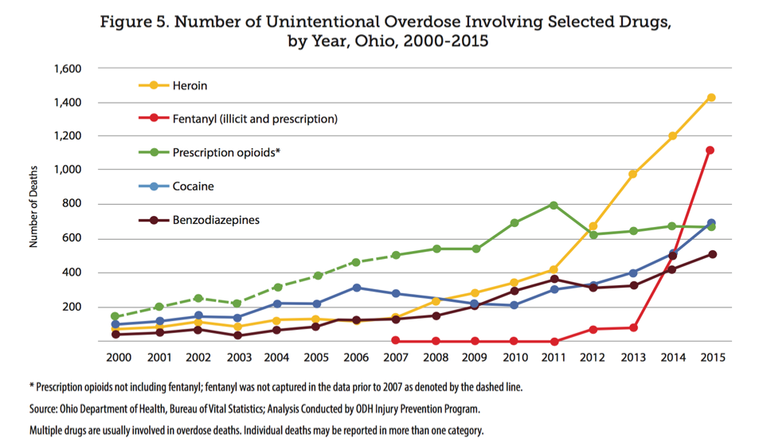
Pain in America InfoGram
Notes:
Estimates are that 8 people die every day in Ohio from an overdose. That number is quickly rising.
Dr. Anahi Ortiz, Franklin County Coroner, testified that:
· About two people a day are dying from drug overdoses in Franklin County.
· Just last year, 144 people in Franklin county died after overdosing on the highly potent and dangerous drug fentanyl and/or fentanyl analogues.
· Opioid related deaths are roughly double the number of people who die from homicides.

Slide 4
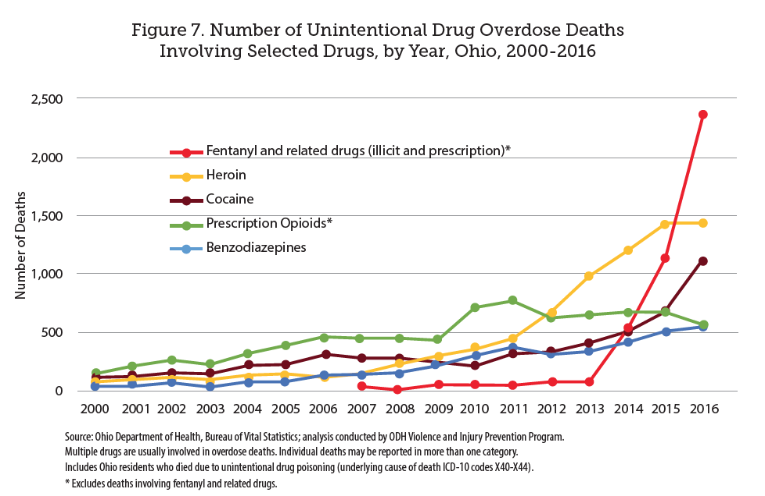

Notes:
In 2016, unintentional drug overdoses caused the deaths of 4,050 Ohio residents, a 32.8 percent increase compared to
2015 when there were 3,050 overdose deaths.
Estimates are that 8 people die every day in Ohio from an overdose. That number is quickly rising.
Dr. Anahi Ortiz, Franklin County Coroner, testified that:
· About two people a day are dying from drug overdoses in Franklin County.
· Just last year, 144 people in Franklin county died after overdosing on the highly potent and dangerous drug fentanyl and/or fentanyl analogues.
· Opioid related deaths are roughly double the number of people who die from homicides.
31 Child Overdoses in Dayton in 2016.
4X as many babies are born with NAS (Neonatal Abstinence Syndrome) since 2002
10,000 overdose deaths this year in Ohio, far outpacing the rest of the country.

Slide 5
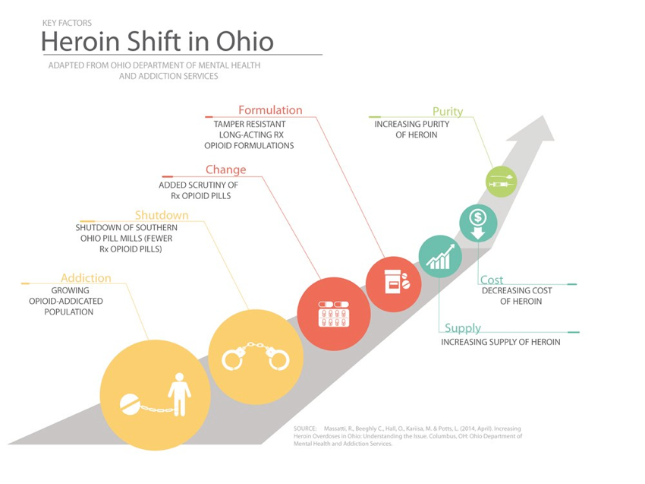

Slide 6
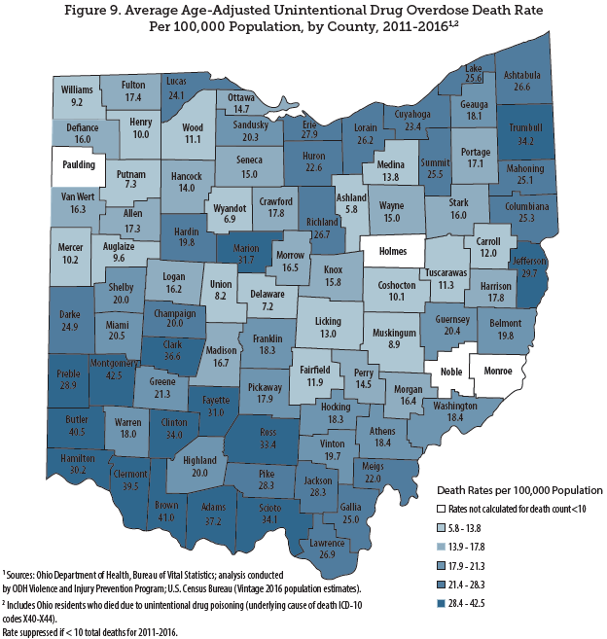

Slide 7
Montgomery County – 2017
Accidental Overdose Deaths Total
Notes:
http://www.mydaytondailynews.com/news/local/the-overdose-epidemic-shifting-dayton/Sq8LWkPvPO4TO0adxeGkrI/

Slide 8
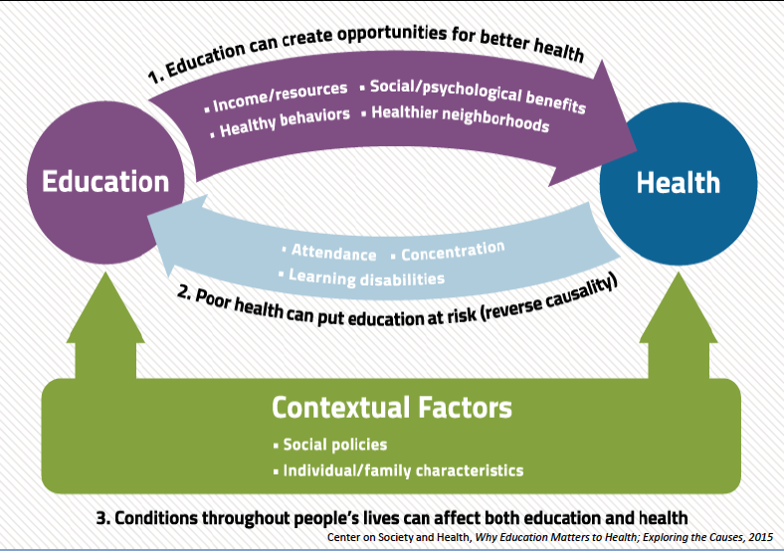
What is the role of the teacher in
drug-abuse prevention?

Slide 9
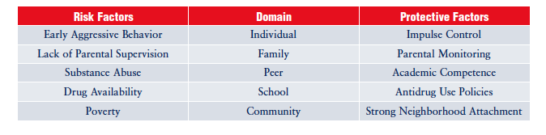
Risk Factors & Protective Factors
Risk Factors – those factors associated with a greater potential for drug abuse.
Protective Factors – Those factors that are associated with reduced risk.
*Most at risk do not start using
*Risk factor for one may not be for another.
“Risk Trajectory or Path”
(National Institute on Drug Abuse (2003). Preventing Drug Use among Children and Adolescents: A research-based guide for parents, educators and community leaders)
Notes:
Trajectory – how risks become evident at different stages of a child’s life.

Slide 10
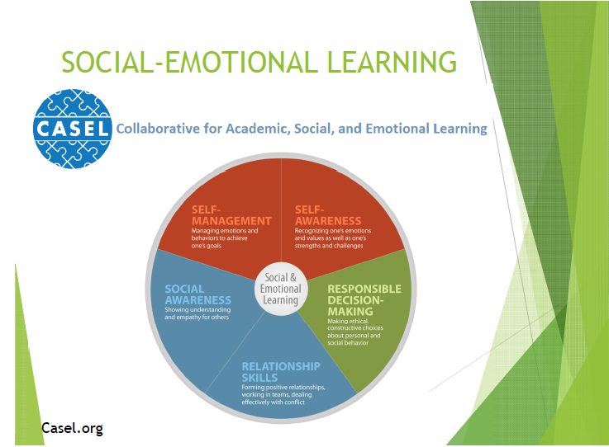
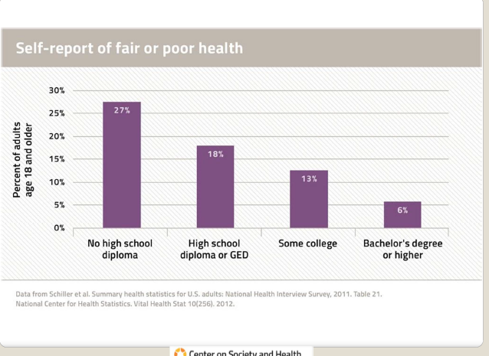
Notes:
PAX & Social-emotional learning is the foundation that develops protective factors and reduces risk factors
Generation RX – opiate information and descriptions of pharmacology (for pharmacists)
Start Talking – classroom, family and community support resources
HOPE – scope and sequenced curriculum for health education (and classroom teachers)

Slide 11
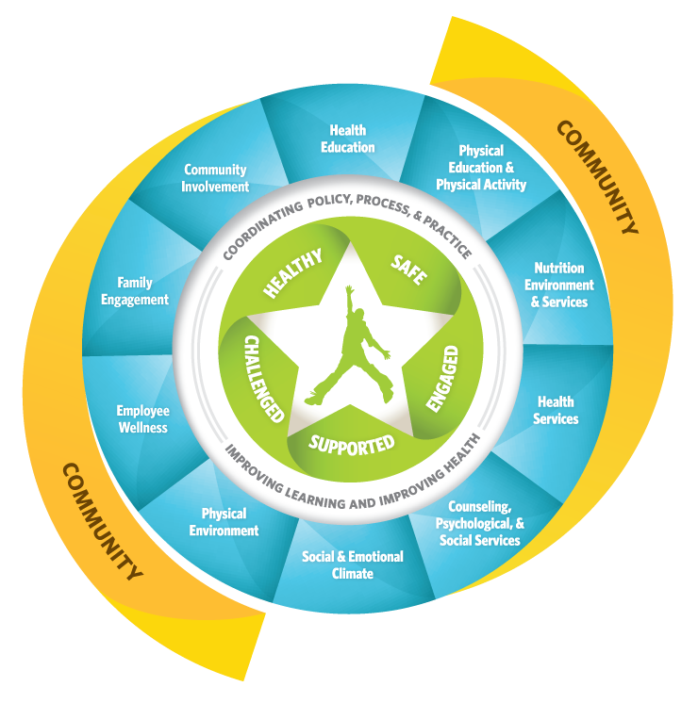
HOPE
Generation Rx
Start Talking!
Notes:
Success is possible through system change. Consistent, coordinated messages will be effective.

Slide 12
HB 367 Overview
Requires Ohio schools to select a health curriculum that includes instruction on the dangers of prescription opioid abuse and the connection between prescription opioid abuse and addiction to other drugs, such as heroin.
  Governor’s Cabinet Opiate Action Team (GCOAT) makes recommendations that are published by ODE.
  ODE provided recommendations for instruction at each grade band (K-2, 3-5, 6-8, 9-12)

Slide 13
Health Education in Ohio
Ohio is the ONLY state without health education standards.
Health Education is the ONLY academic content area without academic content standards.
General Assembly has oversight of health education, not the Ohio Department of Education (ODE).
  Ohio is a local control state
NO ODE health education consultant.
ODE cannot develop or publish curriculum, but they can provide links and resources.

Slide 14
Ohio’s Health Education Requirements:
Graduation Requirement: One-half unit (60 hours)
K-8: NO Time Requirement, but……
ALL Schools MUST have a health education curriculum that includes:
Nutrition - including natural and organically produced foods, the relation to health and the use and effects of food additives.
Harmful effect and legal restrictions against the use of drugs of abuse, alcoholic beverages, and tobacco.
Venereal disease*
Personal safety and assault prevention
  K-6: child abuse prevention,
  7-12: Dating violence and healthy relationships.
Prescription opioid abuse prevention.
Anatomical Gifts

Slide 15
Effective Health Education
Curriculum
Focused on Health-related Skills, Attitudes, and Functional Knowledge.
  Emphasizing health-enhancing beliefs and norms
  Analyzing peer pressure as well as media pressure
  Helping students to develop competency and self-efficacy in health-enhancing skills
Skills v. Information Approach to Health Education:
  An Example.
Resources for Effective Health Education:
  Health Education Curriculum Analysis Tool (HECAT)
  Characteristics of Effective Health Education Curriculum.

Slide 16
Health Education Standards
KEY CONCEPTS – comprehend concepts related to health promotion and disease prevention.
ANALYZING INFLUENCES – analyze the influence of others, culture, media, technology on health.
ACCESSING VALID HEALTH RESOURCES - access valid information, products and services.
INTERPERSONAL COMMUNICATION SKILLS - use interpersonal communication skills to enhance health and avoid or reduce health risks.

Slide 17
Health Education Standards
DECISION-MAKING SKILLS - use decision-making skills to enhance health.
GOAL-SETTING SKILLS - use goal-setting skills to enhance health.
SELF-MANAGEMENT SKILLS – demonstrate health-enhancing behaviors to avoid or reduce health risks.
ADVOCACY SKILLS - advocate for personal, family, and community health.

Slide 18
Characteristics of the HOPE Curriculum
Designed for K-12 with lessons for each grade band
    K-5 - designed for classroom teachers, aligned with English Language Arts.
    Middle and High School - designed for licensed health education teacher.
Enhance health education, not a new program.
Designed to supplement, not replace, a comprehensive approach to alcohol and other drugs prevention education.
Connected with Start Talking!; Generation Rx; youth-led prevention programs.

Slide 19
Why the Classroom Teacher?
Classroom teacher is a trusted adult at school.
Role of one caring adult.
Consistent messages across the school day and school year.
Already contributing to drug prevention
Why not science?
  Science provides knowledge about our bodies, but not how to make health choices to be healthy.
  Easy connection with ELA outcome

Slide 20
HOPE Curriculum
Lesson Plans - Draft Completed ✓
  Three lesson plans for each grade K-8, 10 lessons for HS.
  Includes with an lesson enhancements and extensions.
Teacher Guide
  Tips to implement the lessons and additional content knowledge packets with instructor notes
School Administrator Guides
  Additional resources; FAQs; letter to parents overviewing the topic and resources.
Staying Connected
  Ideas for additional follow-up, community and parent engagement, and social marketing based on the foundation established by Start Talking!

Slide 22
HOPE Key Concepts:
Only take medicine from a trusted adult
  Who is a trusted adult?
Never share or take some else’s medicine
Store medicines in locked cabinet and out of reach of children.
Properly dispose excess or expired prescriptions.
If it is unhealthy, unsafe or you’re unsure – Don’t take, Don’t taste, Don’t touch & tell a trusted adult.

Slide 23
HOPE Essential Skills:
Decision-making
  Stop, Think, Choose
Analyzing influences
  Media, peers, other
Communication skills
  Refusal Ways to say No!
  Assertive verbal and nonverbal communication
  Empathy & supporting others

Slide 24
Key Outcomes:
Grades K-2
Lesson 1 - Identify rules about medicines at home and school
  Identify trusted adults who can help with taking medicines.
  Recognize the healthy decision when encountering medicine, unknown or unsafe substances.
    Don’t know = Don’t touch, don’t taste, don’t take & tell a trusted adult.
Lesson 2 - Decision Making.
  Choose a healthy option when making a decision.
Lesson 3 – Communication Skills. Use effective communication skills to make healthy choices.

Slide 25
Lesson | K | 1st | 2nd
1 | Trusted Adults & Using Medicines Safely Students will differentiate between an adult, friends and trusted adults at home, school or in the community who can help with taking medicines. The emphasis is to only take medicine with the help of a trusted adult. | We Make Healthy Choices Students will read multiple scenarios and sort them into healthy and unhealthy choices. The lesson reinforces how to make healthy and safe choices with medicine and only take medicines from a trusted adult. | Making Healthy Choices to Protect My Brain Students play a Jeopardy-type game to make a healthy choice and to identify trusted adults. The lesson reinforces making healthy choices to protect the brain from the negative consequences of drug misuse.
2 | Safe, Unsafe, or Unsure? Making Healthy Decisions Students will look at pictures to decide if they are safe, unsure or unsafe decisions. Students are reminded it is an unhealthy, unsafe or they are unsure to “Do NOT touch, take, taste and get help from a trusted adult!” | Who Wants to Make Healthy Choices? Students will play the game “Who Wants to Make Healthy Choices?” Students analyze the situation to determine if it was a healthy and safe, or unhealthy and unsafe choice. | Steps to Making Healthy Choices Students will use the steps of making a healthy decision in three situations. Students will apply school and home rules for medicines and drugs to make healthy choices and unlock the “Code of Choices.”
3 | Healthy Decisions Keep “Sammy Safe” Students will analyze choices and determine if they are safe and healthy or unsafe and unhealthy. Students will apply the guidelines for making healthy decisions with medicine to help the “Sammy Safe” puppet. | Asking a Trusted Adult for Help to Make a Healthy Decision Lesson 3 applies decision-making and communication skills in scenarios. The emphasis will be to identify healthy choices and when to ask for help from a trusted adult. | Being Assertive To Be Healthy This lesson introduces assertive communication skills to make a healthy decision to avoid unhealthy and unsafe situations. Students will practice assertive communication and asking for help from a trusted adult.
4* | I Will Make Healthy Choices Students will develop and sign the pledge to be safe with medicines and harmful substances, “I will make healthy choices about medicine. I will only take medicine from a trusted adult.” | I Will Make Healthy Choices about Medicine Students will brainstorm three possible reasons for making healthy choices. The student selects their favorite reason and writes a sentence. The student also writes a sentence about who can help them make a healthy choice. | Encouraging Others to Make Healthy Choices about Medicines Students will develop a paragraph that describe how to make healthy choices, who can help with making healthy choices, and the reasons to make healthy choices to encourage others to make healthy choices.

Slide 26
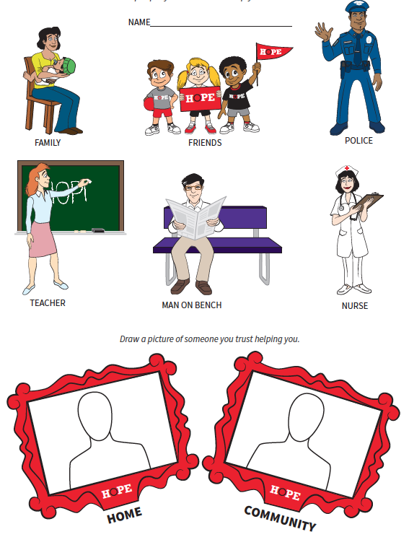
Kindergarten, Lesson 1

Slide 27
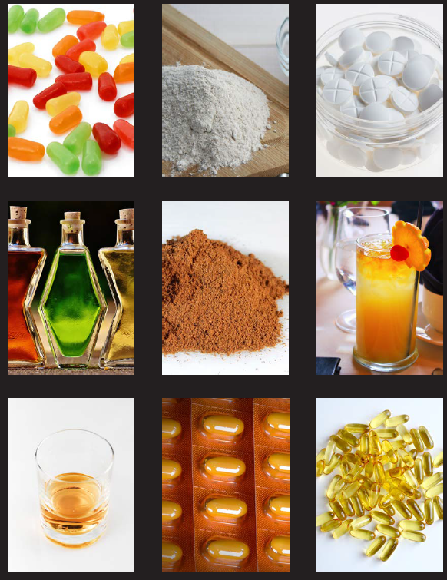
Kindergarten - Lesson 2
Notes:
The testimony of Dr. Andrea Gielen, Professor at the Johns Hopkins Bloomberg School of Public Health, and Director of the Johns Hopkins Center for Injury Research & Policy, offers an in-depth look at the scope of the problem with unsafely stored prescription drugs.
Among the key statistics:
· Only 9% of our 1032 respondents reported storing the medication in a locked place; 57% had or planned to have leftover pills, and almost one-half of these people said they would keep them for future use.
· Among the 681 families who had children living in the home, only 12% of those with children ages 7-17 stored their pills in a locked place.

Slide 28
Key Outcomes:
Grades 3-5
Lesson 1 – Rules, consequences and healthy choices
  Explain how to use medicines correctly
    Identify family and school rules about medicines and drug use.
    Identify trusted adults who can help with taking medicines or how to get help for others.
  Explain the harmful effects of unhealthy decisions or misuse of medicines, drugs and harmful products.
Lesson 2 - Identify options and their potential outcomes when making a healthy decision.
Lesson 3 - Demonstrate effective verbal and nonverbal communication skills to avoid drug use.
Lesson 4 – Advocating to be Drug-Free!

Slide 29
Lesson | 3rd | 4th | 5th
1 | Healthy Choices are Best for Me! Students will compare and contrast the positive and negative consequences of making healthy choices about medicines. The lesson will reinforce following school and family rules for medicine use and always asking for help from a trusted adult to take medicine. | Your Health is not a Game of Chance The purpose of the lesson is to reinforce making healthy choices and the consequences of unhealthy choices. We will use a “Game of Chance,” or “Roll of the Dice” activity to show the risks and consequences of making healthy or unhealthy decisions. | Healthy Decisions: Over-The-Counter and Prescription Medicines. Students will compare and contrast OTC and prescription medicines. The lesson will reinforce home and school rules for taking, storing and disposing medicines in the context of learning about prescription medicines.
2 | Healthy Decision Detective Students will apply the steps to making a healthy decision in the role of Detective H.S. (Healthy, Safe) Decision. As Detective H.S. Decision, students will use the steps of making a healthy decision, identify consequences of the decision, and determine if the decision healthy, safe and respectful. | Your Mission? Making Healthy Decisions Students will pose as a Secret Agent and complete a series of case files that require a healthy decision to complete the mission. The missions will require students to “think ahead,” and determine if places, people or things could lead to unhealthy decisions. | Stop, Think, & Choose to Make Healthy Decisions The Stop, Think, Choose model will be used to help student think about the alternatives and possible consequences before making a choice. Students will play a board game where they will review key concepts, identify consequences of decisions and apply the decision-making skills.
3 | Refuse to Use The focus is on standing up for yourself and the healthy decisions you make. Students will learn practice the four aspects of assertive communication including: looking at the person, stating the decision firmly but politely, walking away if pressured continuously, and telling a trusted adult about an unhealthy/unsafe situation. | Being Confident & Assertive to Make Healthy Choices The lesson will develop assertive communication skills and strategies to be confident and stand up for yourself and your healthy decisions. Students will think about what they will say in a situation, and then practice being assertive in delivering the message with a peer. | Don’t Give in to Peer Pressure: Make Healthy Choices Students will practice the “Three No’s and a Walk” refusal technique. Students will apply the refusal techniques in two different scenarios. The teacher will debrief the scenarios to reinforce positive influences on healthy choices, and being assertive to make healthy choices.
4* | Advocating to be Drug-Free - Lesson 4 is a lesson enhancement. This lesson could be added as an extension to another lesson or it can be a separate stand-alone lesson if time allows. Students are asked to share what they have learned about healthy choices and express that in a creative manner using a RAFT (Role, Audience, Format, Topic).
Notes:
Underline key aspects – e.g. decision-making

Slide 30
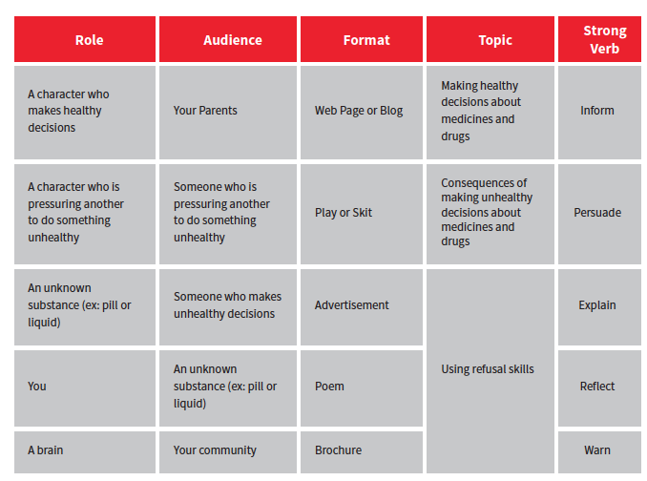
Lesson 4: Advocacy

Slide 31
Lesson | 6th | 7th | 8th
1 | Proper Use v. Misuse The purpose of this lesson is for students to understand the dangers associated with taking prescription and Over the Counter (OTC) medications inappropriately. Students will discuss perceptions of norms regarding prescription and OTC medications. They will practice identifying proper and improper use of medications by analyzing various scenarios. | Reasons for Drug Abuse This lesson takes a closer look at why some teens use drugs and identify alternatives to drug use. Students will look at influences on behavior and examine how positive personal values, beliefs, and goals for their future can help them make healthy choices. Students develop a visual that includes five reasons to make healthy choices about drugs and medicines. | Influences on Drug Use The purpose of this lesson is to analyze the influence of media on healthy choices, in particular prescription drugs. Students identify other valid and reliable sources of information for healthy use of prescription drugs and medicines. Students develop a message using one of the techniques to encourage healthy choices about prescription and other drugs.
2 | Communication Strategies for Refusing Drugs Students will understand the key elements and practice verbal and nonverbal communication skills. Students will learn the difference between passive, assertive, and aggressive communication and strategies. | Refusal Skills The goal of this lesson is for students to gain confidence in using refusal skills. Students will learn refusal strategies to say no to drugs and put them into practice through role plays. Students will analyze the effectiveness of a peer’s refusal skill performance. | Refusal & Communication Skills In this lesson Students will analyze situations that could lead to drug use and different influences that are present when it comes to peer pressure to apply a refusal skill or strategy that best fits the situation.
3 | Making Healthy Decisions about Drug Use The purpose of this lesson to reinforce the decision-making process of Stop, Think, Choose and to identify all the important things they need to consider when making decisions. Students will gain confidence in decision-making by practicing the proper decision-making steps through scenarios. | Decision-Making This lesson is for students to review the Stop, Think, Choose decision making model and analyze the outcomes of a decision. Students will also identify various influences on the decisions we make and how to combat them to make the healthiest choice. | Effective Communication to Facilitate Healthy Choices This lesson will practice decision-making using “Stop, Think, Choose” and effective communication skills in scenarios. Students will identify possible consequences from making poor choices and gain confidence with how to handle these situations through skill practice and class discussion.
4* | Advocating to be Drug-Free *Lesson 4 – Advocating to be Drug-Free by writing a letter that encourages a 5th grader to make drug-free choices when they get to middle school. (*Lesson 4 is an additional that can be used as a culminating assessment in middle school).

Slide 32
1 | 2 | 3
Drug Use & Its Impact on You Students will discuss appropriate and inappropriate uses of a drug, explore reasons why a person would abuse a drug, and find alternatives to drug use. Students will explore the scope of the problem by analyzing the impact of drug use on relationships, society, as well as the user’s health, education, and future. | Addiction Students will take a closer look at the stages of addiction. The lesson uses scenarios to help students understand addiction leads to a progression of consequences on themselves and others they care about. Students writing a personal anti-drug message stating specific reasons to make healthy and drug-free choices. | Proper Use of Prescription and OTC Medicines Students will identify the characteristics of appropriate use, storage and disposal of OTC and prescription medicines. Students will describe the consequences associated with misuse of prescription and OTC medicines. Students will read scenarios and identify proper use/misuse and alternatives to OTC and prescription medicine misuse.
4 | 5 | 6
Decision-Making Students will apply the Stop, Think, Choose Model in scenarios. Students will apply their knowledge about prescription and other drugs to identify the healthy choice. A class discussion will identify others who could be helpful and a positive influence in making healthy, drug-free choices. | Opioid Abuse Prevention Students will identify the consequences associated with opioid use. Students will analyze the impact opioid use has on an individual’s health, relationships with loved ones, career opportunities, academic success, and the communities we live in. | Influences on Drug Use Students will identify various biological, psychological, environmental, and social influences on drug use. Students will also describe the influence of risk and protective factors in regard to drug use. Students will develop strategies to overcome these influencers and identify healthy choices.
7 | 8 | 9
Refusal Skills Students will practice peer resistance skills in role play scenarios. By the end of this lesson, students will have multiple strategies to keep them safe from the pressures associated with drug use. | Avoiding Driving or Riding with a Person Under the Influence Students will analyze situations to understand the dangers associated with impaired driving. Students will practice what to say and do if they want to prevent a person from driving while under the influence. | Getting Help Students will learn how to get help for themselves and/or others who are dealing with drug addiction. They will learn how to identify warning signs and the proper steps for getting help. Students will practice demonstrating empathy to reach out and support the individual while also seeking out help from others.
Lesson 10 - Advocating to be Drug-Free Lesson 10 is an advocacy lesson where students will put the skills and information they have learned from the unit into action by formulating a drug-free promotion message for their target audience. Promotion messages can include: video, news story, poster, poem, rap, commercial, role play, etc. Students who advocate for healthy behaviors are more likely to adopt those healthy behaviors.
Notes:
Underline key aspects – e.g. decision-making
In 2015, more than 50% of the 969,000 12-17 year olds who reported misusing a prescription pain reliever said they got it from a friend or relative, and 9% said they took the pills without asking. This is almost twice the proportion that reported buying pills from a drug dealer (5%).
· The National Survey on Drug Use and Health reported that in 2015, 11% of 12-17 year olds who reported misuse of prescription pain medications also reported heavy drinking (including binge drinking) in the prior month, a rate that is more than twice that reported by those over 18 years of age (4%).

Slide 33
HOPE
Generation Rx
Start Talking!
Notes:
Success is possible through system change. Consistent, coordinated messages will be effective.

Slide 34
HOPE Curriculum:
K-5 Recommendations
Utilize & coordinate existing school, community and prevention resources.
  Use the Whole School Model
Examine opportunities to integrate and reinforce drug abuse prevention education in ELA.
Provide professional development or resources for teachers.
Examine presence & potential of health education in K-5 for other topics.
Notes:
Judy – ODE website.

Slide 35
HOPE Curriculum:
Health Education Recommendations
Refine the focus to functional health knowledge, skills, and behaviors to be drug-free.
Revise Middle School & High School Curriculum to align with health education standards.
      Consistent messaging across different content.
Develop an effective ATOD Unit.
Examine opportunities to integrate consistent messages to families & integrate consistent drug-free messages in your school and community using the WSCC Model.

Slide 36
Supporting Teachers & Students:
Recognize, Reach Out, & Refer
RECOGNIZE:
  Sudden CHANGE in indicators
REACH OUT:
  Tell them you care.
REFER:
  Follow district policies for reporting incidents of abuse or mental or behavioral health issues.
    Know whom to report incidents also make connections to social service agencies or 211 systems in the community
The Power of ONE Caring Adult
  *Safer Schools Ohio Training
Notes:
Key messages to use with the student once disclosure has occurred:
Thank you for sharing something so personal with me.
You deserve to be safe.
I appreciate that you trust me with this information.
I will explain the limits of confidentiality and Mandated Reporter Role.
Let’s talk for a little bit about our next steps.
I am glad you brought this issue to my attention. I may not be able to answer all your questions, but I will get you connected to someone who can help.
I am concerned about you. Can we talk about this more with the guidance counselor (or other trusted adult at school)?

Slide 37
Ohio Drug Prevention
Education Initiatives
Start Talking
  Governor Kasich’s initiatives to give families, educators, and community leaders the tools to start the conversation with Ohio’s youth about the importance of living health, drug-free lives
Parents360Rx
Know!
5 minutes for Life
  Information, teachable moments in the classroom, athletics and law enforcement.
Notes:
Other resources:
Generation Rx
Drug-Free Action Alliance

Slide 38

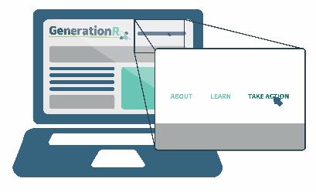
Generation Rx: www.generationrx.org
A partnership between the Ohio State University College of Pharmacy and the Cardinal Health Foundation
Provides free, ready-to-use educational resources and digital activities to teach medication safety and the dangers of prescription drug misuse

Slide 39





The Collaborate portal:
Connecting teachers with support

Slide 40
The Collaborate portal: www.generationrx.org/collaborate/

Slide 41
Parent Education
What do parents want?
What do they need?
  Skills
    How to talk with their kids?
    How to recognize?
  Knowledge
    Key concepts of medicine safety and opioids
      Adults
      Kids
Engage & involve

Slide 42
Ohio Joint Study Committee on Drug Use Prevention Education Recommendations
K-12 Substance Abuse Prevention Education
  Consistent, age-appropriate, evidence-based.
Required Reporting for Schools
  How are schools fulfilling the requirements to provide substance abuse education?
Social and Emotional Learning Standards
  Standards exist for K-3, extend to K-12.
School & Community Surveys
  Complete YRBS or OHYES! Survey annually.
Notes:
Convened by AG Mike DeWine
22-members of lawmakers, state agencies, prevention specialists, organizations and educators
Develop recommendations for policies, legislation and practices to enhance drug abuse education in schools.

Slide 43
Ohio Joint Study Committee on Drug Use Prevention Education Recommendations
Expand Substance Abuse Curriculum across Subjects.
Resources for schools about substance abuse prevention.
Substance Abuse and Mental Health Intervention Training.
Dedicated Prevention Personnel at the Department of Education.
Notes:
Convened by AG Mike DeWine
22-members of lawmakers, state agencies, prevention specialists, organizations and educators
Develop recommendations for policies, legislation and practices to enhance drug abuse education in schools.

Slide 44
Ohio Joint Study Committee on Drug Use Prevention Education Recommendations
Strengthen and Involve Law Enforcement.
Support Before- and After-school Programs
Community-based Prevention
Engaging Families and Caregivers
Youth-led prevention
Incorporate Prevention in Higher Education
Study Committee keeps working.
Full Report
Notes:
Convened by AG Mike DeWine
22-members of lawmakers, state agencies, prevention specialists, organizations and educators
Develop recommendations for policies, legislation and practices to enhance drug abuse education in schools.

Slide 45
Drug Education Recommendations
Scare Tactics DON’T work!
Recovering addicts have NOT been shown to be effective
  May normalize the behavior
Do NOT show methods of drug use or specific products or paraphernalia.
Be more than facts, (because they probably already know more than you).
Engage your students in learning.
  NO teacher preaching.

Slide 46
Drug Education Recommendations
Address short & long-term consequences
  Girls are more likely to take risk info seriously, and boys are less likely.
Use local data to share the norm
  – e.g. 80% of students have not misused prescription drugs.
Classroom teacher is more effective than one-time presenter (consistent messaging).
They need to know you care!
  Give students a reason to care.
The Power of One Caring Adult!

Slide 47
School-wide Drug Prevention Plan Recommendations
Assemblies don’t work unless they are followed up by reinforcing messages or work to address what was learned.
  Reflection and commitment are great ways to put a drug-free plan into action.
Youth led prevention is effective.
Consistent, coordinated, and purposeful approach that engages your students, school, parents and community.
Notes:
JOE – Add references to each of these to support these statements.

Slide 48
HOPE Curriculum Writing Team
Kevin Lorson
Joe Dake
Mary Huber
Tina Dake
Holly Raffle
Laura Rooney
Tracey Kramer
  Shannon Dipple
  Allison Tomlin
  Lindsey Steuer
  Pam Malone
  Trevor Thomas
  Dennis Eichinger
  Desiree Powell
Funded by an Ohio Department of Higher Education Grant

