Slide 1
The New FAPE Standard and Serving Students with Learning Disabilities
February 2, 2018
Presented by: Christina Henagen Peer
Walter | Haverfield LLP
The Tower at Erieview
1301 East Ninth Street, Suite 3500
Cleveland, Ohio 44114
Telephone: (216) 781-1212

Slide 2
Providing FAPE
After Endrew F.

Slide 3
New FAPE Standard
U.S. Supreme Court Issued its Unanimous Decision March 22, 2017, creating a new FAPE standard:
“to meet its substantive obligation under the IDEIA, a school must offer an IEP reasonably calculated to enable a child to make progress appropriate in light of the child’s circumstances.”

Slide 4
New FAPE Standard
Implications
The child’s IEP need not “aim for grade-level advancement if that is not a reasonable prospect.” However, that child's “educational program must be appropriately ambitious in light of his circumstances, just as advancement from grade to grade is appropriately ambitious for most children in the regular classroom.”

Slide 5
New FAPE Standard
Implications
Adequacy of the IEP will turn on the unique circumstances of the child, with an analysis of the child’s capabilities and potential for learning
Similar to the “meaningful educational benefit” standard we already had in the 6th Circuit
Renews the need for comprehensive evaluation and ongoing data to demonstrate that progress is appropriate in light of the child’s circumstances

Slide 6
New FAPE Standard
Implications
IEP goals should align with the needs set forth in the evaluation team report
Even more important now to collect data in accordance with each IEP goal and reconvene the IEP team as necessary based on that data

Slide 7
Tips
Follow established procedures – IDEA and Ohio Operating Standards – for procedural compliance
Ensure meaningful parental participation and address parental concerns with appropriate documentation
Write measurable goals – link assessment results to goals and programming – and develop meaningful educational programming and services
Address transition needs and services

Slide 8
Tips
COLLECT DATA to show progress and revise goals and services timely when necessary

Slide 9
Case Law Analysis:
Serving Students with Specific Learning Disabilities

Slide 10
Akron Public Schools Case No. SE 3242-2016
Case involved whether district provided FAPE to student with specific learning disabilities in reading and math during the 2013-2014, 2014-2015 and 2016-2016 school years
Student was in first, second and third grades, respectively, during these school years.

Slide 11
Akron Public Schools Case No. SE 3242-2016
Parents alleged the district failed to:
draft measurable goals and objectives to address all areas of need
provide appropriate and intensive intervention in all areas of need
implement research-based methods of instruction to the extent practicable
revise/amend the IEP when it knew adequate progress was not being made

Slide 12
Akron Public Schools Case No. SE 3242-2016
Allegations (cont’d)
provide extended school year services (ESY) to prevent/reduce regression over the summer
provide adequate or accurate data on reporting student progress
advise the parents of a change in placement in the 2015-16 IEP
obtain parent consent prior to changing the student’s placement in the 2015-16 IEP.

Slide 13
Akron Public Schools Case No. SE 3242-2016
IHO and SLRO concluded:
District violated IDEA (and denied student FAPE) with change of placement from “pull-out” to “push-in” model
Student had the potential to complete grade-level work (IQ was average, although cognitive profile was uneven)
Student showed lack of meaningful progress in reading, writing and math (goals not met)
Goals were for grade-level work; however, student was well behind grade level.

Slide 14
Akron Public Schools Case No. SE 3242-2016
Findings (cont’d)
IEPs were inappropriate
Failed to implement recommendations from ETR (specifically, “explicit instruction in phonics”)
Failed to address all areas of need identified in ETR (reading comprehension, applied math and phonics)
IEP eventually amended to address phonics, but no additional SDI time

Slide 15
Akron Public Schools Case No. SE 3242-2016
Findings (cont’d)
Specially designed instruction was inappropriate
District used research-based methodologies in most areas; however, IHO concluded these methodologies were not appropriate to meet the student’s needs
The fact that the programs being used by the district were scientifically-based was insufficient in light of the student’s lack of progress

Slide 16
Akron Public Schools Case No. SE 3242-2016
Compensatory Education Award
1:1 instruction in reading, 90 minutes per day, in a resource room, using the Wilson Reading Program (WRP), for 12 months per year for two years.
1:1 writing instruction, one hour per day, five days a week, of one-on-one writing instruction in a resource room utilizing Framing Your Thoughts, for 12 months per year for two years.

Slide 17
Akron Public Schools Case No. SE 3242-2016
Compensatory Education Award (cont’d)
Math instruction in a resource room, using TouchMath, 60 minutes per day, five days per week, 12 months per year for two years (small group of 2-3 students)
Counseling services to be provided twice a week, for 30 minutes per session at the counselor's office or in a resource room, for 12 consecutive months or until the counselor determines that this service is no longer necessary, whichever is sooner.

Slide 18
Akron Public Schools Case No. SE 3242-2016
Take Aways…
Alignment of ETR and IEP is critical
Goals must be written at student’s current academic level
Don’t ignore lack of progress - reconvene team if progress is not sufficient or as expected
May be necessary to utilize a different methodology – even if the district’s methodology is research-based
Comply with all procedural requirements

Slide 19
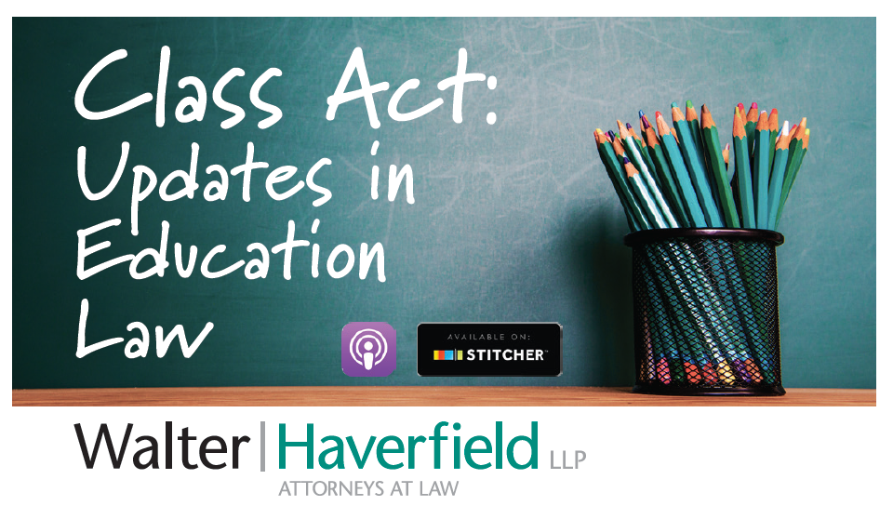
Podcast available on iTunes, Google Play and Stitcher

Slide 20
QUESTIONS
Christina Peer
216-928-2918
cpeer@walterhav.com

