Slide 1
Milestones Autism Resources: Supporting School Districts and Their Students
Milestones Autism Resources
Leslie Rotsky
Conference Director
Beth Thompson, MSSA, LSW
Program Director

Slide 2
Overview
Milestones Autism Resources
Services, Supports & Resources
Trivia and Activities
Evidence-Based Strategies
Key Resources
Annual Conference
Questions & Give-Aways!
Questions!

Slide 3
Milestones Autism Resources
Mission Statement
To improve the quality of life for individuals on the autism spectrum.
Vision Statement
Focus on education and evidence-based practices provides the foundation for a better life for individuals with autism across the life span.

Slide 4
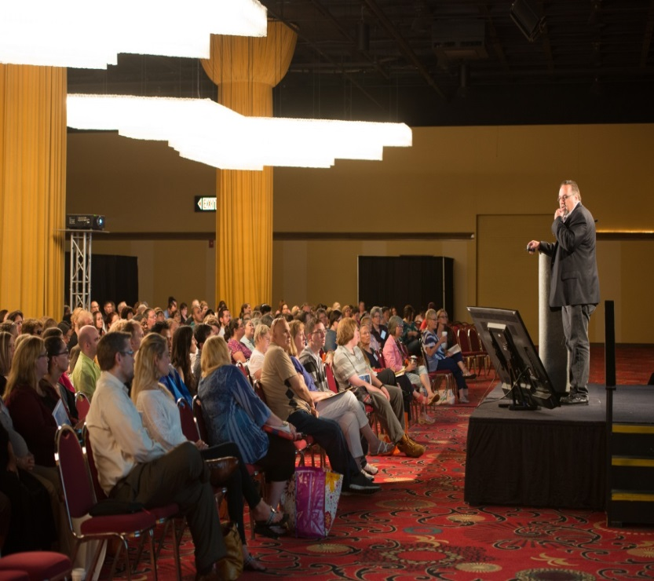
Milestones Autism Resources
Core Services:
Annual Conference
June, 80+ workshops, 40+ exhibitors, networking, awards
HelpDesk
Free phone/online for all ages & stages
Consultations & Trainings
Private Consultations for families & agencies
Customized Trainings
Online Resources
Community Calendar
Resource Database
Guiding Questions
Toolkits

Slide 5
Milestones HelpDesk Support: Ms. Sally Who:
Social & Support Groups
Refferals to appriopraite agencies
First Diagnosis
Milestones
Supported Family & Patient
Medical Specialists
Education about Edvidence-based Inventions
Long-term supports & planning options
Continuous touchstone

Slide 6
Milestones HelpDesk Support
I need help with my child…
School Choices & Auxiliary Services Available
Milestones
Staff
Ms. Sally Who
& 3 yr. old with ASD (Molly)
Clinic Pediatrician
Referrals to County Boards of DD & Services
7 yr. old typical sibling
Connection to support groups and education
Hair-cuts
Play Groups
Therapies
New to Autism & Scared
Single Parent, Works full time

Slide 7
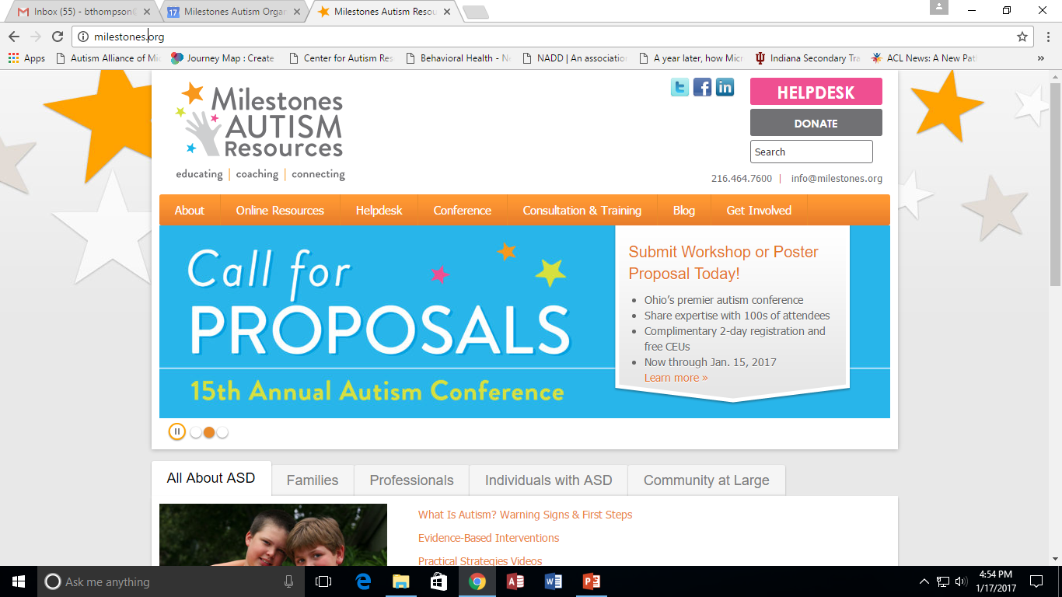

Slide 8
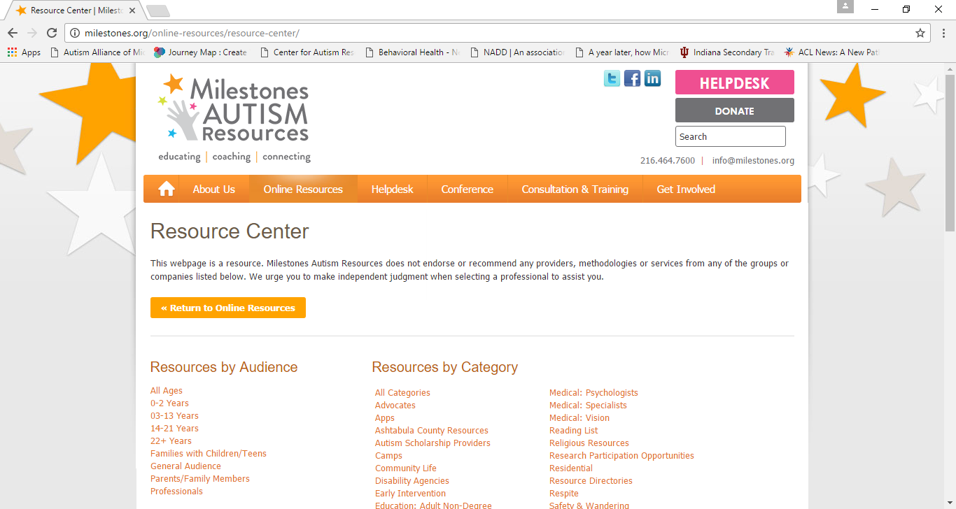

Slide 9
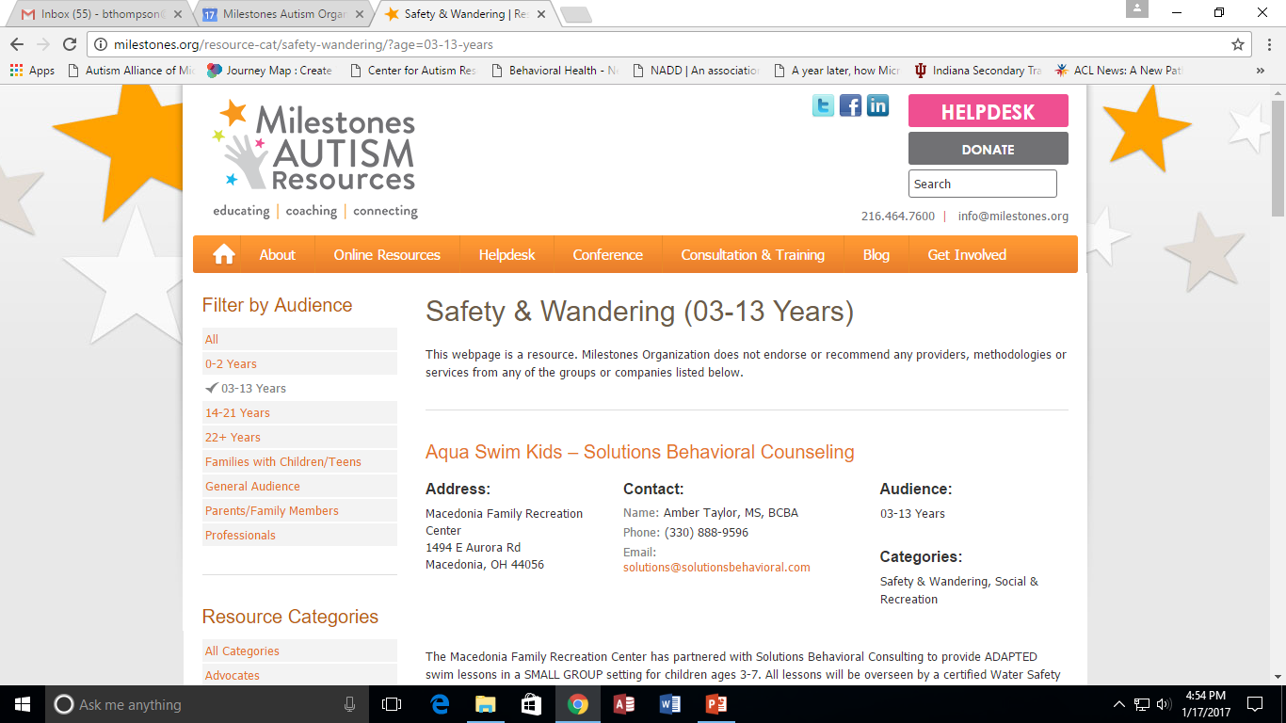

Slide 10
James Durbin
Diagnosed with Asperger Syndrome and Tourette Syndrome when he was 10 years old at Stanford Medical Center.
Rose to fame as a finalist on the tenth season of American Idol.
Proud to have Autism.

Slide 11
Daryl Hannah
Refused to do talk shows or attend her own movie premieres "because I (she) was terrified.“
Has played leading lady to Tom Hanks & Steve Martin
Has been in long-term relationships with John F. Kennnedy Jr, Jackson Browne and Neil Young

Slide 12
Dan Aykroyd
Was diagnosed in the 1980s when wife persuaded him to see a doctor
Long time SNL comedian
One symptom of ASD included obsession with ghosts and law enforcement — He became obsessed by Hans Holzer, the “greatest ghost hunter ever”. That’s when the idea for his film ________________ was born.”

Slide 13
Alexis Wineman
Prior to the Miss America 2012 competition, she rarely wore high heels and makeup.
Crowned Miss Montana 2012.
Her platform as Miss Montana was “Normal is just a dryer setting – Living with autism”.
At the age of 18, she was the youngest contestant in the Miss America 2014 pageant.

Slide 14
Temple Grandin
Never formally diagnosed with autism in childhood or in youth, not until her 40s
Built her 'squeeze machine' at the age of 18 when she was still attending Mountain Country School for Children with Behavioral Problems
Struggled in school, now has a bachelors, masters and PhD in animal science

Slide 15
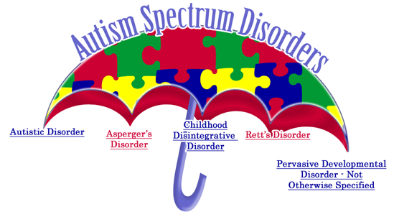
What is Autism?
Referred to as Autism Spectrum Disorders (ASD)
Autism
Asperger Syndrome
PDD-NOS (Pervasive Developmental Disorder)
Rett Syndrome
Childhood Disintegrative Disorder
Neurological Disorder that affects:
Communication
Social Interaction
Behavior
Sensory Processing
Developmental - Characteristics begin prior to the age of 3
Notes:
Autism -1 in 110, 1.5 million individuals, boys are four times as likely, Rett – almost exclusive in girls, normal development then regression, CDD – 3 or 4 yrs old rapid loss of already gained skills, extremely rare

Slide 16
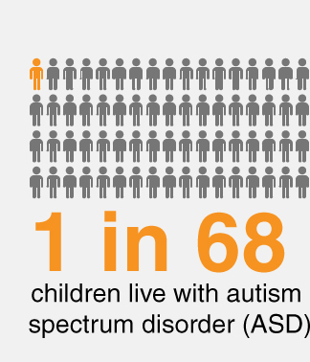
What is Autism: Statistics & Risk Factors
1 in 68 children identified with ASD
Almost 5 times more common among boys
Impacts every socioeconomic and cultural population
Half “missed” & half “new” cases
Centers for Disease Control 2016
Genetic link has been identified
Identical twins, if one child has ASD, then the other will be affected about 36-95% of the time
Sibling with ASD increases chances by 2%–18%
More often in people who have certain genetic or chromosomal conditions
About 10% of children with autism are also identified as having Down syndrome, fragile X syndrome, tuberous sclerosis, and other genetic and chromosomal disorders.
- Centers for Disease Control, 2012

Slide 17
Evidence-Based Strategies and Resources

Slide 18
Milestones Autism Resources helps individuals with autism reach their unique potential. We focus on educating and coaching for family members and professionals in evidence-based practical strategies. Our conferences, workshops, professional development, referral calls and online resources connect the autism community with vital information, and each other.

Slide 19
Evidence Based Strategies: Schedules
Provide a behavioral checklist for student alongside a schedule if needed
Helps youth learn self-management
Provide choice and encourage student to make their own schedules and choose where it goes (wall, phone)

Slide 20
Evidence Based Strategies: Schedules
Encourage age-appropriate visual items and themes
Include interests to increase motivation and the likelihood that visual schedules will be used
Use micro-schedules when needed

Slide 21
Evidence Based Strategies: Resources
Autism Visuals: Communicating Through Pictures Our mission is to provide visual aids, resources, and general information on autism and the treatment of autism to parents, educators, and the community in general to assist in the development of communication, curriculum, legislation, and ultimately the betterment of autistic children. autism-visuals.com
AutiPlan Pictoplanner For people who need more structure and overview in daily activities. Plan detailed activities using clear pictograms and text with drag & drop. Show plans with notifications and speech on a phone, tablet or laptop. Use alarms and text-to-speech to help keep focus on planned activities. Plan recurring days automatically by using templates and week schedules. www.autiplan.com

Slide 22
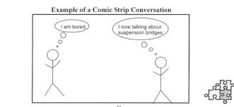
Evidence-Based Strategies: Social Stories & Scripts
Social Stories are a concept devised by Carol Gray in 1991 to improve the social skills of people with autism spectrum disorders (ASD). Social stories are used to educate and as praise.
Comic strip conversations are "visual representations" of conversations and social interactions that aim to help an individual understand social processes and increase their comprehension of other peoples thoughts and actions.

Slide 23
Evidence-Based Strategies: Social Stories & Scripts
Easy Social Stories EasySocialStories.com offers low cost, instantly delivered social stories that you can print again and again. We are constantly adding titles, addressing subjects important for school, hygiene and socialization. Custom stories also available. easysocialstories.com
Autism Speaks
Customize these personalized story templates with your own pictures to help your child know what to expect in various situations!

Slide 24
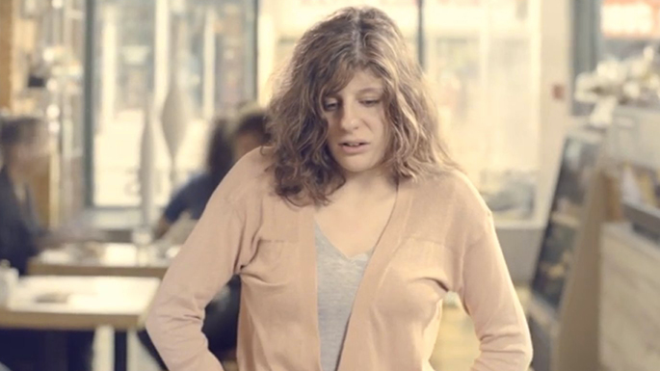
Sensory Processing/Integration – Carly’s Cafe
https://www.youtube.com/watch?v=KmDGvquzn2k

Slide 25
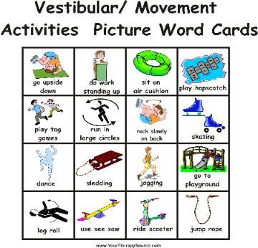
Evidence Based Strategies: Sensory/Stimming
Working with OT is critical
Could be many things:
Exercise Ball
Chewies/Gum
“Heavy work”
“Running work”
Headphones
Needs to be included in schedule until
student become self-aware of needs

Slide 26
Evidence Based Strategies: Sensory/Stimming
Teaching Relaxation: 1) Start with gross motor areas (easier to learn to tense and relax these muscle groups rather then starting at the head). 2) We tighten and we relax each arm individually, and then the same for each leg individually. Many people with autism exhibit stereotypic behavior, concentrating on tightening and relaxing each hand helps understand what relaxed feels like. 4) After the arms, legs and hands, start deep breathing exercises. Teach them to inhale and exhale (5 in, 10 out). 5) Then teach them to associate a meaningful calming word, such as peace or the word "relax" as they exhale. The word then becomes associated with a relaxed feeling. 6) Praise every opportunity presented, “I like the way you are counting with me”.

Slide 27
Educational Resources: Do2Learn & JobTips

Slide 28
Educational Resources: Vizzle & Monarch
VizZle™ has more than 20,000 images designed to attract, and myriad helpful tools necessary to quickly and easily tailor lessons. Users can employ VizZle™ images or import their own, and start from scratch or use library content. Because VizZle™ is web-based, it can be accessed anytime and from any computer.
For more information, please visit www.monarchteachtech.com

Slide 29
Educational Resources: NEA
ACTIVITIES AND MATERIALS
Make picture cards, create stories with picture symbols, free tracing sheets
The Learning page- chock full of more free resources and worksheets for teachers.
Dr. Carol Gray’s Social Stories technique.
Pyramid Educational Products: The inventors of PECS and Pyramid Approach to Education
The Attainment Company sells books, videos, and educational materials and specializes in school-to-work transition
Future Horizons, sells products and holds conferences around the country
Starfish Press, publisher of books on autism and families living with Autism
http://www.nea.org/home/15151.htm

Slide 30
Educational Resources: National Autism Center

Slide 31
Educational Resources: Integrated Classrooms
The ASD Nest Model: A Framework for Inclusive Education for Higher Functioning Children With Autism Spectrum Disorders by Shirley Cohen, PhD and Lauren Hough, MsEd This well-researched and evidence-based program was formulated in response to the severe shortage of educational programs designed for higher functioning school age children with ASD. The program uses a positive behavior support approach and incorporate strategies that address areas of difficulties common in children with ASD, specifically sensory functioning, social relatedness, self-regulation, managing anxiety, and selective cognitive problems. aacpublishing.net

Slide 32
Educational Resources: Up-to-date for Educators
Autism Internet Modules The Autism Internet Modules were developed with one aim in mind: to make comprehensive, up-to-date, and usable information on autism accessible and applicable to educators, other professionals, and families who support individuals with autism spectrum disorders (ASD). Written by experts from across the U.S., all online modules are free, and are designed to promote understanding of, respect for, and equality of persons with ASD. www.autisminternetmodules.org

Slide 33
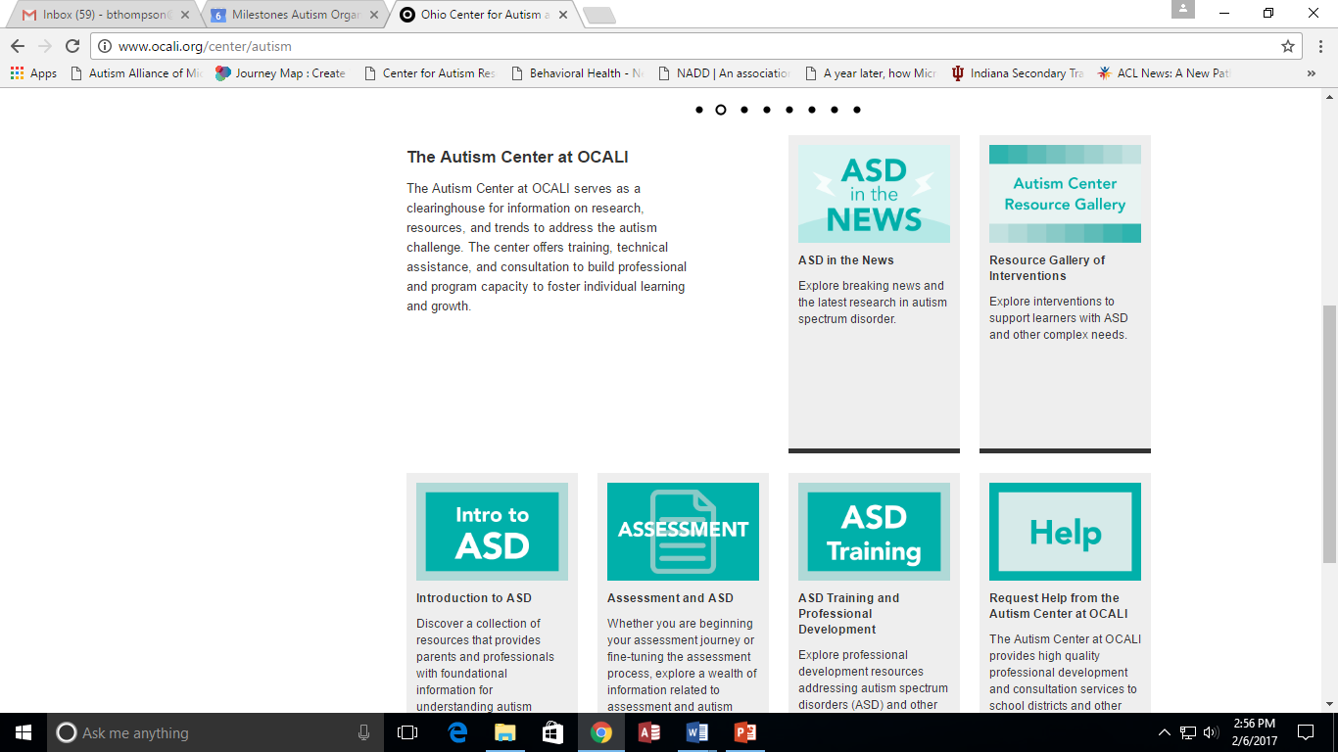
Ohio Center for Autism and Low Incidence (OCALI)
http://www.ocali.org/

Slide 34
Resources
Milestones Autism Resources
www.milestones.org
Helpdesk, Consultations, Conference, Calendar, Resource Bank……..
Organization for Autism Research (OAR)
http://researchautism.org/
Guides free for professionals and families
Autism Society of Ohio & Autism Society of America
http://www.autismohio.org/
http://www.autism-society.org/about-the-autism-society/publications/resource-materials/
Find your local chapter for local services

Slide 35
Trivia Time!
Satoshi Tajiri:
Enjoyed insect collecting as a hobby; “Dr. Bug"
Wanted to have a profession as an entomologist
Inspiration for his later video game work
Wanted his games to allow children to have the feeling of catching and collecting creatures
The character of Ash Ketchum (Satoshi in Japanese), is largely a version of Tajiri as a child
What is the name of the video game he created?

Slide 36
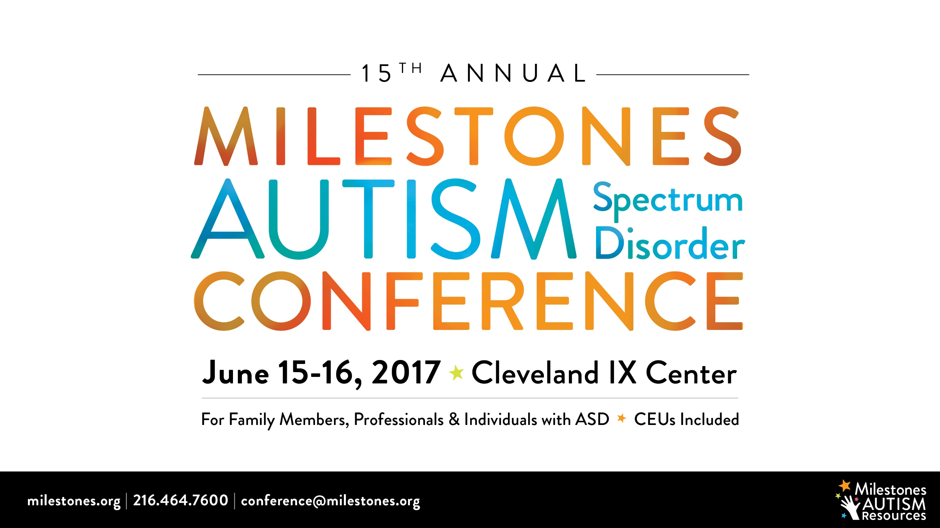

Slide 42
Questions?
Milestones is the first call for help,
at any stage or age.
Milestones Autism Resources
www.milestones.org

