Slide 1

School Health Requirements:
How to Get it Done
Joan Keith, MEd, BSN, RN, LSN, NCSN
School Nurse Consultant
Ohio Department of Health
Ohio Association of Pupil Service Administrators
May 5, 2017

Slide 2
Overview
Introduction
School Health Requirements
School Nursing Role / Responsibilities
Current Issues
Summary

Slide 3

School Health Requirements

Slide 4
School Health Policies
In general school health policies are developed in response to:
Requirements of Federal and State Law
Community Norms
Best Practices

Slide 5

School Health Related Laws
Examples
Concussions/TBI
Sudden Cardiac Arrest in youth athletes
Diabetes care of students
Permission to self carry: epinephrine autoinjector &/or asthma inhalers
Stock emergency medications:
  Naloxone
  Asthma Inhalers
  Epinephrine Autoinjector
School laws may also be passed in response to public health issues and/or legislator special interest.

Slide 6
Some laws are driven by specific diseases
Acute & Chronic
Asthma Diabetes
Acquired
Concussions
Other type
MRSA
Infectious
Severe Allergies
Epilepsy
Bed bugs, lice
Depression
Immunizations
/TBI
Mumps
Those in media
Pertussis

Slide 7
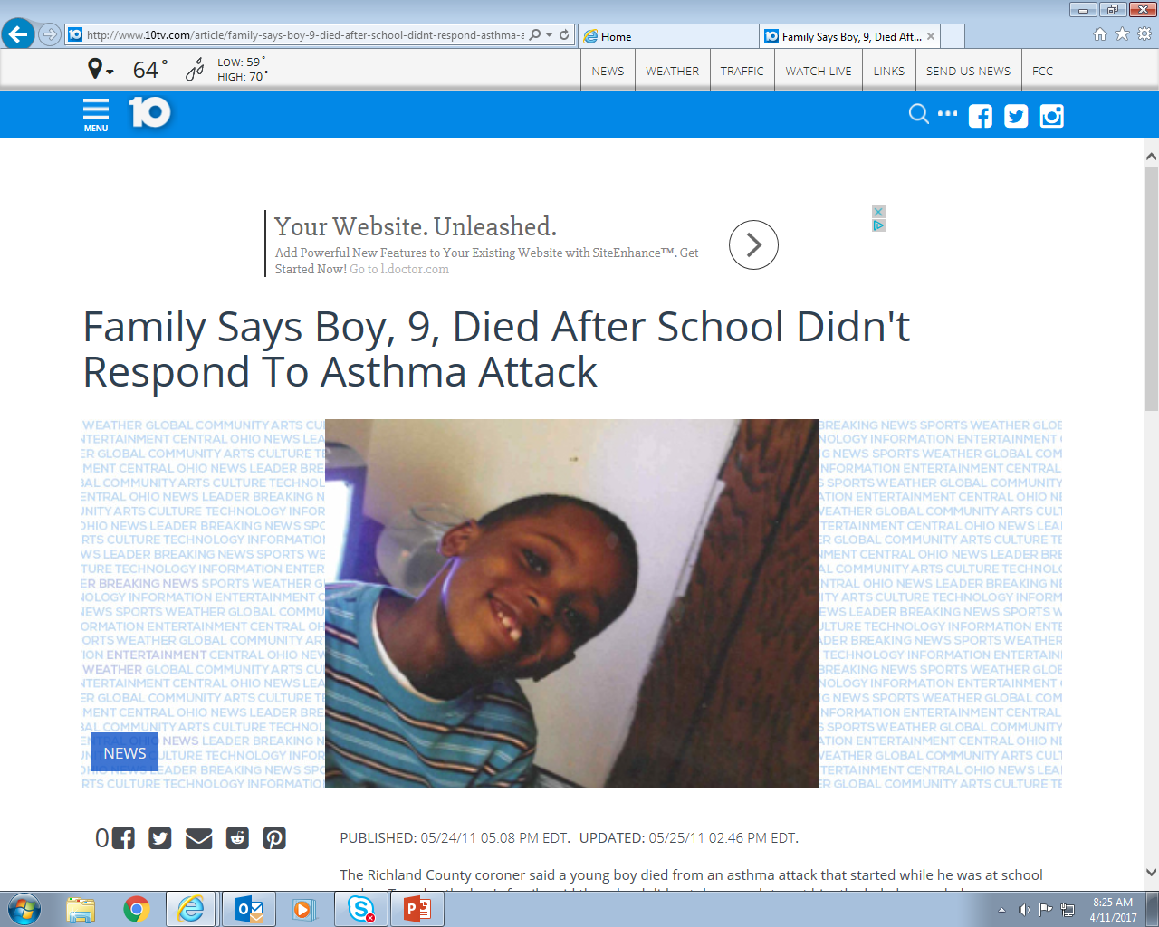

School Responsibilities and Asthma
Mansfield, Ohio 2011
6th grader, died Sept, 2013- after school failed to recognize severity of symptoms. (Philadelphia)
Girl, 13, grade 8, dies after
severe asthma attack at school
Boy, 12, Dies from Asthma Attack After School Locks up his Inhaler (Ontario, Canada)
Family points to school nurse shortage in death-6 yo – asthma death
Boy with Asthma Dies After School Confiscates His Inhaler
Local kindergartner dies after apparent asthma attack; family thinks pollen contributed to death (Ohio, May, 2015)
Teen with asthma dies in locker room, 1997 NE Ohio

Slide 8
Asthma Numbers
2015: Per CDC Current national rate of asthma in children is 8.4% …Ohio 15.2%
Ohio (2008 data)
Adult lifetime asthma prevalence was 14.2% and adult current asthma prevalence was 9.6%
Child lifetime asthma prevalence was 13.6% and child current asthma prevalence was 9.4%

Slide 9
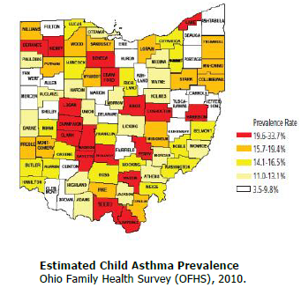
Depending on where a child lives… rates can be higher or lower for schools
https://www.odh.ohio.gov/-/media/ODH/ASSETS/Files/chss/asthma/OSSAbrochure.pdf?la=en

Slide 10
Ohio Schools
Type of Schools | Number of Schools | Number of Students
Public (Oct, 2016) | 4,237 | 1,803,461
Private (Oct, 2015) | 586 | 144,512
Total | 4823 | 1,947,973
Number of students estimated to have asthma | n/a | 163,630-296,092
https://education.ohio.gov/Topics/Data/Frequently-Requested-Data/Enrollment-Data
Notes:
8.4% x 1,947,973 =
163,630 Students

Slide 11
What does this mean for a school with 750?
10% = 75 students with asthma
15% = 113 with asthma

Slide 12

School Responsibilities Regarding Asthma
Provide access to asthma inhaler during an asthma emergency
Three ways an asthma rescue inhaler can be at school:
  School has Prescribed Medication Administration order for a specific student to receive medication
  Student has written permission to self-carry inhaler and use inhaler…form on file at school
  School has “stock” asthma inhaler medication administration policy and procedure in place. NOTE: This inhaler can be used for anyone on school premises who is having an asthma emergency
  .

Slide 13

Ohio Laws Regarding Asthma
ORC 3313.713
Policy for designated, trained employees to administer drugs prescribed by physicians to students.
ORC 3313.716 – effective Nov., 1999
Possession and use metered dose inhaler or dry powder inhaler to alleviate asthmatic symptoms.
ORC 3313.7113 /3313.7114- effective February, 2016.
Procurement of inhalers by board.

Slide 14








Life ThreatEning Allergies
At School

Slide 15
Facts About Life Threatening Allergies
All types of allergies are increasing
Anaphylaxis is a serious allergic reaction that is sudden in onset and can cause death
1 in 13 children in the U.S. has a food allergy
20-25 % of epinephrine administrations in schools involve individuals whose allergy was unknown at the time of the reaction
>15 % of school-aged children with food allergies have had a reaction in school; 40% have experienced anaphylaxis
Compared to children who do not have a medical condition, children with food allergy are twice as likely to be bullied

Slide 16
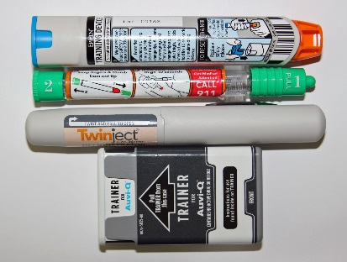
School Responsibilities and Life Threatening Allergies
Provide access to an epinephrine autoinjector and trained staff to respond and administer the medication
Three ways an epinephrine autoinjector can be at school:
ORC 3313.713 Policy for employees to administer drugs prescribed by physicians to students (training staff)
ORC 3313.818 Possession and use of epinephrine autoinjector to treat anaphylaxis (“student self-carry”)
ORC 3313.7110 Procurement of epinephrine autoinjectors for public schools. (“stock”, effective 9/1/206 )

Slide 17
Diabetes in Children and Teens
About 208,000 young people under 20 years of age have diagnosed diabetes
Between 2001 and 2009 there was a 21% increase in the prevalence of Type 1 Diabetes in people under age 20
The number of children diagnosed with type 2 diabetes is growing due to more overweight youth

Slide 18
Diabetes: What is Type 1 and Type 2
Type 1 diabetes (T1D) is an autoimmune disease in which a person’s pancreas stops producing insulin, a hormone that enables people to get energy from food.
Student with T1D must:
Balance insulin doses with eating and other activities
Monitor their blood-glucose levels
This is lifelong disease requiring care 24 hours/day 7days a week.
Notes:
Even with perfect care, the student with T1D still runs the risk of dangerously high or low blood-glucose levels, both of which can be immediately life threatening as well cause serious complications

Slide 19
Type 2 Diabetes
Type 2(T2D) diabetes is a chronic disease that affects the way the child’s body processes sugar (glucose). Blood sugar must be monitored and controlled to prevent long-term consequences.
Facts about T2D in children:
In past was primarily only a disease of adulthood
Rates in children are increasing (obesity ↑ risk)
Treated by diet, physical activity & maintaining a healthy weight
Oral medication or insulin treatment may be needed

Slide 20
School Responsibilities: Diabetes
ORC 3313.7112 Diabetes care
Regarding the student with diabetes, the school must:
Provide appropriate and needed diabetes care per medical order
Permit attendance at home school building
Train school staff to provide for care needs
Understand calculation of insulin dose based on food intake
Understand and follow recommended schedule of meals and care needs
Offer 504 plan within 14 days
Provide ODE report by Dec. 31 annually

Slide 21
School Responsibilities: Diabetes
ORC 3313.7112 Diabetes care
School must also:
Be involved with checking and recording blood glucose levels and ketone levels
Responding to blood glucose levels outside of student’s target range – low or high
Administer medications per order
Allow for self care of needs

Slide 22
Staff Training Requirement
ORC 3313.7112 Diabetes Care
Who gets trained in diabetes care?
School employee who has primary responsibility for supervising student majority of day
School employee(s) who volunteer:
  School cannot use coercion – no repercussions if declines
  School can advertise for staff
Bus Driver

Slide 23
Staff Training Requirements
ORC 3313.7112 Diabetes Care
Staff training on diabetes must :
Be coordinated by school nurse
  Take place before the start of the year, or within 14 days
Include follow-up supervision
Include determination of competency after trainig

Slide 24
Medication Administration in Ohio Schools

Slide 25
MEDICATION TYPES IN SCHOOLS
Rx
OTC
Stock
Are medication policies required by schools? Yes
Rx=Prescription Medications given by school staff to students. State law requires school policy.
OTC=Over the Counter Medications.
Stock= Law allows Optional emergency medications: epinephrine autoinjectors, asthma inhalers, Naloxone

Slide 26
Rx Medication Administration
Why is medication needed during the school day?
Children with chronic and acute health conditions may require medication administration during the school day in order to be academically successful.
School employees administering medications must be:
  A licensed health professional OR
  Complete a drug administration training program conducted by a licensed health professional and considered appropriate by the board
Notes:
Slide Notes
Many Ohio school students are able to attend school because of the effectiveness of their medication. The health circumstances requiring medication administration during school are diverse.
For most students, the use of medication is beneficial to control acute minor or major illnesses, allowing a timely return to the classroom with minimal interference to learning or missed days of school.
ORC 3313.713 (B)(2) now states “Effective July 1, 2011, only employees of the board who are licensed health professionals, or who have completed a drug administration training program conducted by a licensed health professional and considered appropriate by the board, may administer to a student a drug prescribed for the student.”

Slide 27
Over the Counter (OTC) Medications
Ohio law does not address OTC medications
School districts should have a policy addressing the administration of OTC (including homeopathic medications)
School OTC policies vary because they are based on the community needs

Slide 28
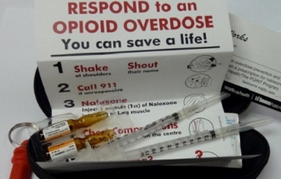
Stock Emergency Medications
Naloxone in Schools SB 319
Schools are “Service Entities” who MAY procure Naloxone
Must have a written protocol for administering naloxone from a physician
Liability is addressed in the law
Procure via purchase from a licensed wholesaler or licensed TDDDL entity

Slide 29
Stock Emergency Medication
Epinephrine Autoinjectors
ORC 3313.7110
School may procure and store stock epinephrine autoinjectors. School must have:
  Prescriber’s order
  Protocol developed with prescriber
  Identification and training of school staff
  Must store in secure location
  For use on the school premises
  Must call EMS/911 if used
Must report to ODE annually when asked

Slide 30
Stock Emergency Medication
Asthma Inhalers
ORC 3313.7113
School may procure and store stock asthma inhalers for use in an asthma emergency by anyone on school premises
School must have:
  Prescriber’s order
  Protocol developed with prescriber
  Identification and training of school staff
  Must store in secure location
  Must call 911/EMS if used
Must report asthma inhaler procurement and use to ODE

Slide 31

School Responsibilities:
Self Carrying Medication
Ohio law permits some students to self-carry selected emergency medications:
Regarding this, school personnel should know:
  Which student is self-carrying and what medication
  Reason student self-carries the emergency medicine
  Location of back up dose in building if required to have
  Proper required paperwork from prescriber ordering self carry
Notes:
Slide Notes:
Ohio law permits some students to self-carry selected emergency medications.
Local school district prescription medication administration policies must address self-carry medications.
Regarding student self-carry of prescribed emergency medication, school personnel should be aware of:
Who is self carrying what medication
How and why student carries the emergency medicine
Location of required school backup dose of their emergency medication
Medication Administration Record authorizing self-carry of medication by the student

Slide 32
Three Things to Keep In Mind When Designating
Staff To Be Trained
Employee must be willing to be trained
Employee must be
capable of being trained
Employee must demonstrate competency once trained

Slide 33
Aiming for Success in Staff Trainings
Training 3 Deep Increases Success
Staff Training
Primary Employee
Back up #1
Back up #2
Also, depending on EMS response time for your area, school may want to consider training a School Emergency Response Team

Slide 34



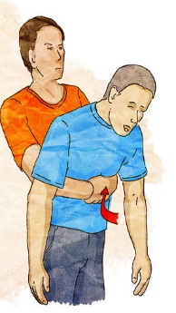

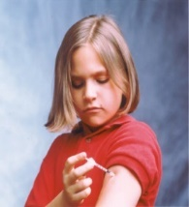
Other Kinds of Staff Trainings
Bloodborne Pathogens
Response to Choking
AED Staff Training (effective7/2018)
Coaches: Sudden Cardiac Arrest / Lindsay’s Law (3/2017)

Slide 35
Other Kinds of Staff Trainings
ORC 3313.815 Employee trained in Heimlich maneuver to be present while students served food
Requires school to have at least one employee trained in Heimlich maneuver to be present while students are being served food
Bloodborne Pathogen Training – must be done annually – staff must have access to nurse for follow up questions
OSHA / Public Employment Risk Reduction Program (PERRP) Schools are required to develop a written exposure-control plan detailing the procedures to eliminate or minimize employees’ bloodborne pathogen exposure.

Slide 36
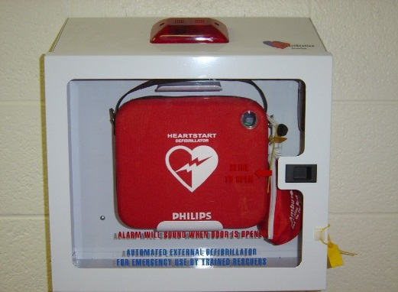
Training Requirements
Sudden Cardiac Arrest
New:
AED Staff Training (effective7/2018)
  Training on AED required; best practice to include also CPR training
Sudden Cardiac Arrest Lindsay’s Law (3/2017)
  Youth Athletes, Parents, Coaches
CPR/AED training for grades 9-12
QUESTIONS, contact Ryan Eldridge at ODE

Slide 37

School Policies
Required for:
Accidents – reporting/preventing
Integrated Pest Management
Bus Idling
Return to Play/Learn (post concussion/TBI)
Anti-Harrassment, Intimidation and Bullying
Confidentiality
Drug and alcohol – employee/students
Playground safety

Slide 38
Required Policy: Return to Play/Learning
Return to Play - Ohio's Youth Concussion Law
ORC 3313.539 or ORC 3314.03
Requires youth athletes who are suspected of sustaining a concussion be removed from practice or play.
Prohibits return to play (practice or competition) on the same day
Permits return the following day if cleared in writing by an authorized healthcare provider stating that they did not sustain a concussion.
Return to Play- A Concussion Team Model –
Training program for teachers on the ways to help students with concussion transition back to school.
http://www.odh.ohio.gov/health/vipp/child/returntoplay/Return%20to%20Play%20-%20Ohio%20Youth%20Concussion%20Law.aspx

Slide 39
School Responsibilities:
Student Injury Report Form
Completing a student injury report form is best practice for tracking the occurrence of school-related injuries.
ODH suggests completing the form when an injury leads to any of the following:
1. The student misses 1⁄2 day or more of school.
2. The student seeks medical attention (health care provider office, urgent care center, emergency department).
3. EMS 9-1-1 is called.

Slide 40
Required Screenings
Children who cannot see or hear well are at risk for academic failure
Vision Screenings
K, 1, 3, 5, 7, 9, (and soon 11)
Hearing Screenings
K, 1, 3, 5, 9, 11
All new students to district
K or Gr 1 Screening
Vision, Hearing, Speech,
All new students to district
Those referred
Those referred
Health/medical conditions
Developmental disorders
By Nov 1st
ORC:

Slide 41


Required Screenings
Vision & Hearing Screenings - Required
  November 1st for Kindergarteners & New First Graders
NEW By June 1, Required: Annual reporting of Hearing Results to Ohio Department of Health.
NEW Effective 2015-16:
11th grade hearing screening requirement.
Hearing & Vision Screening Guidelines available at: http://www.odh.ohio.gov/odhPrograms/cfhs/hvscr/hvscr1.aspx

Slide 42
“Kindergarten Screening”
  Prior to Nov 1: K or Grade 1– first time in school
  Screening for problems with:
    Vision and Hearing
    Speech and Communications
    Health or medical conditions and any developmental disorders
    Results revealing any special learning needs, BOE shall conduct further assessment
    Regardless of whether using own staff or contracting staff: all must follow ODH guidelines for screenings

Slide 43
Immunizations
ORC 3313.67 Immunization of pupils - immunization record - annual summary.
School must keep immunization records of each pupil, and make available to parent/guardian upon written request
By Oct 15th, school must file with ODH an immunization summary of all students in the district
3313.671 Proof of required immunizations - exceptions.
New students must present within 14 days of attendance
Proof of immunizations must be written.

Slide 44
Resources- Immunizations
Ohio Department of Health provides resources to aid understanding of the pupil immunization requirements for school attendance:
Director’s Journal – current information about immunization requirements for Ohio schools
School Immunization Summary – brief listing of required vaccines by grade
http://www.odh.ohio.gov/odhprograms/bid/immunization/imunchsc.aspx

Slide 45


Slide 46

School Nursing Role / Responsibilities

Slide 47
What is School Nursing
Definition of School Nursing
“School nursing, a specialized practice of nursing, protects and promotes student health, facilitates optimal development, and advances academic success.
School nurses, grounded in ethical and evidence-based practice, are the leaders who bridge health care and education, provide care coordination, advocate for quality student-centered care, and collaborate to design systems that allow individuals and communities to develop their full potential.”
Adopted by the National Association of School Nurses, Board of Directors February 2017.

Slide 48

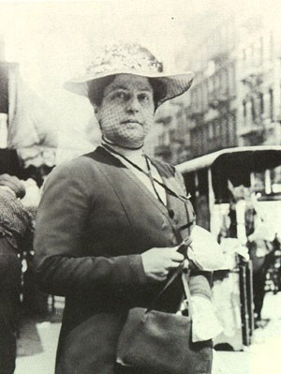
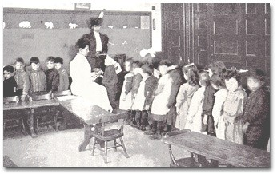
History
Lillian Wald
•Founder of school nursing
•Founded the Henry Street Settlement and Visiting Nurse Association in NYC
•In 1902 conducted a 1 month “experiment” by placing a PHN in 4 NYC schools
•Lina Rogers RN started in October
•Primary objective was to keep students in school
•By December, Rogers was made superintendent of school nurses and hired 12 more (up to 27 the next year)
•School exclusions for illness:
•1902= 10,567
•1903=1,101

Slide 49
School Nurse Responsibilities
Managing students with chronic conditions
Identifying and treating accidents and injuries
Acting as case manager for students with complex medical needs – physical, emotional, mental
Promoting a safe environment for students and staff by providing education and training on health issues

Slide 50
School Nurse Qualities
To be successful in supporting the education mission of schools, the school nurse must:
Possess sufficient clinical knowledge and experience to independently practice as a solo healthcare practitioner in a nontraditional healthcare environment
Possess an understand of education terminology, operations and state/federals laws

Slide 51
School Nurse Qualities
To be successful in supporting the mission of schools, the school nurse also:
Utilizes nursing process of assessment, planning, implementation and evaluation
Understands social determinants of health and impact on family, home and school
Must update nursing knowledge and skills to maintain RN and ODE licensure

Slide 52
School Nurse License in Ohio
Minimum requirements:
Ohio Registered Nurse Licensure
Bachelor’s Degree
Completion of a School Nurse Licensure Program
License from ODE
ODE School Nurse Licensure : 2 types Temporary (1 year) 5 year (NOTE: ODE does not offer a substitute school nurse license) | OAC 3301-24-05 OAC 3301-23-44

Slide 53
Five Ways A School Nurse
Benefits the School
Attendance
Academics
Time
Staff Wellness
Accountability
http://www.nasn.org/advocacy/advocacy-skill-building

Slide 54
Five Ways a School Nurse Benefits the School
#1 Attendance
Improves attendance through health promotion, disease prevention and disease management.
Promotes student quick return to classroom through nursing interventions in timely manner
Students with a full-time school nurse have about half the student illness- or injury-related early releases from school where no school nurse is present.
http://www.nasn.org/advocacy/advocacy-skill-building

Slide 55
Five Ways a School Nurse Benefits the School
#2 Academics
Improved attendance means the healthy student is in the classroom and ready to learn
School Nurses enable better performance, which also contributes to reducing drop-out rates.
http://www.nasn.org/advocacy/advocacy-skill-building

Slide 56
Five Ways a School Nurse Benefits the School
#3 Time
School nurses save time for principals, teachers and staff.
A school nurse in the building saves:
Principals almost an hour a day
Teachers almost 20 minutes a day
Clerical staff over 45 minutes a day
http://www.nasn.org/advocacy/advocacy-skill-building

Slide 57
Five Ways a School Nurse Benefits the School
#4 Staff Wellness
School nurses improve the general health of staff:
Healthy teachers can focus on teaching
Healthy office staff are more productive
Wellness activities can improve staff health resulting in less substitute teachers needed
http://www.nasn.org/advocacy/advocacy-skill-building

Slide 58
Five Ways a School Nurse Benefits the School
#5 Accountability
School nurses help schools stay accountable by:
Promoting compliance with federal and state law mitigates lawsuits
Assisting with disaster preparedness to save lives and property
Addressing student mental health links to academic achievement
Advocating for adequate staffing aligns with Healthy People 2020 recommendations of the ratio of one school nurse per 750 well students (1:750)
http://www.nasn.org/advocacy/advocacy-skill-building

Slide 59
School Nurse
Effectively identifies and refers to community resources to meet health needs/risks
Is often the only health professional who sees the student on a regular basis
Provides guidance/support to student/family
Provides staff training on student health needs to keep students safe and ready to learn
Ensures confidentiality of student and staff health information

Slide 60
School Nurse Role
School Nurses Reduce Chronic Absenteeism by:
Reaching out to students and families
  Helping with access to needed healthcare providers
  Providing support to the student and family
  Providing health education
Notes:
Supporting a positive school climate to ensure students feel safe at school
Supporting school-wide approach to addressing chronic absenteeism and tardiness

Slide 61
School Nurse Role and Responsibilities
State mandated reporter of suspected child abuse /neglect
Conducts staff training on needs of students and building
Monitors and reports communicable diseases
Maintains immunization records
Conducts health screenings according to ODH guidelines
Provides immediate care to acute and chronic health conditions

Slide 62
Which of these staff would be the best equipped to teach 8th grade Algebra?
High School English Teacher
Kindergarten Teacher
Latin Teacher
Bus Driver
Algebra Teacher

Slide 63
A nurse is not a nurse is not a nurse!
What does this mean?
How is it related to education?

Slide 64
Staffing
Licensed School Nurse
Registered Nurse
Licensed Practical Nurse
Health Aide

Slide 65
Registered Nurse
Licensed by Ohio Board of Nursing
Levels of education: Associate or Bachelor’s
Role: Independent practitioner under Ohio Nurse Practice Act
Follows nursing process to develop care plans
Experience varies which may/may not be useful to working in the school setting

Slide 66
Licensed Practical Nurse
Licensed under Ohio Board of Nursing
Level of Education: Nursing program 1 year
Role: Dependent practitioner under Ohio Board of Nursing Rules with limited scope of practice
Must work under the direction of an RN
May or may not have board authorization to administer medications
Not allowed under law to write individualized health care plans

Slide 67
Health Aide
Job title and description create by district
No universal recognition

Slide 68
Medical Assistant
No license or certification in Ohio
High school graduate?
May or may not be trained in CPR/AED and first aid
In schools, must work under direction of the nurse

Slide 69

Steps to Safe Care of Students
Health Conditions
Diabetes
Asthma
School Nurse
Assessment
School Staff
Be Designated
Epilepsy
Planning
Intervention
Evaluation
Severe Allergies
Medical orders
Training
Heart Conditions
Other
Attend trainings
Receive Periodic updates

Slide 70
Current Issues
Head Lice
Both the American Academy of Pediatrics (AAP) and the National Association of School Nurses (NASN) advocate that "no-nit" policies should be eliminated
For more information, go to: https://www.cdc.gov/parasites/lice/head/schools.html
Bed Bugs – Great hitchhikers, must be addressed quickly for best outcome; rarely schools have infestations, expensive to treat
Opiate Crisis – Is resulting in orphaned students; schools can now stock Naloxone; growing issues; every Ohio community has been affected

Slide 71
Head Lice: Students diagnosed with live head lice do not need to be sent home early from school; they can go home at the end of the day, be treated, and return to class after appropriate treatment has begun. Nits may persist after treatment, but successful treatment should kill crawling lice.
Both the American Academy of Pediatrics (AAP) and the National Association of School Nurses (NASN) advocate that "no-nit" policies should be discontinued. "No-nit" policies that require a child to be free of nits before they can return to schools should be discontinued for the following reasons:
Many nits are more than ¼ inch from the scalp. Such nits are usually not viable and very unlikely to hatch to become crawling lice, or may in fact be empty shells, also known as 'casings'.
Nits are cemented to hair shafts and are very unlikely to be transferred successfully to other people.
The burden of unnecessary absenteeism to the students, families and communities far outweighs the risks associated with head lice.
Misdiagnosis of nits is very common during nit checks conducted by nonmedical personnel.

Slide 72
Issues to Consider
Survival of very premature babies is resulting in increased number of students with complex health care needs
Ohio immunization rates have declined…schools play a role…seeing re-emergence of serious diseases
Loss of student and family health insurance may increase use of school clinics as primary care for student
Lead exposure– any level is not acceptable, lead damages the brain, leads to learning problems

Slide 73
School Nurse Role
Caring for Students with Complex Medical Needs
Example: Student has
Breathing Tube
Ventilator
Oxygen
Continuous G-Tube Feedings
Colostomy
Diabetes
Asthma
Severe Allergies
Heart Diseases
Seizure disorders/Epilepsy
Severe mental health issues coupled with medical issues
Traumatic brain injury
Stroke survivor
Cancer / Bone Marrow Transplant
Genetic disorders / rare disease
Crohn’s disease
Immunodeficicency disorders

Slide 74
Ways to Support the School Nurse
Provide orientation for nursing staff
Provide access to student records
Consult with nurse for legal documentation needs
Support membership in professional organizations
Support sharing of clinic news: Webpage, Newsletter
Ensure inclusion in building and parent meetings
Ensure inclusion in school improvement / wellness / disaster planning
Offer support during medical emergencies

Slide 75


Celebrate
National School Nurse Day
Wednesday
May 10, 2017

Slide 76
Summary
Schools have complex challenges in providing for care needs of students with serious health conditions.
Staff training for medication administration must be done by a licensed health professional using a board approved program.
School Nurses can provide great benefit to the school
School Nurse can greatly help the school achieve it’s mission of educating students

Slide 77
Case Studies
11 y.o sustains a fracture to femur while on family vacation, has surgical repair and now in wheelchair for several weeks. Coming back to school tomorrow.
6 y.o kindergarten student is to arrive tomorrow with tracheostomy and continuous oxygen after an aa
Parent of 11th grader calls – child has bacterial meningitis and is hospitalized in critical condition
6th grade boy with first time asthma emergency

Slide 78


Slide 79


Questions
Thank you for your attention!

Slide 80
Contact Information
Joan Keith, MEd, BSN, RN, LSN, NCSN
School Nurse Consultant
Ohio Department of Health
(614) 728-2953 or joan.keith@odh.ohio.gov

Slide 81
References to Health Services in Ohio Law
Employment of physicians, dentists and nurses - delegation of duties and powers to board of health. School nurse and school nurse wellness coordinator Preschool: (Director responsibilities) Ensuring that the health and safety of the children are safeguarded by an organized program of school health services… Education of children with disabilities definitions Healthcare for students | ORC 3313.68 ORC 3319.221 OAC 3301-37-04 ORC 3323.01 ORC 3323.01 ORC 3313.721

Slide 82
School Policies | Laws
Policy for employees to administer drugs prescribed by physicians to students** | ORC 3313.713
Proof of required immunizations – exceptions** | ORC 3313.671
Immunization of pupils - immunization record - annual summary.** | ORC 3313.67
Diabetes care of students** | ORC 3313.7112
Emergency medical authorization** | ORC 3313.712
Procurement and Use of Epinephrine Auto Injectors in Emergency Situations | ORC 3313.7110
Procurement and Use of Asthma Inhalers in Emergency Situations | ORC 3313.7113
**Required

Slide 83
Resources
Allen, G. (2003). The impact of elementary school nurses on student attendance. Journal of School Nursing, 10(4), 225- 231.
Baisch, M.J., Lundeen, S.P., & Murphy, M.K. (2011). Evidence-based research on the value of school nurse in an urban school system. Journal of School Health, 81(2), 74-80. Retrieved from http://onlinelibrary.wiley.com/doi/10.1111/j.1746-1561.2010.00563.x/abstract
Engelke, M., Guttu, M., Warren, M., & Swanson, M. (2008). School nurse case management for children with chronic illness: Health, academic, and quality of life outcomes. The Journal of School Nursing, 24(4), 205-214.
Fauteux, N. (2011). Unlocking the Potential of School Nursing: Keeping Children Healthy, In School, and Ready to Learn.
Charting Nursing’s Future, 14, 1-8. Retrieved from http://www.rwjf.org/files/research/cnf14.pdf
Levy, M., Heffner, B, Stewart, T., & Beeman, G. (2006). The efficacy of asthma case management in an urban school district in reducing school absences and hospitalizations for asthma. Journal of School Health, 76(6), 320-324
Puskar, K. & Bernardo, L. (2007). Mental health and academic achievement: Role of school nurses. Journal of Specialists in Pediatric Nursing, 12(4), 215-223.

Slide 84
ORC 3313.673
http://codes.ohio.gov/orc/3313.673
Screening of beginning pupils for special learning needs
ORC 3313.50
http://codes.ohio.gov/orc/3313.50
Record of tests - statistical data - individual records
ORC 3313.69
http://codes.ohio.gov/orc/3313.69
Hearing and visual tests of school children – exemptions
ORC 3313.73
http://codes.ohio.gov/orc/3313.73
Examination – Report – Recommendations to Parents

Slide 85
Summary
Medication | Law allowing trained staff to administer medications | Can student self-carry this medication with proper authorization? | Is there law to allow schools to “stock” this medication?
Asthma Inhaler | ORC 3313.713 | Yes ORC 3313.716 | Yes ORC 3313.7113
Epinephrine Autoinjector | ORC 3313.713 | Yes ORC 3313.718 | Yes ORC 3313.7110
Diastat | ORC 3313.713 | No | No
Midazolam | ORC 3313.713 | No | No
Glucagon | ORC 3313.713 | Yes * included ORC 3313.7112 | No

