Slide 1

A Short Term Solution to the Shortage of School Psychologists: Reallocating ETR Resources
Presented by:
Donna Stelzer, Director MCESC Sch. Psych. Dept. & Executive Director of OAPSA
Monika Aune, MCESC School Psychologist & Coordinator
Mendy Hamilton, Director of Sp. Ed., Fairfield Local (Highland County)
“We Work to Serve”

Slide 2
Introductions by Donna Stelzer
Donna Stelzer
donna.stelzer@mccesc.org
Monika Aune
monika.aune@mccesc.org
Mendy Hamilton
Mendy.Hamilton@Fairfield.k12.oh.us
Another Contributor:
Maryanne Ryno Vrabel
maryanne.rynovrabel@mccesc.org
“We Work to Serve”

Slide 3
Reason For Creating Bootcamp
Shortage of school psychologists
Need for creative solution to a difficult and complex problem
“We Work to Serve”

Slide 4
History of Bootcamp
Started in 2015 when we had 5 openings (3 were new positions from our districts)
We couldn’t fill one school psychologist position & we weren’t alone with that problem
“We Work to Serve”

Slide 5
Where Did The Idea Originate?
Out of desperation of not being able to fill positions we looked for possible way to support services
School Psychologist Aide is referenced in Section 1 of the Operating Standards for Education of CWD under psychological services and under definition of a paraprofessional
So we came up with idea of bootcamp (intensive 3 days of training) with year long on site support which moved from weekly on site to monthly
“We Work to Serve”

Slide 6
ODE’s Related Service Personnel Shortage Workgroup
Greatest shortage is School Psychologists
ODE asked us to present to them what we were doing with Bootcamp
Presentation was August 1
Got permission to share with this group today

Slide 7
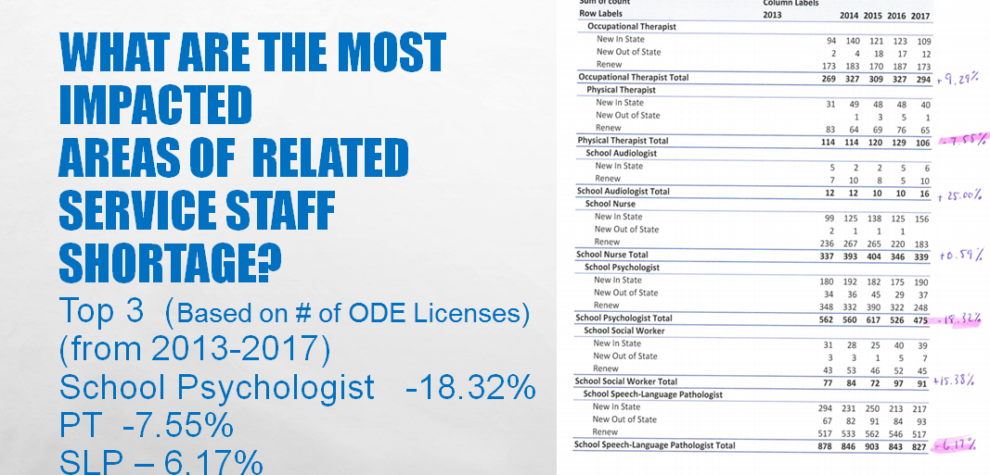

Slide 8
So what’s in a name?
School Psychologist Assistant
Bootcamp
That term Psychologist Assistant is owned by the Ohio Board of Psychology and requires licensing process and must have OPA License and they must be supervised by licensed School Psychologist
http://codes.ohio.gov/oac/4732-13
Alternative Terminology may be:
Teacher Supporting Psychological Services or
Teacher on Special Assignment (EMIS Code)
“We Work to Serve”

Slide 9
After that summer of 2015 we
Used Bootcamp to train another school psychologist who had been out of field for decades while she was Superintendent in another state (15-16)
Used Bootcamp again for a new School Psychologist Assistant for North Union(16-17)
Used Bootcamp again for Group of 5 District Reps who were helping out due to shortage of School Psychologists in Southern Ohio(17-18)
Used Bootcamp to replace Teacher Supporting School Psychologist (18-19)

Slide 10
Bootcamp
Promotes best practice when identifying students with educational disabilities
Trains individual evaluator how to support the school psychologist to ensure ETR draft portions are completed prior to proposed meeting date
Provides traditional case management support to school psychology services

Slide 11
Details about Bootcamp
3 day course targets
Test Administration Introduction
Scoring
Evaluation Team Report : Writing and Summarizing
Special Education Policy & Procedures
Follow Up : Year long intensive on site follow up which gradually fades out to the school psychologist on site

Slide 12
Bootcamp Trained Staff Can Help:
Complete Observations
Interview Parents and Teachers
Administer CBM’s and gather academic data
Gather educational backgrounds
Allow more time for the school psychologist to support districts in ways other than completing evaluations
“We Work to Serve”

Slide 13
Bootcamp To The Rescue
Urbana City Schools (fourth year)
North Union Local (Union County) (third year)
Hillsboro City Schools (Highland County) (first year)
Fairfield Local (Highland County) (first year)
“We Work to Serve”

Slide 14
Bootcamp to the Rescue
Southern Ohio’s Struggle and Solution

Slide 15
The Future Of Bootcamp
Training of more staff to support districts’ needs
Training of other school psychologists to train other ETR staff
Promotion of the profession to build applicants for school psychology programs
“We Work to Serve”

Slide 16
Next Steps?
Turning current training program into a systematic curriculum for training staff to support school psychological services which can be disseminated across agencies in Ohio
Prepare a trainer of trainer program using the curriculum reference above
Seek in depth feedback on curriculum and training from participants
Target date for Train the Trainer July 31 – August 2, 2019
Limit of 30 Participants – Selection Process Anticipated

Slide 17

Cautions
Requires on site supervision weekly from a licensed school psychologist
Candidates who will support school psychologist need to meet Class B test requirements as defined by publishers (transcripts must include courses in testing and assessment)
Same candidates’ qualifications should include: “Preferred to have knowledge of special education procedures and forms”

Slide 18


Questions?
“We Work to Serve”

