Slide 1
When we finally return to school…
How do we address the psychological effects of the COVID-19 quarantine with our students and with each other?
By:
Dr. Gina Beaman, Psy.D, LMFT, LEP, PPSC
Adapted from Brooks, S. K., Webster, R. K., Smith, L. E., Woodland, L., Wessley, S., Greenberg, N., & Rubin, G. J. (2020, March 14). The psychological impact of quarantine and how to reduce it: rapid review of the evidence. Rapid Review, 395(10227), 912-920. http://dx.doi.org/https://doi.org/10.1016/S0140-6736(20)30460-8

Slide 2
Quarantine is defined as the separation and restriction of movement of people who have potentially been exposed to a contagious disease to ascertain if they become unwell, so reducing the risk of them infecting others.
During the coronavirus (COVID-19) outbreak, quarantine was used as a public health strategy to reduce disease transmission, whether you were sick or not.

Slide 3
While quarantine broadly served the public good, it was also associated with unpleasant feelings and psychological challenges for all of us who were separated from loved ones, isolated, and those who suffer from anxiety and depression. These events may have been especially difficult for our students.

Slide 4
What do I need to know?
What do I do and say?
Where can I find more resources?

Slide 5
What do I need to know?
Psychological impact of quarantine on mental health and psychological wellbeing
Factors that contribute to the effects
Factors that mitigate these effects

Slide 6
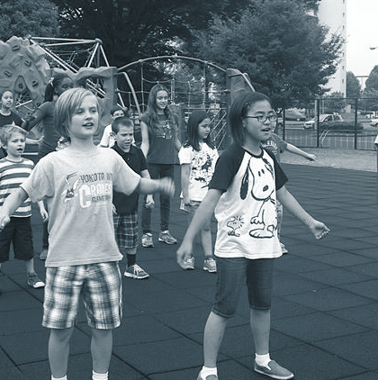
What may be some psychological impacts of quarantine?
Acute stress
Anxiety
PTSD like symptoms
Insomnia
Depressive symptoms
Emotional exhaustion
Fear of crowds
Avoidant behaviors
Nervousness
Poor concentration
Reluctance to work

Slide 7
Factors that contributed to the effects
Duration of the quarantine: longer durations are associated with increased mental distress.
Fears of infection: fears of infecting others (family members) and/or getting infected.
Frustration and boredom: confinement, loss of routine, reduced social and physical contact, and a sense of isolation.
Inadequate supplies and resources: low food supplies, poor internet connection, limited finances, and limited access to medical care and medication.
Misinformation: lack of clarity of the risk levels and lack of protocol

Slide 8
School Connectedness:
“The belief by students that the adults and the peers in the school care about their learning as well as about them as individuals” (CDC, 2009, p.3)
FACTORS THAT MITIGATE THESE EFFECTS INCLUDE...

Slide 9
Communicate that you are that someone who cares and understands their struggles.
Bring things into perspective for them.
Maintain the high expectations they have been accustomed to before the quarantine for both academics and school related behaviors.
Persistence. The effects of the probable trauma from quarantine may last a few months.
Know your limits
HOW DO YOU CONNECT?

Slide 10
Elicit and honor student voices.
Respond calmly and compassionately
Reassure safety.
Honestly answer questions in developmentally appropriate language.
Expand their “feelings” vocabulary so they can increase their ability to express themselves.
Encourage positive decision-making skills.
Use strength-based language: how teachers talk to their students influences their self-concept and how they see themselves.
What do I say?

Slide 11
What do I do?
Lead
Remain attentive
Seek other resources and the expertise of others
Be prepared and anticipate questions and concerns
Communicate
Encourage communication

Slide 12
Trauma
https://www.nasponline.org/resources-and-publications/resources-and-podcasts/school-climate-safety-and-crisis/mental-health-resources/trauma
Supporting Students Experiencing Childhood Trauma: Tips for Parents and Educators
https://www.nasponline.org/resources-and-publications/resources-and-podcasts/school-climate-safety-and-crisis/mental-health-resources/trauma/supporting-students-experiencing-childhood-trauma-tips-for-parents-and-educators
10 Tips for Teachers with Students Who Have Experienced Trauma
https://www.weareteachers.com/10-things-about-childhood-trauma-every-teacher-needs-to-know/
Where can I find more resources?

