Slide 1
Dec. 4, 2020 OAPSA Business Meeting
Call to Order
OAPSA President Sarah Walker

Slide 2
Secretary Report
Approval of September Minutes
Jackie Vance OAPSA Secretary
www.OAPSA.org Follow Us on Linked in and Twitter @OAPSA1

Slide 3
Treasurer Report
Gwenn Spence
OAPSA Treasurer
www.OAPSA.org Follow Us on Linked in and Twitter @OAPSA1

Slide 4
Program Report Talia St. Clair OAPSA President Elect Mark Your Calendars for OAPSA Conferences February 25 & 26, 2021 May 7, 2021
www.OAPSA.org Follow Us on Linked in and Twitter @OAPSA1

Slide 5
News & Updates from our Past President
Deidre Parsons
OAPSA Past President
www.OAPSA.org Follow Us on Linked in and Twitter @OAPSA1

Slide 6
Communications Report
Dr. Valerie Riedthaler
Communications Officer
www.OAPSA.org Follow Us on Linked in and Twitter @OAPSA1

Slide 7
Executive Director Report Donna Stelzer Executive Director 937-902-0671
OAPSA.DonnaStelzer@gmail.com

Slide 8
NAPSA Report – Deidre Parsons,
OAPSA Past President and President Elect of NAPSA
NAPSA Membership Benefits:
Individual Professional Liability Insurance*
NAPSA News (Quarterly)
NAPSA Tidbits (Updates & Breaking News)
NAPSA Website (Articles, Tools & Resources)
National Legislative Affiliations
Reduced Rates for NAPSA Members at NAPSA Conferences
Notes:
This is one of 4 slides on NAPSA presented by Deidre

Slide 9
Additional New Benefits from NAPSA
Notes:
# 2 of 4 slides on NAPSA presented by Deidre

Slide 10
Find out more about benefits of being a NAPSA Member and how to become a NAPSA member (with $10 savings) for OAPSA members on OAPSA’s Web Site by going to home page of www.OAPSA.org and clicking NAPSA (Above arrow)
Notes:
#3 of 4 slides on NAPSA presented by Deidre

Slide 11
NAPSA Conferences Fall 2021 and 2022
NAPSA’s Conference in 2021 will be at Drury Plaza Hotel in Pittsburgh
Oct. 24 – 27, 2021
Fall 2022 - NAPSA conference returns to Ohio in the Cleveland area
Pittsburgh, Pennsylvania
Notes:
This is 4 of 4 slides presented on NAPSA presented by Deidre.

Slide 12
SAPEC Report – Donna Stelzer
Notes:
This is 1 of 1 slides presented on SAPEC by Donna.

Slide 13
Ohio Coalition for the Education of Children with Disabilities Report by Donna Stelzer
Notes:
This is 1 of 3 slides presented by Donna on Ohio Coalition

Slide 14
Ohio Coalition for the Education of Children with Disabilities (OCECD) Report – Donna Stelzer
Notes:
This is 2 of 3 slides presented by Donna on Ohio Coalition.

Slide 15
Annual Report from OCECD Emailed to OAPSA Members Nov. 19, 2020

Slide 16
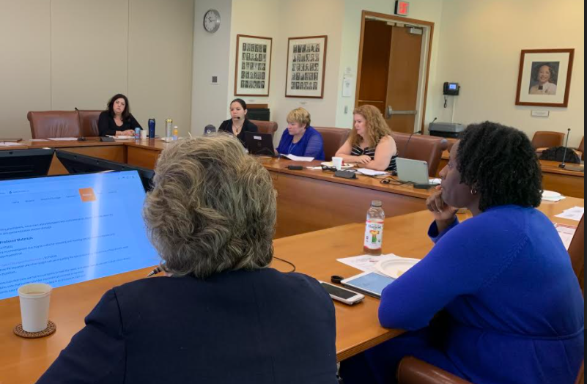
NCPSSERS Report by Donna Stelzer OAPSA is a proud member of the National Coalition on Personnel Shortages in Special Education and Related Services. Critical shortages of special education teachers and instructional support personnel exist in all regions of our country. We meet every other month. Specialedshortages.org
Meeting at ASHA in Rockville, MD
Notes:
This is first of 2 slides on shortages presented by Donna.. This is part one on NCPSSERS section.

Slide 17
Ohio’s Related Service Workgroup
Panel Discussion at OCALICONLINE 2020
2019 Report, video clips & 1 page flyers
available at ODE’s & OAPSA Sp Ed
Shortage Section
(Search at ODE for Related Services)
Notes:
This is 2 of 2 slides on shortages. This is part 2 on Ohio’s Related Service Workgroup.

Slide 18
CASE Report – TALIA St. Clair : Top Ten Reasons You Should Belong to CASE
Keep up to date on SpEd Issues, significant research, practical help, & trends
Network, Network, Network
Targeted Electronic Communication
Increase Your Professional Involvement
Add to Your Expertise
Get the Resources You Need at Affordable Prices
Develop Your Leadership Skills
Make a Difference with Policy Makers
Influence Your Profession
and the # 1 reason is:
Improve the Educational Success of All Students!
Notes:
This is one of two slides on CASE Report by Talia.

Slide 19
July 11-14 2021
Sp Ed Legislative Summit
Washington DC
Make a Difference!
Talk with our Legislators
from Ohio on Capitol Hill
Westin, Alexandria, Virginia
Nov 11-13 2021
CASE Fall Conference
Marriott, Little Rock, Arkansas
Notes:
This is 2 of 2 slides on CASE report reported by Talia.

Slide 20
Disproportionality Stakeholder Group Report
Talia St. Clair
Notes:
1 of 1 slide on Disproportionality by Talia St Clair.

Slide 21
Old Business

Slide 22
New Business

Slide 23
Adjournment

