Slide 1
TRAUMA RESPONSIVE EDUCATIONAL PRACTICES
Trauma & Its Effects
How Trauma Shows Up in Behaviors At School
Developmental Relationships
Secondary Traumatic Stress & Collective Care
September 2020

Slide 2
Introduction

Slide 3
Understanding trauma and its effects are important because…
Teachers often assume that because it is new school year that new teacher-student relationships should begin from a position of trust
Students may start from a position of distrusting adults/teachers based on past experiences inside and outside the school
Currently, children are experiencing an additional source of trauma due to the change of life Covid-19 has unfolded in their lives
Research informs us that people who have experienced trauma may have significantly diminished ability to self-regulate.
They seem to always to be in a state of high alert, ready to “fight or flight” - to protect themselves from remembered harmful experiences. This is their automatic, learned response. Our task as educators is to help them learn new ways of responding.
Notes:
1:16

Slide 4
TRAUMA AND ITS EFFECTS

Slide 5
How Trauma Builds
Potentially Traumatic Event
Singular major event, several moderate events, or the accumulation of repeatedly occurring small events

Slide 6
How Trauma Builds
Potentially Traumatic Event
Trauma
Singular major event, several moderate events, or the accumulation of repeatedly occurring small events
The individual’s response to a highly stressful event or ongoing series of events; not the event itself

Slide 7
How Trauma Builds
Potentially Traumatic Event
Trauma
Traumatization
Singular major event, several moderate events, or the accumulation of repeatedly occurring small events
The individual’s response to a highly stressful event or ongoing series of events; not the event itself
Develops when the person does not have individual or interpersonal coping resources to restore sense of safety and protection

Slide 8
How Trauma Builds
Potentially Traumatic Event
Trauma
Traumatization
Developmental
Trauma
Singular major event, several moderate events, or the accumulation of repeatedly occurring small events
The individual’s response to a highly stressful event or ongoing series of events; not the event itself
Develops when the person does not have individual or interpersonal coping resources to restore sense of safety and protection
Traumatic experiences occurring early in life that disrupts development in ways that result in loss of core cognitive, emotional, and behavioral
self-regulation capacities

Slide 9
Question: Which Students & Classrooms?
Students in classrooms with a general education teacher
Students in classrooms with a special education teacher

Slide 10
Stress & Trauma on the Brain
This video will be embedded
https://www.youtube.com/watch?v=RTp5OHtuAec
Notes:
7:54
https://www.youtube.com/watch?v=RTp5OHtuAec

Slide 11
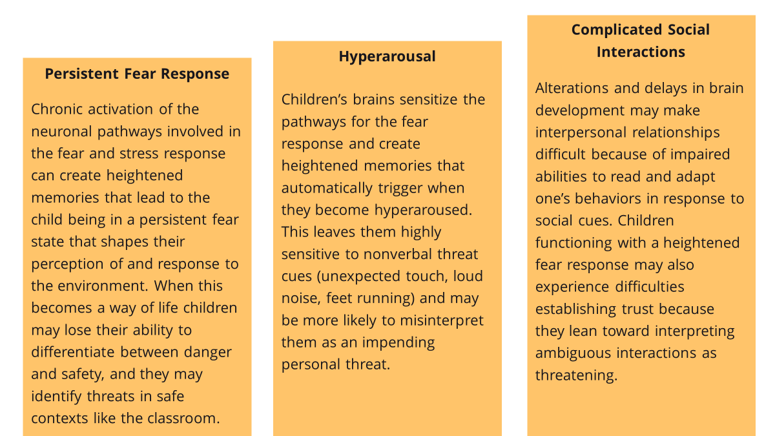
Developmental Impairments May Include:

Slide 12
Developmental Impairments May Include:

Slide 13
Developmental Impairments May Include:

Slide 14
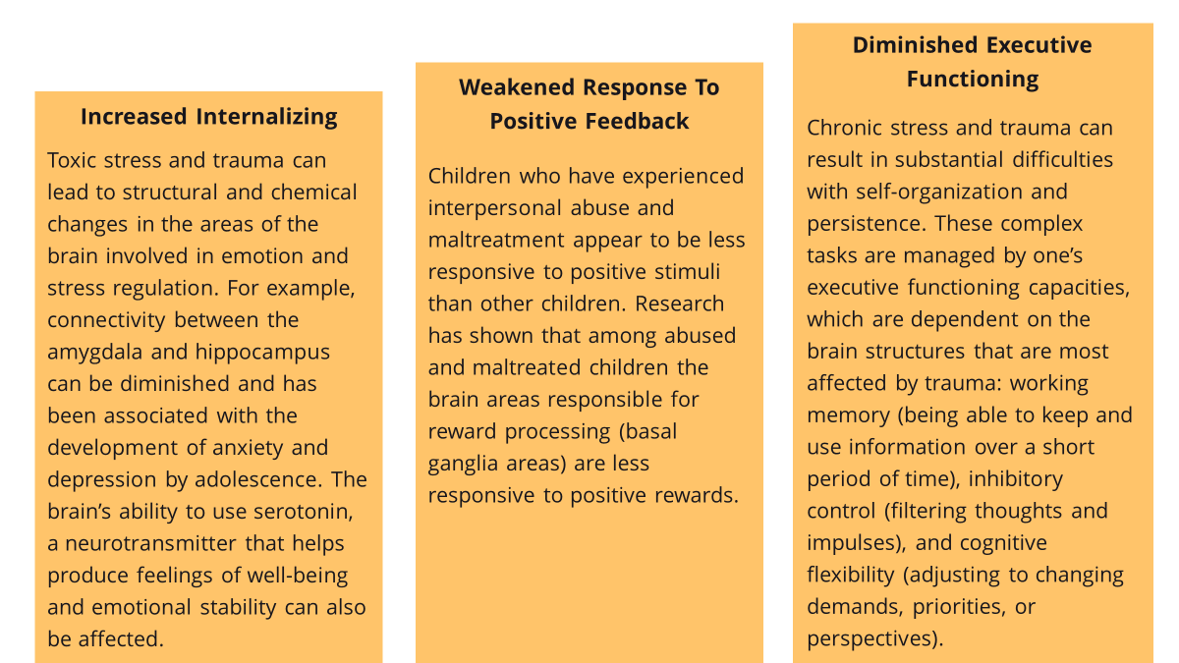
Developmental Impairments May Include:

Slide 15
Developmental Impairments May Include:

Slide 16
Developmental Impairments May Include:

Slide 17
Domains of Impairment
Brain & Body
Cannot access rational thought in the face of overwhelming emotion
Thinking & Learning
Delays in learning, memory, reasoning, and attention
Emotion Regulation
Easily aroused and high intensity emotional expression
Dissociation
Having thoughts, emotions, and sensations that are disconnected from awareness
Attachment
Withholding their emotions from others
Self-Concept
Sense of one’s self as valued, worthy, and competent
Behavior Regulation
Ranges from being overly confrontational to overly compliant

Slide 18
Educators tasked with meeting the developmental and educational needs of traumatized students must…
Be able to… Read and respond to children’s emotional states as signaled by their behavior
Offer acceptance and warmth as well as accurate and appropriate feedback
Support children in learning how to tolerate frustration during the learning process
Provide limits on the boundaries of acceptable behavior while providing space for individual expression

Slide 19
Educators tasked with meeting the developmental and educational needs of traumatized students must…
Be able to… Read and respond to children’s emotional states as signaled by their behavior Offer acceptance and warmth as well as accurate and appropriate feedback Support children in learning how to tolerate frustration during the learning process Provide limits on the boundaries of acceptable behavior while providing space for individual expression
While managing their own… Feelings of frustration and irritation with students’ off-task behaviors
Impetus to respond with harsh or rejecting statements
Desire to isolate or neglect or emotionally withdraw from students exhibiting dysregulation
Symptoms of secondary traumatic stress
Need for emotional distance from students’ traumas

Slide 20
Prevention And Management Of Secondary Traumatic Stress
SEL Integrated Into Core Curriculum And Instruction
Strong Relationships For All
Physical
Safety
Psychological Safety
Emotional
Safety
Mindfulness For All

Slide 21
How Trauma Shows Up In Behaviors At School

Slide 22
Coping with Trauma
Children growing up in chronically stressful environments develop coping behaviors that don't transfer well to safe and prosocial contexts like schools. The important thing for educators to keep in mind is that many of the student behaviors that educators perceive as challenging behaviors are protective in a different context.
For example, a child may develop a rigid avoidant coping response that “protects” them in a context that has high levels of risk for violence and victimization. Both situations are experienced by the child as stressful, and they only have that one way of responding to stress.

Slide 23
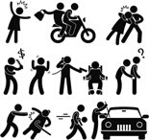
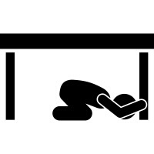
The Same Behavior Can Be Functional And Dysfunctional Depending On Context
Child uses their learned coping strategies for protection from perceived stress.
Chronically Stressful Environment
Learned Coping Strategies

Slide 24
Common Ways Behavior is Challenging at School
Behavioral dysregulation is one of the most common challenges that educators face when addressing trauma and stress in the classroom.
HYPERACTIVE
EXPLOSIVE BEHAVIORAL
RESPONSES
DENIAL OF
RESPONSIBILITY
The dysregulated brain “re-sets" baseline state of arousal such that even when no external threats or demands are present, a physiological state of persistent alarm and agitation is active.
Behaviors are often impulsive, without forethought of the consequence or danger.
Increased reactivity results in dramatic behavior changes in the face of seemingly minor annoyance.
Over-reading of threat leading to "fight or flight" reaction and impulsive violence.
Introduction of external stressors like difficulties, result in more "reactive" responses. Even a relatively small stressor can instigate a state of fear or terror
Child views violent actions as defensive, not aggressive.
They will quickly turn the focus on the other person’s actions as cause for their reaction.
Often they will turn to arguing their side.

Slide 25
Common Ways Behavior is Challenging at School
Behavioral dysregulation is one of the most common challenges that educators face when addressing trauma and stress in the classroom.
HYPERACTIVE
EXPLOSIVE BEHAVIORAL
RESPONSES
DENIAL OF
RESPONSIBILITY
The dysregulated brain “re-sets" baseline state of arousal such that even when no external threats or demands are present, a physiological state of persistent alarm and agitation is active.
Behaviors are often impulsive, without forethought of the consequence or danger.
Increased reactivity results in dramatic behavior changes in the face of seemingly minor annoyance.
Over-reading of threat leading to "fight or flight" reaction and impulsive violence.
Introduction of external stressors like difficulties result in more "reactive" responses. Even a relatively small stressor can instigate a state of fear or terror
Child will views violent actions as defensive, not aggressive.
They will quickly turn the focus on the other person’s actions as cause for their reaction.
Often they will turn to arguing their side.
Have you seen any of these effects of trauma in your students?

Slide 26
Both Ends of a Spectrum of Behaviors
Pay attention to both…
Hypoarousal, which may show up as
Daydreaming, “spacing out”
Forgetting assignments
Forgetting material previously mastered
Not processing material just read or discussed
Lethargy, sleeping in class
Hyper-focused on an activity and unaware of other activities
Blocks an event or activity but maintains some level of functioning for other activities
Lack of motivation
Hyperarousal, which may show up as:
Inability to remain seated
Tension, irritability, and impatience
Anger outbursts and aggression
Reactivity
Defiance
Hypervigilance
Impulsivity
Exaggerated startle response
Excessive Chatter

Slide 27
Developmental Relationships

Slide 28
Not all stress is bad for development. In fact, most stress is helpful for child and adult development. There are three kinds of stress: positive, tolerable, and toxic stress.
Adapted from Center on Youth Wellness

Slide 29
Not all stress is bad for development. In fact, most stress is helpful for child and adult development. There are three kinds of stress: positive, tolerable, and toxic stress.
Positive Stress
Tolerable Stress
Toxic Stress
Mild/moderate and short-lived stress response necessary for healthy development.
More severe stress response but limited in duration which allows for recovery.
Extreme, frequent, or extended activation of the body's stress response without the buffering presence of a supportive adult.
Adapted from Center on Youth Wellness

Slide 30
Not all stress is bad for development. In fact, most stress is helpful for child and adult development. There are three kinds of stress: positive, tolerable, and toxic stress.
Positive Stress
Tolerable Stress
Toxic Stress
Mild/moderate and short-lived stress response necessary for healthy development.
More severe stress response but limited in duration which allows for recovery.
Extreme, frequent, or extended activation of the body's stress response without the buffering presence of a supportive adult.
Intense, prolonged, repeated, and unaddresed
Social-emotional buffering, early detection, and effective intervention
Adapted from Center on Youth Wellness

Slide 31
Toxic stress occurs when events are so physically, psychologically, and/or emotionally damaging, and occur in the absence of buffering social supports that the brain and body’s stress management chemicals become toxic.
When acute or chronic traumatic events occur because of harmful adults or in the absence of caring adults, they are often left with a limited set of rigid coping responses based in defensiveness, avoidance, and overreaction.

Slide 32
Investing in building relationships with students who exhibit challenging behaviors is a high-return investment because research shows that students are more likely to engage in self-regulation when they feel connected to their educators.
The challenge is that the interpersonal experiences of students with histories of rejecting, harmful, or neglectful relationships, make it difficult for them to:
ONE
TWO
THREE
Accept Relationship-
Building as Genuine
Express Their Appreciation of Relationship-Building
Reciprocate in Healthy Ways
They do value their educators’ caring actions, particularly attentiveness and active listening.

Slide 33
In DEVELOPMENTAL RELATIONSHIPS, one person assumes greater responsibility for developing and maintaining the relationship in an effort to support the development of the other person.
Developmental relationships are not completely one-sided, but one partner (the educator) does hold greater power and responsibility than the other (the student).

Slide 34
Dysregulated Relational Partners
It is daunting to be asked to build and maintain relationships with dysregulated students.
Despite their best intentions, dysregulated students are difficult relational partners.

Slide 35
Dysregulated Relational Partners
Students coping with trauma are more likely than others to exhibit the coupling of two emotional and behavioral patterns that research suggests are particularly challenging for school success: being both aggressive and withdrawn

Slide 36
Dysregulated Relational Partners
Students coping with trauma are more likely than others to exhibit the coupling of two emotional and behavioral patterns that research suggests are particularly challenging for school success: being both aggressive and withdrawn
Student aggression is experienced as a threat to one’s safety, and, in the classroom, it is perceived as defiance of authority that could be setting a bad example for the whole class and is therefore often responded to with punitive discipline.

Slide 37
Dysregulated Relational Partners
Students coping with trauma are more likely than others to exhibit the coupling of two emotional and behavioral patterns that research suggests are particularly challenging for school success: being both aggressive and withdrawn
Student aggression is experienced as a threat to one’s safety, and, in the classroom, it is perceived as defiance of authority that could be setting a bad example for the whole class and is therefore often responded to with punitive discipline.
Student withdrawal from interpersonal interactions reduces the likelihood of positive student-teacher relationships, those relationships are an important foundation for helping traumatized students develop a sense of school belonging.

Slide 38
LUNCH

Slide 39
Mindful return from lunch
Square Breathing
https://www.youtube.com/watch?v=YFdZXwE6fRE

Slide 40
Mindful return from lunch
Visual Breathing Exercise
https://www.youtube.com/watch?v=5f5N6YFjvVc
Relaxed Breathing Training
https://www.youtube.com/watch?v=gLbK0o9Bk7Q
Visual Meditation
https://www.youtube.com/watch?v=RlOZ02HgAnE
Using Shapes to Teach Deep-Breathing
https://copingskillsforkids.com/blog/using-shapes-to-teach-deep-breathing
Breathe Bubble
https://www.youtube.com/watch?v=9tOJZQhO_Uw
Six Simple Mindfulness Practices for Kids with Autism

Slide 41
Domains of Impairment
Brain & Body
Cannot access rational thought in the face of overwhelming emotion
Thinking & Learning
Delays in learning, memory, reasoning, and attention
Emotion Regulation
Easily aroused and high intensity emotional expression
Dissociation
Having thoughts, emotions, and sensations that are disconnected from awareness
Attachment
Withholding their emotions from others
Self-Concept
Sense of one’s self as valued, worthy, and competent
Behavior Regulation
Ranges from being overly confrontational to overly compliant

Slide 42
Dysregulated Relational Partners
Students coping with trauma are more likely than others to exhibit the coupling of two emotional and behavioral patterns that research suggests are particularly challenging for school success: being both aggressive and withdrawn
Student aggression is experienced as a threat to one’s safety, and, in the classroom, it is perceived as defiance of authority that could be setting a bad example for the whole class and is therefore often responded to with punitive discipline.
Student withdrawal from interpersonal interactions reduces the likelihood of positive student-teacher relationships, those relationships are an important foundation for helping traumatized students develop a sense of school belonging.

Slide 43
Secondary Traumatic Stress & Collective Care

Slide 44
The 4 Rs?
Realizes trauma is real
Recognizes signs and symptoms
Responds from a toolkit
Resists re-traumatization
When we care for ourselves, we have better resilience, stronger coping skills, more creativity and less reactivity allowing ourselves more room in our brains and bodies to be responsive and resist re-traumatizing.

Slide 45
Negative effects of educator stress
Compassion Fatigue
Often referred to as the cost of caring. After investing too much compassion, there can be a gradual decline in ability to feel empathy for students and/or work

Slide 46
Negative effects of educator stress
Compassion Fatigue
Secondary Traumatic Stress
Extreme emotional distress resulting from witnessing the aftermath or hearing about students’ traumatic experiences

Slide 47
Negative effects of educator stress
Compassion Fatigue
Secondary Traumatic Stress
Vicarious Traumatization
Emotional, psychological, and behavioral changes in which one seems to have entered into another’s traumas, as if they had experienced the trauma themselves

Slide 48
Negative effects of educator stress
Compassion Fatigue
Burnout
Secondary Traumatic Stress
Vicarious Traumatization
Physical, emotional, psychological, and spiritual exhaustion that can occur over time. It Includes emotional exhaustion, depersonalization, and reduced sense of personal accomplishment

Slide 49
Cascading effects of educator stress
Educator
Stress
Can Negatively
Impact Self
Can Impact
Students
Emotional exhaustion
Social detachment
Heightened sense of fear
Anxiety
Feelings of helplessness
Estrangement from work
Alteration/disruption of processing & response to experiences & information
Physical & psychological ailments
Decreased professional capacity/effectiveness
Increased risk of compassion fatigue and burnout
Decline in student achievement & connectedness to school
Destabilization of schools
Personal Resources
Professional Isolation
Job Demands
Educational Structure

Slide 50
Irritability
Difficulty concentrating
Anxiety
Sleep disturbance
Hopelessness
Low self-esteem
Hypervigilance
Poor self-care
Emotional rollercoaster
Self-doubt
SIGNS THAT STRESS IS COMPROMISING WELL-BEING
Triggered by students’ traumas
Inability to concentrate
Appetite changes
Apathy
Overwhelmed
Decreased sexual intimacy
Forgetfulness
Loss of purpose
Anger
Withdrawal/
isolation
Notes:
Symptoms That Stress Is Compromising Your Well-being

Slide 51
Factors That May Increase Your Vulnerability To the Impact of Workplace Stress
Previous traumatic experience
Close connection with student/ colleague who experienced trauma
Heightened sense of empathy
MORE VULNERABLE
Trying to do everything on your own
Neglect/ unawareness of own social and emotional needs
Pushing too hard to get things done
Notes:
As teachers, there are many important factors to consider because these factors may increase your vulnerability to stress. If you don’t have the adequate resources and capacity to overcome challenges, then you become much more at risk of developing negative coping behaviors as well as illnesses. For example, you’re more likely to catch a cold or the flue when you’re coping with high levels of stress. How you cope with stress, though, is one of the ways in which you can disrupt the connection between stress and illness.

Slide 52
Recognition
Knowledge of the signs of stress and added vulnerabilities and understanding it from a personal vantage point, will help to equip you to better recognize these signs and symptoms in your peers and staff.

Slide 53
The Balancing Act
Supports
Resources & Assets
Challenges
Risk Factors
Physical
Psychological
Cognitive
Social
Economic
Physical
Psychological
Cognitive
Social
Economic
Well-Being
Adapted from Schultze-Lutter et al. (2016)
Notes:
Here’s how we conceptualize well-being: Having enough resources, assets, and supports to be able to balance out the challenges and risk factors.

Slide 54
Attending to Collective
Well-Being

Slide 55
Working Toward Collective Care
Collective-care is socially oriented care that encourages the holistic support of the group or community. Collective-care guards against the isolation of managing our challenges alone.
Self-care alone can ignore the fact that stressful contexts are collectively stressful and can be collectively managed or changed
People who work in the same context are better able to understand each others’ stressors and needs for support
Rather than simply expecting individuals to improve their coping skills, collective-care actively works to transform workplace stressors.

Slide 56
Working Toward Collective Care
Coworker social support is a significant protective factor against high levels of stress. How does it look?
Collaborative work environment
Collective recognition of and healing from stress and trauma
Collective care activities
Healing circle
Small group check-ins and practical supports
Teacher-to-teacher conversations
Wellness group (e.g. group exercise using the school gym)
Collective agreement and implementation of school policies, practices, and procedures

Slide 57
Collective Care Examples That We Have Seen
Social Support
5-minutes of open socialization time before meetings begin.
An all-staff gathering or cook-out at the home of the principal or other staff member, before school started back. (The casual meet-up can be at a local park, beach, or any relaxing place.)
Grade-Level Teams rotate planning and hosting a monthly staff outing. Families welcome! (baseball game, bowling, comedy club, etc.)
Birthday and special celebration acknowledgements in weekly newsletter, announcements, or lounge.
Have a social club or team in charge of sharing personal celebratory notes, cards, or expressions of sympathy
Prioritize self-care for staff, by letting teachers host various teacher classes once a week, after school, based on their own gifts, talents, and interests, such as cooking, yoga, pilates, dance, walking for exercise, art with a twist activities, and more.

Slide 58
Collective Care Examples That We Have Seen
Teaching Support
Assuring that every staff member has a thought partner and team to work with. New teachers should always have an assigned veteran mentor.
Engage your Enrichment team and other personnel in meeting student needs, including reinforcing tough concepts through creative lessons in their classes (Gym, Art, Music, etc.)

Slide 59
Collective Care Examples That We Have Seen
Emotional Support
Mindfulness or other regulation activity starts every meeting.
Emotional check-ins for each meeting.
Coffee/Tea in lounge daily with a “Pick-Me-Up” printed message changed periodically.
Teacher awards or specific thank yous for everyday kinds of activities that have been noticed and noted by the admin, acknowledged in weekly staff communication or at staff meetings and trainings. Assure that EVERY staff member is equitably acknowledged.
Party at the school with music and cake for staff to celebrate test scores
A Friday after-school dinner paid-for, at a local casual restaurant, to celebrate staff, after school’s overall status went up.

Slide 60
Collective Care Examples That We Have Seen
Coping Support
Informal self-Care challenges issued weekly and reported on by post-it note or polls next to the teacher mailboxes or in the teacher’s lounge.
Set up an optional weekly/ biweekly circle time for staff (without administrators) to just get to talk. School provided light refreshments.
Invited a psychologist monthly to host an optional talking circle session with the staff
Spruce up the Techer’s Lounge, so that it is inviting, encouraging, and a nice reprieve for staff during the day. (No students or talking about students allowed.)

Slide 61
Daily Support Needed
Activities and events are nice and necessary, but don’t neglect to focus on the ongoing DAILY support that needs to be given, to help maintain wellness within your staff.

Slide 62
Implications & Considerations in the Midst of COVID-19
Strategies based on research of schools, teachers, and students in the aftermath of a major collective traumatic event.
Based on Ideas from Policy Brief: Learning from Hurricanes to plan for aftermath of COVID-19 by Cassandra Davis

Slide 63
COVID-19 Increased Stress Considerations: COLLABORATION
Arrange ongoing staff collaboration
Rotate enrichment teachers to meet with grade level teams in order to further support them in teaching their most challenging concepts or concepts that students consistently score poorly on in standardized testing data, through reinforcement activities in the enrichment classes.
Be flexible and understanding with time off needs

Slide 64
COVID-19 Increased Stress Considerations: COMMUNICATION
There is more likely to be a communication break-down, as people have become accustomed to not having help and keeping private, any stigmatized issues, such as COVID infection, mental health challenges, isolation/ loneliness, food and shelter needs.

Slide 65
COVID-19 Increased Stress Considerations: COMMUNICATION
Use a wide variety of tools to communicate with staff, students, and families.
Email is not enough.
Encourage private and public communication, in which asking for and/ or seeking help becomes normalized.

Slide 66
COVID-19 Increased Stress Considerations: COMMUNICATION
Idea: Staff Community Board, on which staff can post reliable resources that they have found to be helpful, that others may be interested in. These may be categorized by service type: help with shelter, bills, food, mental health services, support groups, etc.
Also on the board, may be a request area, in which staff can make general requests on sticky notes, such as “Does anyone know of a good place to go for…” Does anyone have a __ that I can borrow for a week?” or “Is anyone up for going to the baseball game on Saturday?” Those posting have the option to anonymously post and get answers right on the board or leave a contact.

Slide 67
COVID-19 Increased Stress Considerations: SOCIAL AND PEER COPING SUPPORT
Embed time for staff to freely talk to one another at every meeting or more.
Encourage social interaction through weekly staff check-ins, polls, interactive websites on which they all post a quick answer to a social-emotional related question.
Arrange an optional weekly circle time for teachers to be able to simply express themselves in a safe community of peers.

Slide 68
COVID-19 Increased Stress Considerations: RELATIONSHIP BUILDING
Communicate with your staff as soon as possible about anything that will impact them, as you receive information from your district, local, state, or federal agencies.
Acknowledge your staff’s worries, concerns, fears and help them to know that you are on their side. You are also building critical relationships with your staff.

Slide 69
Collective care starter guide
https://docs.google.com/document/d/1wPUdvtBdW4ViVgcYw1c_bpvLwhiPwSOadyL3WlFelCY/edit?usp=sharing

Slide 70
???

