Slide 1
Notes:
RI President Mark Maloney challenged all Rotary clubs to expand connections in their communities and to embrace innovative membership models. He said; “The first emphasis is to grow Rotary — to grow our service, to grow the impact of our projects, but most importantly, to grow our membership so that we can achieve more.”

Slide 2
Calculating and Understanding Club Retention
Membership as of 07/01/2019
Number of new members inducted
Membership as of 07/01/2020
New members from membership on 07/01/20
Net gain or loss
Membership 07/01/20 divided by 07/01/19
RETENTION RATE %
Example:
54
11
49
49-11=38
-16
38/54
70.38%

Slide 3
Grow Your Club and Grow Rotary
Membership Goals
Attract new members
(set a target rate)
Retain, Retain, Retain!
Increase retention rate
(set a target % above your clubs current retention rate)
Get them in, keep them in!
That is how you will grow your club & Rotary!

Slide 4
Attract
Engage
Retain
Notes:
There are three main gears to an effective membership plan. One cannot work successfully without the other. They are Attract, Retain, and Engage. Understand, attraction and retention are not separate functions. Both depend on an active club with a variety of hands-on projects and activities. So let’s see if I can give you some ideas on how you build your membership machine. Let’s start with attraction.

Slide 5
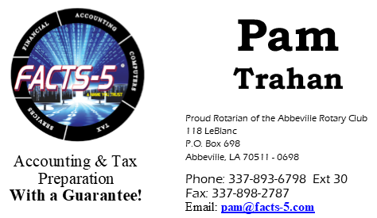
ATTRACT
Notes:
Attracting new members is about being fresh, fun and relevant, so here a few ideas to try. It’s important to make a good 1st impression, so update your club’s signs, banners, brochures, and club shirts with the new Rotary logo. Spend some money and freshen things up.
Social media is a great way for clubs to advertise. Spruce up your accounts, be sure the last thing that was posted to the page isn’t from 2017. Keep the page relevant and current! And be sure to tag the people in the photos and write a catchy description of what your club is doing.
Create “events” for all the fun things your club is doing, not just the fundraiser.
Go live on Facebook during your club meetings, fundraisers, and socials.
Create a YouTube channel and upload recordings of the club meetings and events. This is a great way for club members to do a makeup as well as allowing others to see what your club is all about. My club recently purchased a camcorder and began doing just that and our club members are loving it!
Recycle those Rotarian magazines; Attach a business card and leave them in doctors’ offices, office lobbies, waiting rooms, and so on.
Make Rotarian business cards for club members OR ask members to add “Rotarian” to their personal business cards. Do whatever it takes to make your club attractive.

Slide 6
Retain
Here to Stay
Notes:
Don’t let your members slip through the cracks. Get to know them, find out what they like or would like to see changed. Conduct a survey, their feedback is a valuable planning tool. Be flexible by trying new things and be willing to make any necessary changes to your club to accommodate members’ requests and changing demographics.
When we invite someone to join Rotary, we are asking them to donate quite a bit of time and money. By offering club members meaningful service projects, social events, networking opportunities, and leadership opportunities, the value of their Rotary membership will increase. And when someone asks the question, “what’s in it for me?”, you will be ready to brag about the long list of wonderful thing your club is doing in your local community and the world.
Be sure to keep your members informed. Since RI adopted a relaxed attendance policy, some members may not attend every meeting so they miss out on the club announcements and other important information. Assign someone to be your Clubs Communications Director. Let them be in charge of important member notifications and reminders. Try using the “Remind Me App” to keep club members up-to-date.

Slide 7
What does it mean to engage?
En·gage:
engaged; engaging
Cause someone to become involved
Participate or become involved
Establish a meaningful contact or connection
Notes:
Now let’s take a closer look at engagement since it is the most vital component of our membership machine. Lets start off by defining the word Engage. The definition of Engage is: (1) Cause someone to become involved (2) Participate or become involved and (3) Establish a meaningful contact or connection with.
The keywords here are Involve – Participate – Connection.
That’s what engagement is all about. It is about getting members involved and participating. It’s about establishing connections and friendships that will last a lifetime.

Slide 8
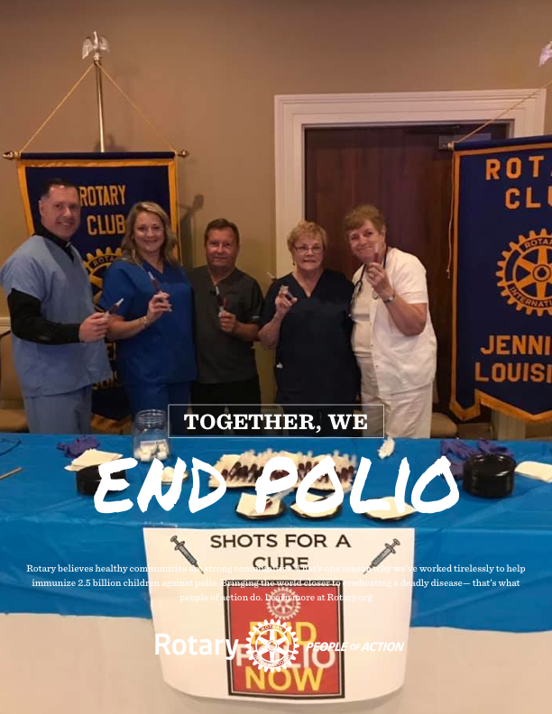
Engagement Starts with..
Knowing Your Members:
What is their family life?
What is their vocation?
What are their passions?
Why did they join Rotary and why do they stay in Rotary?
Notes:
For engagement to work, you have to get to know your members – make the connection!!!!
Why did they join Rotary? What is the main reason they stay in Rotary?
Don’t just know your members’ names, find out more about them:
Look for common interests. What are their passions? What do they do for fun? What is their vocation? What’s their family life like? Where do they like to vacation? Knowing your members better will help you develop service opportunities and projects that they are more likely to engage in.

Slide 9
Engagement is Rotarians at work!
Service Projects
BOOTS ON THE GROUND!!
Notes:
Earlier I offered you ways to make your club attractive. But there is no better way to attract and involve your members than with service projects. I like to call service projects “Boots on the Ground”. Surveys have shown that most club members are looking for hands-on service projects that will make an impact on their local communities. Boots on the Ground-types of projects, where members are doing the work, will take the club energy and visibility to a whole new level! Now I know it’s possible that some clubs may tend to shy away from a lot of hands-on projects because they are concerned that some club members may not be able to participate due to their age or health, and as I told you earlier, 32% of members are over the age of 60. I once had someone say to me; “Pam, you know if we do something like that, some of our older members won’t be able to participate and I worry that they’ll feel left out.” My response was: “Listen, if you do service projects, centered around the belief, that every one of them, must be compatible, with every member of the club, you’ll limit the opportunities for service.” Those guys and gals in the 32% group of members over the age of 60 were once the young bucks that were out there working those service projects to building a stronger community and club, and Rotary is the best service organization in the world because of them. At the same time, the younger members may not be in a financial position to “write checks” for every project, but they are ready to break their back and give you their valuable time because it’s important to them to know that they are making a difference, and they are willing to work for it! My point is, you have to have a variety of diversified service projects appropriate for everyone. But one more thing, don’t assume just because they are older means they can’t get dirty.

Slide 10
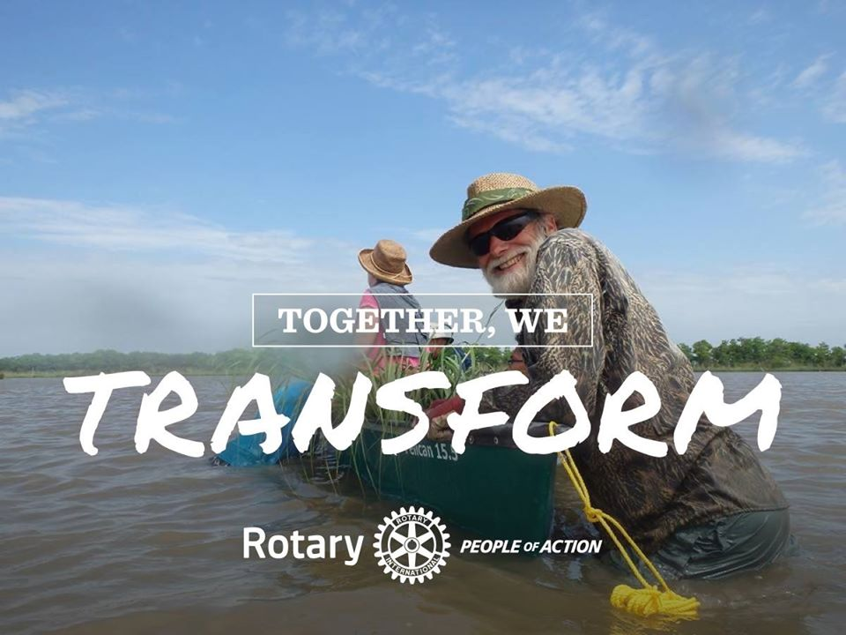
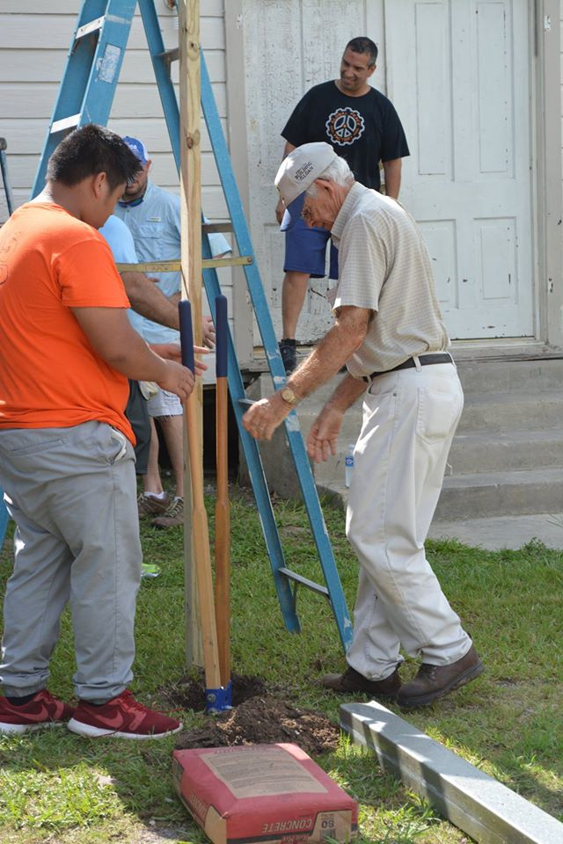
Notes:
This is a picture of a Rotarian planting marsh grass in the gulf – he’s 66. And this is a picture of Rotarian helping remodel a soup kitchen, in 92-degree weather, in the middle of June, and he’s 87 years old. I’ve learned not to assume gray hair stops a Rotarian. Give them a chance to surprise you. And if it’s too much, they can pass out the water just as I did for the 1st marsh grass planting project - I was too chicken to get into that the alligator and snake-infested muddy water so I handed out snacks and water. I did end up doing it another day because Mark Shirley picking on me.

Slide 11
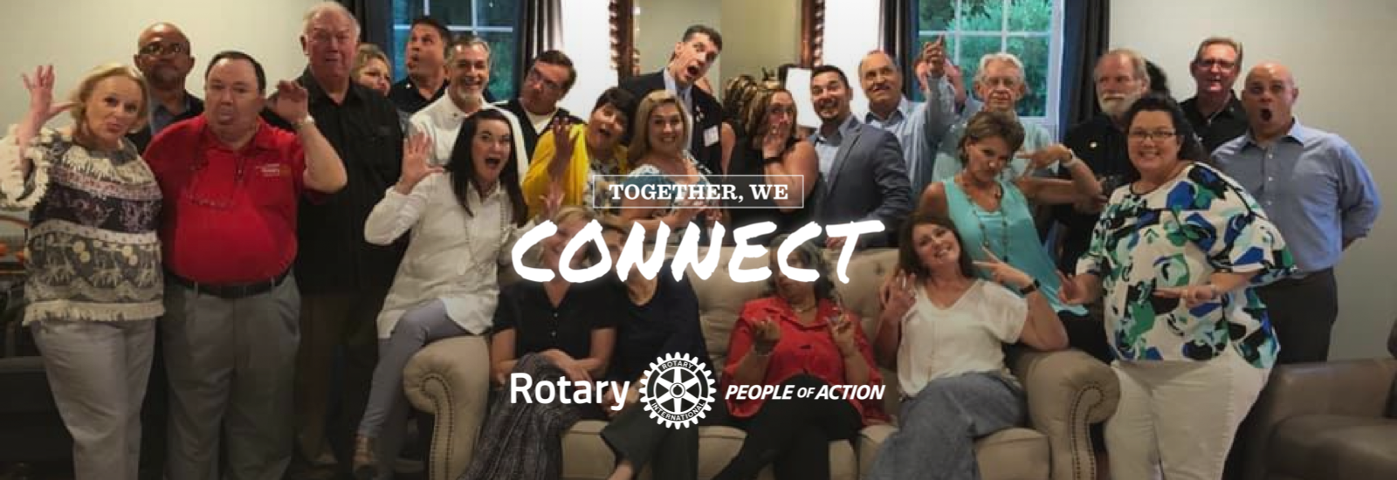
Engagement is having fun together!
Social Events, Network Working, and Other Fun Activities
Notes:
Fun is mandatory because if it’s not fun they aren’t staying! Consider not having a program presentation every meeting, maybe go with a 2-1-1 approach, where you have only 2 programs a month, and make the other 2 a social or service activities such as a field trip or go bowling or play softball to “Strike Out Polio”; think projects vs. programs. And when you are out of creative ideas for meetings or events, try playing games: corn hole, UNO, Pictionary, Rotary Feud…just have fun.
When clubs have a gathering, with a good turn out, take a group photo – one formal and one silly. The silly one is the one your club should promote; It lets everyone know that when your Club members gets together, they are having fun! I think that's attractive.

Slide 12
PO Box 698
Abbeville, LA 70511-0698
pam@facts-5.com
Notes:
We all must keep membership at the forefront of our minds. Hopefully, I’ve got you thinking about the importance that membership has on your club. I encourage each of you to go back to your clubs and have a meaningful conversation with club leaders and committee chairs on how your club can improve its approach to membership. Talk to them about scheduling a meeting date with your assigned DMF, if they haven’t already done so. When we are all on the same page working as a team, membership success is sure to happen. Just you being here shows your commitment to Rotary and I hope you share my passion for Rotary and make membership growth your #1 priority! Together we will grow Rotary!
This is my contact information. Email me - I’m ready to help you! Thank you. Any questions? {if time permits have them share success stories or ideas}

