Slide 1

It’s Great to Be a
Signal Mountain Lion !

Slide 2

Lions Clubs International
100 Years of Service
LCI is the largest and most effective community service organization in the world, founded in 1917 by Melvin Jones.
1.425 million members in 210 countries and geographic areas.
Approximately 47,000 clubs.
Mission: To be the global leader in community and humanitarian service. To empower volunteers to serve their communities, meet humanitarian needs, encourage peace and promote international understanding through Lions clubs.
“WE SERVE” is our motto

Slide 3
Lions Clubs International is an Association of Lions Clubs.
The individual Lions Club is the most essential part of our Lions organization.
Whether the needs of a community are met depends upon the strength or weakness of the Lions Club in that community.
Also, as a Lion, you have the opportunity to impact the lives of those in need in your local community and the world.
Notes:
A COMMUNITY’S MOST VALUABLE ASSET …IS AN ACTIVE LIONS CLUB.

Slide 4
Core Messages of Lionism
We serve where we live.
We are global.
We give 100 percent.
We do it ourselves.
We are rich in heritage and pride.
We are in good company.
We’re open.
We are dedicated to sight – and more

Slide 5


Lions Clubs International Foundation
Lions Clubs International Foundation was begun in 1968 and grants an average of US$30 million annually. It provides clubs with the means to build schools, health clinics, vocational rehabilitation, training centers and other projects that address community needs.

Slide 6
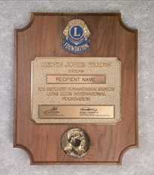
Melvin Jones Fellowship
Since 1973 The Melvin Jones Fellowship has been the backbone of LCIF funding and provides 70 percent its revenue.
MJF is a recognition for humanitarian service and awarded to those who donate US$1,000 to LCIF or to people for whom a donation was made. Clubs will often use this award to acknowledge outstanding contributions by its members.
Melvin Jones Fellows receive an attractive lapel pin, a plaque and a congratulatory letter.

Slide 7
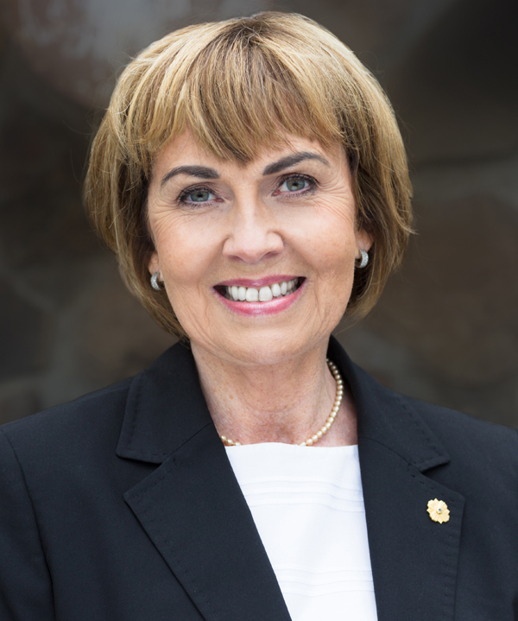
International President 2018-2019
GUDRUN BJORT YNGVADOTTIR
Our President is vice director of the Institute of Continuing Education at the University of Iceland.
A member of the Gardabaejar Eik Lions Club since 1992
Notes:
7

Slide 8
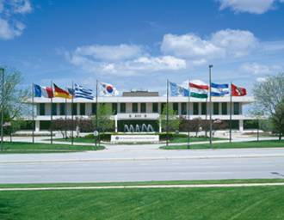
LCI Headquarters
Has been located outside of Chicago, IL, in a 150,000 square foot building in Oak Brook, IL, since 1971.
Nearly 300 staff work there to serve Lions worldwide.

Slide 9
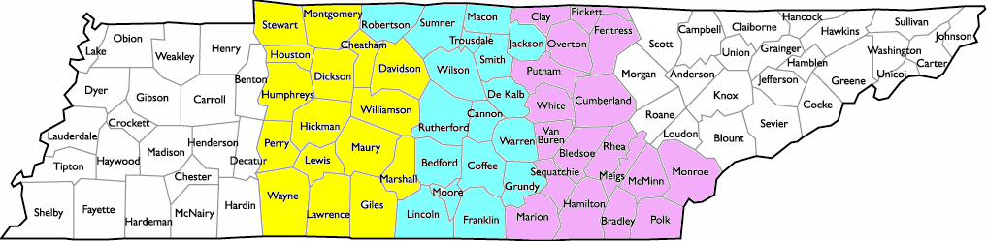
LIONS DISTRICT ORGANIZATION
The state of Tennessee is a Multiple District
12-L 12-I 12-S 12-O 12-N
Notes:
9

Slide 10
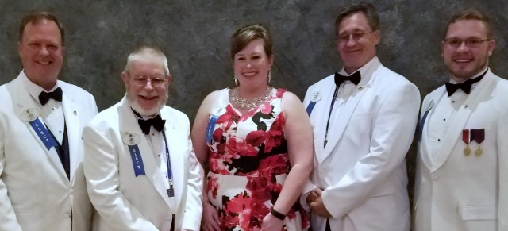
MD -12 District Governors
2018 - 2019
Left to Right:
12 – L Glen Mullins
  12 – I Paul Murray
    12 – S Tawnya Buster
      12 – O Pete LeGro
        12 – N Brandon Johnson

Slide 11
District 12-O Membership
Fairfield Glade | 101 | Delano | 24 | Dayton | 19 | Englewood | 9
Signal Mtn. | 91 | Chattanooga - Downtown | 23 | Celina | 17 | Ooltewah-Coll. | 8
Jasper | 48 | Monterey | 23 | Athens | 16 | Jamestown | 7
Red Bank | 47 | Cookeville-Eve | 22 | Crossville | 16 | Tennessee Tech | 7
Dunlap | 41 | Sale Creek | 22 | Overton County | 16 | White County | 7
Lookout Valley | 39 | East Hamilton | 21 | Benton | 14 | Whitwell-Cross. | 7
Cleveland | 28 | Meigs County | 21 | Byrdstown | 13 | Daisy-Dallas | 6
Cookeville Noonday | 28 | Spring City | 21 | So. Pittsburg | 12 | Soddy Daisy | 3
Bakewell Tri-Cty. | 26 | Etowah | 20 | Sweetwater | 12
Chat. UTC | 25 | Hixson | 20 | Algood | 10
 |  |  |  |  |  | TOTAL | 890
Notes:
11

Slide 12

District Programs

Slide 13
District 12-O White Cane Fund
District 12-O collects funds for nine local and national non-profit agencies, ultimately benefiting thousands of Tennesseans.
These agencies are supported cooperatively by all the Lions Clubs in District 12-O, a $50 per club member donation is suggested.
In 2019 two additional organizations were added, Low Vision & Diabetes Camp.
District 12-O Sight Restorations
Leader Dogs for the Blind ( Rochester, MI )
TN School for the Blind ( Nashville, TN )
TN School for the Deaf ( Knoxville, TN )
KidSight Outreach (TLC – Nashville)
Learning Ally (RFB&D) ( Prinston, NJ )
World Services for the Blind ( Little Rock, AR )
2019 District 12–O Low Vision Rehabilitation Program Diabetes Youth Camp

Slide 14
District 12-O White Cane Fund Distribution
 | 2016-2017 | Amount
District 12-O Sight Restorations | 48% | $16,911
Leader Dogs for the Blind | 25% | $8,807
TN School for the Blind | 8% | $2,818
TN School for the Deaf | 8% | $2,818
KidSight Outreach | 5% | $1,761
Learning Ally | 3% | $1,056
World Services for the Blind | 3% | $1,056
Total | 100% | $35,227
Notes:
14

Slide 15
District 12-O Lions Sight Restorations
Funds Eye Surgeries for Needy
10 Years (2007-2017)
84 Cases
30 Clubs in District 12-O
$ 550,000 Value of Service Provided
$ 6,547 Avg. per case
$ 55,000 Avg. per year

Slide 16
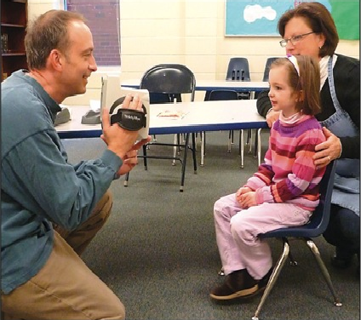
District 12-O KidSight Screening
12 out of 38 clubs in District 12-O conducted screenings sessions in 2018 vs. 17 clubs in 2017.
In 2018 there were 88 sessions held in District 12-O with 2,733 children screened and 171 referred vs. 106 sessions, 2969 screened and 174 referred in 2017.
Since the program began in June, 1997, 603,858 children have been screened in TN at year end 2018.

Slide 17
Lions Club Operations
Every Club operates independently but is governed by a constitution and by-laws under the jurisdiction of Lions Clubs International.
The structure of all Clubs is basically the same, but committees and activities may vary from club to club.
LIONS CLUB CONSTITUTION AND BY-LAWS Chartered by and under the jurisdiction of THE INTERNATIONAL ASSOCIATION OF LIONS CLUBS
Notes:
17

Slide 18
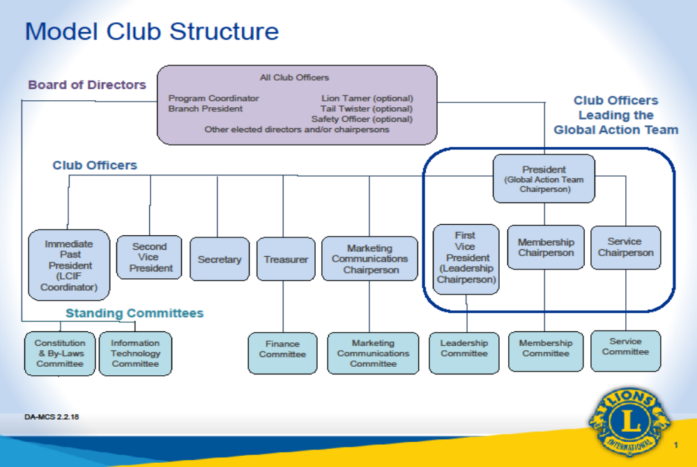

Slide 19
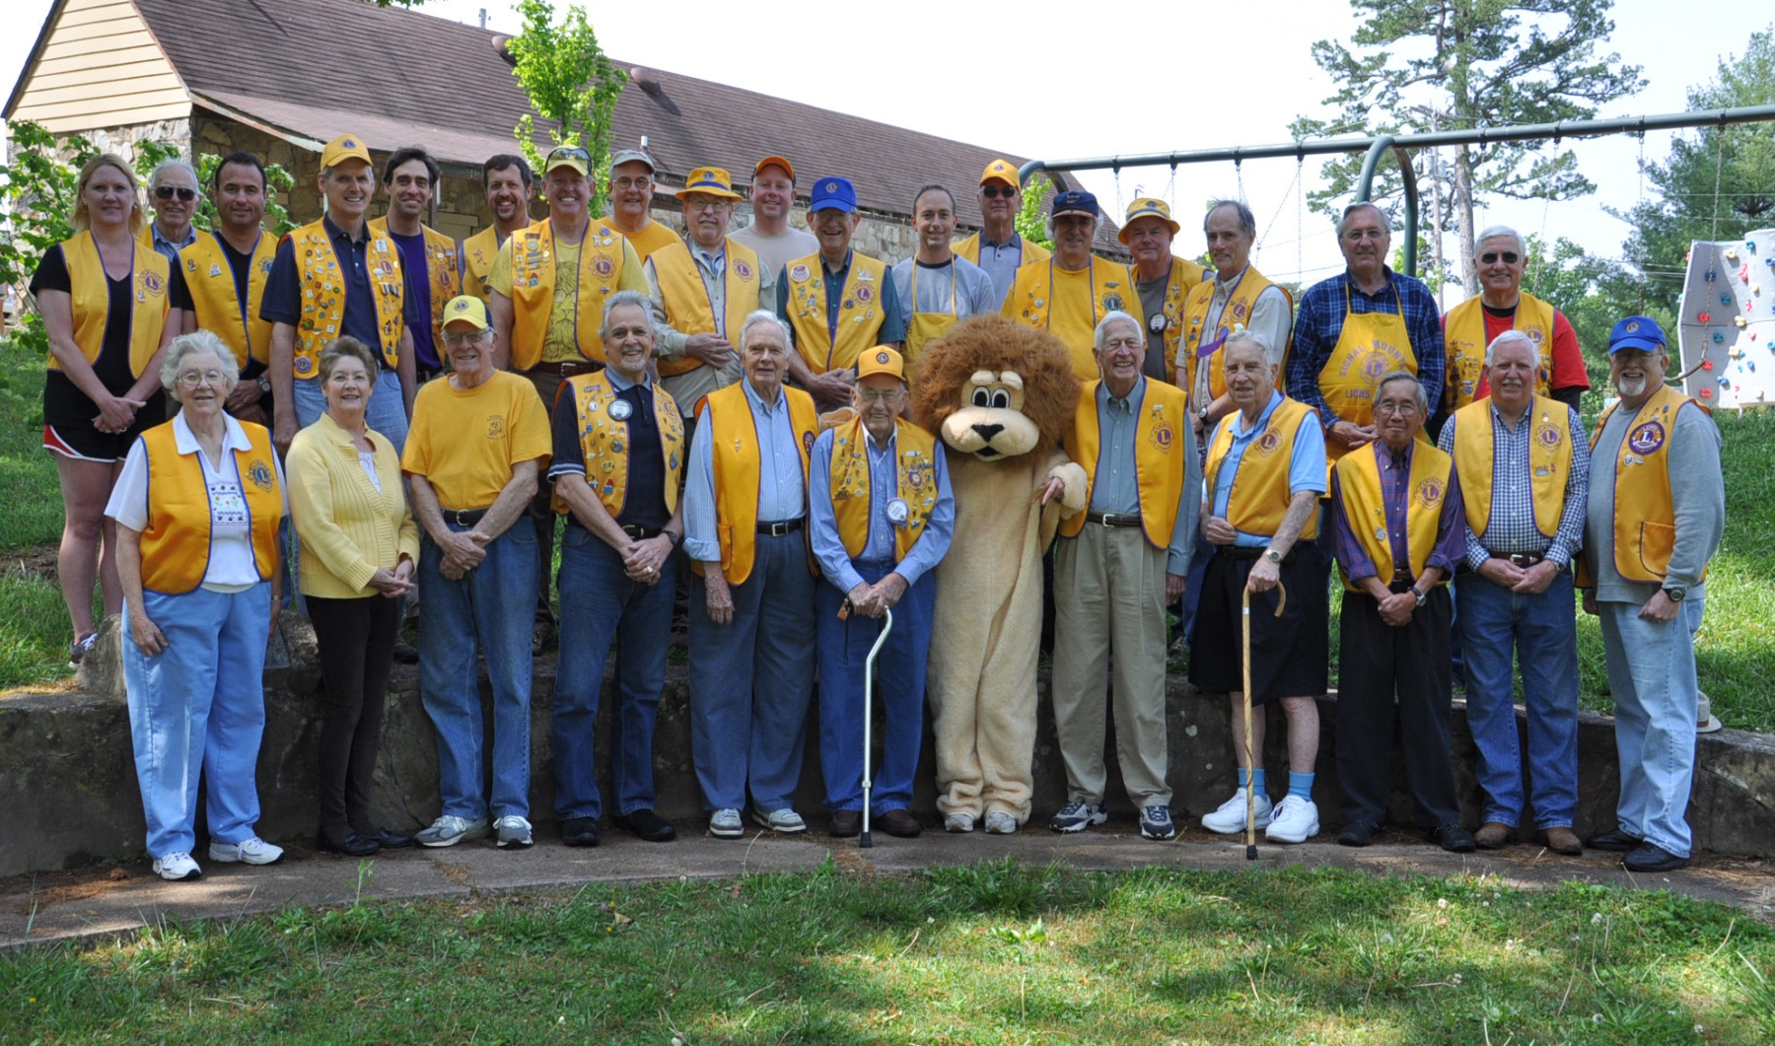
Signal Mtn. Lions at Althaus
Park – circa 2015
Notes:
Here we are! Some of us anyway. We have 90 members.

Slide 20


Club President
2018 – 2019
Jim Fields
2019 – 2020 Nancy Tryon
John Niemeyer

Slide 21

1st Vice President
2018 – 2019
Nancy Tryon
2019 – 2020 Owen Maddux

Slide 22

2nd Vice President
2018 – 2019
Owen Maddux
2019 – 2020 Craig Smith

Slide 23
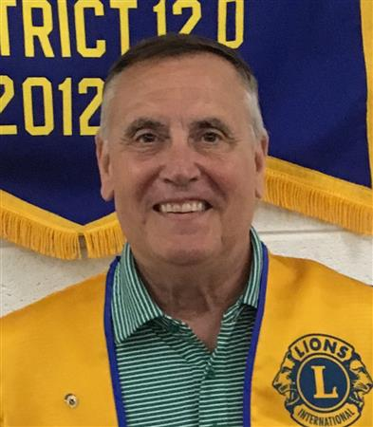
3rd Vice President
2018 – 2019
Craig Smith
2019 – 2020 Win Cooke

Slide 24
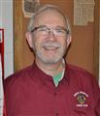


Secretary
2018 -2019 2019 - 2020
Paul Hendricks
Mel Tryon
Recording Sec.
Daphne Kirksey
Daphne Kirksey

Slide 25
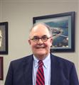
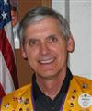
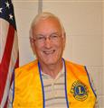
Treasurers
2018 -2019 2019 - 2020
Club Account
Dan Saieed
Jerry Pala
Charity Account
John Behrmann
John Behrmann

Slide 26
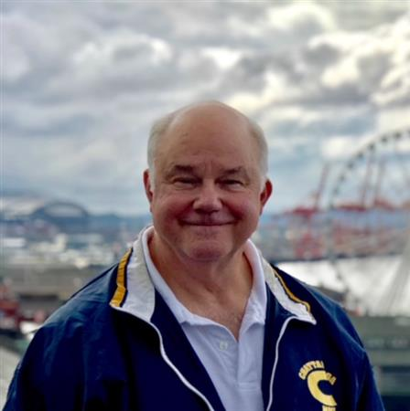
Membership Chair
2018 – 2019
John Moon
2019 – 2020 Jim Fields
John Niemeyer

Slide 27
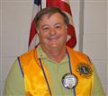
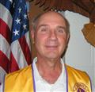
Service Chair
2018 – 2019
Gary Lowder
2019 – 2020 John Niemeyer

Slide 28
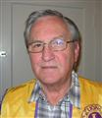
2018 - 2019 and 2019 - 2020
Marketing/Communications

Slide 29
Immediate Past President and LCIF Chair
2018 – 2019
Gary Lowder
2019 – 2020 Jim Fields

Slide 30
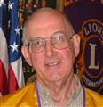
Lion Tamer
2018 – 2019
Ken Abel
2019 – 2020
Larry Bascom

Slide 31

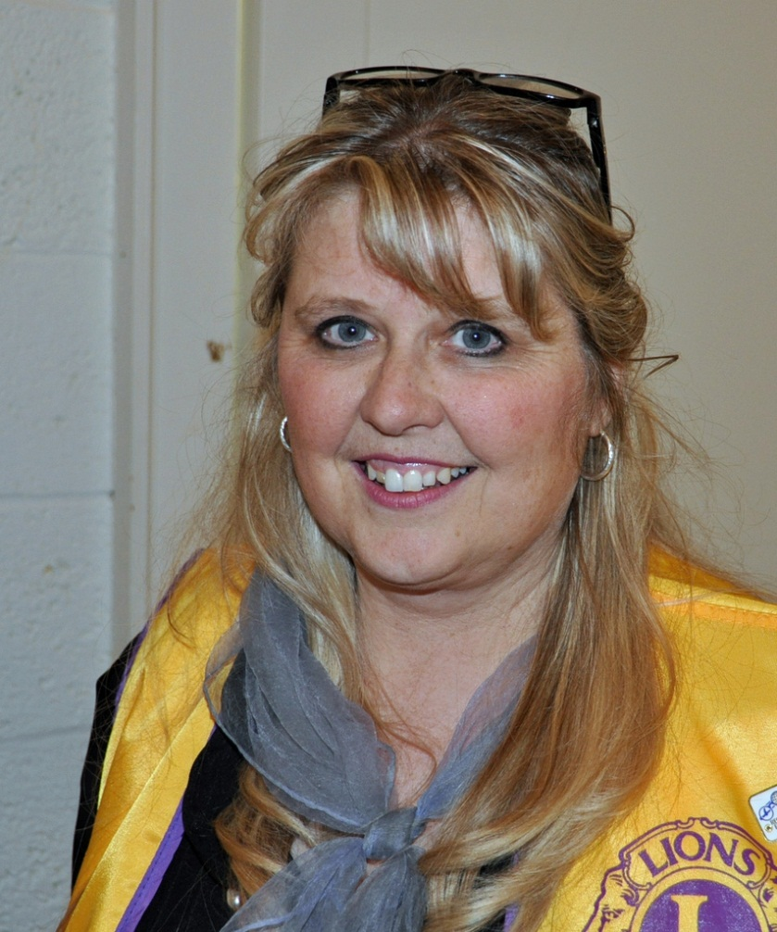
Tail Twister
2018 – 2019
Tom Blewett
2019 – 2020
Kandy Stolpmann

Slide 32
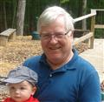
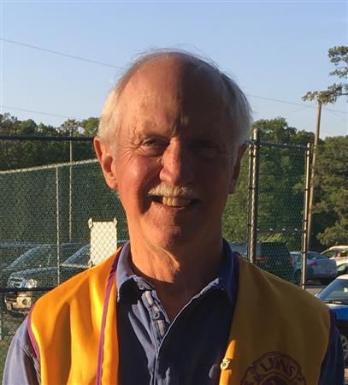
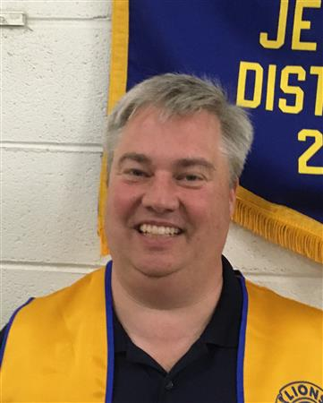
Two Year Directors
2018 -2019 2019 - 2020
Dan Watson
Bruce Bishop
Win Cooke
Stuart Vaughn

Slide 33
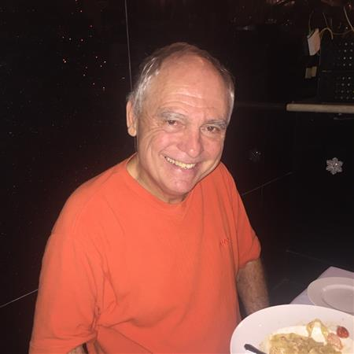
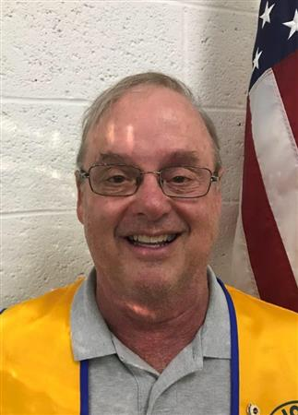
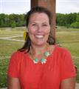
One Year Directors
2018 -2019 2019 - 2020
Ralph Mann
Dan Watson
Julie Briggs
Bill Heck

Slide 34
Club Activities
Fund Raising
Service
Administrative

Slide 35
Our Club Fundraising Activities
4th Of July Bar B Q
Labor Day Bar B Q
Banner Sales
Car Raffle
Turkey Sales
Notes:
35

Slide 36
Club Donations 2018-19 2017-18
4th of July Fireworks | $4,350 | $3,640*
Bachmann Community Center | $1,500 | $1,500
Christmas Train Restoration | $600 | $0
District 12-O White Cane Fund | $5,000 | $5,000
Hamilton County Sight Services | $1,000 | $1,000
Hosanna Community | $500 | $500
LEO Club – SMMHS | $300 | $300
LEO Club – McCallie School | $300 | $300
LCIF (Melvin Jones Fellowship) | $2,500 | $1,000
Notes:
* Not included in totals on 3rd screen

Slide 37
Club Donations 2018-19 2017-18
Lindsey Jennings (Kid Sight) | $0 | $0
Lone Oak Community Ctr. (Clinic) | $1,000 | $1,000
McCoy Farm and Gardens | $1,000 | $1,000
McCoy Farm (Blacksmith Bldg.) | $1,000 | $1,000
Mountain Arts Comm. Ctr. | $1,000 | $0
Mountain Education Fund | $0 | $0
Sea Cadets (SMMHS) | $300 | $300
Signal Centers-Low Vision Project | $2,500 | $2,500
Signal Mountain Library | $0 | $1,000

Slide 38
Club Donations 2018-19 2017-18
SM Police & Fireman Fund | $1,000 | $1,000
SM Town Employees Christmas | $500 | $500
Signal Mountain Social Services | $2,500 | $2,000
SM Beautification Projects | $0 | $300
Student Scholarships |  | $8,400*
W.R.E.S | $500 | $500
Totals (* not included in the total shown, separate accounts) | $22,000 | $20,700

Slide 39
Our Club Service Activities
4th of July & Labor Day BBQ’s
Eye Glass Recycling.
Hamilton County Sight Service Administration and eye glass applicant screening.
Kid-Sight Screening.
MyRide & Low Vision Transportation Services.
District Sight Restoration Committee Administration.
Remote Area Medical program support.
Manage District Disaster Relief Fund.
Manage & finance Senior HS Student Scholarships.
Weekly Bingo activities at Alexian.
Renovation Projects at the MACC.
Renovation Projects at Bachman Comm. Ctr.
Football Concessions at SMMHS.
Notes:
39

Slide 40
More Club Service Activities
LEO Club Support at SMMHS & McCallie.
Veterans Pancake Breakfast.
Sponsor & run monthly Military History Group.
Weekly support for the Medal of Honor Museum.
Free Shredding Services, semi-annually.
District Chairpersons and Multi-District Service.
Restoration of the Mountain Christmas Train.
“Welcome To Signal Mountain” sign maintenance.
Library project volunteers.
Clothing donations to Ronald McDonald House.
Clothing donations to Signal Mountain Social Services.
McCoy Park & Gardens Memorial Day Cookout.
McCoy Park & Gardens Blacksmith Shop construction.
McCoy Park & Gardens Property maintenance support.
Notes:
In no particular order but #1 should be 15.
40

Slide 41
More Club Service Activities
Recycle Cell Phones and Printer cartridges.
Diabetes Awareness Activities.
Support for SMMHS Track Meet & Basketball concessions.
Participate in Community Emergency Response Training.
Hiking trail maintenance.
Chili Cook-Off at Bachmann.
Support for MBA Sunday on Signal.
Lions Day of Service, e.g. Althaus Park repairs.
Other Senior Services projects, e.g. Bachman Bingo.
Christmas Caroling.
Salvation Army Bell Ringing.
Notes:
#1 should be 29.
41

Slide 42
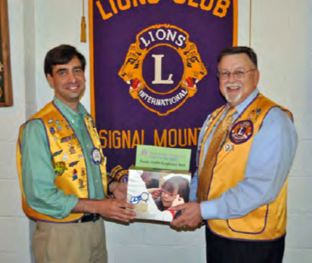
SM Sight Service Committee
Collection Boxes
SM Pharmacy
Post Office
Pruett’s
Bread Basket
Action Jack’s
Eyes on the Mountain
Alexian Village
MACC
Bachmann Community Center
Notes:
JUST SO YOU KNOW WHERE THEY ARE.

Slide 43
Suggested New Member Activities
Formal Induction, Orientation, Find a Mentor
View Club, District and LCI Websites
Attend Club meetings and Meet Active Members
Attend Board Meetings and Committee Meetings
Participate In Club Service Activities
Participate In Club Fundraising Activities
Attend Zone, District and Multi-District Meetings
Attend a Hamilton County Sight Service, District Low Vision, or District Sight Restoration Meeting
Visit another Club
Attend the annual Lions Learning Retreat in January
Invite a Prospective Member
Notes:
43

Slide 44

Learn More
LION Magazine
LCI website - lionsclubs.org
District website – district12olions.org
MD-12 website – lionsoftennessee.com
Club Runner – smtnlions.org
Low Vision – tnlionslowvision.org
Facebook
www.facebook.com/lionsclubs
Twitter
https://twitter.com/lionsclubsorg

Slide 45
It’s Great to Be a
Signal Mountain Lion !

Slide 47
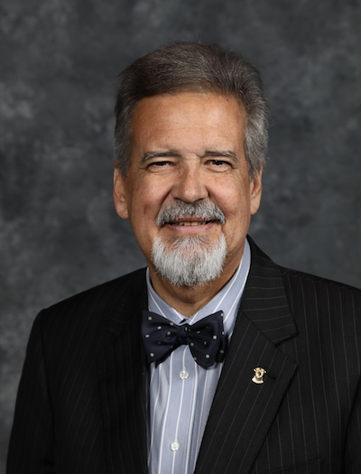
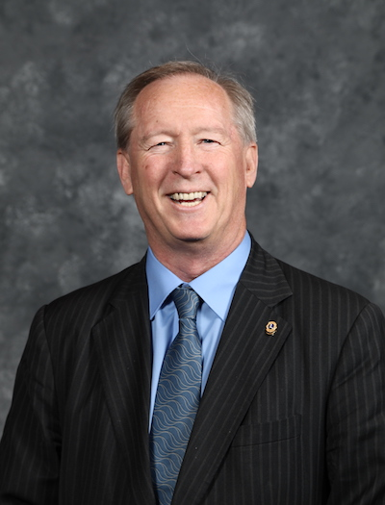
International Vice Presidents
2nd VP Judge Haynes Townsend 3rd VP Brian Sheehan
Dalton, GA
Bird Island, MN

Slide 48
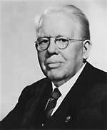
Celebrating 100 Years of Service
Melvin Jones
As a young man, made his home in Chicago and formed an insurance agency
On June 7, 1917, he formed the Association of Lions Clubs.
22 Clubs from 9 states came together and began to organize throughout the United States and became International in 1920.

Slide 49
Where Are the Lions
 | Clubs | Members
US & Affiliates | 11,607 | 323,178
Europe | 9,470 | 251,321
Orient & SE Asia | 8,773 | 319,961
India, S. Asia, & Middle East | 10,039 | 341,442
Mexico, Central & South America | 4,044 | 107,540
Australia, NZ, & S. Pacific | 1,919 | 45,789
Canada | 1,537 | 36,176
China | 1,417 | 48,955
Total | 47,390 | 1,425,795
Notes:
49

Slide 50
Largest States
 | Clubs | Members
Texas | 867 | 25,585
Pennsylvania | 693 | 19,199
California | 745 | 20,772
Wisconsin | 530 | 18,049
Illinois | 508 | 14,761
New York | 532 | 14,940
Ohio | 413 | 11,901
Michigan | 387 | 10,630
Indiana | 386 | 10,140
Notes:
50

Slide 51
Southeast US
 | Clubs | Members
N. Carolina | 306 | 6,356
Florida | 228 | 5,540
Georgia | 218 | 5,096
Tennessee | 208 | 4,992
Kentucky | 177 | 4,723
Louisiana | 151 | 4,313
S. Carolina | 138 | 3,632
Arkansas | 125 | 3,052
Alabama | 130 | 3,108
Mississippi | 104 | 2,310
Notes:
51

Slide 52
Tennessee Multiple District 12
Growth of Lionism changed the State of Tennessee from a single district into five sub-districts.
A sub-district must have a minimum of 35 clubs and 1,250 members.
1918 – 1941 One District Single District 12
1941 – 1947 Two Districts 12-E and 12-W
1947 – 1955 Three Districts 12-E, 12-M & 12-W
1955 – 1986 Four Districts 12-L, 12-I, 12-O & 12-N
1986 – Present Five Districts 12-L, 12-I, 12-O, 12-N & 12-S

Slide 53
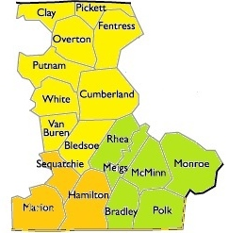
18 Counties in District 12-O
Region I
Region II
Region III

Slide 54
Region I Organization
Clay County – Celina (20)
Pickett County – Byrdstown (14)
Overton County – Overton (17)
Fentress County – Jamestown (6)
Putnam County – Cookeville (22)
Cookeville Noon (28)
Algood (20)
Monterey (20)
TTU (14)
White County – White County (10)
Cumberland County – Crossville (12)
Fairfield Glade (95)
Bledsoe – No Club
Van Buren – No Club

Slide 55
Region II Organization
Rhea County – Dayton (22)
Spring City (24)
Meigs County - Meigs County (23)
McMinn County - Athens (24)
Sweetwater (12)
Etowah (22)
Deleno (14)
Englewood (9)
Monroe County - Madisonville (9)
Polk County - Benton (15)
Bradley - Cleveland (31)

Slide 56
Region III Organization
Sequatchie County – Dunlap (32)
Marion County – Whitwell (7)
Jasper (29)
South Pittsburg (14)
Hamilton - Sale Creek (24)
Soddy Daisy (4)
Daisy Dallas (6)
Hixson (18)
Red Bank (34)
Signal Mtn. (97)
Chatt. Dwtn. (11)
Lookout Valley (34)
Dalewood-Lakeside (37)
Ooltewah-Collegedale (13)

Slide 57

TN Lions Eye Center
The Tennessee Lions established a partnership with Vanderbilt University Medical Center to create a free-standing pediatric eye care center. The Tennessee Lions Eye Center (TLEC) at Vanderbilt Children’s Hospital opened in August of 1997 as a result of funding provided by the LCIF and Tennessee Lions who pledged $4.1 million dollars to start the KidSight Outreach Program.

Slide 58

Lions Sight Service
Lions have been recycling eyeglasses for almost 90 years.
The used eyeglasses are cleaned, repaired and classified by prescription. The eyeglasses are then distributed to those in need by Lion volunteers and other organizations hosting optical missions in developing countries.
LIONS take applications to supply needy individuals with new glasses.

Slide 59

District 12-O Lions Quest
Lions Quest provides curricula, products, training, and services to support adults in helping young people deal with the complex issues they face every day.
Character Education &
Life Skills Program
Enhanced Academic Performance through Social and Emotional Learning
Introduce Students to Service-Learning
Notes:
59

Slide 60

Diabetes is the #1 cause for blindness in adults. Clubs are encouraged to distribute information to inform the public and seek testing.

Slide 61

LEO Clubs
Leadership – Experience –Opportunity
Those are just a few of the rewards young people gain from participating in Leos. They also happen to be the values that create the acronym of our club name.
The Leo program introduces high school students to community service.

Slide 62
Message of Service
“We Serve" is something that every Lion should say with great pride. However, our service to others is more than just a slogan or even a description of what we do.
We Serve is a commitment that Lions have, and that commitment defines who we are.
We Serve because we know we can change lives.
We Serve because we know we can make a difference in the world.
We Serve because there are needs to be met.

Slide 63
It’s Great to Be a Mountain
Creek/Red Bank Lion !

Slide 64
It’s Great to Be an
Ooltewah/Collegedale Lion !

Slide 65
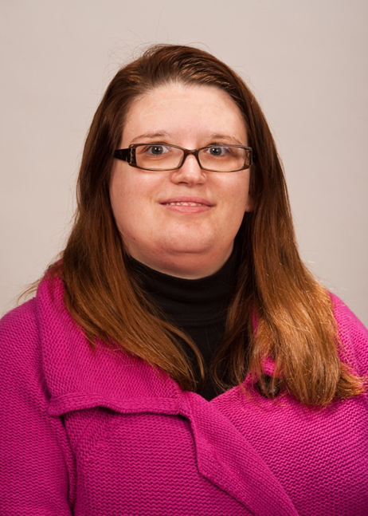
District Governor Lelia Gibson
Member of the Tennessee Tech Lions Club
Chief Administrative Officer
Presides Over Meetings
Serves One Year Term
Supervises District Officers
Ensure DG Team Club Visits
District Expenditures
See Page 7
Notes:
65
65

Slide 66
LION CLUBS
FINANCES & BUDGETS
Clubs should have two accounts and two budgets for each fiscal year:
Administrative account is what finances Club operations. Its income comes mostly from Member Dues.
Activities account finances the club’s fundraising activities and donations that the Club makes.
Monies raised by the Club by asking for public support shall be held in a separate account and distributed in the community unless otherwise specified.
Income from the club’s fundraising projects cannot be used for the club’s administrative costs.

