Slide 1
KiwanisClub ofAtlanta Centennial Presentation
January 1, 1980
to
May 1, 1988

Slide 2
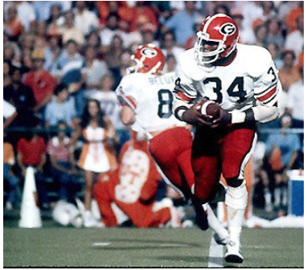
Hershel Walker led the University of Georgia to the National Collegiate Football Championship in 1980

Slide 3
First Women Admitted to the Kiwanis Club of Atlanta
September 8, 1987
Joanna Adams Judge Orinda Evans Theresa Mottoros
Mary Lou Austin Cinda P. Fowler Dr. Mary Lynn Morgan
Judge Dorothy T. Beasley Betty Fuller Ruth Osborne
Millie H. Bell Donna Johns Alicia Philipp
J. Veronica Biggins Naomi Lynn Ann D. Salo
Anita Bryant Stephanie B. Manis Alana Shepherd
Susan A. Cahoon Sandra Mackey Celestine Sibley
Myrtle Davis Dr. Marilu H. McCarty Betty Siegel
Barbara Morgan Jean Smith
Julia A. White

Slide 4
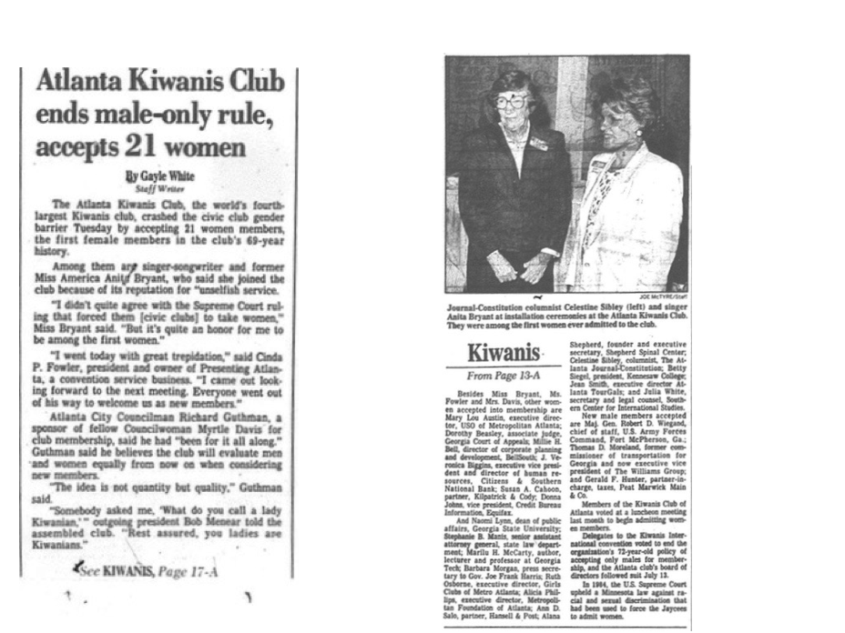
AJC, Wed. 9/30/87, Metro Section, p. 1-D

Slide 5
The Club joins the computer age in December 1987. Here is a photo of what passed as a portable at the time.

Slide 6
Georgia-Pacific Corporation donated property along the Broad River in Madison County for a new site for Camp Kiwanis
December 28, 1987

Slide 7
Initially the new site for Camp Kiwanis had 127 acres of forested land along the Broad River.

Slide 8
Kiwanis Club
of Atlanta
Centennial Celebration
January 1, 1980 to May 1, 1988

