Slide 1
A Project that turned into a Program
16.8 million books in 400 sea containers
25 countries
Approximately $2,600,000 spent in 20 years of
sending literacy material
How Rotary Books for the World
Succeeded?
Notes:
This presentation will take you through the history of the Books for the World project. The project has turned out to be a leap of faith for us because it has had several points at which the project could have ended, but a solution to immediate problems came forth at exactly the right time. So we began to trust our fellow Rotarians and obey our better instincts.
The project first was a club project then a district project but the need to spent major dollars abroad led to it becoming a 501c3 charity. To date it has spent over $2 million dollars as a charity but yielded $130 million dollars of literacy materials in the hands of local educators to assist them in boot strapping their own communities.
Consequently we will walk you through 16 years of history in the next 20 or so minutes.

Slide 2
In 2000, then DGE Ted Pope, 9300, and DGE Charlie Clemmons, 5890, met by chance and ROTARY MAGIC happened. The Texas districts took on the challenge.
Notes:
The project come about through a dinner meeting at the Clemmons’ house between Charlie Clemmons and Ted Pope. Both were incoming Rotary Governors for Districts 5890 and 9300. They were to be trained in California the next week for serving as Rotary District governors.
From the dinner meeting come a discussion of what can we do together as a service to both districts. Ted said “We need books.” Clemmons’ had just tried to give books to their local library who said “We’ll take these but don’t bring us any more. We don’t have room for them.”
So 9300 needed books and 5890 needed to have a place for books which wasn’t the trash dump. The Books for the World project was started with a Matching Grant from the Rotary Foundation.

Slide 3
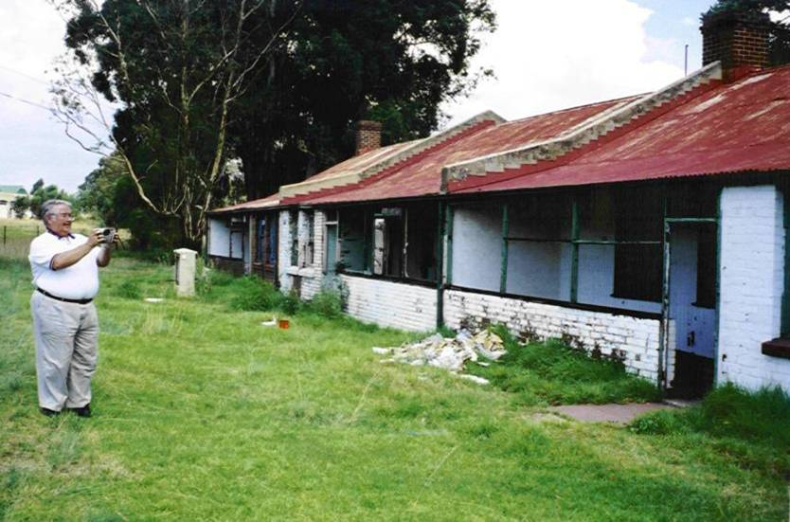
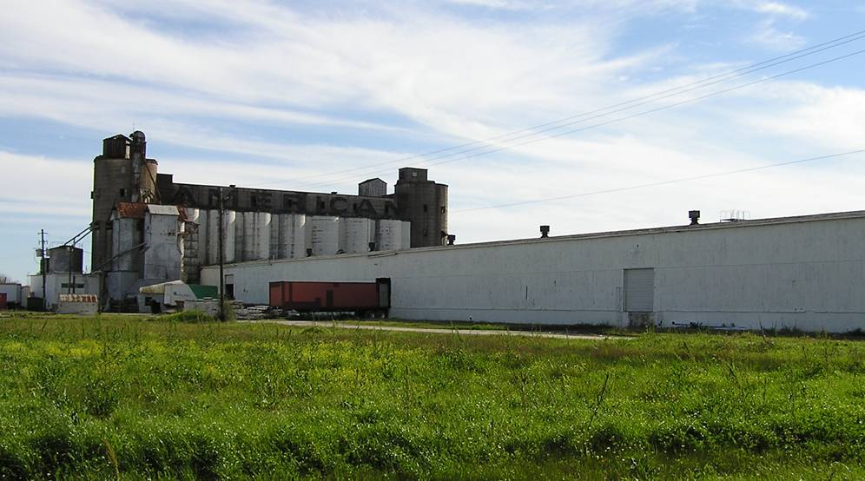
Collaboration between Houston and Johannesburg begins
The South Africa distribution was located in an abandoned mining housing project (left) which opened once a week to prequalified schools, libraries, prisons, etc. for book distributions. The Texas Collection Center was hosted by the Christian Alliance in Pearland (right).
Notes:
In 2001 the book project was operated by the Rotary Club of Bedfordview in Johannesburg, South Africa. Book distribution was made in a row of abandoned mining supervisor’s houses shown in the left picture. The project had been operating since the mid-1990s with a limited amount of books available to them. Everything had been stolen from the houses except the books.
District 5890 started its operation partnered with the Christian Alliance in an old rice dryer shown on the right. The warehouse portion of the dryer served our proposes well. However the old rice dryer burnt down not long after we had found new quarters.
We sought new quarters when we discovered that Christian Alliance was appropriating 10% of what we took in as what they considered to be a reasonable charge. We also were contacted by some Rotary friends in Beira, Mozambique that had two containers in storage drawing daily storage charges. Christian Alliance had charged us for shipping the containers to Durban, South Africa but they had shipped them without charge via USAID. The containers did arrive in Durban. We didn’t pay storage charges when our Congressional representative threatened to have USAID and their contractor audited.

Slide 4
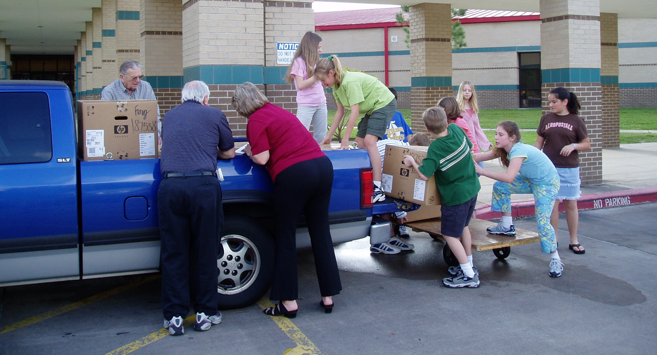
Initial book collection were a pickup load at a time. The word got passed around slowly!
Book collection was by individual schools and libraries. Now it is by schools, individuals, book resellers, and other NGOs.
Notes:
The collection of books started small. We would go to the individual schools and drop brochures with the front office. They would call us at the end of the school term to come and collect the books. This photo is of the students at one of the schools loading our pickup. These kids are out of high school now and in the workplace if they can find jobs.
These books were sent to Johannesburg through our second hosting warehouse at an assisted living facility. The project expanded to include all the out-of-adoption textbooks from an ISD as well as library culled books and the culls from used book sellers.

Slide 5
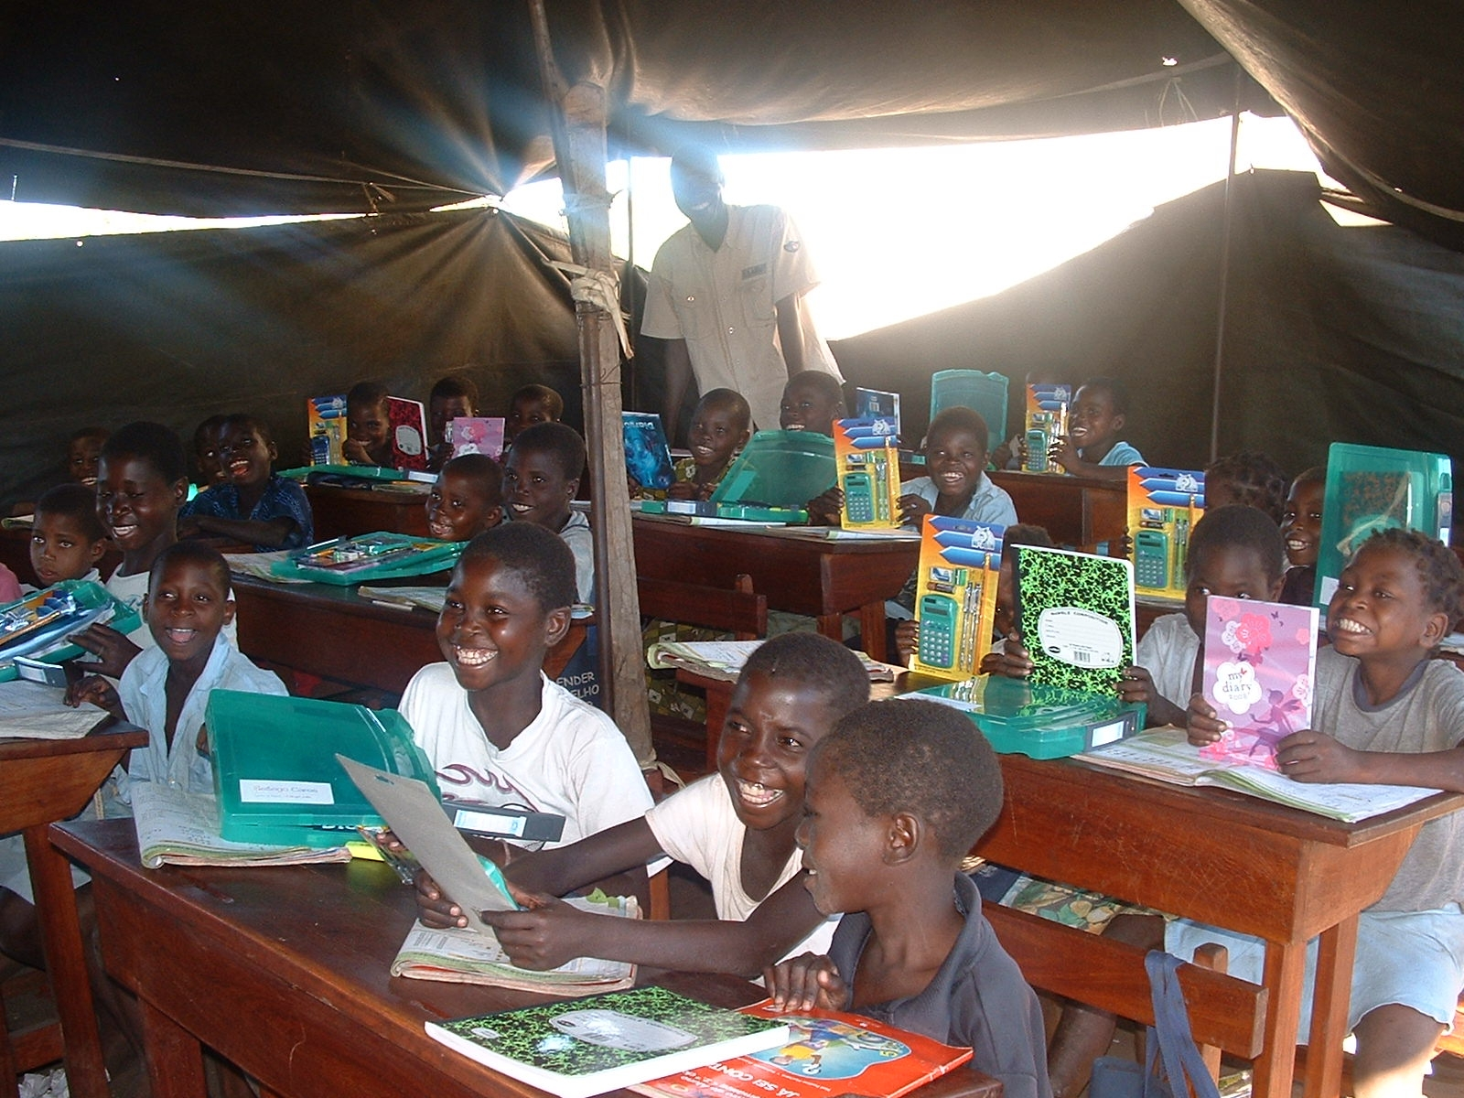
The distribution of books went to needy schools. Some of the schools like this one had no building, no books, and no school supplies.
Notes:
We have so much and the world of developing countries has so little. This school is meeting in a tent. They had no books until they visited the distribution center in Johannesburg. Note the smiles on the kids faces. They were pleased to have their own book and workbook. The books were riches that they had never had before.
Around the world people do the best they can for their kids. We can make it that much better by sharing the resources that we cast away.

Slide 6
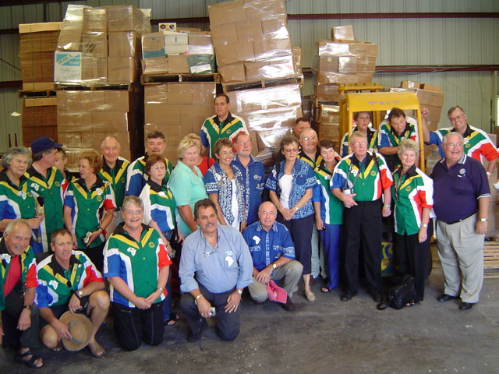
Our second warehouse home was an assisted living facility warehouse. We transferred operations there after we discovered that the shipping charges paid to Christian Alliance were shipped for free on USAID ships. This was discovered when a shipment scheduled for Johannesburg was offloaded in Beira, Mozambique.
Notes:
Our second warehouse was hosted by an assisted living facility. It came into being when we got an email from Rotarians at the port in Beira, Mozambique saying we had two containers in storage drawing storage fees. We thought the containers had been booked to Durban, South Africa but the Christian Alliance had charged us for booking them to Durban but sent them on a USAID ship for free which dropped them in Beira.
By asking our congressional represent to investigate for us, USAID and the shipping company decided that they could get the containers to Durban after all and without storage or transportation charges. We abandoned storing at the Christian Alliance warehouse after that, which turned out to be a great stroke of luck. A couple of years after we left, the Christian Alliance warehouse burnt down.
Pictured here is our second warehouse and a group of South Africans and Zimbabweans on their way through Houston to Chicago to the RI Convention.

Slide 7
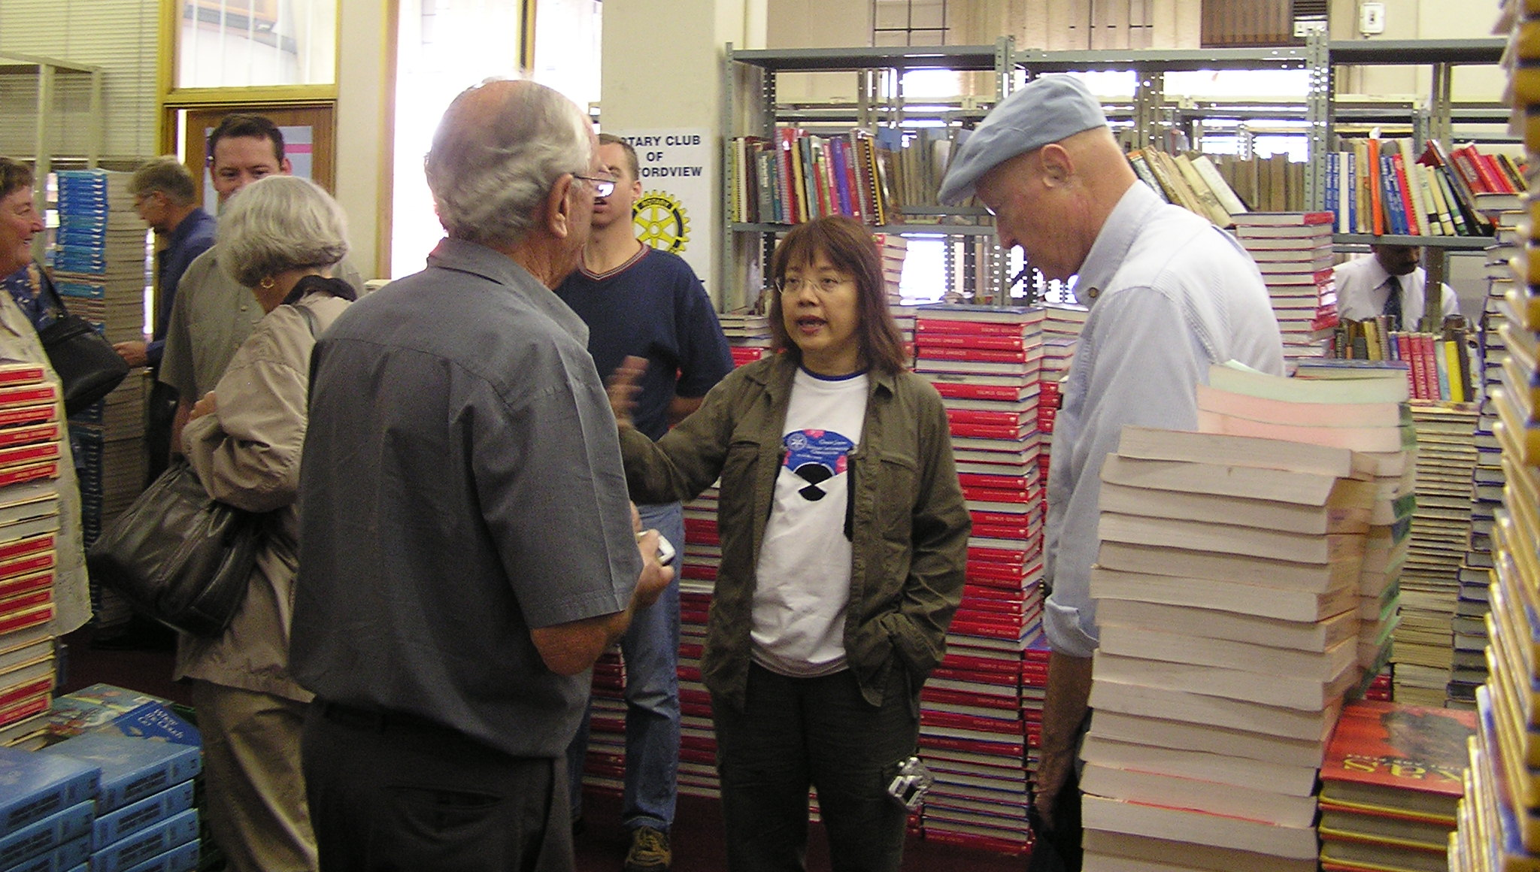
In Johannesburg, The Rotary Club of Bedfordview got a bank to give them rent free an old warehouse and book distribution got larger. The Johannesburg Public Library started coming to the warehouse for books.
Notes:
Likewise the Bedfordview Rotary Club upgraded their facilities for distributing books with this old unused bank warehouse in downtown Johannesburg. It handled many more books than the mining houses, which was required because we were sending more books and more South Africans had discovered that free books were available from Rotary.
Among the groups shown in the picture are representatives from the Johannesburg Public Library who had come for the first time to see what books are available. Over the years they have become regular customers of the book project.

Slide 8
The Assisted Living Warehouse was sold as part of a divorce decree. Enter Angie Jimenez and McClean Cargo. We learned what professional warehousing and loading could mean. The project grew.
It become a Texas wide service project!
Notes:
Our third home was McLean Cargo Company which was owned by a Houston Rotarian. For the first time, we became professional in our handling of the book project. The warehouse had the equipment to handle the increased volume of books and secure them in the containers with legal weights within the limits for transfer over the roads was important.
In our second warehouse, a group of Rotary Club volunteers had over loaded a container by 150% of the legal weight which we learned when a special high capacity crane was required to load and unload the container on and off the transport ship. As in many Rotary projects, we learned more about logistics as the project grew.
Through Angie Jimenez and McLean Cargo we learned how to ship to the world’s markets and documentation needed to clear custom in the different countries. We significantly increased the volume of our output.

Slide 9
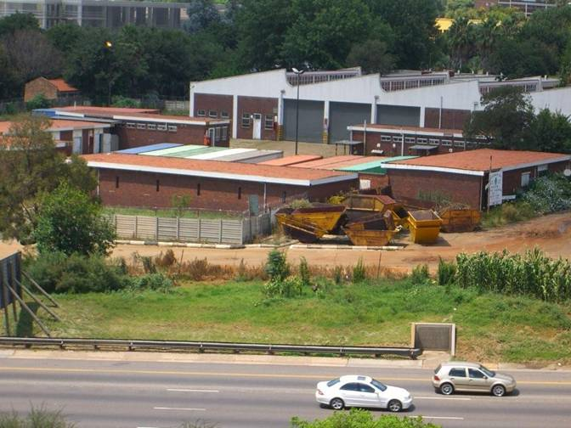
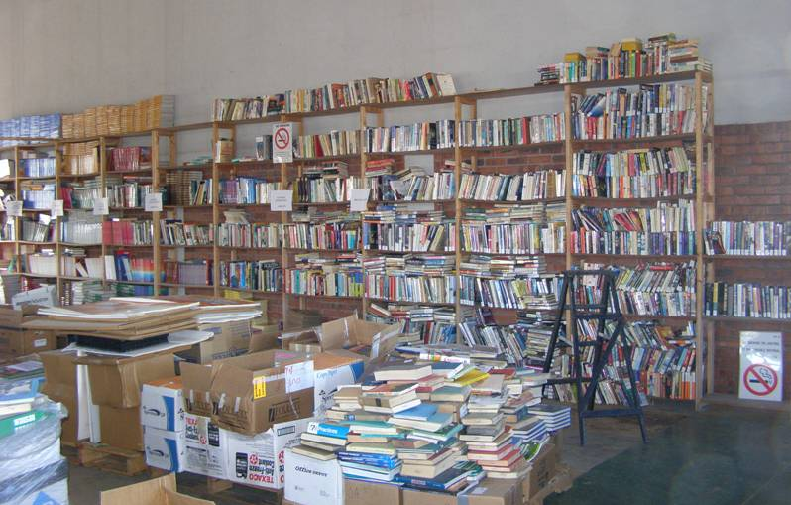
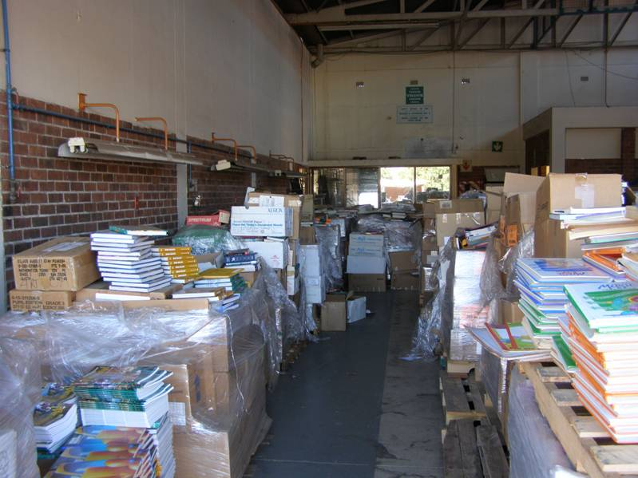
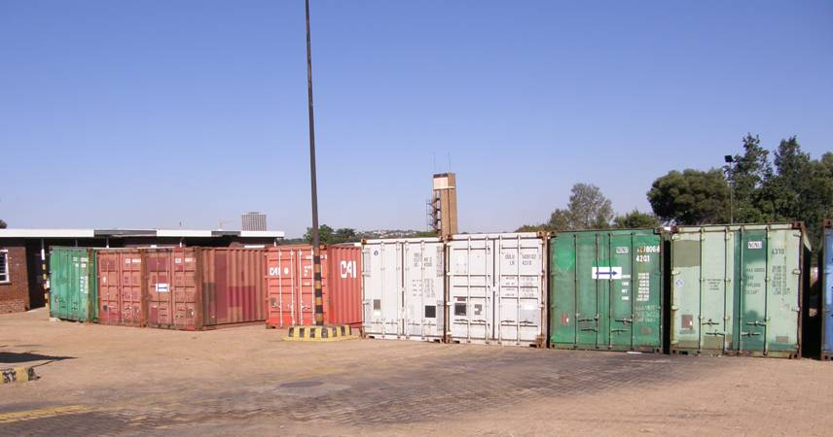
The Rotary Humanitarian Aid and Distribution Centre Johannesburg, learned what enlarging their facility meant to book distributions.
It becomes a District 9300 wide project!
Notes:
By now the South Africans have discovered that Rotary has books to give away and the District acquired an abandoned postal maintenance facility to turn into a Humanitarian Aid Centre which distributes books, bedding, school equipment, and for a while refurbished computers. The Centre became a district project and dispensed aid to South Africa, Mozambique, Zimbabwe, and Zambia.
The upper left hand picture is an overview of the facility in Johannesburg. The upper right hand view is of the books which are sorted by subject matter and placed on the shelves by type and subject. The lower left hand picture is of 14 containers which were waiting to be unpacked and dispensed. The lower right hand picture is of the sorting room where the boxes are unpacked and sorted and the bedding and furniture is stored.

Slide 10
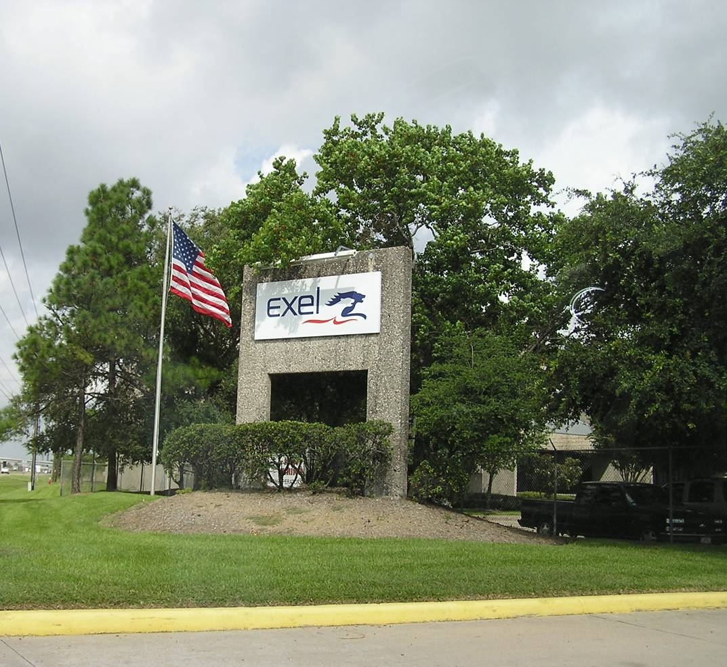
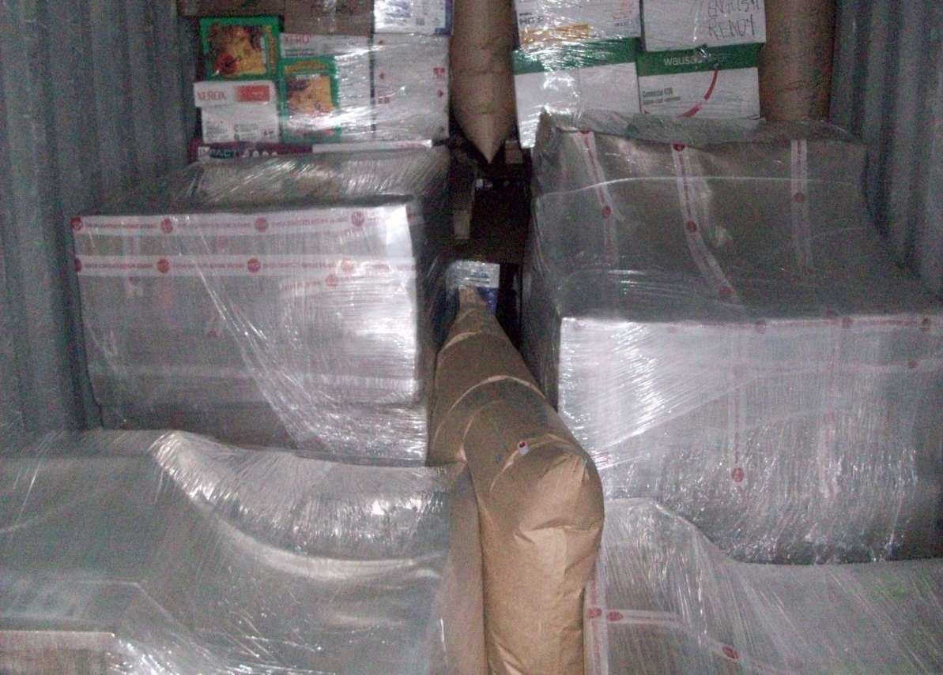
Angie Jimenez sold McClean Cargo and we had a pipeline full of books. What should we do?
For the last nine years Exel has hosted our pallets in a climate controlled warehouse and professionally loaded our containers. Note the air bags separating the books. They emerged when we were without a warehouse with a pipeline full of books. By now we knew that something would turn up. Exel is now going by their corporate family name, DHL Supply Chain.
Notes:
Angie Jimenez sold McClean Cargo and we had a pipeline full of books. Exel took us into a climate controlled warehouse and hosted us at no charge for storage and professionally loaded our containers.
Thus for the last nine years Exel has hosted our pallets and professionally loaded our containers. Note the air bags in the right hand picture separating the books. Exel emerged when we were without a warehouse with a pipeline full of books. By now we knew that something would turn up. Exel is now going by their corporate family name, DHL Supply Chain.
From time to time, the paying client, Dow Chemical, will produce a large amount of product when there are future market demands for it and our storage is limited. This was the case last year when the school systems dumped their hard backed textbooks on us as they converted to ebooks.

Slide 11
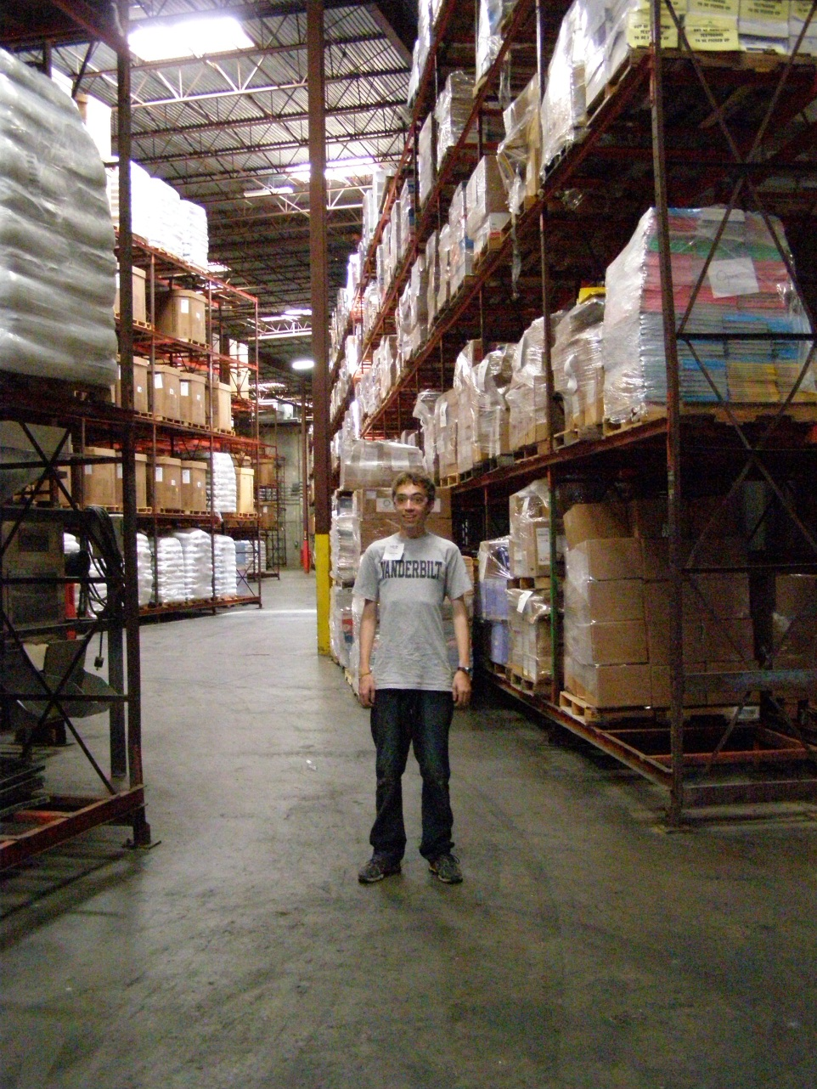
Where are we now?
As we topped 1000 pallets of books in storage (approximately 1.5 million books), Exel placed a hold on us adding any more preventing us from squeezing out their paying customer, Dow Chemical. From time to time as markets vary Dow produces more or less of a product thus creating a demand for more storage space.
Notes:
In this picture you can see the racks of books in the climate controlled warehouse at Exel. The storage, handling, and loading of these pallets is handled by Exel free of charge.
Books from the collection centers in New York, Wisconsin, Nebraska, as well as all over the Midwest and especially from Texas are transferred into Exel for storage.
From time to time, the paying client, Dow Chemical, will produce a large amount of product when there are future market demands for it and our storage is limited. This was the case last year we the school systems dumped their hard backed textbooks on us as they convert to ebooks.

Slide 12
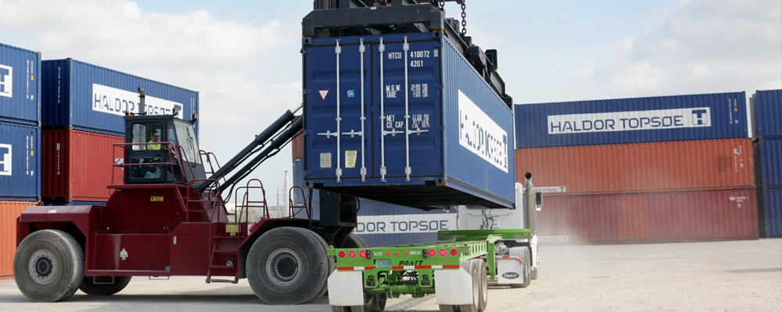
Loaded Container Handling
To deal with such surges we have garnered overflow storage. We can store up to ten loaded containers at Dunavant. We have backed up our capacity at Exel with similar capabilities at Gulf Winds Intentional. We have added the Pasadena Tx sorting and packing facility and we are out of space again.
Notes:
Our early approach to solving the problem of the over supply of books was to load a container with books and store the loaded container until a distributor had room to receive it. Dunavant is a company with sites in 17 states but has a storage yard and the heavy equipment necessary to handle a loaded container. They are about a half mile from Exel so cooperation is beneficial for all concerned.
Dunavant hosts up to 10 loaded containers for us at no charge.
Gulf Winds International has served as a backup storage location when Exel is on hold and we need to receive and load containers. They function as our receivers and loaders in much the same way as Exel.

Slide 13
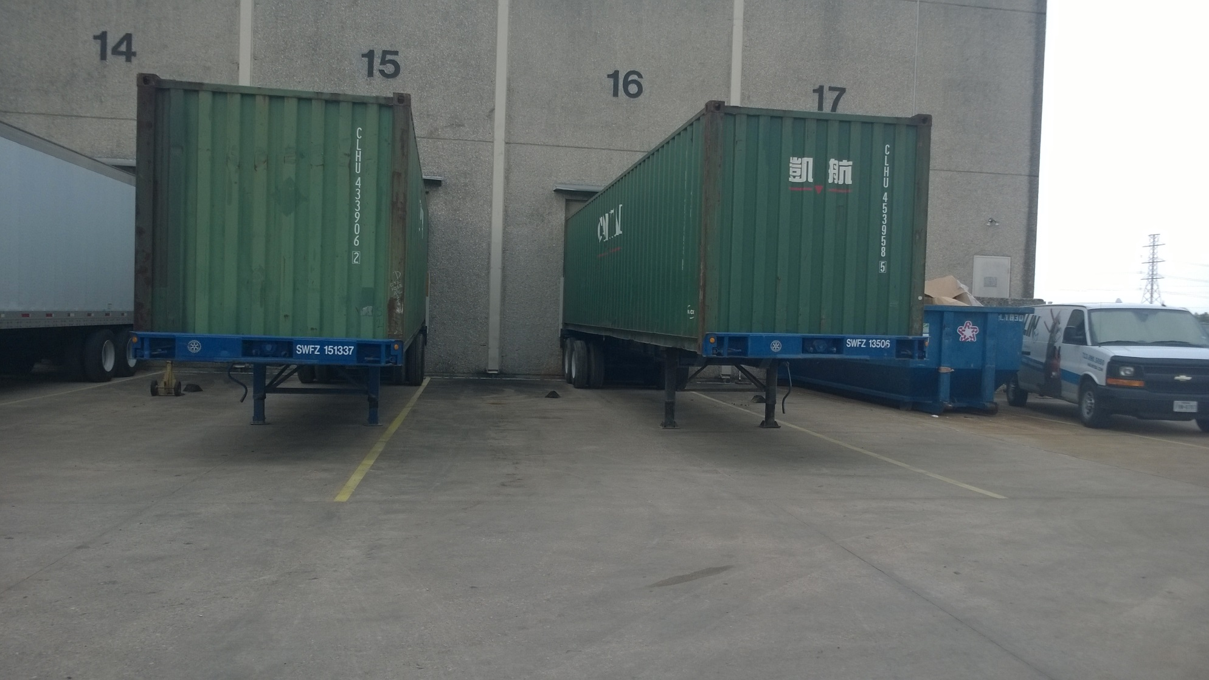
Clark Freight Lines a Long Term Partner
And The Second Wind Foundation Rolling Chassis
Notes:
The oldest of all our supports is Clark Freight Line who has hauled our containers from yard to yard and yard to port since the beginning of the project. While we do not have a picture of Clark Freight tractors we do have a picture of containers on the two Second Wind Foundation chassis that Clark maintains for us. Clark also rents us chassis when we need to load more than two containers at a time which has been the case for the last several months. This rental is important from a cost standpoint for we have had six to seven containers at a time at Exel to clear the 1000 pallet inventory down to about 500 pallets.
When we investigated the cost of owning over renting the chassis we discovered the yearly costs or maintaining and insuring the chassis was cost prohibitive. Clark covers them with blanket fleet policies.

Slide 14
She’s gone from us now but she’s still making a difference
Barbara Clemmons’s mother worked on her father’s manuscripts for college textbooks on accounting for many years. Through persistent investing she accrued enough shares of Johnson and Johnson to endow the book project. Rotary Clubs and individuals provide some funding and the Second Wind Foundation has obtained some grants but the majority of the funding is from the endowment.
Notes:
Barbara’s mother (now deceased) worked on her father’s manuscripts for college textbooks on accounting for many years. Through persistent investing she accrued enough shares of Johnson and Johnson (15,000) to endow the book project. Rotary Clubs and individuals provide some funding and the Second Wind Foundation has obtained some grants but the majority of the funding is from the endowment.
However, the project was started with a matching grant from the Rotary Foundation in 2000. The Second Wind Foundation was founded in 2006 when the project had grown too large for a single Rotary Club to guide its operations and funding. The first containers were sent in January 2001. We are now passing the 300th container of educational supplies and equipment.

Slide 15
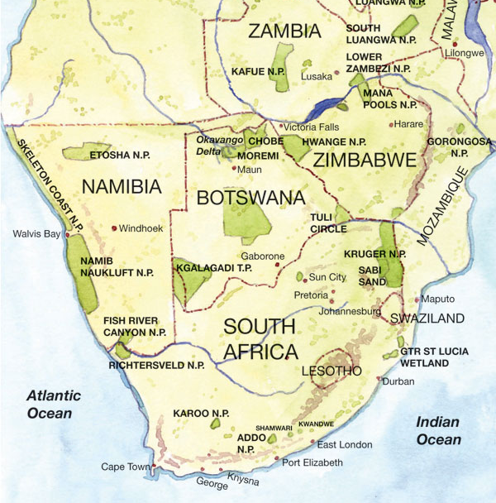
Rotary Books for the World
Southern Africa Distributors
Lilongwe
Lusaka
Harare
Walvis Bay
Johannesburg
Manzini
Pinetown
Durbin
Hibiscus
Coast
Cape Town
Notes:
Our primary distribution centers in southern Africa are in Namibia at Walvis Bay, in Swaziland at Manzini, and in South Africa at Johannesburg and Cape Town.
The Pinetown and Hibiscus Coast sites are currently inactive but they are in a newly redistricted Rotary district which includes most of central South Africa.
Johannesburg has become a major supplier taking about 10 containers a year and distributing them to South Africa, Zambia, Zimbabwe, Malawi, and Botswana.
The inland transportation costs for Zambia, Zimbabwe, and Malawi are as high as the ocean freight costs which means that they must sponsor the inland costs. To date, they have only taken one container each shipped directly to them. However, they do ship copper to Durban and take books back to their countries from the Centre in Johannesburg.

Slide 16
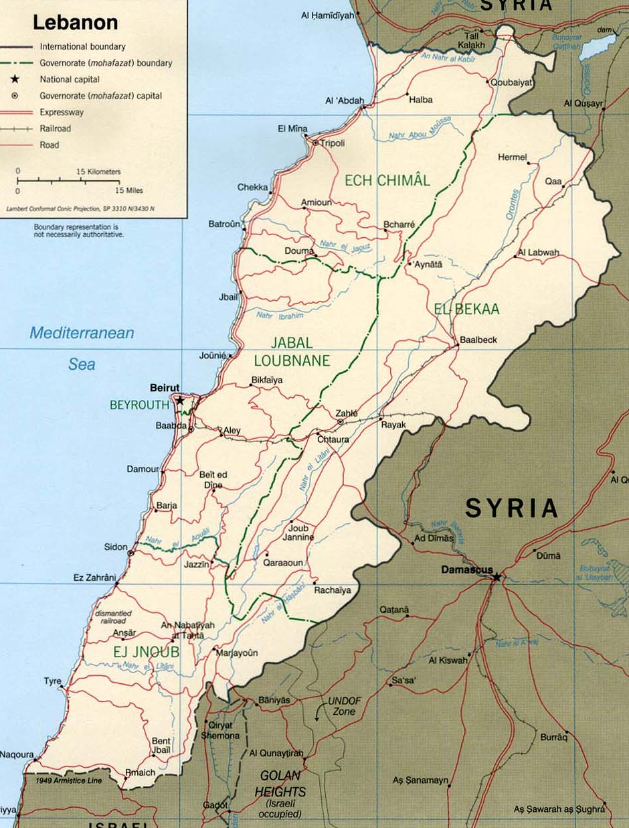
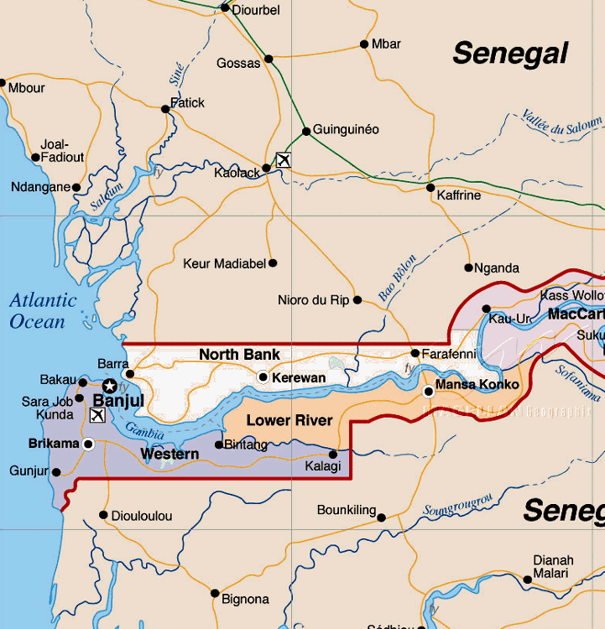
Rotary Books for the World
Middle Eastern and
West African Distributors
Tripoli
Beirut
Gambia &
Senegal
Notes:
In Lebanon, we sent our first container to the Rotary Club of Beirut Cedars. The government had rebuilt the schools after they were bombed out but the kids had few books. We sent books. Next the Rotary Club replaced the books destroyed by the radicals in Tripoli, Lebanon with our second container. Just now we have sent a third container for the Syrian refugees that the Rotary Clubs are caring for. Many Syrians have fled to Lebanon to escape the civil war. Now the villages in Lebanon are petitioning Rotary to populate libraries in their communities. So far the Rotary Club of Beirut Cedar was done five villages with our books.
On the right we are shipping to The Gambia for book distribution there and in the surrounding Senegal. The shipments are sent to the Ministry of Basic and Secondary Education. Some of the books are finding their way to orphanages in Senegal carried by Gambian Rotaractors.

Slide 17
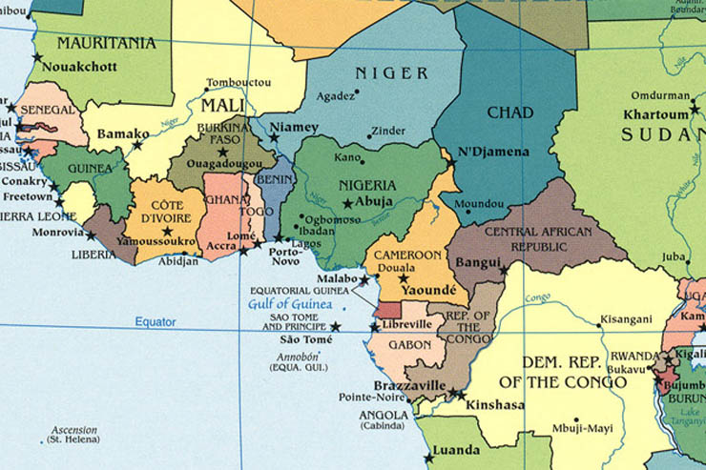
Rotary Books for the World
West African Distributors
Ghana
Nigeria
Cameroon
Notes:
A Houston area Rotarian retired to Ghana to start a school and the first container went to her school. Since then we have sent more containers to Ghana were the books are needed.
We have sent only one container Cameroon and know it was received but have not gotten the require report on the books are the container. Consequently, we have not shipped more.
It too us a long time to find the forces in Nigeria who won’t looking for either free books or bribes. That problem was solved three years ago. We have now sent five containers to the DGN for District 9101. District 6200 (Louisiana) helped with financing the last container.

Slide 18
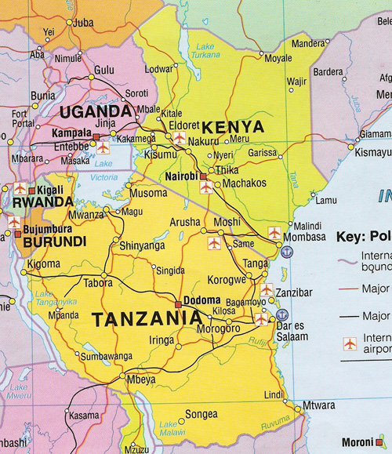
Rotary Books for the World
East African Distributors
It took us a decade to find our way into Uganda without going thru Kenyan customs but with the help of Pastor Joe we have sent eight containers so far to Kenya and Uganda.
Uganda, Rwanda,
& South Sudan
Tanzania
Kenya
Notes:
Most recently we overcome the Kenyan bureaucracy to get a container through the Port of Mombasa to Kampala, Uganda. The container was such a success that several of the Ugandan Rotary Clubs wanted the have their own container.
We have five containers headed for Uganda now and hope to see the impact it has on Ugandan children in 2018.
We are now sending a container to Kenya. If the container gets through Mombasa without bribes which the Kenyan Rotarians assure us, we will start sending more containers. The Kenyan children are in dire need of textbooks in English.
We will continue to try for Der es Salaam, Tanzania. We believe that the Tanzanian Rotarian will catch the service need from the Ugandans.

Slide 19
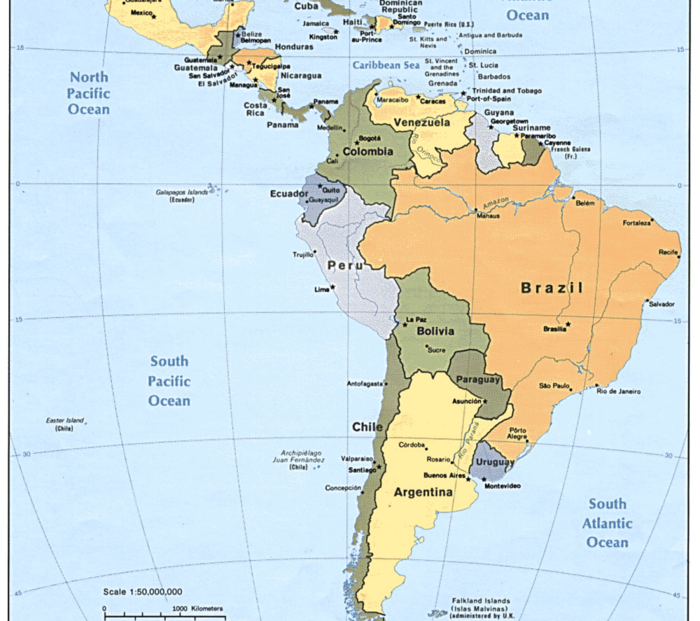
Rotary Books for the World
Central and South America Distribution
Belize
St. Kitts and Nevis
Panama
Nicaragua
Guyana
Ecuador
Argentina
Notes:
The active site in Latin America is Guyana where the coordinator has asked for English language books to prepare their students for skills in the tourist industry. We get a limited amount of Spanish books. The change of government in Guyana has temporarily stopped our flow of books to Guyana. However, we hope that the General Council for Guyana in Houston, a new Rotarian, will reconnect to the new government. We have receive a verbal request for 11 more containers but are waiting for the request to come in writing.
Latin America is our only current outlet for Spanish books. Our target for expansion is Venezuela when it becomes stable and Santa Domingo. We currently have 24 pallets of Spanish language books. A container takes about 30 pallets at max weight.
We are currently shipping to St. Kitts and Nevis, Belize, and Panama but are limited by the size of the country and population.

Slide 20
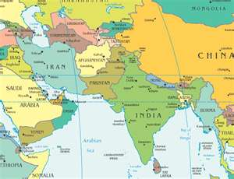
Rotary Books for the World
Asian Distributors
Kabul
Islamabad
Lahore
Karachi
Pune
Chennai
Sri Lanka
Notes:
In Asia, we are actively distributing in Pakistan through our Rotary Clubs and the Hashoo Foundation. While religious extremists in Pakistan are attacking the effort, Pakistani Rotarians are willing to risk their lives to bring education to both boys and GIRLS in their country. We will continue to support this investment in peace.
In Afghanistan in partnership with the US Air Force, we delivered 16 pallets of textbooks to Kabul. Unfortunately, we think that a young State Department worker and several Afghans gave their lives delivering these books.
We have just resumed shipments to India after shutting down shipments because of corrupt custom officials on the west coast of the country. We are shipping to Chennai on the east coast.

Slide 21
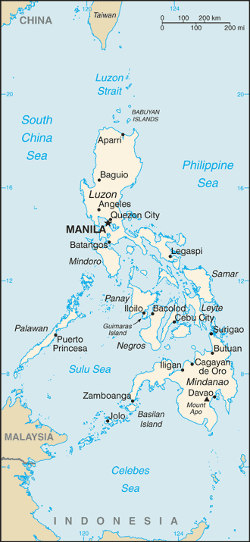
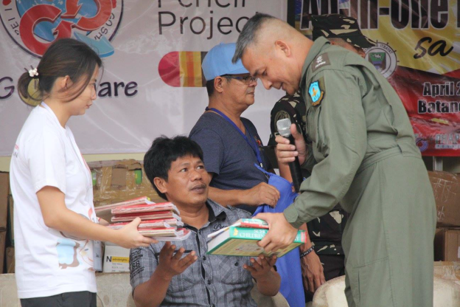
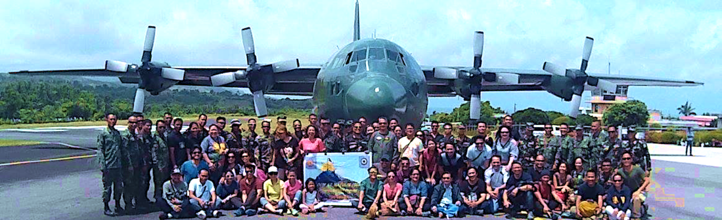
You make a difference in the Philippines
Pacific Distribution
The latest addition to our distributors is a non-Rotary group in the Philippines, namely the National Council of Women in the Philippines which was founded just after World War II.
The collection group in Oregon recommended this group as the group they had worked with in the past.
From North of Luzon
To the South in Cebu and Zamboanga.
Notes:
After years of trying to partner with Rotary Clubs in the Philippines, we finally reached out to a women’s group successfully. Our partnering organization is the National Council of Women (NCWP) in the Philippines. They were organized in the early 1940’s as a resistance group during the Japanese occupation. They have involved the Filipino Air Force and Navy in the distribution of books into the areas of greatest need. The first container had books transported to Zamboanga in the south where extremists had destroyed several institutions in the city. The government has retaken the city and rebuild the physical facilities but the textbooks for the schools came from the first container we sent.
Some of the books went to the north where the Philippines, Vietnam, and China all have disputed claims on the islands.
The Philippine connection came from an assist by the Booklegger effort in Beaverton, Oregon. Thank you very much Beaverton!
The Ministry of Social Services are employing ghetto kids to catalog and place book plates in each of the books we send.

Slide 22
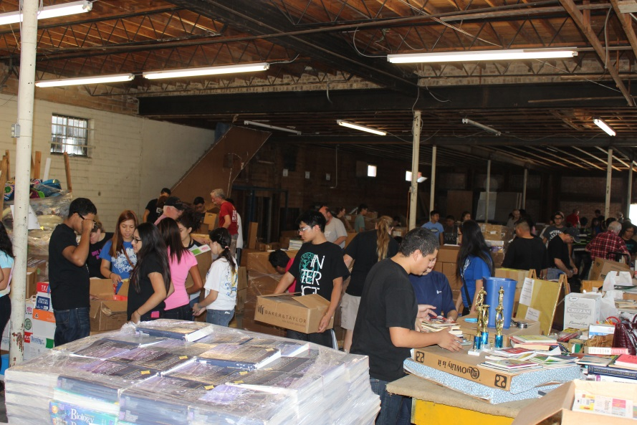
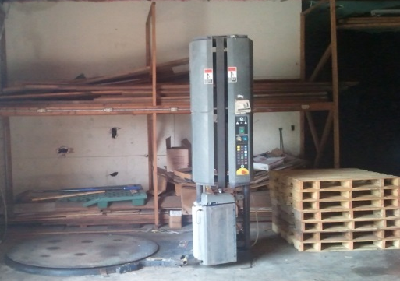
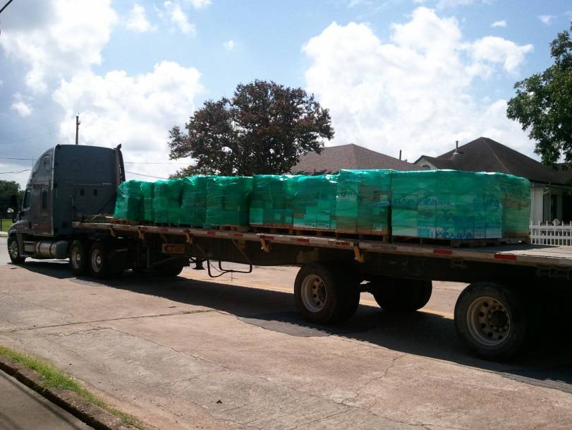
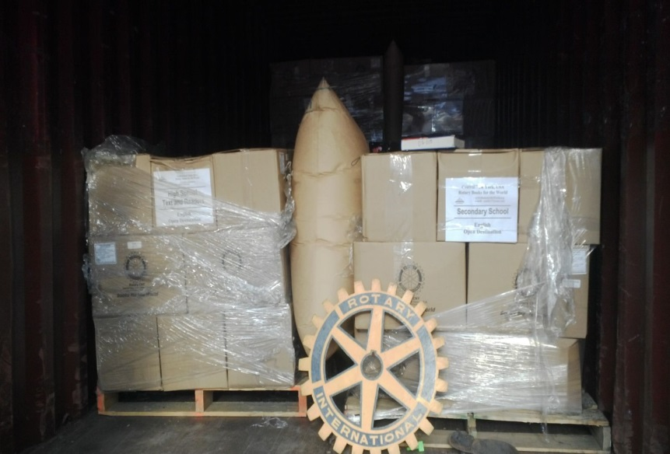
The Latest Additional
Pasadena Tx sorting & packing facility
Notes:
As books are collected there is a need to generally categorize them, boxing them, and palletize like material together on a pallet. This allows the warehousing and loading of the books to meet the needs of different distributors. Some distributors service primarily schools. Others focus on building libraries. Shipment are made with these constraints in mind.
The top left picture shows Interactors sorting and repackaging books in Houston. The top right picture is of the automatic pallet wrapping machine that Shell Oil donated to us which made pallet building much quicker. The bottom left picture shows the completed pallets being transferred from Pasadena to Exel in La Porte, TX where they are loaded into a container. The transfer is sponsored by TAM International using Mike Pena Delivery services. The bottom right pictures is of the books arriving in Nigeria.

Slide 23
The Interact Volunteers with
Adult Supervisors
Interact and Rotaract helps once a month
with Rotarian supervision.
Rotary Youth Boxing and Palletizing Books
Notes:
One of the most valuable benefits of the program is the once a month gathering of the youth of District 5890 to sort and palletize incoming books for the project. Besides it being an international project for the Interact clubs, it provides a vehicle for the required community service by the schools for many of them.
They are a valuable resource which makes the project work. In other locals, volunteers do much the same thing which makes the project affordable and functioning.
There were about 120 Interactors on this October morning.

