Slide 1
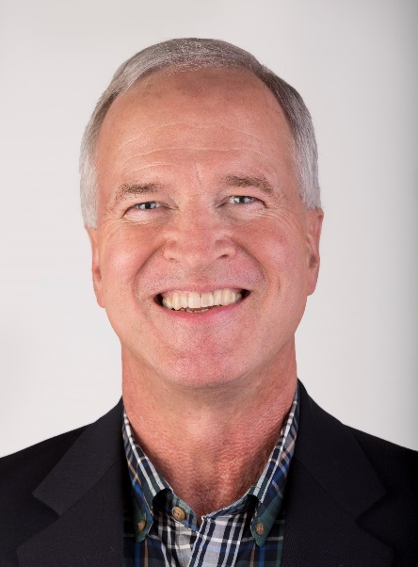
Lone Star PETS 2019
Rotary Basics
Your Host:
George Ritcheske
gritcheske@yahoo.com

Slide 2

The Right Answer
Roger von Oech,
A Whack on the Side of the Head
Select the figure that is different from all the others.

Slide 3
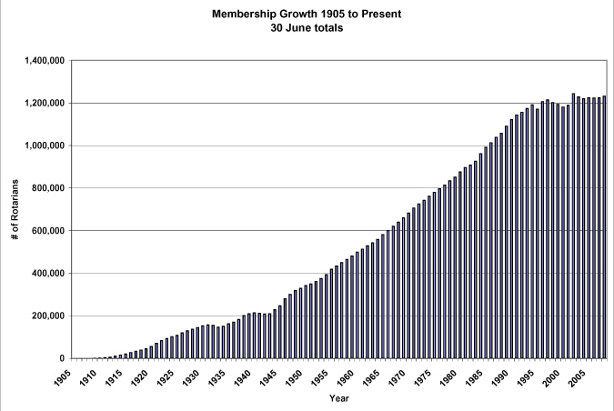
Membership Growth Rate
1st 90 Years:
15% /yr
1996 - 2018:
Flatlining

Slide 4
RI Messages: Rotary.org
People of Action
“Rotary is where neighbors, friends, and problem-solvers share ideas, join leaders, and take action to create lasting change”.
WE CONNECT PEOPLE
WE TRANSFORM COMMUNITIES
WE SOLVE PROBLEMS
Notes:
And when asked to comment on the tagline “Humanity in Motion” individuals did present many positive responses.
“Humanity in Motion makes sense for Rotary. Moving. Doing. Action. Giving.”
“Humanity in Motion. Everyone works together.”
Once again supporting the need for immediate action and involvement.

Slide 5
Innovation is the Key to Healthy Organizations
“You can change without
improving, but you cannot
improve without changing.”
Pat Haggarty, former TI Leader

Slide 6
Innovation is the Key to Healthy Organizations
"This is a changing world; we must be prepared to change with it. The story of Rotary will have to be written again and again!“
Paul Harris – Founder of Rotary
“This Rotarian Age”, 1935

Slide 7
What Time is It?
People
Service Projects
Engaging
Programs
Time to
Rethink
Rotary

Slide 8


Slide 9

Rotary Vision Statement:
“Together, we see a world where people unite and take action to create lasting change — across the globe, in our communities, and in ourselves.”

Slide 10
Rotary’s Strategic Priorities and Goals
INCREASE OUR IMPACT
EXPAND OUR REACH
ENHANCE PARTICIPANT ENGAGEMENT
INCREASE OUR ABILITY TO ADAPT

Slide 11
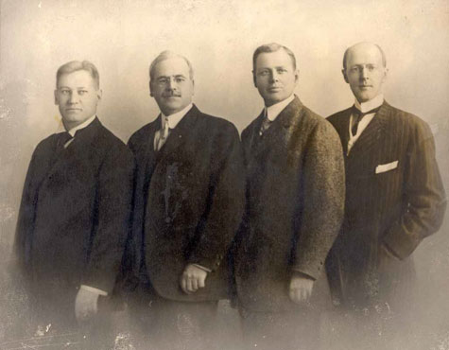

.
Harris unfolded his general plan for a club.
Out of this simple beginning sprang the world's first international service organization
The first four Rotarians (from left): Gustavus Loehr, Silvester Schiele, Hiram Shorey, and Harris.
February 23, 1905

Slide 12

Rotary goes international
1912
The Rotary Club of Winnipeg - 1st official non-
USA club chartered 4/13/12
The Rotary Club of London –1st European club
to be chartered.
Rotary becomes the International Association
of Rotary Clubs
Source: Rotary.org

Slide 13

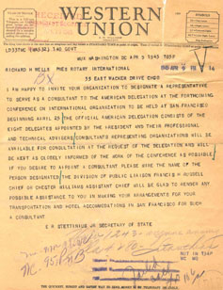
1945
49 Rotarians help draft the United Nations Charter.
Rotary International is granted adviser status at the UN Charter Conference.
Source: Rotary.org

Slide 14
Continuing to Learn
Go to the my.rotary.org/learning-reference for learning resources for you and your club members
Rotary Basics , a thorough introduction to RI
and Rotary Foundation programs and
membership benefits and responsibilities.
Source: Rotary.org

Slide 15
ROTARY
BASICS
a reference guide for members

Slide 16
Overview of Rotary International's
Leadership Structure
The RI Boards
The 19-member RI Board of Directors
which includes the RI President and
President-elect, meets quarterly to
establish policies.
The RI president, who is elected
annually, develops a theme and
emphasis for the year.

Slide 17
Overview of Rotary International's
Leadership Structure
The Secretariat
RI is headquartered in Evanston, Illinois,
USA, with 7 int’l offices
The office of RI in Great Britain &
Ireland (RIBI), located in England,
serves clubs and districts in that region.
The Secretariat’s active managing officer is
the General Secretary & heads a 750-
member staff working to serve Rotarians
worldwide.

Slide 18
Overview of Rotary International's
Leadership Structure
The Trustees of The Rotary Foundation
The 15 directors of The Rotary Foundation (TRF) are appointed by the RI president,
with the agreement of the RI Board.
The Trustees manage all business of the
Foundation. The Trustee chair, (serves
for 1 year as Chair), heads the Trustees.
Each trustee is appointed to a
four-year term.

Slide 19
Rotary’s Guiding Principles
Object of Rotary
Classification System
Five Avenues of Service
The Four-Way Test
Source: Rotary.org

Slide 20
Object of Rotary
The Object of Rotary is to encourage and foster the ideal of service as a basis of worthy enterprise and, in particular, to encourage and foster:
FIRST The development of acquaintance as an opportunity for service;
SECOND High ethical standards in business and professions; the recognition of the worthiness of all useful occupations; and the dignifying of each Rotarian’s occupation as an opportunity to serve society;
THIRD The application of the ideal of service in each Rotarian’s personal, business, and community life;
FOURTH The advancement of international understanding, goodwill, and peace through a world fellowship of business and professional persons united in the ideal of service.
Source: Rotary.org

Slide 21
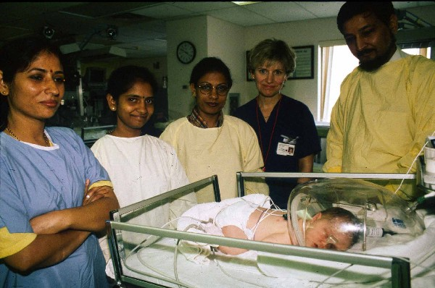
Classification
Classification is based on the founders' model of choosing cross-representation of each business, profession, and institution within a community.
Source: Rotary.org

Slide 22
Avenues of Service
Based on the Object of Rotary, the Avenues of Service are Rotary’s philosophical cornerstone and the foundation on which club activity is based:
Club Service focuses on strengthening fellowship and ensuring the effective functioning of the club.
Vocational Service encourages Rotarians to serve others through their vocations and to practice high ethical standards.
Community Service covers the projects and activities the club undertakes to improve life in its community.
International Service encompasses actions taken to expand Rotary’s humanitarian reach around the globe and to promote world understanding and peace.
Youth Service (formerly New Generations) recognizes the positive change implemented by youth and young adults through leadership development activities, involvement in community and international service projects, and exchange programs that enrich and foster world peace and cultural understanding.

Slide 23
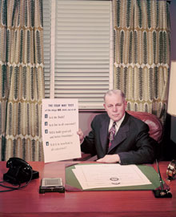
Herbert Taylor with
The Four-Way Test
It has become assimilated
into the genetic code of the organization.
In 1932, Herbert J. Taylor, the newly appointed President of a nearly bankrupt Chicago cookware company, believing his employees were in need of an “ethical yardstick,” wrote four questions on a small, white piece of paper:
Is it the TRUTH?
Is it FAIR to all concerned?
Will it build GOODWILL and BETTER FRIENDSHIPS?
Will it be BENEFICIAL to all concerned?

Slide 24
Rotary Foundation Motto & Mission
Doing Good in the World
…to enable Rotarians to advance world understanding, goodwill, and peace through the improvement of health, the support of education, and the alleviation of poverty.
COL Endorsed, April 2007
Notes:
Early in the process the trustees, through the recommendation from the Future Vision Committee, adopted the motto mission statement and priorities of the Future Vision Plan, which were approved and endorsed by the Rotary International Board of Directors and the 2007 Council on Legislation. The motto for The Rotary Foundation is “Doing good in the world”, the famous words of past president Arch Klumph from 1917.
The mission of The Rotary Foundation is to enable Rotarians to advance world understanding, good will and peace, through the improvement of health, the support of education and the alleviation of poverty. Based upon the principle areas of the mission statement the Trustees of The Rotary Foundation and the Board of Directors of Rotary International have approved six areas of focus for The Rotary Foundation in the future.

Slide 25
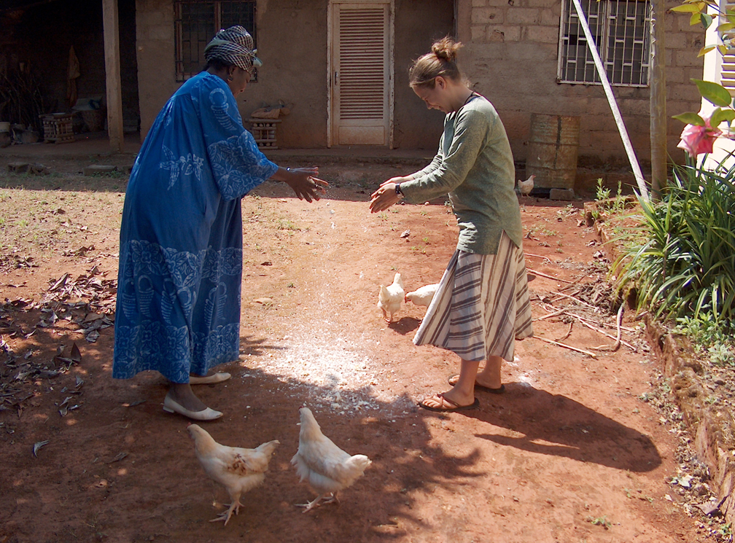
Educational Programs
Ambassadorial Scholarships
Vocational Training Teams
Rotary Peace Centers
Notes:
The Ambassadorial Scholarships Program has funded nearly 37,000 men and women from 100 nations to study abroad since 1947. We are one of the world's largest privately funded international scholarship programs. Nearly 1,000 scholarships were awarded for study in 2004-05 representing some 70 countries.
Group Study Exchange is a unique cultural and vocational exchange opportunity for young business and professional men and women between the ages of 25 and 40 and in the early years of their professional lives. Teams exchange visits between paired areas in different countries. For four to six weeks, team members experience the host country's institutions and ways of life, observe their own vocations as practiced abroad, develop personal and professional relationships, and exchange ideas.
Rotary Centers for International Studies in peace and conflict resolution allows for up to 70 fellows to study at one of the seven Rotary Centers worldwide. The selected Rotary World Peace Fellows gain a master's degree in conflict resolution, peace studies, and international relations.
This photo depicts Alla Lefkowitz, an Ambassadorial scholar currently sponsored by the Rotary Club of Claremont Sunrise in District 5300, California. Alla is studying development studies in Cameroon and has been assisting with a plan to work and conduct research with many NGOs, especially those handling HIV/AIDS pandemic in Cameroon.
(Speaker’s note: optional)
You can find more information regarding these programs and other Educational Programs on the Educational Programs Web pages on the Rotary Web site.
Or
Talk about a GSE team or recent scholar sponsored by the club.

Slide 26


Polio cases:
2018: 33
2016: 37
2011: 650
2010: 1,352
As of 2-28-19

Slide 27

Annual Programs Fund (APF)
Every
Rotarian
Every
Year
Notes:
The Annual Programs Fund addresses the need to support the day-to-day functioning of the wide range of educational and humanitarian programs.
The Annual Programs Fund addresses the need to support the day-to-day functioning of the wide range of programs.
What does Every Rotarian, Every Year (EREY) mean?
It means encouraging all of our members to get involved in an club or district project.
It means supporting The Rotary Foundation with a minimum $100 contribution to the Annual Programs Fund…every year.
It means you becoming a Rotary Foundation Sustaining Member.
It means our collective commitment to help make our world better.
As a reminder, all contributions to the Annual Programs Fund are eligible for Paul Harris Fellow recognition.

Slide 28
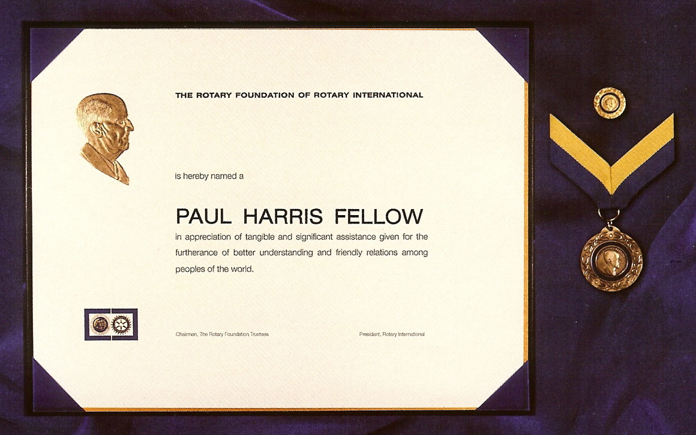
Paul Harris Fellow Recognition
$1,000.

Slide 29
Understanding APF/SHARE
Spend
Select Participants
Plan/Allocate
Contribute
YEAR 3
Earnings
Pay TRF Administrative
Expenses
YEAR 2
YEAR 1
50% World Fund
50% District Designated Funds (DDF)
Matching Grants
Volunteer Service Grants
Health, Hunger and Humanity Grants (3-H)
District Simplified Grants
Matching Grants
Ambassadorial Scholarships
Additional Vocational Team
Rotary Centers for International Studies
Notes:
Fifty percent (50%) of all contributions come back to our district through District Designated Funds (DDF) in three years to spend on educational and humanitarian programs chosen by us; even grants that may be used for projects in our local community. Through the SHARE system, our contributions to the Foundation help both the locally and globally.
Here’s an example:
Year 1: Our district raised $100,000 in 2004-05
Year 2: $50,000 is available in DDF for programs we select.
Year 3: Spending takes place in 2007-08
Programs funded through District Designated Funds include: Matching Grants; District Simplified Grants; Ambassadorial Scholars; Rotary Centers for Int’l Studies; additional Group Study Exchanges, etc.
The other 50% goes to the World Fund and is used to fund other Foundation programs in which we can participate, such as GSE and Matching Grants. (Each district receives one GSE that is funded from the World Fund.)
The Rotary Foundation provides a 1:1 match for District Designated Funds (or SHARE) contributions and a 0.5:1 match for new cash contributions for Matching Grants. And, districts can request up to 20 percent of District Designated Funds (DDF) for a grant to support multiple projects locally or internationally.

Slide 30
Areas of Focus
Rotary is dedicated to six areas of focus to build international relationships, improve lives, and create a better world to support our peace efforts and end polio forever.
Promoting Peace
Fighting Disease
Providing Clean Water, Sanitation & Hygiene
Saving Mothers and Children
Supporting Education
Growing Local Economies
Notes:
The approved areas of focus, calling upon key points of The Rotary Foundation mission are:
peace and conflict prevention and resolution…
disease prevention and treatment…
water and sanitation….
maternal and child health…..
basic education and literacy…..
and economic and community development.
The Trustees have committed to these areas of focus for at least nine years. The Trustees and the Board of Directors of Rotary International are encouraging clubs and districts to focus their foundation efforts in these six areas even before the Future Vision Plan is implemented.

Slide 31
Club Assembly
District Assembly
District Conference
Zone Institute
Rotary International Convention

Slide 32
Thank You for Your
Commitment to Rotary!

