Slide 1
Discover New Horizons
Notes:
Thank you DG Scott for the invitation to speak today.
The Houston Host Committee have been trying to reach every club to let them know about the Houston Rotary Convention which will be held at the GRB June 4-8 2022.
But before we get into the program…lets have some fun with some Trivia and win some prizes!

Slide 2
History of your 2022 Host Organization Committee
We officially became the
“2022 Houston Host Committee Inc.”
on August 17, 2016
and our 501C3 was obtained shortly thereafter

Slide 3
2022 RI Convention Houston
Host Organization Committee (HOC)
&
Rotary International Convention Committee
Working as Partners with Different Responsibilities

Slide 4
Rotary International Convention (RIC)
Houston 2022 Host Committee
Executive Committee
Special Advisory
Committee
PRID Andy Smallwood
Special Advisor
RID Suzi Howe
HOC Chair
Rhonda Kennedy
Chairman of RI ICC
John Smarge
Vice Chair
General Services
Jeff Tallas
Vice Chair
Pre/Post Convention Events
TBA

Slide 5
Discovery Green Welcome Event
Notes:
Entire area will be fenced, Flags of all Rotary countries will be floating in the lake ,2 entertainment stages, Aerial Entertainment, Roaming Photos booths, Roaming entertainers, Beer and wine garden, 8000 tickets available, Conclude the night with a surprise show on the outside of the GRB and a fireworks show from the top f the GRB.. This is commonly called the Cultural event but Houston is such a diverse city there will be something for everyone at this event.

Slide 6
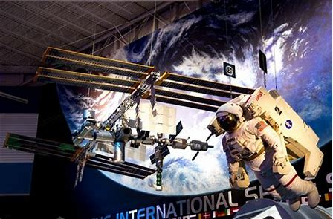
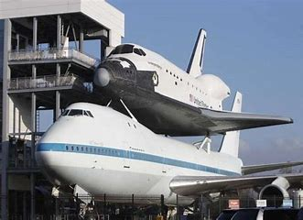
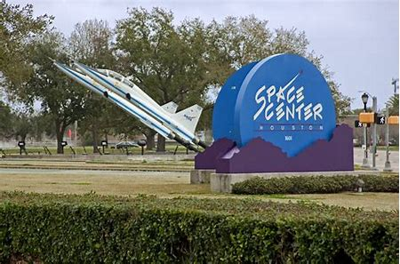
SPACE CENTER HOUSTON
Notes:
This will be one of our most popular events with 3000 tickets available. Food and full access to SCH

Slide 7
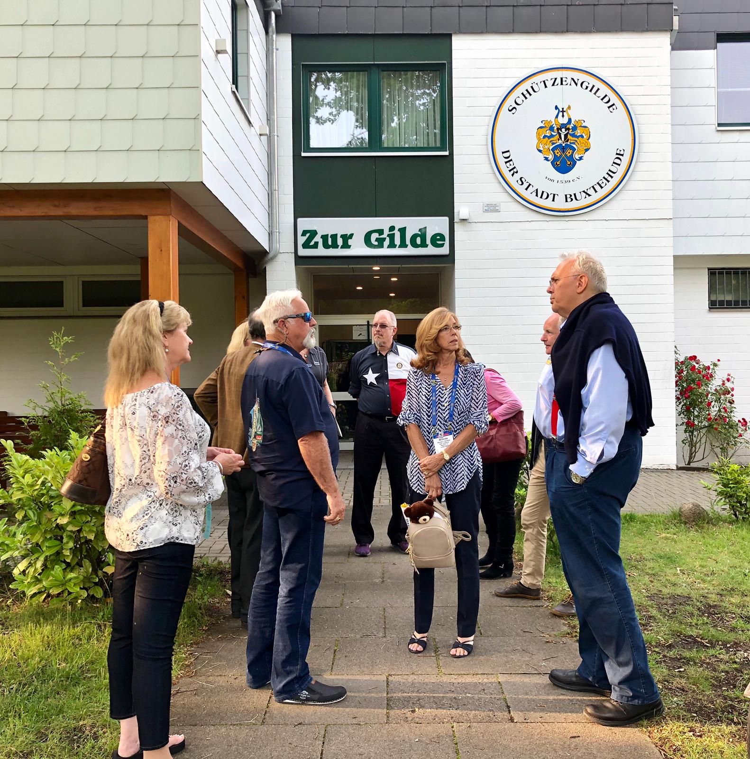
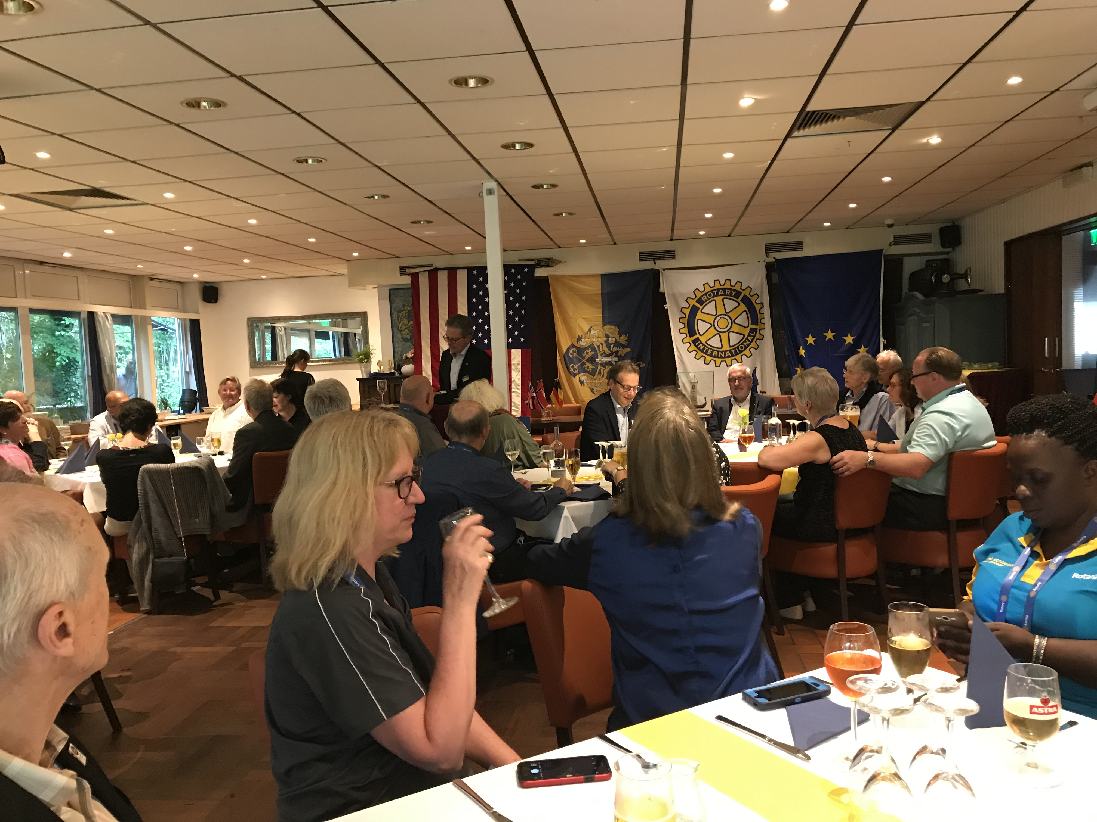
HOST HOSPITALITY NIGHT
Notes:
Your club or a group of clubs can host international guest for an evening.
Your event can be a regular Rotary meeting, a social event, a show…your choice
Event venue should be within 30-40 minutes from the GRB.
Can someone tell me what the biggest opportunity that this event will present to your club?

Slide 8
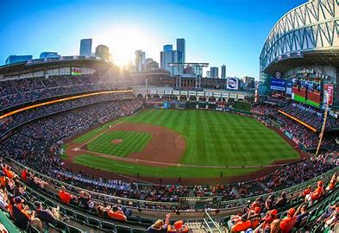
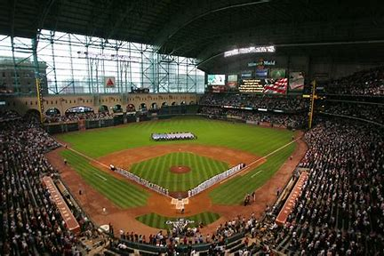
Rotary at the Houston Astros Baseball
Will be added later
Notes:
Rotary is working to secure the park…why
Most Convention centers only hold about 10-15K seated guest.
RI generally has 2 – 3 opening and closing ceremonies. Each one a repeat of the first.
MM Park would allow Houston to have 1 opening and 1 closing ceremony with every Rotarian in the same session….
Imagine how amazing that would be!

Slide 9
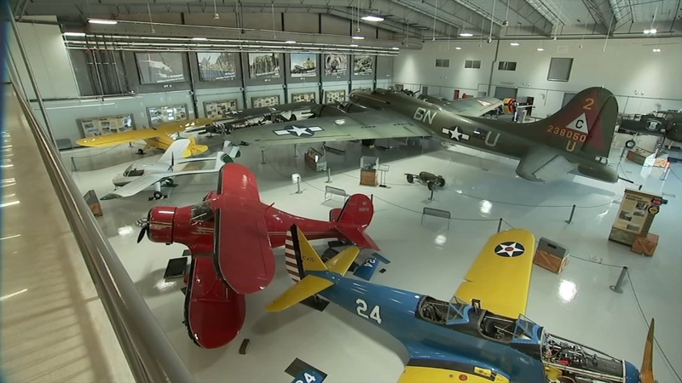
LONE STAR FLIGHT MUSEUM
Notes:
Aviator's delight! Fellowship of Flying Rotarians---this is the event for you!
An evening of Food, Fun and Functional Vintage aircraft.

Slide 10
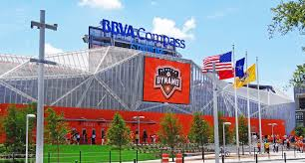
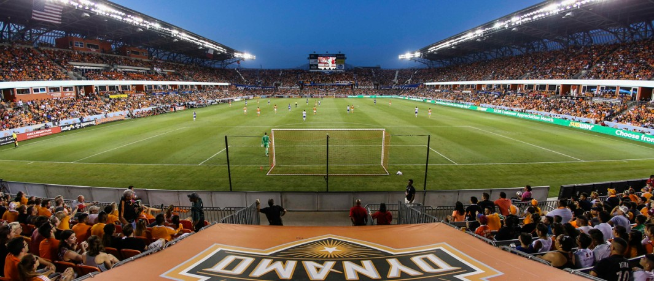
DYNAMO SOCCER GAME AND PITCH 25 PARTY
Notes:
This is an event I hope to attend…and I don’t know anything about soccer.
Many International guest love Soccer and here they will see a Champion Soccer Team.
The Party starts at Pitch 25 with food, beverages and games then a short walk across the street takes them to the
BBVA Compass Stadium for a game.
All just 2-3 blocks from the GRB

Slide 11
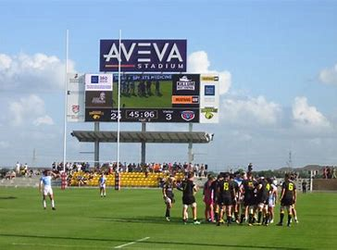
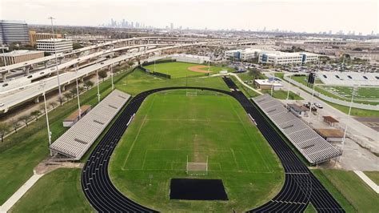
Rotary At the HOUSTON SABERCATS RUGBY
Notes:
For our International Rugby fans here is a short bus ride, Stadium food and lot of fun…Perfect!

Slide 12
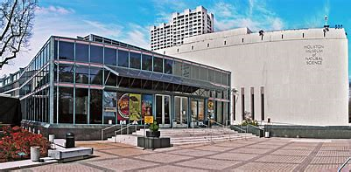
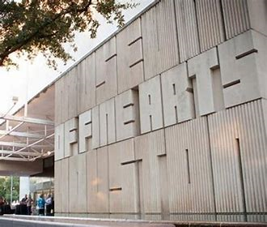
Rotary Night AT the Museums
CURRENTLY
CLOSED FOR
REMODEL
Notes:
An evening of heavy Hors’ d oeurves Wine and a choice of Houston’s finest Museums.

Slide 13
Magic on the Bayou
An evening of food, wine, laughter and magic!
The Ballroom at Bayou Place
Roaming magicians and 2-time International Champion of Magic and Winner of the World of Magic Seminar in Las Vegas
Ben Jackson, More than Magic
Will perform his show
“Magic, Music and Mayhem”
Notes:
NEW EVENT!
Craig Howard of the RC of Houston…Thank you for suggesting this event.
Ballroom on the Bayou is the place!
Dinner, wine, laughter, cash bar…add to that magicians walking table to table amazing you with their magical skills.
Top the evening off with 2 time International Champion of Magic and the Winner of the World of Magic Seminar in Las Vegas,
Ben Jackson, More than Magic will preform his “Magic, Music and Mayhem” show.

Slide 14
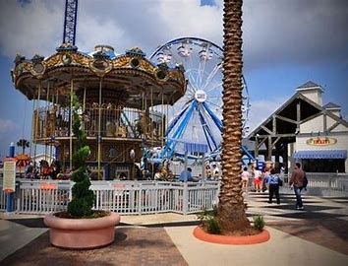
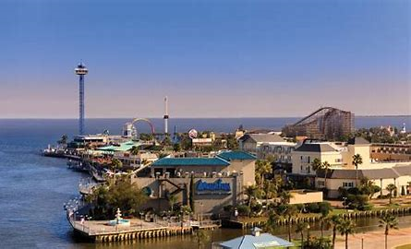
Kemah Amusement Park
Notes:
This will be a fun filled day enjoying amusement park rides, shopping and restaurant dining all with a view of the Gulf of Mexico.

Slide 15
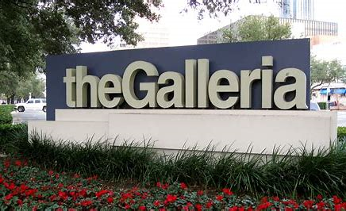
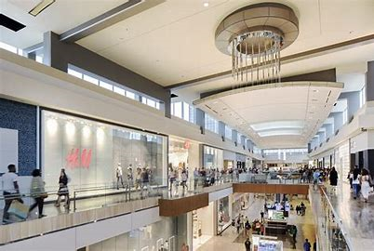
Shopping at the Galleria
Notes:
For those attendees that did not get a chance to souvenir shop, here is their chance.

Slide 16
Environmental Service project
IN the spirit of the new 7th Area of Focus – Supporting the Environment
Footprint App. (www.footprintapp.org)
The Goal is to Offset the Convention Carbon Footprint
Impacts all registered Rotarians
Compliant with Data Protection
Notes:
In keeping with the past traditions of a convention Service Project and celebrating the spirit of RI’s newest Area of Focus,
Convention guest will use the Footprint App to offset the Conventions Carbon Footprint.
The app can be downloaded prior to leaving home and each attendee can track their Carbon footprint.
Then follow suggestions on how to offset that footprint.
Attendees will learn new habits to help save our environment.
Depending on how well this works in Houston, RI may adopt this and use it at future conventions.

Slide 17
Event Ticket Sales
Begin June 10th, 2021
at the Virtual
Convention
Notes:
As you can see the HOC and Event Chairman have been very busy to make sure we are ready to sell tickets to all events on June 12.

Slide 18
www.houstonri2022.org
Notes:
Visit our website to see list of events
Buy Merchandise and support the HOC
Volunteer to be a part of the HOC and the Houston Convention
Find contact information to all Vice Chairman

Slide 19
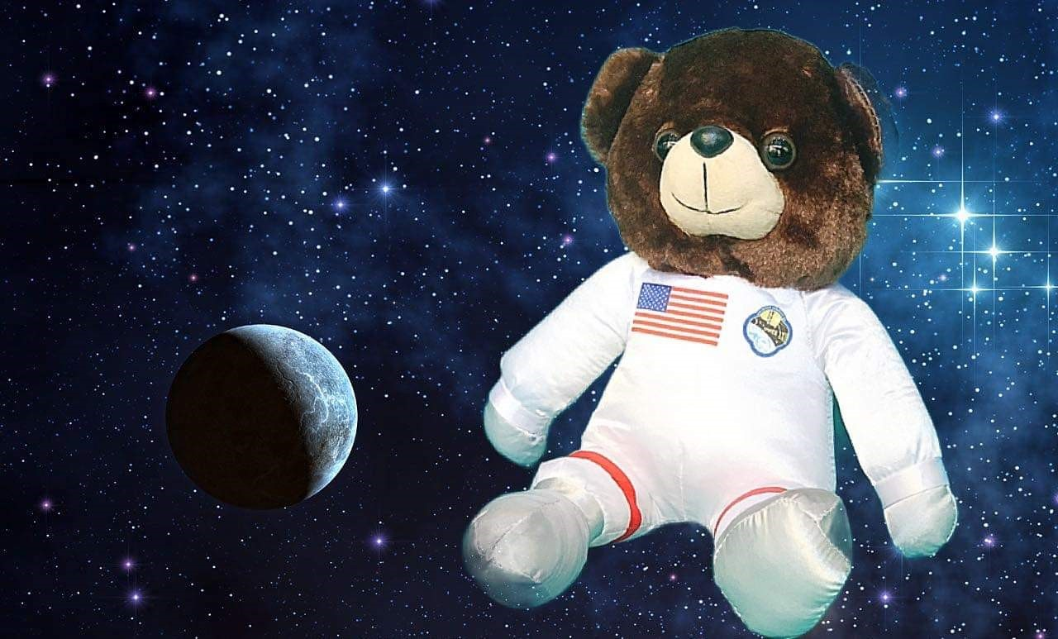
PROMOTIONAL ITEMS
ORBIE THE BEAR
$30.00 includes tax and shipping
CREW MEMBER PATCH
$5.00
Includes tax and shipping
CREW MEMBER PIN
$22.00
Includes tax and shipping
A must for every Youth Exchange Jacket!
Notes:
These prices includes shipping, but you can get them today and save money.
The Crew member pins serves as a dual purpose pin. The HOC is planning on an area in the GRB call the International Spirit Station. This pin is your admittance into this area. The ISS will be a place to socialize and enjoy the beverage of your choice.
The Space bear “Orbie” is the HOC Mascot but has quickly become loved by all and has even become a bit of a celebrity because he is starring in his own
Movie…”The Adventures of Orbie”

Slide 20
Sponsorships
Would your business benefit from International audience?
Would your business benefit from a National wide or local audience?
Are you just a kindhearted business owner that loves Houston & Rotary?
See Lisa Faith Massey for more information!
Notes:
The HOC has 3 ways of raising money…
Merchandise sales
Ticket Sales to Host Events
Sponsorships!

Slide 21
Texas District Partners
Thank You to District 5830
Special Thanks to District 5910
Notes:
The HOC has 3 ways of raising money…
Merchandise sales
Ticket Sales to Host Events
Sponsorships!

Slide 22
Volunteer Recruitment and Training
Finally, after years of asking…
Here is how you can help!
See Jack Hardin and sign up now!

Slide 23
Volunteers Positions will include but not limited to…
Airport Greeters
Host Event Ticket Scanners
Discovery Green Set Up/Committee Members
Host Event Greeters/Information Assistants
Host Event Bus Attendants
Host Event Committee Members
GRB Information Booth Attendants
House of Friendship Committee Members
www.houstonri2022.org

Slide 24
Future Rotary International Convention Locations
Tentative sites:
2023 Melbourne, Australia
2024 Singapore
2025 Calgary, Canada
2026 Honolulu, Hawaii
2027 – The next possible U.S. Conventions

Slide 25
Rotary International Conventions are open to all Rotarians and their guest.
Houston will be open for non-Rotarians
All District Rotarians & Rotaract members
should register and attend…
It is in your BACKYARD!

Slide 26
Discover New Horizons

