Slide 1


RMDTI
August 5, 2023

Slide 2
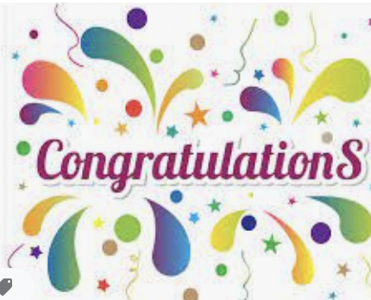

Slide 3

Together, we see a world where people unite and take action to create lasting change — across the globe,
in our communities,
and in ourselves.

Slide 4

Rotary’s
Action Plan
Notes:
ROTARY’S ACTION PLAN

Slide 5

Increase
our impact
Expand
our reach
Enhance
participant
engagement
Increase
our ability
to adapt

Slide 6
Aligning Goals
Membership, Polio, Foundation, Public Image
To achieve major goals, we need to be aligned and working toward the same goal
Board, with support from President Line, Trustee Leadership, and Rotary Secretariat and Executive Management Staff
  Alignment of Goals – Measures
  Focus on Goals – Outcomes; Experience of Members
  Resource Support – Processes, structural support, monitor unexpected consequences
  Three Year Goals
    Provide continuity
    Most goals cannot be achieved in one year

Slide 7
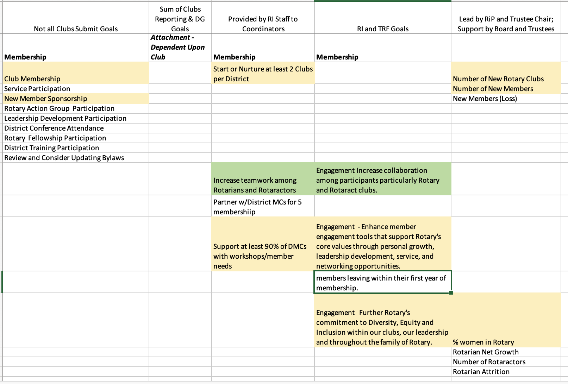

Slide 8
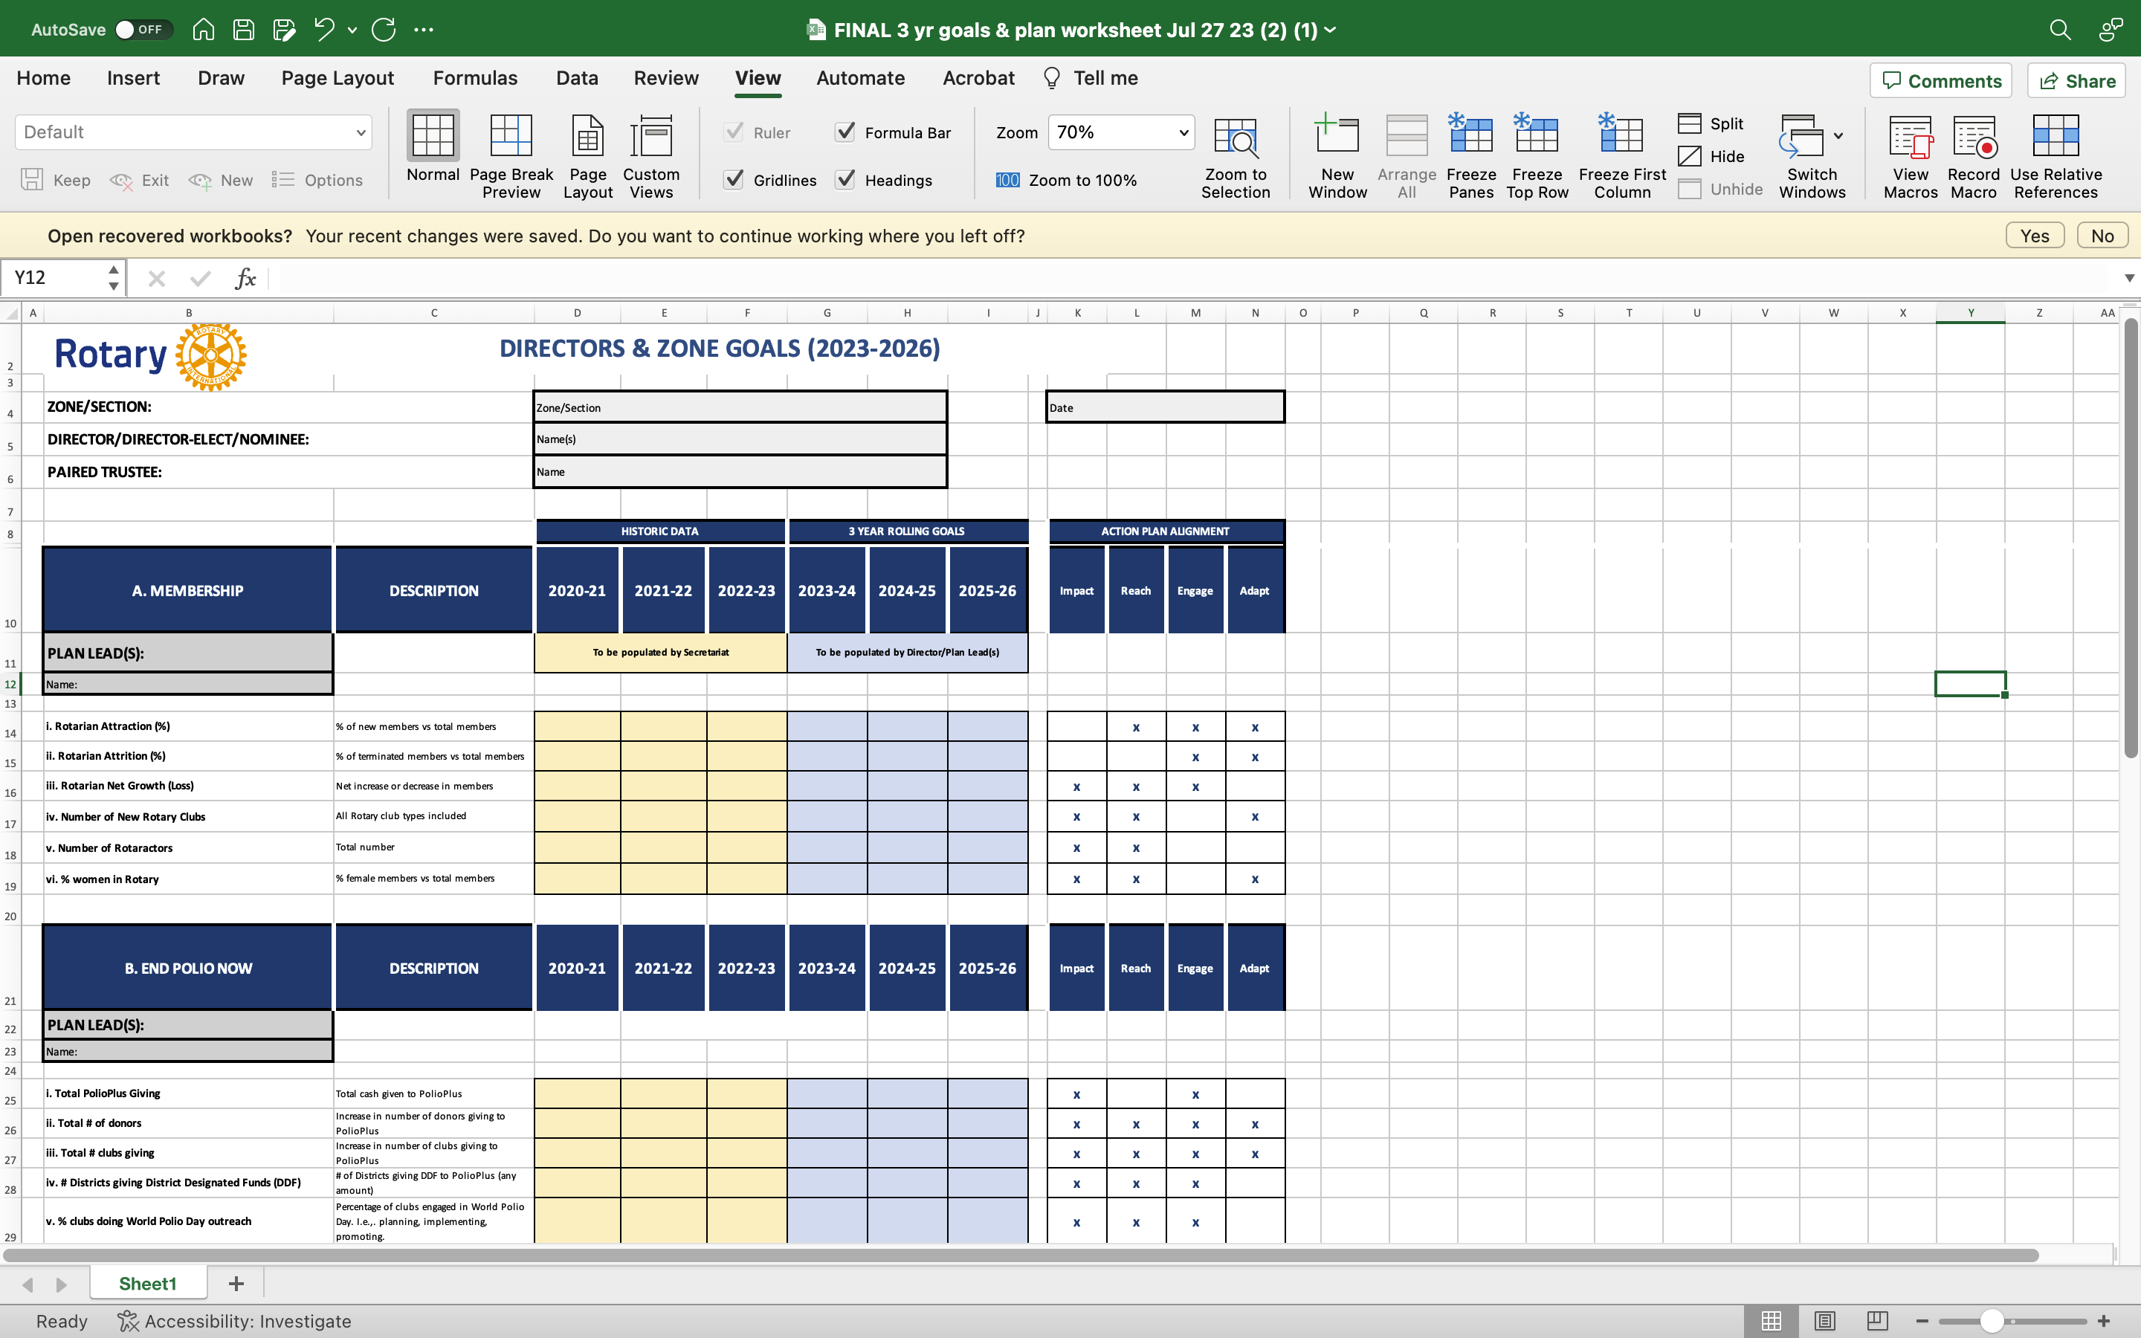

Slide 12
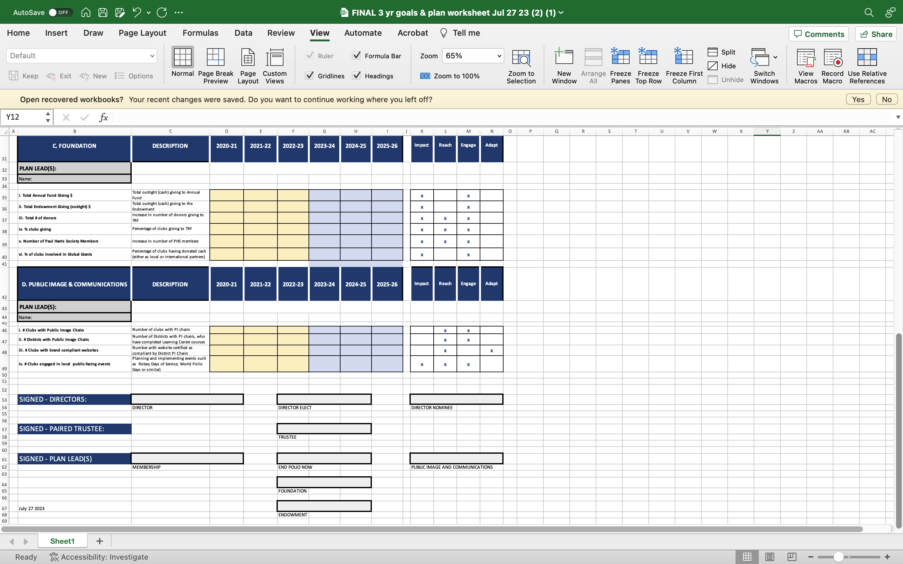

Slide 15
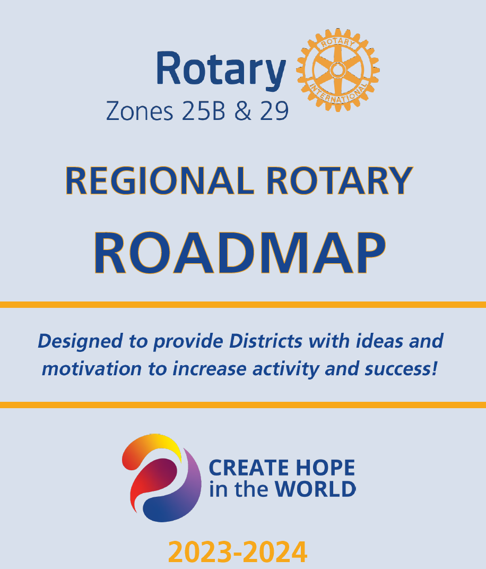
How Will We Get There?

Slide 16
Time Frames for Deliverables
Three Year Goals
  Zone Data Populated in Mid-August
  Education on Rotary Strategic Plan – August 28 with PDG Andrea Krauss
  Goals Due September 30, 2023
  Announcement of Awards for Top Performers in 2023-2024
  Implementation Plans
    Due February 2024 (in time for PETS!)
    Zone Institute – October 20, DGs Lead Their District in Developing Plan Approach with IPDG, DGE, DGN, PDGs, District Chairs for Membership, Foundation, Polio, Endowment, Public Image
    Modify

