Slide 1
1
RMDTI
DG Elects / Nominees
Grow Rotary Through Leads
Saturday August 6th
Title Page Option
Notes:
Long time no see. I want to talk about an easy way to grow your membership
How many are familiar with membership leads?
How many have used it?

Slide 2

Notes:
For years, Districts have been ignoring people who want to join Rotary.
Does that make any sense?
Can you believe:
Fact #1
Fact #2
Fact #3

Slide 3
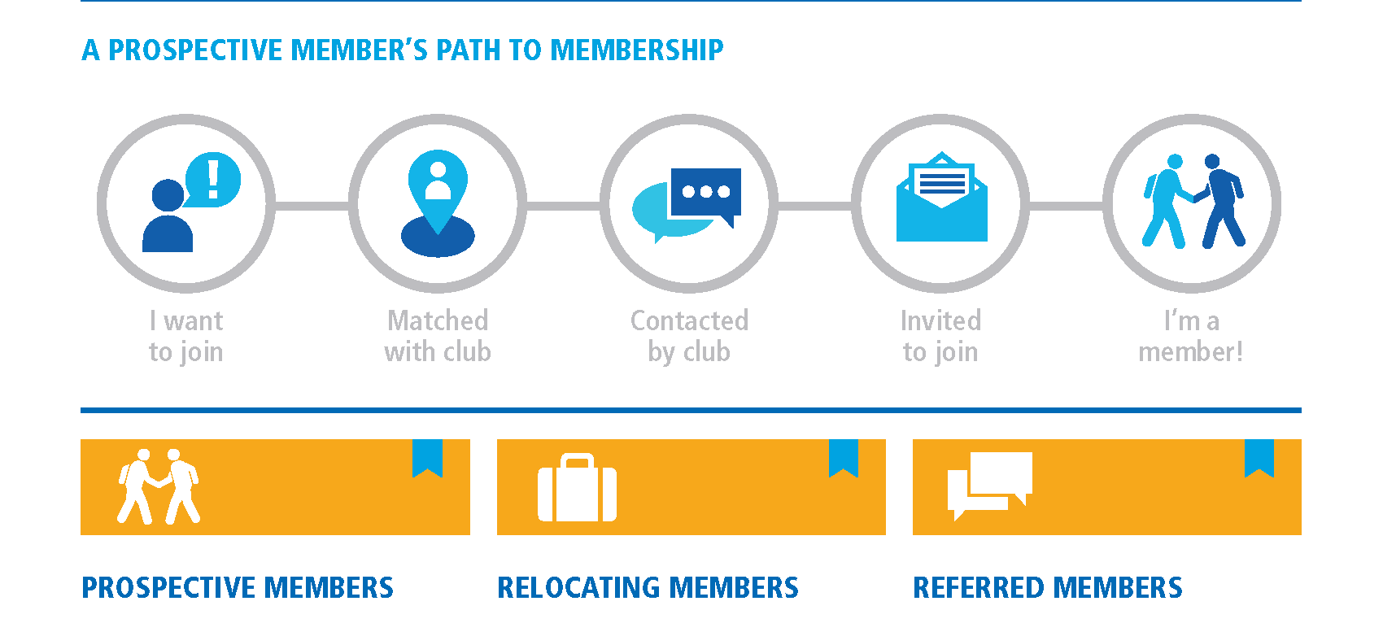
Notes:
The path to memberships starts with your leads manager
Let’s take a stroll to see all the potentials leads your district could capture

Slide 4
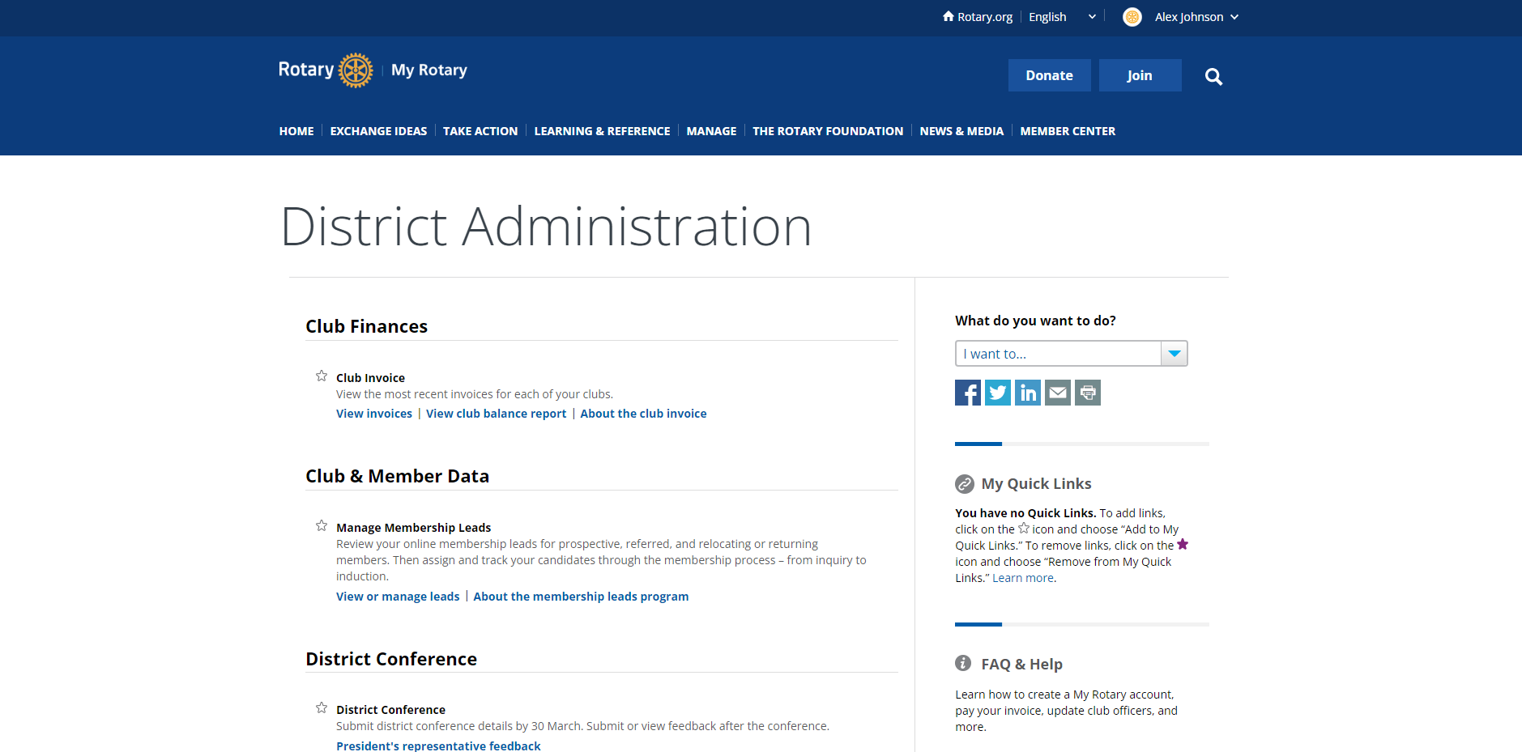
Notes:
Everyone login and get to your districts leads
How many of you will support your Leads Manager in converting those leads?

Slide 5

Why should your Leads Manager follow up quickly?
Notes:
Let’s talk about why your Leads Manager should follow up with the leads quickly?
Low hanging fruit
Catch it while the lead is hot
People deserve the gift of Rotary
Audience response #1
Audience response #2
Audience response #3

Slide 6

Attraction
Leads
Engagement
District Membership Chair
New Clubs
Notes:
What are the traits needed for a great Leads Manager?
Audience response #1
Audience response #2
Audience response #3
Knows clubs well
Good at communicating
Can develop a District plan and help Clubs develop one too

Slide 7
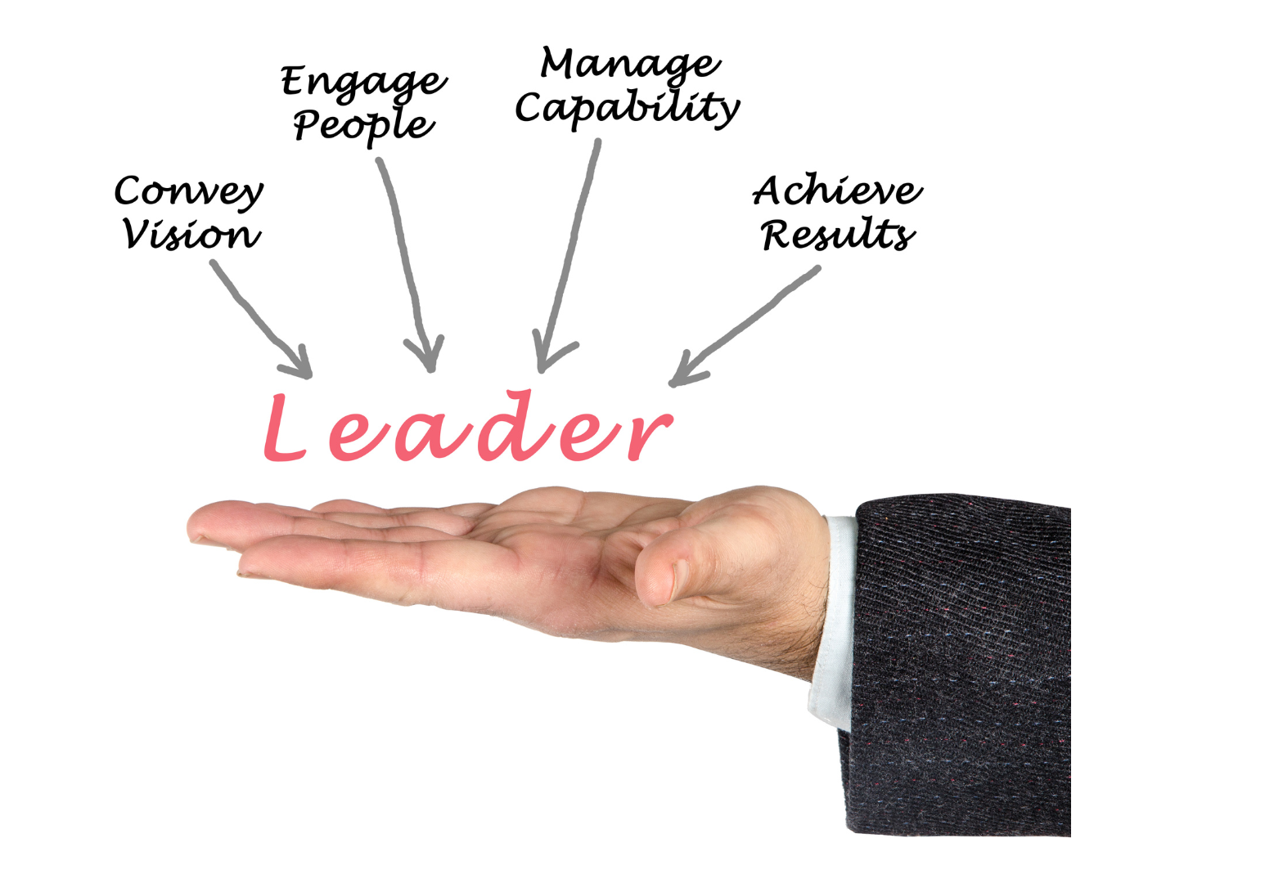
Notes:
Let’s talk about what the governor line can do to improve the conversion rates of leads
Not be the Leads Manager!
Audience response #1
Audience response #2
Audience response #3
Appoint Leads Manager early
Support Leads Manager
Encourage Clubs

Slide 8
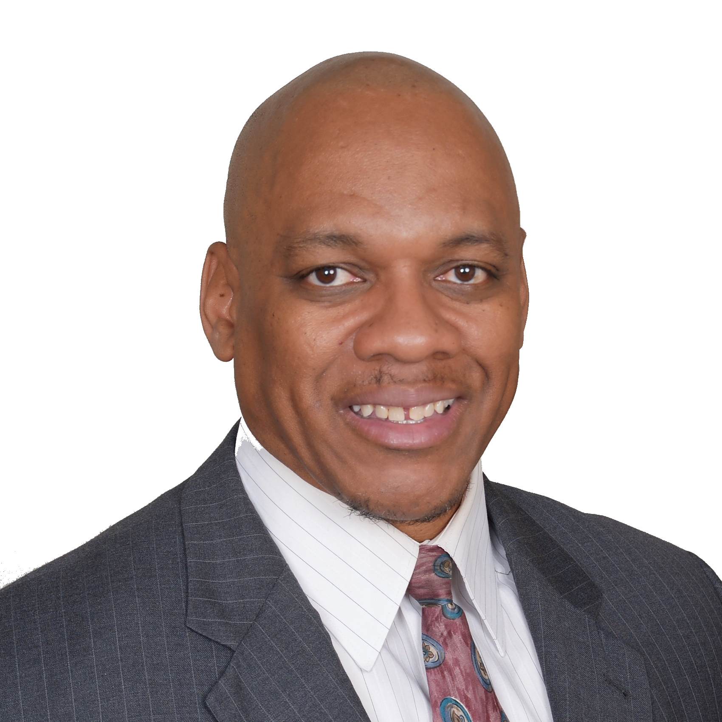
Grow rotary through leads
Appoint leads manager
Support leads manager
Encourage clubs
Alex Johnson
Innovative Club Advocate
alex@laurexadvisors.com
Notes:
Growing Rotary through Leads is easy and rewarding!
Appoint a Leads Manager
Support Leads Manager
Encourage Clubs to embrace leads

