Slide 1
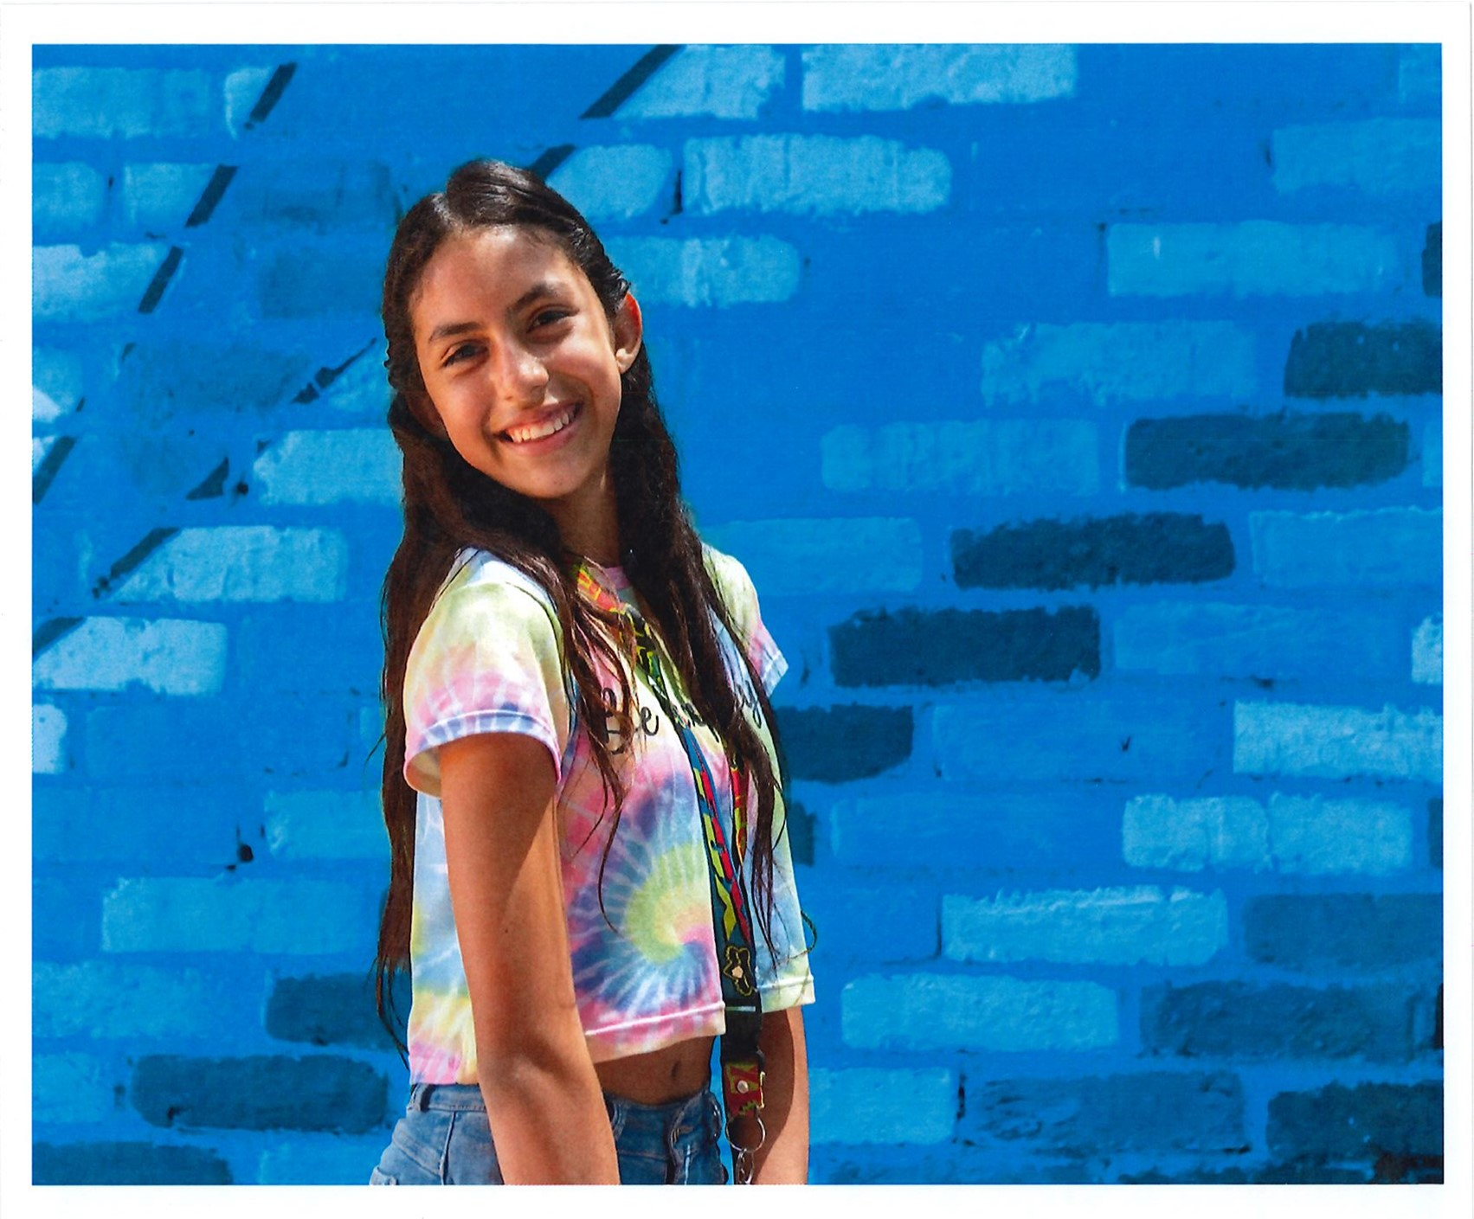
EMPOWERING GIRLS

Slide 2
CREATE HOPE IN THE WORLD
By helping girls
Have the opportunity to stay in school as long as they desire
Have access to feminine and personal hygiene products
Not be sold into human trafficking or forced to marry as mere children
Feel inspired and encouraged to obtain any career they chose
CREATE HOPE IN THE WORLD BY
EMPOWERING GIRLS

Slide 3
REALITY: Economics and Education
As of 2023, UNESCO estimates nearly 130 million girls globally are denied access to formal education
Just 39% of rural girls attend secondary school
Hunger, Health and Sanitation and Cultural Norms create barriers to education.

Slide 4
WATER, MENSTRUAL HYGIENE AND EDUCATION
Globally, 500 million women and girls lack adequate facilities for menstrual hygiene management and access to feminine hygiene products
A Girl’s inability to manage menstrual hygiene results in absenteeism and lack of education, which then affects economic advancement

Slide 5
Rotarians Are People of Action: So Take Action
Create partnerships and collaborate with other clubs, districts and organizations
October 11 is International Day of the Girl: Plan a hands-on project on that day that focuses on girl empowerment
Share your success on Rotary Showcase to encourage others to take action

Slide 6
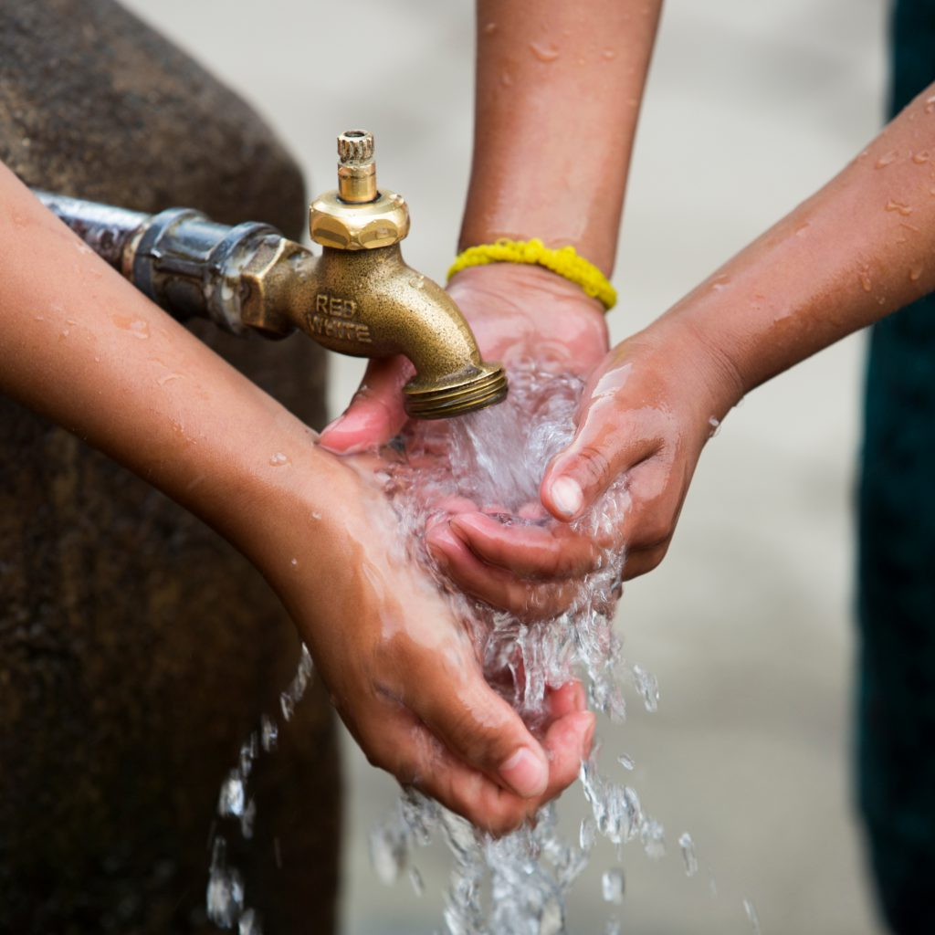
ACTION OPPORTUNITIES
Clean Water: partner with a District in a 3rd World Country and build showers and restrooms at schools so little girls have the opportunity to continue their education
Support Girls in Crisis: create or sponsor education programs for business and schools around the signs of grooming and trafficking. Partner with organizations provided safe houses and rescuing girls out of human trafficking
Mentor: create a mentorship program with local Junior High and High Schools to mentor young girls on education and career opportunities
Invest in Girls: create scholarships that are specific geared to support girls desiring to enter traditionally male dominated trades like auto mechanics and truck driving
Use your voice: tell every young woman in your life that you care for them, support them and believe that can do anything that they aspire to do. Be an active supporter

Slide 7
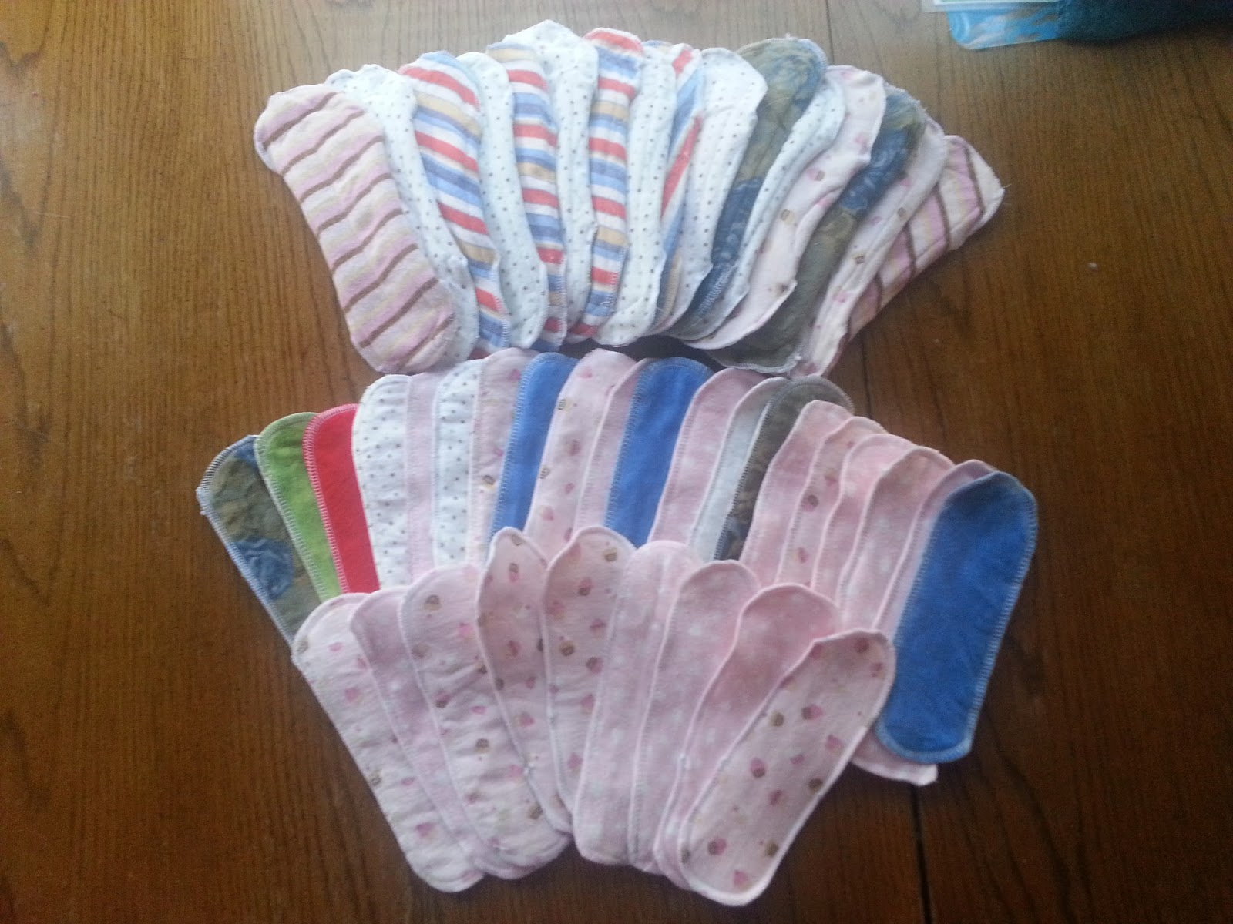
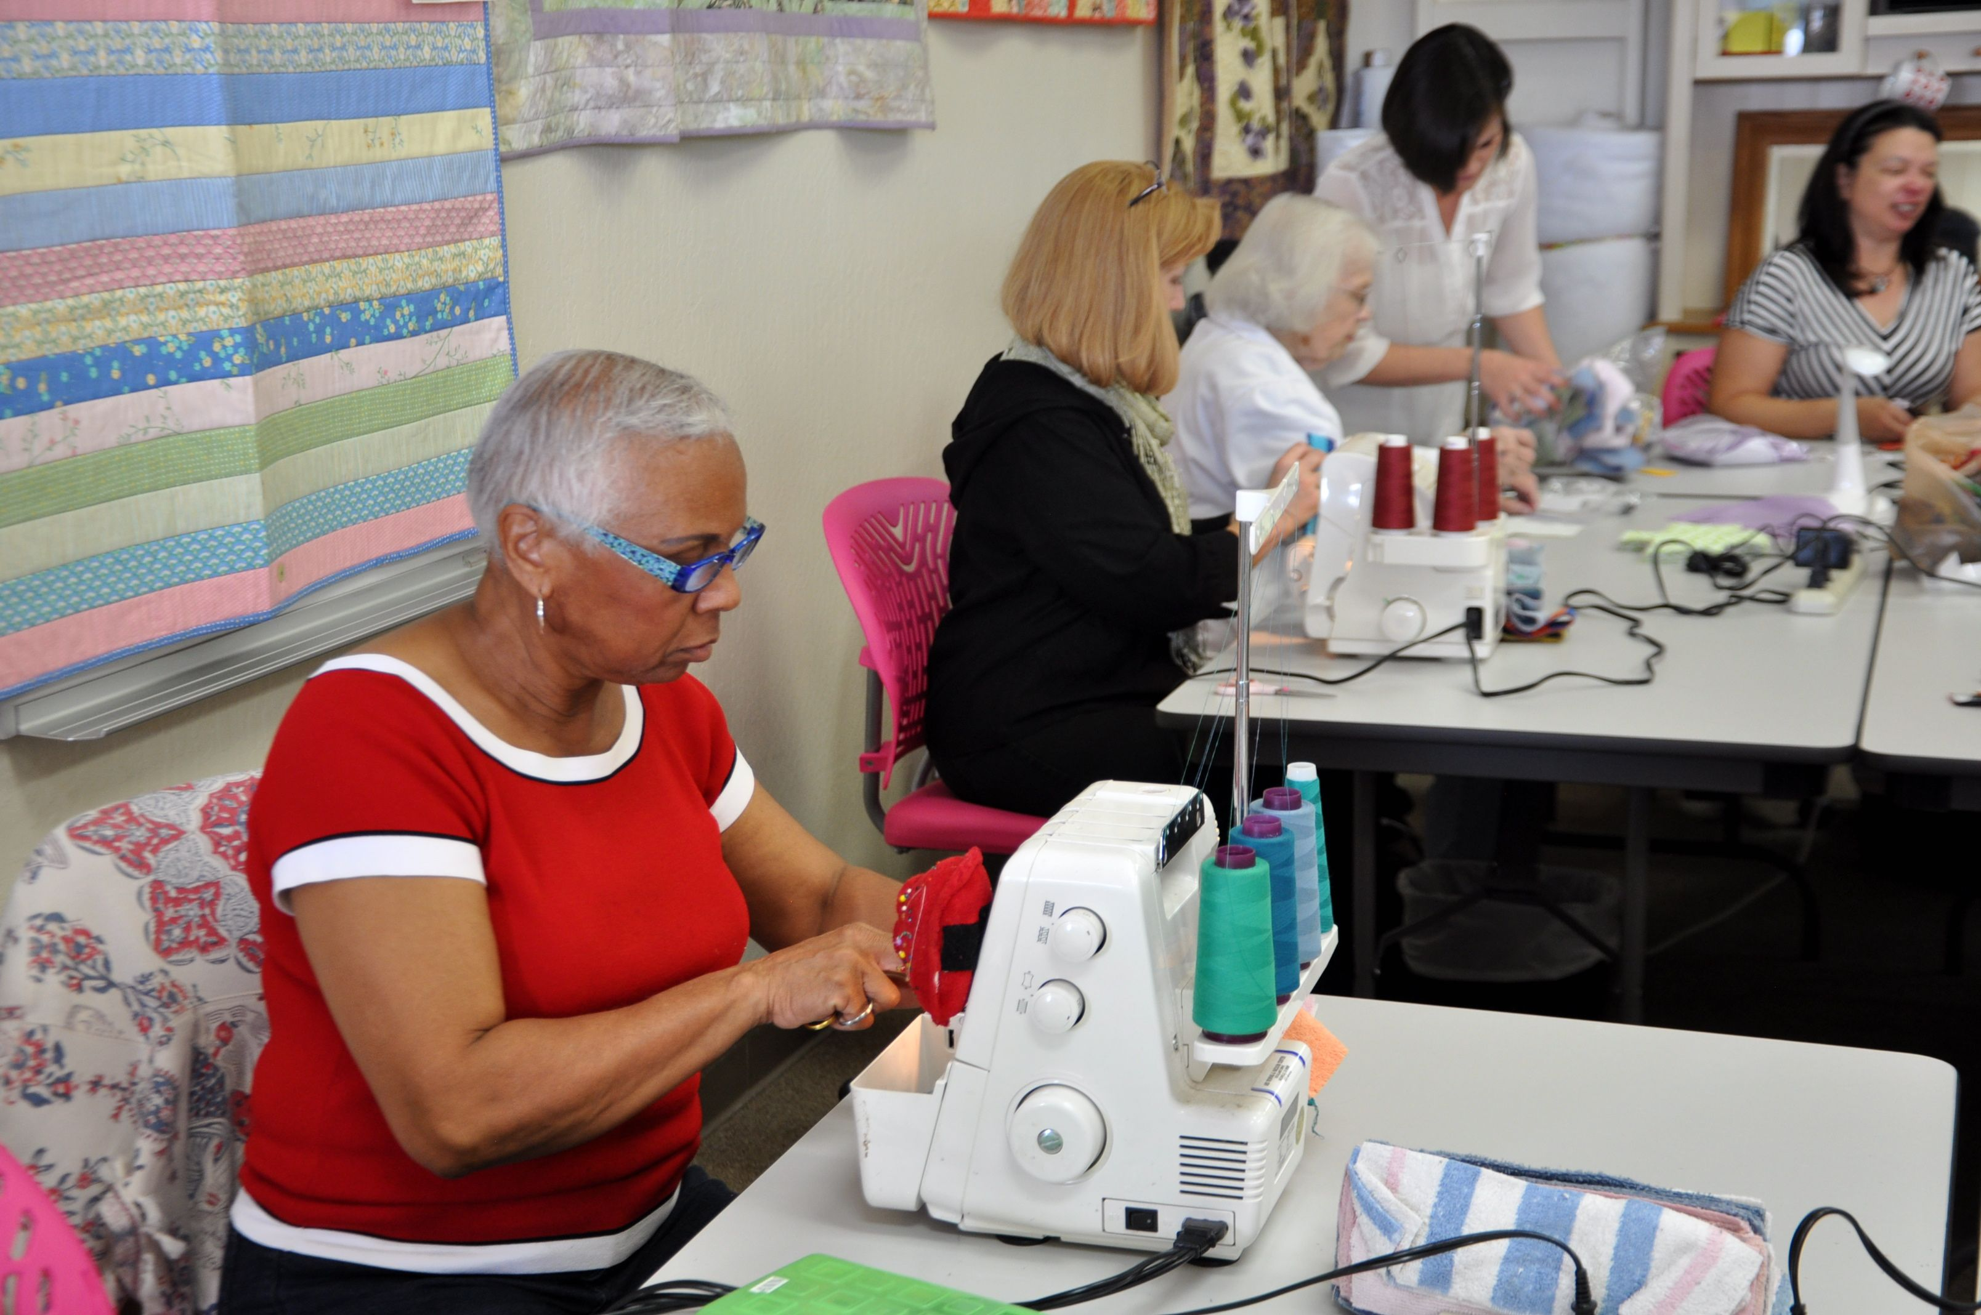
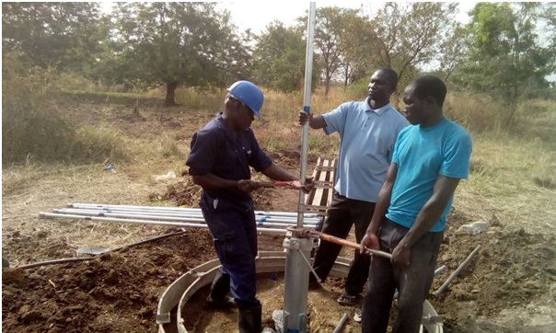
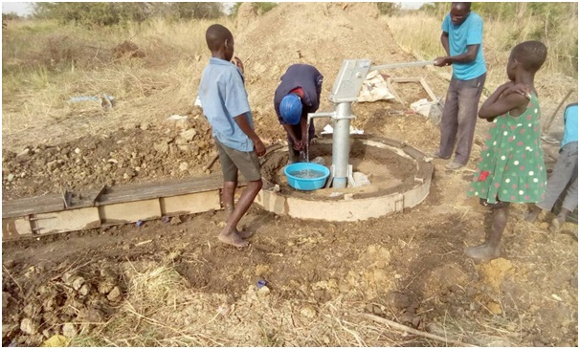
PARTNERSHIP OPPORTUNITIES
Rotary Districts in Mexico, all African Countries, and India
Days for Girls
The Pad Project
Engineers without Borders (will help build water well needed to then build restrooms and showers)

Slide 8
SHARE YOUR STORIES AND STAY IN TOUCH
Connect Me to your District Empowering Girls Chair
Include a presentation on Empowering Girls at a District Educational Opportunity
Share your projects and successes on Rotary Showcase
PDG E. Michelle Bohreer
District 5890
8821 Echo Valley Drive
Houston, TX 77055
832-622-4400
dgmichelle5890@gmail.com

