Slide 1
DGE/DGN Session
Kyle Haugen
Rotary Public Image Coordinator, Zones 25B & 29
August 5, 2022

Slide 2
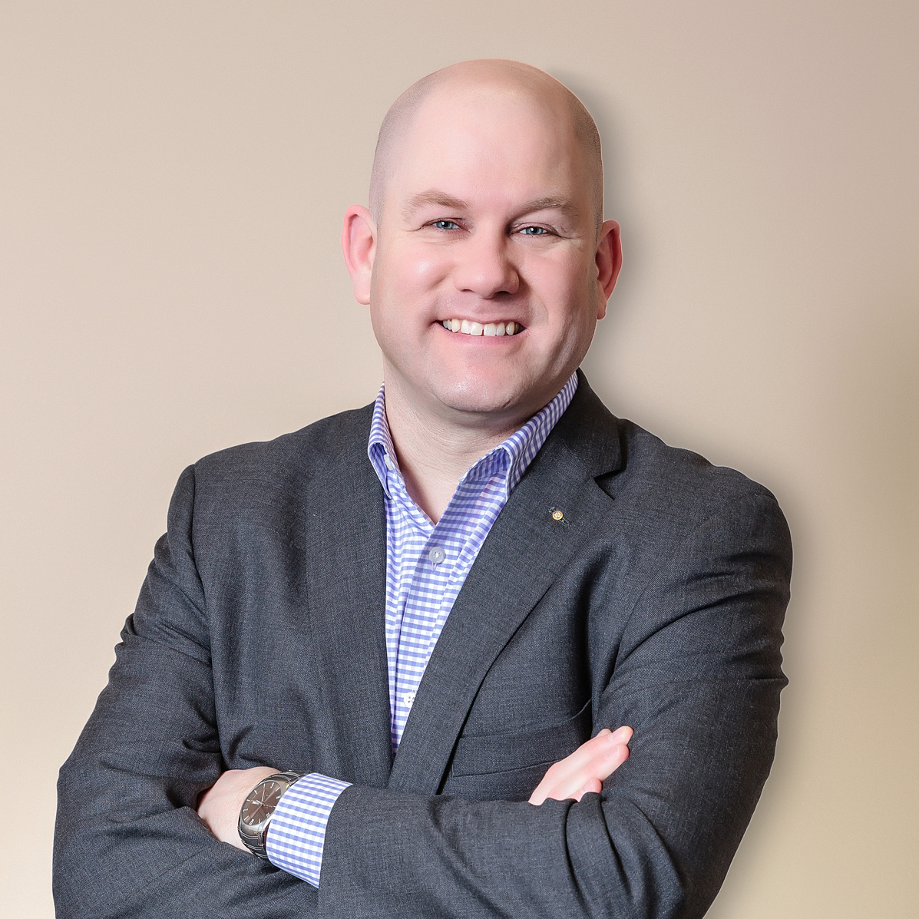
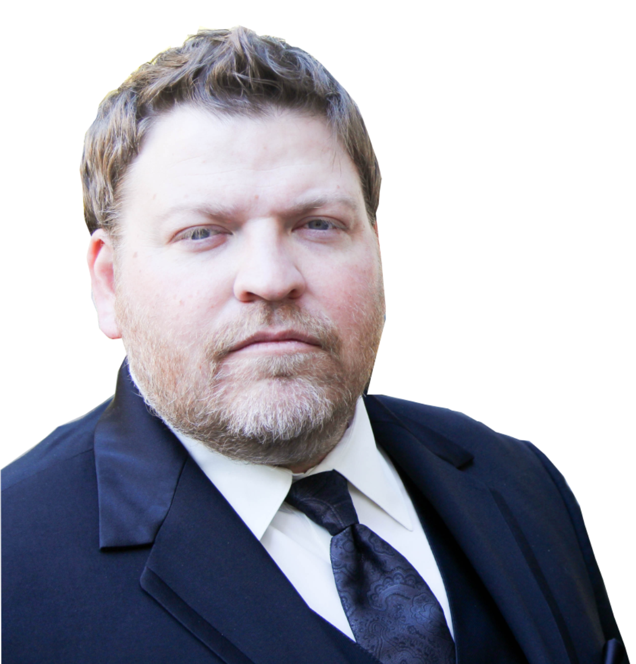
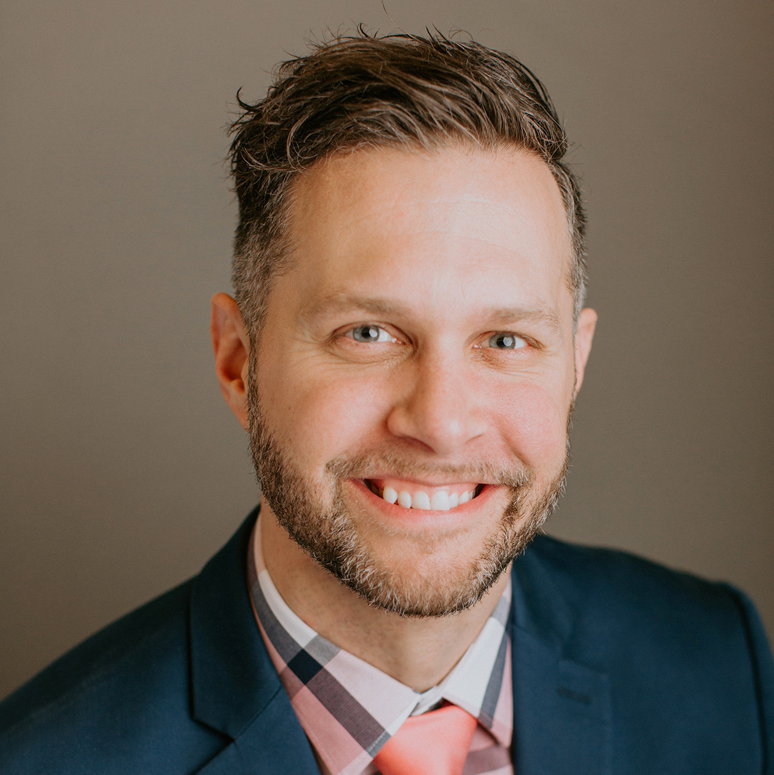
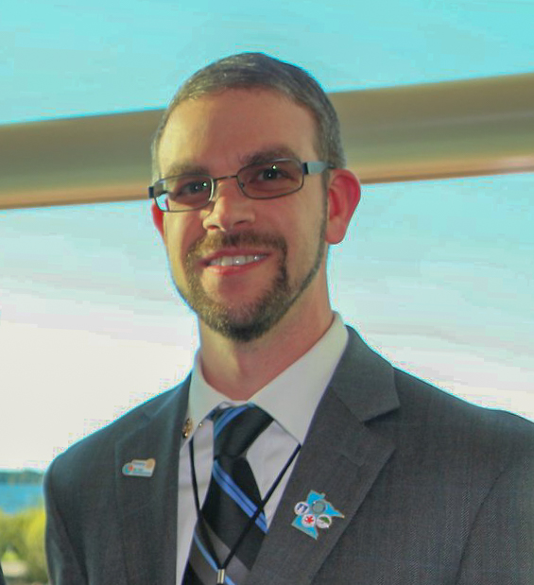
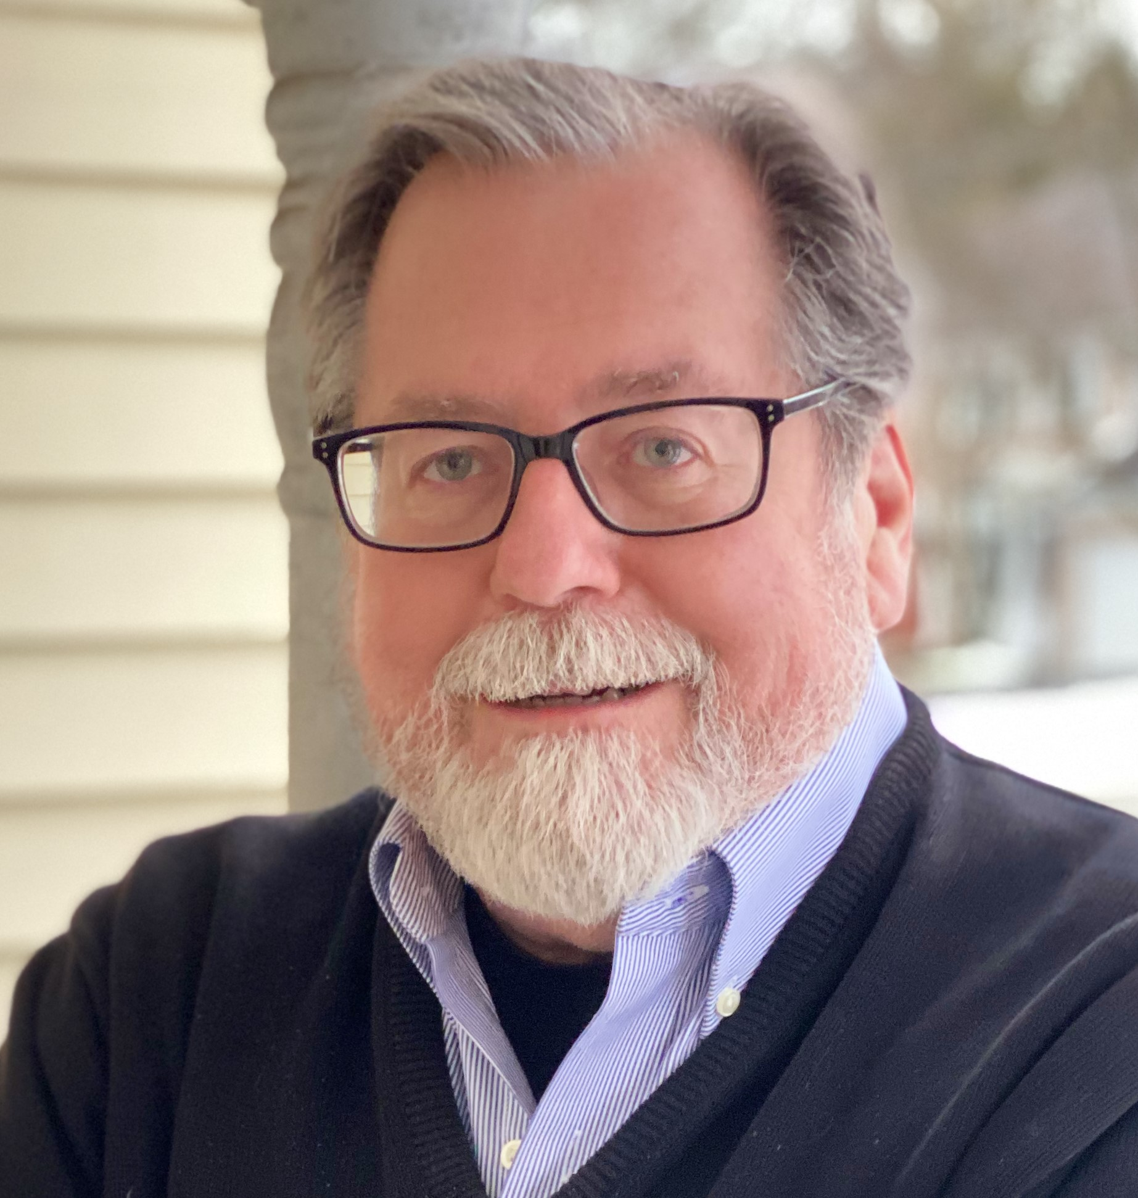
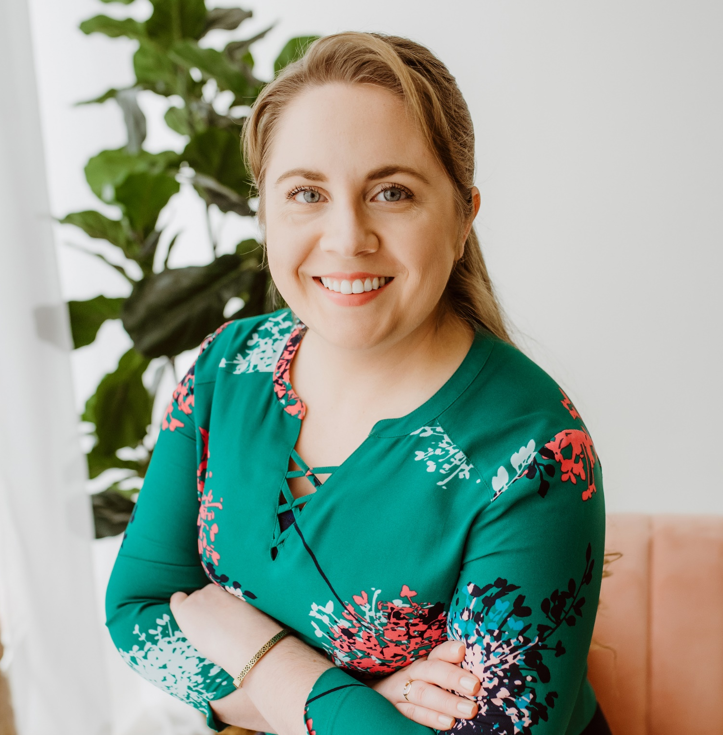
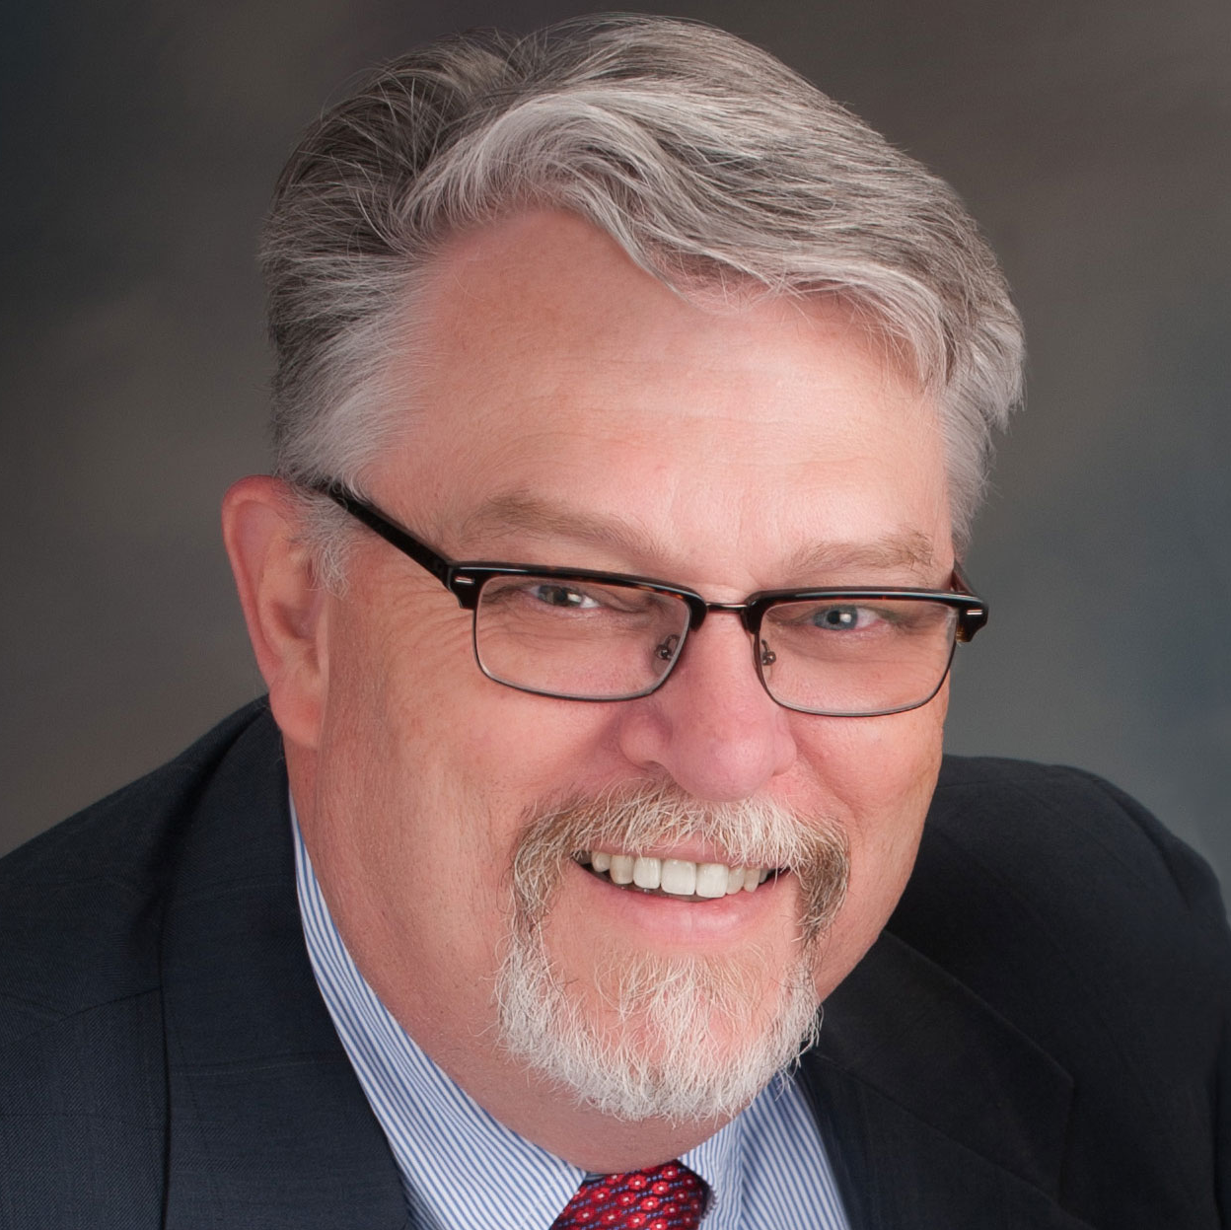
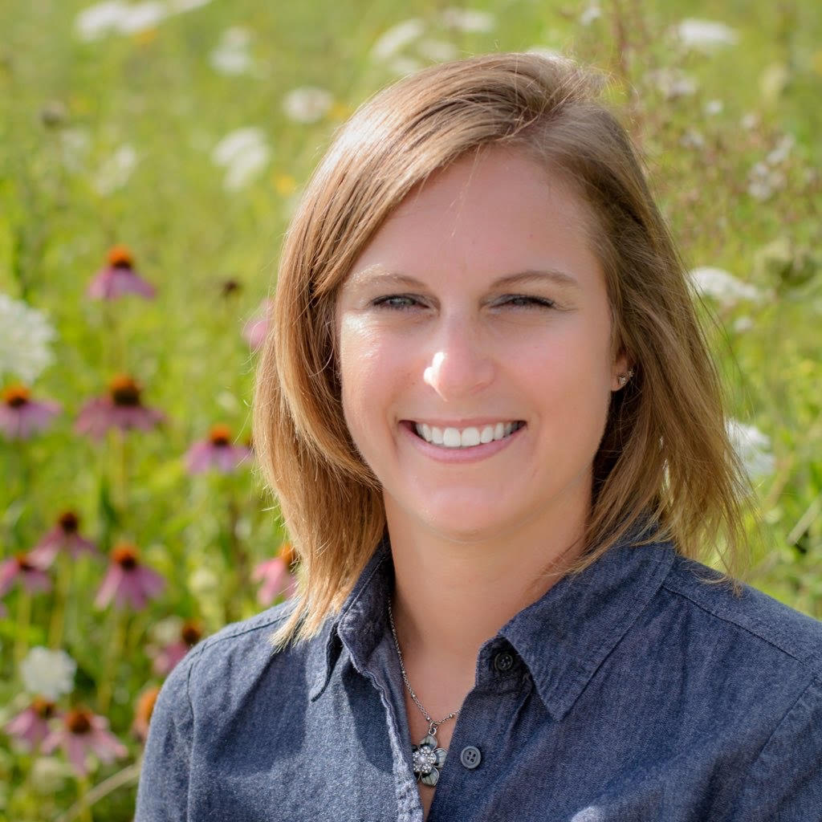
2023-24 REGIONAL ROTARY PUBLIC IMAGE TEAM
Kyle Haugen
PI Coordinator
Patrick Harrison
PI Advisor
Ben Bauer
6220, 6250, 6270
Shawn Berry
5580, 5950, 5960
Hunter Byington
6420, 6440, 6450
Rebekah Maxwell
5840, 5890, 5910, 5930
Scott McLaughlin
5610, 5630, 5680, 5710
Gretchen Nollman
5650, 5970, 6000
Rod Zuniga
5790, 5810, 5870
Notes:
HIDE or DELETE THIS SLIDE AFTER YOU SELECT THE ARCs PHOTO NEEDED FOR THE MULTI-DISTRICT SESSION

Slide 3
TEN TIPS TO SUPPORT/ENHANCE OUR PUBLIC IMAGE
WHAT CAN YOU DO AS DISTRICT GOVERNOR?
Build a TEAM
Provide FUNDING
Provide SUPPORT
Increase VISIBILITY
EMPOWER PI Leader
PUBLIC IMAGE…not just PR
CONSISTENT messaging
SEE something, SAY something
Promote ONE ROTARY
Identify good STORIES
HAVE FUN!!

Slide 4
CONTACT INFORMATION
Kyle Haugen
Rotary Public Image Coordinator
jkylehaugen@gmail.com
612-382-3168

