Slide 1
District Public Image Leader Session
Facilitator:
Kyle Haugen
Rotary Public Image Coordinator, Zones 25B & 29
August 6, 2022

Slide 2
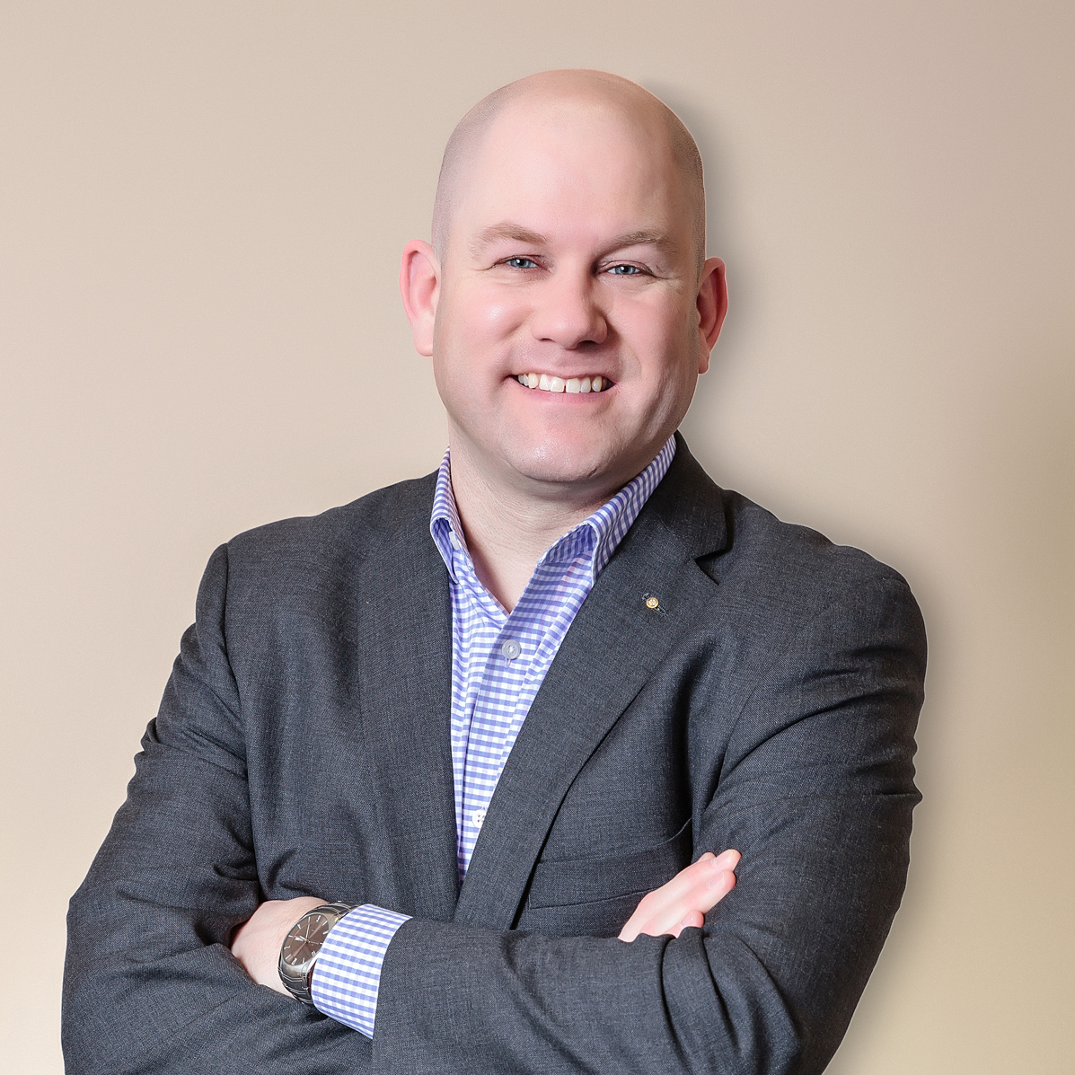
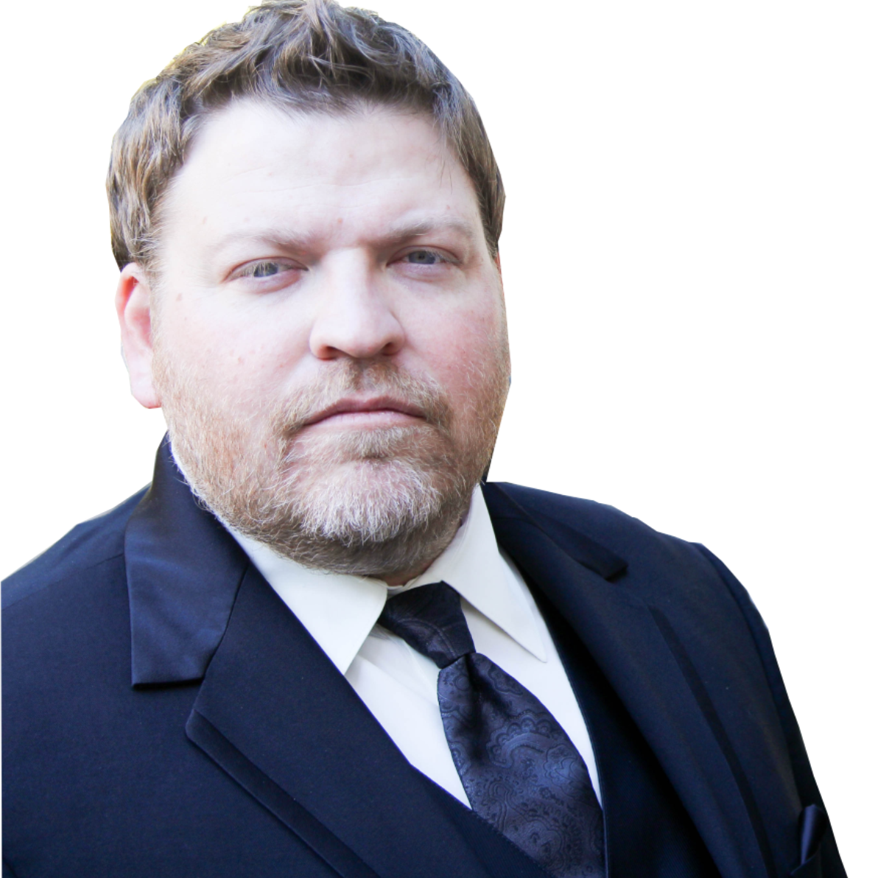
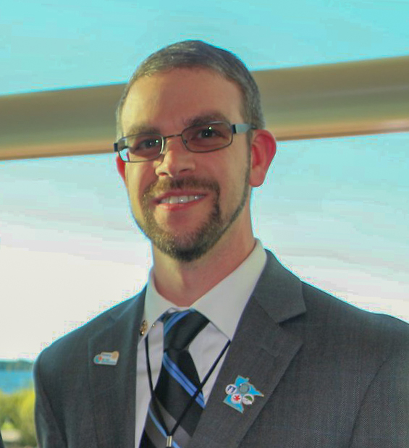
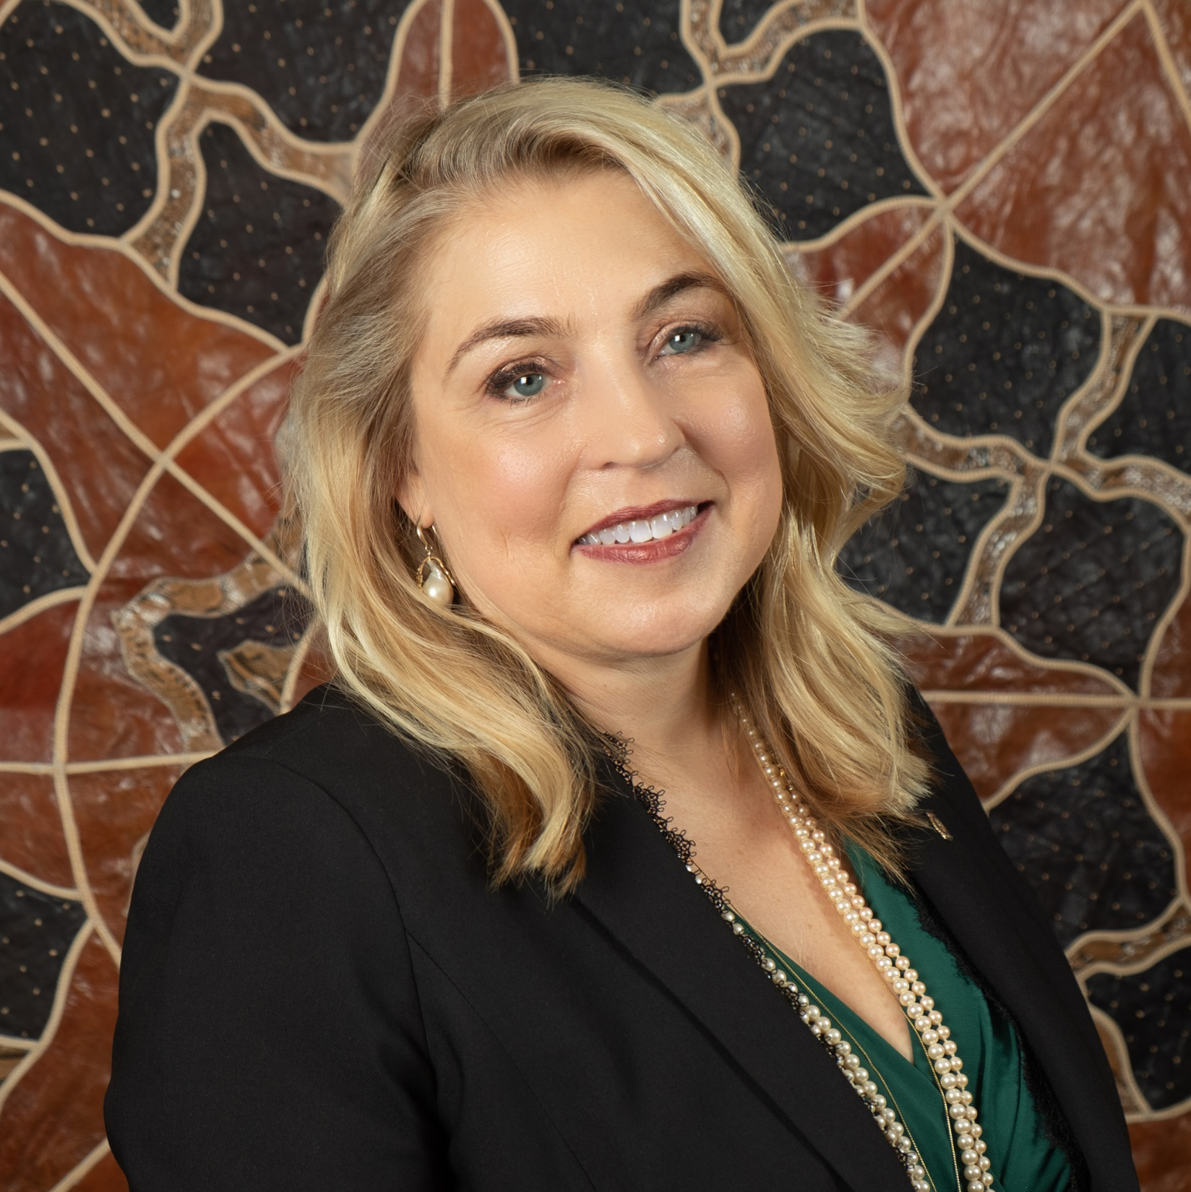
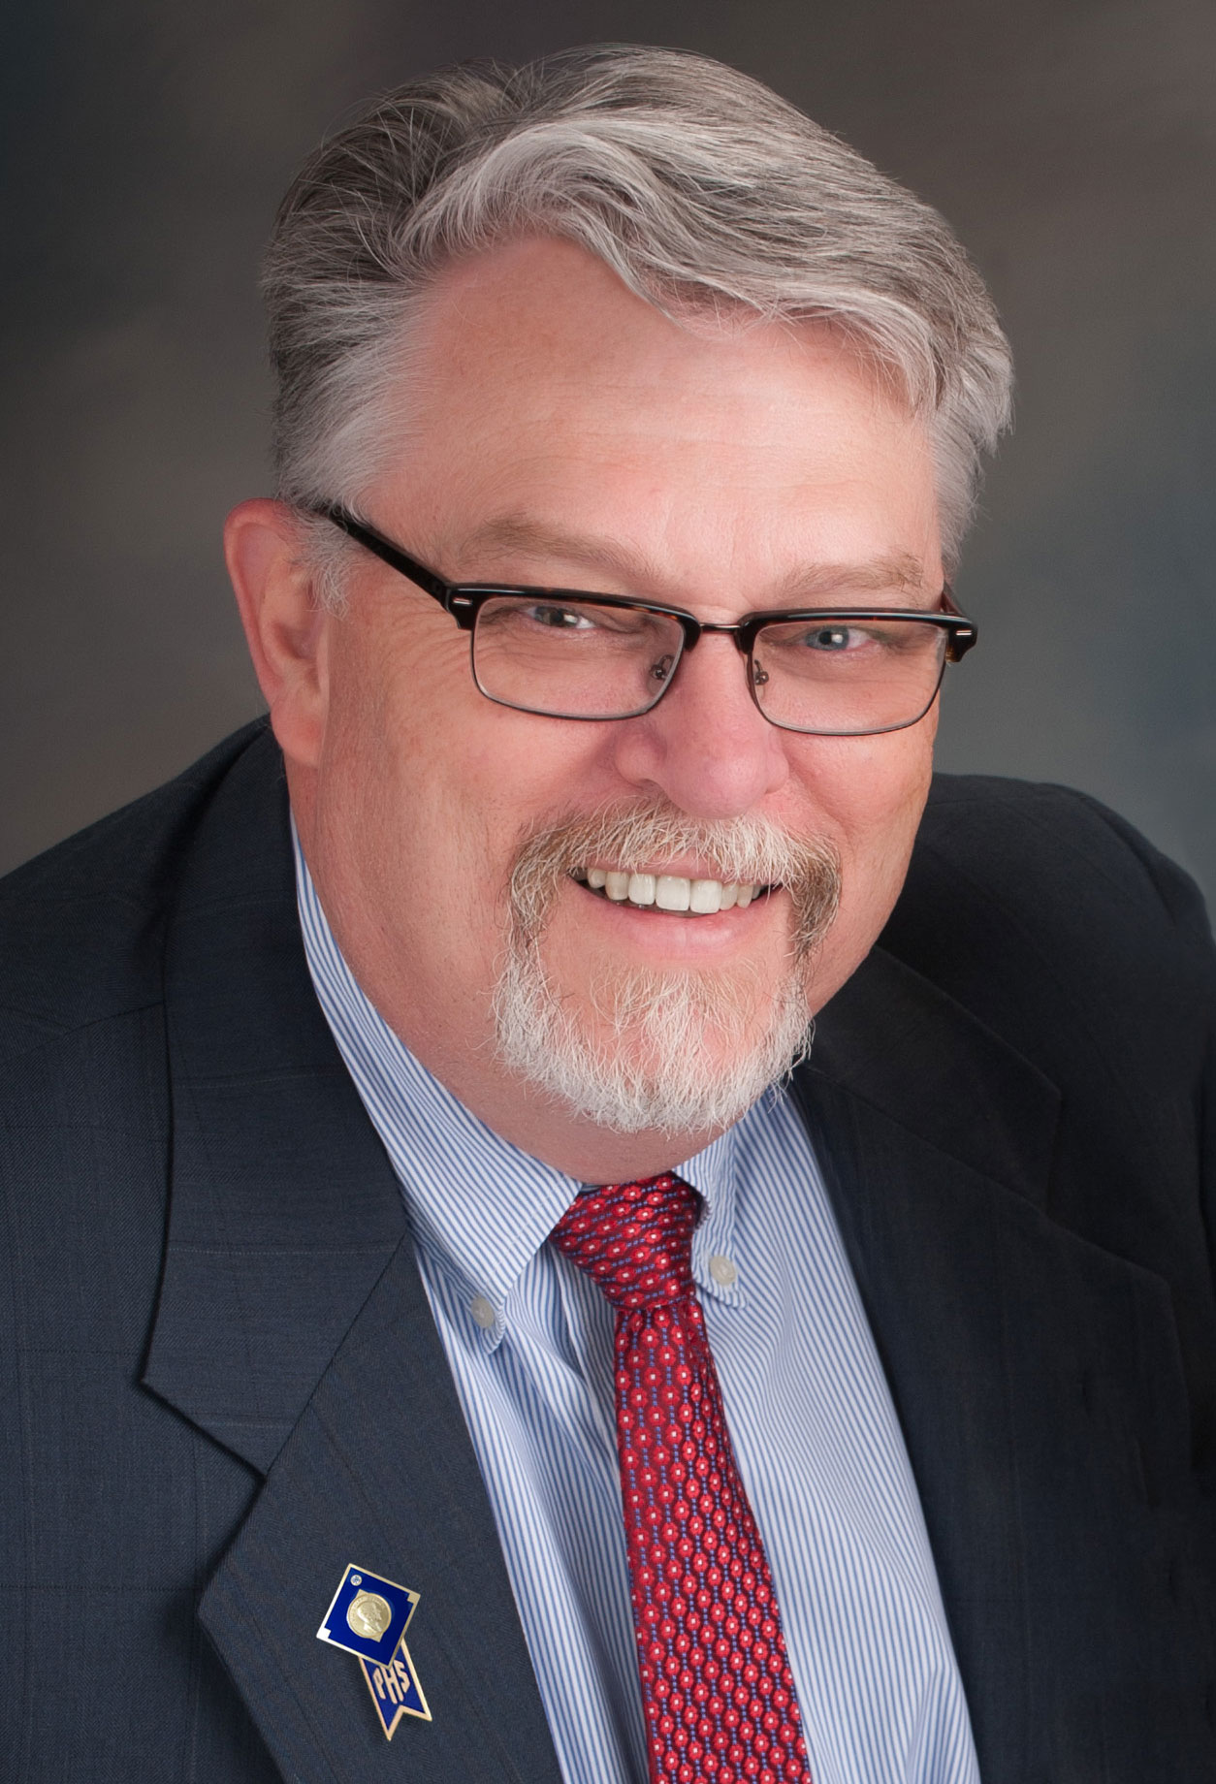
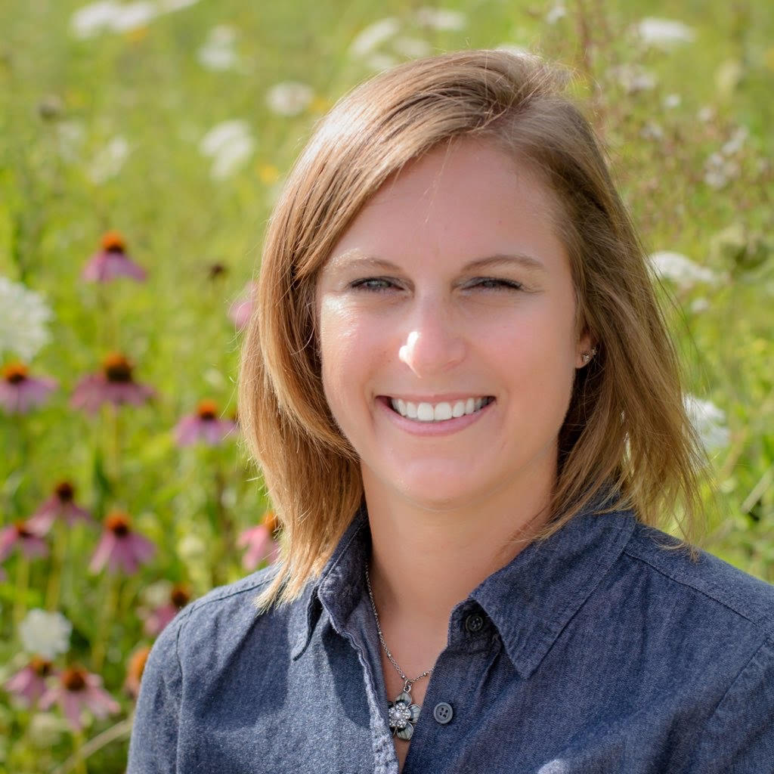
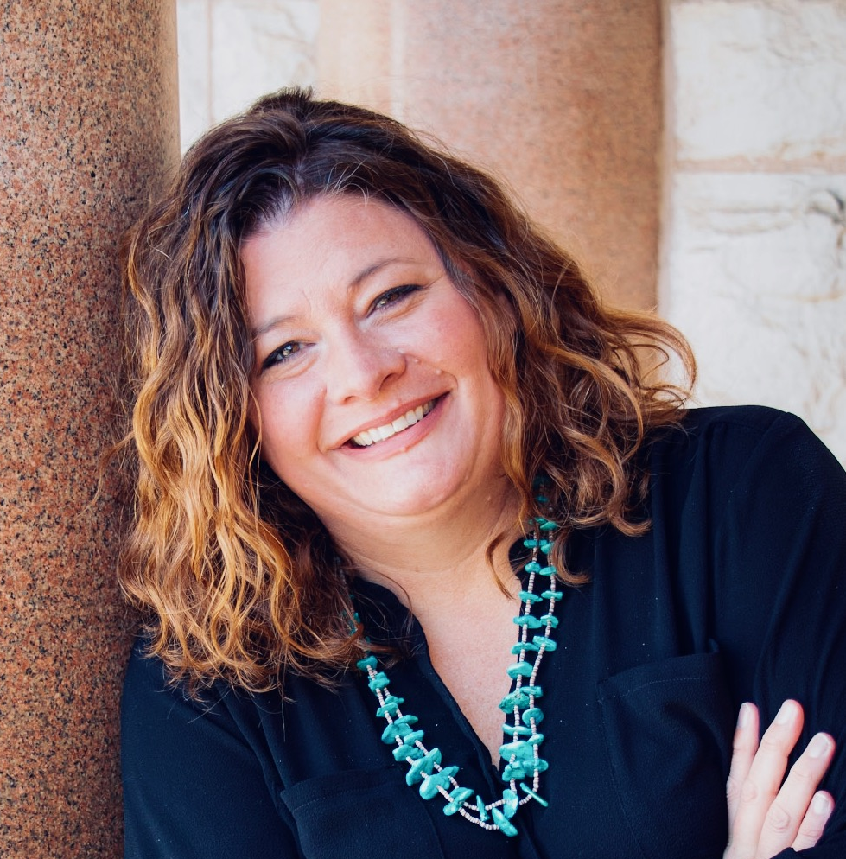
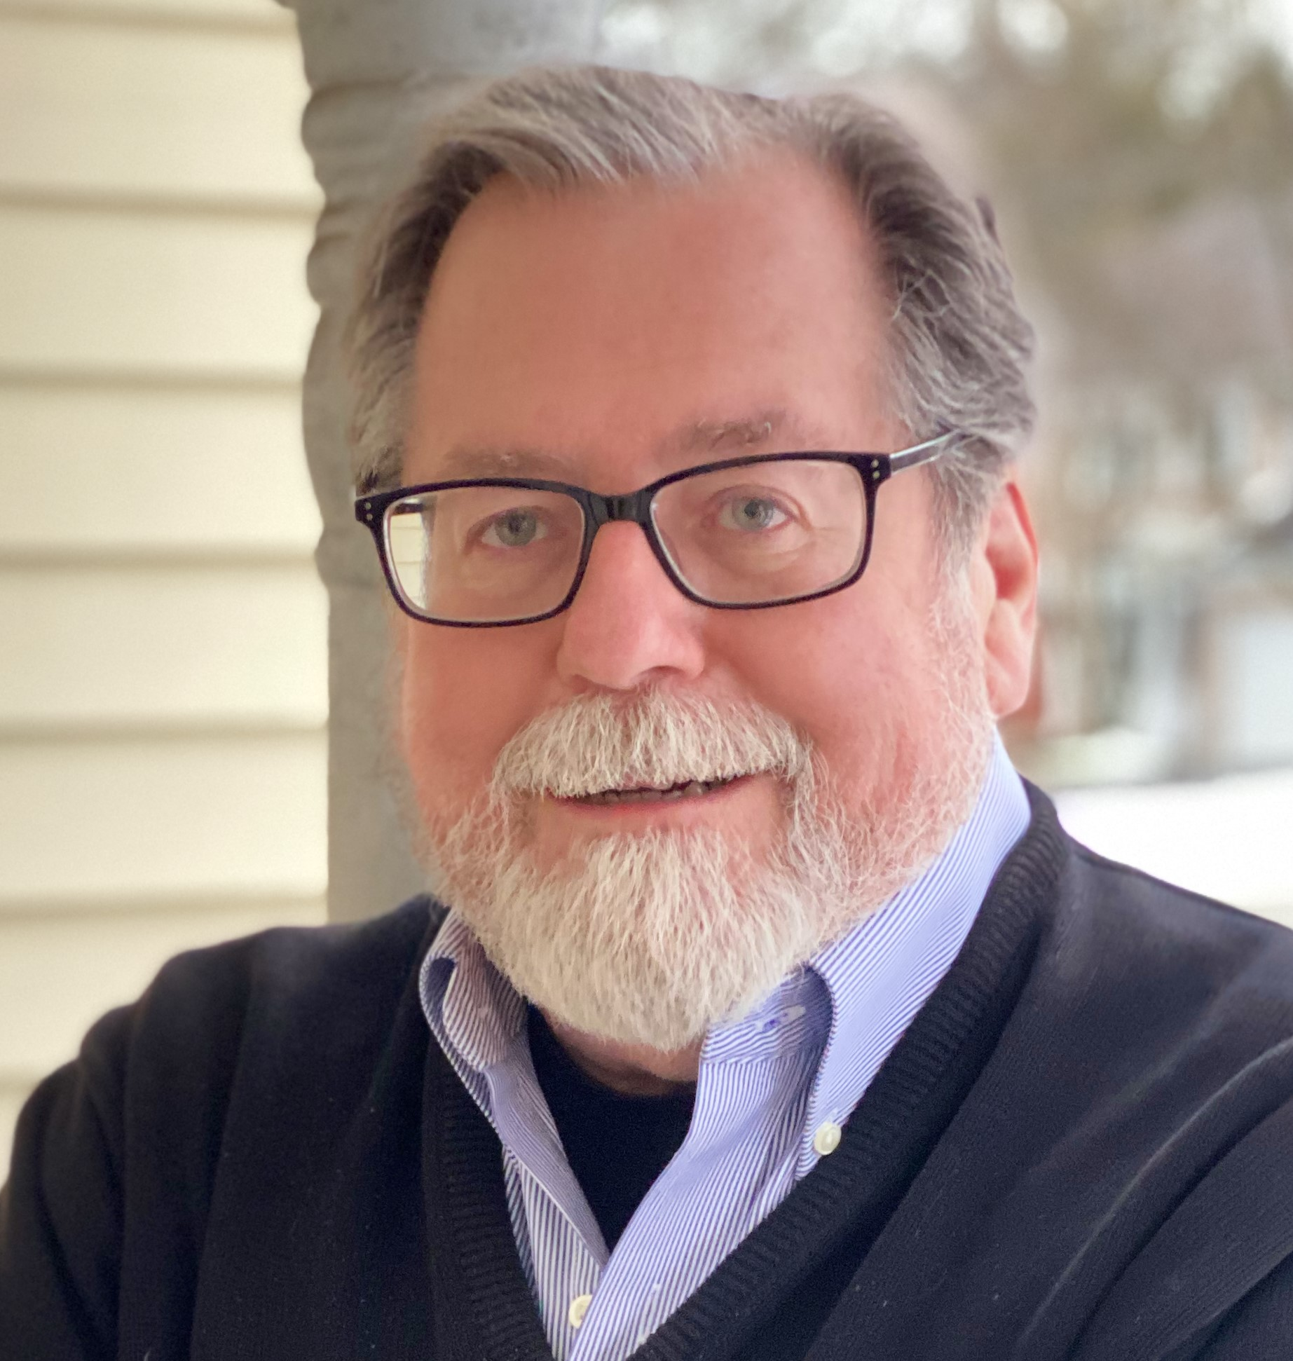
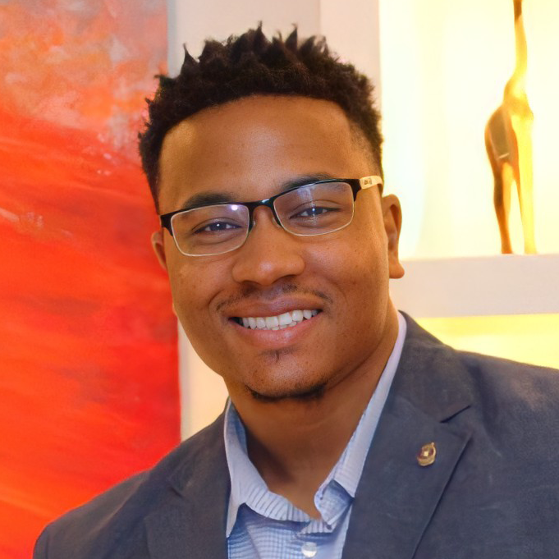
2022-23 REGIONAL ROTARY PUBLIC IMAGE TEAM
Kyle Haugen
PI Coordinator
Patrick Harrison
PI Advisor
Shawn Berry
5580, 5950, 5960
Julie Craig
6220, 6250, 6270
Scott McLaughlin
5610, 5630, 5680, 5710
Gretchen Nollman
5650, 5970, 6000
Amber Scarborough
5790, 5810, 5870
Hunter Byington
6420, 6440, 6450
Xavier Toson
5840, 5890, 5910, 5930
Notes:
HIDE or DELETE THIS SLIDE AFTER YOU SELECT THE ARCs PHOTO NEEDED FOR THE MULTI-DISTRICT SESSION

Slide 3
INTRODUCTIONS
Name
Club
District
Years in Rotary
Favorite Area of Focus

Slide 4
ROTARY PUBLIC IMAGE GOALS
Elevate Rotary’s global profile as people of influence, people of purpose and people of action through six of your communications
Tell the stories of effective club, district, and international programs and projects, particularly in Rotary’s areas of focus, to four target audiences
Highlight Rotary’s role in eradicating polio in six of your communications
Ensure 100% of your district public image chairs complete their learning plan in the Learning Center and offer two region-specific brand training sessions

Slide 5
GROUP DISCUSSION
How can you help us towards these goals?
What do you do well in your district?
Any ideas you could implement?

Slide 6
ROTARY PUBLIC IMAGE TACTICS
Broad encouragement of telling our Rotary stories!
Continue to build “Resource Library”
Monthly webinars with Membership, TRF, Polio Plus
Increase dialogue with district leaders
Regional Challenge program

Slide 7
REGIONAL ROTARY CHALLENGE
MEMBERSHIP
PUBLIC IMAGE
END POLIO NOW
ROTARY FOUNDATION

Slide 8
REGIONAL ROTARY CHALLENGE
MEMBERSHIP
END POLIO NOW
PUBLIC IMAGE
ROTARY FOUNDATION
Complete 3 activities per section: Regional (Area) Citation
Achieve Citation in all 4 areas: All Star District
Most activities completed: (Area) District of the Year
Best cumulative performance: Zone District of the Year

Slide 9
REGIONAL ROTARY CHALLENGE
Road Map
Good Habits
Teamwork
Sharing Ideas
Recognition
Historical Record
Friendly Competition
FUN!

Slide 10
CATEGORY 1: PUBLIC IMAGE TEAM MAKE-UP
CATEGORY 2: TRAINING/COMMUNICATION
CATEGORY 3: BRAND CONSISTENCY
CATEGORY 4: SOCIAL MEDIA
CATEGORY 5: COMMUNICATION WITH CLUBS/MEMBERS/PUBLIC
CATEGORY 6: PARTNERSHIPS
CATEGORY 7: OTHER

Slide 11
CATEGORY 1: PUBLIC IMAGE TEAM MAKE-UP
More hands make lighter work and allows for more to be accomplished. Creating a strong team will lead to success!
Have a team of at least 5 members, identified by September 1 that meets quarterly or more
Establish PI Team goals by September 1 that are clear and measurable
Promote the PI Team, resources and activities on district website
Identify roles/responsibilities of team members
Develop a succession plan for PI Team members to ensure continuity
Other significant & innovative PI Team related initiatives

Slide 12
CATEGORY 2: TRAINING/COMMUNICATION
The more you communicate with clubs and the more you assist in their learning and development, the more success you’ll have!
At least 75% of clubs have PI Team leader identified in MyRotary
Conduct at least two PI training seminars/workshops with different purposes
At least 50% of clubs have a member complete a PI related course on Rotary’s Learning Center
District PI Team leader, or other significant member, attends PI training session at RMDTI or Zone Institute
Create a “New Year” checklist with activities/objectives clubs can accomplish
Other significant & innovative training related initiatives

Slide 13
CATEGORY 3: BRAND CONSISTENCY
Making Rotary memorable starts with brand consistency. Efforts to educate & encourage clubs about proper use sets you on the right path.
Have brand compliant district website and social media sites
Conduct training for clubs highlighting importance of proper branding
Conduct audit of club websites & social media sites
60% or more of clubs have websites & social media that adhere to brand standards
90% or more of clubs have websites & social media that adhere to brand standards
Other significant & innovative brand consistency related initiatives

Slide 14
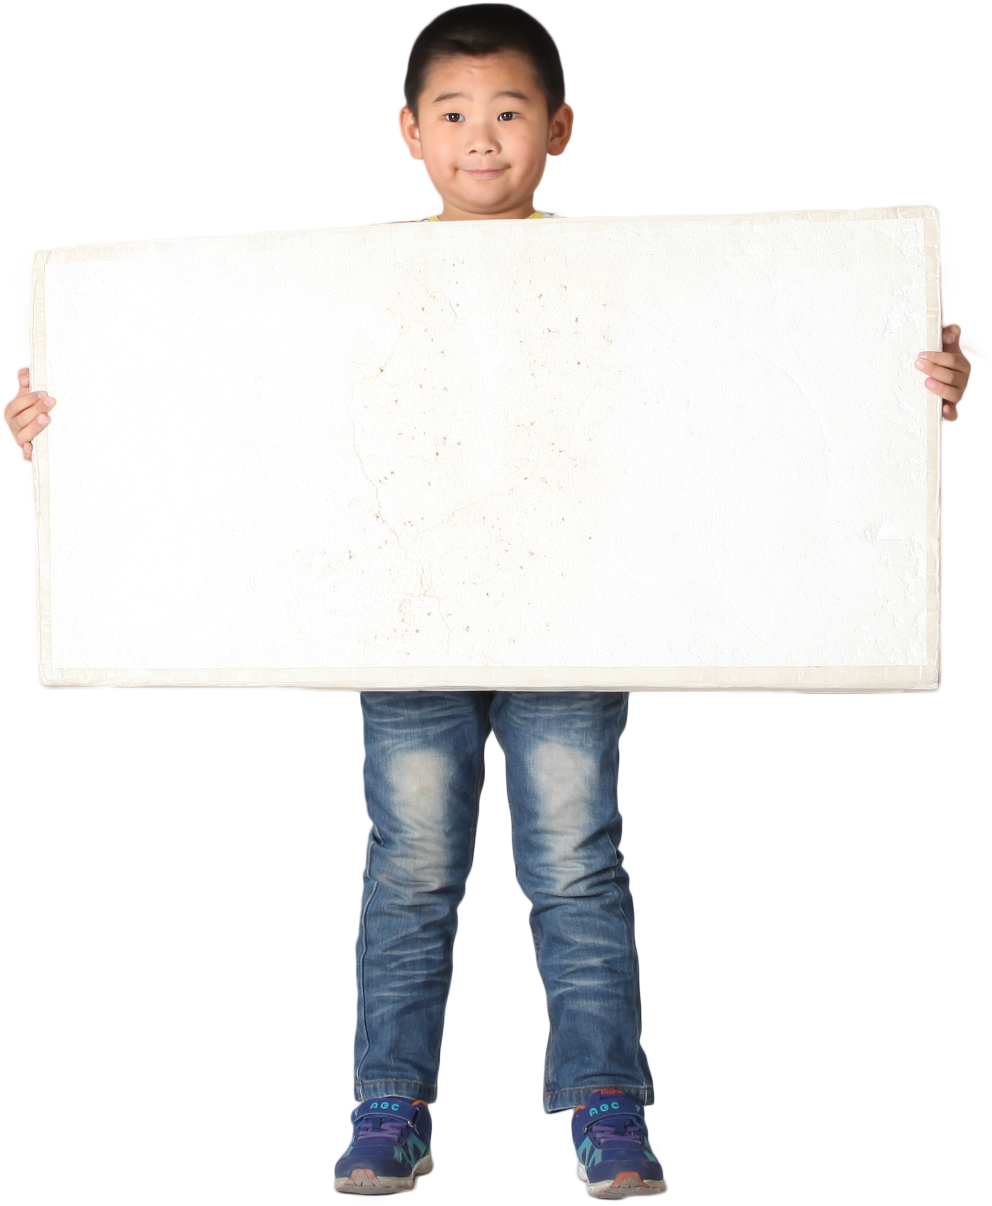
SPECIAL GUEST!
Rotary International Director
Pat Merryweather

Slide 15
See you after lunch!

Slide 16
Welcome back!

Slide 17
CATEGORY 4: DISTRICT SOCIAL MEDIA USAGE
A great and inexpensive way to communicate with your members and the public. Are you taking advantage?
Have at least two district social media accounts
Promote at least two district or club programs / projects each month
Utilize People of Action materials at least 10 times in social media posting
Develop, promote, and utilize at least one district hashtag on social media
Create and post at least two videos promoting a district project/initiative
Other significant & innovative social media related initiatives

Slide 18
CATEGORY 5: DISTRICT COMMUNICATION WITH CLUBS/MEMBERS/PUBLIC
Having a clear path of consistent communication will pay dividends, but it doesn’t happen accidentally.
Identify & promote at least 50 club events on district website and/or social media
Promote Rotary Showcase so at least 20 clubs enter a project on Showcase
Promote at least three club or district events in local traditional media
Create a press release template and have at least 50% of clubs submit a press release to local media
Submit at least five press releases for club or district activities to media in district
Other significant and innovative communication related initiatives

Slide 19
CATEGORY 6: PARTNERSHIPS
Acting individually reduces impact and creates redundancy… partnering increases our effectiveness and efficiency!
Partner with another district in at least one Public Image initiative
Partner with another organization to leverage promotion of the Rotary District & Clubs
Work with district Membership team to feature at least 10 activities that engage members throughout district
Work with district TRF, Polio Plus, and Membership teams to share at least five powerful stories of Rotary service
Participate in implementation of at least one “One Summit” training with TRF, EPN and membership teams to show importance of working together
Other significant & innovative partnership related initiatives

Slide 20
CATEGORY 7: OTHER
There are more activities you can do to promote Rotary’s image!
At least 95% of clubs set Rotary PI goals in Rotary Club Central by September 1
District PI Team members deliver presentations to at least 40% of clubs regarding telling our story and providing actionable steps to increase profile
Work with district leaders to identify clubs that conduct Rotary Days of Service and help them comply with brand guidelines
Promote World Polio Day so at least 10 clubs submit events to End Polio Now
In support of Rotary’s commitment to DEI, work with district leaders to organize/conduct at least three inclusive virtual or in-person events
Other significant & innovative initiatives that didn’t fit otherwise

Slide 21
BREAK TIME
Please be back soon!

Slide 22
DISCUSSION QUESTIONS
What excites you about this program?
How do you think you can utilize this in your district?
What questions do you have?

Slide 23
PI RESOURCES
Brand Center & MyRotary
POAPhotos.com
Zones 25B & 29 Website
Other Districts
Rotary Public Image Team

Slide 24
DISCUSSION QUESTIONS
What can the Regional Public Image Team do for you?

Slide 25
SPECIAL GUEST!
Regional Rotary Foundation Coordinator
Rich Kaye

Slide 26
WRAP-UP
Kyle Haugen
Jkylehaugen@gmail.com
Patrick Harrison
pharrisonrotary@gmail.com

