Slide 1
Club Runner and you

Slide 2
We will explore -How to access and use the app -How to access member side of Kiwanis website -How to use and create “events”

Slide 3
Using the App
Log in credential’s were emailed after the website transition and yesterday.
Your login username is... FirstName.LastName.101899 (remember to put in the periods) and password of your choice.
*if it does not work with periods, try without them

Slide 4
Go To app store
Type in Club Runner
Type in your log in info

Slide 5
Home page and features
Home Page
Executives
Members List
Events
Menu

Slide 6
Members Page
Bottom Corner

Slide 7
Events Page
Calendar icon

Slide 8
https://aurorakiwanis.org/
Let’s go to the website!!!!

Slide 10
Member log in

Slide 11
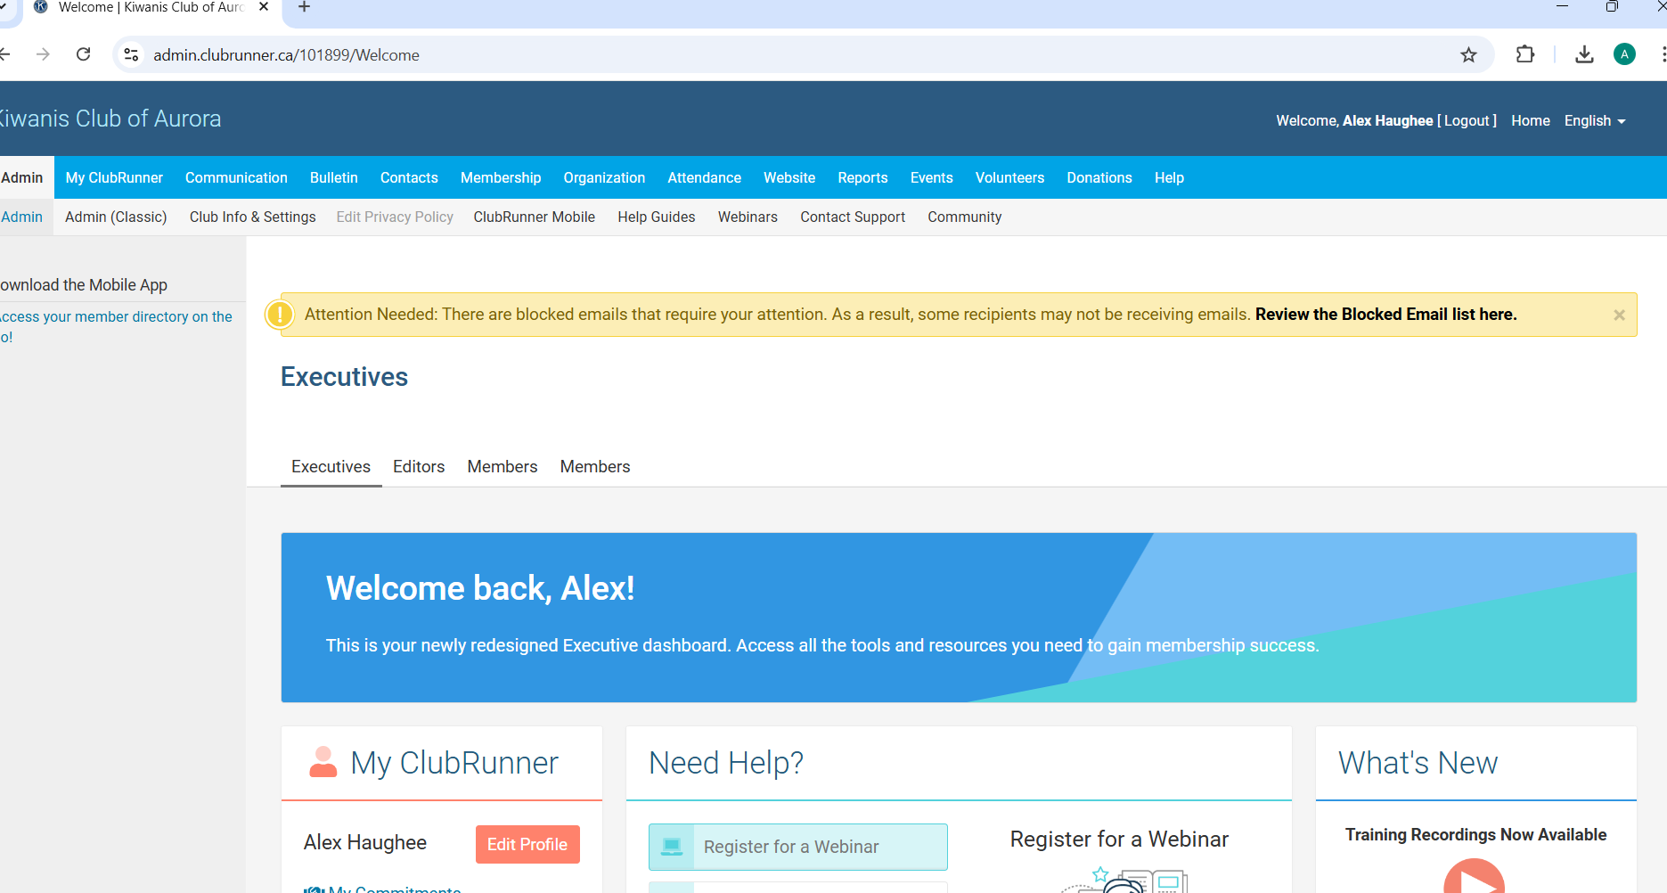
Landing page

Slide 12
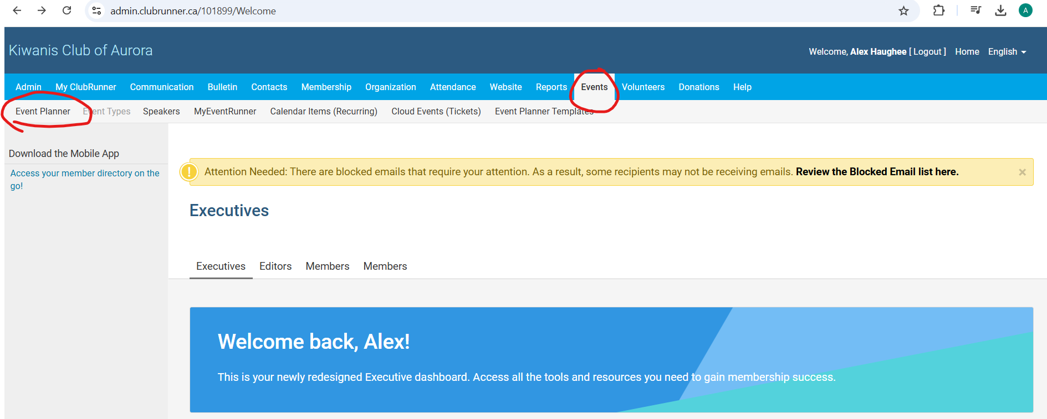
Create an event

Slide 13
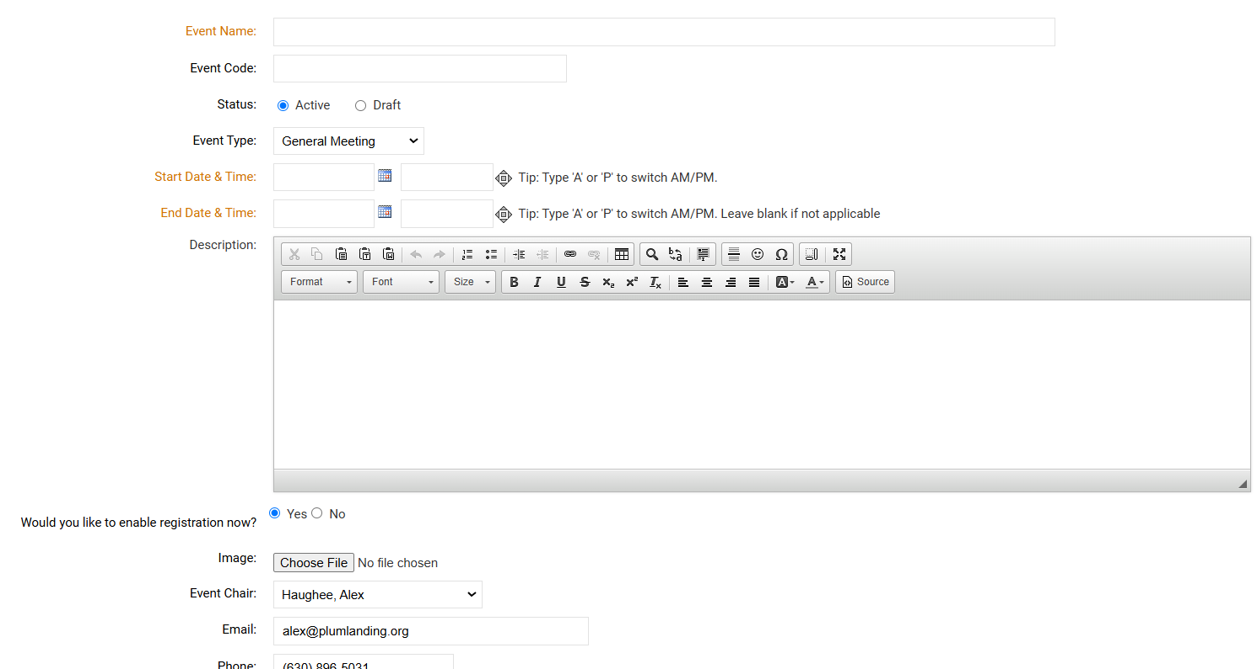
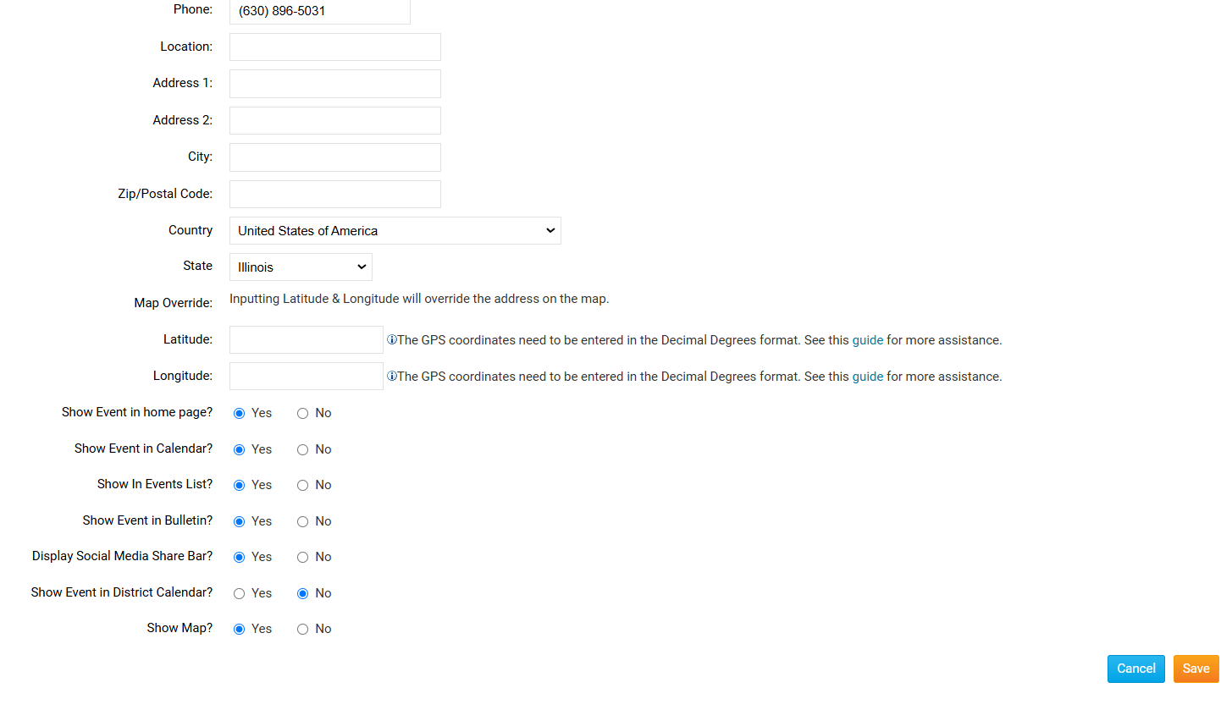
Fill in details
-Complete the name
-Skip event code
-Use drop down to select event type
-Add in a description
-Enable registration (especially for offsite or special events
-Add Address
-Adjust final settings and save!

Slide 14
Walkthrough
https://www.crsadmin.com/gen/EventPlanner/EventEdit.aspx?aid=101899

