Slide 1
Welcome to ClubRunner
An Official Rotary International Licensee
Club Presentation
ClubRunner
1-877-469-2582

Slide 2
What is ClubRunner?
ClubRunner, is an award-winning software for clubs that want to effectively:
Boost Public Relations
Increase visibility
Improve communication between members
Better organize their club
It is an online service comprised of powerful tools designed to:
Give your club a strong online presence
Maintain your club data
Boost communications
Organize events and volunteers
Help your club run more efficiently and easily
ClubRunner
1-877-4MY-CLUB
1-877-469-2582

Slide 3
Key Benefits of ClubRunner
Superior communication features
No need to know any technical language
Effective club image & improved public relations with professional website themes and layout options
Stronger membership growth and retention
Centralized club reporting and administration
Better handling of events and volunteers
Efficient and easy management of committees
Increased data security
Automatic transfer of information between districts and other clubs
ClubRunner
1-877-4MY-CLUB
1-877-469-2582

Slide 4
ClubRunner Features
Take a closer look at the powerful suite of features:
Website Designer
Member Directory
Email Message Center
eBulletin
Contacts Module
Event Planner & Calendar
Volunteers Module
Dues & Billing
Attendance Manager
RI Database Integration
Custom Reports & Directories
Photo Albums
Committee Management
Online Payment & E-Commerce
MyEventRunner
Mobile App
Social Media Integration
Sponsorship Feature
ClubRunner
1-877-4MY-CLUB
1-877-469-2582

Slide 5
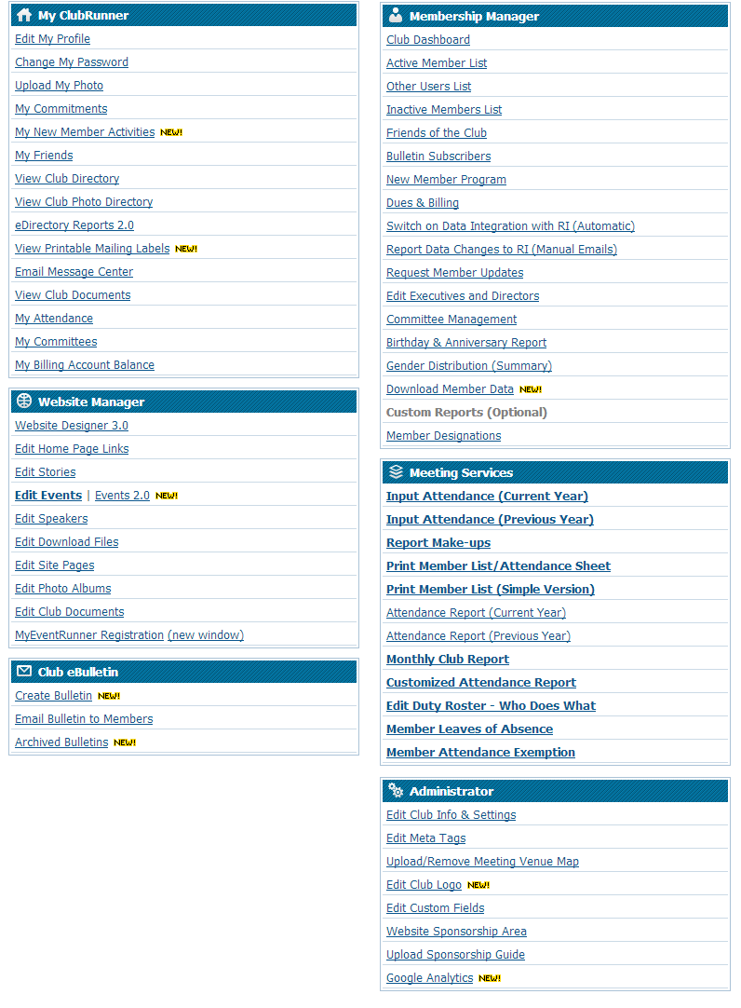
Website Designer
Administration
Maintaining the website is done through a secure login.
ClubRunner has seven levels of access so you can get more members involved while maintaining security levels for each area.
ClubRunner
1-877-4MY-CLUB
1-877-469-2582

Slide 6
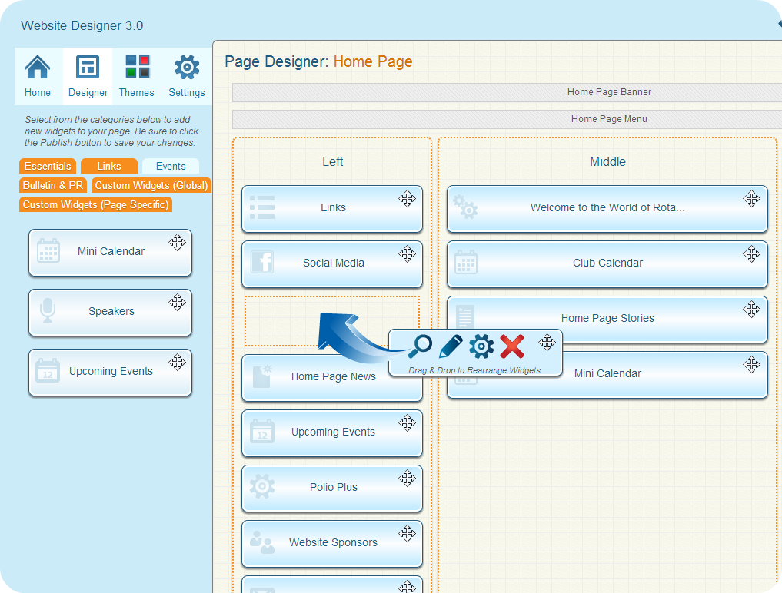
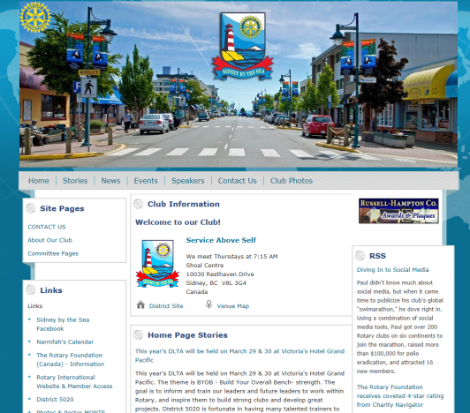
Website Designer
Display live information from your database:
Meeting information for visitors
Events calendar and speakers
Club executives, directors & committees
Useful links to other relevant websites
Download files
Photo Albums with slideshows
Home page stories and news
Home Page
…all without having to know HTML!
ClubRunner
1-877-4MY-CLUB
1-877-469-2582

Slide 7
Website Designer
That visitors typically leave a website within 20 seconds if you are not able to capture their attention?
Boost your public image with a dynamic, engaging site that will retain visitors.
Themes
Design and personalize the look of your website to suit your club’s style. Presentation, layout and style is easily configured by choosing from multiple layouts and themes so you can focus on the content!
Select from a variety of colour and style options. Familiar with CSS? Upload your own stylesheet to fine-tune your website further.
ClubRunner
1-877-4MY-CLUB
1-877-469-2582

Slide 8
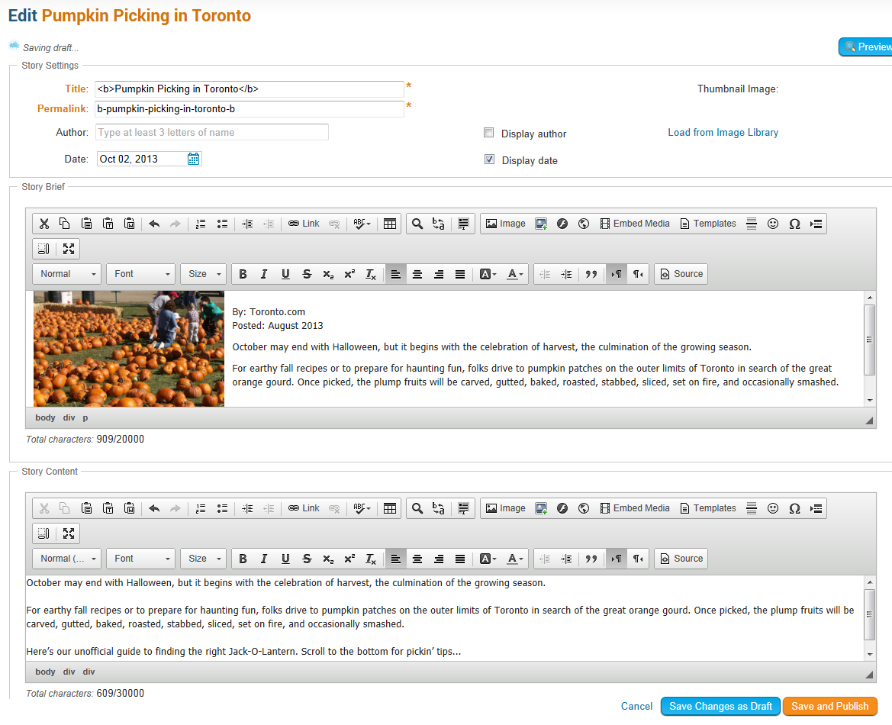
Website Designer
Adding Content
To add a story to the home page, any member who has been granted editor rights can log in, then type content into the built-in editor.
Pictures are automatically resized and compressed for optimized downloading on the web and are saved in your image library for future use.
Options available to allow you publish or save as draft, hide or show an article on the home page, story library, and eBulletin.
ClubRunner
1-877-4MY-CLUB
1-877-469-2582

Slide 9
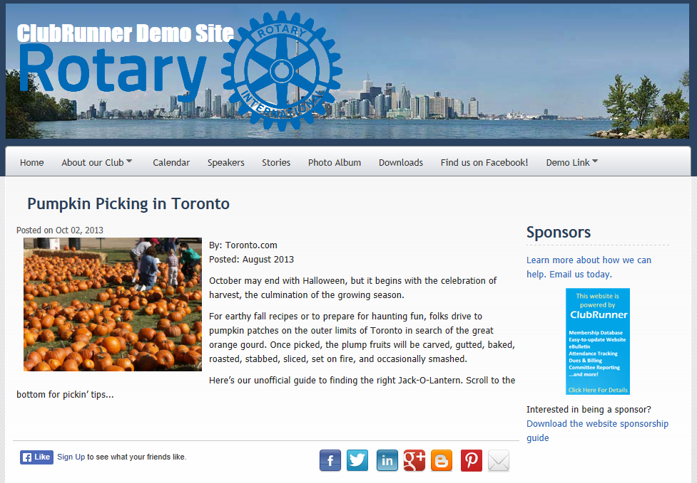
Website Manager
Immediate Results
Contents appear immediately on the home page and eBulletin (if selected).
Links can be embedded within contents to take visitors to other websites or pages within your site.
Add the built-in social media share buttons to share your content on various channels.
ClubRunner
1-877-4MY-CLUB
1-877-469-2582

Slide 10
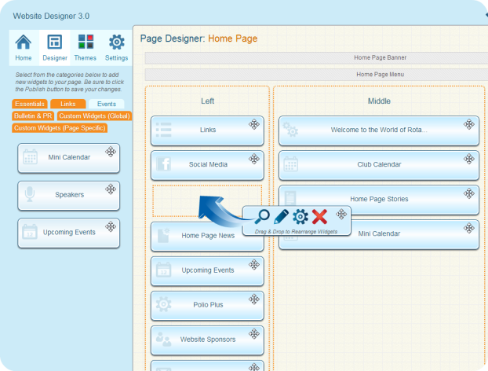
Website Designer
Content
You can build your website and customize your banner, footer and navigation menu. Add the following content with a simple drag and drop:
Upcoming speakers
Links to other websites
Events calendar
Photo albums
Registration forms and flyers
Custom site pages for committees and projects
Sponsor advertisements to raise funds
Private members only document storage for Word, Excel or PDF
YouTube videos, RSS feeds, and links to social networking sites
Social Media Share Buttons
Custom Content
and more.
ClubRunner
1-877-4MY-CLUB
1-877-469-2582

Slide 11
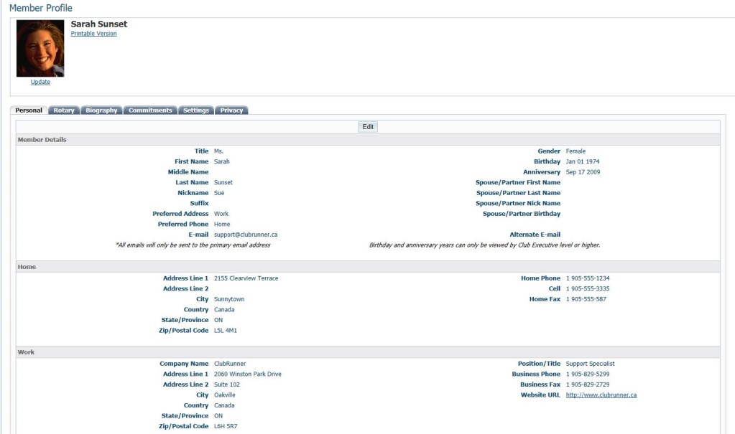
Member Directory
ClubRunner makes it easy to manage your member directory by:
Maintaining your member database with photos
Allowing each member update his or her own profile
Printing or downloading an up-to-date photo directory
Creating additional fields to track more information
Sending automatically generated notices to RI to synchronize with their databases
Easy conversion to Excel, Word and CSV
ClubRunner stores your directory database safely in a password-protected members-only area of your site.
ClubRunner
1-877-4MY-CLUB
1-877-469-2582

Slide 12
Member Directory
Easy maintenance
Your members can easily login and update their own profiles. No more excuses for out-of-date directories! Use the Update Request feature to prompt members to review their information and link into their profile if any updates are required.
Each profile includes ample contact information such as email, home and work phone numbers, mailing addresses, spouse information, and more.
Add custom fields to store more data! Rotary specific fields are already built-in.
Information is automatically updated at the District and Zone level, including executives and directors
Track and maintain member designations to better identify and recognize accomplishments and titles. Rotary specific labels are already included!
ClubRunner
1-877-4MY-CLUB
1-877-469-2582

Slide 13
Member Directory
Printable Directories
Build and customize your own printable directories easily. The directories are generated and formatted for you in Microsoft Word, PDF or ready to print by any member.
Each profile contains both standard contact information, plus custom fields you can define
ClubRunner
1-877-4MY-CLUB
1-877-469-2582

Slide 14
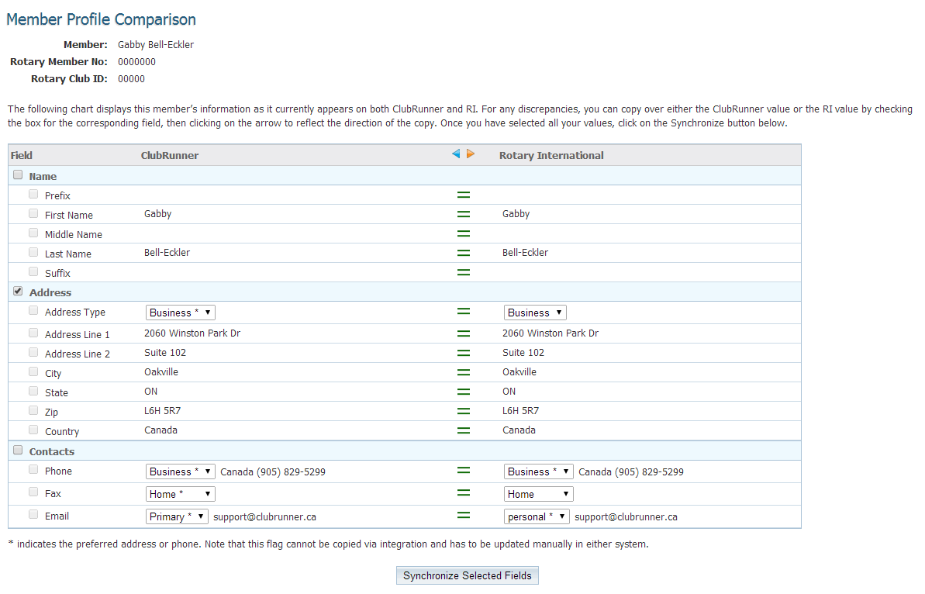
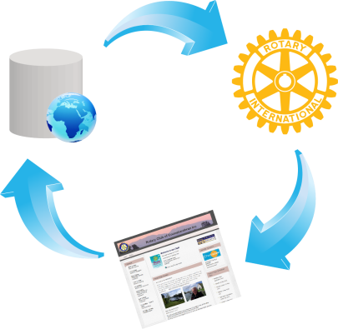
Member Directory
RI Integration
Keep your club records at RI up-to-date without duplicate data entry. The RI Integration feature syncs member data, officer changes and club information automatically.
The Compare and Sync feature lets you compare your member information as it appears on Rotary International’s Member Access, giving you the option to push selected data from ClubRunner to RI or pull your information from RI to ClubRunner.
ClubRunner
1-877-4MY-CLUB
1-877-469-2582

Slide 15
Member Directory
Friends
Adding friends to your ClubRunner site is a great way to attract new members. Friends are non-members that can receive your eBulletins and event invitations. You can also add visitors, speakers, family members, co-workers and more!
Each member has the ability to add friends
This is a great way to keep prospective members in the loop!
ClubRunner
1-877-4MY-CLUB
1-877-469-2582

Slide 16
Email Message Center
ClubRunner simplifies the way club members communicate via email—whether it be within their club, to prospective members, club directors or special groups and committees.
In addition, email addresses are centralized. This means that if a member changes his/her address, it is reflected everywhere, in all distribution lists, without the need to notify others.
ClubRunner
1-877-4MY-CLUB
1-877-469-2582

Slide 17
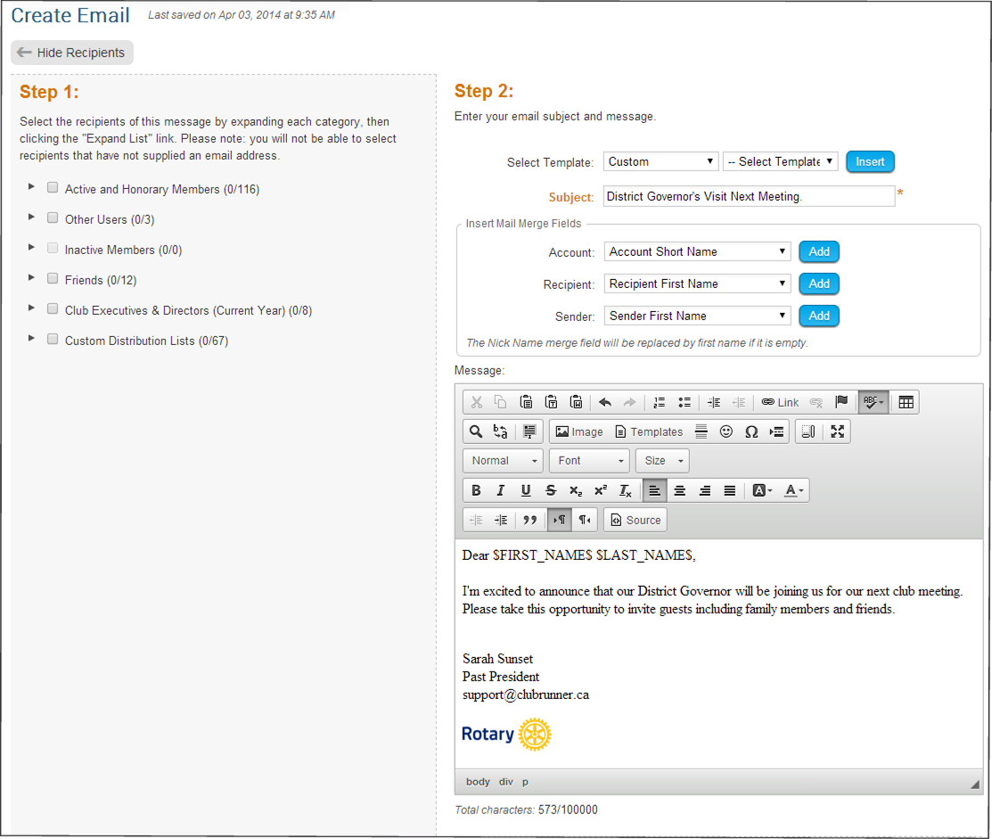
Email Message Center
Composing & Messages to Recipients
Since your site has all the club members’ email addresses, sending a broadcast message to all or selected members is easy.
Customize emails with personalized greetings and key information by inserting mail merge fields.
Distribution lists by member type are automatically generated. You can also create custom lists for club executives, directors, committees, etc.
ClubRunner
1-877-4MY-CLUB
1-877-469-2582

Slide 18
eBulletin
The eBulletin is a great way to boost public relations, club image and membership growth and retention.
Create a professional email newsletter quickly by incorporating contents such as stories, news, speakers and events from the website.
Easily personalize the look of your bulletin with custom banners, footers, themes and layouts.
ClubRunner
1-877-4MY-CLUB
1-877-469-2582

Slide 19
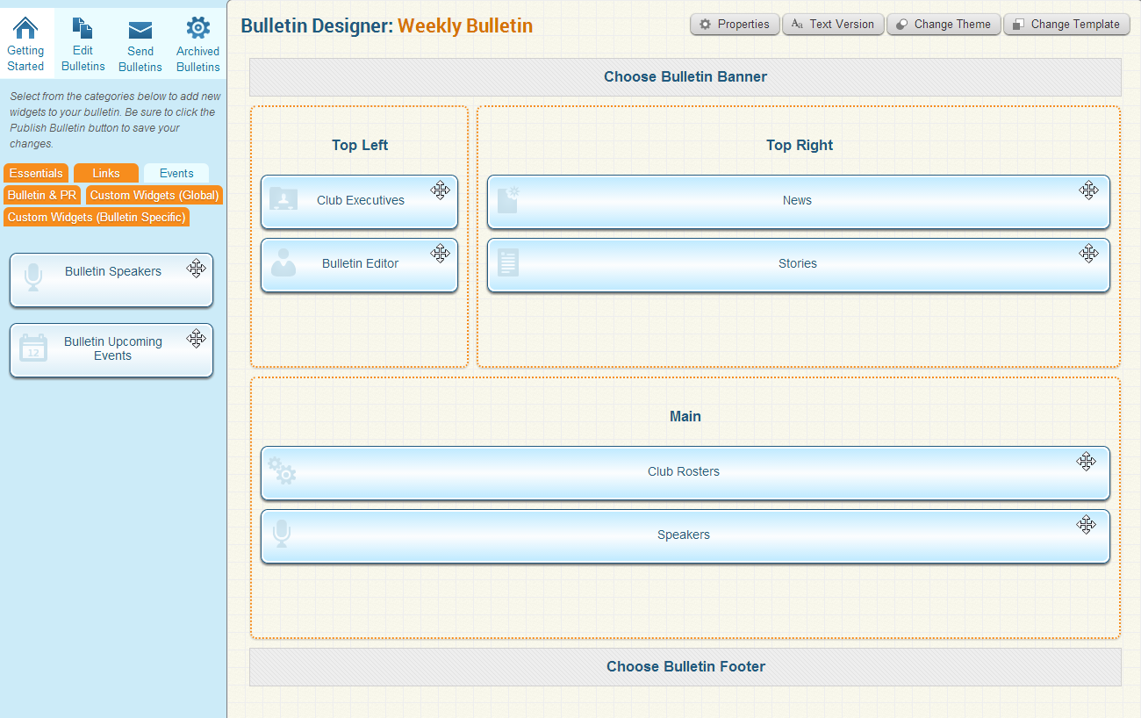
eBulletin
Content
Editors can focus on the content of the bulletin and not have to worry about the layout or technical issues. Integrating stories, events, announcements and speakers is as simple as selecting a checkbox.
The eBulletin includes a personalized Commitments section at the bottom of each member’s email, which contains reminders for all event registrations, volunteer sign-ups, and new member orientation tasks.
ClubRunner
1-877-4MY-CLUB
1-877-469-2582

Slide 20
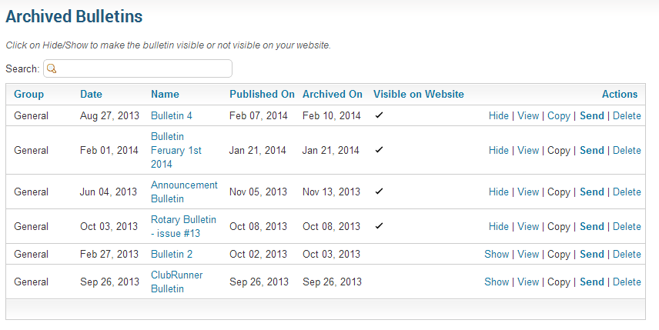
eBulletin
Archiving
Create separate groups and editions of your eBulletin, each tailored with their own design and content for your members, prospective members, friends of the club and other contacts.
Quickly and easily build, publish and email your eBulletin, which automatically gets archived and linked to your homepage.
ClubRunner
1-877-4MY-CLUB
1-877-469-2582

Slide 21
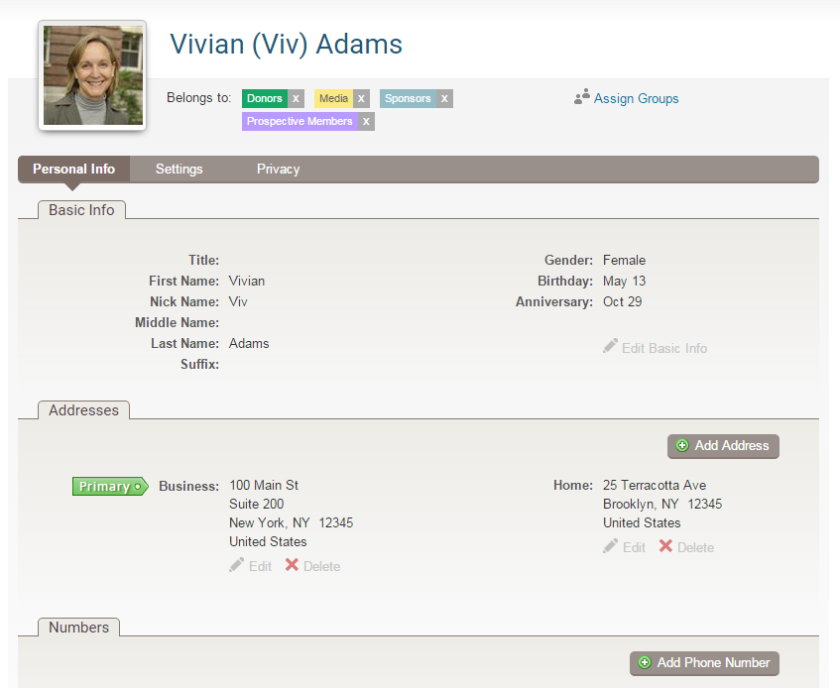
Contacts
Profile
Integrated with emails and the eBulletin, setup non-member lists to track sponsors, volunteers, supporters, prospective members and more!
Store:
First name
Last name
Nickname
Email address
Birthday
Anniversary
Gender
Addresses
Phone numbers
And more!
ClubRunner
1-877-4MY-CLUB
1-877-469-2582

Slide 22
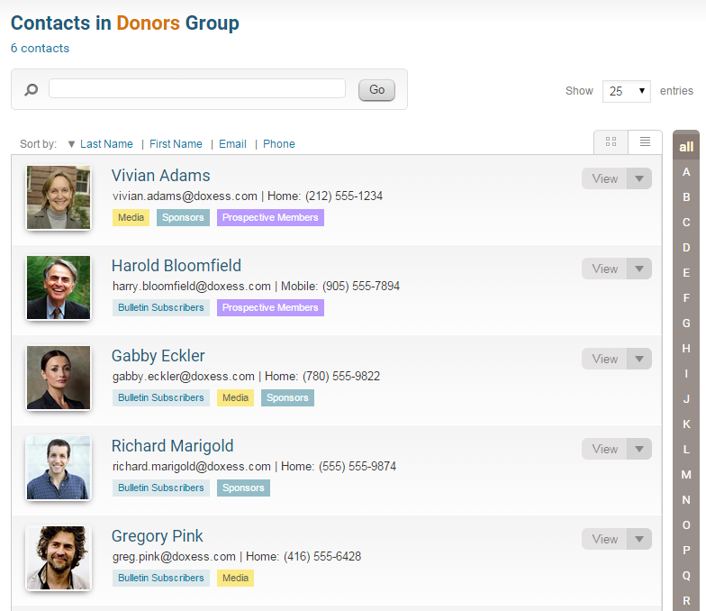
Contacts
List
Assign groups to manage your contacts; separate by friends, prospective members, bulletin subscribers, sponsors and more.
Segment and create different distribution lists to send customized emails and event invitations.
Import contacts in bulk & even export contacts to excel!
ClubRunner
1-877-4MY-CLUB
1-877-469-2582

Slide 23
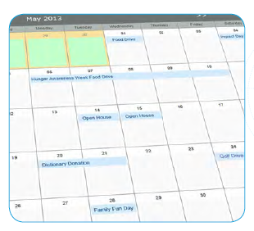
Event Planner
Organizing and promoting your club’s events has never been easier. A listing of upcoming events automatically appears in your eBulletin and on your website, which links back to a detailed event page.
Club members and non-members can register or decline for events with a simple click, no password required. Members can register their guests, include comments and see a reminder of their events in their eBulletin.
Event chairs can print up to date attendee lists, send emails and reminders and even print name tags! Even create online sign-up sheets to easily allow members and non-members to volunteer for tasks!
ClubRunner
1-877-4MY-CLUB
1-877-469-2582

Slide 24
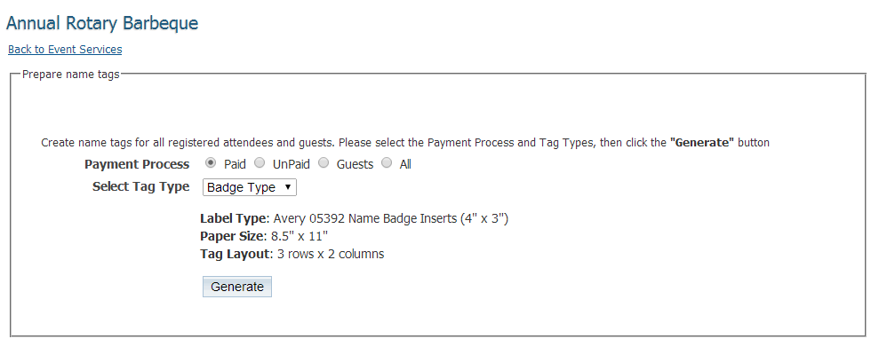
Event Planner
Print Name Tags
Name tags are very time-consuming for events with a large number of registrations. ClubRunner takes the pain out of printing name tags by doing it for you! Create name tags for registered attendees and guests.
ClubRunner
1-877-4MY-CLUB
1-877-469-2582

Slide 25
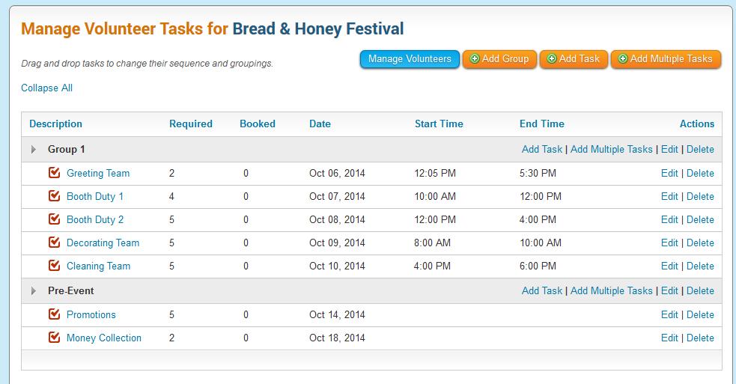
Volunteers Module
Build your signup lists for virtually any scenario where you need to coordinate people in various commitments, organized by day, task or group.
Create detailed signup lists and further define groups, tasks and time slots.
Register members and the public to help with events.
Great for shifts, volunteers, committee signups or anything involving a schedule.
ClubRunner
1-877-4MY-CLUB
1-877-469-2582

Slide 26
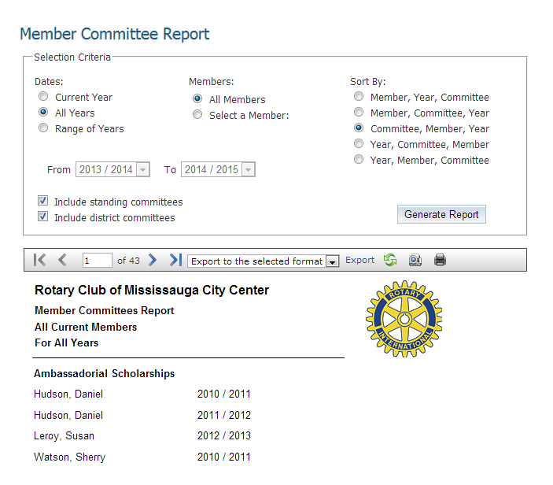
Committees Module
Store your committee lists and information in a dedicated area for your club. All members, chairs and secretaries can be identified and listed and have their own directory listing.
Create and view all yearly and standing committees along with corresponding chairpersons
Generate a directory listing of all members within a specified committee by year
Run reports to see member participation history, or members that are not part of any committee
ClubRunner
1-877-4MY-CLUB
1-877-469-2582

Slide 27
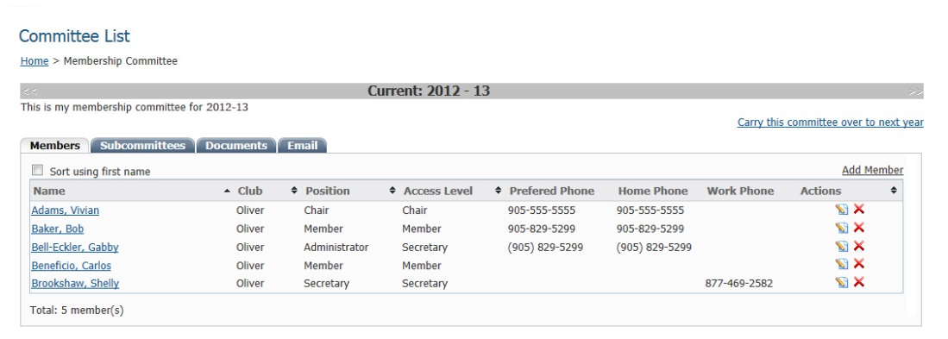
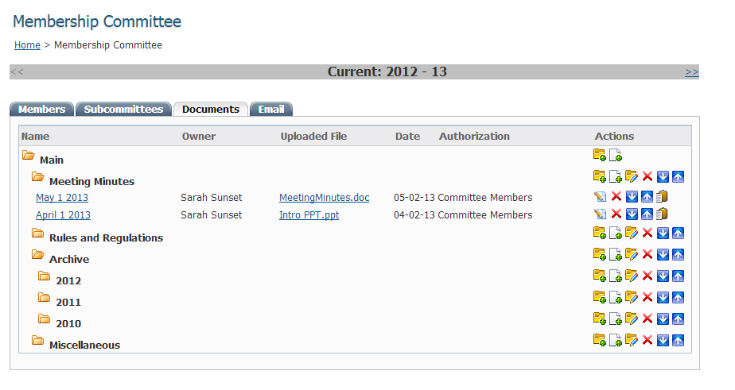
Committees Module
Committees (Enhanced Add-On)
The Enhanced Committees version allows you to foster communication within your committees, by allowing your members to share documents privately. Email members of your committee of sub-committee to keep all communication in one place.
Post documents ands set their security levels to be visible by committee members only
Create and send targeted emails to committee and sub-committee members
Create multiple levels of sub-committees
ClubRunner
1-877-4MY-CLUB
1-877-469-2582

Slide 28
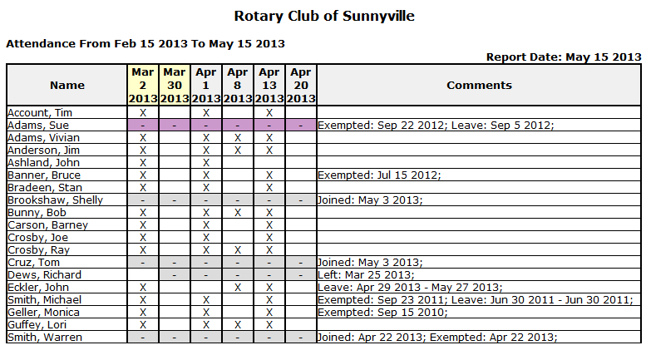
Attendance Manager
Keeping track of members’ attendance is quick and easy. Just add the meeting, then check off those who attended.
Various reports such as Year-to-Date, Semi-Annual and Month-End percentages do all the calculations for you, including handling make-ups, leaves of absence and exemptions.
Don’t have Internet access at your meeting venue? Printable attendance sheets make it easy to record each meeting’s attendees.
Monthly attendance statistics are created automatically and can easily be sent to your District.
Larger Clubs: Add the optional Barcode Scanner module for convenience.
Detailed Attendance Report
ClubRunner
1-877-4MY-CLUB
1-877-469-2582

Slide 29
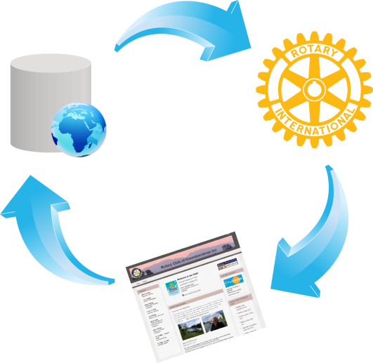
Database Integration with RI
ClubRunner is the first vendor to have fully integrated its database with RI and is the leader in terms of the number of fields integrated.
The RI Integration feature syncs:
Member Information
Member Terminations
Club Officers and Executive Information
Club Information
With the RI Integration feature, you will eliminate countless hours of duplicate data entry, reduce instances of human error, eliminate the need to manually process and send semi-annual reports and instantly update member information at RI’s end.
ClubRunner
1-877-469-2582
http://web.clubrunner.ca/ri-integration

Slide 30
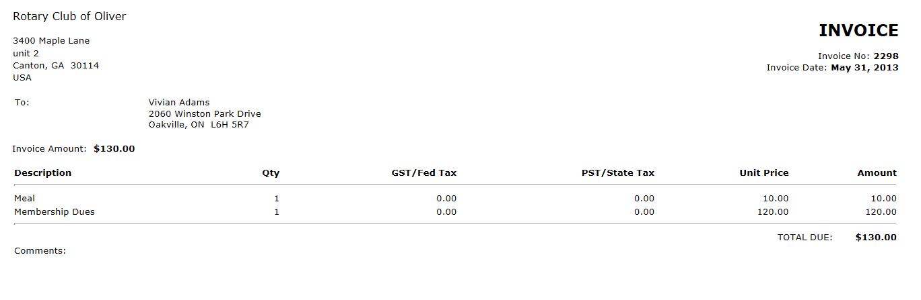
Dues & Billing
Generate invoices and email or print them to members with ease with ClubRunner’s Dues & Billing module.
Create invoices by entering a default quantity and amount and apply to all members with one click. Override items, add credits and debits and generate all invoices at once. Email or print invoices for effortless distribution.
ClubRunner
1-877-4MY-CLUB
1-877-469-2582

Slide 31
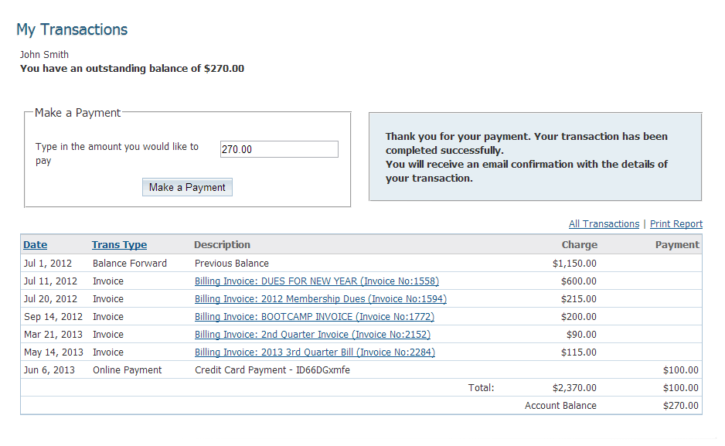
Dues & Billing
Payments and Tracking
Track payments made by members either manually or online. Enter adjustments, generate and email account statements for each member, and allow them to view their detailed account history.
Generate debit and credit reports in Excel with start and end balances for each month. Reports lets you see how much is owed by each member, as well as a total for the club.
The self-serve feature lets members securely access their own billing account statements and invoices. With the integrated Online Payment & eCommerce module, members can easily pay their invoices online.
ClubRunner
1-877-4MY-CLUB
1-877-469-2582

Slide 32
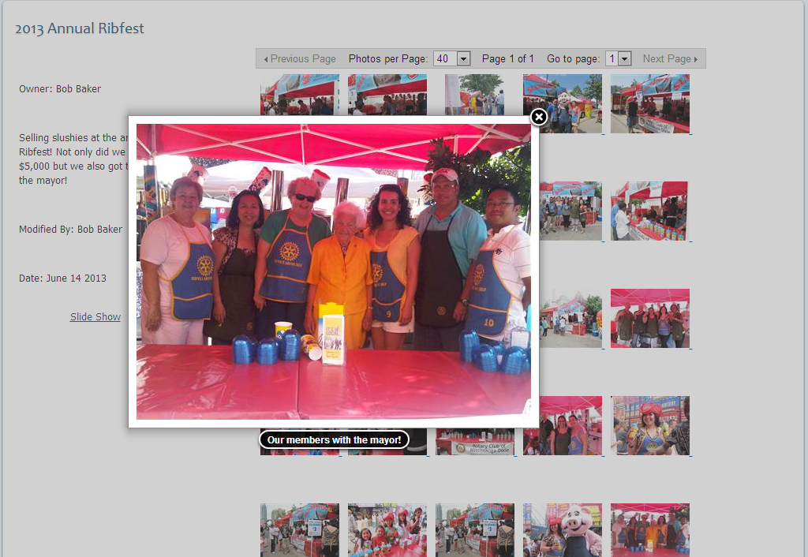
Photo Albums
Showcase your events and the latest happenings in your club to the community and world.
Any member with authorized access can post pictures to your website without the necessary technical and design skills.
ClubRunner handles all the technical aspects of image compression and resizing and publishes your albums in a professional online gallery, complete with captions and a slideshow option.
ClubRunner
1-877-4MY-CLUB
1-877-469-2582

Slide 33
Custom Reports & Directories
Reports available in ClubRunner can be exported in either PDF or Excel format.
Complete with charts and graphs, ClubRunner allows you to create numerous reports to help you keep track of the most important information.
Choose from the various built-in reports or build our own by choosing the format, layout and data fields.
ClubRunner
1-877-469-2582

Slide 34
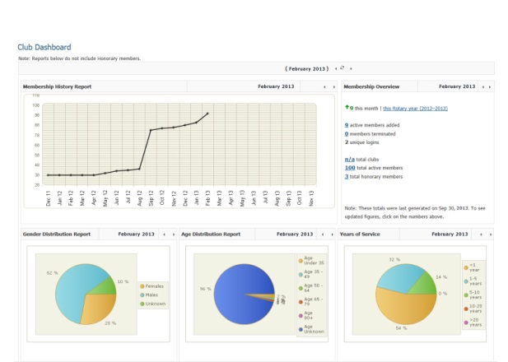
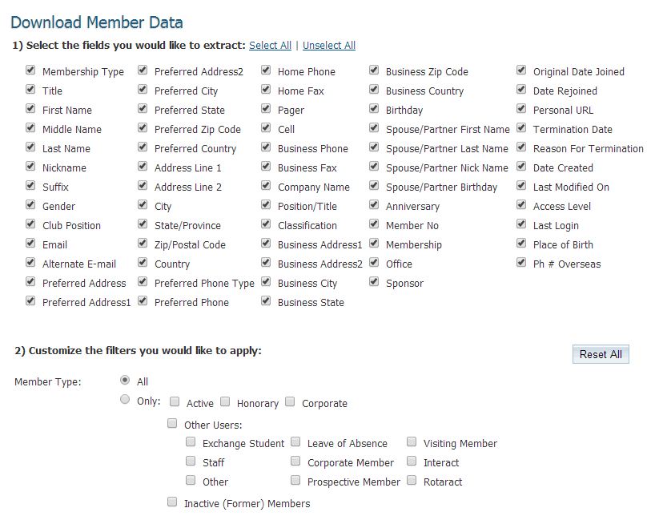
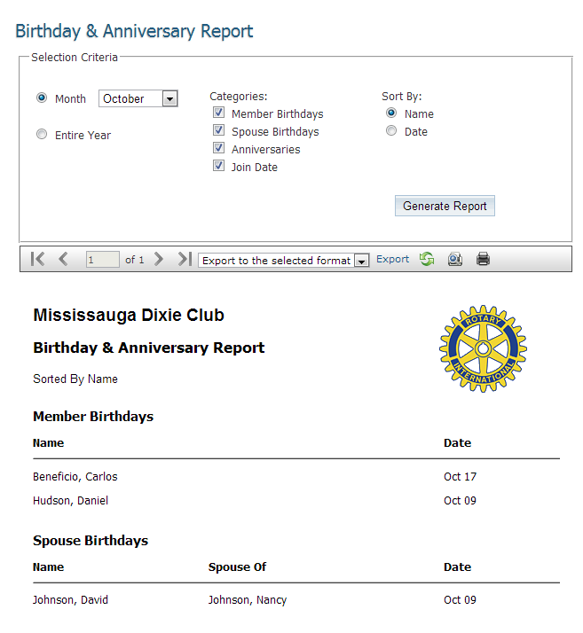
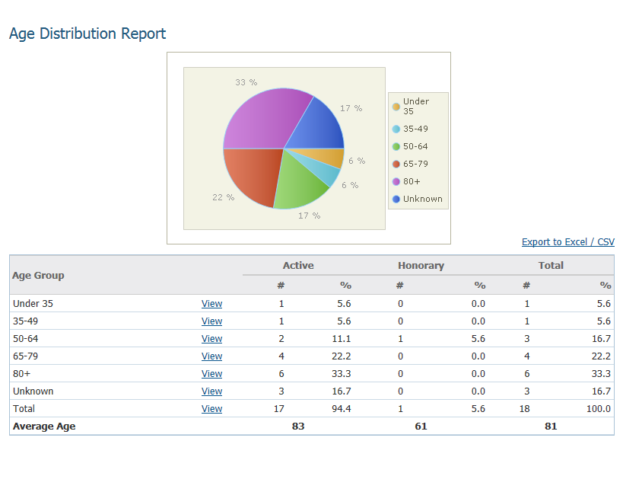
Custom Reports & Directories
Reports
Built-in reports include:
Birthday and Anniversaries
Years of Service
Rule of 85
Age Distribution
Gender Distribution
Login Activities
Organization Charts
Committees
eDirectory Report Builder
Club/District Dashboard
Member Data
RI Integration Sync
Missing Email Addresses
…and many more!
ClubRunner
1-877-469-2582

Slide 35
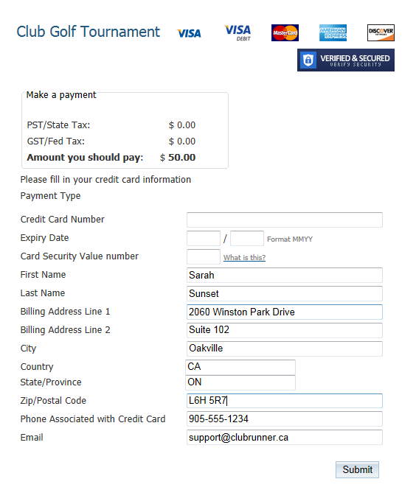
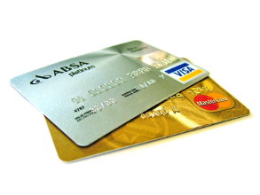
Online Payment & eCommerce
Allows for online payments by integrating credit card payments safely and securely into your site
Integrated with the Dues & Billing Module and MyEventRunner™
Choose when and where to allow payments
Use the Virtual Terminal
All funds are deposited into your bank account immediately
Generate reports linking payment transactions to members and events
See exactly who has paid and how much immediately
Collect donations with the option to setup recurring donations
ClubRunner
1-877-4MY-CLUB
1-877-469-2582

Slide 36
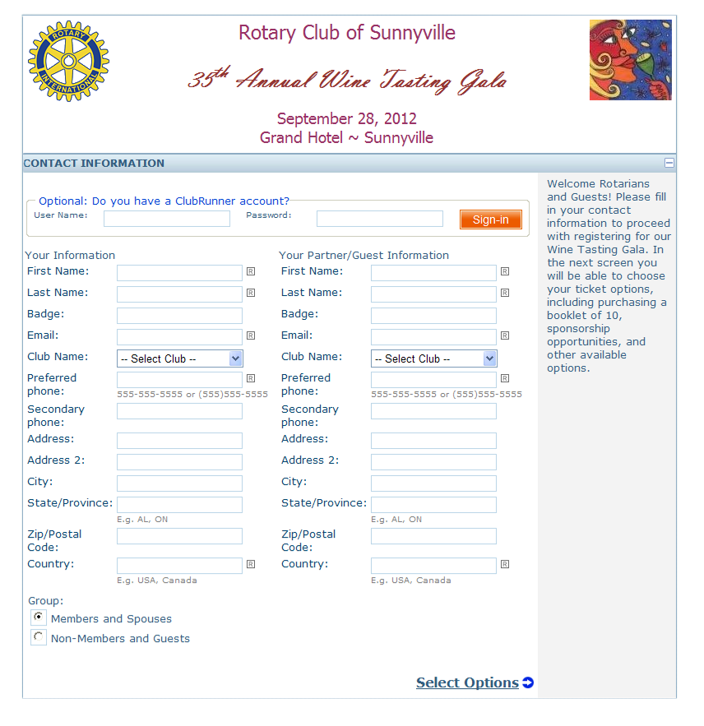
MyEventRunner
TM
A powerful do-it-yourself online registration form designer that allows you to build your own form with custom fields and advanced options such as early bird pricing and promo codes.
Accept online registrations from your members and the general public. Integrated with the Online Payment & eCommerce module, you can choose to process payments right away by credit card.
Use MyEventRunner for:
Auctions
Event Tickets
Golf Tournaments
Fundraiser Sales
Assemblies
PETS
District Conferences
and more!
ClubRunner
1-877-4MY-CLUB
1-877-469-2582

Slide 37
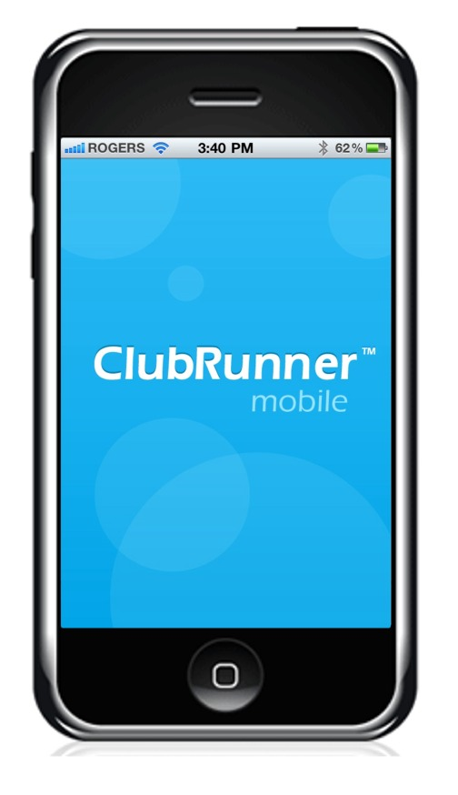
Mobile App
Your key to connect to your club on the go!
Password protected, just like your website, the ClubRunner Mobile App consists of 3 main modules:
Member Directory
Latest Stories Feed
Rotary Club Locator
ClubRunner
1-877-469-2582

Slide 38
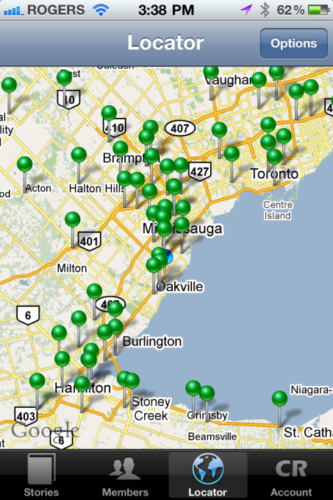
Mobile App
Overview
Member Directory
View the most up to date member directory, upon login. Browse through member profiles, make a call to any of their phone numbers, e-mail them directly or add them to your contacts list.
View Posts on Your Website
View the latest feed of home page stories that are on your site directly on your phone.
Rotary Club Locator
Instantly displays a map showing you the closest clubs near you. By clicking on the drop pin, you get access to more information including their meeting day, time, venue and directions from your current location to meeting venue.
ClubRunner
1-877-469-2582

Slide 39
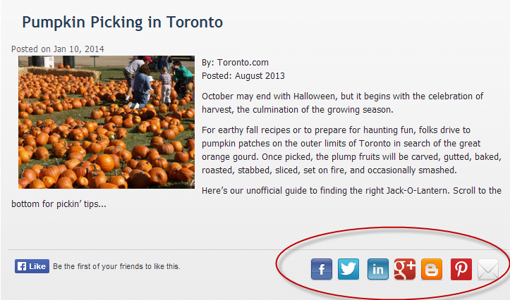
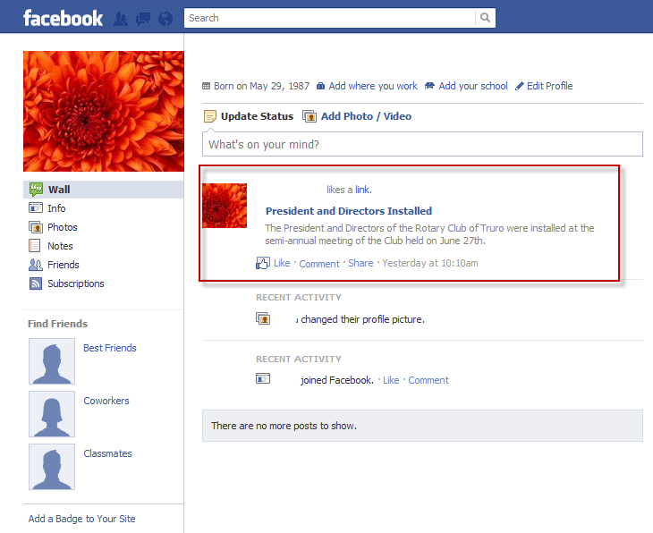
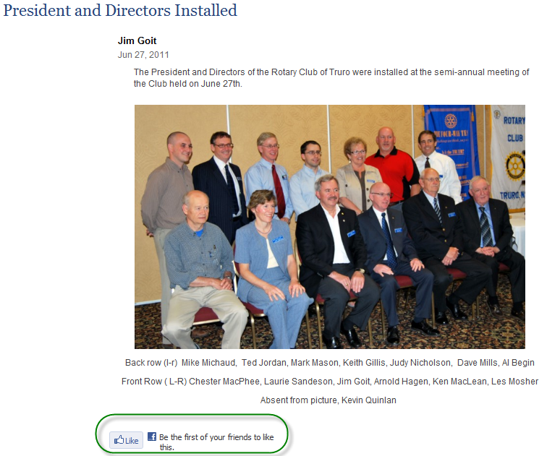
Social Media Integration
Use the widget selector to simply drag and drop social media plug-ins such as Facebook to your homepage.
Add share icons throughout your site, making it one click away from being promoted to the world! Additionally, add any RSS feed to instantly display the latest Rotary news headlines to your site visitors!
ClubRunner
1-877-469-2582

Slide 40
Sponsorship Feature
Showcase your club’s sponsors while earning fundraising revenue from your website!
ClubRunner allows your club to sell ad links for your website and upload them directly. This is a great opportunity to raise funds from your website.
Ads can be text or image based and can be added to your homepage, subsequent secondary pages and your eBulletin.
You get total control! Set up your own pricing and policies and keep 100% of the revenue!
ClubRunner
1-877-4MY-CLUB
1-877-469-2582

Slide 41
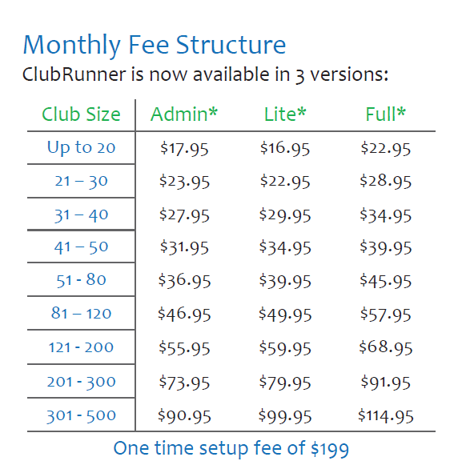
Affordable Pricing
Subscriptions include:
Core modules, hosted in a world class data center
Disk storage, bandwidth and automated data backup
Initial upload of your membership data to your site
Integration with RI’s database
Access to our Knowledgebase and eSupport center
Dedicated technical support
Ongoing webinar training
Every subscription comes with a 30-day full money back guarantee.
*Payable annually in advance. Subject to the terms and conditions of the ClubRunner subscription agreement. Prices subject to change.
ClubRunner
1-877-4MY-CLUB
1-877-469-2582

Slide 42
What About Security?
You can rest assured that your data is secure and private as ClubRunner is equipped with:
Unique login names and passwords for each member
Multi-level access rights for members
Firewall and anti-virus protection
Protection features for private information that is not meant for the public
Backups of your website and membership information automatically made every four hours
Features that help maintain the privacy of email addresses
Public Messaging tools that allow for anonymous contacts
ClubRunner
1-877-4MY-CLUB
1-877-469-2582

Slide 43
Testimonials
Don’t take our word for it! Read all about what current users are saying about ClubRunner.
Click here to our Google reviews
(Internet connection required)
“ClubRunner is making my life so much easier as Club President.”
George R. (Peterborough, ON)
“ClubRunner is nothing short of phenomenal!”
Robert N. (Islip, NY)
“Just wanted to let you know how much our club likes ClubRunner. It has revolutionized the way that we attract prospects and communicate with current members. Since we launched the website, every weekly speaker and every guest has mentioned that our website is really good. Thanks to ClubRunner!”
Scott L. (Boston, MA)
"ClubRunner is fantastic... we struggled for years to get "on-line" and what you have engineered makes it so easy for us to communicate with members as well as with our local community. Well done!"
Bob A. (North Delta, BC)
“ClubRunner gets the information and tools right to our member’s fingertips. Communication is easier than before. It is a big time saver – flexible and easy to use yet powerful.”
Justin R. (St. Martin)
ClubRunner
1-877-4MY-CLUB
1-877-469-2582

Slide 44
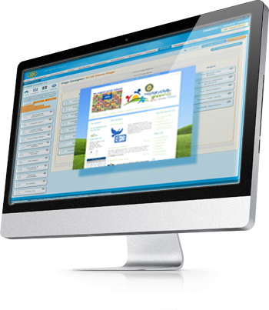
Let’s Get Started!
Subscribing is quick and easy.
Just complete our order form at www.clubrunner.ca/order and your site will be ready in a few days!
ClubRunner
1-877-4MY-CLUB
1-877-469-2582

Slide 45
Contact Us
For more information, or to set up ClubRunner for your club or district, please call 1-877-4MY-CLUB, or email us at sales@clubrunner.ca.
Visit us at www.clubrunner.ca to find out more!
facebook.com/clubrunner
twitter.com/clubrunner
iloveclubrunner.blogspot.com
ClubRunner Beta & Early Access Participants Group
© 2016 ClubRunner. All Rights Reserved. This presentation is for informational purposes only. ClubRunner makes no warranties, express or implied, in this summary.
ClubRunner
1-877-469-2582
1-877-4MY-CLUB

