Slide 1
Welcome to ClubRunner
District Presentation

Slide 2
What is ClubRunner?
ClubRunner is an administration and communication software package that will enable clubs and districts to effectively:
Reach members
Improve communication between members
Better organize their club
It is an online service comprised of powerful tools designed to:
Maintain your club data
Boost communications
Organize events and volunteers
Help your club run more efficiently and easily
1-877-4MY-CLUB

Slide 3
Key Benefits of ClubRunner
Superior communication features
No need to know any technical language
Improved flow of communication with a single centralized hub of information for all clubs
Automatic transfer of information between clubs to the district to the zone to RI
Better handling of events and volunteers
Improved data tracking with built-in reports and reminders
Efficient and easy management of committees
Increased data security
1-877-4MY-CLUB

Slide 4
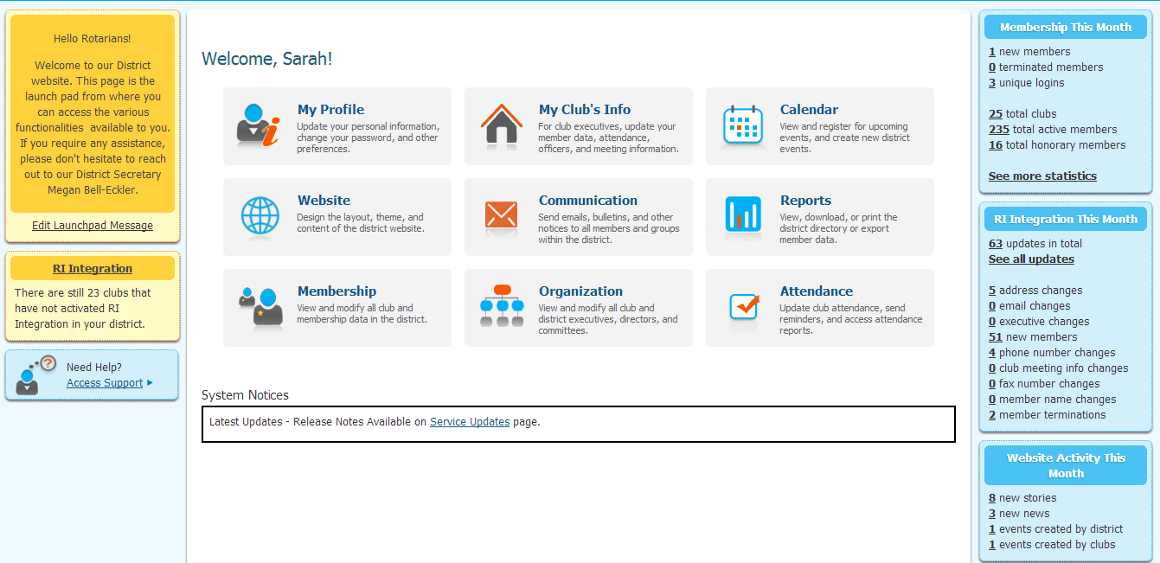
Website Designer
Maintaining the website is done through a secure login.
Launch Pad
ClubRunner has various levels of access based on roles and positions, so you can get more members involved while maintaining security levels for each area.
1-877-4MY-CLUB

Slide 5
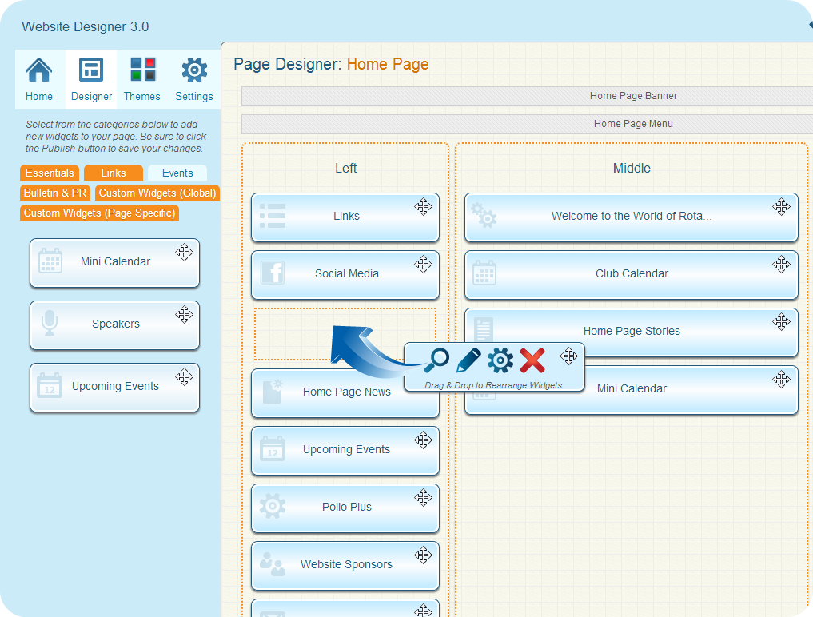
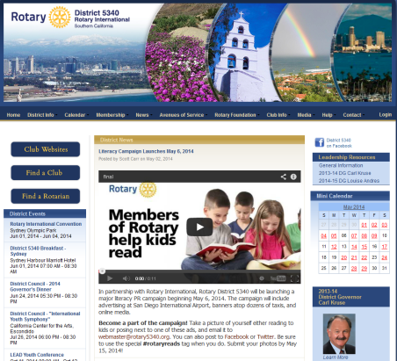
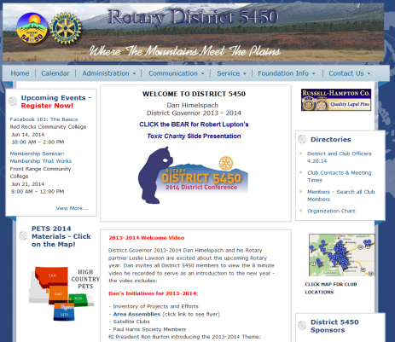
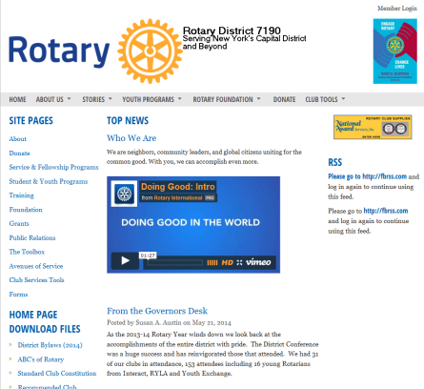
Website Designer
Display live information from your database:
DG Messages
Events calendar and speakers
District Organization Charts (Photos)
Club Directory
Useful links to other relevant websites
Download files
Photo Albums with slideshows
Home page stories and news
Home Page
…all without having to know HTML!
1-877-4MY-CLUB

Slide 6
Website Designer
That visitors typically leave a website within 20 seconds if you are not able to capture their attention?
Boost your public image with a dynamic, engaging site that will retain visitors.
Themes
Design and personalize the look of your website to suit your district style. Presentation, layout and style is easily configured by choosing from multiple layouts and themes so you can focus on the content! Clubs and Districts can all achieve various looks.
Select from a variety of colour and style options. Familiar with CSS? Upload your own stylesheet to fine-tune your website further.
1-877-4MY-CLUB

Slide 7
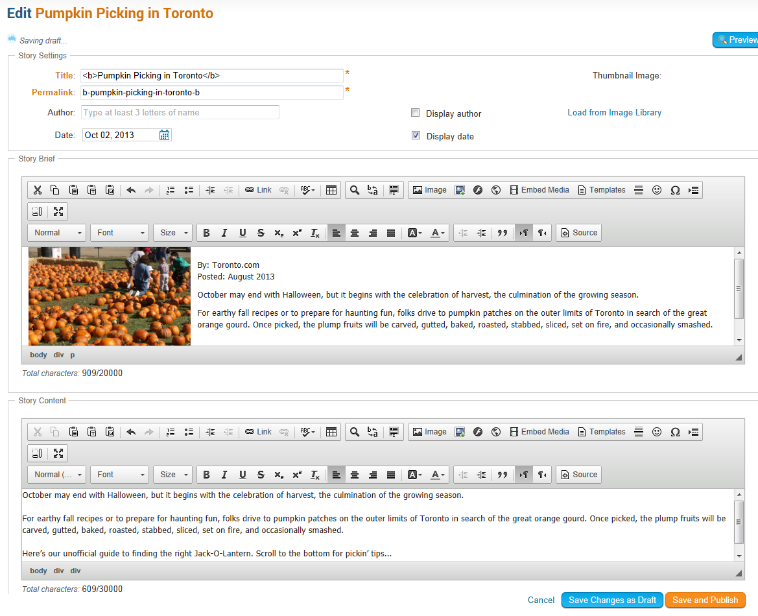
Website Designer
Adding Content
To add a story to the home page, any member who has been granted editor rights can log in, then type content into the built-in editor.
Pictures are automatically resized and compressed for optimized downloading on the web and are saved in your image library for future use.
Options available to allow you publish or save as draft, hide or show an article on the home page, story library, and eBulletin.
1-877-4MY-CLUB

Slide 8
Full District Database
Maintain a secure online database accessible by district officers, club executives and members
List executives and directors, committees and the District organization chart for current and future years
Changes made at a club level are automatically reflected at the district level
Report club attendance and generate club statistics chart
Track member designations and awards for each member to be displayed on their member profiles
Report data changes automatically to Rotary International

Slide 9
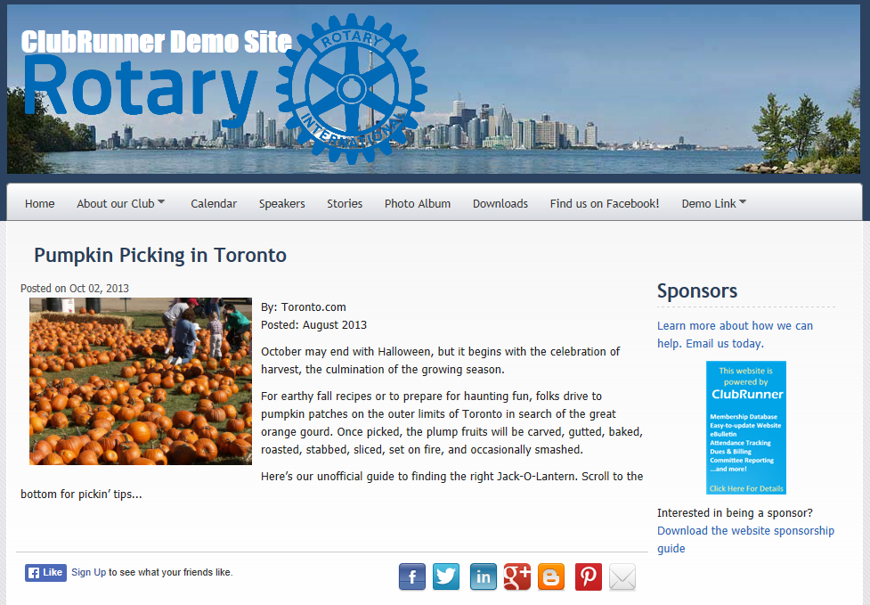
Website Manager
Immediate Results
Contents appear immediately on the home page and eBulletin (if selected).
Links can be embedded within contents to take visitors to other websites or pages within your site.
Add the built-in social media share buttons to share your content on various channels.
1-877-4MY-CLUB

Slide 10
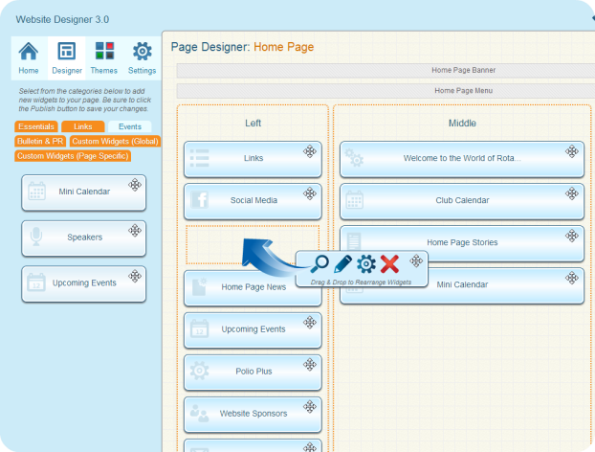
Website Designer
Content
You can build your website and customize your banner, footer and navigation menu. Add the following content with a simple drag and drop:
Website Sponsors
Links to other websites
Events calendar
Photo albums
Registration forms and flyers
Custom site pages for committees and projects
Secure Member Directories (Require login)
Private members only document storage for Word, Excel or PDF
YouTube videos, RSS feeds, and links to social networking sites
Social Media Share Buttons
Custom Content
and more.
1-877-4MY-CLUB

Slide 11
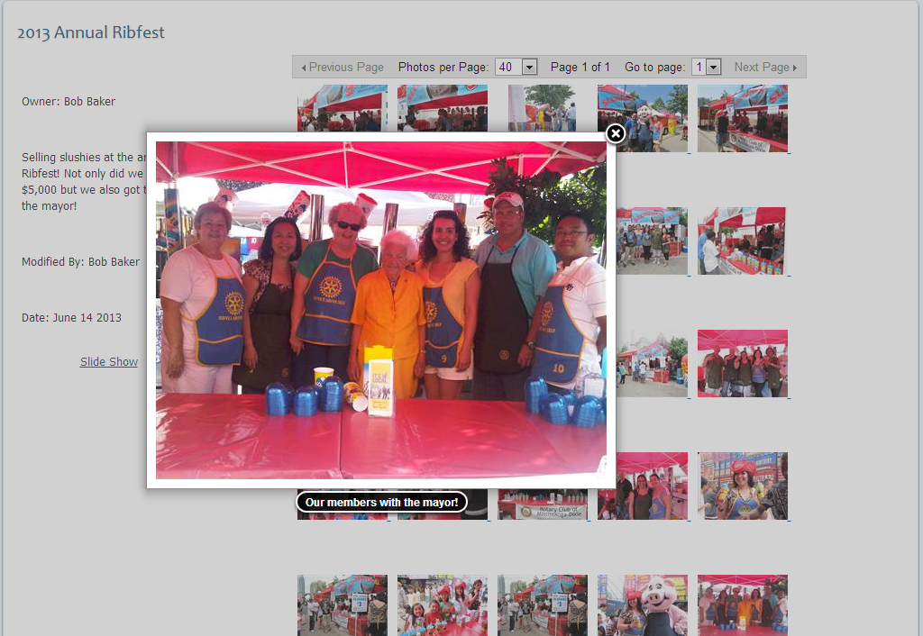
Photo Manager
Showcase your events and the latest happenings in your district to your membership, community and world.
Any member with authorized access can post pictures to your website without the necessary technical and design skills.
ClubRunner handles all the technical aspects of image compression and resizing and publishes your albums in a professional online gallery, complete with captions and a slideshow option.
1-877-4MY-CLUB

Slide 12
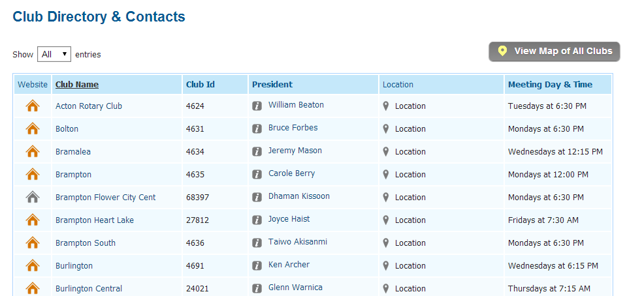
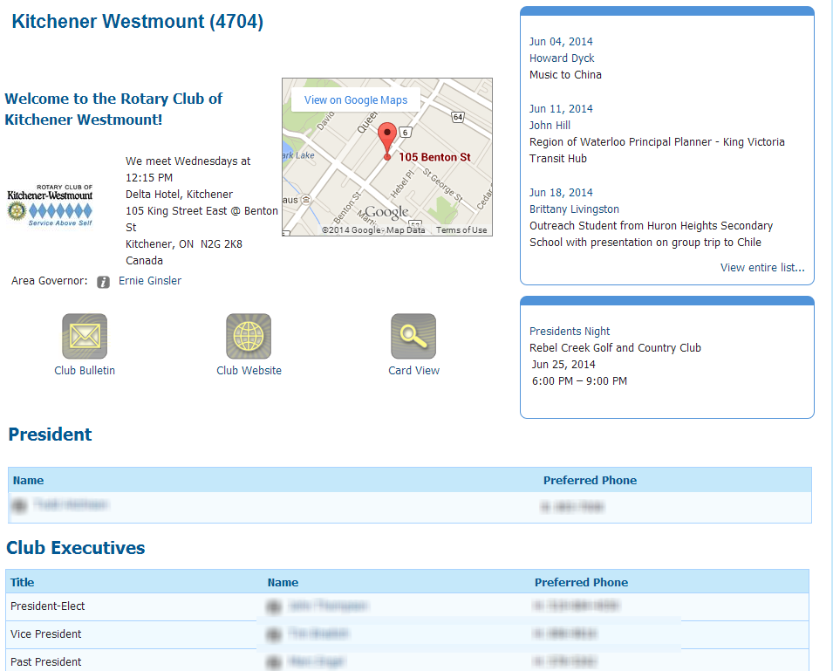
Club Directory
The Club Directory page displays all clubs, their meeting days and times, along with President names, and links to club websites as well as their meeting day, name of President, location, address, and an auto-generated map.
Drill down further and view the club executive information, bulletin, events and speakers list, and more.
1-877-4MY-CLUB

Slide 13
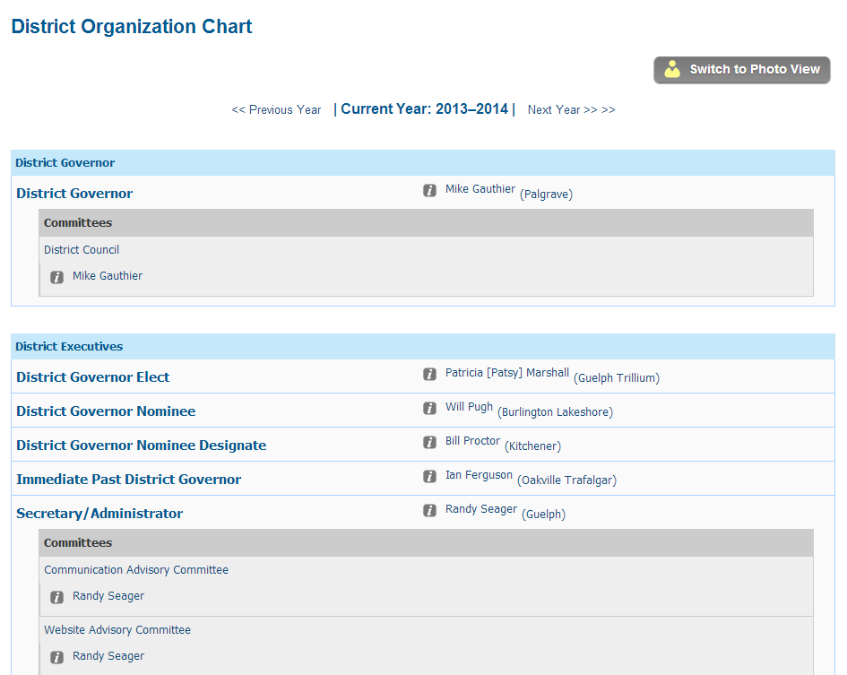
District Organization Chart
Displays all District Executives, Officers, Assistant Governors and their clubs and executives, committee directors and sub-committee chairs.
Build your own directories with the eDirectory builder!
1-877-4MY-CLUB

Slide 14
What Can Club Executives Do?
Update their membership listing
Specify current and next year’s club executives
Create Committee listings with their corresponding Chairs and Secretaries
Update their club information such as meeting time, date, location, website address
Report monthly attendance
Register members for district events
View online district directory
Maintain their own club page
1-877-4MY-CLUB

Slide 15
What can District Executives Do?
Everything a club executive can do, for any club, plus:
Generate monthly district attendance reports
Remind clubs that have not submitted attendance
Register any member for district events, plus view registered attendees and email
Broadcast emails to all Presidents, all Secretaries, all Officers, etc.
Send out a bulletin to all members
and much more.
1-877-4MY-CLUB

Slide 16
Custom Reports & Directories
Reports available in ClubRunner can be exported in either PDF or Excel format.
Complete with charts and graphs, ClubRunner allows you to create numerous reports to help you keep track of the most important information.
Choose from the various built-in reports or build our own by choosing the format, layout and data fields.

Slide 17
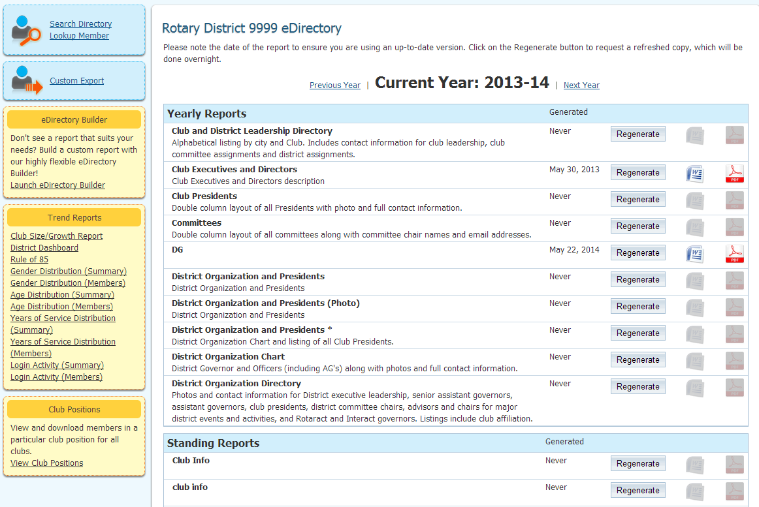
District Directories & Reports
All members can download a Word or PDF version of the District Directory, which is generated from all the data on the website
Choose from a variety of district directories, including:
Fill District Directory
District Staff & Clubs
Next Year’s Club Executives
and more.
1-877-4MY-CLUB

Slide 18
District Directories & Reports
Printable Directories
Build and customize your own printable directories easily. The directories are generated and formatted for you in Microsoft Word, PDF or ready to print.
Other built-in reports include:
RI Integration Sync
eDirectory Report Builder
Club Dashboard
AG Reports
Organization Charts
Member Data
Club/Size Growth
Years of Service
Gender Distribution
Login Activity
Missing Email Addresses
…and much more!
Information is automatically updated at the District and Zone level, including executives and directors
1-877-4MY-CLUB

Slide 19
E-mail Message Center
Streamline communication across a group
When executives change, the system will automatically redirect communication to the new person
Two-level circulation allows you to integrate the flow of information among clubs, districts, and zones
ClubRunner maintains a centralized, up-to-date list of all groups and e-mail addresses so if an email address is changed, it is reflected everywhere, in all distribution lists.
Message Center is great for managing committee meetings, sending invitations or agendas for meetings, and circulating the latest news
1-877-4MY-CLUB

Slide 20
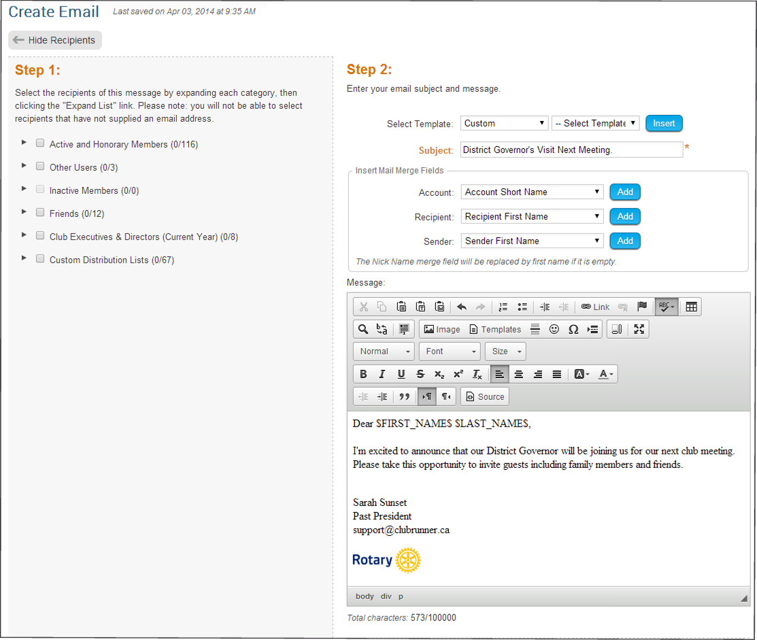
Email Message Center
Composing & Messages to Recipients
Since your site has all the club members’ email addresses, sending a broadcast message to all or selected members is easy.
Customize emails with personalized greetings and key information by inserting mail merge fields.
Distribution lists by member type are automatically generated. You can also create custom lists for club executives, directors, committees, etc.
1-877-4MY-CLUB

Slide 21
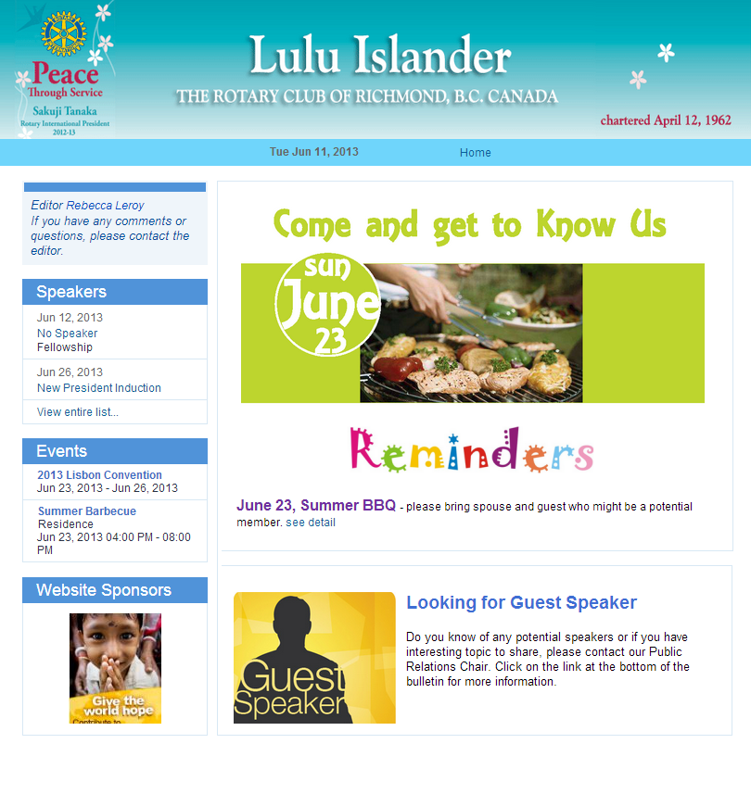
eBulletin
The eBulletin is a great way to share the latest district news and membership growth and retention information.
Create a professional email newsletter quickly by incorporating contents such as stories, news and events from the website. Easily personalize the look of your bulletin with custom banners, footers, themes and layouts.
Editors can focus on the content of the bulletin and not have to worry about the layout or technical issues. Integrating stories, events, announcements and speakers is as simple as selecting a checkbox.
1-877-4MY-CLUB

Slide 22
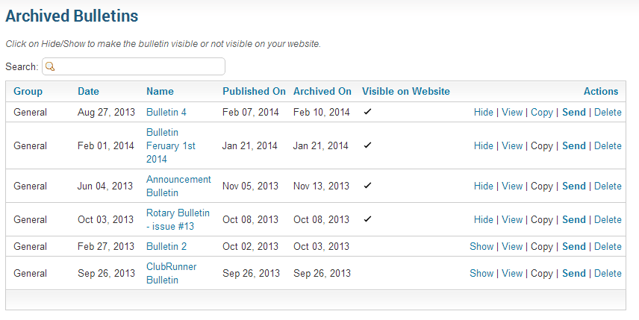
eBulletin
Archiving
Create separate groups and editions of your eBulletin, each tailored with their own design and content for your clubs, bulletin subscribers, former members, and other contacts.
Quickly and easily build, publish and email your eBulletin, which automatically gets archived and linked to your homepage.
1-877-4MY-CLUB

Slide 23
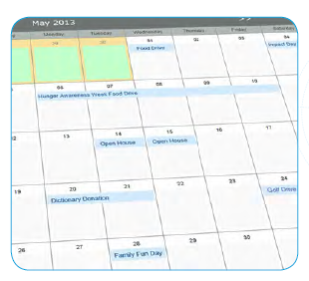
Event Planner
Organizing and promoting your district events has never been easier. A listing of upcoming events automatically appears in your eBulletin and on your website, which links back to a detailed event page.
Club members and non-members can register or decline for events with a simple click, no password required. Members can register their guests, include comments and see a reminder of their events in their eBulletin.
Event chairs can print up to date attendee lists, send emails and reminders and even print name tags! Even create online sign-up sheets to easily allow members and non-members to volunteer for tasks!
1-877-4MY-CLUB

Slide 24
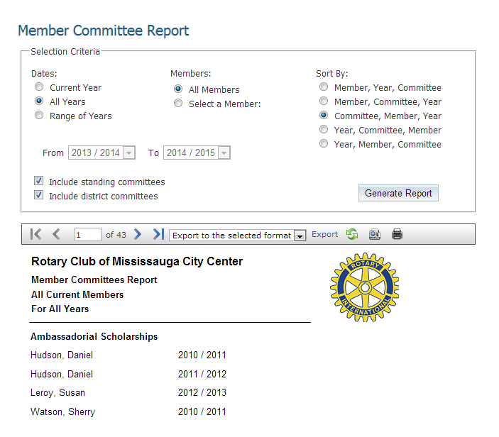
Committees Module
Store your committee lists and information in a dedicated area for your district. All members, chairs and secretaries can be identified and listed and have their own directory listing.
Post documents ands set their security levels to be visible by committee members only
Create and send targeted emails to committee and sub-committee members
Create multiple levels of sub-committees
1-877-4MY-CLUB

Slide 25
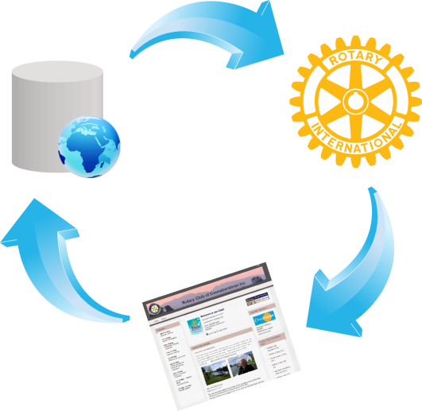
Database Integration with RI
ClubRunner is the first vendor to have fully integrated its database with RI and is the leader in terms of the number of fields integrated.
The RI Integration feature syncs:
Member Information
Member Terminations
Club Officers and Executive Information
Club Information
With the RI Integration feature, you will eliminate countless hours of duplicate data entry, reduce instances of human error, eliminate the need to manually process and send semi-annual reports and instantly update member information at RI’s end. Clubs can activate this feature on their own club sites or through their district site. District executives can run reports to see the progress of each club.
http://web.clubrunner.ca/ri-integration

Slide 26
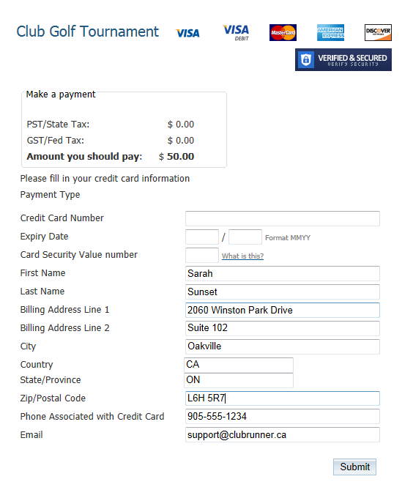
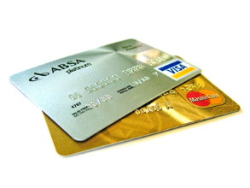
Online Payment & eCommerce
Allows for online payments by integrating credit card payments safely and securely into your site
Integrated with the Dues & Billing Module and MyEventRunner™
Choose when and where to allow payments
Use the Virtual Terminal
All funds are deposited into your bank account immediately
Generate reports linking payment transactions to members and events
See exactly who has paid and how much immediately
Collect donations with the option to setup recurring donations
1-877-4MY-CLUB

Slide 27
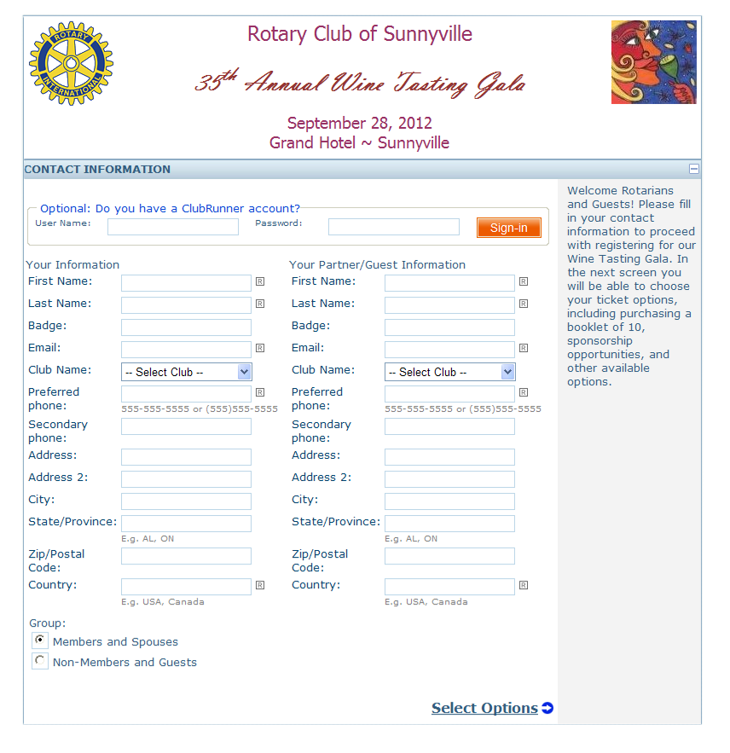
MyEventRunner
TM
A powerful do-it-yourself online registration form designer that allows you to build your own form with custom fields and advanced options such as early bird pricing and promo codes.
Accept online registrations from your membership and the general public. Integrated with the Online Payment & eCommerce module, you can choose to process payments right away by credit card.
Use MyEventRunner for:
Auctions
Event Tickets
Golf Tournaments
Fundraiser Sales
Assemblies
PETS
District Conferences
and more!
1-877-4MY-CLUB

Slide 28
How Will MyEventRunner Benefit Us?
Access your event registration form anywhere you have an Internet connection
Set your registration form up in minutes! Build it yourself using our easy to use tools, and accept registrations the next day.
Collect your fees instantly with registrations, ensuring financial success for your event.
Gather more information from your registrants through our questionnaire section, to help you plan your event
Run reports up to the minute to monitor the success of your event.
1-877-4MY-CLUB

Slide 29
Key Benefits of ClubRunner
Professional online presence
Efficient reporting tools
Highlight events
Using email reduces costs of administration, postage and telephone
Centralizing information keeps everyone on the same page
Allowing clubs to update their information directly reduces maintenance required for website
Online District Directory eliminates need for printed directory
1-877-4MY-CLUB

Slide 30
What About Security?
You can rest assured that your data is secure and private as ClubRunner is equipped with:
Unique login names and passwords for each member
Multi-level access rights for members
Firewall and anti-virus protection
Protection features for private information that is not meant for the public
Backups of your website and membership information automatically made every four hours
Features that help maintain the privacy of email addresses
Public Messaging tools that allow for anonymous contacts
1-877-4MY-CLUB

Slide 31
“Our ClubRunner District Website has dramatically increased our
ability to directly reach the vast majority of our members.
Now that a large number of our Rotary Clubs are also choosing
ClubRunner websites, our web-based communication system
throughout the district is becoming even more valuable.”
Testimonials
“ClubRunner is so easy for someone
with little computer experience or
HTML knowledge, to create an
interesting and informative site
quickly.”
"ClubRunner has literally revolutionized communications in District 7080. For the first time ever we are able to selectively target our communications. We are no longer forced to funnel everything through the club presidents.
As a result we have been able to decrease the information overload generally experienced by presidents and increase our information flow to every level of Rotary membership in the District.
ClubRunner has enabled Rotarians in District 7080 to be more efficient and more effective. We are able to spend less time as administrators and more time doing community service. ClubRunner delivers a service that allows us to operate as volunteers but deliver as professionals."
“It has forced our club to consider a whole new approach
to communications, both internal
and external…”
"As a former district webmaster I can't begin to extol the advantages of our new District ClubRunner site.
Seems like every time I login, I discover yet another feature I wasn't aware of. Superb communication tool - highly recommend to all Rotary clubs."
“ClubRunner is one of the easiest turnkey websites I have ever used.”
1-877-4MY-CLUB

Slide 32
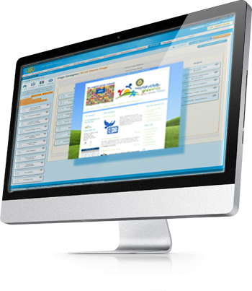
Let’s Get Started!
Give us a call or email us and we’ll be happy to have arrange a demo specifically for your committee!
salesinquiry@clubrunner.ca
webdemo@clubrunner.ca
90
1-877-4MY-CLUB

Slide 33
Awards
ClubRunner was awarded the Microsoft Impact Award for Community Leadership after its release in April 2003.
This award is presented by Microsoft to one software application across the country, that makes a lasting impact on the community and is beneficial to its recipients.
1-877-4MY-CLUB

